Slide 1

The Network Layer: NAT, IPv6, Routing Algorithms
CS 352, Lecture 15, Spring 2020
http://www.cs.rutgers.edu/~sn624/352
Srinivas Narayana

Slide 2
Course announcements
Take-home mid-term this weekend
Practice problems and review mid-term released soon
Open-book and open-notes, but not open-Internet
Not permitted to search the Internet for answers
No collaboration permitted; all answers and work must be your own
Calculators are allowed
This class will follow absolute grading with generous thresholds
i.e., no curve, you’re only competing with yourself
We trust you to do the right thing

Slide 3
Review of concepts
Internet Protocol:
Headers: src/dst, upper layer, fragmentation, time to live
Dynamic host configuration protocol (DHCP):
How does an endpoint get its IP address?
Broadcast-based: endpoint asks entire network for answers
DHCP server returns IP address, subnet mask, local DNS server address, gateway router address
Internet Control Message Protocol (ICMP):
Network troubleshooting protocol
Ping: reachability using ICMP echo request and reply
Traceroute: router-level path using ICMP time-exceeded messages and incrementing TTL

Slide 4
Network Address Translation (NAT)
How do you survive in a world where names are scarce?

Slide 5
NAT: Network Address Translation
rest of
Internet
local network
(e.g., home network)
10.0.0/24
10.0.0.1
10.0.0.4
10.0.0.2
138.76.29.7
10.0.0.3
All datagrams leaving local
network have same source IP address: 138.76.29.7, with
different source IP port numbers

Slide 6
NAT: Network Address Translation
NAT translation table
WAN side addr LAN side addr
1: host 10.0.0.1
sends datagram to
128.119.40.186, 80
2: NAT router
changes datagram
source addr from
10.0.0.1, 3345 to
138.76.29.7, 5001,
updates table
138.76.29.7, 5001 10.0.0.1, 3345
…… ……
S: 10.0.0.1, 3345
D: 128.119.40.186, 80
10.0.0.1
1
2
S: 138.76.29.7, 5001
D: 128.119.40.186, 80
10.0.0.4
10.0.0.2
138.76.29.7
S: 128.119.40.186, 80
D: 10.0.0.1, 3345
4
S: 128.119.40.186, 80
D: 138.76.29.7, 5001
3
10.0.0.3
4: NAT router
changes datagram
dest addr from
138.76.29.7, 5001 to 10.0.0.1, 3345
3: Reply arrives
dest. address:
138.76.29.7, 5001

Slide 7
NAT: Network Address Translation
Features: local network uses just one IP address as far as outside world is concerned:
range of addresses not needed from ISP: just one IP address for all devices
can change addresses of devices in local network without notifying outside world
can change ISP without changing addresses of devices in local network
Devices inside local network not explicitly addressable
Devices inside local network invisible to the outside world (a security plus) unless the device inside connects first.
Your home WiFi router implements NAT-ting.
If you’re at home, you’re almost surely behind a NAT gateway right now.

Slide 8
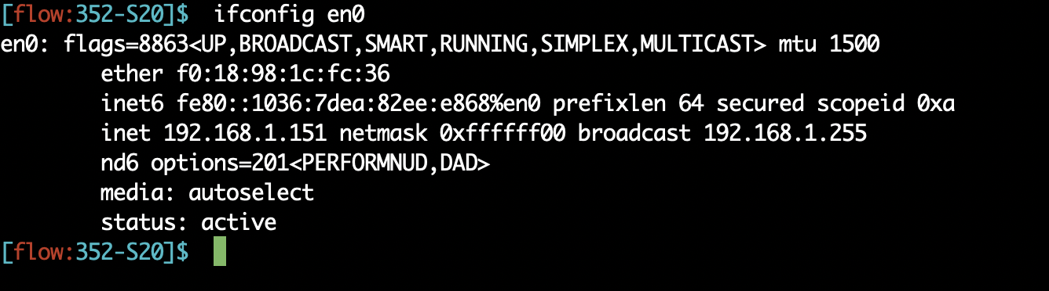
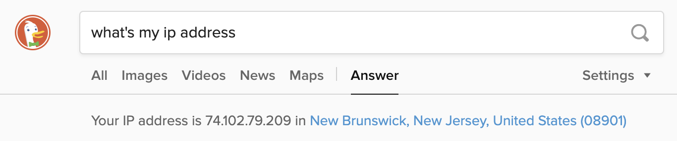
The impact of NATs

Slide 9
NAT: Network Address Translation
16-bit port-number field:
60,000 simultaneous connections with a single LAN-side address!
NAT is controversial:
Routers should only work upto the network layer, not transport ports!
violates “end-to-end argument”
NAT must be taken into account by app designers
e.g., P2P applications like skype
Purists: address shortage should instead be solved by IPv6

Slide 10
Think about…
How do the hosts inside the home network get their IP addresses?
How does your home router get its externally visible IP address?

Slide 11
Poll #1
The length of the TCP port field is 16 bits. Assume that a NAT router has a single external IP address. In principle, how many TCP connections can the router support between the NAT and the outside world?
(a) 1
(b) 2^16
(c) none of the above

Slide 12
Internet Protocol v6 (IPv6)

Slide 13
Recent Developments: IPv6
IPv4 has limited address space (32 bits) and is running out of addresses. 32 bits are not enough!
More devices: phones, watches, your refrigerator(!), …
Real-time traffic and mobile users are also becoming more common
IP version 6

Slide 14
IPv6: Main changes from IPv4
Large address space:
128-bit addresses (16 bytes)
Allows up to 340,282,366,920,938,463,463,374,607,431,768,211,456 unique addresses (3.4 x 10 ³⁸ )
Fixed length headers (40 bytes)
Improves the speed of packet processing in routers
IPv6 “options” processing happens through a separate mechanism

Slide 15
IPv6 datagram format
priority: identify priority among datagrams in flow
flow Label: identify datagrams in same “flow”
(concept of“flow” left undefined)
next header: identify upper layer protocol for data
ver
pri
flow label
payload len
next hdr
hop limit
source address
(128 bits)
destination address
(128 bits)
data
32 bits

Slide 16
Other changes from IPv4
checksum: removed entirely to reduce processing time at each hop
options: allowed, but outside of header, indicated by “Next Header” field
ICMPv6: new version of ICMP
additional message types, e.g. “Packet Too Big”
multicast group management functions

Slide 17
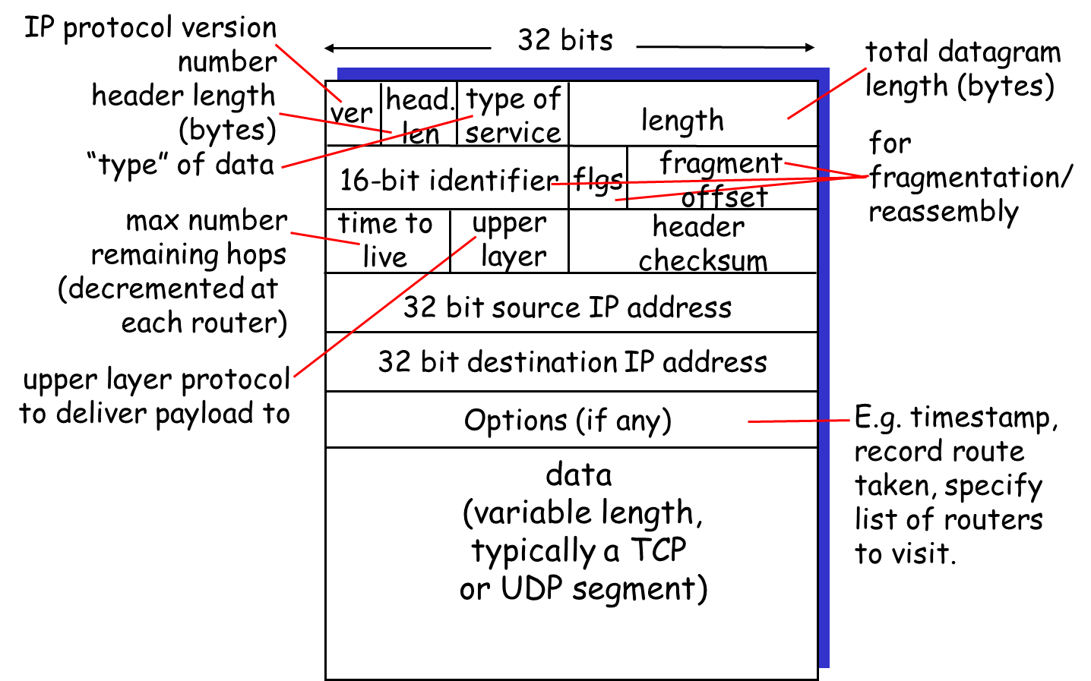
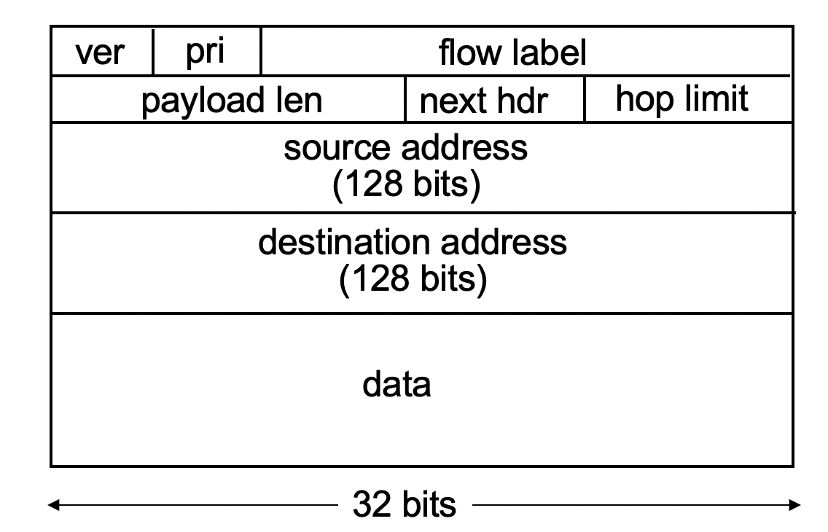
IPv4 vs IPv6: Can you tell the differences?

Slide 18
IPv6 Flows
Support for “flows”
Flows help support real-time service in the Internet
A “flow” is a number in the IPv6 header that can be used by routers to see which packets belong to the same stream
Guarantees can then be assigned to certain flows
Example:
Packets from flow 10 (e.g., audio call) should receive rapid delivery
Packets from flow 12 (e.g., web traffic) should receive reliable delivery

Slide 19
IPv6 Addresses
Classless addressing/routing (similar to CIDR)
Notation: xx:xx:xx:xx:xx:xx:xx:xx
x = 4-bit hex number
contiguous 0s are compressed: 47CD::A456:0124
IPv6 compatible IPv4 address: ::128.64.18.87
First 96 bits are 0
Global unicast addresses start with 001….
2000::/3 prefix

Slide 20
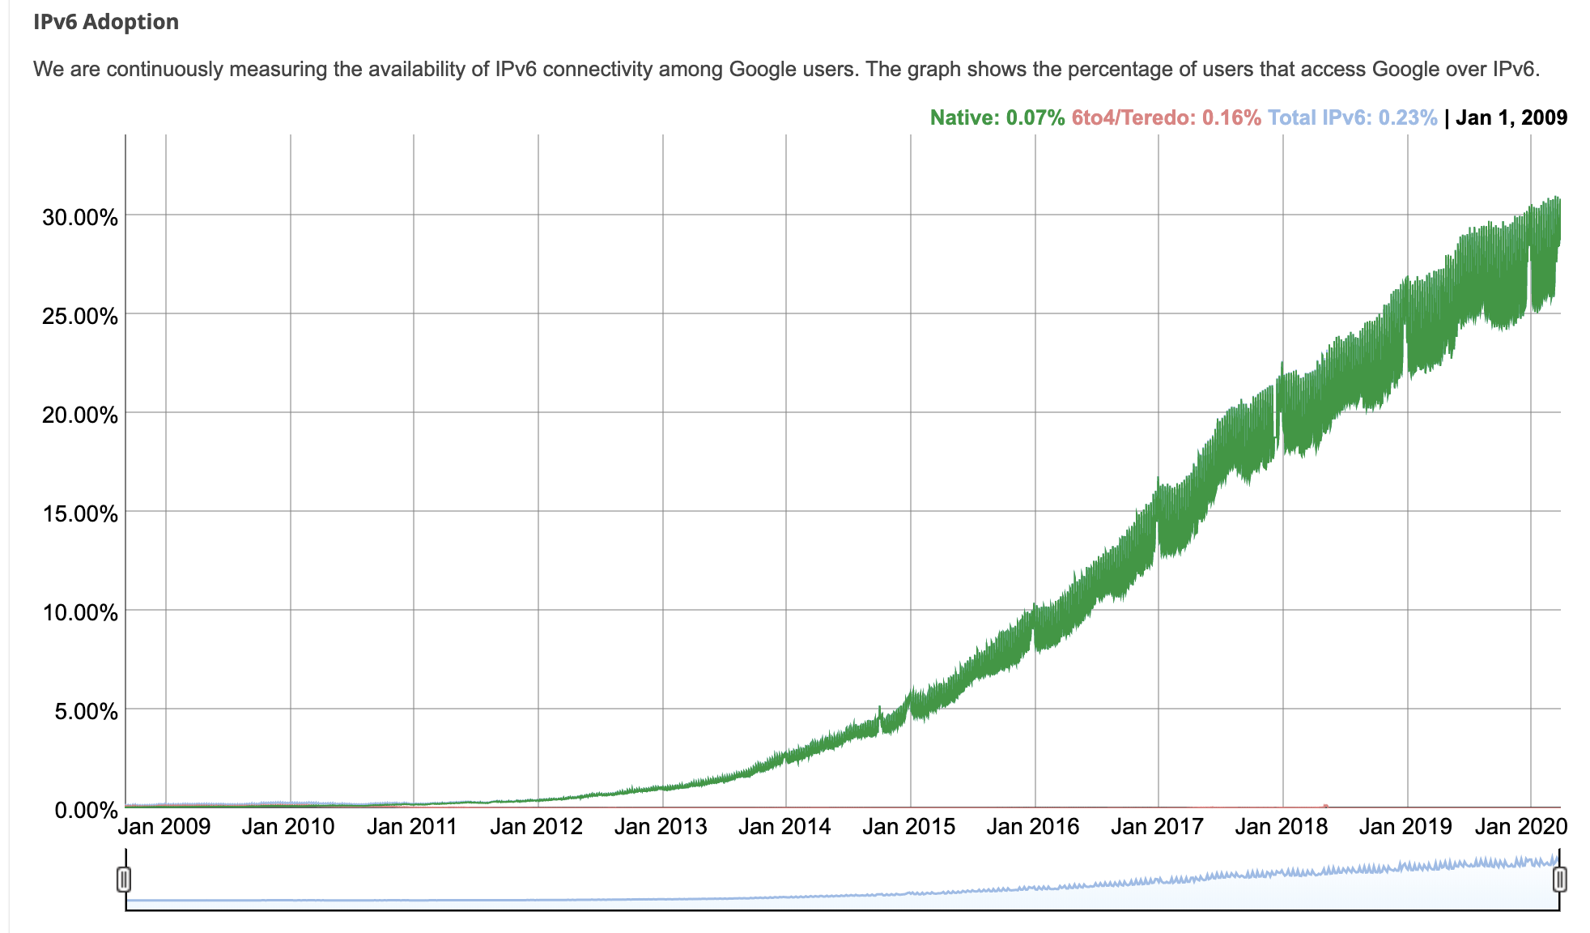
IPv6 adoption

Slide 21
IPv6: Adoption
Google: ~1/3 of clients access services via IPv6 (Apr 2020)
Long (long!) time for deployment, use
20 years and counting!
Think of application-level changes in last 20 years: WWW, Facebook, Skype, video streaming, AR, telesurgery,…
Why?

Slide 22
Poll #2
What’s the primary difference between IPv4 and IPv6?
(a) Larger address space
(b) Fixed-length, fewer headers by default
(c) No fragmentation
(d) All of the above

Slide 23
Routing Protocols
How do we design a “Google Maps” navigator for the Internet?

Slide 24
Network-layer functions
Recall: two network-layer functions:
forwarding: move packets from router’s input to appropriate router output
data plane
routing: determine route taken by packets from source to destination
control plane
Two approaches to structuring network control plane:
per-router control (traditional)
logically centralized control (software defined networking)

Slide 25

Per-router control plane
Individual routing algorithm components in each and every router interact with each other in control plane to compute forwarding tables
Routing
Algorithm
control
plane
data
plane

Slide 26
Routing protocols
Routing protocol goal: determine “good” paths (equivalently, routes), from sending hosts to receiving host, through network of routers
path: sequence of routers packets will traverse in going from given initial source host to given final destination host
“good”: least “cost”, “fastest”, “least congested”
routing: a “top-10” networking challenge!

Slide 27
Graph abstraction
5
v
3
w
2
5
u
2
1
z
3
1
2
x
y
1
Graph: G = (N,E)
N = set of routers = { u, v, w, x, y, z }
E = set of links ={ (u,v), (u,x), (v,x), (v,w), (x,w), (x,y), (w,y), (w,z), (y,z) }
Remark: Graph abstraction is useful in other network contexts
Example: P2P, where N is set of peers and E is set of TCP connections

Slide 28
Graph abstraction: costs
5
c(x,x’) = cost of link (x,x’)
- e.g., c(w,z) = 5
cost could always be 1, or
inversely related to bandwidth,
or inversely related to
congestion
v
3
w
2
5
u
2
1
z
3
1
2
x
y
1
Cost of path (x₁, x₂, x₃,…, x_{p}) = c(x₁,x₂) + c(x₂,x₃) + … + c(x_{p-1},x_{p})
Question: What’s the least-cost path between u and z ?
Routing algorithm: find “good” paths from source to
destination router.

Slide 29
Routing algorithm classification
Q: global or decentralized information?
global:
all routers have complete topology, link cost info
“link state” algorithms
decentralized:
router knows physically-connected neighbors, link costs to neighbors
iterative process of computation, exchange of info with neighbors
“distance vector” algorithms
Q: static or dynamic?
static:
routes change slowly over time
dynamic:
routes change more quickly
periodic update
in response to link cost changes

Slide 30
Poll #3
What is a good candidate to use to fix edge weights in a network graph representation?
(a) 1/link rate
(b) round-trip time
(c) congestion
(d) any of the above

Slide 31
Link State Algorithms

Slide 32
A Link-State Routing Algorithm
Dijkstra’s algorithm
net topology, link costs known to all nodes
accomplished via link state broadcast
all nodes have same info
computes least cost paths from one node (‘source”) to all other nodes
gives forwarding table for that node
iterative: after k iterations, know least cost path to k dest.’s
Notation:
c(x,y): link cost from node x to y; = ∞ if not direct neighbors
D(v): current value of cost of path from source to dest. v
p(v): predecessor node along path from source to v
N': set of nodes whose least cost path definitively known

Slide 33
Dijsktra’s Algorithm
1 Initialization:
2 N' = {u}
3 for all nodes v
4 if v adjacent to u
5 then D(v) = c(u,v)
6 else D(v) = ∞
7
8 Loop
9 find w not in N' such that D(w) is a minimum
10 add w to N'
11 update D(v) for all v adjacent to w and not in N' :
12 D(v) = min( D(v), D(w) + c(w,v) )
13 /* new cost to v is either old cost to v or known
14 shortest path cost to w plus cost from w to v */
15 until all nodes in N'

Slide 34
Dijkstra’s algorithm: example
Step
0
1
2
3
4
5
N'
u
ux
uxy
uxyv
uxyvw
uxyvwz
D(v),p(v)
2,u
2,u
2,u
D(w),p(w)
5,u
4,x
3,y
3,y
D(x),p(x)
1,u
D(y),p(y)
∞
2,x
D(z),p(z)
∞
∞
4,y
4,y
4,y
5
v
3
w
2
5
u
2
1
z
3
1
2
x
y
1

Slide 35
Poll #4
Link-state information of a router is sent to all routers before computing shortest paths in a link-state protocol.
(a) true
(b) false

Slide 36
Poll #5
Link-state protocols don’t compute shortest paths when there are cycles in the network topology.
(a) true
(b) false

Slide 37
Distance Vector Algorithms

Slide 38
Distance Vector Algorithm
D_{x}(y) = estimate of least cost from x to y
Distance vector: D_{x} = [D_{x}(y): y є N ]
Node x knows cost to each neighbor v: c(x,v)
Node x maintains D_{x}
Node x also maintains its neighbors’ distance vectors
For each neighbor v, x maintains D_{v} = [D_{v}(y): y є N ]
Notes:
At each node we need
- an array (known as DV) that lists the current least costs to reach all known destinations
- also need to maintain the next-hop along the least cost path
- the DV’s from all neighbors

Slide 39
Distance vector algorithm
Bellman-Ford equation (dynamic programming)
let
d_{x}(y) := cost of least-cost path from x to y
then
d_{x}(y) = min {c(x,v) + d_{v}(y) }
v
cost from neighbor v to destination y
cost to neighbor v
min taken over all neighbors v of x

Slide 40
Distance vector algorithm
Basic idea:
Each node periodically sends its own distance vector estimate to neighbors
When node a node x receives new DV estimate from neighbor, it updates its own DV using Bellman-Ford equation:
D_{x}(y) ← min_{v}{c(x,v) + D_{v}(y)} for each node y ∊ N
Under some conditions, the estimate D_{x}(y) converge the actual least cost d_{x}(y)
Notes:
The algorithm …

Slide 41
Distance vector: example
5
Start with d_{v}(z) = 5, d_{x}(z) = 3, d_{w}(z) = 3
v
3
w
2
5
u
2
1
z
3
1
2
d_{u}(z) = min { c(u,v) + d_{v}(z),
c(u,x) + d_{x}(z),
c(u,w) + d_{w}(z) }
= min {2 + 5,
1 + 3,
5 + 3} = 4
x
y
1
Node that achieves minimum is next
hop in shortest path ➜ forwarding table
Notes:
Just to reaffirm the idea behind Bellman-Ford Equations

Slide 42
D_{x}(y) = min{c(x,y) + D_{y}(y), c(x,z) + D_{z}(y)} = min{2+0 , 7+1} = 2
D_{x}(z) = min{c(x,y) + D_{y}(z), c(x,z) + D_{z}(z)}
= min{2+1 , 7+0} = 3
node x table
cost to
cost to
cost to
x y z
x y z
x y z
x
0 2 7
x
0 2 3
x
0 2 3
from
y
∞
∞
∞
from
y
2 0 1
from
y
2 0 1
z
∞
∞
∞
z
7 1 0
z
3 1 0
node y table
cost to
cost to
cost to
x y z
x y z
x y z
y
2
1
x
∞
∞
x
0 2 7
x
0 2 3
z
∞
2 0 1
x
from
y
from
y
2 0 1
from
y
7
2 0 1
z
∞
∞
∞
z
7 1 0
z
3 1 0
node z table
cost to
cost to
cost to
x y z
x y z
x y z
x
∞ ∞ ∞
x
0 2 7
x
0 2 3
from
y
from
y
2 0 1
from
y
2 0 1
∞
∞
∞
z
z
3 1 0
z
3 1 0
7
1
0
time
Notes:
This example assumes that nodes are computing routes in a lock-step fashion.

Slide 43
Distance vector: link cost changes
link cost changes:
node detects local link cost change
updates routing info, recalculates distance vector
if DV changes, notify neighbors
1
y
4
1
x
z
50
“good
news
travels
fast”
t₀ : y detects link-cost change, updates its DV, informs its neighbors.
t₁ : z receives update from y, updates its table, computes new least cost to x , sends its neighbors its DV.
t₂ : y receives z’s update, updates its distance table. y’s least costs do not change, so y does not send a message to z.

Slide 44
Problem: Count-to-Infinity
With distance vector routing, good news travels fast, but bad news travels slowly
When a router goes down, it takes can take a really long time before all the other routers become aware of it

Slide 45
Count-to-Infinity
A
B
C
D
E
1
2
3
4
Initially
3
2
3
4
After 1 exchange
3
4
3
4
After 2 exchanges
5
4
5
4
After 3 exchanges
5
6
5
6
After 4 exchanges
7
6
7
6
After 5 exchanges
etc… to infinity

Slide 46
Count-to-infinity
“Bad news travels slowly”
Poisoned reverse:
If Z routes through Y to get to X :
Z tells Y its (Z’s) distance to X is infinite (so Y won’t route to X via Z)
Will this completely solve count to infinity problem?

Slide 47
Comparison of LS and DV algorithms
message complexity
LS: with n nodes, E links, O(nE) msgs sent
DV: exchange between neighbors only
convergence time varies
speed of convergence
LS: O(n²) algorithm requires O(nE) msgs
DV: convergence time varies
may be routing loops
count-to-infinity problem
robustness: what happens if router malfunctions?
LS:
node can advertise incorrect link cost
each node computes only its own table
DV:
DV node can advertise incorrect path cost
each node’s table used by others
error propagate thru network

Slide 48
Poll #6
Which routing protocol(s) ensure that routers have a view of the network that is consistent with each other at all times?
(a) Link-state protocols
(b) Distance-vector protocols
(c) All of the above
(d) None of the above

Slide 49
Routing protocols are widely deployed
OSPF: a link-state protocol
“Open Shortest Path First”
IS-IS, nearly identical to OSPF
RIP: a distance-vector protocol
LS and DV deployed inside an autonomous system
Additional tricks to scale the protocols with network size:
Areas; Hierarchy
“Border routers” that summarize each area
Next lecture: Routing across autonomous systems

