Slide 1

Operating Systems

Slide 2


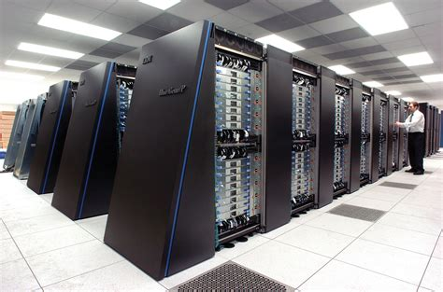

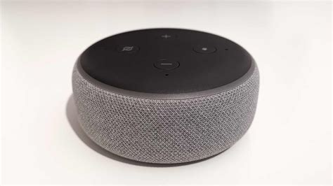
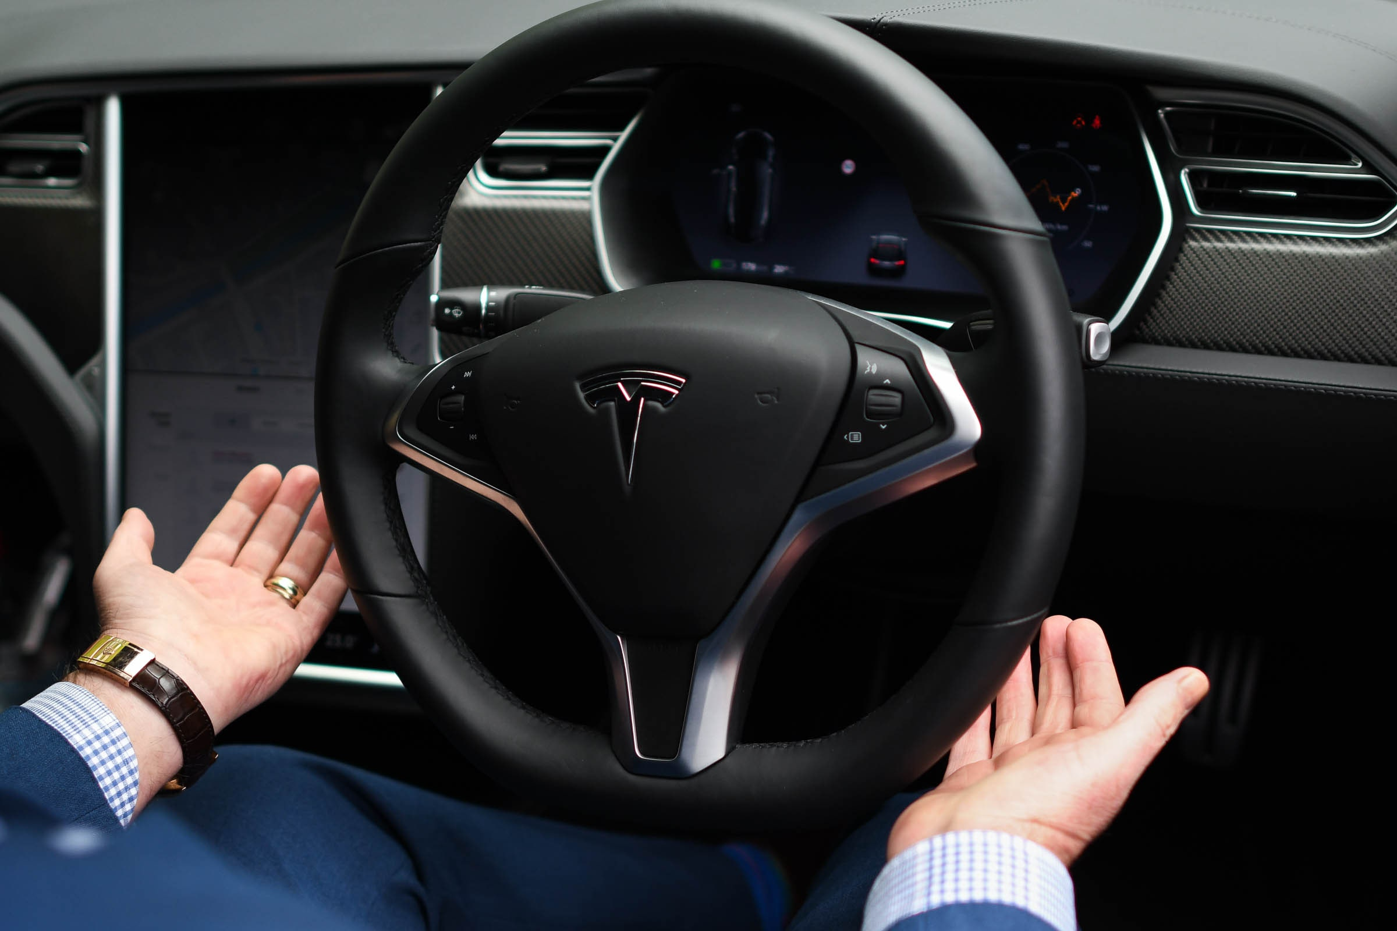
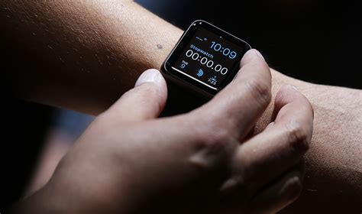
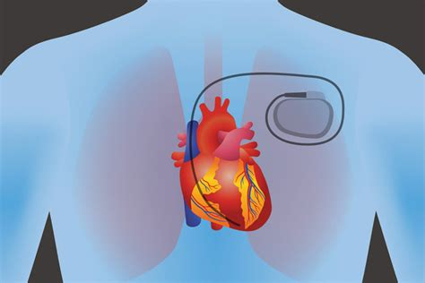
Computers everywhere
Software everywhere

Slide 3
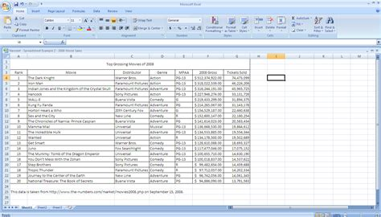

Making software useful means making it…
Interact with human users
Interact with the physical world
Process data
Easy to develop software
Easy to run software
Hardware access
Abstractions
Resource isolation; performance

Slide 4
This Course: Operating Systems
Abstractions: How exactly does modern software use hardware?
Resource Management: How to isolate resources?
How to achieve the above correctly and with high performance?
Operating systems form the foundation of modern computing.
Conceptual learning and intensive programming

Slide 5
What is an Operating System?
Software that abstracts and manages hardware resources.
Users
Applications
Operating System
Hardware

Slide 6

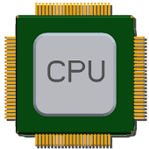


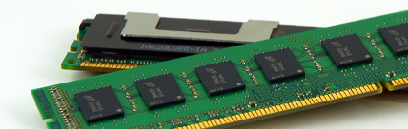
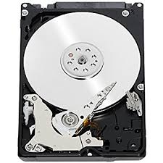
What hardware are we talking about?
Application
malloc()
Cache
OS
send()/ recv()
File System
Memory
Network
Memory Controller
write()/read()
Network adapter
SATA
DRAM
Disk

Slide 7
Operating system provides…
Software library (abstraction) between applications and hardware to make the hardware easier to use
Simple, uniform view of diverse hardware devices
Mechanisms and policies for resource management, to provision and isolate hardware across many applications
Effective multi-tenant and multi-application systems

Slide 8
#1. Abstraction
What abstraction does modern OS typically provide for each resource?
CPU: process and/or thread
Memory: address space
Storage: files
Advantages of OS providing abstraction?
Allow applications to reuse common facilities
Make different devices look the same
Provide higher-level or more useful functionality
Challenges
What are the correct abstractions?
How much of the hardware capabilities should be exposed?

Slide 9
System Calls
System call allows user to tell the OS what to do on hardware
The OS provides a standard software interface (APIs)
A typical OS exports a few hundred system calls
Run programs, access memory, access hardware devices, …

Slide 10
#2. Resource Management
Want fair and efficient use of hardware across applications
Advantages of OS providing resource management:
Protect applications from one another
Provide efficient access to resources (cost, time, energy)
Provide fair access to resources
Challenges
What are the correct mechanisms?
What are the correct policies?

Slide 11
Benefits of studying Operating Systems
Pragmatic: Understand the limits of software performance
Behavior of OS impacts entire machine
Tune application performance
Apply knowledge across many layers
Computer architecture, programming languages, data structures and algorithms, and performance modeling
Puzzle solving: Fun to understand large, complex systems
Technology: Build, modify, or administer an operating system

Slide 12
Course Logistics

Slide 13
About us
Faculty Instructor: Srinivas Narayana
http://www.cs.rutgers.edu/~sn624
sn624@rutgers.edu
Office hours in person Wed 4—5 pm ET (or by appointment)
Subject to change in the next 1—2 weeks. TA office hours TBA
Lectures Wed 8:30—11:30 ET
TAs and Recitations: two UG sections, one G section
Qiongwen Xu (qx51), Harishankar Vishwanathan (hv90), Adithya Murugadass (am3372)
Post q’s to Piazza (Canvas announcement to sign up)
Class info: http://www.cs.rutgers.edu/~sn624/416-F23/

Slide 14
Class philosophy
We want you to learn and to be successful
Attend recitations and office hours regularly to discuss material
Be proactive: interact, ask, support.
Use Piazza
Full video lectures will be made available

Slide 15
Grading
45% programming projects
20% weekly quizzes
15% mid term
20% final exam (cumulative)
Schedule of projects, exams, etc. will be made available at https://www.cs.rutgers.edu/~sn624/416-F23
Book: https://pages.cs.wisc.edu/~remzi/OSTEP/
This course uses absolute grading. There is no curve

Slide 16
45% programming projects
4 large software projects
Groups of 2. Pick partner and keep them throughout semester
Program and short write-up required
Use hosted VMs (will provide instructions for use)
Hand projects in on Canvas

Slide 17
45% programming projects
Please follow all instructions carefully and exactly
You will lose significant points if:
We are unable to run your code
Your information (e.g., team member names and netids) is incorrect or incomplete
We do not receive your submission in a timely fashion

Slide 18
Collaboration and Integrity policies
Intellectual collaboration is welcome and encouraged
Do
Ask questions on Piazza
Discuss projects and problem sets with us and each other
Read references (textbooks, Internet tutorials) widely
Acknowledge each other and all the references in psets & project reports
Each problem set & project has a prompt on collaboration
Include who you talked to, references (including on the web) you consulted
Be as accurate and complete as possible

Slide 19
Collaboration and Integrity policies
All your written (coded) work must be your (team’s) own
Understand the problem deeply and produce your own solutions
Do not
blindly lift or incorporate other solutions
look at other people’s code or solutions
copy code from the web (e.g., other people’s GitHub projects)
post problem sets or projects (questions or solutions) on piazza, GitHub, Chegg, CourseHero, etc.
Ask us for permission if you are ever in doubt
We will check for plagiarism across submissions from this year and the last few years

Slide 20
Programming projects are time-intensive
Cannot score high by pulling all-nighters close to the due date
Please approach the projects (and this course) diligently from day 1
Get the most out of this course
Use the projects to improve your programming skills
Job search, grad school, better learning outcomes

Slide 21
20% weekly quizzes
Due every Tuesday night over the semester (including next Tue)
Work individually
Can consult the textbook and own notes
No collaboration or searching for answers on the Internet
We will consider the 10 highest scores out of 13

Slide 22
Late policy
Don’t be late
If you must be late, inform us in advance
If you cannot inform us in advance (e.g., medical), provide official medical note of absence through the University
Unexcused late submissions will result in losing significant fraction of points

Slide 23
24/7 Grading Policy
You may not dispute a grade or request a regrade before 24 hours or after 7 days of receiving it
Please contact us if you have a legitimate regrading request:
After 24 hours of receiving the grade: Please take the time to review your case before contacting the instructors
Before 7 days have elapsed: we don’t want to forget what the test/project was all about.

Slide 24
Help, Accommodations, etc.
We’ll make every effort to accommodate reasonable requests that support your learning better
sn624@cs.rutgers.edu
Course staff is committed to help you succeed

Slide 25
Recommendation Letters
For students applying to grad school or jobs, and seeking a reference letter:
Do well in the class (i.e., get an A)
Ask questions and interact with the instructor during office hours

Slide 26
Three Easy Pieces

Slide 27
Operating systems are complex.

Slide 28
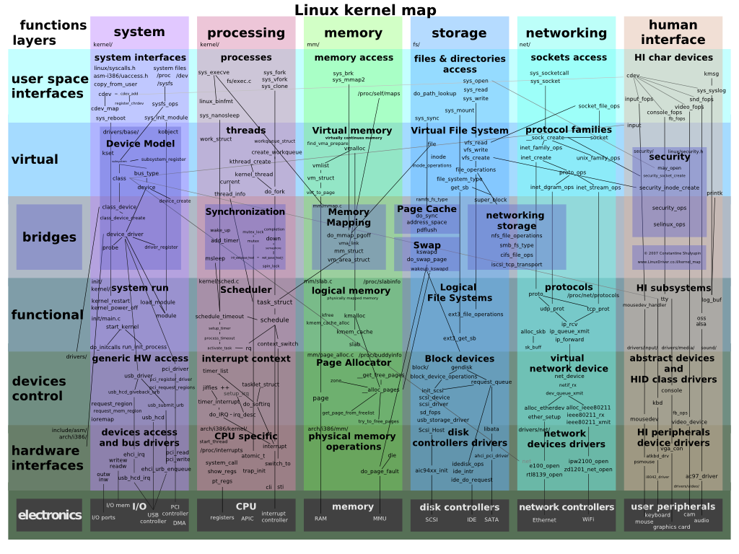
OS Organization

Slide 29
How to systematically approach studying it?

Slide 30
Three pieces: (1) Virtualization
Make each application believe it has each hardware resource to itself
Resources considered in this course: CPU and memory

Slide 31
Virtualizing CPU
The system has a very large number of virtual CPUs.
Turning a single CPU into a seemingly infinite number of CPUs.
Allowing many programs to seemingly run at once, virtualizing the CPU

Slide 32
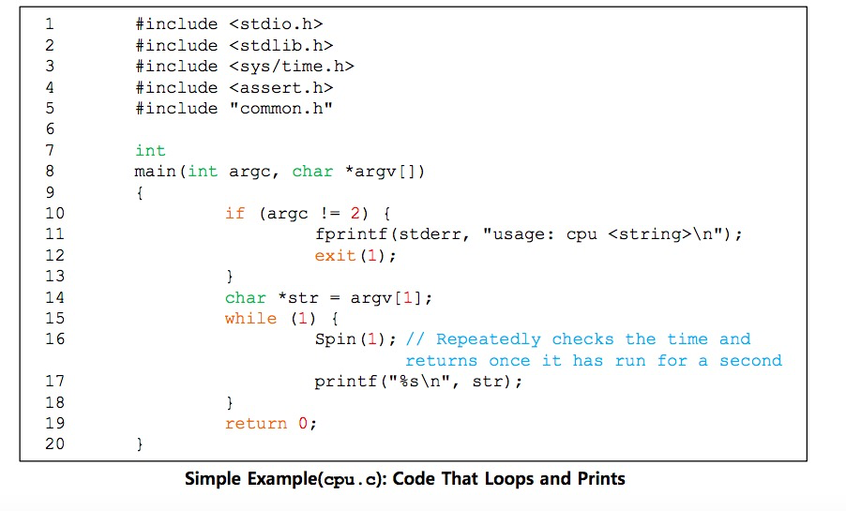
Virtualizing CPU

Slide 33
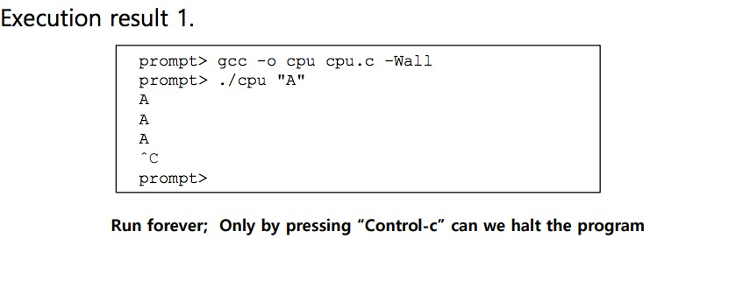
Virtualizing CPU

Slide 34

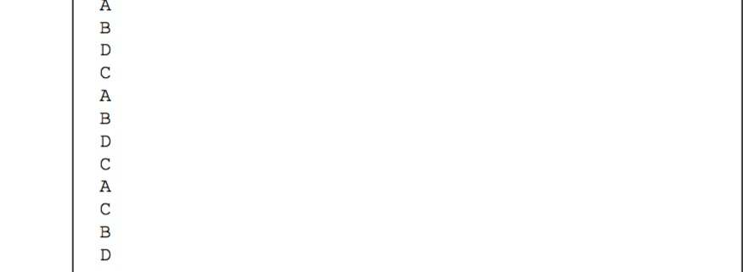
Virtualizing CPU
Even though we have only one processor, all four programs seem to be running at the same time!

Slide 35
Virtualizing Memory
The physical memory is an array of bytes.
A program keeps all of its data structures in memory.
Read memory (load):
Specify an address to be able to access the data
Write memory (store):
Specify the data to be written to the given address

Slide 36
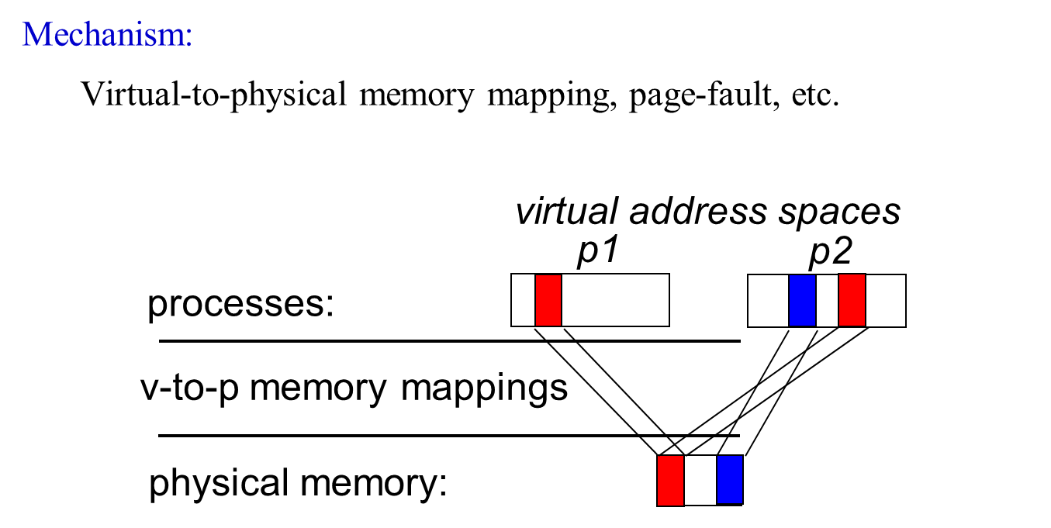
Virtualizing Memory

Slide 37
Virtualizing Memory
# include < unistd.h >
# include < stdio.h >
# include < stdlib.h >
# include " common.h "
int main( int argc , char * argv [])
{
int *p = malloc ( sizeof ( int )); // a1: allocate some memory
assert(p != NULL );
printf ("(%d) address of p: %08x \ n",
getpid (), (unsigned) p); // a2: print out the address of the memory
* p = 0 ; // a3: put zero into the first slot of the memory
while ( 1 ) {
Spin( 1 );
* p = *p + 1 ;
printf ("(%d) p: %d \ n", getpid (), *p); // a4
}
return 0 ;
}
gcc mem.c –o mem

Slide 38
Virtualizing Memory
prompt> ./mem
[1] 10
memory address of p: 00200000
p: 1
p: 2
p: 3
p: 4
p: 5
ˆC
The newly allocated memory is at address 00200000 .

Slide 39
Virtualizing Memory
prompt> ./mem &; ./mem &
[1] 10
[2] 11
memory address of p: 00200000
memory address of p: 00200000
(10) p: 1
(11) p: 1
p: 2
(10) p: 2
(10) p: 3
p: 3
ˆC
You may or may not get this output.
(non-deterministic malloc()).
It is as if each running program has its own private memory .
Each program could allocate memory at the same address
Each updates the value at address 00200000 independently.

Slide 40
Virtualizing Memory
Each process accesses its own private virtual address space.
The OS maps address space onto the physical memory.
A memory reference within one running program does not affect the address space of other processes.
Physical memory is a shared resource, managed by the OS.

Slide 41
Three pieces: (2) Concurrency
Concurrency: Events are occurring simultaneously and may interact with one another
OS must be able to handle concurrent events
Easier case
Hide concurrency from independent processes
Trickier case
Manage concurrency with interacting processes
Provide abstractions (locks, semaphores, condition variables, shared memory, critical sections) to processes
Ensure processes do not deadlock
Interacting threads must coordinate access to shared data

Slide 42
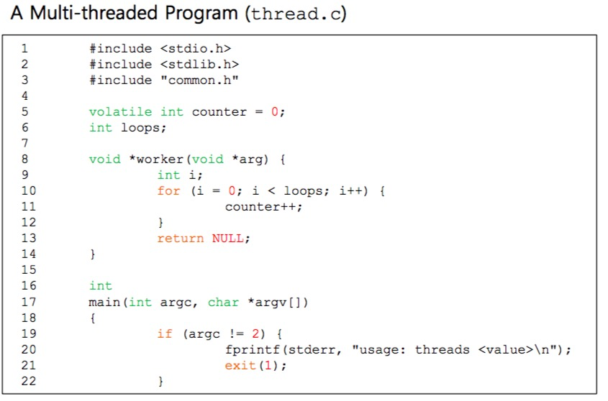
Concurrency

Slide 43
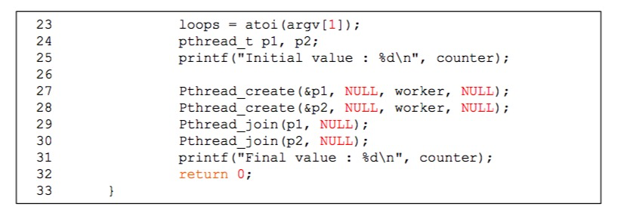
Concurrency
The main program creates two threads.
Thread: a function running within the same memory space.
Each thread start running in a routine called worker().
worker(): increments a counter

Slide 44
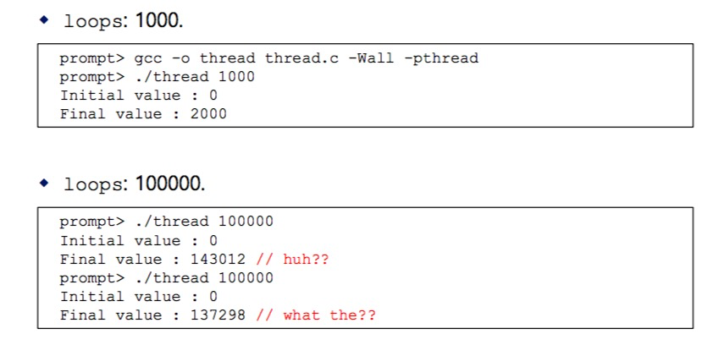
Concurrency
Loops determines how many times each of the two workers will increment the shared counter in a loop.

Slide 45
Three pieces: (3) Persistence
Persistence: Access information permanently
Lifetime of information is longer than lifetime of any one process
Machine may be rebooted, machine may lose power or crash unexpectedly
Issues:
Provide abstraction so applications do not know how data is stored : Files, directories (folders), links
Correctness with unexpected failures
Performance: disks are very slow; many optimizations needed!
Demo
File system does work to ensure data updated correctly

Slide 46
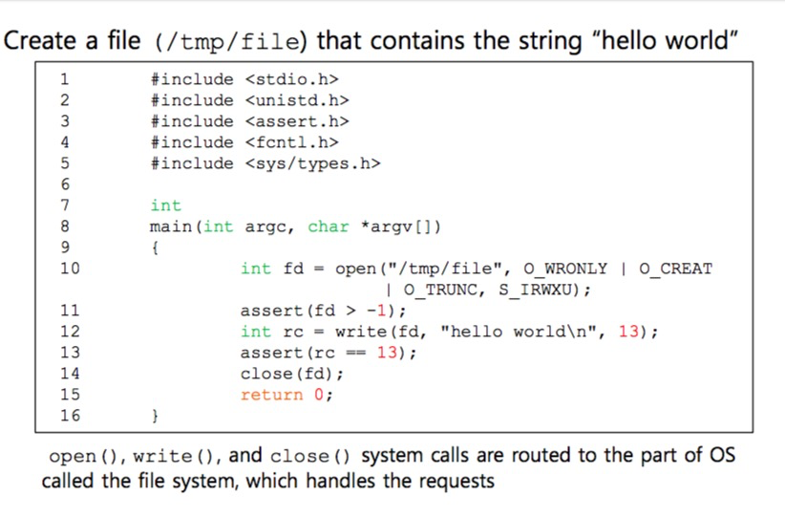
Persistence

Slide 47
System Call
Process P
RAM
movl $6, %eax; int $64
syscall-table index
trap-table index

Slide 48
Persistence
What does the OS do to write to disk?
Figure out where on disk this new data will reside
Issue I/O requests to the underlying storage device
File system handles system crashes during write
Journaling or copy-on-write
Carefully ordering writes to disk

Slide 49
Next lecture: CPU virtualization

Slide 50
Next steps
Finish weekly quiz by next Tuesday 8 pm ET
Look out for C self-assessment homework (not graded) and review
Starting projects early helps the project grade significantly
Sign up for class Piazza (link TBA on canvas announcement)
Ask questions well ahead of time
Contact me if interested: independent study & research opp’s
See you at next week’s lecture

