Slide 1
VL2: Virtual Layer 2 Backup slides

Slide 2
VL2 goals
The Illusion of a Huge L2 Switch
1. L2 semantics
2. Uniform high capacity
3. Performance isolation
A
A
A
…
A
A
…
A
A
A
A
A
A
A
A
A
A
A
A
A
A
A
A
A
…
A
A
…
A
A
A
A
A
A
A
A
A
A
A
A
A

Slide 3
VL2 design principles
Randomizing to cope with volatility
Tremendous variability in traffic matrices
Separating names from locations
Any server, any service
Embracing end systems
Leverage the programmability & resources of servers
Avoid changes to switches
Building on proven networking technology
Build with parts shipping today
Leverage low cost, powerful merchant silicon ASICs, though do not rely on any one vendor

Slide 4
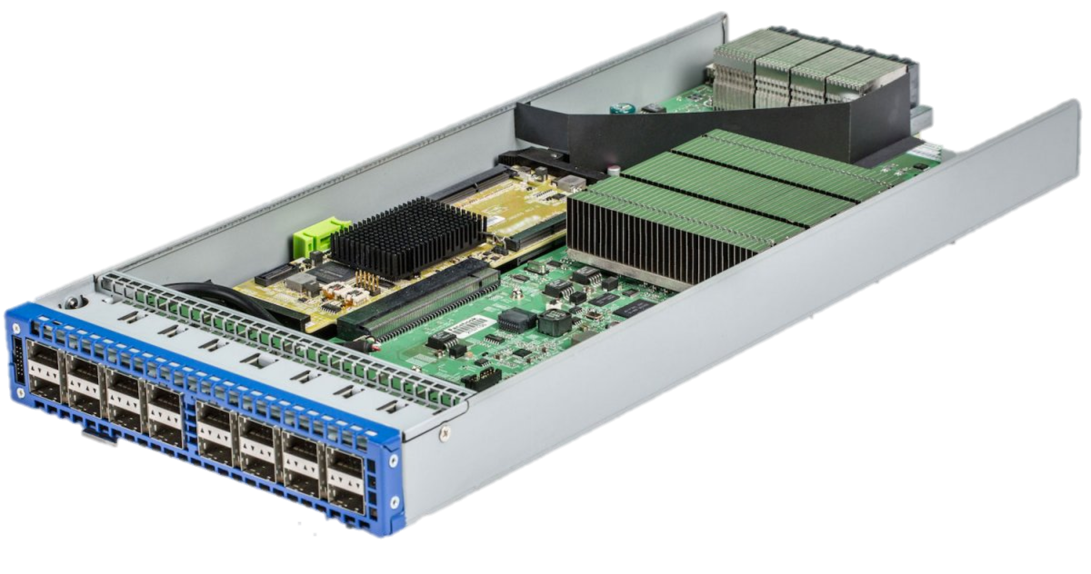
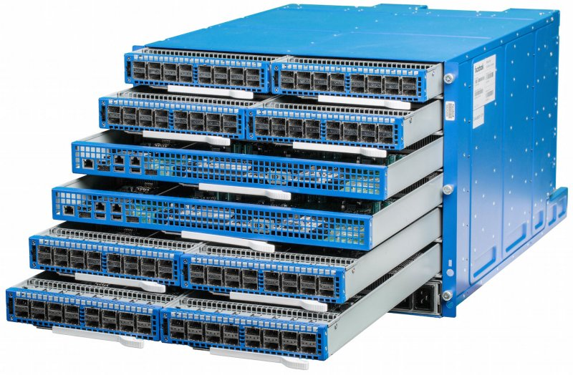
Single-chip “merchant silicon” switches
Switch ASIC
6 pack
Wedge
Image courtesy of Facebook

Slide 5
Specific objectives and solutions
Objective
Approach
Solution
1. Layer-2 semantics
Employ flat addressing
Name-location separation & resolution service
2. Uniform high capacity between servers
Guarantee bandwidth for hose-model traffic
Flow-based random traffic indirection (Valiant LB)
3. Performance Isolation
Enforce hose model using existing mechanisms only
TCP

Slide 6
Addressing and routing: Name-location separation
Cope with host churns with very little overhead
VL2
Switches run link-state routing and maintain only switch-level topology
Directory Service
…
x → ToR₂
y → ToR₃
z → ToR₄
…
…
x → ToR₂
y → ToR₃
z → ToR₃
…
ToR₁
. . .
ToR₂
. . .
ToR₃
. . .
ToR₄
ToR₃
y
payload
Lookup &
Response
y, z
ToR₄
x
y
z
ToR₃
z
z
payload
payload
Servers use flat names

Slide 7
Addressing and routing: Name-location separation
Cope with host churns with very little overhead
VL2
Switches run link-state routing and maintain only switch-level topology
Directory Service
Allows to use low-cost switches
Protects network and hosts from host-state churn
Obviates host and switch reconfiguration
…
x → ToR₂
y → ToR₃
z → ToR₄
…
…
x → ToR₂
y → ToR₃
z → ToR₃
…
ToR₁
. . .
ToR₂
. . .
ToR₃
. . .
ToR₄
ToR₃
y
payload
Lookup &
Response
y, z
ToR₄
x
y
z
ToR₃
z
z
payload
payload
Servers use flat names

Slide 8
Example topology: Clos network
Offer huge aggr capacity and multi paths at modest cost
VL2
Int
. . .
Aggr
. . .
K aggr switches with D ports
. . .
. . . . . .
TOR
. . .
. . . . . . . .
20 Servers
20*(DK/4) Servers

Slide 9
Example topology: Clos network
Offer huge aggr capacity and multi paths at modest cost
VL2
Int
. . .
D (# of 10G ports) | Max DC size (# of Servers)
48 | 11,520
96 | 46,080
144 | 103,680
Aggr
. . .
K aggr switches with D ports
. . .
. . . . . .
TOR
. . .
. . . . . . . .
20 Servers
20*(DK/4) Servers

Slide 10
Traffic forwarding: Random indirection
Cope with arbitrary TMs with very little overhead
I_{ANY}
I_{ANY}
I_{ANY}
Links used for up paths
Links used for down paths
T₁
T₂
T₃
T₄
T₅
T₆
I_{ANY}
T₃
T₅
y
z
payload
payload
x
y
z

Slide 11
Traffic forwarding: Random indirection
Cope with arbitrary TMs with very little overhead
I_{ANY}
I_{ANY}
I_{ANY}
Links used for up paths
Links used for down paths
[ ECMP + IP Anycast ]
Harness huge bisection bandwidth
Obviate esoteric traffic engineering or optimization
Ensure robustness to failures
Work with switch mechanisms available today
T₁
T₂
T₃
T₄
T₅
T₆
I_{ANY}
T₃
T₅
y
z
payload
payload
x
y
z

Slide 12
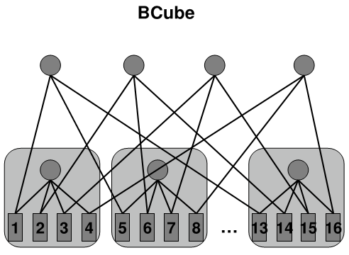
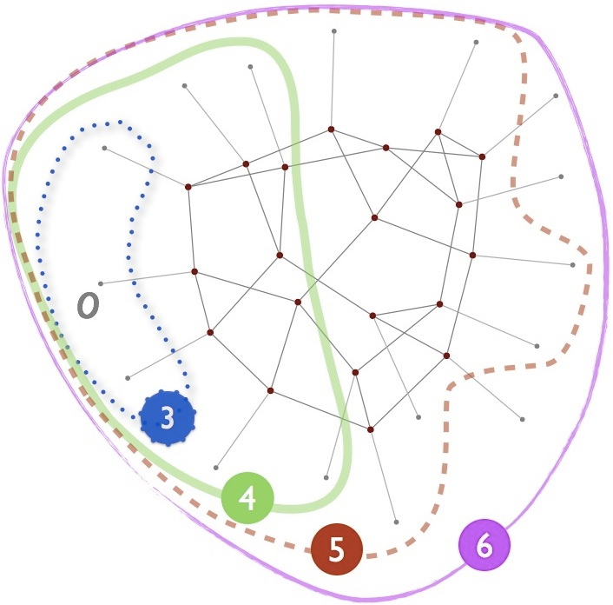
Some other DC network designs…
BCube [SIGCOMM’10]
Jellyfish (random) [NSDI’12]

