Slide 1

Multi-Path Congestion Control
Lecture 20, Computer Networks (198:552)
Fall 2019

Slide 2
Review: TCP congestion control
Keep some in-flight (un-ACK’ed) packets: congestion window
Adjust window based on several algorithms:
Startup: slow start
Steady state: AIMD
Loss: fast retransmission, fast recovery
Classically, TCP uses a single path provided by the underlying network routing

Slide 3
If a TCP conn could use multiple paths…
Better resilience
If one path becomes unavailable, keep traffic flowing over others
Higher throughput
Use multiple paths to overcome single-path bottlenecks
Seamless mobility
More paths as they become available, “handing off” as needed
Example uses
Mobile phone (WiFi/cellular)
High-end servers (multiple NICs)
Data centers (many paths available)
Goal: Do all this without application-level changes

Slide 4
TCP throughput equation
Steady-state behavior

Slide 5
Model of single-path TCP
AIMD: W := W + 1 (RTT), W := W/2 (drop)
Only a single flow using the bottleneck link
Loss
Congestion
Window
halved
time

Slide 6
Model of single-path TCP
Idealization: Repeat exactly same window evolution over multiple epochs of a single packet loss
Loss
Congestion
Window
halved
Epoch
time

Slide 7
Model of single-path TCP
Window goes from W_{min} to 2 * W_{min}
Loss rate p: number of packets dropped per packet sent
Loss
Congestion
Window
2W_{min}
halved
W_{min}
time

Slide 8
Model of single-path TCP
Loss rate assumed to be independent of sending rate
In reality: more you send, more links traversed, more you drop
Loss assumed deterministic (e.g., buffer full)
In reality: AQM, stochastic channel loss (e.g., cellular)
Congestion
Window
2W_{min}
halved
W_{min}
time

Slide 9
Model of single-path TCP
Goal: Find TCP’s throughput as a function of link rate, RTT, and packet loss rate
Throughput = (#packets sent per epoch) / (time per epoch)
Congestion
Window
2W_{min}
halved
W_{min}
time

Slide 10
TCP throughput equation
Throughput depends inversely on sqrt of loss rate, p^{-1/2}
Throughput drops steeply with increasing loss rate
Ideal: want it to be linear drop, ie: C*(1-p)
Throughput depends inversely on the RTT
An issue known as RTT unfairness: lower-RTT connection on a bottleneck gets higher throughput than higher-RTT connection
Ideal: independent of RTT
Is throughput independent of the link rate and buffer size?

Slide 11
Multipath TCP
Design of the congestion control algorithm
Slides adapted from Damon Wischik’s

Slide 12
Goal #1: Fairness at Shared Bottlenecks
Why not just open multiple TCP connections?
To be fair, Multipath TCP should take as much capacity as TCP at a bottleneck link, no matter how many paths it is using.
A multipath TCP flow with two subflows
Regular TCP
Notes:
This is the very first thing that comes to mind with multipath TCP, and it’s something that many other people have solved in different ways.
This is just a warm-up... Design Goal 3 is a much “richer” generalization of this goal, which accommodates different topologies, different RTTs. So there’s no point giving an evaluation here.

Slide 13
Goal #2: Use Efficient Paths
12Mb/s
12Mb/s
12Mb/s
Each flow has a choice of a 1-hop and a 2-hop path.
How should each flow split its traffic?
Notes:
I’m thinking of the paths as given. MPTCP has the choice of how to split its traffic over those given paths.

Slide 14
Use Efficient Paths
12Mb/s
Equal-window TCP (EWTCP): split flow traffic 1:1 over paths
Achieve fairness using W_{s} := W_{s} + a (RTT), a < 1
8Mb/s
8Mb/s
12Mb/s
8Mb/s
12Mb/s

Slide 15
Use Efficient Paths
Move some traffic to better paths:
What if each flow split its traffic 2:1?
12Mb/s
9Mb/s
9Mb/s
12Mb/s
9Mb/s
12Mb/s

Slide 16
Use Efficient Paths
12Mb/s
12Mb/s
Best: Each connection on its one-hop path
→ Least congested path
12Mb/s
12Mb/s
12Mb/s
12Mb/s

Slide 17
Use Efficient Paths
12Mb/s
12Mb/s
Goal: Get each flow to send all its traffic on the least-congested path
Achieve by coupling the subflow TCP window updates
W_{s} := W_{s} + 1/W_{total} (ack), W_{s} := W_{s} – W_{total}/2 (drop)
12Mb/s
12Mb/s
12Mb/s
12Mb/s

Slide 18
Use Efficient Paths
12Mb/s
12Mb/s
12Mb/s
W_{s} := W_{s} + 1/W_{total} (ack), W_{s} := W_{s} – W_{total}/2 (drop)
Consequence: the more drops a subflow sees, the faster its window W_{s} reduces (note: increments same across all paths)
More lossy paths have zero window in the limit
12Mb/s
12Mb/s
12Mb/s

Slide 19
Use Efficient Paths
12Mb/s
12Mb/s
12Mb/s
W_{s} := W_{s} + 1/W_{total} (ack), W_{s} := W_{s} – W_{total}/2 (drop)
Consequence: Remaining paths have balanced loss rate ➔ equal window if RTTs same
If loss not balanced, window would drop to zero
12Mb/s
12Mb/s
12Mb/s

Slide 20
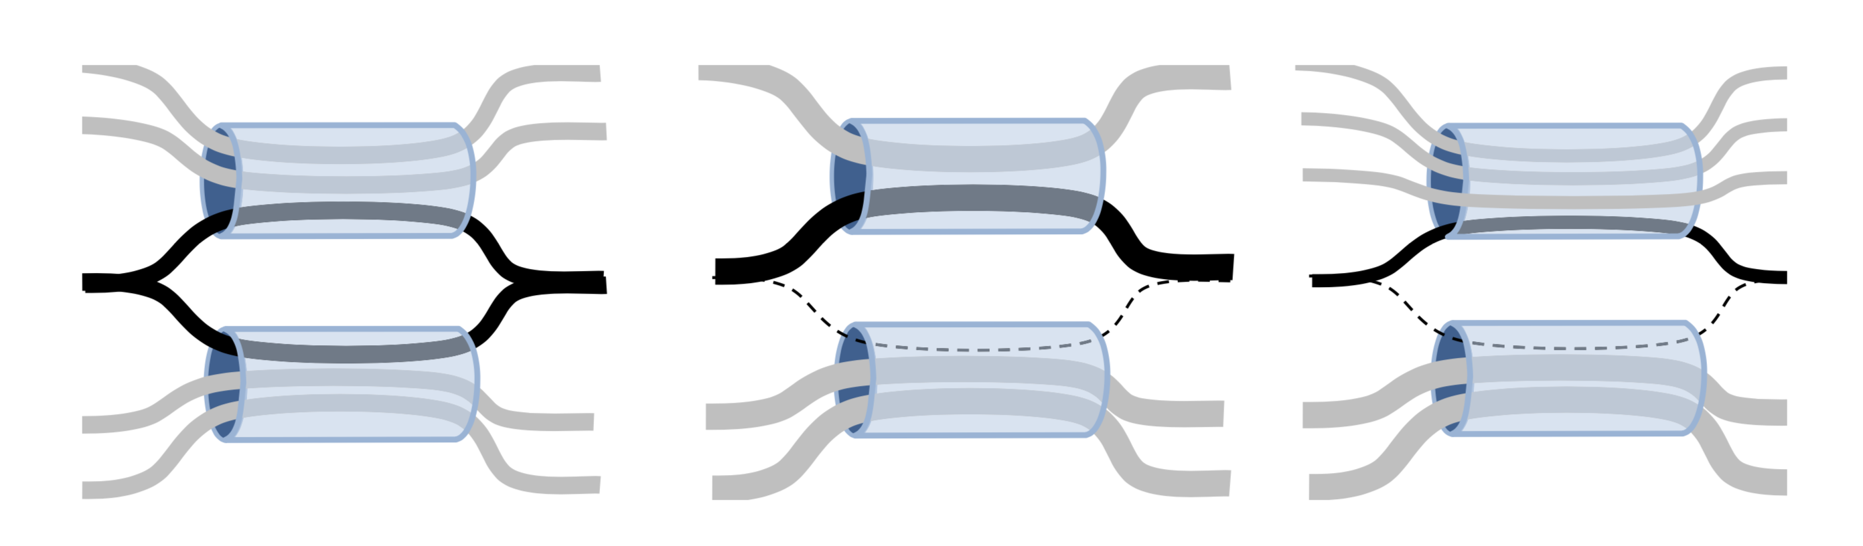
Coupled CC can get trapped
Keep a little traffic on each path (even if congested) to probe for capacity always
i.e., keep your options open ☺

Slide 21
Coupled CC can get trapped
Semi-coupled TCP
W_{s} := W_{s} + a/W_{total} (ack), W_{s} := W_{s} – W_{s}/2 (drop)
Compare with coupled:
W_{s} := W_{s} + 1/W_{total} (ack), W_{s} := W_{s} – W_{total}/2 (drop)

Slide 22
Goal #3: Be Fair Compared to TCP
Least-congested paths may not be best
Low loss rate, but low throughput due to differences in RTT
Example: Two paths
WiFi: high loss, low RTT
Cellular: low loss, high RTT
Using the least-congested path
Choose the cellular path, due to low loss
But, the RTT is high
So throughput is low!
Formalize fairness requirement using actual throughput

Slide 23
Be Fair Compared to TCP
To be fair, Multipath TCP should give a connection at least as much throughput as it would get with a single-path TCP on the best of its paths, given the same loss rate
Ensure incentive for deploying MPTCP
A Multipath TCP should take no more capacity on any path (or collection of paths) than if it was a single-path TCP flow using the best of those paths, given the same loss rate
Do no harm

Slide 24
Achieving These Goals
Regular TCP
Maintain a congestion window w
On an ACK, increase by 1/w (increase 1 per window)
On a loss, decrease by w/2
MPTCP
Maintain a congestion window per path w_{s}
On an ACK on path s, increase w_{s}
On a loss on path s, decrease by w_{s}/2
How much to increase w_{s} on an ACK?
If s is the only path at that bottleneck, increase by 1/w_{s}

Slide 25
If Multiple Paths Share Bottleneck?
Don’t take any more bandwidth on a link than the best of the TCP paths would
But, where might the bottlenecks be?
Multiple paths might share the same bottleneck
This is hard to know across the Internet
So, consider all possible subsets of the paths
Set R of paths
Subset S of R that includes path r
E.g., consider path 3
Suppose paths 1, 3, and 4 share a bottleneck
… but, path 2 does not
Then, we care about S = {1,3,4}

Slide 26
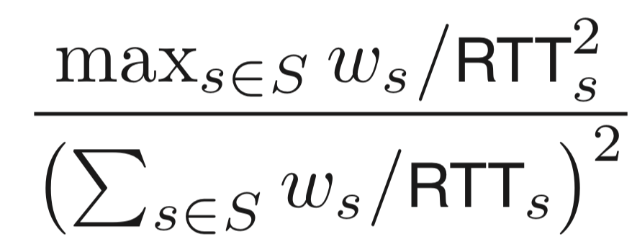
Achieving These Goals
What is the best of these subflows achieving?
Path s is achieving throughput of w_{s}/RTT_{s}
So best path is getting max_{s}(w_{s}/RTT_{s})
What total bandwidth are these subflows getting?
Across all subflows sharing that bottleneck
Sum over s in S of w_{s}/RTT_{s}
Consider the ratio of the two
Increase by less if many subflows are sharing
And pick the results for the set S with min ratio
To account for the most paths sharing a bottleneck

Slide 27
MPTCP Implementation

Slide 28
Implementation Issues
Buffer space: per-subflow or shared for entire connection?
Reassembly across multiple paths
Different sequence spaces across subflows
But shared flow control
Ensure packets across subflows reach at approx. the same time
Middleboxes
Avoid impact due to rewritten sequence numbers
Initiating new subflow: new TCP flag; auth token

