Slide 1

CS 352 Ordered Delivery
CS 352, Lecture 11.1
http://www.cs.rutgers.edu/~sn624/352
Srinivas Narayana

Slide 2


Transport
Application
HTTPS
FTP
HTTP
SMTP
DNS
Transport
TCP
UDP
Network
IP
Host-to-Net
X.25
…
802.11
ATM

Slide 3
Modularity through layering
Apps: useful user-level functions
HTTP
FTP
NV
TFTP
Transport: provide guarantees to apps
TCP
UDP
IP
Network: best-effort global pkt delivery
Ether
ATM
…
WiFi
Link: best-effort local pkt delivery

Slide 4

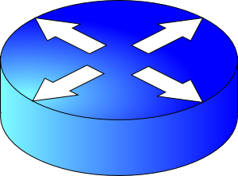
How do apps get perf guarantees?
The network core provides no guarantees on packet delivery
Transport software on the endpoint oversees implementing guarantees on top of a best-effort network
Three important kinds of guarantees
Reliability
Ordered delivery
Resource sharing in the network core
Transmission Control Protocol (TCP)

Slide 5
CS 352 Flow Control
CS 352, Lecture 11.2
http://www.cs.rutgers.edu/~sn624/352
Srinivas Narayana

Slide 6
CS 352 Congestion Control: Intro
CS 352, Lecture 11.3
http://www.cs.rutgers.edu/~sn624/352
Srinivas Narayana

