Slide 1

Verification

Slide 2
Networks are complex
Many control plane protocols
Protocols interact in complex ways, cascading effects
Protocols must often work across administrative boundaries
Significant outages often due to avoidable reasons
Human errors cause >50% of outages
Responding to physical connectivity disruptions
Network is in a constant state of change

Slide 3
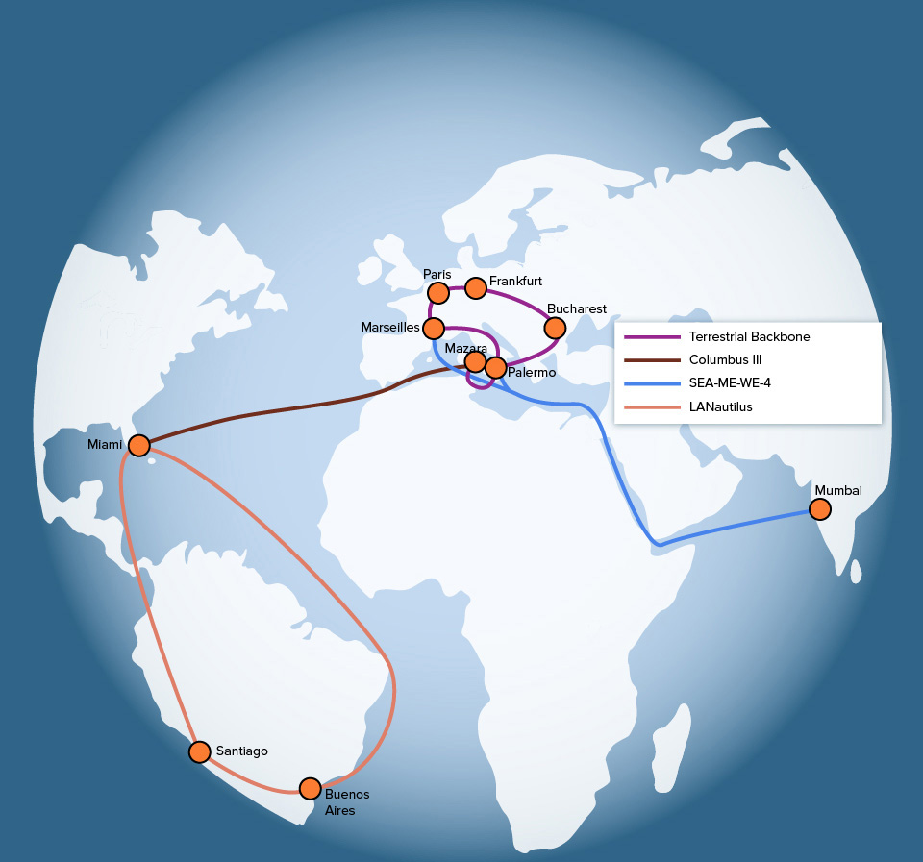
Physical faults
Single cable fault or break can take out multiple ISP paths
Cascading effects due to load on other links
New inter-dom paths taken
Peering points overloaded
Drop traffic worldwide
https://www.thousandeyes.com/blog/smw-4-cable-fault-ripple-effects-across-networks

Slide 4
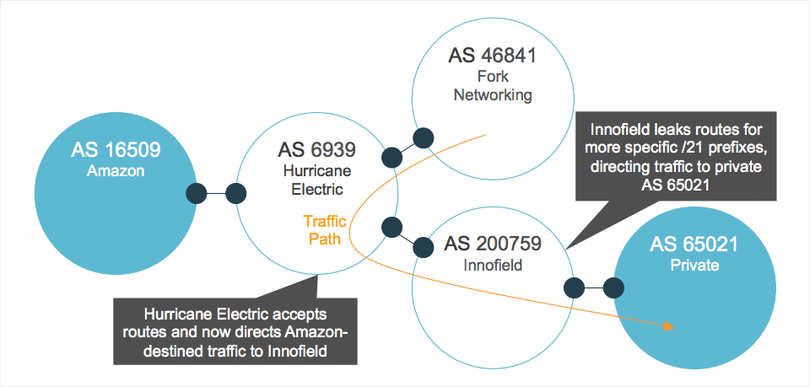
Route misconfigurations
Leaks: e.g., ISP announces more specific routes to a destination
Prefix “hijacking”
Likely to be misconfigurations
e.g., Youtube08
But can also be deliberate: MITM
E.g., Belarus
https://blog.thousandeyes.com/nanog-68-decoding-performance-data-internet-outages/

Slide 5
Some operator requirements
Know answers to simple questions
Can A talk to B?
Reachability
A and B can be hosts, IP prefixes, “slices”
Are there loops, blackholes? Do slices leak?
Know the effects of a change, preferably before it happens
What-if analyses
Link failures, protocol messages accepted from peers
Answer these Qs fast to keep up with change in the network

Slide 6
Verification (software)
For a program P, property X, input I, asking:
Will P satisfy X on all inputs I?
For what inputs I will P satisfy property X?
Example:
Can a program f(x) := return x + 1 guarantee output f(x) > x?
Does g(x, y) := return x/y execute without exceptions always?
Related problem: Synthesis
Can I generate a program P that satisfies X on all inputs I?
Example:
Using binary & arithmetic operators alone (+, -, &, …) produce a program that determines whether input (int) x is a power of 2

Slide 7
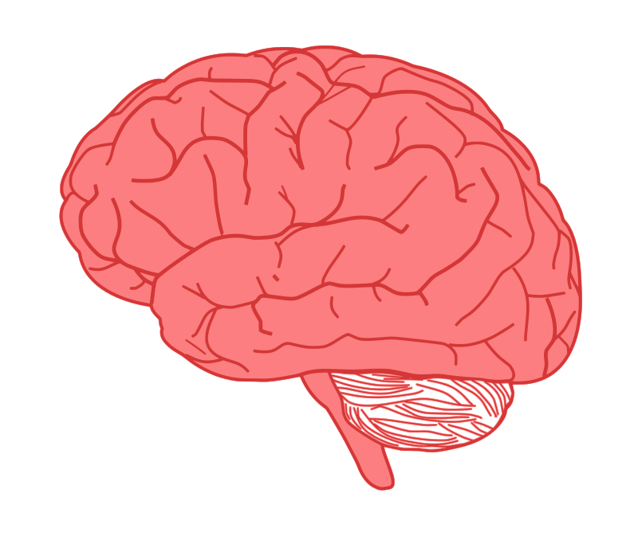


SDN verification
Program + data plane should satisfy desired properties
Single box state + program
Network Verification
Control plane verification
Do routing protocol configurations result in desired data plane properties?
Compute fixed points
Consider failures, route protocol message injections
Routing
Algorithm
control
plane
data
plane
Data plane verification
Do the devices together satisfy desired properties in the data plane?
Compute logical representations
Loop-free, blackhole-free, waypoints
1
0111
3
2

Slide 8
for all M, does N satisfy P?
Decision Procedure: An efficient algorithm that answers yes/no
Ask the question under assumptions about network change:
static, incremental, or dynamic
Property of interest:
Loop freedom
Blackholes
Waypoints
Equivalence
Sequence of messages:
Packets,
Routing protocol
Link failures
Network representation:
Data plane
Control plane
Need good abstractions

Slide 9
A simple example: Modeling firewall rules
Assume packets just have 2 bits; there are only 2 ports
Firewall config: 10 -> fwd(2); x1 -> fwd(1). All others dropped
Boolean representation of the network:
N: (d1 & ~d0) | ((d1 | ~d1) & d0)
Property: only the packets from 00 are dropped
P: (~d1 & ~d0)
Messages (M): all combinations of Boolean variables d0, d1
Verification question: for all d0, d1, is formula P <=> ~N valid? i.e.,
Is P <=> N a tautology?
Decision procedure: SAT solver

Slide 10
Verification, testing, synthesis, eq checks
Verification: for all M, does N satisfy P?
Testing: For the given M, does N satisfy P?
Synthesis: Given P, can you produce an N that satisfies it
For a given set of M? (including for all M)
Let N’ be another network representation
Equivalence checking: For all M, do N and N’ behave in the same way with respect to P?, i.e.,
i.e., either both satisfy P or both violate it

Slide 11
Header Space Analysis
Ack: Thanks to slides from Peyman Kazemian!
https://web.cs.ucla.edu/~varghese/NETWORK_VERIFICATION_COURSE/Lecture4.pptm

Slide 12
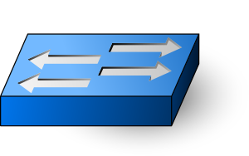


Abstracting across devices
Input ACL
IP table
Output ACL
VLAN
Table
Spanning
Tree
MAC
Table
Filtering Rules
ARP
Table
MAC
Table
Spanning
Tree
Input ACL
IP table
Output ACL
IP Table
MPLS
Mappings
MAC
Table
ARP
Table
MAC
Table
Spanning
Tree
Notes:
So that instead of looking at different types of boxes, from different vendors, running different protocols distributed over multiple tables…

Slide 13
Vision for Network Verification
Input ACL
IP table
Output ACL
VLAN
Table
Spanning
Tree
MAC
Table
Filtering Rules
ARP
Table
MAC
Table
Spanning
Tree
Input ACL
IP table
Output ACL
IP Table
MPLS
Mappings
MAC
Table
ARP
Table
MAC
Table
Spanning
Tree
Notes:
We look at a simple unified representation of packets and networking boxes. I want to exploit the fact that forwarding state of network determines the behavior of network and use it as a foundation for systematic analysis of network.

Slide 14
Networks as geometric transformers
Model header as point in high dimensional space and all networking boxes as transformers of header space
P1
Packet
Forwarding
P2
Action
Match
0xx1..x1
Send to port 2
Rewrite with 1x01xx..x1
MATHEMATICAL FRAMEWORK TO REASON ABOUT WHICH
SET OF POINTS ENTERING CAN EXIT NETWORK
Notes:
If Cerf were to describe an IP router forwarding rule, he would probably describe it as matching some bits in the header and then forwarding it to an output port after possible rewriting. This is actually a good abstraction because it abstracts across the diversity of manufacturers (Cisco Juniper etc) and devices (load balancers, firewalls etc). But its hard to see this description as a mathematical object we can reason about.
But Hoare may think of every bit as being a dimension and a packet header as having saying a 100 relevant bits for forwarding (the IP headers and TCP minimally, then perhaps a more geometric view is that all possible headers form a header space of 2^100 bits. Each match rule forms a subspace, a hypercube that maps from a subspace anchored at an input interface to a subspace or hypercube anchored at an output interface. An input packet is a point that is mapped to an output packet which is just another point in this header space.
If so, the set of forwarding rules in a router become a set of guarded commands: if you match space A, map to space A’; if you match space B, map to space B’ etc. So the forwarding behavior of a router becomes a program. If we concoct a compositional model, then router programs compose to form a network program that really takes points at the edge of the network and transforms them through intermediate spaces within the networks to produce a new point at the exit of a network
At this point, it is also worth noting that if the network with its collection of fiber optic cables and boxes can be abstracted as a large program then : we can ask why we can’t use any PL methods and ask why we cannot have PL tools for static checking, compiling, and debugging. We’ll return to this thought later in the section on Network Design Automation but for now lets concentrate on building only a static checker for reachability

Slide 15
Header Space Framework
Step 1 - Model a packet, based on its header bits, as a point in {0,1}^{L} space – The Header Space
Header
Data
01110011…1
0xxxx0101xxx
L
Sets of packets (ternary expressions) are hypercubes in {0,1}^{L} space
Notes:
* More time on this – field → bits
The first step is to model a packet based on its header as a point in {0,1}L space, which we call the header space. The idea here is that we look at packet headers a a flat sequence of 0s and 1s, without any protocol specific meaning for those bits. We don’t care whether the 32 bits corresponds to IP source or destination. That’s related to protocols. Then based on value of those bits, we map the packet to a point in the header space. Here we need to choose L large enough to contain all bits in the header. Similarly, a flow that has some wildcard bits in it, will corresponds to a region in the header space. Like Fourier transform in communication systems, the header space representation give us a simple and unified view of all packets.

Slide 16
Header Space Framework
Step 2 – Model all networking boxes as transformer of header space
1101..00
Transfer Function:
3
1
Packet
Forwarding
1110..00
2
Match
Action
+
0xx1..x1
+
11xx..0x
Send to port 3
Rewrite with 1xx011..x1
Send to port 2
Rewrite with 1x01xx..x1
Notes:
The second step is to model all networking boxes as transformer of header space. Here I am showing a simple packet forwarding element consisting of 3 ports, and I also show the header space corresponding to each port. We know that we can represent the forwarding functionality of this box by a set of rules. Each rule consists of a match which tell us which packets match on this rule and an action which tell us how the matching packets are sent to output. The match basically corresponds to a region in the input port header space and the action shows how that region is transformed to output. Similarly if we have more rules, we will have more match regions that is transformed to output header space….

Slide 17
Transfer Function Example
IPv4 Router – Forwarding Behavior
172.24.74.x Port1
172.24.128.x Port2
171.67.x.x Port3
1
2
3
(h,1) if dst_ip(h) = 172.24.74.x
T(h, p) =
(h,2) if dst_ip(h) = 172.24.128.x
(h,3) if dst_ip(h) = 171.67.x.x
Notes:
Mask notation 101…10xxx…xx
Explain why we have prefixes. Maybe tell each subnet is for a department: chemistery, cs, etc

Slide 18
Composing Transfer Functions
By composing transfer functions, we can find the end to end behavior of networks.
R1
R2
R3
T₁(h, p)
Notes:
previously people had to log into boxes, understand different notion, from different protocols and different vendors.
By composing transfer functions, we can find the end to end behavior of networks and the faith of packets as they traverse in the network. Let’s look at one example. Consider this packet arriving at box R1. by applying the transfer function of R1 to the packet, we can see the packet reaches to R2. we then apply the transfer function of R2 to the result, and see the packet reaching R3. repeating the same process, we can see that applying the transfer functions sequentially to the input packet, which is equivalent to composing those transfer functions, will show the faith of the packet after going through the network.
Therefore, for packet between these two ports, we can model the forwarding behavior of the network by a black box, withT3T2T1 transfer function. Remember that without this mechanism, we had to log into every box and comprehend the overall behavior from different tables running different protocols and belonging to multiple vendors.

Slide 19
Header Space Framework
Step 3- Header Space Set Algebra.
Intersection
Complementation
Difference
Check subset and equality condition.
Every region of Header Space, can be described by union of Wildcard Expressions. (example: 10xx U 011x)
Goal: do set operations on wildcard expressions.
Notes:
As the 3rd step, we want to define set operations on regions of header space or header space objects. We want to find intersection, complementation, difference and check for subset and equality conditions. As you will see when develop algorithms later in the talk, these are important constructs. For example when we check if two slice of networks are isolated or not, we should makes sure that their header space definition does not intersect, so we need a way way for checking that. Also in the loop detection algorithm, when we want to check if the loop is infinite or not, we need to check if two regions are subset of each other or not.

Slide 20

Computing Reachability
All Packets that A
can possibly send
All Packets that A can use
to communicate with B
All Packets that A can possibly
send to box 2 through box 1
A
T⁻¹₁
Box 1
Box 2
T⁻¹₂
T₂(T₁(X,A))
T⁻¹₁
T₁(X,A)
T⁻¹₄
T₄(T₁(X,A))
All Packets that A can
possibly send to box 4
through box 1
T⁻¹₃
Box 4
Box 3
B
T⁻¹₃
T₃(T₂(T₁(X,A)) U T₃(T₄(T₁(X,A))
PROPAGATE MILLIONS OF SETS OF HEADERS IF DONE NAIVELY
Notes:
We can put these tools to work to solve the first problem we want to look at, is finding reachability between two hosts in the network. We want to find out whether A can talk to B and if so, what are all packet header that will reach B.
To do that, we start by injecting test packet with wildcard in all bit positions into this simulated network. An all-x test packet is a packet whose bits are all wildcarded, and it represent the set of all possible packet headers that A can generate.
I want to emphasize that we don’t actually send any packet in the actual network, we get a complete snapshot of network and generate transfer function for each box in the network and use it for our analysis.
We apply the all-x packet to the transfer function of box 1, and gets some header space regions passed through the box, so we get the headers at the output of box1. we then apply the result to second transfer function – get the output header space after 2 hops, and finally to the 3rd transfer function giving us the ultimate results….
This looks easy and is only around 12 lines of higher level code using the higher level constructs like composition, union and inverses. But the real problem is scalability. Without care, after starting with a large space of 2^100 bits, the number of header spaces at intermediate royters can grown to billions. We need a data structure to compress these intermediate represenations of the reachable header spaces that we call difference of cubes

Slide 21
Computer Networks

Slide 22
Outro

Slide 23
Computer Networks
Abstractions and algorithms for communication among interconnected machines
End to end and per-node
A research experiment that escaped the lab and became fundamental to the world as we know it
Architecture; transport; network data plane; network control plane; verification

Slide 24
What next?
Thanks, and all the best!
Live with deeper appreciation of the Internet and networking
Does more bandwidth matter? Why do Internet apps run slowly? Why am I seeing outages in connectivity?
Put your programming knowledge to good use
Significant tech work builds on the fundamentals in this course
Build, debug, optimize networked applications
Principles to organize communication across machines
Go deeper
Research projects, independent study, theses, …

