Slide 1

552: Layering
Srinivas Narayana
Fall 2020

Slide 2

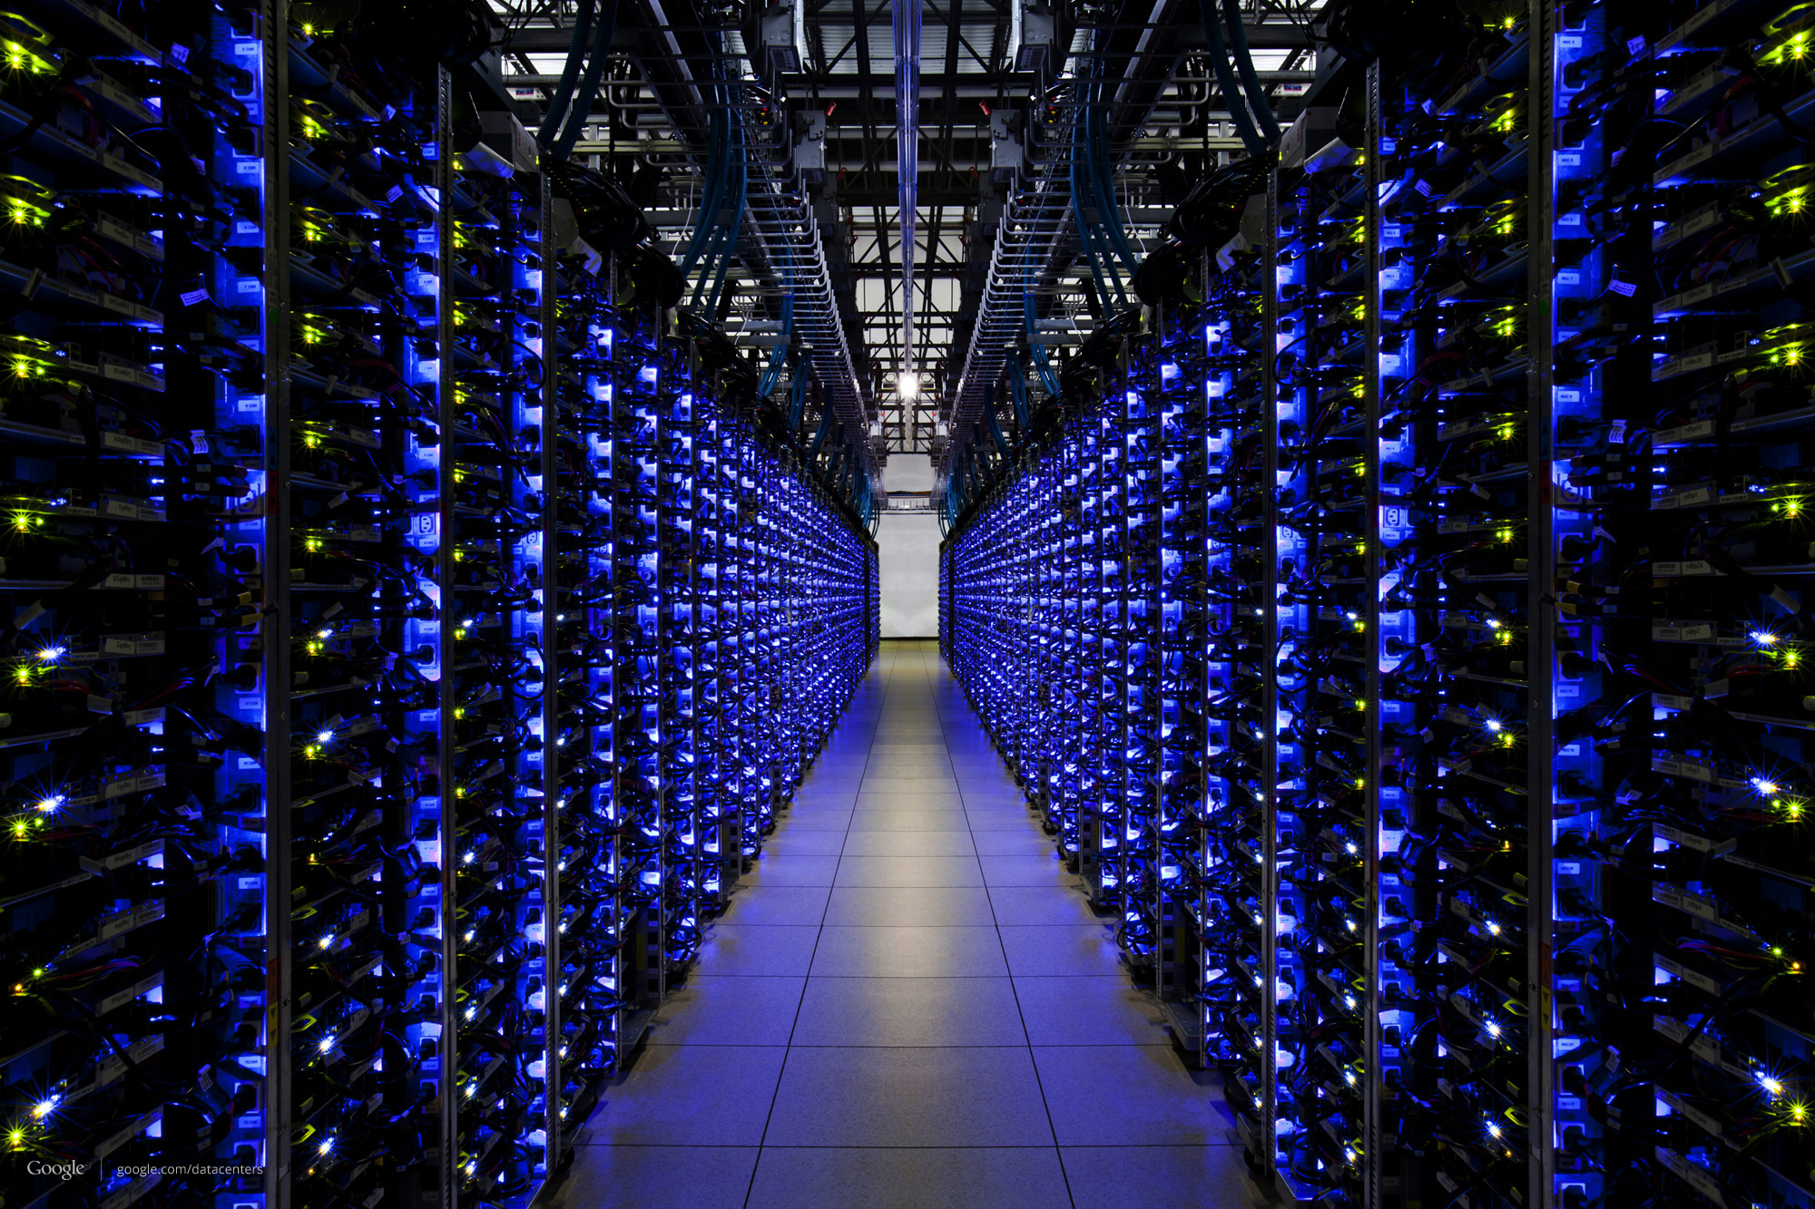



What happens when you browse?
(1) Send a query to google.com with keywords
(2) Google churns on your request
(3) Receive & display the response!
The Internet

Slide 3
How does your laptop know where the google.com server is, and how to reach it?

Slide 4
How does your laptop know where the google.com server is, and how to reach it?
Addressing
Both your laptop and google.com have many addresses.

Slide 5
How does your laptop know where the google.com server is, and how to reach it?
Routing
There may be many kinds of networks between you and google, each using its own way to stitch together the path

Slide 6
Addressing

Slide 7


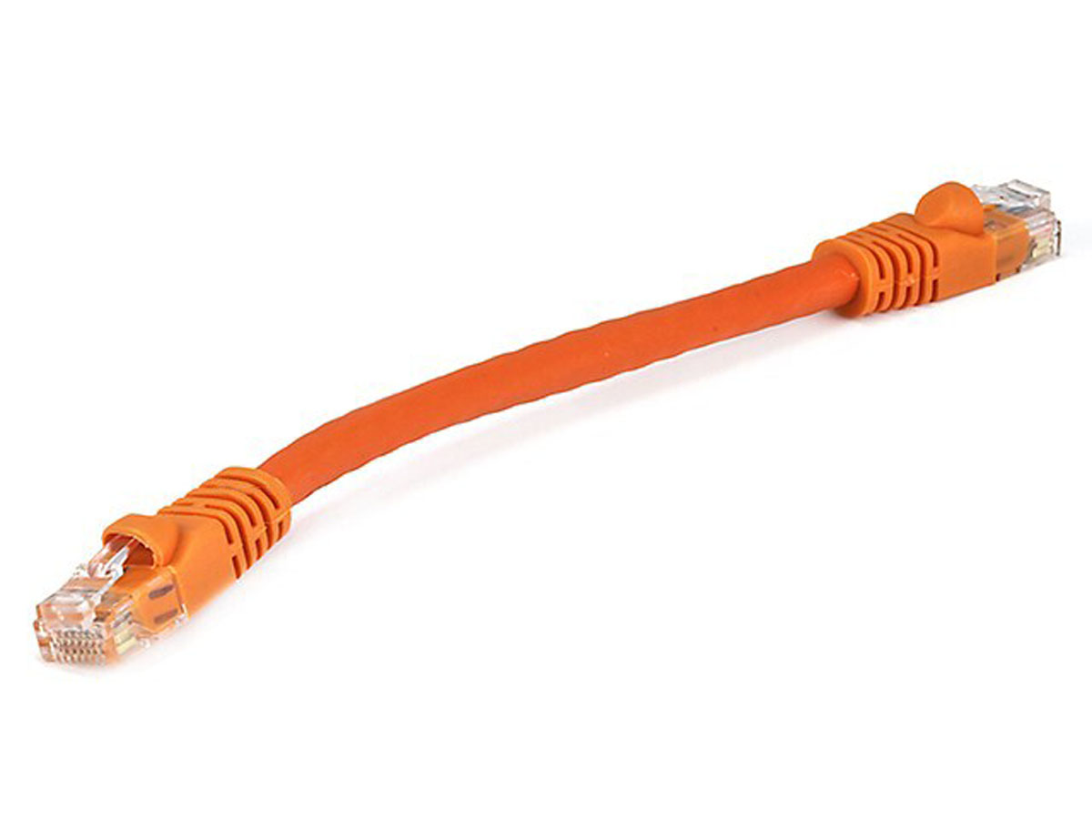
Rutgers campus network
The Internet
Transport address (port)
Ex: 64058
With which app is this conversation associated?
Network address (IP address)
Ex: 192.168.1.4
Whose network am I attached to?
Hardware address (MAC address)
Ex: 00-15-C5-49-04-A9
How do I identify my network interface (device)?

Slide 8
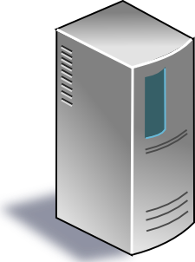
The Internet
Google’s network
Application address (URL)
Ex: mail.google.com
Transport address (port)
Ex: 4096
Network address (IP address)
Ex: 10.1.1.104
Hardware address (MAC address)
Ex: 00-15-C5-49-04-A7

Slide 9
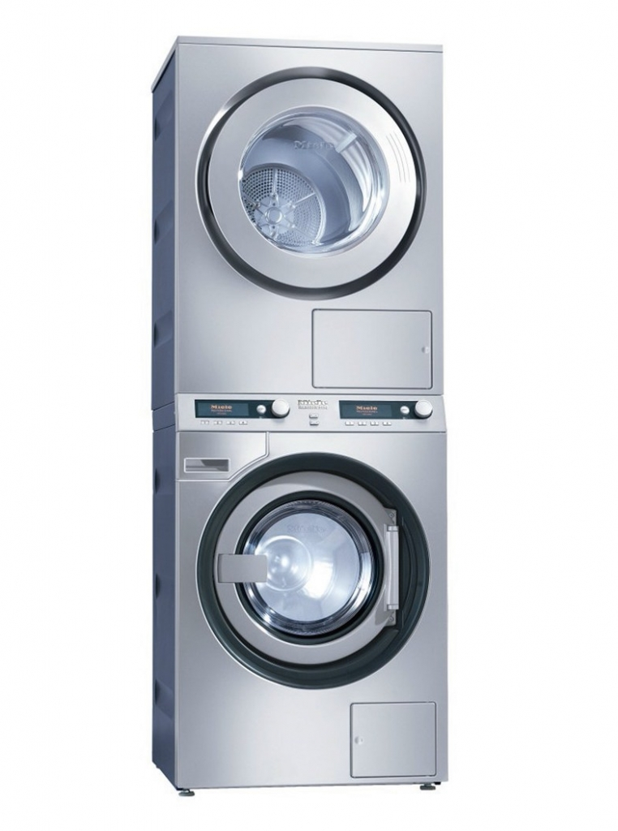
Software and hardware for networking are arranged in layers.
Layering provides modularity:
Each layer has a distinct function
& interacts with other layers through well-defined interfaces.

Slide 10
Modularity through layering
Protocols “stacked” in endpoint and router software/hardware
Apps: useful user-level functions
HTTP
FTP
NV
TFTP
Transport: provide guarantees to apps
TCP
UDP
IP
Network: best-effort global pkt delivery
Ether
ATM
…
WiFi
Link: best-effort local pkt delivery
IP is the “thin waist” of the Internet, enabling
interoperability across apps & network media

Slide 11
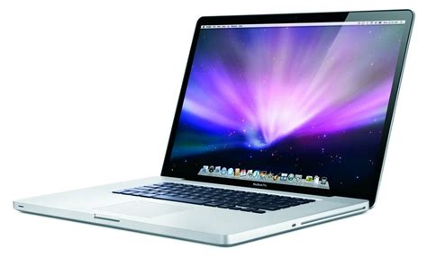
The Internet
Applications
Applications
Packet starts as an
app payload
Transport
Transport
Packet takes on info at each layer
Metadata: header
Network
Network
Link layer
Link layer
The Internet

Slide 12
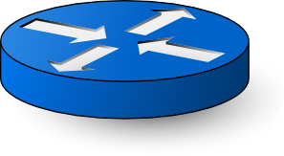
Applications
Applications
Transport
Transport
Network
Network
Network
Network
Link layer
Link layer
Link layer
Link layer

Slide 13
Applications
Routers do not typically have transport or app functionality
(more on this later.)
Applications
Transport
Transport
Network
Network
Network
Network
Link layer
Link layer
Link layer
Link layer

Slide 14

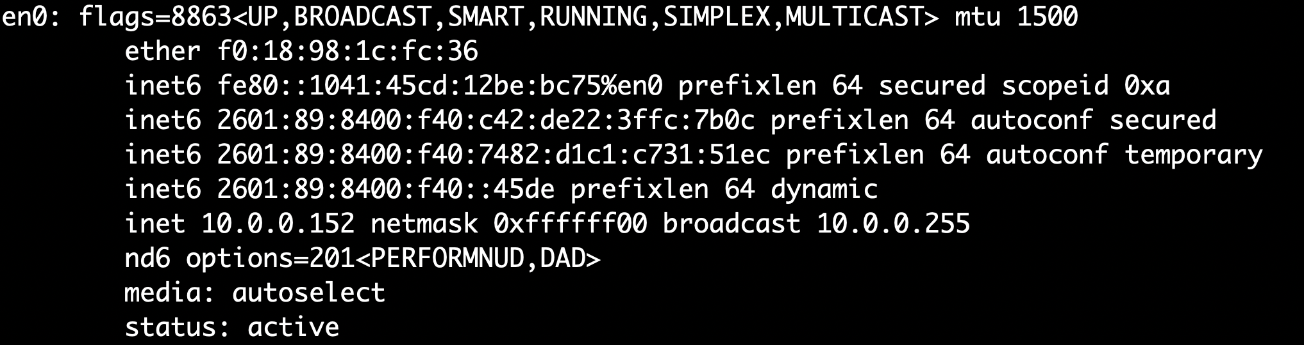
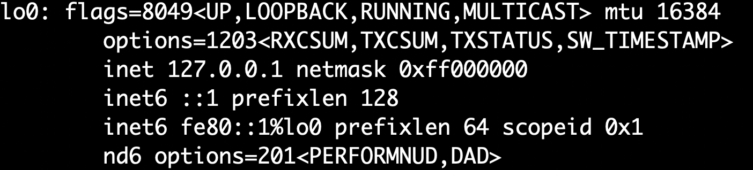
You can see your addresses

