Slide 1

The Transport Layer: Reliability
CS 352, Lecture 7, Spring 2020
http://www.cs.rutgers.edu/~sn624/352
Srinivas Narayana

Slide 2
Course announcements
Project 1 released. Need partners?
Quiz 2 completed, no quiz 3
Mid-term 1 next Wednesday
In class, 1 h 20 m
Covers lectures 1 through 8 (coming Friday)
Closed book
Only calculators allowed. No cell phones
Pattern: multiple choice, reasoning, problem solving
A review will be released later this week

Slide 3


Review of concepts
Mail access protocols: POP, IMAP, HTTP
Transport-layer protocols: UDP, TCP
Support communication between processes
vs. network layer: endpoints
Transport guarantees: reliability, ordering, performance
You get two of these at most
Demultiplexing: map packet to app-level socket
User Datagram Protocol (UDP): thin wrapper around net layer
Connectionless, best-effort service, simple
Demultiplex using dst IP address, dst port
Who uses UDP?

Slide 4
Error Detection
Necessary, but insufficient, for reliability

Slide 5
Data may get corrupted along the way…
32 bits
Bits flipped from 0→1 or 1→0
Packet bits lost
How to detect errors?
Idea: compute a function over the data
Store the result along with the data
Function must be easy to compute
Function & stored data efficient to verify
Ideas for functions?
source port #
dest port #
length
checksum
application
data
(message)
UDP segment format

Slide 6
From the UDP specification (RFC 768)
Checksum is the 16-bit one's complement of the one's complement sum of a pseudo header of information from the IP header, the UDP header, and the data, padded with zero octets at the end (if necessary) to make a multiple of two octets.
The pseudo header conceptually prefixed to the UDP header contains the source address, the destination address, the protocol, and the UDP length.

Slide 7
UDP Checksum
Sender:
treat segment contents as sequence of 16-bit integers
checksum: addition (1’s complement sum) of segment contents
sender puts checksum value into UDP checksum field
Receiver:
compute checksum of received segment
check if computed checksum equals checksum field value:
NO - error detected
YES - no error detected.

Slide 8
UDP checksum example
Note: when adding numbers, a carryout from the most significant bit needs to be added to the result
Example: add two 16-bit integers
1 1 1 1 0 0 1 1 0 0 1 1 0 0 1 1 0
1 1 1 0 1 0 1 0 1 0 1 0 1 0 1 0 1
1 1 0 1 1 1 0 1 1 1 0 1 1 1 0 1 1
1 1 0 1 1 1 0 1 1 1 0 1 1 1 1 0 0
1 0 1 0 0 0 1 0 0 0 1 0 0 0 0 1 1
wraparound
sum
checksum

Slide 9
User Datagram Protocol
A thin shim around best-effort network delivery
Lightweight to send one-off request/response messages
Lightweight transport for loss-tolerant delay-sensitive applications
Provides basic multiplexing/demultiplexing for applications
No reliability, performance, or ordering guarantees
Need Transmission Control Protocol (TCP)
Can do basic error detection (bit flips) using checksums
Error detection is a necessary condition for reliability
But need to do a lot more to achieve reliable data delivery
Subject of the rest of this lecture
Mechanisms in general; some of them implemented in TCP

Slide 10
Reliable data delivery
Stop and Wait

Slide 11

Packet loss
Sender
Receiver
How might a sender and receiver ensure that data is delivered reliably (despite some packets being lost)?
TCP uses three mechanisms

Slide 12
Coping with packet loss: (1) ACK
Key idea: Receiver returns an acknowledgment (ACK) per packet sent
If sender receives an ACK, it knows that the receiver got the packet.
Sender
Receiver
packet
ACK
packet
ACK

Slide 13
Coping with packet corruption: (1) ACK
ACKs also work to detect packet corruption on the way to the receiver
A receiver could send a negative acknowledgment, or a NAK, if it receives a corrupted packet
TCP only uses positive acknowledgments (ACKs).
What if a packet was lost and ACK never arrives?
Sender
Receiver
packet
NAK
packet
ACK

Slide 14
Coping with packet loss: (2) RTO
Key idea: Wait for a duration of time (called retransmission timeout or RTO) before re-sending the packet
In TCP, the onus is on the sender to retransmit lost data when ACKs are not received
Note that retransmission works also if ACKs are lost or delayed
Sender
Receiver
RTO
ACK

Slide 15
Coping with packet loss
What if ACKs are delayed?
Sender may retransmit the same data
Receiver wouldn’t know that it just received duplicate data from this retransmitted packet
Add some identification to each packet to help distinguish between adjacent transmissions
This is known as the sequence number
Sender
Receiver
RTO
Duplicate
packet received!
(Receiver doesn’t know…)
ACK

Slide 16
Coping with packet loss: (3) Seq nums
Bad cases: packet dropped or ACK dropped or ACK delayed beyond RTO
Sequence numbers of adjacent transmitted packets are exactly the same!
Receiver can disambiguate a fresh packet from a retransmission
Sender
Receiver
0
RTO
Duplicate
can be detected using repeated sequence number
0
ACK

Slide 17
Coping with packet loss: (3) Seq nums
Good case: packet received and ACK received within the RTO
Sequence numbers of adjacent transmitted packets are different
Q1: where are the sequence numbers written to, exactly?
Q2: what is the seq# of third packet?
Sender
Receiver
0
RTO
ACK 0
Not duplicate, because sequence numbers are different
1
RTO
ACK 1
???

Slide 18
Stop-and-Wait Reliability
Scheme so far: sender waits for an ACK/RTO before sending another packet
Also called “stop and wait” reliability
Suppose no packets are dropped
Round-trip-time: 100 milliseconds
Packet size: 12,000 bits
Link rate: 12 Mega bits/s
At what rate is the sender getting data across to the receiver?
Sender
Receiver
RTT
RTO
120 Kilo bit/s (1% of link rate)

Slide 19
Reliable data delivery
Pipelined Transmission, a.k.a. Sliding Window Protocols

Slide 20
Amount of “in-flight” data
We term the amount of unACKed data as data “in flight”
With just one packet in flight, the data rate is limited by the packet delay (RTT) rather than available bandwidth (link rate)
Idea: Keep many packets in flight
Also referred to as pipelined transmission
More packets in flight improves throughput
Throughput is the amount of data delivered per unit time.

Slide 21
Keeping many packets in flight
With link rate 12 Mega bits/s and packet size 12,000 bits, what is the transmission delay of a single packet?
Remember the earlier throughput of 120 Kbit/s. If there are, say 4 packets in flight, throughput is 480 Kbits/s!
We just improved the throughput 4 times by keeping 4 packets in flight
Sender
Receiver
RTT
RTO

Slide 22
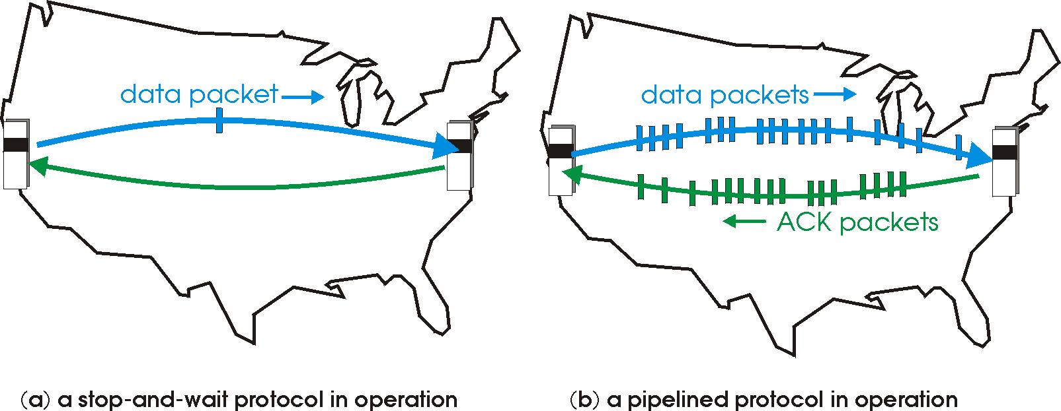
TCP is a pipelined transmission protocol
Sender allows multiple, “in-flight”, yet-to-be-acknowledged packets
A few packets aon the way while, concurrently, new packets are transmitted

Slide 23
What if some packets/ACKs dropped?
Sequence numbers help associate an ACK with its packet
Note: In TCP, every byte has a sequence #
We will often simplify our examples by assuming each packet has a sequence #
In TCP, the ACK contains the sequence number of the next byte expected
Note: example uses packet seq #s
Q1: If a packet is dropped, should the receiver ACK subsequent packets?
Q2: If so, with what sequence number?
Sender
Receiver
1
2
3
4
2
3
4
5
5

Slide 24
Receiver strategies upon packet loss
Sender
Receiver
ACK subsequent pkts?
1
No
Yes
2
3
4
Selective Repeat
What seq # on ACK?
Go-back-N
5
Last pkt in order
Cumulative ACK
Seq # ranges received so far
Selective ACK
TCP’s default

Slide 25
Sliding Window with Go Back N
When the receiver notices a missing or erroneous frame:
It simply discards all frames with greater sequence numbers
The receiver will send no ACK
The sender will eventually time out and retransmit all the frames in its sending window

Slide 26
Go back N
Timeout interval
Sender
0
1
2
3
4
2
3
4
5
6
Maximum
window size = 8
ACK 0
ACK 1
ACK 2
ACK 3
ACK 4
ACK 5
ACK 6
Receiver
0
1
E
D
D
2
3
4
5
6
Maximum
window size = 8
Discarded by
receiver
Frame with
error
Time

Slide 27
Go Back N (cont’d)
Go Back N can recover from erroneous or missing frames
But…
It is wasteful. If there are errors, the sender will spend time retransmitting frames the receiver has already seen

Slide 28
Selective repeat with cumulative ACK
Idea: sender should only retransmit dropped/corrupted segments.
The receiver stores all the correct frames that arrive following the bad one. (Note that the receiver requires a memory buffer for each sequence number in its receiver window.)
When the receiver notices a skipped sequence number, it keeps acknowledging the last good sequence number,. i.e., cumulative ACK
When the sender times out waiting for an acknowledgement, it just retransmits the one unacknowledged frame, not all its successors.

Slide 29
Selective repeat
Timeout interval
Sender
0
1
2
3
4
2
5
6
Maximum
window size = 8
NACK 2
NACK 2
ACK 0
ACK 1
ACK 4
ACK 5
ACK 6
Receiver
0
1
E
3
4
2
5
6
Maximum
window size = 8
Buffered by
receiver
Frame with
error
Time

Slide 31
Keeping track of packets (and ACKs)
Cumulative ACKs: ACK the latest seq# up to which all packets received
Selective ACKs: return one cumulative seq# and ranges of other seq# received
Sender retransmits those packets whose sequence numbers haven’t been ACKed
What are the implications of selective vs. cumulative ACKs here?
Sender
Receiver
1
2
3
4
1
2
3
4
5

Slide 32
How should the RTO be set?
Clearly, RTO must be related to RTT
But how exactly?
Sender
Receiver
1
2
3
4
1
RTT
2
3
4
5
RTO

