Slide 1

Security: Public Key Cryptography
CS 352, Lecture 19
http://www.cs.rutgers.edu/~sn624/352-S19
Srinivas Narayana
(heavily adapted from slides by Prof. Badri Nath and the textbook authors)

Slide 2
Review: Security
Key properties: Confidentiality, integrity, authenticity
Cryptography: prevents adversaries from reading our data
Terminology: Encryption, decryption, plain text, cipher text, keys, ciphers
Symmetric key cryptography: shared secret among communicating parties
Key building blocks: substitution and permutation
Stream and block ciphers
Block ciphers that use substitution: use a mathematical function instead of a lookup table

Slide 3
Encryption using symmetric keys
Same key for encryption and decryption
Efficient to implement: Often the same or very similar algorithm for encryption and decryption
Achieves confidentiality
No integrity: message vulnerable to tampering
No authentication by itself
Vulnerable to replay attacks
Bad guy can steal the encrypted message and later present it on behalf of a legitimate user
How to agree on keys?

Slide 4
Problems with Block Ciphers
Hence, also problems with symmetric key cryptography

Slide 5
An example: Login system
Bob runs a login server to provide access to protected resources
Alice must present a password to login
Exchange of password implemented using symmetric key cryptography on top of block ciphers

Slide 6
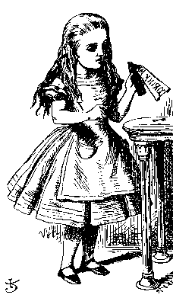
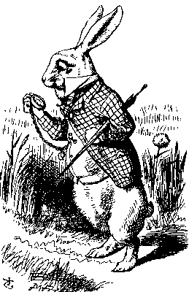
Replay attack
“Login: Alice”
Password please
E_{K}(Alice’s password)
Alice
Bob
Alice’s password is encrypted
From both Bob and attackers
If Bob is trusted, he can decrypt using the shared secret key
But subject to replay attack

Slide 7
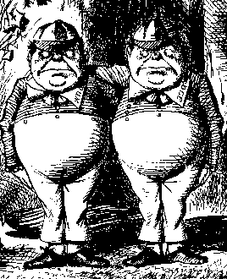
Replay attack
“Login: Alice”
Password please
E_{K}(Alice’s password)
Alice
Bob
Store: E_{K}(Alice’s password)
Trudy

Slide 8
Replay attack
Login: Alice
Password please
E_{K}(Alice’s password)
Trudy
Bob
This is a replay attack
How can we prevent a replay?
By adding a NONCE value; Number used once only
Use a temporary random number

Slide 9
Challenge-Response
Login: Alice
“Password please” + Nonce
E_{K}(Alice’s password, Nonce)
Alice
Bob
Nonce is a challenge that is changed every time
The encrypted message is the response
Critically, the ciphertext depends on the nonce

Slide 10
How do nonces help?
What if Trudy steals the ciphertext?
Nonce changed every time ➔ ciphertext is fresh for each login
Even if Trudy steals the authenticating ciphertext, she can’t reuse it
Does the nonce need to be confidential?

Slide 11
General problems with repeated ciphertext
Block ciphers take chunks of info (ex: 64-bit) to other chunks
Previous example: Repeated passwords can be replayed
But more generally, easy to guess parts of the payload with repeated plaintext
Example: “HTTP/1.1” often occurs on HTTP messages
Trudy could guess which ciphertext payloads contain that plaintext
Then use those parts of a message to guess other parts of the payload
… and so on

Slide 12
Can we use nonces for all messages?
Yes!
Remember, nonces can be sent as plain text
Example: Use ciphertext E_{k}(message ⊕ nonce) to respond to the challenge
Here, ⊕ is the bitwise XOR operation
But very inefficient:
For the example above, send double # bits for every message
Use a method to generate nonces automatically
Cipher block chaining: use the previous ciphertext as a nonce for the next plain text block
First block “randomized” using Initialization Vector (IV)

Slide 13
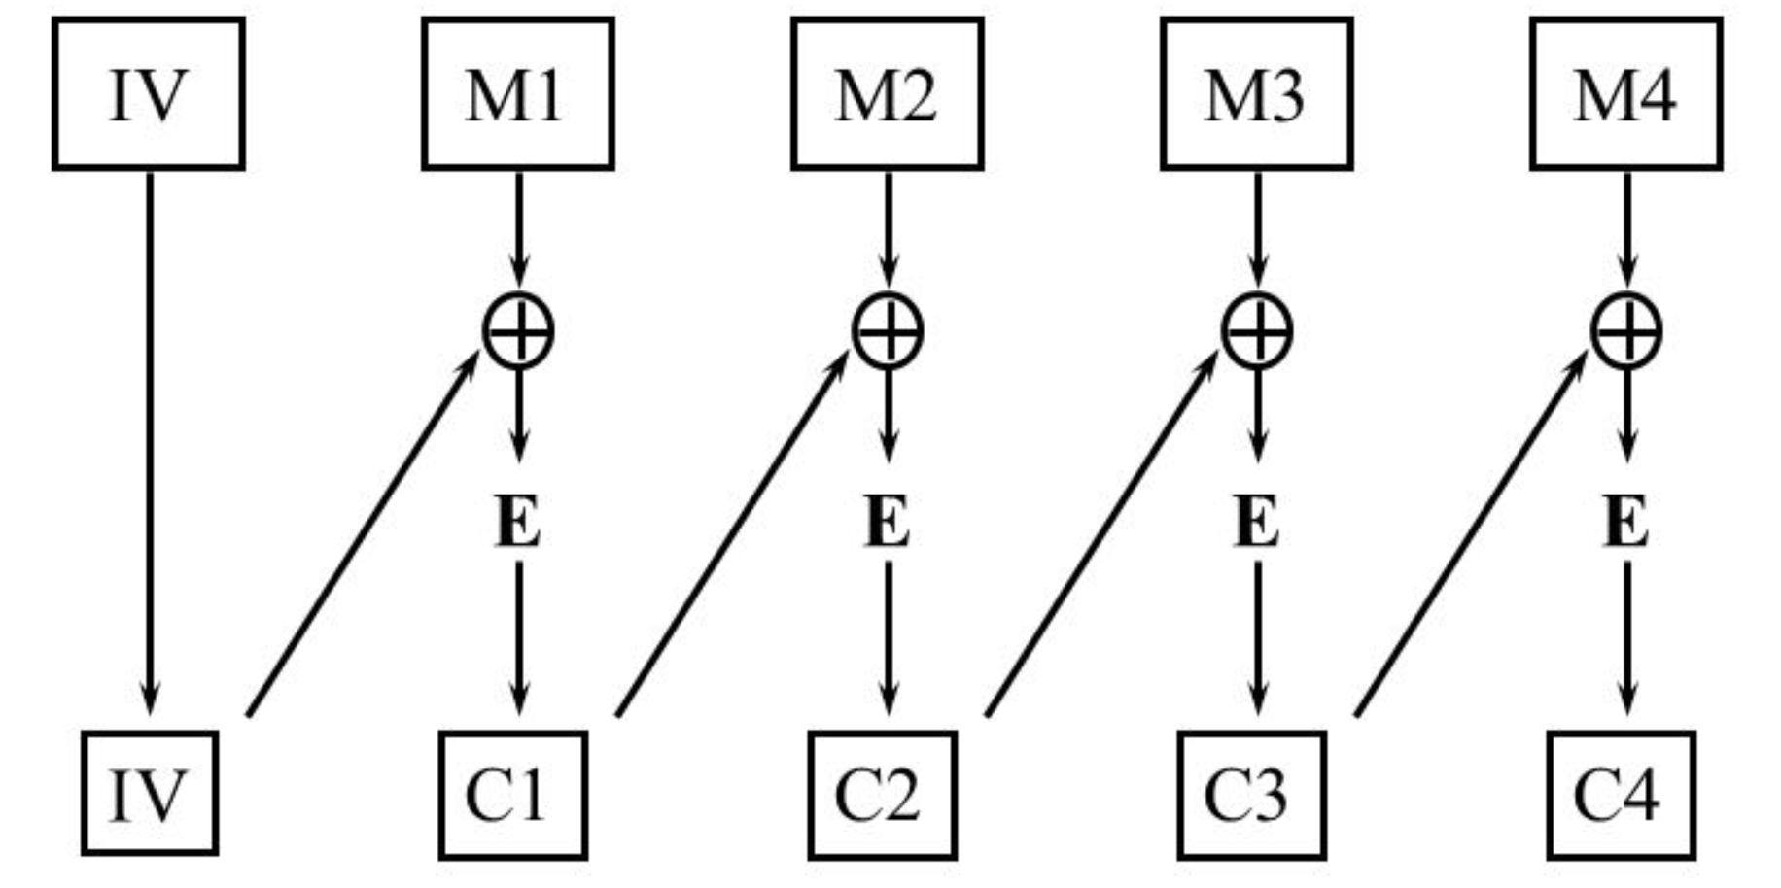
Cipher block chaining: Encryption
Exercise: how would decryption work?

Slide 14
How to agree on a shared secret key?
In reality: two parties may meet in person or communicate “out of band” to exchange shared key
But communicating parties may never meet in person
Example: An online retailer and customer
It’s very common not to meet someone you talk to over a network
What if the shared secret is stolen?
Must exchange keys securely again
Is there a way to communicate securely without worrying about secure key exchange?
Next topic: Public key cryptography

Slide 15
Public key cryptography

Slide 16
Public Key Cryptography
A radically different approach [Diffie-Hellman76, RSA78]
sender, receiver do not share secret key
public encryption key known to all
private decryption key known only to the receiver
16

Slide 17


Public key cryptography
+
Bob’s public
key
K
B
-
Bob’s private
key
K
B
plaintext
message, m
encryption
algorithm
ciphertext
decryption
algorithm
plaintext
message
+
K (m)
-
+
B
m = K (K (m))
B
B
17

Slide 18
Public Key Cryptography An Example
Sally
Jeff
Two keys:
K_{pub,sally}
K_{priv,sally}
Two keys:
K_{pub,jeff}
K_{priv,jeff}

Slide 19
Public Key Cryptography An Example
K_{pub,sally}
Sally
Jeff
K_{pub,jeff}
Two keys:
K_{pub,sally}
K_{priv,sally}
Two keys:
K_{pub,jeff}
K_{priv,jeff}
Sally and Jeff exchange public keys
(As we’ll see later, this may happen through
a trusted third authority)

Slide 20
Public Key Cryptography An Example
C
C = E_{Kpub,sally}(P)
Sally
Jeff
Two keys:
K_{pub,sally}
K_{priv,sally}
Two keys:
K_{pub,jeff}
K_{priv,jeff}
If Jeff wants to send an encrypted plaintext
message P to Sally, he uses Sally’s public key
to encrypt the message to form ciphertext C

Slide 21
Public Key Cryptography An Example
P = D_{Kpriv,sally}(C)
C
Sally
Jeff
Two keys:
K_{pub,sally}
K_{priv,sally}
Two keys:
K_{pub,jeff}
K_{priv,jeff}
Sally uses her private key to decrypt the message
C from Jeff. Only Sally can decrypt messages that
are encrypted using her public key. A message to
Sally cannot be decrypted using Sally’s public key.

Slide 22
Public key ciphers
RSA

Slide 23
Public key encryption algorithms
requirements:
.
.
+
-
1
need K ( ) and K ( ) such that
B
B
-
+
K (K (m)) = m
B
B
2
+
given public key K , it should be impossible to compute private key K
B
-
B
RSA: Rivest, Shamir, Adelson algorithm
23

Slide 24
Prerequisite: modular arithmetic
x mod n = remainder of x when divide by n
facts:
[(a mod n) + (b mod n)] mod n = (a+b) mod n
[(a mod n) - (b mod n)] mod n = (a-b) mod n
[(a mod n) * (b mod n)] mod n = (a*b) mod n
thus
(a mod n)^{d} mod n = a^{d} mod n
example: x=14, n=10, d=2: (x mod n)^{d} mod n = 4² mod 10 = 6 x^{d} = 14² = 196 x^{d} mod 10 = 6
24

Slide 25
RSA: getting ready
message: just a bit pattern
bit pattern can be uniquely represented by an integer number
thus, encrypting a message is equivalent to encrypting a number
example:
m= 10010001 . This message is uniquely represented by the decimal number 145.
to encrypt m, we encrypt the corresponding number, which gives a new number (the ciphertext).
25

Slide 26
RSA step 1: Creating public/private key pair
1. choose two large prime numbers p, q.
(e.g., 1024 bits each)
2. compute n = pq, z = (p-1)(q-1)
3. choose e (with e<n) that has no common factors
with z (e, z are “relatively prime”).
4. choose d such that ed-1 is exactly divisible by z.
(in other words: ed mod z = 1 ).
5. public key is (n,e). private key is (n,d).
+
-
K
K
B
B
26

Slide 27
RSA step 2: encryption and decryption
0. given (n,e) and (n,d) as computed above
1. to encrypt message m (<n), compute
e
c = m mod n
2. to decrypt received bit pattern, c, compute
d
m = c mod n
magic
happens!
e
d
m = (m mod n)
mod n
c
27

Slide 28
RSA example:
Bob chooses p=5, q=7. Then n=35, z=24.
e=5 (so e, z relatively prime).
d=29 (so ed-1 exactly divisible by z).
encrypting 8-bit messages.
m
e
e
bit pattern
m
c = m mod n
encrypt:
0000l000
12
24832
17
d
d
c
c
m = c mod n
decrypt:
17
481968572106750915091411825223071697
12
28

Slide 29
Why does RSA work?
must show that c^{d} mod n = m where c = m^{e} mod n
fact: for any x and y: x^{y} mod n = x^{(y mod z)} mod n
where n= pq and z = (p-1)(q-1)
thus, c^{d} mod n = (m^{e} mod n)^{d} mod n
= m^{ed} mod n
= m^{(ed mod z)} mod n
= m¹ mod n
= m
29

Slide 30
RSA: another important property
The following property will be very useful later
(for authentication and integrity):
-
+
+
-
K (K (m)) = m
=
K (K (m))
B
B
B
B
use public key first, followed by private key
use private key first, followed by public key
result is the same!
30

Slide 31
Why
-
+
+
-
K (K (m)) = m
?
=
K (K (m))
B
B
B
B
follows directly from modular arithmetic:
(m^{e} mod n)^{d} mod n = m^{ed} mod n
= m^{de} mod n
= (m^{d} mod n)^{e} mod n
31

Slide 32
Why is RSA secure?
Suppose you know Bob’s public key (n,e). How hard is it to determine d?
Essentially need to find factors of n without knowing the two factors p and q
Turns out that no one knows efficient algorithms to factor big numbers, especially a product of two large primes
32

Slide 33
RSA in practice: session keys
exponentiation in RSA is computationally intensive
DES is at least 100 times faster than RSA
use public key crypto to establish secure connection, then establish second key – symmetric session key – for encrypting data
session key, K_{S}
Bob and Alice use RSA to exchange a symmetric key K_{S}
once both have K_{S}, they use symmetric key cryptography
33

Slide 34
RSA in practice: session keys
E_{Kpub,Jeff}(Sally,R_{Sally})
E_{Kpub,Sally}(R_{Sally}, R_{Jeff}, K_{S})
Sally
Jeff
E_{KS}(R_{Jeff})

Slide 35
Public Key Cryptography: Summary
Why public key cryptography is so powerful:
No need to exchange secret keys securely
Only the receiver of encrypted information holds the secret key
Public keys are exactly that: public!
Examples of public key algorithms:
Merkle-Helman knapsack
Rivest-Shamir-Adleman (RSA)
Pretty Good Privacy (PGP)

Slide 36
Cryptography: the big picture
Algorithms underlying secure communication over the Internet
Pervades almost everything we use
Example: HTTPS? (we’ll see more about that soon…)
Specific algorithms like AES and RSA are widely implemented on host and server systems
So far: mainly confidential communication
Next lectures: We’ll see how cryptography is a building block for integrity and authenticity of communication as well

