Slide 1

552: Directories
Srinivas Narayana
Fall 2020

Slide 2
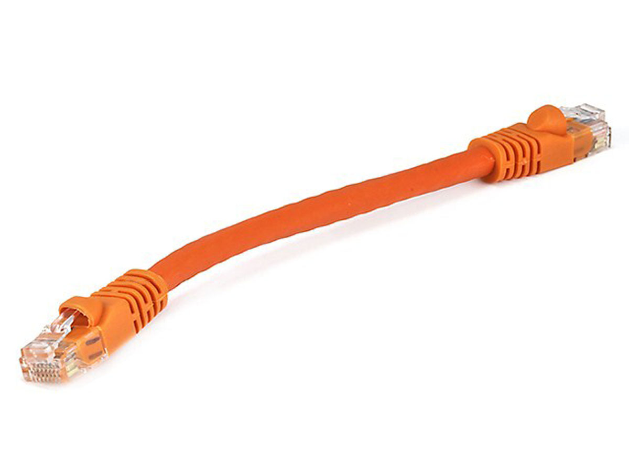


The Internet
Google’s network
Application address (URL)
Ex: mail.google.com
Transport address (port)
Ex: 4096
Network address (IP address)
Ex: 10.1.1.104
Hardware address (MAC address)
Ex: 00-15-C5-49-04-A7

Slide 3
Where do all the addresses come from? Who assigns them, and how?

Slide 4
Where do all the addresses come from?
You, as the user, only know the application address of your destination (google.com)

Slide 5
Addresses and what they correspond to
Transport address (TCP/UDP port): app-level conversation
Network-level address (IP address): point of attachment
Link-level address (MAC address): device

Slide 6

Directory Services
Directories map a name to an address
Simplistic designs
Centralized directory
Ask everyone (e.g., flooding in ARP)
Tell everyone (e.g., pushing /etc/hosts)
Fix a value a priori (e.g., dst port 80 is typically HTTP)
Scalable distributed designs
Hierarchical namespace (e.g., Domain Name System)
Flat name space (e.g., Distributed Hash Table)

Slide 7
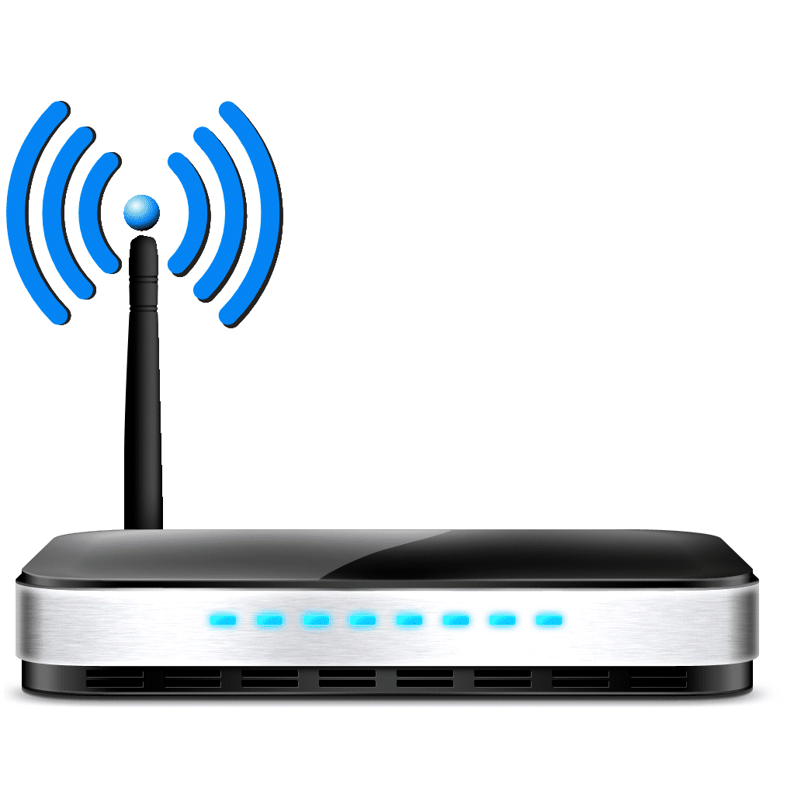

Domain Name System
root DNS server
Host at cis.poly.edu wants IP address for gaia.cs.umass.edu
2
3
TLD DNS server
4
local DNS server
dns.poly.edu
At your home, your Wi-Fi router typically runs the local DNS resolver.
5
7
6
1
8
authoritative DNS server
dns.cs.umass.edu
requesting host
cis.poly.edu
Recursive query: #1
Iterative queries: #2, 4, 6
gaia.cs.umass.edu

Slide 8

ARP: address resolution protocol
Question: how to determine interface’s MAC address, knowing its IP address?
ARP table: each IP node (host, router) on the local network has table
ARP
137.196.7.78
Contain IP → MAC address mappings for some nodes:
< IP address; MAC address; TTL>
TTL (Time To Live): time after which address mapping will be forgotten (typically 20 min)
1A-2F-BB-76-09-AD
ARP
ARP
LAN
71-65-F7-2B-08-53
58-23-D7-FA-20-B0
137.196.7.23
137.196.7.14
ARP
0C-C4-11-6F-E3-98
137.196.7.88
Credit: http://gaia.cs.umass.edu/kurose_ross/ppt.htm

Slide 9
ARP protocol in action
example: A wants to send datagram to B
B’s MAC address not in A’s ARP table, so A uses ARP to find B’s MAC address
A broadcasts ARP query, containing B's IP addr
destination MAC address = FF-FF-FF-FF-FF-FF
all nodes on LAN receive ARP query
Ethernet frame (sent to FF-FF-FF-FF-FF-FF)
1
C
Source MAC: 71-65-F7-2B-08-53
Source IP: 137.196.7.23
Target IP address: 137.196.7.14
…
TTL
A
B
1
ARP table in A
IP addr
MAC addr
TTL
71-65-F7-2B-08-53
58-23-D7-FA-20-B0
137.196.7.23
137.196.7.14
D

Slide 10
ARP protocol in action
example: A wants to send datagram to B
B’s MAC address not in A’s ARP table, so A uses ARP to find B’s MAC address
ARP message into Ethernet frame (sent to 71-65-F7-2B-08-53)
C
Target IP address: 137.196.7.14
Target MAC address:
58-23-D7-FA-20-B0
…
ARP table in A
IP addr
MAC addr
TTL
TTL
A
B
2
71-65-F7-2B-08-53
58-23-D7-FA-20-B0
137.196.7.23
137.196.7.14
2
B replies to A with ARP response, giving its MAC address
D

Slide 11
ARP protocol in action
example: A wants to send datagram to B
B’s MAC address not in A’s ARP table, so A uses ARP to find B’s MAC address
ARP uses broadcasting as a method to implement a directory service
C
ARP table in A
IP addr
MAC addr
TTL
TTL
A
B
137.196.
7.14
58-23-D7-FA-20-B0
500
71-65-F7-2B-08-53
58-23-D7-FA-20-B0
137.196.7.23
137.196.7.14
3
A receives B’s reply, adds B entry into its local ARP table
D

Slide 12


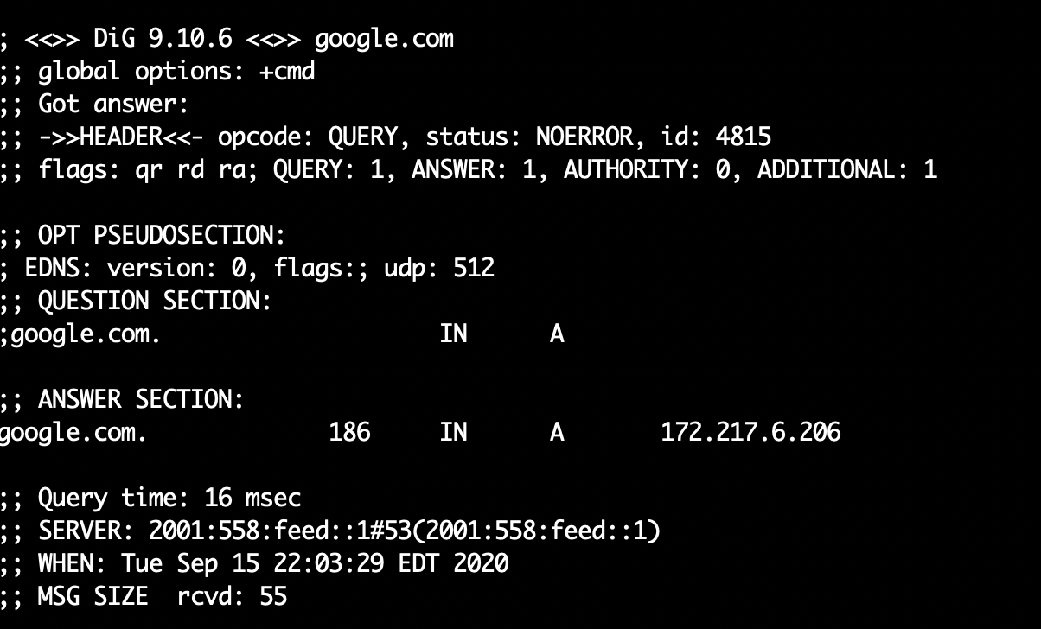
Playing with DNS

Slide 13

Playing with ARP

