Slide 1

552: Distributed Control Planes
Srinivas Narayana
Fall 2020

Slide 2

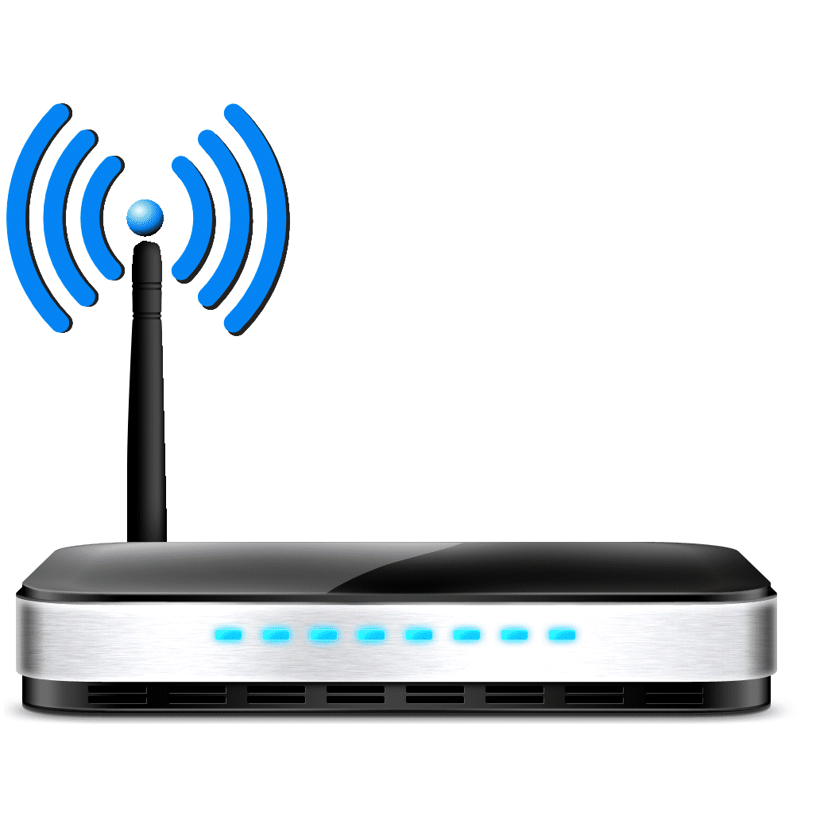
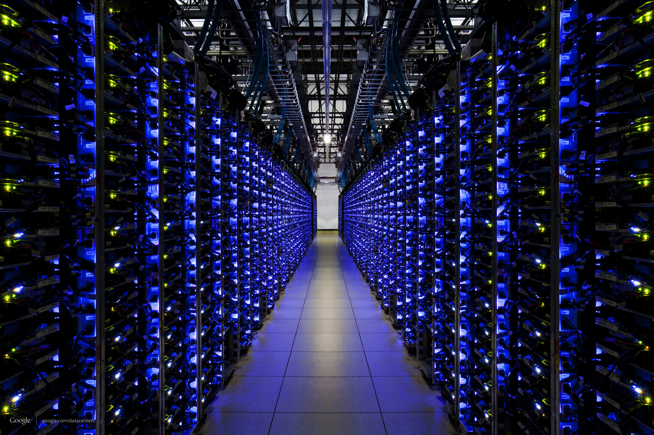
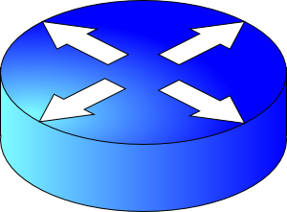
Recall…
Internet composed of many autonomously administered entities (ASes)
Routing computes paths
Verizon
AT&T
Rutgers
Sprint

Slide 3

Control & Data Planes inside a router
Traditionally:
Individual routing algorithm components in each and every router interact in the control plane
Control plane
per route-change processing
(~ a few seconds)
Routing
Algorithm
control
plane
data
plane
Data plane
per-packet processing
(~ tens of nanoseconds)
0111
1
3
2
values in arriving
packet header

Slide 4
Routing enables forwarding
Each router creates & looks packets up in its own forwarding table
But the computation of the table is itself distributed
So, how is a forwarding table computed?
Typically, by routers running a distributed computation: the routing protocol.
Three aspects of a routing protocol:
What outcome it computes
What algorithm it runs
How routers discover each other

Slide 5
E.g.: Open Shortest Path First
Verizon
AT&T
Rutgers
Sprint
OSPF: an intra-domain routing protocol

Slide 6
What OSPF computes
Shortest path(s) between each pair of nodes
Separate shortest-path tree rooted at each node
Path(s) with minimum sum of link metrics
Disadvantages
All nodes need to agree on the link metrics
Multipath routing is limited to “equal cost multipath”
Edge weights set by the network administrator

Slide 7
Discovering other routers: Link State ads
Each router sends out its own address and neighborhood link costs over all of its links: link state advertisement
Each router forwards advertisements from others
A process known as link state flooding
As long as the neighboring router and the link to it are alive, the link cost is included in the flooded message
OSPF is a link state protocol: if the state of a link changes (up/down/cost change), the entire network will know

Slide 8
OSPF link-state routing algorithm
Dijkstra’s algorithm
net topology, link costs known to all nodes due to link state broadcast
all nodes have same info
Compute least cost paths from one node (‘source”) to all other nodes
Extract forwarding table for that (source) node
iterative: after k iterations, know least cost path to k dest.’s
Notation:
c(x,y): link cost from node x to y; = ∞ if not direct neighbors
D(v): current value of cost of path from source to dest. v
p(v): predecessor node along path from source to v
N': set of nodes whose least cost path definitively known

Slide 9
Dijsktra’s Algorithm From Source Node u
1 Initialization:
2 N' = {u}
3 for all nodes v
4 if v adjacent to u
5 then D(v) = c(u,v)
6 else D(v) = ∞
7
8 Loop
9 find w not in N' such that D(w) is a minimum
10 add w to N'
11 update D(v) for all v adjacent to w and not in N' :
12 D(v) = min( D(v), D(w) + c(w,v) )
13 /* new cost to v is either old cost to v or known
14 shortest path cost to w plus cost from w to v */
15 until all nodes in N'
…
v
…
c(w,v)
D(v)
u
w
D(w)

Slide 10
Dijkstra’s algorithm: example
Step
0
1
2
3
4
5
N'
u
ux
uxy
uxyv
uxyvw
uxyvwz
D(v),p(v)
2,u
2,u
2,u
D(w),p(w)
5,u
4,x
3,y
3,y
D(x),p(x)
1,u
D(y),p(y)
∞
2,x
D(z),p(z)
∞
∞
4,y
4,y
4,y
5
v
3
w
2
5
u
2
1
z
3
1
2
x
y
1

Slide 11
Constructing a forwarding table
resulting shortest-path tree from u:
v
w
u
z
x
y
resulting forwarding table in u:
destination
link
v
(u,v)
x
(u,x)
y
(u,x)
w
(u,x)
z
(u,x)

Slide 12
Other Kinds of Routing Protocols
Distance Vector Protocols
Don’t flood link state throughout the network: more scalable
Exchange local vector of distances to other nodes with neighbors
RIP, IS-IS
Instability: a buggy router can propagate buggy info to many routers
Path Vector Protocols
Exchange local vector of paths to other nodes with neighbors
BGP: Border Gateway Protocol, the glue of the Internet
Stability issues still exist! Route hijacks, blackholing, …
Complex and prone to misconfiguration (recent CenturyLink outage)
https://www.bleepingcomputer.com/news/technology/centurylink-routing-issue-led-to-outages-on-hulu-steam-discord-more/

Slide 13
How essential is distributed route computation?
Internet-scale: ASes are managed by different entities
E.g., AT&T and Verzon
Each AS with their own policies, business arrangements, etc.
Commercial interests: ASes not willing to open proprietary details about their connectivity, topology, capabilities, …
Very hard to get operators (or equivalently, code) from 50,000+ ISPs of the Internet to compute routes together
An inter-AS protocol like BGP is fundamentally necessary for the Internet’s operation

Slide 14
How essential is distributed route computation?
Within an AS: e.g., Rutgers,
It’s conceptually possible to compute all paths centrally
Rutgers NOC observes the entire network from one place
Teams within Rutgers are open and willing to collaborate
A Significant fraction of the OSPF spec is dedicated to maintenance of the distributed link state database
Path computation is just a small part of OSPF!
https://tools.ietf.org/html/rfc2328
So why not compute routes in a centralized fashion?

