Slide 1

Transport: Congestion control
Srinivas Narayana
Fall 2020

Slide 2

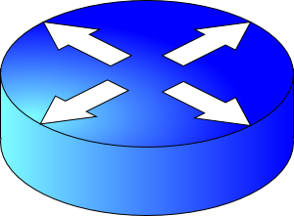
How do apps get perf guarantees?
The network core provides no guarantees on packet delivery
Transport software on the endpoint oversees implementing guarantees on top of an unreliable network
Three important kinds of guarantees
Reliability
Ordered delivery
Resource sharing in the network core
Transmission Control Protocol (TCP)

Slide 3
Congestion control

Slide 4

How should multiple endpoints share net?
It is difficult to know where the bottleneck link is
It is difficult to know how many other endpoints are using that link
Endpoints may join and leave at any time
Network paths may change over time, leading to different bottleneck links (with different link rates) over time

Slide 5
The approach that the Internet takes is to use a distributed algorithm to converge to an efficient and fair outcome.

Slide 6
The approach that the Internet takes is to use a distributed algorithm to converge to an efficient and fair outcome.
No one can centrally view or control all the endpoints and bottlenecks in the Internet.
Every endpoint must try to reach a globally good outcome by itself: i.e., in a distributed fashion.
This also puts a lot of trust in endpoints.

Slide 7
The approach that the Internet takes is to use a distributed algorithm to converge to an efficient and fair outcome.
If there is spare capacity in the bottleneck link, endpoints should be allowed to use it.

Slide 8
The approach that the Internet takes is to use a distributed algorithm to converge to an efficient and fair outcome.
If there are N endpoints sharing a bottleneck link, they should be able to get equitable shares of the link’s capacity.

Slide 9
The approach that the Internet takes is to use a distributed algorithm to converge to an efficient and fair outcome.
So, how to achieve this?

Slide 10
The guessing game
Suppose I think of a positive integer. It can be arbitrarily large
Your objective: Guess the number I’m thinking of
I’ll tell you whether your guess is correct, higher, or lower than the number I’m thinking of
You must guess the correct number as quickly as possible
How would you go about it?

Slide 11
TCP feedback loop
Sender
Feedback signals
Control actions
Network

Slide 12
TCP feedback loop
Signals
Packets being dropped (ex, RTO fires)
Packets being delayed
Rate of incoming ACKs
Actions
Suppose receiver buffer is large (flow control window is infinite)
Let’s call the amount of in-flight data per RTT the congestion window
Every packet and ACK is a way to get network feedback
Increase congestion window: e.g., by x or by a factor of x
Decrease congestion window: e.g., by x or by a factor of x
“Implicit” feedback signals
(more on explicit signals later)

Slide 13
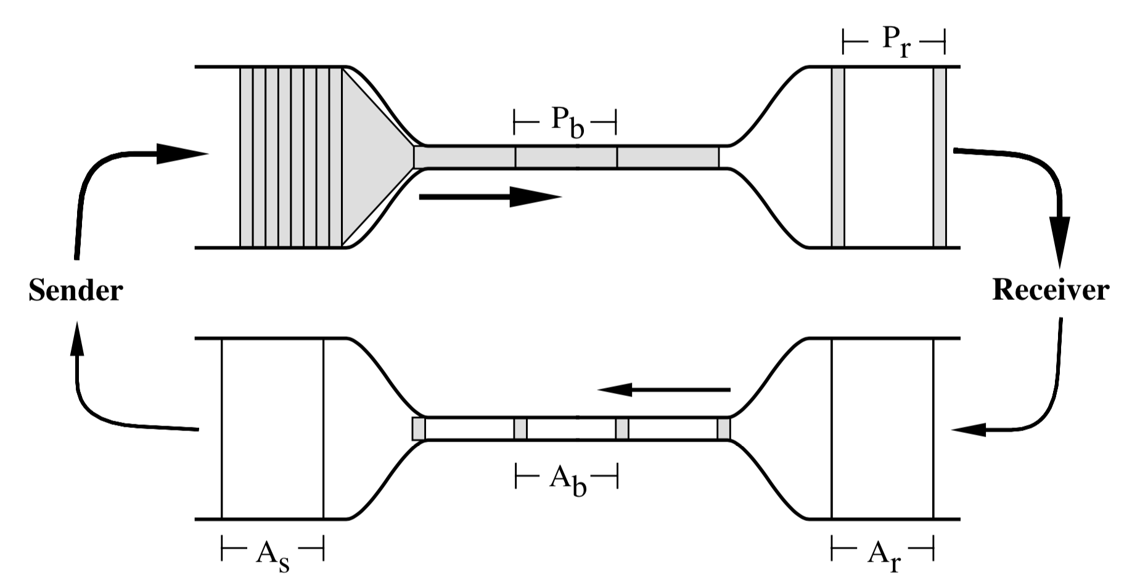
Steady state: ACK clocking
Jacobson & Karels, congestion avoidance & control

Slide 14
Aside: Receiver buffer at steady state
Bandwidth-delay product: enough data to fill the pipe
Implications to achieve high throughput:
More memory required at high bandwidth
More memory required at high RTT
Consider 100 Gbit/s connection at 100 ms RTT
With this window size, can you guarantee that you will never “block” the connection due to a filled-up receiver buffer?
You can’t! If app never reads from receiver buffer, it will fill up and not allow any more data to come in.

Slide 15
How to get to steady state?
Slow start up to a threshold: exponential increase
Congestion avoidance: Additive increase, multiplicative decrease (AIMD) beyond the threshold
Loss
Congestion
Window
Figure depicts AIMD only.
halved
time

Slide 16
How to get to steady state?
Upon a timeout, drop the window to a small fixed value (IW)
Upon idling, drop the window to a small fixed value (RW)
Loss
timeout
Congestion
Window
halved
IW
time

Slide 17
Why AIMD?
fairness
line
Converges to fairness
Converges to efficiency
Increments to rate smaller as fairness increases
(x₁,x₂)
(b_{D}x₁+a_{I}, b_{D}x₂+a_{I})
User 2: x₂
(b_{D}x₁,b_{D}x₂)
efficiency
line
User 1: x₁
Chiu and Jain, Analysis of the increase and decrease algorithms for congestion avoidance in computer networks

Slide 18
TCP’s steady state is not static
TCP probes network capacity iteratively
… Until it induces a loss
… and then probes for network capacity again
It is important to have efficient mechanisms to detect and recover from packet loss

Slide 19
Loss detection & recovery in TCP
Detecting loss before timeouts occur through fast retransmit
Basic idea:
if the receiver did not receive a packet
but did receive a subsequent few packets (duplicate ACKs)
… the unreceived packet must have been dropped.
Fast recovery: Don’t drop the window too much
If you’re receiving dup ACKs, packets are being delivered
Do congestion avoidance instead of slow start from slow start threshold
RFC 2581

Slide 20
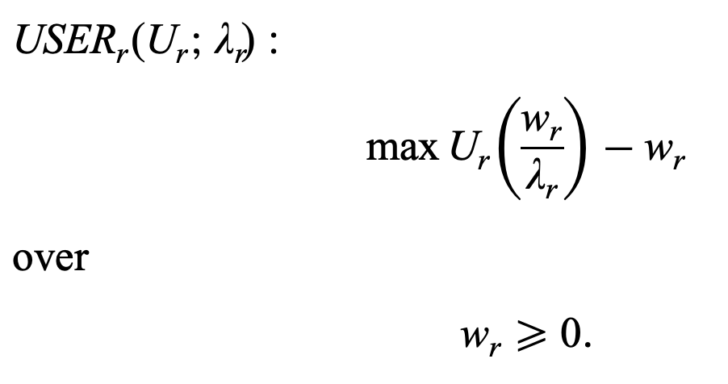
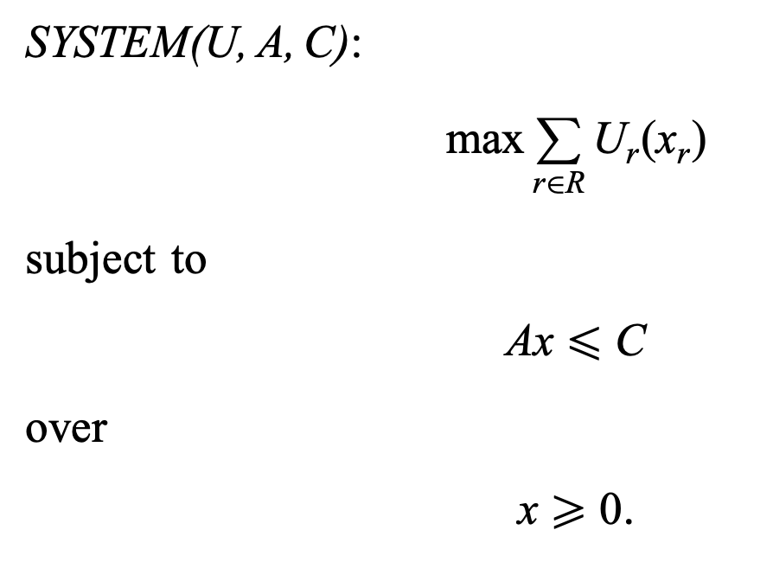
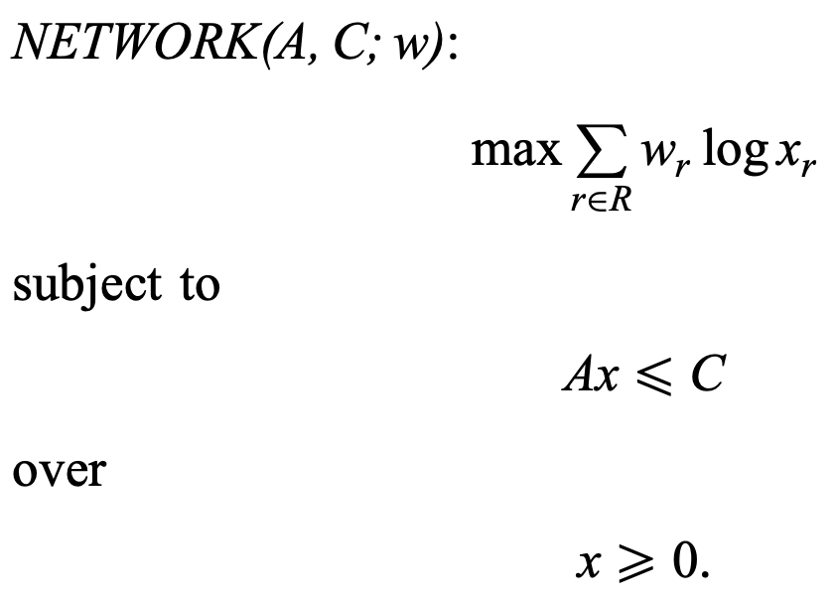
A top-down view: TCP maximizes “social utility” over rates
Kelly, Maulloo, Tan: Rate control for communication networks: shadow prices, proportional fairness and stability

Slide 21
Still, lots of problems!
RTT unfairness
Utilization in high bandwidth-delay product networks
Conflating congestion with random packet drop (e.g. wireless)
Buffer-bloat
Tradeoff between smoothness and responsiveness
Connection startup delay
Retransmitting too late or too early

