Slide 1

Packet Scheduling Algorithms
Srinivas Narayana
Fall 2020

Slide 2
The approach that the Internet takes to allocate resources in the network core is to use a
distributed algorithm (congestion control)
running at endpoints.
This allows the Internet to scale to a large # of endpoints.
However, it also places trust in endpoints.

Slide 3

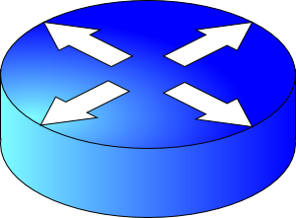


Endpoint algorithms are not enough!
What if an endpoint is buggy, or malicious?
We’d like the network core to do something better than best-effort

Slide 4
Packet Scheduling Algorithms
Which packet to send next? (order)
When to send the next packet? (timing)

Slide 5
A taxonomy
b
=
4
=
4
b
4
Granularity of allocation
Per-packet vs. per-flow vs bit-by-bit
Pre-emptive vs. non-pre-emptive
Do you interrupt the current packet/flow if another shows up?
Size-aware vs. unaware
Do you consider flow or packet sizes in scheduling?
Class-based (strict priority) vs. shared
Are some flows strictly higher priority than others?
Work-conserving vs. non-work-conserving
Do you always use spare link capacity when there is demand?

Slide 6
Examples of scheduling algorithms (1/N)
B
Y
G
Y
G
B
G
First-In-First-Out (FIFO) over packets
Round-robin over packets of different flows
G, B, Y, G, B, Y, etc. regardless of arrival order
Shortest Remaining Processing Time (SRPT)
Flow-size-aware allocation which strictly prioritizes short flows
Variant: shortest flow first i.e., only consider (initial) remaining processing time
A flow-size-unaware variant may predict remaining processing time using a known flow size distribution

Slide 7
Examples of scheduling algorithms (2/N)
Processor sharing
Assume each flow gets a fair share of the link every unit of time
Ideal: each flow starts receiving service immediately upon arrival
Rate limiting
Non-work-conserving: flow can’t send even if more demand than limit
Class-based strict prioritization
Pre-determined flow classes with strict priorities over each other
Starve low priority flows if higher priority flows are always sending

Slide 8
Examples of scheduling algorithms (3/N)
Hierarchical policies
Arrange scheduling policies in a tree-hierarchy
Example:
Rate-limit A + B
Fair-share among A and B within limit
Fair-share among A+B and C
Complex multi-tenant isolation policies
E.g., amazon AWS
C
A
B

Slide 9
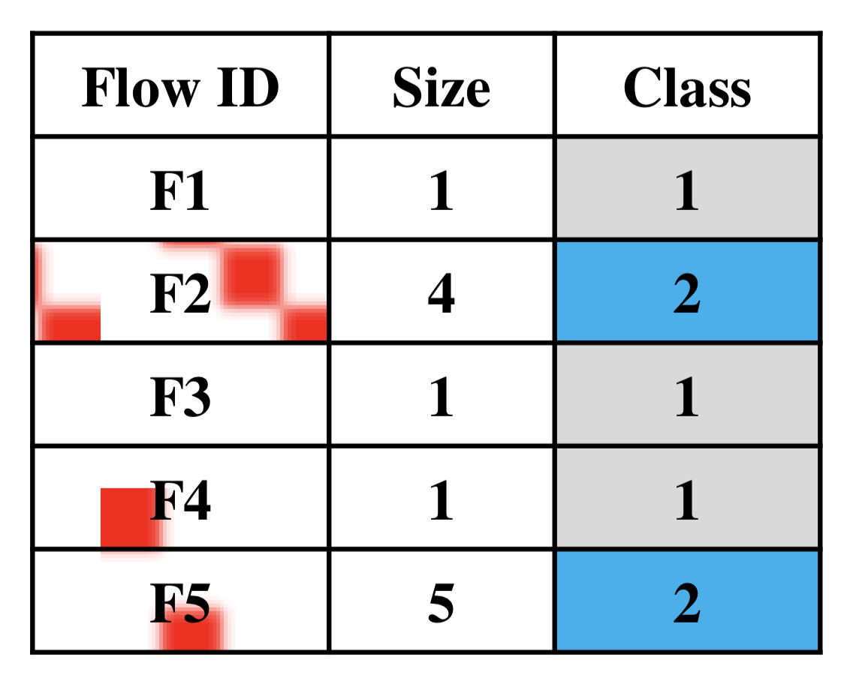
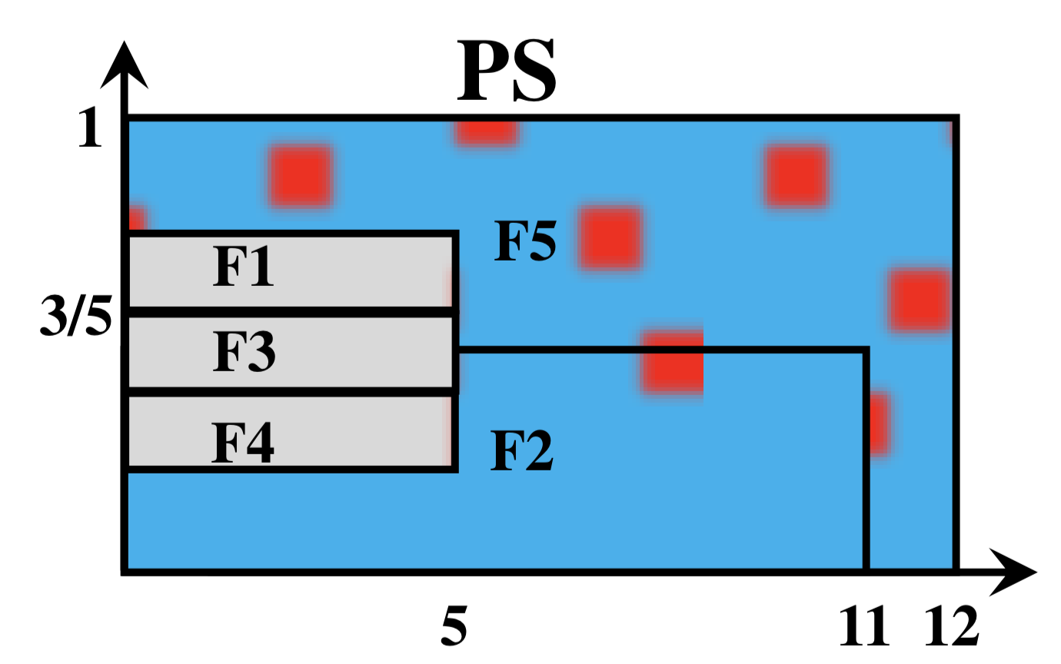
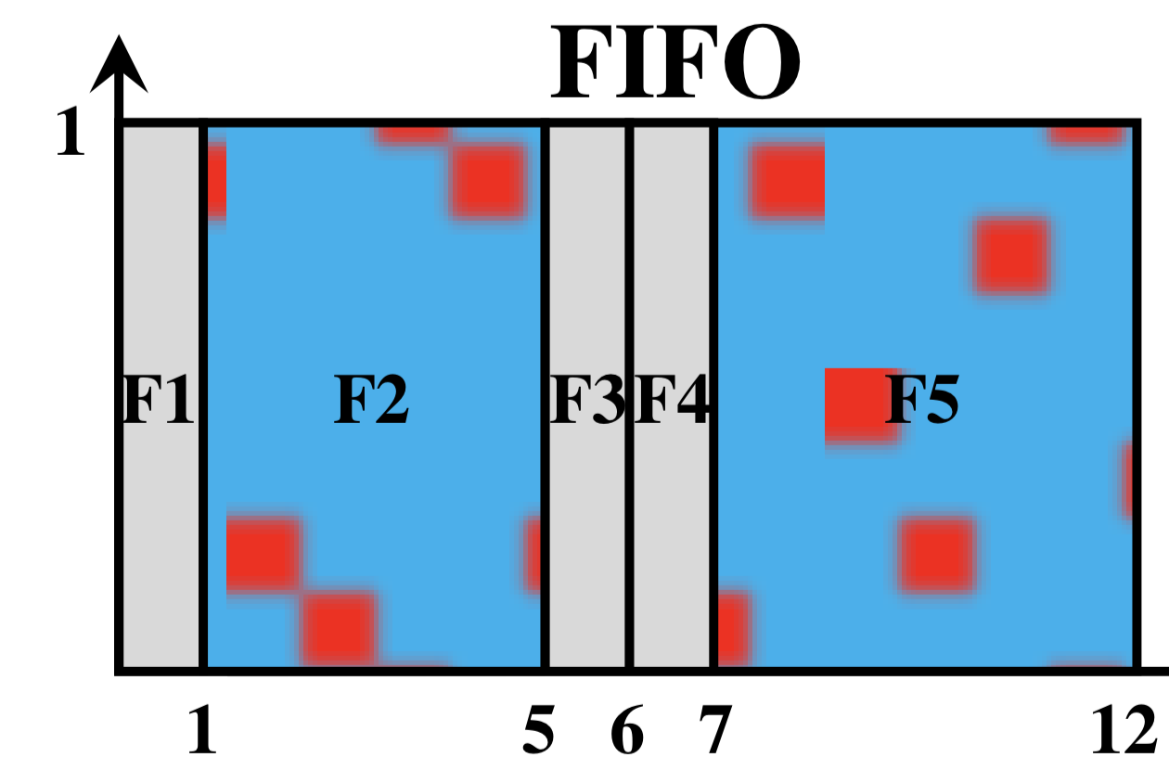
There’s no one optimal scheduling
The best policy depends on the distribution of flows in the workload.
Suppose we consider the metric of average completion time of flows.
Workload adaptive flow scheduling, Faisal et al. CoNEXT 2018

Slide 10

There’s no one optimal scheduling
Multiplexing
Avoids HOL blocking
Serialization
Reduces flow completion time
Workload adaptive flow scheduling, Faisal et al. CoNEXT 2018

Slide 11
Exercise: When does a flow finish?
Consider a mix of “long” and “short” flows arriving at a Q
Ex: A flow may have as few as 2 packets or as many as 10⁵
Suppose a scheduling algorithm provides each flow:
An average per-packet delay d (e.g., 50 ms)
An average link bandwidth share t (e.g., 10 Mbit/s)
Which among d & t determines
when a short flow finishes?
when a long flow finishes?

Slide 12
Fair Queueing
ACM SIGCOMM ’89
Alan Demers, Srinivasan Keshav, and Scott Shenker

Slide 13
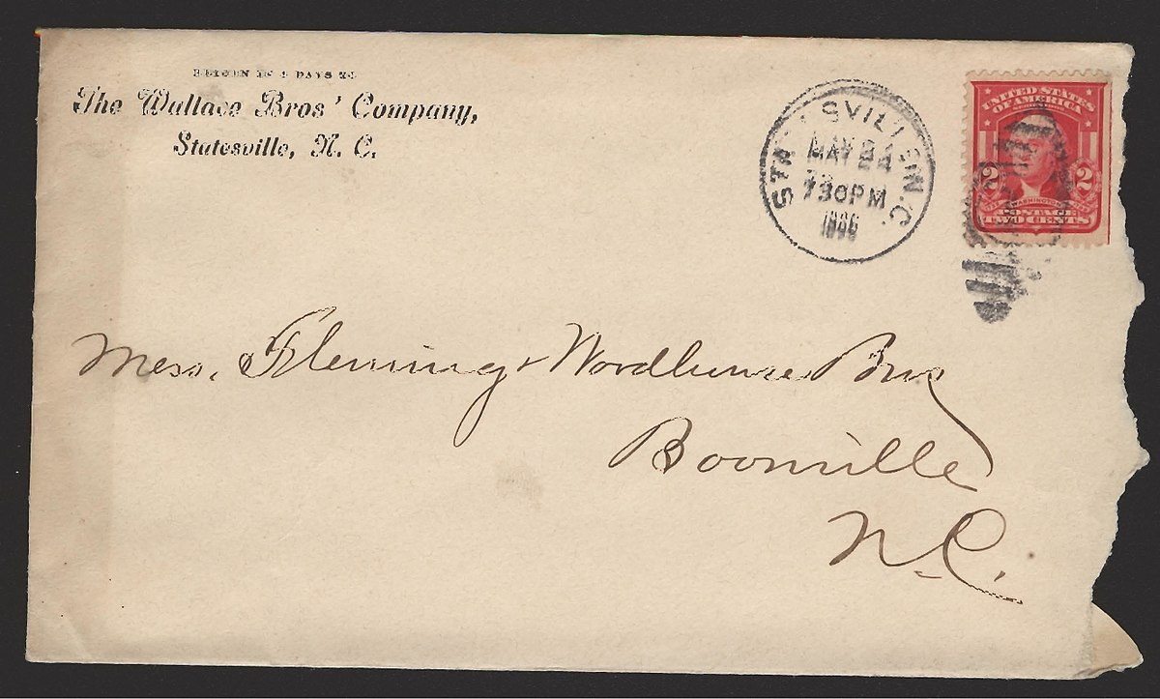
An ideal to emulate: Processor sharing
Fair-share bandwidth in the most fine-grained fashion possible
If there are N active flows, each flow gets 1/N^{th} of the link rate
N varies as flows arrive and leave
“Bit by bit round robin” (BR), also called processor-sharing
Implementing BR directly on routers is unrealistic.
Reason: downstream router has no metadata to route the bit
…

Slide 14
Emulate processor sharing?
How about emulating PS with round robin over packets?
Unfair! A flow can use larger packets and gain larger bandwidth
Instead, determine when a packet would finish with BR
Depends only on packet arrival time & # of active flows
Let’s call this the virtual finish time
FQ: Transmit packets in the order of the virtual finish times
Buffer management: drop packet of flow with the largest backlog
Analysis and simulation of a fair queueing algorithm. Demers, Keshav, and Shenker

Slide 15
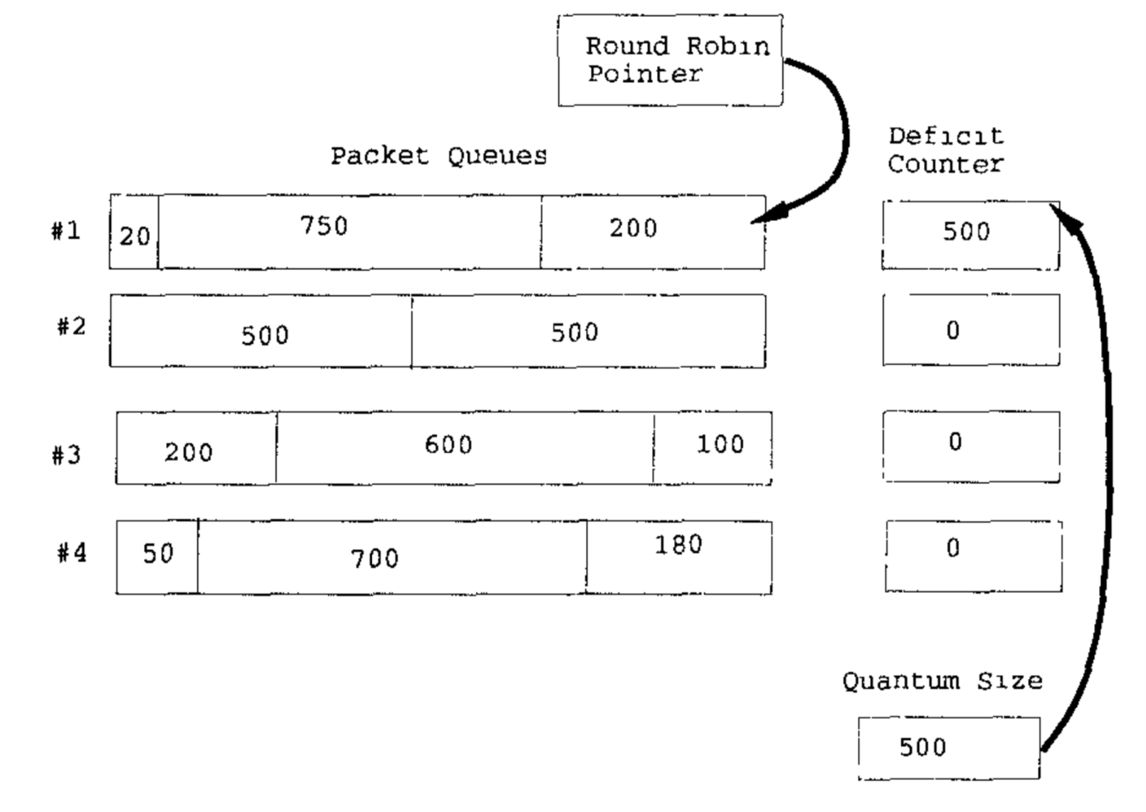
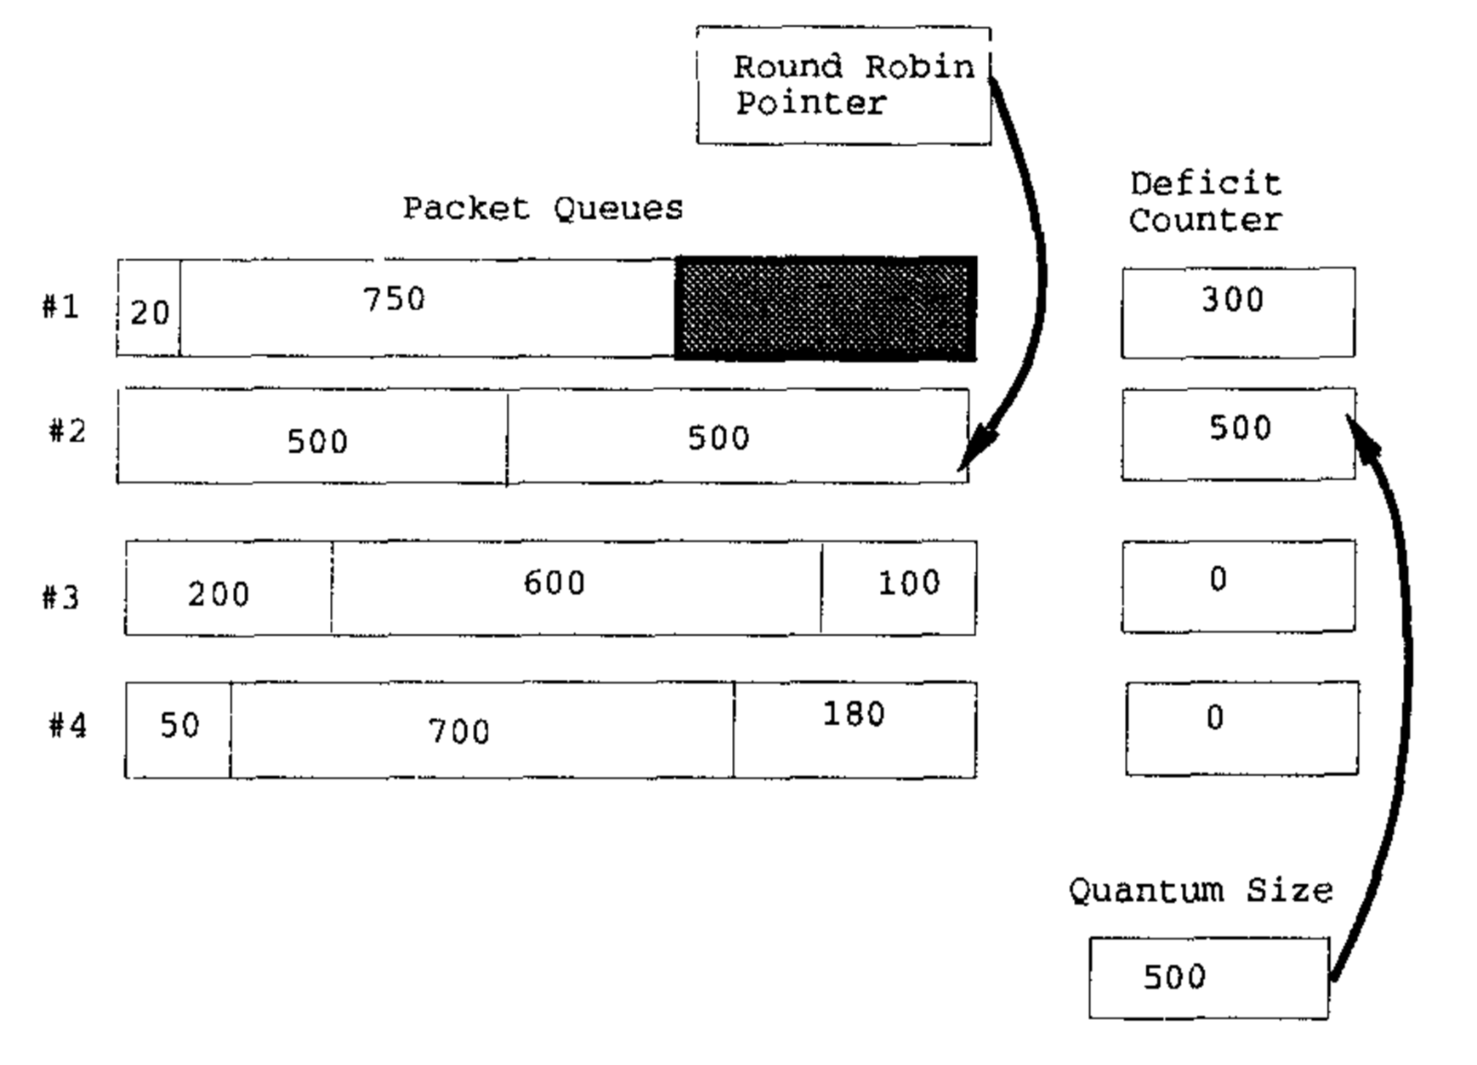
Hardware-friendly: Deficit Round Robin
Router-friendly implementation of a WFQ scheme
Efficient fair queueing using deficit round robin, Shreedhar and Varghese ‘95

Slide 16
Rate Limiting

Slide 17
Providing Isolation through Rate Limiting
Used to isolate flows from each other by giving each a fixed data rate through a link
Three commonly used terms:
(long term) average rate: how many pkts can be sent per unit time (in the long run)
crucial question: what is the interval length? 100 packets per sec or 6000 packets per min have same average, but instantaneous behaviors can be very different
peak rate: e.g., 6000 pkts per min (ppm) avg.; 1500 ppm peak rate
(max.) burst size: max number of pkts sent consecutively (with no intervening idle)

Slide 18
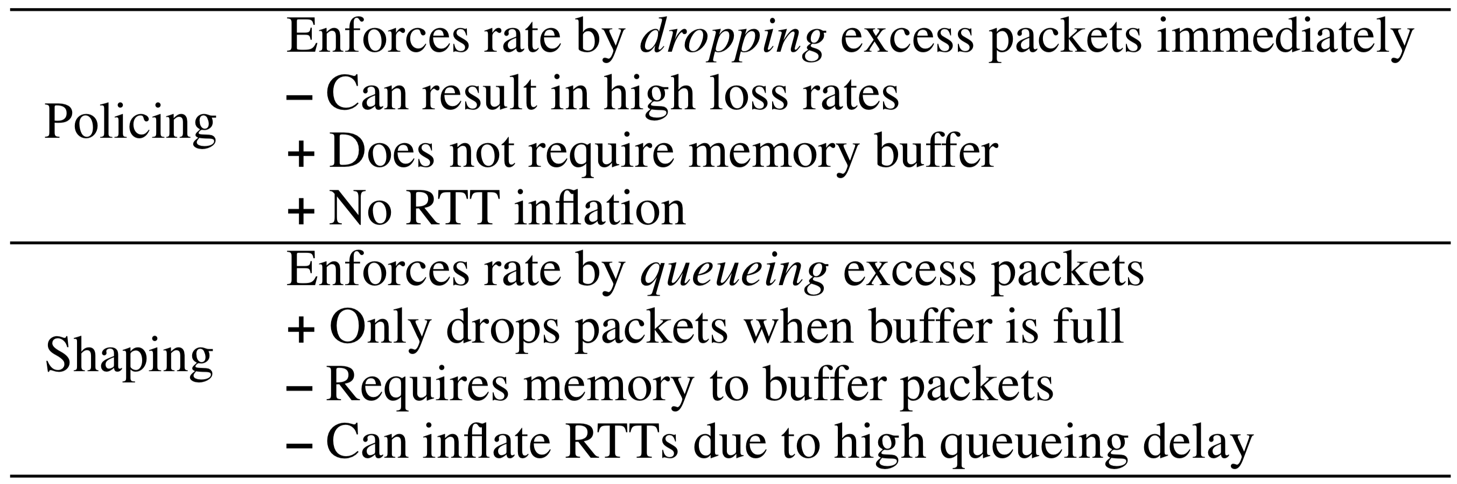
Shaping and Policing

Slide 19
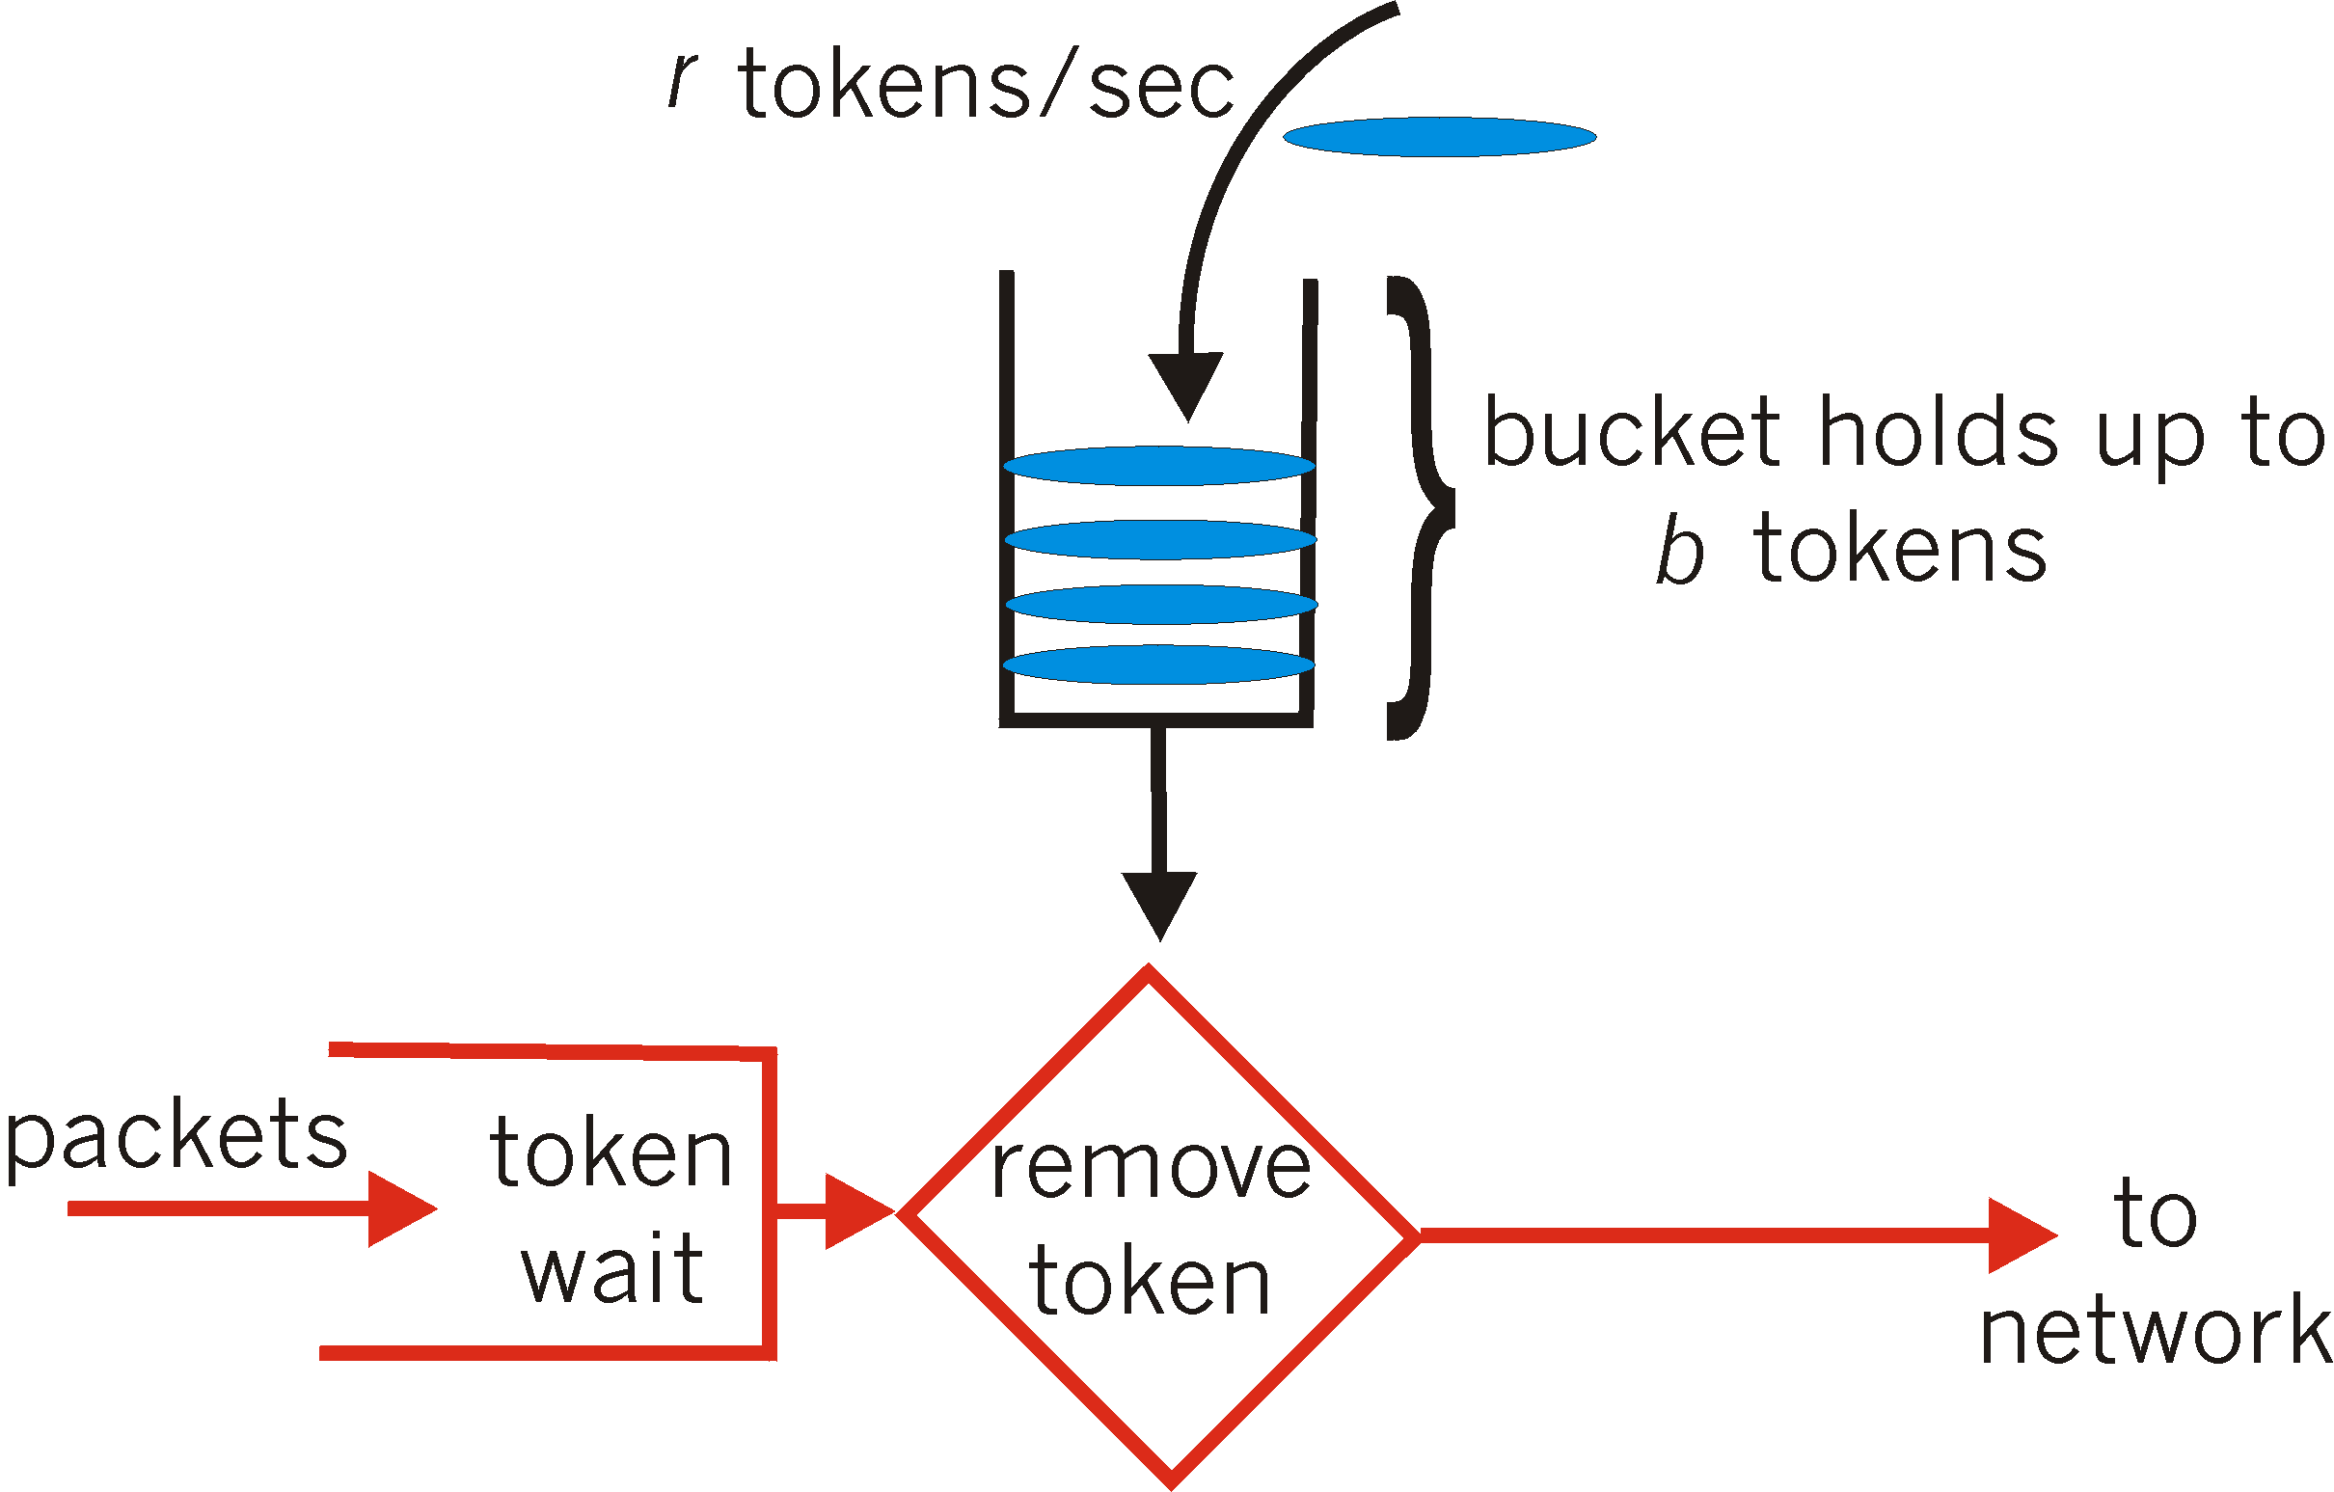
Token Bucket
token bucket: limit input flow to specified burst size and average rate
Tokens generated at rate r tokens/sec, put into bucket
Bucket can hold b tokens. Tokens are not added if bucket is full
A packet can be transmitted successfully if a token is available
Packet “picks up” the token as it leaves the router
Over interval of time t:
number of packets that leave the token
bucket is less than or equal to (r * t + b)
Average rate r
Burst size b

Slide 20
Token Bucket Shaper vs. Policer
Shaper: there is a bucket for tokens and a packet buffer to hold packets waiting for tokens
Packets will be dropped if the buffer is full
A token bucket policer doesn’t contain the packet buffer:
a packet arriving while the bucket is empty is dropped right away
Bucket of tokens enables small bursts to go through unscathed
Short flows can exceed rate limit r, since they use up the reserve in the bucket
Long flows will fit into the rate limit r over longer periods of time, since once they use up the reserve, they are limited by the token-fill rate r

Slide 21
Purpose of the bucket
Suppose each flow starts with a “full” bucket (b tokens)
Bucket of tokens enables small bursts to go through unscathed
Short flows can exceed rate limit r, since they can use up the reserve in the bucket
Long flows will fit into the rate limit r over their lifetime, since they cannot exceed the average token-filling rate r after using up the reserve

Slide 22
Token Buckets are simple to implement
Each time a packet from a flow arrives, refill tokens according to gap in time and bucket size
tokens += r * time since last packet of flow
tokens = min(tokens, b)
Small per-flow state: r, b, timestamp, current # of tokens
Used to build more complex metering schemes, e.g., trTCM (RFC 2698)
You can even remove the shaping packet buffer
→ policer

Slide 23
The Internet uses token bucket policers at many bottleneck links and routers.

Slide 24
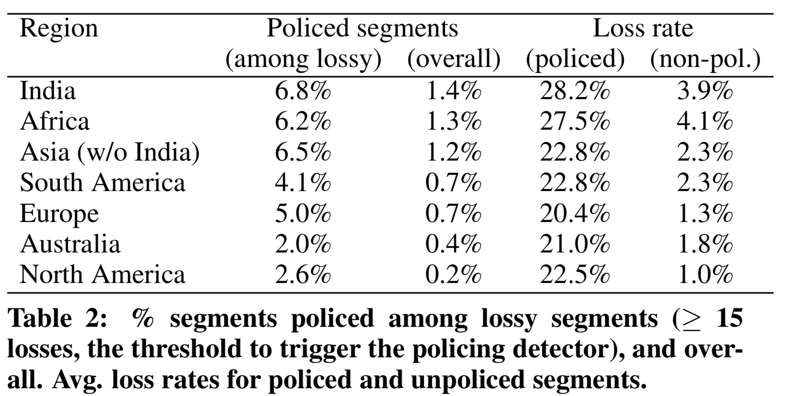
Impact of Token Bucket Policers
Flach et al., An Internet-Wide Analysis of Traffic Policing, SIGCOMM 2016

Slide 25
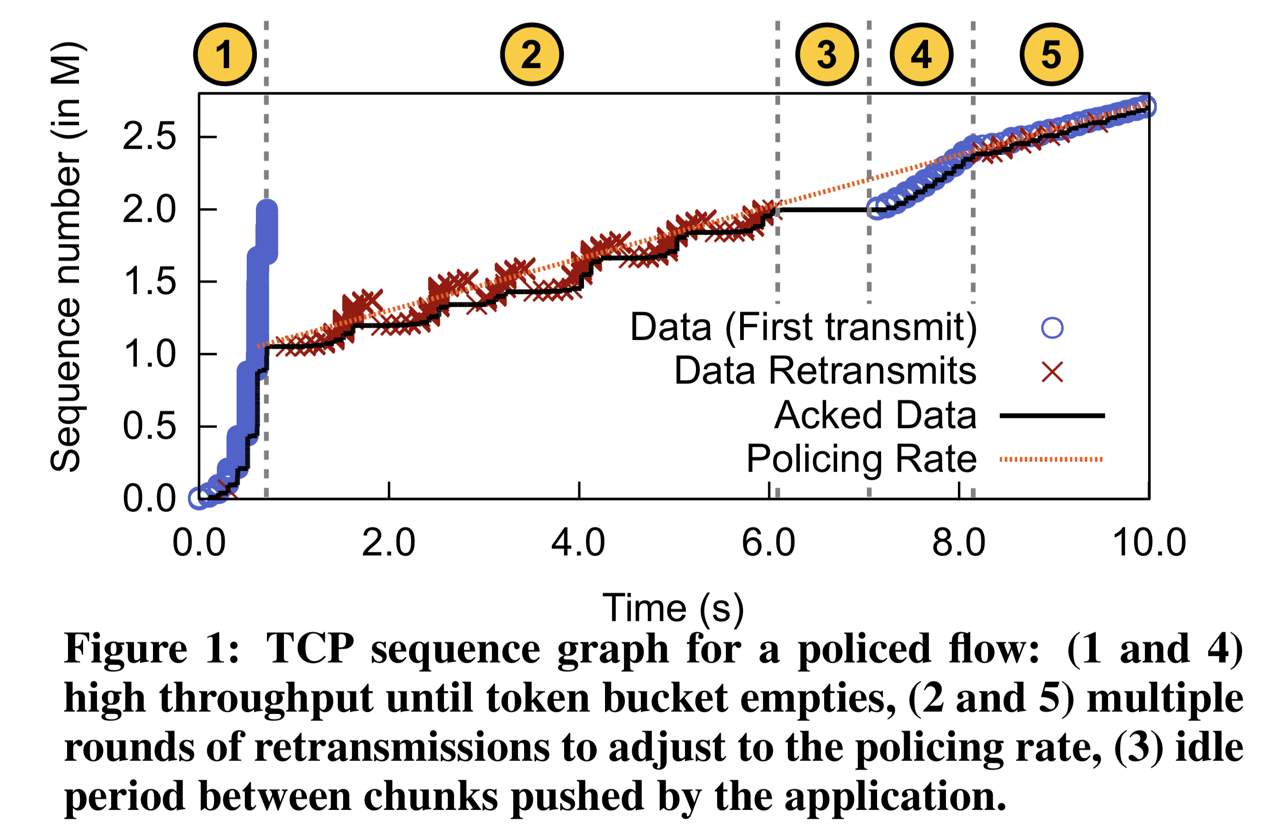
Impact on TCP

Slide 26
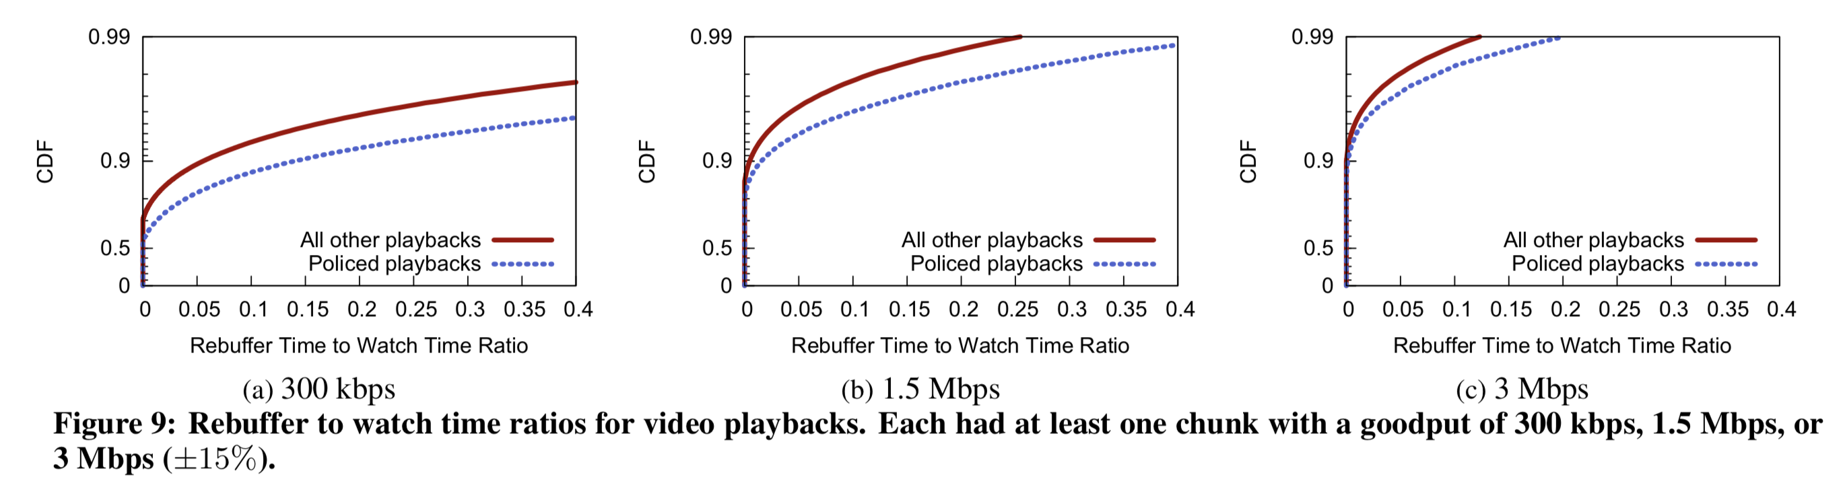
Policing losses impact applications
Video rebuffer rate: rebuffer time / overall watch time
Flach et al., An Internet-Wide Analysis of Traffic Policing, SIGCOMM 2016

