Slide 1

Fast Interconnects
Srinivas Narayana
Fall 2020

Slide 2
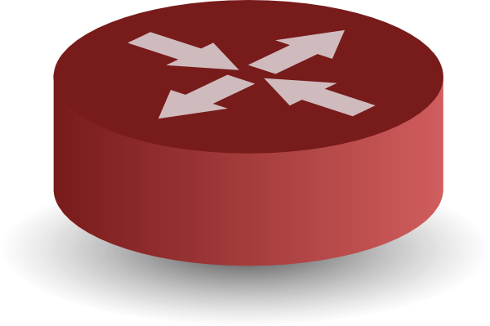
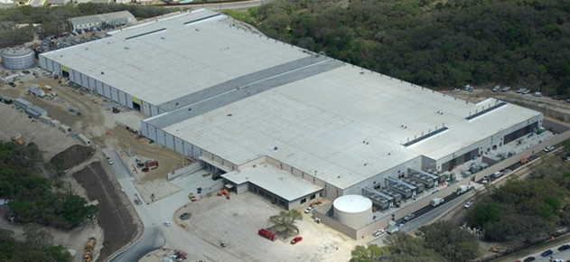


Application 1: Data center topologies
INTERNET
Fabric
Servers

Slide 3
Data center costs
Amortized Cost* | Component | Sub-Components
~45% | Servers | CPU, memory, disk
~25% | Power infrastructure | UPS, cooling, power distribution
~15% | Power draw | Electrical utility costs
~15% | Network | Switches, links, transit
The Cost of a Cloud: Research Problems in Data Center Networks. Sigcomm CCR 2009. Greenberg, Hamilton, Maltz, Patel.
*3 yr amortization for servers, 15 yr for infrastructure; 5% cost of money
Notes:
Source: http://web.cse.ohio-state.edu/icdcs2009/Keynote_files/greenberg-keynote.pdf

Slide 4
Goal: Agility -- any service, any server
Ideal: Want to place workloads where server resources are available
…regardless of which services they belong to
…regardless of how they communicate with each other
Want to view DCN as a pool of compute connected by one big high-speed interconnect (“one big switch”)

Slide 5
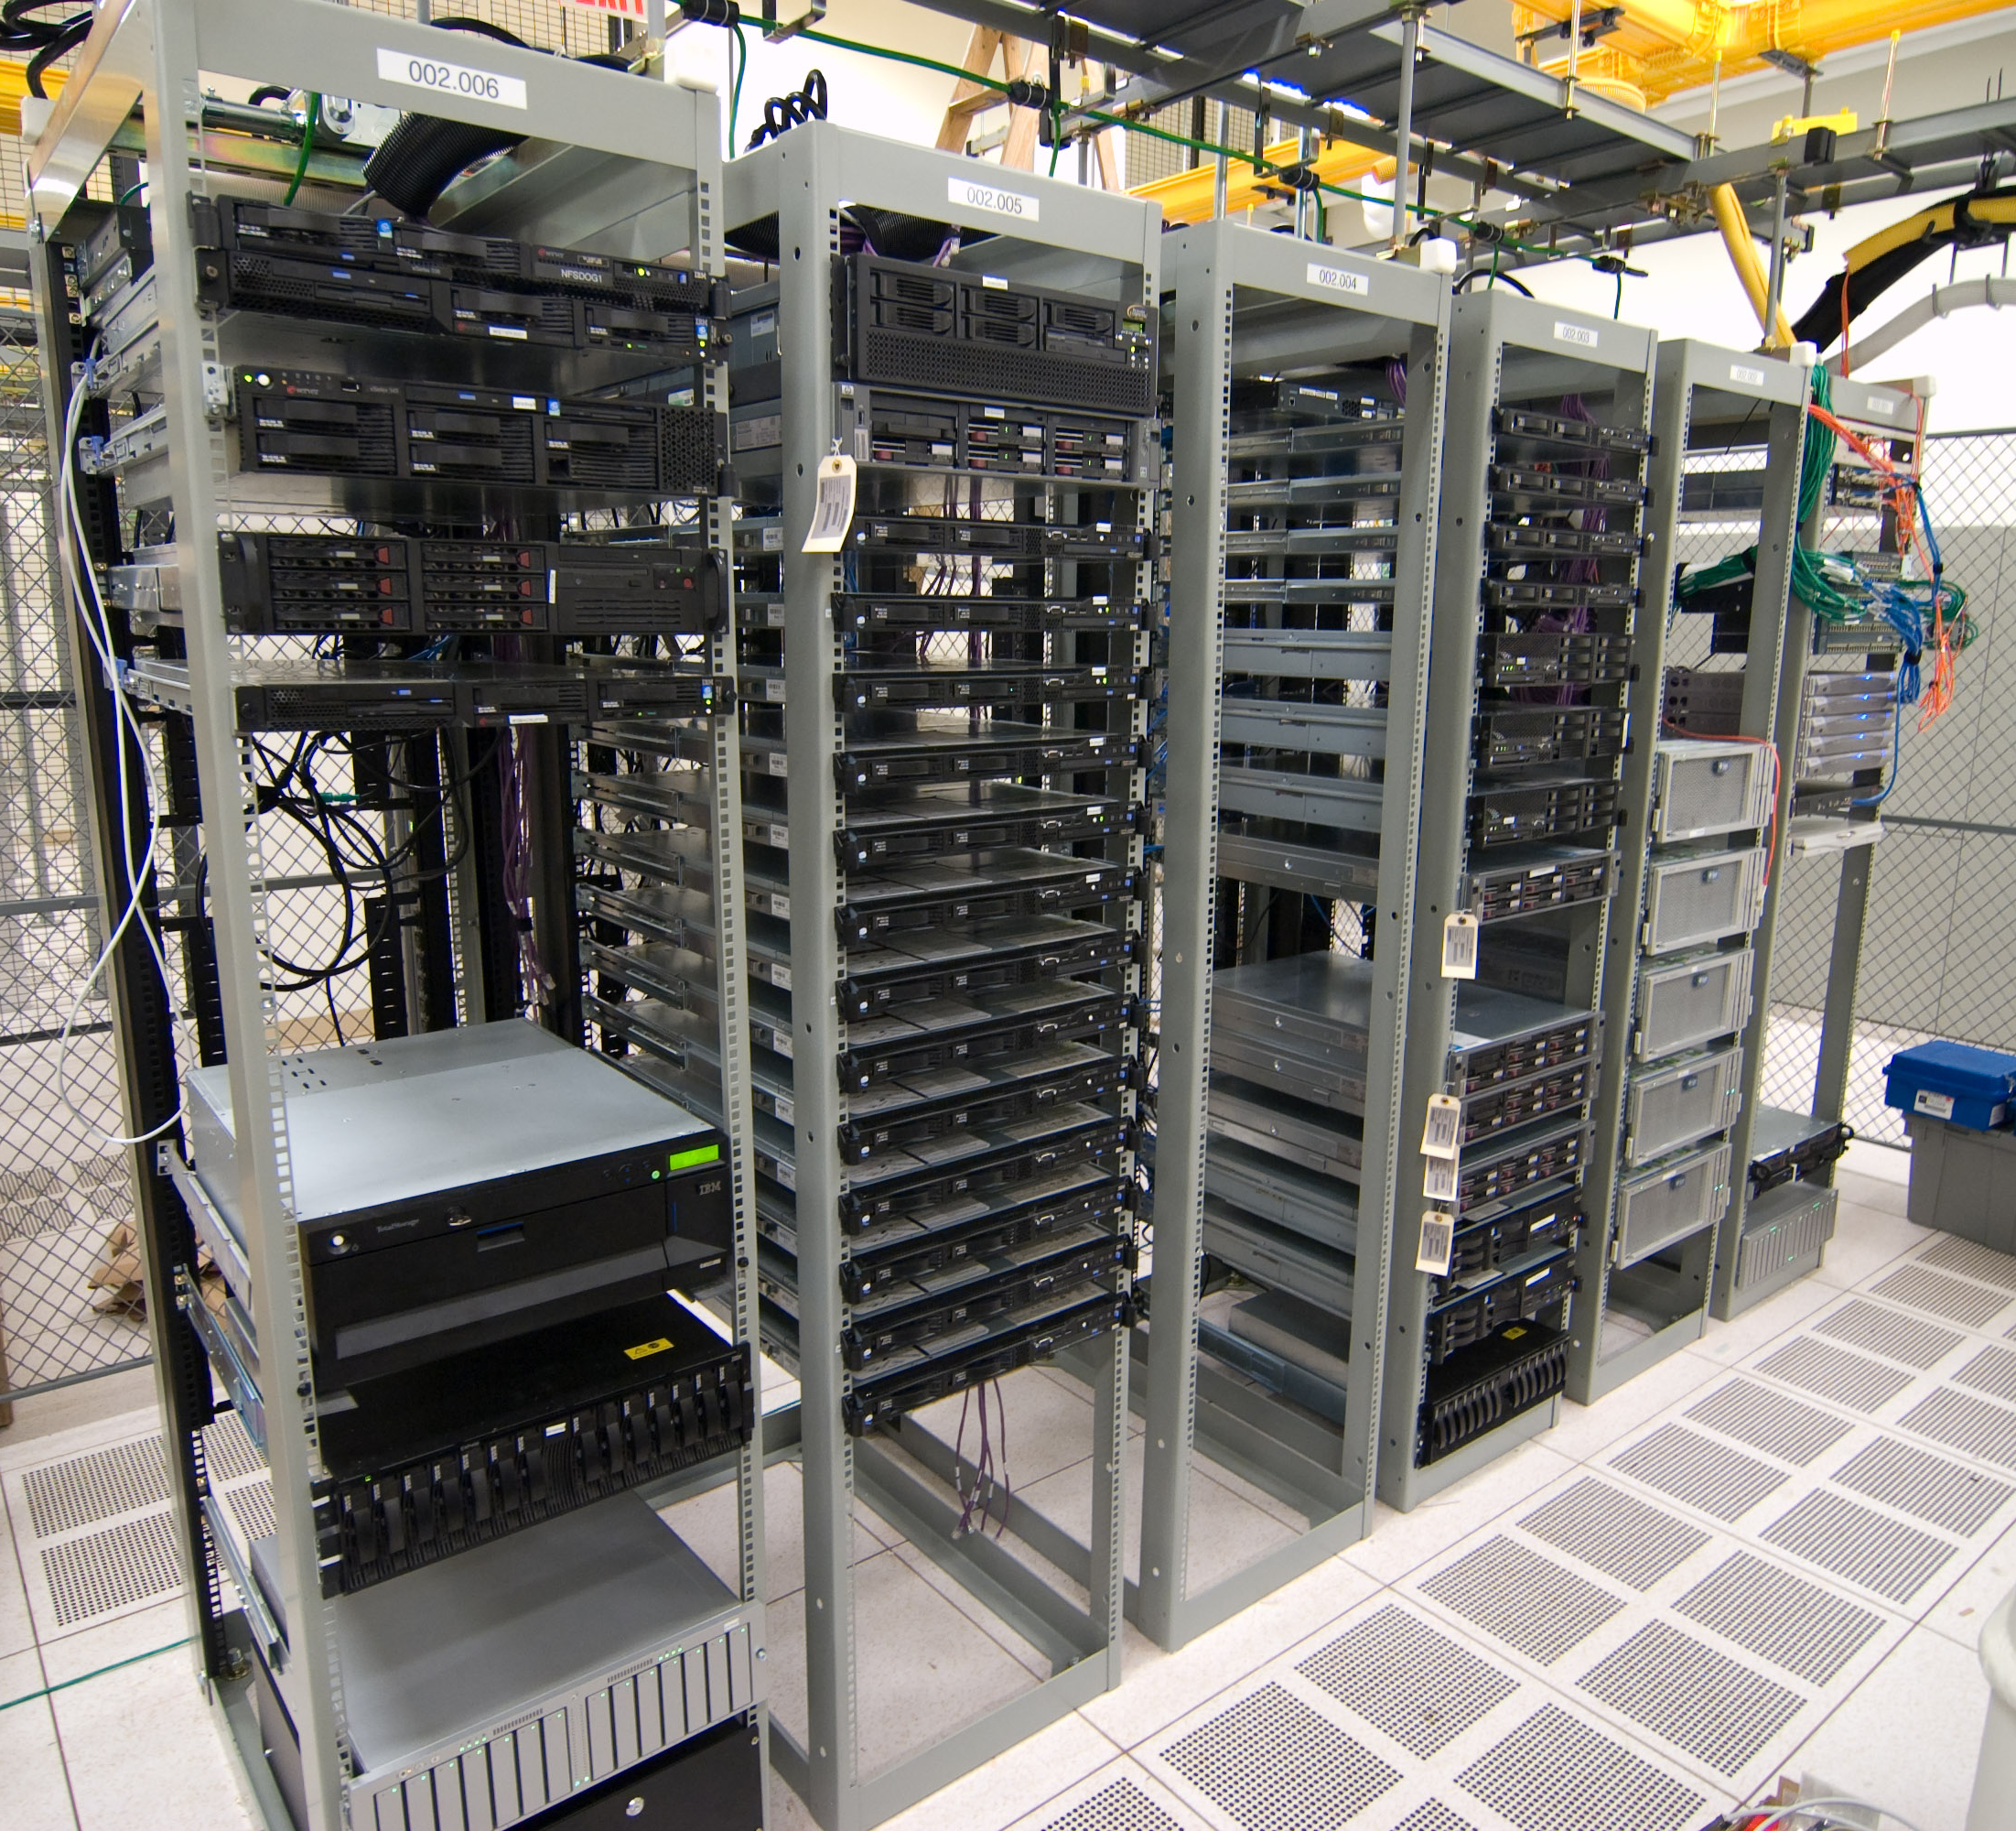
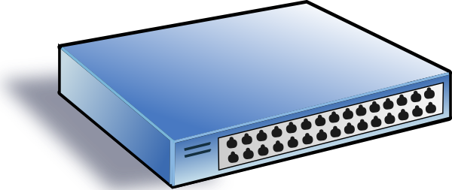
Application 2: High-speed routers!
Example: to interconnect servers together in a data center rack.
(Dense deployments can have 64-100 ports per switch.)
Also applicable to core routers.

Slide 6
Building a high-speed
switching fabric

Slide 7
A single (n X m)-port switching fabric
Different designs of switching fabric possible
Assume n ingress ports and m egress ports, half duplex links
Any ingress port may wish to communicate with any egress port

Slide 8
A single (n X m)-port switching fabric
Circuit switch, used in telephony network switches and modern optical switches
Connect one input and output port at a time
Typically “slow” to change.

Slide 9
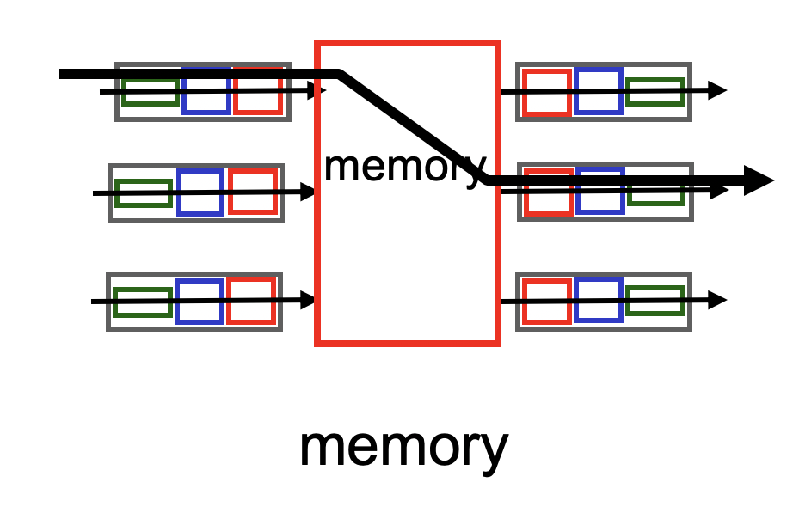
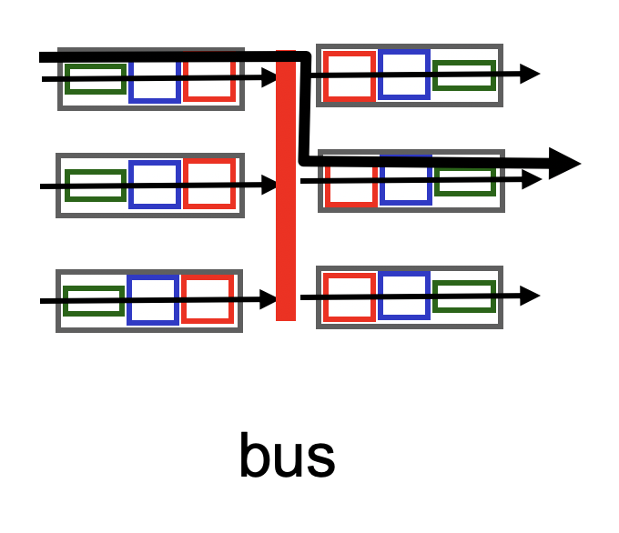
A single (n X m)-port switching fabric
Packet-switched networks require faster change in the
input → output port assignment

Slide 10
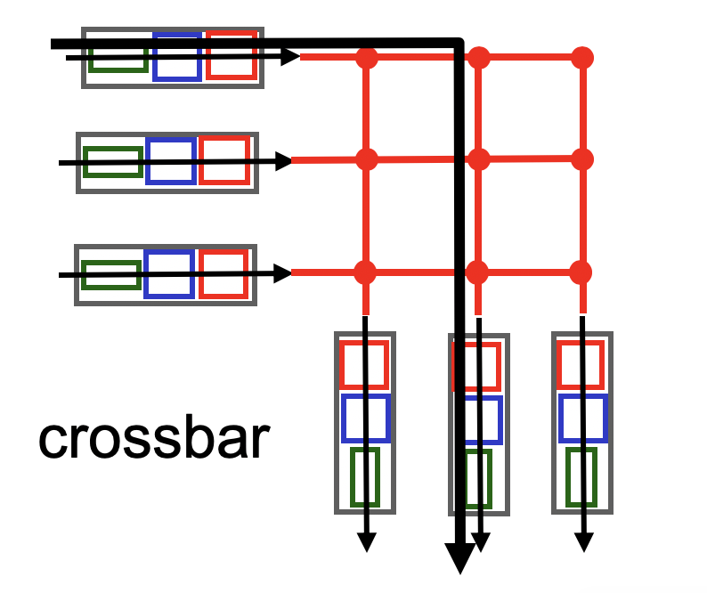
A single (n X m)-port switching fabric
Electrical/mechanical/electronic crossover
Nonblocking: if input port x and output port y are both free, they should be able to connect,
…regardless of which other ports are currently connected.
If not, switch is blocking. Many “fabrics” we encounter in real life are blocking.
Ex: Street intersections, roundabouts

Slide 11
Key challenge: Many ports + Nonblocking
Low-cost nonblocking crossbars are feasible for a small # ports
However, it is costly to be nonblocking with larger # ports
Suppose each crossover is as fast as each input port (rate R)
You need n * m crossover points.
It is often the case that n = m. The cost grows quadratically on the number of input ports
Other possibility: crossover must transition faster than the port
… so that you can keep the number of crossovers small
Fabric/crossover must run at aggregate rate of n*R

Slide 12
Key principle to scale nonblocking switches
Every nonblocking switch with large # ports is built out of many nonblocking switches with a smaller # ports.
So, how do we put together many small nonblocking switches to build one large nonblocking switch?
The subject of interconnection networks

Slide 13
3-stage Clos network (r*n X r*n ports)
n X m
r X r
m X n
…
…
…
…
…
…
n X m
r X r
m X n
…
…
…
…
…
…
n X m
r X r
m X n
…
…
…
r switches n X m
m switches r X r
r switches m X n

Slide 14
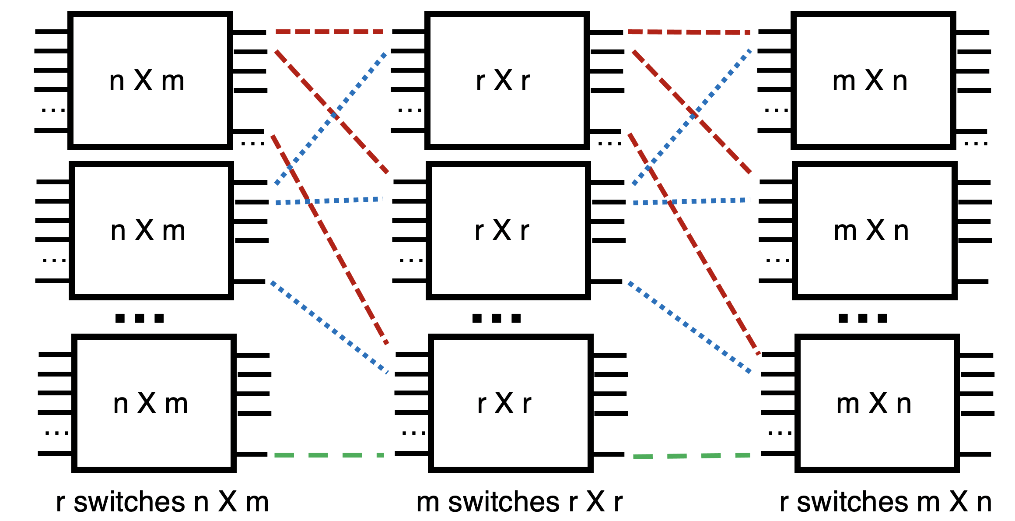
How Clos networks become nonblocking
if m > 2n – 2, then the Clos network is strict-sense nonblocking.
That is, any new demand between any pair of free (input, output) ports can be satisfied without re-routing any of the existing demands.
How?

Slide 15
Need at most (n-1)+(n-1) middle stage
n X m
r X r
m X n
…
…
…
…
…
…
At most n-1 existing demands
n X m
r X r
m X n
…
…
…
…
…
…
n X m
r X r
m X n
…
…
…
r switches n X m
m switches r X r
r switches m X n

Slide 16
Surprising result about Clos networks
if m >= n, then the Clos network is rearrangeably nonblocking
That is, any new demand between any pair of free (input, output) ports can be satisfied by suitably re-routing existing demands.
It is easy to see that m >= n is necessary
The surprising part is that m >= n is sufficient
https://en.wikipedia.org/wiki/Clos_network#Rearrangeably_nonblocking_Clos_networks_(m_%E2%89%A5_n)

Slide 17
Rearrangeably nonblocking Clos built with identical switches
n X n
n X n
n X n
…
…
…
…
…
…
n X n
n X n
n X n
…
…
…
…
…
…
n X n
n X n
n X n
…
…
…
n switches n X n
n switches n X n
n switches n X n

Slide 18
Modern data center network topologies are just folded Clos topologies.

Slide 19
How does one design a Clos DCN?
Switches are usually n X n with full-duplex links
Fold the 3-stage Clos into 2-stages
Share physical resources between ingress and egress stages
Share ports and links across the two “sides” of the middle stage

Slide 20
ToR/aggregation layer
Spine layer
ToR/aggregation layer
n/2 X n/2
n X n
n/2 X n/2
…
…
…
…
…
…
From/to hosts
n/2 X n/2
n X n
n/2 X n/2
…
…
…
…
…
…
n/2 X n/2
n X n
n/2 X n/2
…
…
…
n X n full duplex
n/2 switches n X n full duplex
n X n full duplex

Slide 21
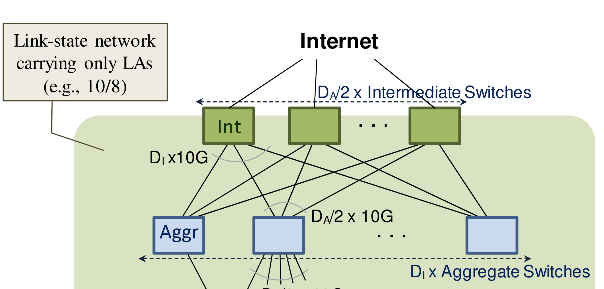
Consequences of using folded Clos
2-stage high throughput data center topology
Every switch is identical in terms of # ports and link rate

Slide 22
What about routing?
We said that the Clos topology above is rearrangeably nonblocking.
So, how to rearrange existing demands when a new packet arrives, so that it can get across as quickly as possible?
How to do it without “interference” to (ie: rerouting) other pkts?
VL2: We don’t need to rearrange anything.

Slide 23
Valiant Load Balancing (VLB)
Designed to move data quickly for shuffling in parallel computing
Setting: Connectivity is sparse (“hypercube” topology): log n links per node in a network with n nodes
Key idea: pick a random node to redirect a message from the source, then follow the shortest path to the destination from there
Guarantee: With high probability, the message reaches its destination very quickly (log n steps)
Practically, this means there is very less queueing in the network

Slide 24
VLB in data center networks
VLB is more general than data center networks or Clos
It is a form of oblivious routing
No need to measure DCN traffic patterns before deciding on routing
Extremely simple to implement: no global state
VLB is very handy in folded Clos topologies due to the numerous options to pick the first-hop from the ToR switch.
Balance load across many paths
Path from spine to destination ToR is deterministic
Very beneficial in practice
Performance isolation: other flows don’t matter
High capacity (“bisection bandwidth”) between any two ToR ports

Slide 25
Is ToR-port to ToR-port high capacity enough?
VLB + Clos provides high capacity if no ToR port demands more than its bandwidth.
When might a ToR port need to service more than its port rate?
Hint: this won’t happen for traffic going from a server → ToR
Typically, server NIC rates are <= ToR port rates

Slide 26
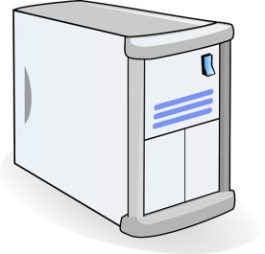
Example: Web Search
TLA
Deadline = 250ms
A bunch of results arrive at MLAs and TLAs in a short period.
Incoming demand to a server may exceed ToR port bandwidth!
MLA
………
MLA
Deadline = 50ms
Deadline = 10ms
Worker Nodes
Notes:
After the animation, say “this follows what we call the partition/aggregate application structure.
I’ve described this in the context of search, but it’s actually quite general
- “the foundation of many large-scale web applications.”

Slide 27
Hose traffic model
The guarantees of VLB + Clos only hold under the hose model:
Demands for any one ToR port (send or receive) must not exceed its bandwidth.
Very hard to enforce especially on the receiver side without sender-side rate limits.
VL2 uses TCP convergence as a way of ensuring that aggregate ToR port demand is within its bandwidth.
Q: think about the problems this might cause…

