Slide 1

Internet Architecture
Lecture 2, Computer Networks (198:552)
Fall 2019

Slide 2

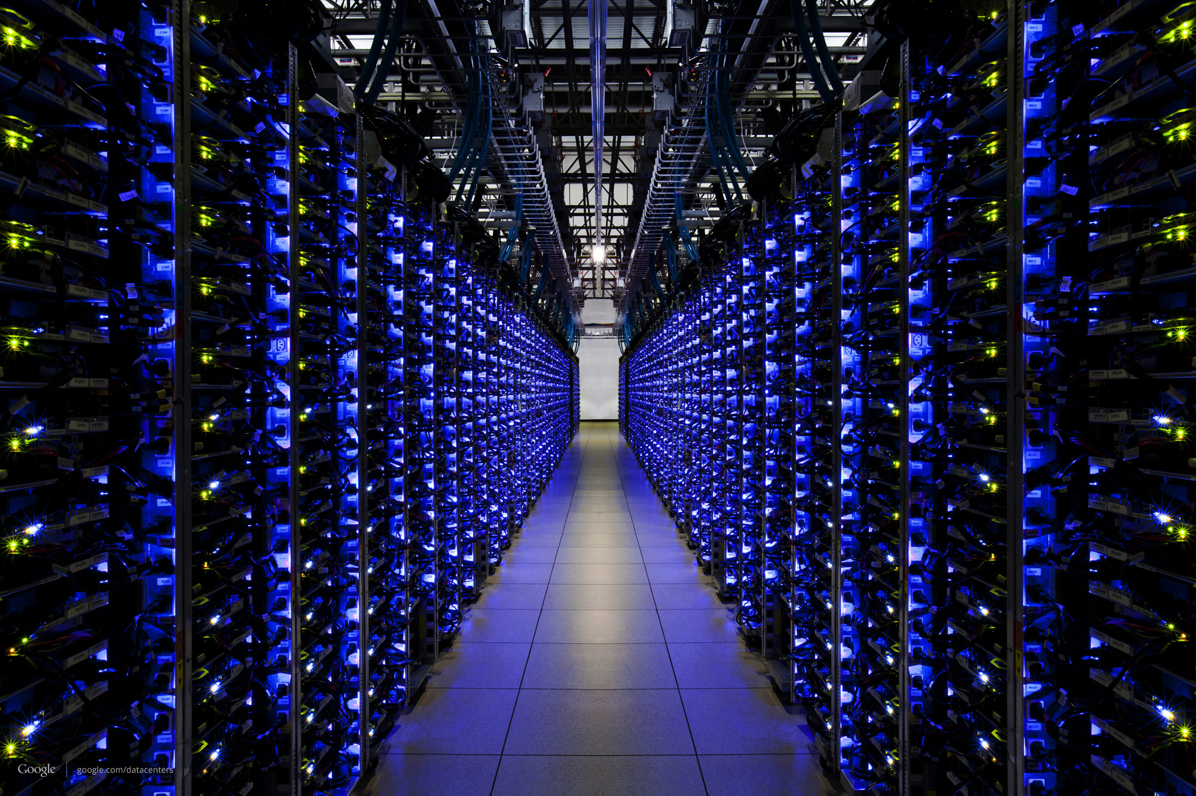



What happens when you browse?
(1) Request gmail.com for your mail
(2) Google churns on your request
(3) Receive & display the response!
The Internet

Slide 3
But how does your laptop know where the google.com server is, and how to reach it?

Slide 4
But how does your laptop know where the google.com server is, and how to reach it?
Addressing
Both your laptop and google.com have many addresses.

Slide 5
But how does your laptop know where the google.com server is, and how to reach it?
Routing
There may be many kinds of networks between you and google, each using its own way to stitch together the path

Slide 6
Addressing

Slide 7


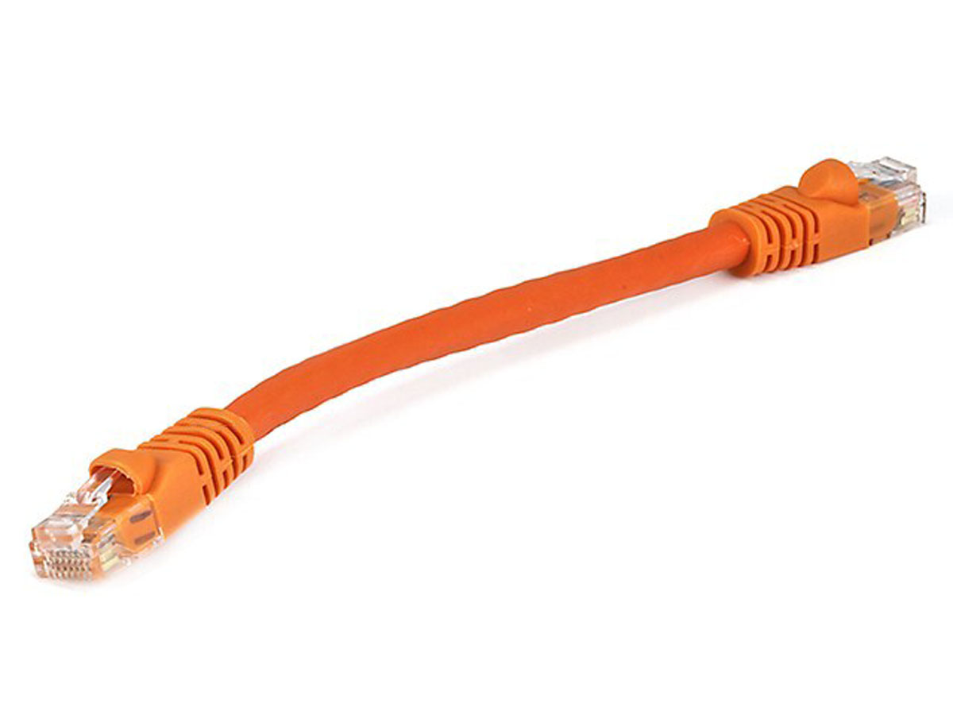
Rutgers campus network
The Internet
Transport address (port)
Ex: 64058
With which app is this conversation associated?
Network address (IP address)
Ex: 192.168.1.4
Whose network am I attached to?
Hardware address (MAC address)
Ex: 00-15-C5-49-04-A9
How do I identify my network interface (device)?

Slide 8
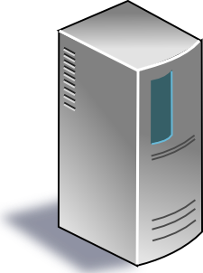
The Internet
Google’s network
Application address (URL)
Ex: mail.google.com
Transport address (port)
Ex: 4096
Network address (IP address)
Ex: 10.1.1.104
Hardware address (MAC address)
Ex: 00-15-C5-49-04-A7

Slide 9
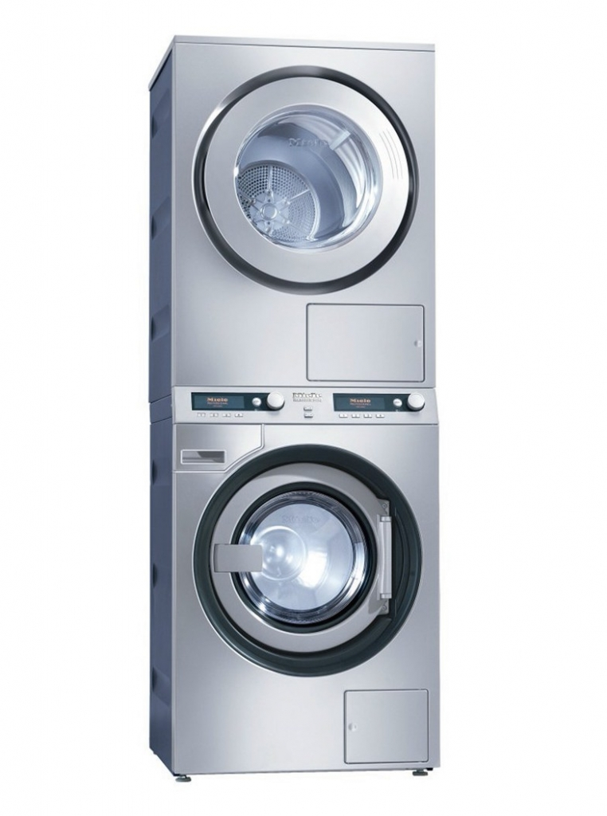
Software and hardware for networking are arranged in layers.
Layering provides modularity:
Each layer has a distinct function
& interacts with other layers through well-defined interfaces.

Slide 10
Modularity through layering
Protocols “stacked” in endpoint and router software/hardware
Apps: useful user-level functions
HTTP
FTP
NV
TFTP
Transport: provide guarantees to apps
TCP
UDP
IP
Network: best-effort global pkt delivery
Ether
ATM
…
WiFi
Link: best-effort local pkt delivery
IP is the “thin waist” of the Internet, enabling
interoperability across apps & network media

Slide 11

The Internet
Applications
Applications
Packet starts as an
app “payload”
Transport
Transport
Packet takes on info at each layer
Network
Network
Link layer
Link layer
The Internet

Slide 12

Applications
Applications
Transport
Transport
Network
Network
Network
Network
Link layer
Link layer
Link layer
Link layer

Slide 13
Applications
Routers do not typically have transport or app functionality
(more later)
Applications
Transport
Transport
Network
Network
Network
Network
Link layer
Link layer
Link layer
Link layer

Slide 14
Time for an activity

Slide 15
Where do all the addresses come from?
You, as the user, only know the application address of your destination (google.com)
Do we need all these addresses, or can we get rid of some?
Should addresses correspond to the endpoint, or point of attachment, or to the application?
How does your laptop find all the other addresses?

Slide 16
Addresses and what they correspond to
Transport address (TCP/UDP port): app-level conversation
Network-level address (IP address): point of attachment
Link-level address (MAC address): device

Slide 17

Directories
Directories map a name to an address
Simplistic designs
Central directory
Ask everyone (e.g., flooding in ARP)
Tell everyone (e.g., pushing /etc/hosts)
Fix a value a priori (e.g., dst port 80 is typically HTTP)
Scalable distributed designs
Hierarchical namespace (e.g., Domain Name System)
Flat name space (e.g., Distributed Hash Table)

Slide 18

Domain Name System
root DNS server
Host at cis.poly.edu wants IP address for gaia.cs.umass.edu
2
3
TLD DNS server
4
local DNS server
dns.poly.edu
5
7
6
1
8
authoritative DNS server
dns.cs.umass.edu
requesting host
cis.poly.edu
Recursive query: #1
Iterative queries: #2, 4, 6
gaia.cs.umass.edu

Slide 19
Routing

Slide 20

Path computation: Routing
“I know where you are, but how do I get there?”
End-to-end paths (e.g., source routing)
Each node picks the best end-to-end path
Spanning tree (e.g., Ethernet)
One tree that connects every pair of nodes
Shortest paths (e.g., OSPF, IS-IS, RIP)
Shortest-path tree rooted at each node
Locally optimal paths (e.g., BGP)
Each node selects the best among its neighbors
More on this in the next lecture…

Slide 21
The Internet’s approach to routing
aggregate routers into regions known as “autonomous systems” (AS) (a.k.a. “domains”)
intra-AS routing
routing among hosts, routers in same AS (“network”)
all routers in AS must run same intra-domain protocol
routers in different AS can run different intra-domain routing protocol
gateway router: at “edge” of its own AS, has link(s) to router(s) in other AS’es
inter-AS routing
routing among AS’es
gateways perform inter-domain routing (as well as intra-domain routing)

Slide 22
Interconnected ASes
3c
3a
2c
3b
AS3
2a
1c
2b
AS2
1a
1b
1d
AS1
Paths configured by both intra- and inter-AS routing algorithm
intra-AS routing determine entries for destinations within AS
inter-AS & intra-AS determine entries for external destinations
Intra-AS
Routing
algorithm
Inter-AS
Routing
algorithm
Forwarding
table

Slide 23
What happens when you browse?
(1) Request gmail.com for your mail
(2) Google churns on your request
(3) Receive & display the response!
The Internet
But how did the Google server and your laptop attach to the network in the first place? How did they get assigned their addresses?

Slide 24
The roles of the endpoint

Slide 25
The roles of endpoint network software
Bootstrapping the host into the network
How does the endpoint get an address?
How does the endpoint make itself known to others?
Providing an interface to networked applications
How do higher-level applications access the network?
What abstractions does the host provide to apps?
Distributed resource sharing
What roles does the host play in network resource allocation decisions?
… apart from other things.

Slide 26
(1) Bootstrapping host into network
adapter
The lowest level address is hard-wired
The network adapter (NIC) comes with MAC address
Higher-level addresses can be statically or dynamically configured
IP address
Statically configured, or dynamically with DHCP
TCP port
Pick a transient value, ex. HTTP src port
… or a value agreed upon a priori, ex. HTTP dst port such as 80
Applications
Transport
Network
Link layer

Slide 27
Dynamic Host Configuration Protocol
DHCP discover
(broadcast)
arriving endpoint
DHCP offer
Host learns IP address,
Subnet mask, Gateway address, DNS server(s), and a lease time.
DHCP server
DHCP request
(broadcast)
DHCP ACK

Slide 28
(2) Socket: the interface to applications
Best-effort packet delivery is a clumsy abstraction
Applications typically want higher-level abstractions
Messages, uncorrupted data, reliable in-order delivery
Applications communicate using “sockets”
Stream socket: reliable stream of bytes (like a file)
Message socket: unreliable message delivery
User process
User process
socket
socket
Operating
System
Operating
System

Slide 29
Two Basic Transport Features
Demultiplexing: port numbers
Error detection: checksums
Server host 128.2.194.242
Service request for
128.2.194.242:80
(i.e., the Web server)
Client host
Web server
(port 80)
Client
OS
Echo server
(port 7)
IP
payload
detect corruption

Slide 30
Two Main Transport Layers
User Datagram Protocol (UDP)
Just provides demultiplexing and error detection
Header fields: port numbers, checksum, and length
Low overhead, good for query/response and multimedia
Transmission Control Protocol (TCP)
Adds support for a “stream of bytes” abstraction
Retransmitting lost or corrupted data
Putting out-of-order data back in order
Preventing overflow of the receiver buffer
Adapting the sending rate to alleviate congestion
Higher overhead, good for most stateful applications

Slide 31
Socket: the interface to applications
User process
User process
A socket is associated with five pieces of information:
Source and destination IP address
Source and destination port
Kind of transport protocol (TCP/UDP)
Together referred to as the connection five-tuple
socket
socket
Operating
System
Operating
System

Slide 32
Discussion
Is a socket between two IP addresses the right abstraction?
Mobile hosts?
Replicated services?
Is end-to-end error detection and correction the right model?
High loss environments?
Expense of retransmitting over the entire path?

Slide 33
(3) Distributed sharing of the network
Best-effort network easily becomes overloaded
No mechanism to “block” excess calls
Instead excess packets are simply dropped
Examples
Shared Ethernet medium: frame collisions
Ethernet switches and IP routers: full packet buffers
Quickly leads to congestion collapse
Increase in load that results in a decrease in useful work done.
Useful work
“congestion
collapse”
Load

Slide 34
Endpoints adjust to congestion
End hosts adapt their sending rates: congestion control
In response to network conditions
Learning that the network is congested
Shared Ethernet: carrier sense multiple access
Seeing your own frame collide with others
IP network: observing your end-to-end performance
Packet delay or loss over the end-to-end path
Adapting to congestion
Slowing down the sending rate for the greater good
Slow down too little: don’t effectively relieve congestion
Slow down too much: lose application performance

Slide 35
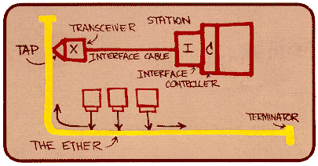
Ethernet back-off mechanism
Carrier sense: wait for link to be idle
If idle, start sending; if not, wait until idle
Collision detection: listen while transmitting
If collision: abort transmission, and send jam signal
Exponential back-off: wait before retransmitting
Wait random time, exponentially larger on each retry

Slide 36
TCP congestion control (much more later)
Additive increase, multiplicative decrease
On packet loss, divide congestion window in half
On success for last window, increase window linearly
Loss
Window
halved
time
Other mechanisms: slow start, fast retransmit vs. timeout loss, etc.

Slide 37
Discussion
What role should the network play in resource allocation?
Explicit feedback to the endpoints?
Enforcing an explicit rate allocation?
What is a good definition of fairness?
What about hosts who cheat to hog resources?
How to detect cheating? How to prevent/punish?

