Slide 1

The Application Layer: Sockets, DNS
CS 352, Lecture 3, Spring 2020
http://www.cs.rutgers.edu/~sn624/352
Srinivas Narayana

Slide 2
Course announcements
Sakai, Piazza, course web page are up
TAs assigned to recitation sections
Office hours will be finalized soon
Start looking for programming project partners
Go over lecture materials for quiz prep
Estimated 3 hours of prep in addition to attending lecture
Your mileage may vary
Work on the textbook problems and test yourself
Attend recitations for problem practice
Quizzes are timed: they close 30 minutes after you start
Quizzes will test both concepts and problem solving

Slide 3


Review of concepts
Switching: circuit, message, packet
Measuring: bandwidth, propagation + transmission + queueing
Layering and modularity
Application
HTTPS
FTP
HTTP
SIP
RTSP
Transport
TCP
UDP
Network
IP
Host-to-Net
X.25
…
802.11
ATM

Slide 4
Intro to app-layer concepts
Protocols, Addressing, Connections

Slide 5
Application-layer protocol
Types of messages exchanged,
e.g., request, response
Message format:
Syntax: what fields in messages & how fields are delineated
Semantics: meaning of information in fields
Actions: when and how processes send & respond to messages
Public-domain protocols:
defined in RFCs
allows for interoperability
e.g., HTTP, SMTP
Proprietary protocols:
e.g., Skype, Microsoft Exchange

Slide 6



Application “addresses”
We usually think of an application executing on a single endpoint
However, applications can reside on, say, 2 different endpoints connected by a network
In order to communicate, need to identify the communicating parties
Telephone network: phone number (10 digits)
Computer network: IP address
IPv4 (32 bits) 128.6.24.78
IPv6 (128 bits) 2001:4000:A000:C000:6000:B001:412A:8000
Suppose there is more than one networked program executing on a host
In addition to host address, we need one more address
“Which Program to talk to?”
Another identity for an application: port number
Host / house (IP address)
App / person (port #)

Slide 7

IP address & port number
Host
Host
process
socket
P4
process
process
P1
socket
socket
P2
Host
Internet
process
A socket is the door between
OS/network and the application process
The application’s programming interface to the network
socket
P3

Slide 8
An app-layer connection is a 4-tuple
Host: IP address B
Host:: IP address A
process
socket
process
process
socket
socket
Host: IP address C
Internet
process
socket
Connection := (IP_{S}, Port_{S}, IP_{D}, Port_{D})
_{(S = source, D = destination)}

Slide 9
Recall: Services provided by lower layers
Host A
Host B
Application
Layer
Application Protocol
Application
Layer
Transport
Layer
Transport Protocol
Transport
Layer
Network
Layer
Network
Layer
Network
Layer
Network
Layer
H-to-N
Layer
H-to-N
Layer
H-to-N
Layer
H-to-N
Layer
Router
Router

Slide 10
Application architectures

Slide 11
Client-server architecture
client
Server:
always-on host
permanent IP address
server farms (“data centers”) for scaling
Clients:
communicate with server
may be intermittently connected
may have dynamic IP addresses
do not communicate directly with each other
server
client

Slide 12
Peer-to-peer (P2P) architecture
peer
Peers:
Intermittently connected hosts
Directly talking to each other
Little to no reliance on always-up servers
Examples: BitTorrent, Skype
Today, many applications use a hybrid model
Example: Skype “supernodes”
peer

Slide 13
Going forward: A few applications
Domain Name System
The web: HTTP
Mail
File transfer

Slide 14
Domain Name System (DNS)
“You have my name. Can you lookup my number?”

Slide 15
Domain Name System (DNS)
Problem statement:
Average brain can easily remember 7 digits for a few names
On average, IP addresses have 12 digits
We need an easier way to remember IP addresses
Solution:
Use alphanumeric names to refer to hosts
We need a directory: add a service to map between alphanumeric host names and binary IP addresses
We call this process Address Resolution

Slide 16

Types of Directories
Directories map a name to an address
Simplistic designs
Central directory
Ask everyone (e.g., flooding)
Tell everyone (e.g., push to a file like /etc/hosts)
Scalable distributed designs
Hierarchical namespace (e.g., Domain Name System (DNS))
Flat name space (e.g., Distributed Hash Table)

Slide 17
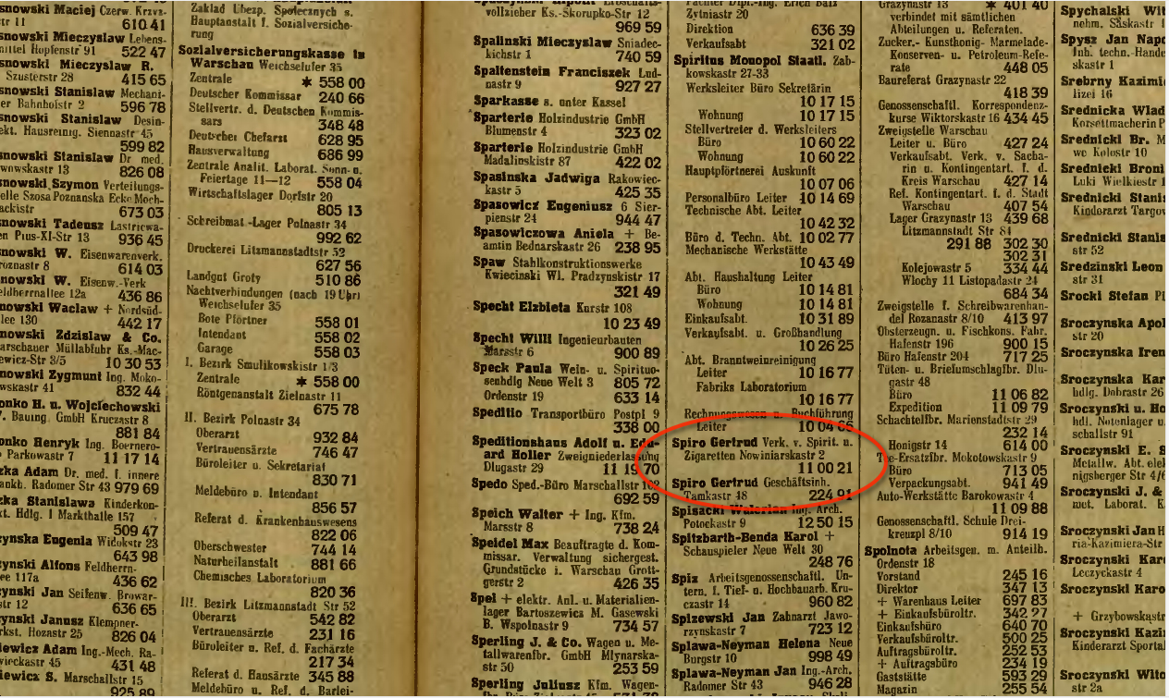
Simple DNS
What if every host has a local directory?
/etc/hosts.txt
How things worked in the early days of the Internet!
What if hosts moved around? How do you keep this up to date?

Slide 18
Simple DNS
DOMAIN NAME | IP ADDRESS
www.yahoo.com | 98.138.253.109
cs.rutgers.edu | 128.6.4.2
www.google.com | 74.125.225.243
www.princeton.edu | 128.112.132.86
<Client IP, CPort, DNS server IP, 53>
QUERY | STD QUERY | cs.rutgers.edu
<DNS server, 53, Client IP, Cport>
RESPONSE | STD QUERY | 128.6.4.2
Idea (2): Implement a server that looks up a table
Simple, but does not scale
Every new host needs to be entered in this table
Performance?
Failure?

Slide 19
DNS design
A centralized DNS design (ex: single server) is problematic.
single point of failure
traffic volume
distant centralized database
security
maintenance
It doesn’t scale to the requirements of the Internet.

Slide 20
Distributed and hierarchical database
Root DNS Servers
com DNS servers
org DNS servers
edu DNS servers
google.com
DNS servers
wnyc.org
DNS servers
rutgers.edu
DNS servers
umass.edu
DNS servers
amazon.com
DNS servers
cs.rutgers.edu DNS server
RFC 1034: Distribution through hierarchy enables scaling

Slide 21
DNS protocol
Client and Server
Client connects to Port 53 on server
DNS server IP address should be known. How?
Either manually configured or automatically (more on this to come…)
Two types of messages
Queries
Responses
Type of Query (OPCODE) methods
Standard query (0x0)
Request domain name for a given IP address
Updates (0x5)
Provide a binding of IP address to domain name
Each type has a common message format that follows the header

Slide 22
DNS Protocol
When client wants to know an IP address for a host name
Client sends a DNS query to the “local” name server in its network
If name server contains the mapping, it returns the IP address to the client
Otherwise, the name server forwards the request to the root name server
The request works its way down the tree toward the host until it reaches a name server with the correct mapping

Slide 23
Example
root DNS server
2
Host at cis.poly.edu wants IP address for gaia.cs.umass.edu
Local DNS server
Root DNS server
TLD DNS server
Authoritative DNS server
3
.edu DNS server
4
5
local DNS server
dns.poly.edu
7
6
1
8
umass.edu DNS server
dns.umass.edu
requesting host
cis.poly.edu
gaia.cs.umass.edu

Slide 24
Query type
root DNS server
2
Iterative query:
Contacted server replies with name of server to contact
“I don’t know this name, but ask this server”
Queries are iterative for the local DNS server
3
.edu DNS server
4
5
local DNS server
dns.poly.edu
7
6
1
8
umass.edu DNS server
dns.umass.edu
requesting host
cis.poly.edu
gaia.cs.umass.edu

Slide 25
Query type
root DNS server
Recursive query:
Puts burden of name resolution on the contacted name server
Problem: think about the root DNS server.
Must it answer every DNS query?
2
3
7
6
.edu DNS server
local DNS server
dns.poly.edu
5
4
1
8
umass.edu DNS server
dns.umass.edu
requesting host
cis.poly.edu
gaia.cs.umass.edu

Slide 26
DNS Records

Slide 27
DNS records
DNS: distributed db storing resource records (RR)
RR format: (name, type, class, ttl, addr)
Type=A
name is hostname
value is IP address
Type=CNAME
name is alias name for some “canonical” (the real) name
www.ibm.com is really
servereast.backup2.ibm.com
value is canonical name
Type=AAAA
name is hostname
value is IPv6 address
Type=NS
name is domain (e.g. foo.com)
value is hostname of authoritative name server for this domain
Type=MX
value is name of mailserver associated with name

Slide 28
DNS Record example
NAME | Design.cs.rutgers.edu
TYPE | A
CLASS | IN
TTL | 1 day(86400)
ADDRESS | 192.26.92.30
RRs in response
to query
records for
authoritative servers
Information about nameserver
NAME | Cs.rutgers.edu
TYPE | NS
CLASS | IN
TTL | 1 day(86400)
NSDNAME | Ns-lcsr.rutgers.edu

Slide 29
DNS caching and updating records
Once (any) name server learns a name to IP address mapping, it caches the mapping
Cache entries timeout (disappear) after some time
TLD servers typically cached in local name servers
In practice, root name servers aren’t visited often

Slide 30
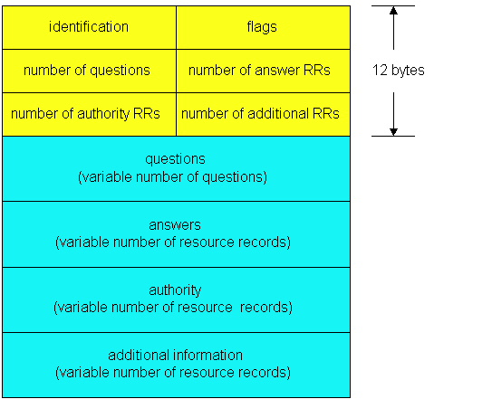
DNS protocol messages
DNS protocol : query and reply messages, both with same message format
QR
Opcode
Message header
QR = 0 for Query, 1 for response
Opcode= 0 standard
identification: 16 bit # for query, reply to query uses same #
flags:
Authoritative answer
recursion desired
recursion available
reply is authoritative

Slide 31
DNS protocol, messages
QR
OPCODE
Name, type fields
for a query
RRs in response
to query
records for
authoritative servers
Information about nameserver
additional “helpful”
info that may be used

Slide 32
Bootstrapping DNS
How does a host contact the name server if all it has is the name and no IP address?
IP address of at least 1 nameserver must be given a priori
or with another protocol (DHCP, bootp)
File /etc/resolv.conf in unix
Start -> settings-> control panel-> network ->TCP/IP -> properties in windows

Slide 33
DNS summary
DNS service:
Hostname to IP address translation
Caching
Hierarchical structure for scaling
Multiple layers of indirection
Host aliasing
Canonical and alias names
Mail server aliasing
Load distribution
Replicated Web servers: set of IP addresses for one canonical name

Slide 34
Themes
Request/response nature of protocols
How Messages are structured
HTTP, SMTP, FTP - simple ASCII protocols
Caching
Name Lookup
Division of concerns (e.g. zones)
Hierarchy structure

