Slide 1

The Transport Layer: Flow Control, Congestion Control
CS 352, Lecture 9, Spring 2020
http://www.cs.rutgers.edu/~sn624/352
Srinivas Narayana

Slide 2
Course announcements
Quiz 3 will go online later today: covers this lecture only
Due Tuesday 03/03
Project 1 due today
Project 2 will go online this weekend
I hear you:
More practice on calculation-style questions in recitations
More time for project questions during recitations
Suggested textbook problems close to exams
More time for class activities and demonstrations

Slide 3
Review of concepts
Stop-and-wait reliability: ACK, RTO, sequence numbers
Pipelined reliability: selective repeat vs. go-back-N
Sequence numbers even more important in pipelined reliability
Cumulative versus selective ACKs
Sliding window, window sizes
Need buffers on the receiver side: why?
Avoid needless sender retransmission
Keep data in order to deliver to application

Slide 4
Ordered Delivery

Slide 5
Ordering at the receiver side
Network writes here
Application can read up to here
1
2
1
2
4
TCP receiver won’t deliver data to app until data is re-assembled in order
1
2
3
4
Socket buffer memory on the receiver

Slide 6
Flow control

Slide 7

Implications of buffering at the receiver
application
process
Applications may read data slower than the sender is pushing data in
e.g., what if you never called recv()?
Hence, the permissible window size may vary over time.
TCP socket
receiver buffers
TCP
code
from sender
receiver protocol stack

Slide 8
Implications of buffering at the receiver
application
process
A TCP sender can only send as much as the free receiver buffer space available, before packets are dropped at the receiver
This number is called the receiver window size or advertised window size
TCP is said to implement flow control
Sender’s window size is bounded by the advertised window size.
TCP socket
receiver buffers
TCP
code
from sender
receiver protocol stack

Slide 9
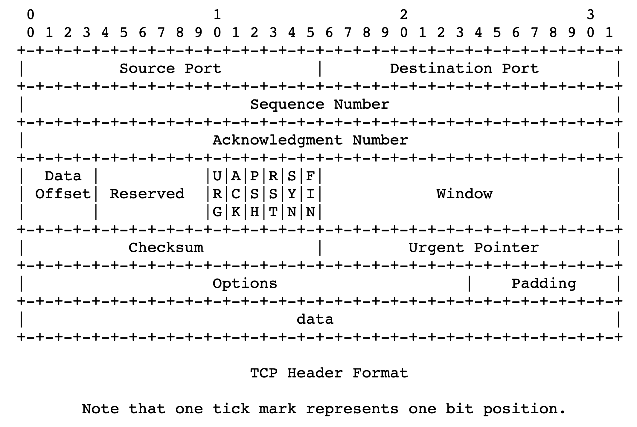
TCP headers

Slide 10
Sizing the receiver socket buffer
For each socket, there is a default size for the memory allocated to the receiving socket buffer
Unimaginatively called the receiver socket buffer size
If this number is too small, sender can’t keep too many packets in flight ➔ lower throughput
If the number is too large, consumes too much memory
How big should the receiver socket buffer be?

Slide 11
Sizing the receiver socket buffer
Sender
Receiver
Assume that, on average, receiver can read data as fast as sender sends
Further, suppose data is received in order
Receiver still needs to buffer data: why?
Sender can send data in bursts
Buffer needed is the size of the largest possible burst
What is this value?
1
2
3
4
5

Slide 12
Bandwidth-delay product
The maximum amount of in-flight data the sender can have
Bandwidth between the sender and receiver * round-trip time
Example:
Sender can send data at 1 Mbit/s
Round-trip time is 100 ms
Maximum amount of in-flight data == maximum burst == 100 Kbit
What if bandwidth was 100 Gbit/s and RTT was 500 ms?
Need a large socket buffer to capture the burst
Smaller socket buffer would degrade throughput to well below 100G

Slide 13
Congestion Control

Slide 14

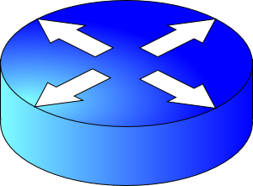

How should multiple endpoints share net?
It is difficult to know where the bottleneck link is
It is difficult to know how many other endpoints are using that link
Endpoints may join and leave at any time
Network paths may change over time, leading to different bottleneck links (with different link rates) over time

Slide 15
The approach that the Internet takes is to use a distributed algorithm to converge to an efficient and fair outcome.

Slide 16
The approach that the Internet takes is to use a distributed algorithm to converge to an efficient and fair outcome.
No one can centrally view or control all the endpoints and bottlenecks in the Internet.
Every endpoint must try to reach a globally good outcome by itself: i.e., in a distributed fashion.
This also puts a lot of trust in endpoints.

Slide 17
The approach that the Internet takes is to use a distributed algorithm to converge to an efficient and fair outcome.
If there is spare capacity in the bottleneck link, the endpoints should use it.

Slide 18
The approach that the Internet takes is to use a distributed algorithm to converge to an efficient and fair outcome.
If there are N endpoints sharing a bottleneck link, they should be able to get equitable shares of the link’s capacity.
For example: 1/N’th of the link capacity.

Slide 19
Flow and Congestion control
Flow control tries not to overwhelm the receiver
Congestion control tries not to overwhelm routers
Flow control manages the receiver’s buffers
Congestion control manages the bottleneck link’s capacity and the bottleneck router’s buffers

Slide 20
Feedback and Actions
The signals and knobs of congestion control

Slide 21
The approach that the Internet takes is to use a distributed algorithm to converge to an efficient and fair outcome.
So, how to achieve this?

Slide 22
Feedback from network offers clues…
Signals
Packets being dropped (ex, RTO fires)
Packets being delayed
Rate of incoming ACKs
Knobs
What can you change to “probe” the sending rate?
Suppose receiver buffer is unbounded:
Let’s call the amount of in-flight data per RTT the congestion window
Increase congestion window: e.g., by x or by a factor of x
Decrease congestion window: e.g., by x or by a factor of x
“Implicit” feedback signals
(more on explicit signals later)

Slide 23
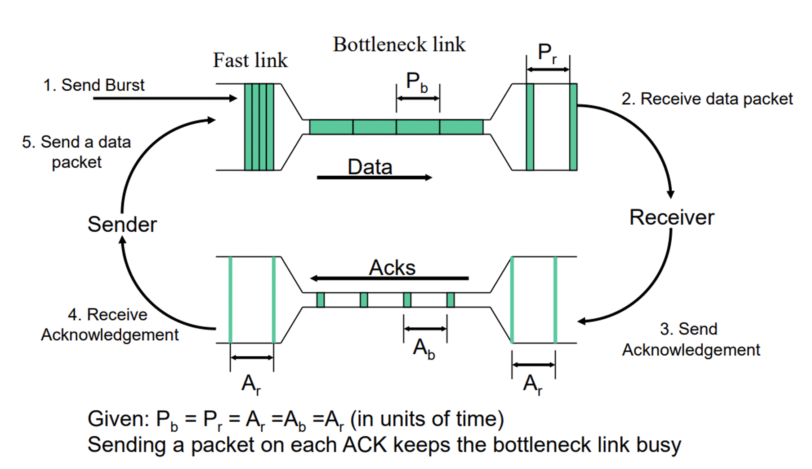
Steady state: Self clocking/ACK clocking

Slide 24
Time for an activity
Notes:
Make people guess a random number that you have in mind. See what strategies they come up with.

Slide 25
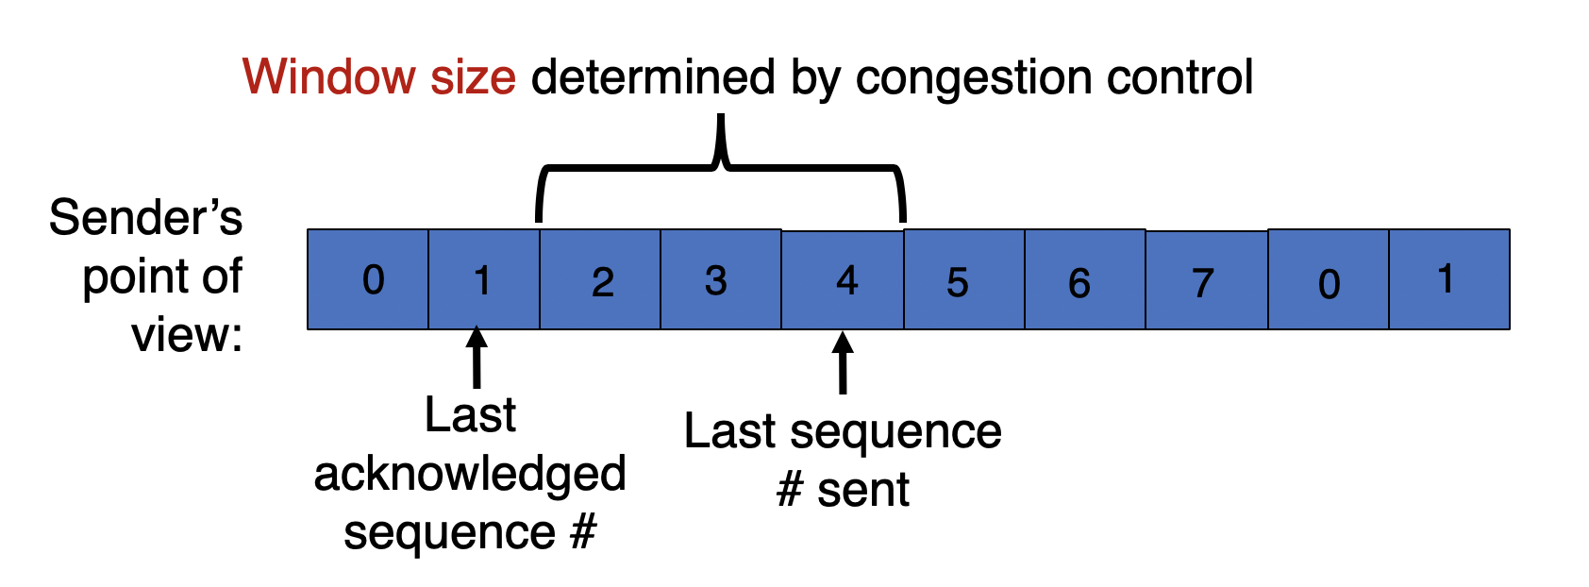
TCP congestion window
Congestion window (cwnd): an estimate of in-flight data needed to keep the pipe full and achieve self-clocking
Sending window = min(congestion window, receiver advertised window). Why min?
Overwhelm neither the receiver nor network routers
Use sliding window concept
Window size is adjusted by congestion control

Slide 26
TCP slow start
Host A
Host B
When connection begins, increase rate exponentially until first loss event:
initially cwnd = 1 MSS
double cwnd every RTT
done by incrementing cwnd for every ACK received
Initial rate is slow but ramps up exponentially fast
On loss, restart from cwnd := 1 MSS
Is this good enough?
one segment
RTT
two segments
four segments
time

