Slide 1

The Network Layer: Router Design, Forwarding
CS 352, Lecture 13, Spring 2020
http://www.cs.rutgers.edu/~sn624/352
Srinivas Narayana

Slide 2
Course announcements
Project 1 grades available
24/7 grading policy: re-grading considered until 10 PM Sunday 29th
TAs have provided feedback on Sakai. Contact TAs for more details
Lecture and recitation logistics:
You will have received WebEx training invitations on Piazza
Use a wired connection if possible
You can hear me better in a quiet environment
Use the chat or Q&A box to ask questions any time
Use raise hand feature during time allotted for verbal questions
Answer WebEx polls throughout the lecture!

Slide 3


Where we are: The network layer
Application
HTTPS
FTP
HTTP
SMTP
DNS
Transport
TCP
UDP
Network
IP
Host-to-Net
X.25
…
802.11
ATM
The network layer exists on every endpoint and router.

Slide 4
Review of concepts
Forwarding and routing
Data plane and control plane
Control plane can be distributed (this course) or centralized (won’t discuss)
Network-layer addresses (IP addresses)
Primary function: identifiers for routing

Slide 5
Poll #1
An IP address corresponds to:
(1) the endpoint
(2) the application
(3) the point of attachment of the endpoint to the network
(4) all of the above
Please use the WebEx poll feature to answer

Slide 6
Review of concepts
Forwarding and routing
Data plane and control plane
Control plane can be distributed (this course) or centralized (won’t discuss)
Network-layer addresses (IP addresses): identifiers for routing
Classful addressing: classes A, B, C, multicast, reserved
Distinguished by first few bits
Different # bits allotted to network address and host address
Classless addressing (CIDR):
Freely change size of network (host) address
Allocate a subset of available addresses using a subnet
Internet routing scales through hierarchy
IP subnetworks are the zip codes of the Internet

Slide 7
Poll #2
Given the IP address and subnet below, what is the value of X?
(1) 11
(2) 23
(3) 32
(4) none of the above
subnet
part
host
part
11001000 00010111 00010000 00000000
200.23.16.0/X

Slide 8
Poll #3
How many hosts can this subnetwork support?
(1) 2⁹
(2) 2²³
(3) 2³²
(4) none of the above
subnet
part
host
part
11001000 00010111 00010000 00000000
200.23.16.0/X

Slide 9
What’s inside a router?

Slide 10
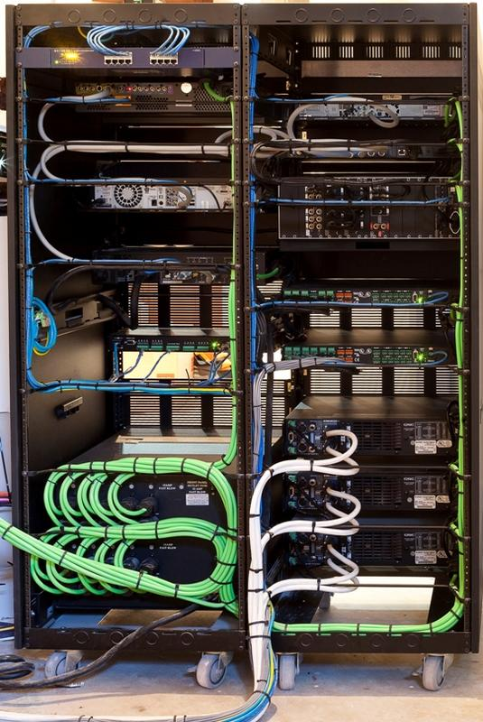
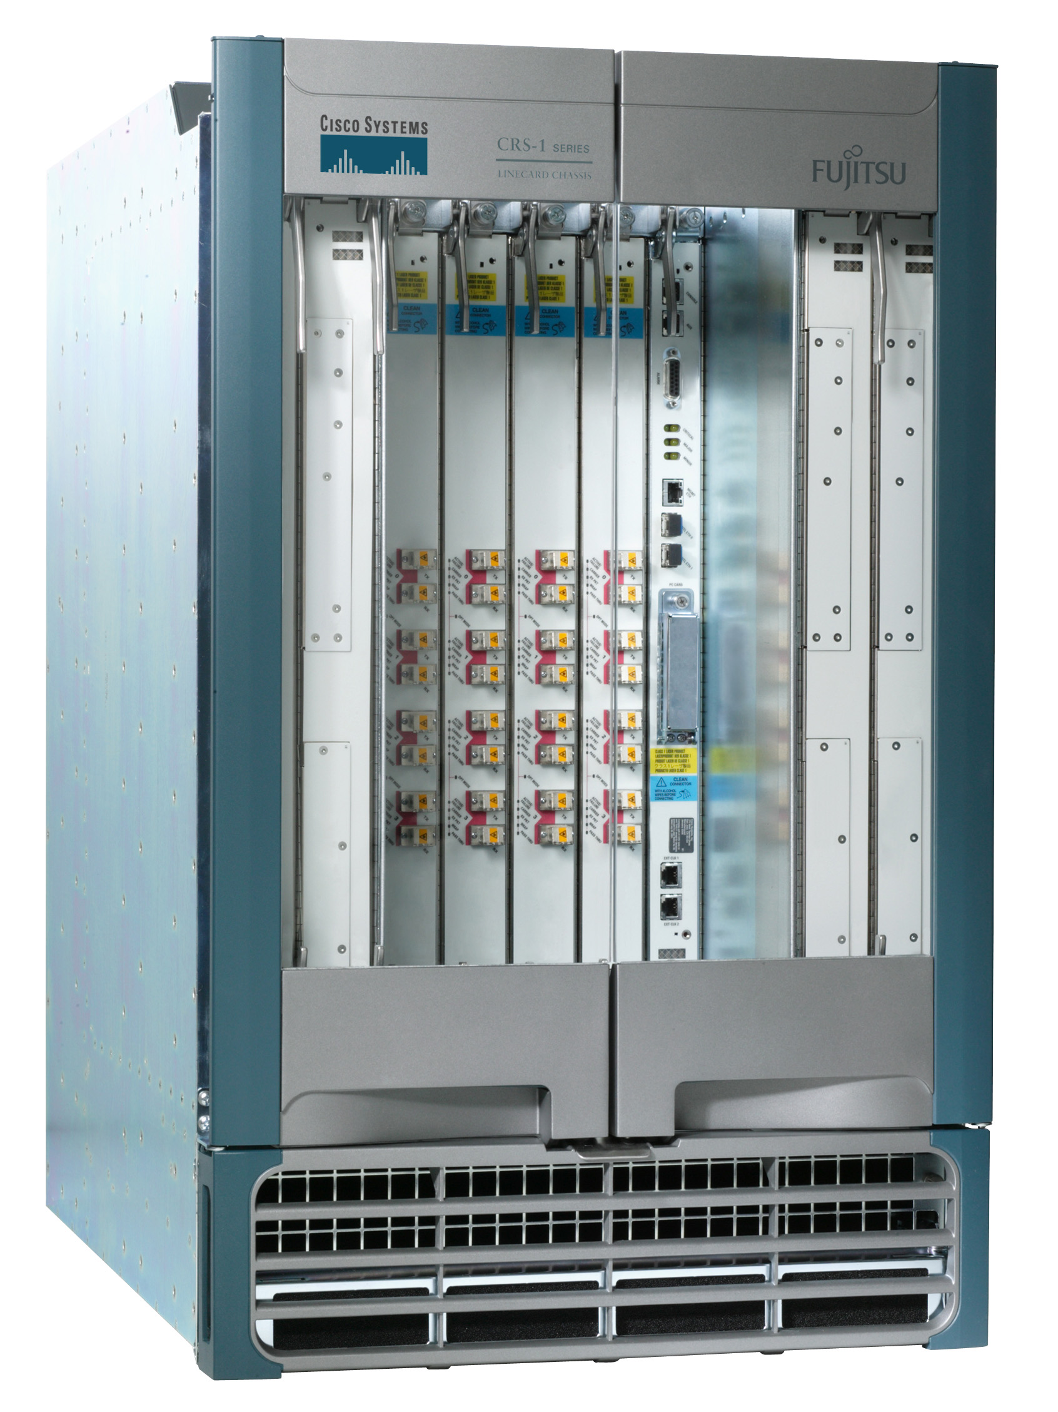
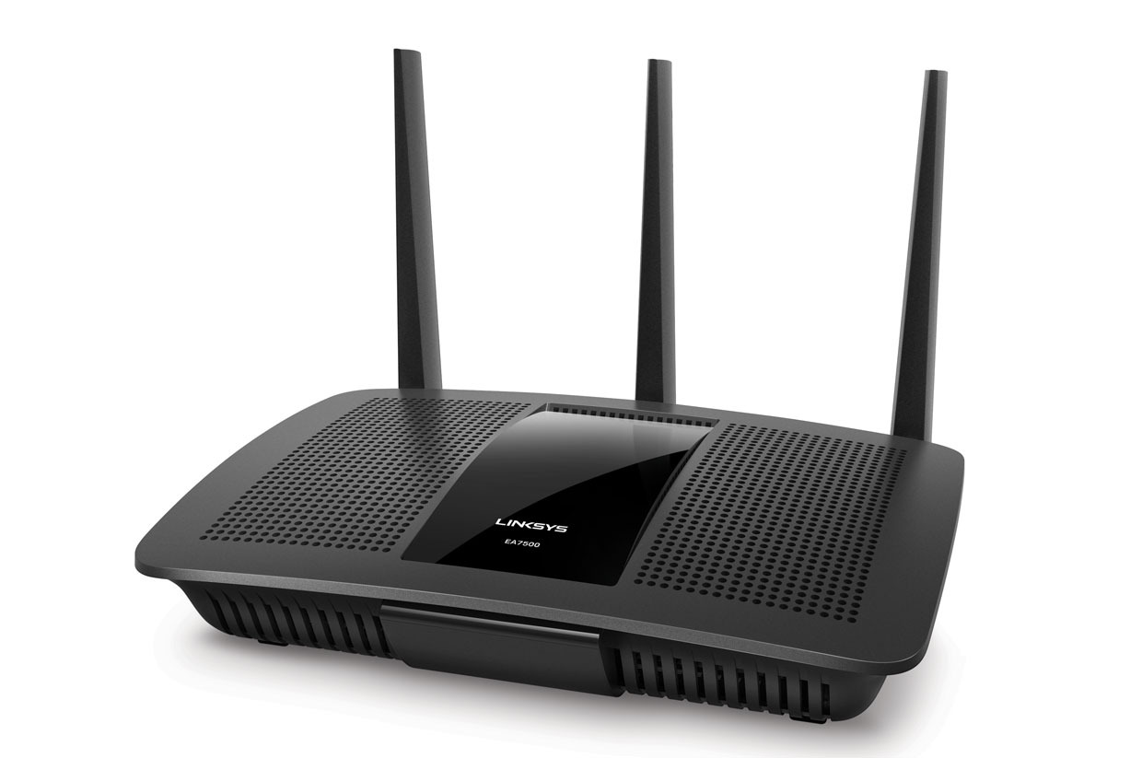

What do routers look like?
Access routers
Core router
Data center top-of-rack switch

Slide 11

Basic components: Control & Data Planes
Traditionally:
Individual routing algorithm components in each and every router interact in the control plane
(Distributed control plane)
Control plane
per route-change processing
(~ a few seconds)
Routing
Algorithm
control
plane
data
plane
Data plane
per-packet processing
(~ tens of nanoseconds)
0111
1
3
2
values in arriving
packet header

Slide 12
Router architecture overview
route
processor
Control plane
Data plane
high-speed
switching
fabric
router input ports
router output ports

Slide 13
Input port functions
lookup,
forwarding
queueing
line
termination
link
layer
protocol
(receive)
switch
fabric
physical layer:
bit-level reception
Switching:
using header field values, lookup output port using forwarding table in input port memory
goal: complete input port processing at line speed (i.e., speed of the interface, say 100 Mbit/s)
queueing: if datagrams arrive faster than they can be sent via the switch fabric to the output port
data link layer:
e.g., Ethernet
(We’ll see this later in the course)

Slide 14
Destination-based Forwarding in the Internet
Packet
payload
header
Router
Destination Address
Routing Lookup Data Structure
Outgoing Port
Forwarding Table
Dest-network
Port
65.0.0.0/8
3
128.9.0.0/16
1
149.12.0.0/19
7

Slide 15
Forwarding in the Internet is based on the destination IP address on packet.
There are exceptions. But Internet forwarding is mostly:
independent of the source, e.g., legitimate vs. malicious source
independent of the type of traffic, e.g., Netflix vs. web

Slide 16
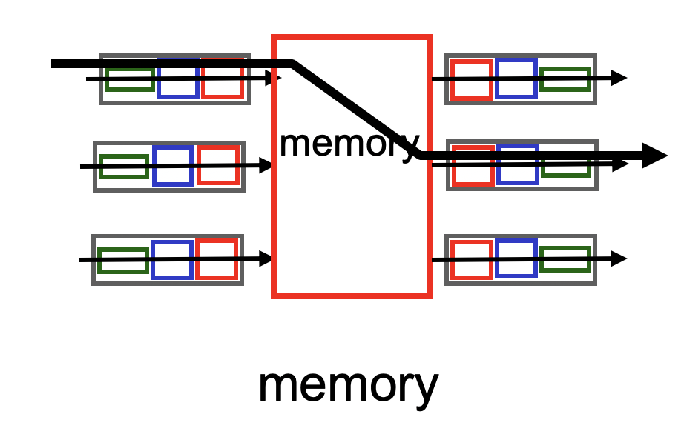
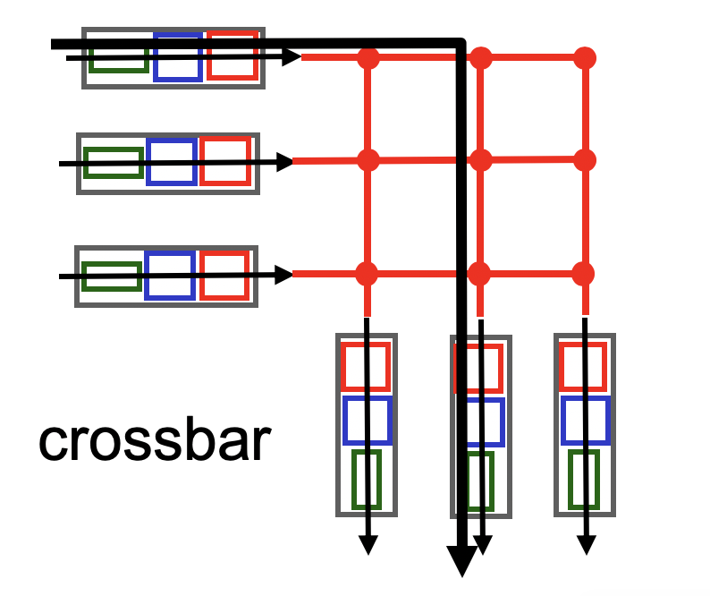
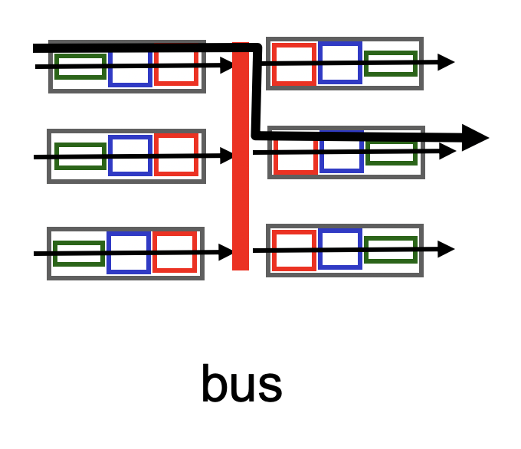
Three types of switching fabrics

Slide 17
Output Ports
datagram
buffer
queueing
switch
fabric
link
layer
protocol
(send)
line
termination
Buffering when datagrams arrive from fabric faster than the output port rate
If buffers filled up, packets are dropped!
Buffer management policy decides which pkts to keep and drop
Scheduling discipline chooses among queued datagrams for transmission
Who gets priority is chosen by the scheduler

Slide 18
Poll #4
Suppose two packets arrive at a router input port. Packet 1 has (src, dst) IP address == (X, Y). Packet 2 has (src, dst) IP address == (Z, Y). Then:
(1) The two packets are unlikely to be forwarded out of the same output port
(2) The two packets are highly likely to be forwarded out of the same port
(3) Not sure

Slide 19
Poll #5
A packet is waiting to be transmitted at a buffer on the router output port. Who decides when the packet will be transmitted?
(1) buffer manager
(2) Packet scheduler
(3) Forwarding table
(4) Line termination

Slide 20
Prefixes and IP lookup

Slide 21
Example Forwarding Table
Destination IP Prefix | Outgoing Port
65.0.0.0/8 | 3
128.9.0.0/16 | 1
65.0.0.128/25 | 4
142.12.0.0/19 | 7
Prefix length
IP prefix: 0-32 bits
Longest prefix match
142.12.0.0/19
128.9.0.0/16
65.0.0.0/8
0
2²⁴
128.9.16.14
2³²-1
65.0.0.0
65.255.255.255

Slide 22
Prefixes can Overlap
Longest matching prefix
128.9.176.0/24
128.9.16.0/24
65.0.0.0/8
142.12.0.0/19
128.9.0.0/16
0
128.9.16.14
2³²-1
Routing lookup: Find the longest matching prefix (the most specific route) among all prefixes that match the destination address.

Slide 23
Reducing Routing Table Size
Without CIDR:
200.71.0.0
200.71.1.0
200.71.2.0
…..
200.71.255.0
200.71.0.0
200.71.1.0
200.71.2.0
…..
200.71.255.0
service
provider
Routing
table
With CIDR:
200.71.0.0
200.71.1.0
200.71.2.0
…..
200.71.255.0
service
provider
200.71.0.0/16
Routing
table

Slide 24
Hierarchical addressing: Route aggregation
Efficient advertisement of routing information!
Organization 0
200.23.16.0/23
Organization 1
200.23.18.0/23
“Send me anything
with addresses
beginning
200.23.16.0/20”
Organization 2
200.23.20.0/23
.
Fly-By-Night-ISP
.
.
.
.
Internet
Organization 7
.
200.23.30.0/23
ISPs-R-Us
“Send me anything
with addresses
beginning
199.31.0.0/16”

Slide 25
LPM: Announcing more specific routes
ISPs-R-Us has a more specific route to Organization 1
Longest prefix match will be used to route IP packets
Organization 0
200.23.16.0/23
“Send me anything
with addresses
beginning
200.23.16.0/20”
Organization 2
200.23.20.0/23
.
Fly-By-Night-ISP
.
.
.
.
Internet
Organization 7
.
200.23.30.0/23
ISPs-R-Us
“Send me anything
with addresses
beginning 199.31.0.0/16
or 200.23.18.0/23”
Organization 1
200.23.18.0/23

Slide 26
Poll #6
If the destination IP address of a packet matches three forwarding rules 128.0.0.0/16, 128.0.0.0/20, 128.0.0.0/24, which rule will the router use?
(1) 128.0.0.0/16
(2) 128.0.0.0/20
(3) 128.0.0.0/24
(4) None of the above
(1) 128.0.0.0/16

Slide 27
Poll #7
If an ISP owns two prefixes 128.0.0.0/16 and 128.1.0.0/16, what prefix can it legitimately advertise to the rest of the Internet?
(1) 128.0.0.0/8
(2) 128.0.0.0/15
(3) 128.0.0.0/14
(4) None of the above

