Slide 1
Internet Players
Users of applications
Everyone (mom and pop, kids) to get something done
Network Designers
Protocol design and implementation
Performance, cost, scale
Internet Service Providers
Administrators and ISPs (AT&T)
Management, revenue, deployment
Market/businesses on the Internet
Consumer to consumer (ebay), Business to consumer (amazon, netflix), Business to business (alibaba, importers.com,21food.com), Consumer to business (hotjobs, monster), Govt to C, Govt to B, etc.

Slide 2
Internet service providers (ISPs)
Local ISPs: Tier 3 (cablevision)
Regional ISPs: Tier2 (internap)
Global ISPs: Tier 1 (Verizon, Sprint, AT&T, level 3, century link, Deutsche Telekom, NTT) provide access to the entire internet; connect ISP to other ISPs
Peering ISPs
Have a mutual relationship about forwarding traffic of each others customers (no $ involved)
Transit ISPs
Provides access to all reachable customers ($$ involved)

Slide 3
Core Networks: ISP Tiers
local
ISP
Tier 3
ISP
local
ISP
local
ISP
local
ISP
Local and tier- 3 ISPs are customers of
higher tier ISPs
connecting them to rest of Internet
Tier-2 ISP
Tier-2 ISP
Tier 1 ISP
NAP
Tier 1 ISP
Tier 1 ISP
Tier-2 ISP
Tier-2 ISP
Tier-2 ISP
local
ISP
local
ISP
local
ISP
local
ISP

Slide 4
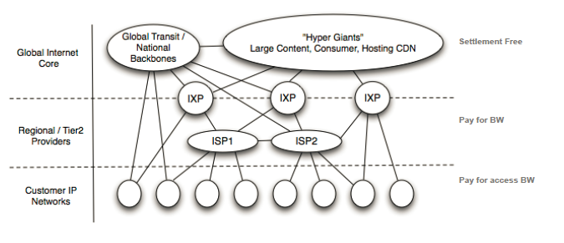
ISPs connected via Exchanges
Flatter Internet
Business models among, content provider, transit providers, and customers
Net Neutrality
Internet Inter-domain traffic By Labovitz et.al, SIGCOMM 2010

Slide 5
Types of Networks in an Internet
Local area networks (LAN)
Privately owned, within building
High speed, broadcast, Ethernet
2 to 100 Mbps
Wide area networks (WAN)
Spans a large area
Point-to-point, high speed fiber lines
Long delays but very high speed links
Several Gbps

Slide 6
Types of Networks (cont’d)
Wireless networks
Hosts connected by radio or infrared links
Local area and wide area
Satellite networks

Slide 7
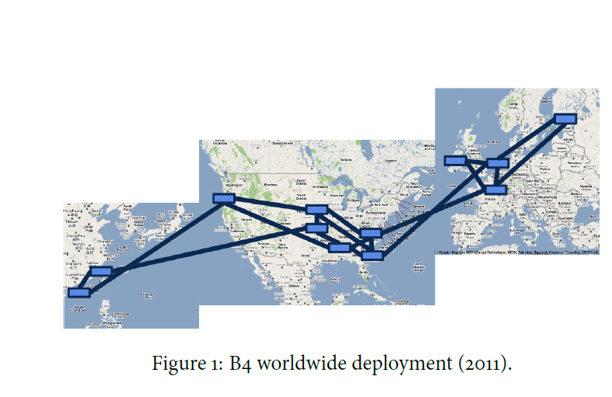
Google WAN

Slide 8
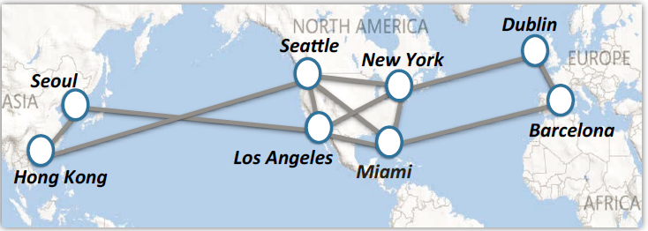
Microsoft WAN

Slide 9
Historical perspective
Late 1960’s: ARPAnet (4 nodes)
Early 1970’s: Aloha net, ethernet, multiple access problem
Mid-to-late 1970’s: TCP/IP, 4.2BSD
1980’s to early 1990’s: early internet growth, e-mail & file transfer dominant, NSFNET
Mid 1990s: NSFnet handed over to commercial service providers, WWW explodes
Late 90s, business models using the internet; dot-com boom and bust
Early to mid 2000s, Web 2.0, Facebook, google, Wikipedia
Future: “Embedded networks”, 5 to 10 billion devices waiting to be networked, media convergence, ubiquitous RFID tags

