Slide 1

Measurement, App Layer
Lecture 3
http://www.cs.rutgers.edu/~sn624/352-F24
Srinivas Narayana

Slide 2
Review
Switching: Circuit, Message, Packet
Layering: Modularity
Application: useful user-level functions
User space
Transport: provide guarantees to apps
Kernel space
Network: best-effort global pkt delivery
Functionality is implemented in protocols
Link: best-effort local pkt delivery

Slide 3
Protocols: The “rules” of networking
Protocols consist of two things
Message format
structure of messages exchanged with an endpoint
Actions
operations upon receiving, or not receiving, messages
Example of a Zoom conversation:
Message format: English words and sentences
Actions: when a word is heard, say “yes”; when nothing is heard for more than 3 seconds, say “can you hear me?”

Slide 4

The protocols of the Internet
Standardized by the Internet Engineering Task Force (IETF)
through documents called RFCs (“Request For Comments”)
Layering of protocols
HTTP
FTP
NV
TFTP
HTTPS
FTP
HTTP
SIP
RTSP
TCP
UDP
TCP
UDP
IP
IP
Ether
ATM
…
WiFi
X.25
…
802.11
ATM

Slide 5
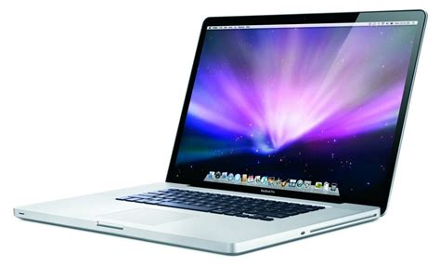
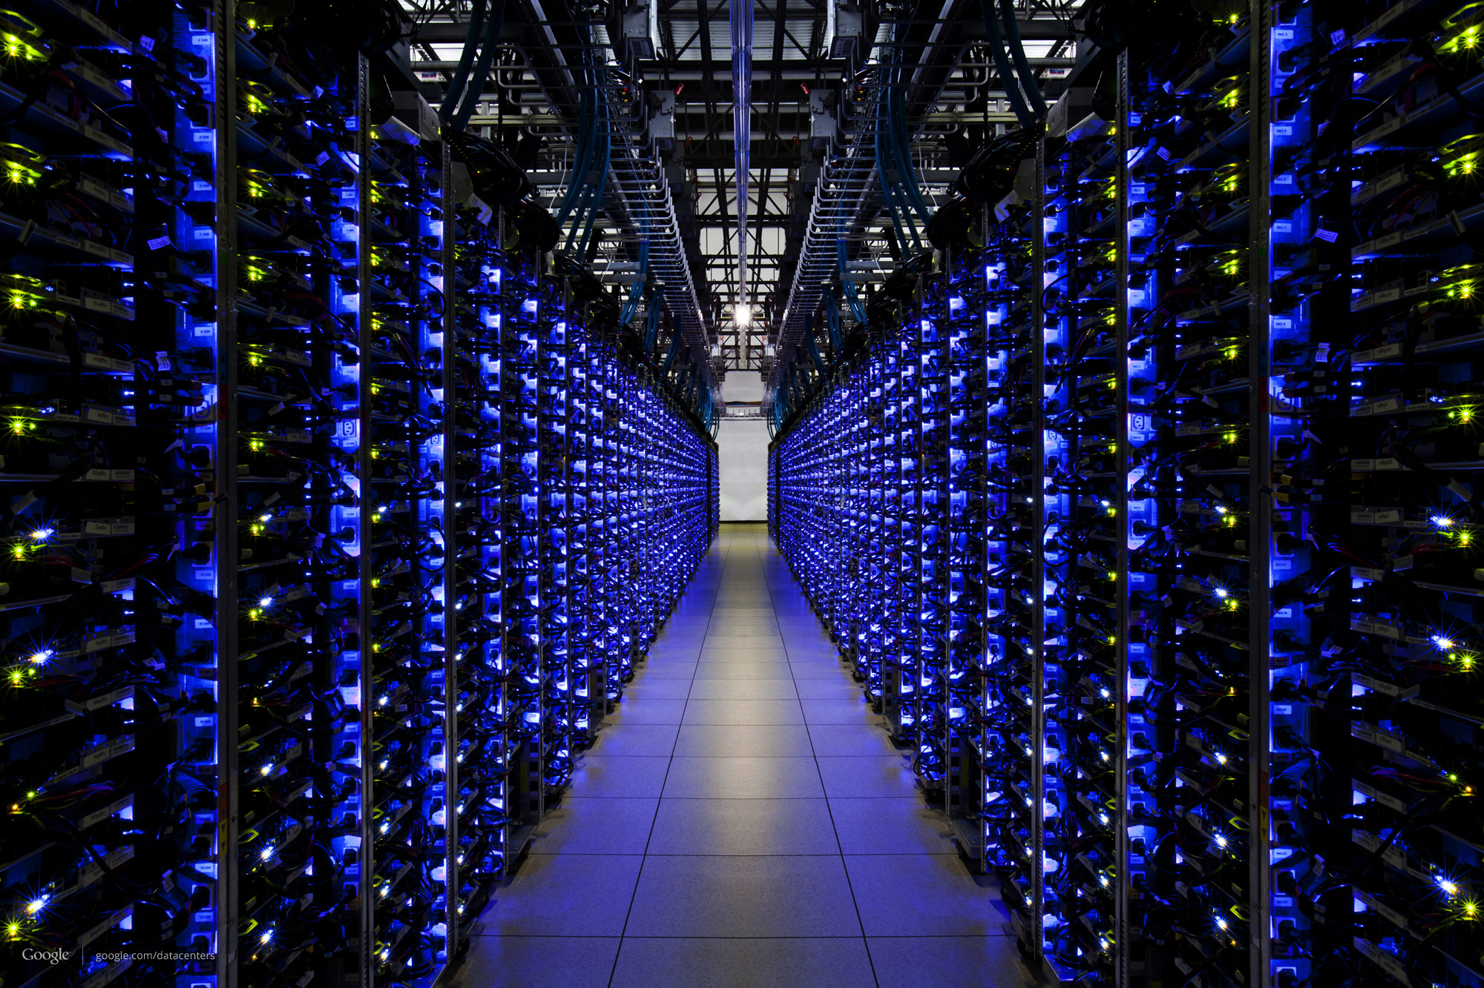
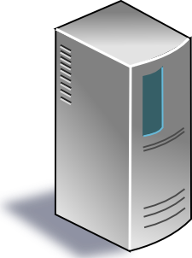

The Internet
Applications
Applications
Packet starts as an
app message
Transport
Packet takes on headers at each layer
Transport
Network
Network
Link layer
Link layer
The Internet

Slide 6

Applications
Applications
Transport
Transport
Network
Network
Network
Network
Link layer
Link layer
Link layer
Link layer

Slide 7
Applications
Applications
Routers have network and link layers too!
Transport
Transport
Network
Network
Network
Network
Link layer
Link layer
Link layer
Link layer

Slide 8
Layering
Communication over the Internet is a complex problem.
Layering simplifies understanding, testing, maintaining
Easy to improve or replace protocol at one layer without affecting others

Slide 9

This course has layers
Application
HTTPS
FTP
HTTP
SIP
RTSP
Transport
TCP
UDP
Network
IP
Host-to-Net
X.25
…
802.11
ATM

Slide 10
Measuring the Internet
Speed, by any other name

Slide 11
What exactly do we mean by speed?
A packet consists of many bits, including header and data
Packet size: length of the packet (bits or bytes) incl. header and data
Bandwidth: For a single link, amount of data it can transmit per unit time (bits/second or Bytes/second or packets/second)
Total packet delay: time from the first bit@sender to the last bit@receiver

Slide 12
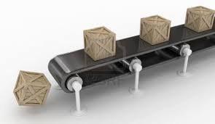
Bandwidth and delay are related but distinct
Propagation delay
Bandwidth
Total packet delay = time for a box to travel the length of the belt
Bandwidth = the number of boxes put on the belt per minute (“rate”)

Slide 13
High
Bandwidth
GPU—GPU link in an AI compute cluster
Trans-continental optic fiber
Low delay
High delay
Bluetooth link
Satellite link
(e.g., on a foggy day)
Low
Bandwidth

Slide 14
Total Packet Delay has a few pieces
Propagation delay: Time needed to move one bit across (second)
Imposed by the communication medium; depends on the link “length”
Transmission delay: Time from first bit@sender to last bit@sender
Determined by link bandwidth and packet size
Packet size / link bandwidth
Queueing delay: Time that a packet waits for transmission
Determined by contention for the link
Total packet delay = propagation delay + queueing delay + transmission delay for a single packet

Slide 15

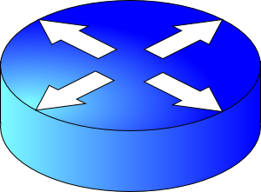
Visualizing the components of delay
Transmission delay at the first link
Propagation delay of first link
Queueing at the router
Increasing time
Transmission delay at the second link
Propagation delay of second link

Slide 16
Bandwidth and delay demo
Throughput (related to bandwidth)
iperf –s # at the destination
iperf –c <destination> # at the source,
e.g., iperf –c localhost
(total) delay
ping <destination>
e.g., ping google.com
(you can try it!)

Slide 17
Application Layer

Slide 18









App-layer communication
Internet applications reside on multiple endpoints
Need addresses to identify the communicating endpoints
E.g., Telephone network: xxx-yyy-zzzz
Internet: Internet Protocol (IP) addresses
IPv4 (32 bits) 128.6.24.78
IPv6 (128 bits) 2001:4000:A000:C000:6000:B001:412A:8000
Which app on each endpoint? Port number
IP addr
IP addr
Internet
port
port

Slide 19
How are addresses used?
Socket: abstraction (API) of the Internet for applications
IP_{A}
IP_{B}
Internet
port_{B}
port_{A}
App process
App process
User space
User space
Socket
Socket
Kernel space
Kernel space
Operating system’s network stack
Operating system’s network stack
Internet
App-layer connection is a 4-tuple: (IP_{A}, port_{A}, IP_{B}, port_{B})

Slide 20
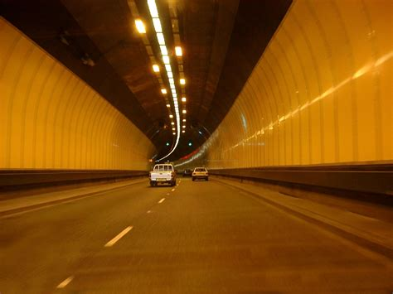



Socket system calls
Process A
(client)
connect(
IP_{B}, port_{B})
send()
Process B
(server)
bind(IPaddr_{B}, port_{B})
listen()
accept()
recv()
process
process
IP_{B} + port_{B}
socket
socket
IP_{A} + port_{A}

Slide 21
Seeing app-layer connections
netstat
ss

Slide 22
Common Architectures of Applications

Slide 23
Client-server architecture
client
Server:
Always-on endpoint
Provides a “service” to the world
Typically, a permanent IP address
Compute clusters to scale to many users
Clients:
A “customer” of the server
May be intermittently connected
May have dynamic IP addresses
Typically, do not communicate directly with other clients
The web and most mobile apps use a client-server architecture
server
client

Slide 24
Peer-to-peer (P2P) architecture
peer
Peers:
Intermittently connected hosts
Directly talking to each other
Little to no reliance on always-up servers
Examples: BitTorrent
Today, many applications use a hybrid model
Example: (webRTC) Google meet, Facebook messenger, …
peer

Slide 25
Going forward: A few app-layer protocols
Domain Name System
The web
Streaming video

Slide 26
Domain Name System

Slide 27
You have my name. Can you lookup my address?

Slide 28
Domain Name System (DNS)
Problem: We need an easier way to remember IP addresses
Average brain can easily remember 7 digits for a few names
On average, IP addresses have 12 digits
Solution:
Use alphanumeric names to refer to hosts.
Called host names or domain names (e.g.: cs.rutgers.edu)
We need a directory (address book)
A service to map alphanumeric host names to binary IP addresses
We call this process Address Resolution

Slide 29

Types of Directories
Directories map a name to an address
Simplistic designs
Central directory
Ask everyone (e.g., flooding)
Tell everyone (e.g., push to a file like /etc/hosts)
Scalable distributed designs
Hierarchical namespace (e.g., Domain Name System (DNS))
Flat name space (e.g., Distributed Hash Table)

Slide 30
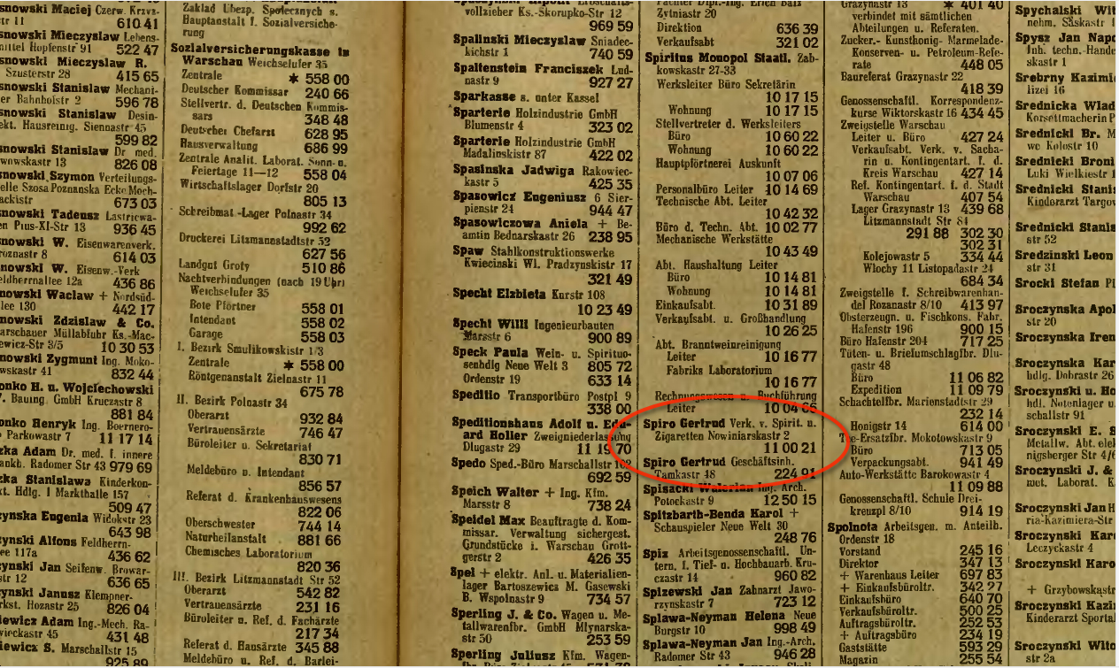
Simple DNS
What if every endpoint has a local directory?
/etc/hosts.txt
How things worked in the early days of the Internet!
What if endpoints changed addresses? How do you keep this up to date?

Slide 31
Simple DNS
DOMAIN NAME | IP ADDRESS
spotify.com | 98.138.253.109
cs.rutgers.edu | 128.6.4.2
www.google.com | 74.125.225.243
www.princeton.edu | 128.112.132.86
<Client IP, CPort, DNS server IP, 53>
QUERY cs.rutgers.edu
<DNS server, 53, Client IP, Cport>
RESPONSE 128.6.4.2
Key idea: Implement a server that looks up a table.
Will this scale?
Every new (changed) host needs to be entered in this table
Performance: can the server serve billions of Internet users
Failure: what if the server or the database crashes?
How to secure this server?

