Slide 1

CS 352 Web (part 2); E-Mail
Lecture 6
http://www.cs.rutgers.edu/~sn624/352-F22
Srinivas Narayana

Slide 2
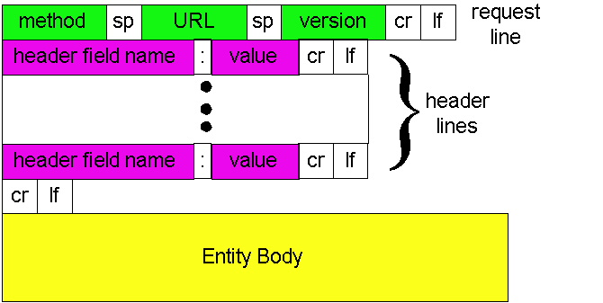
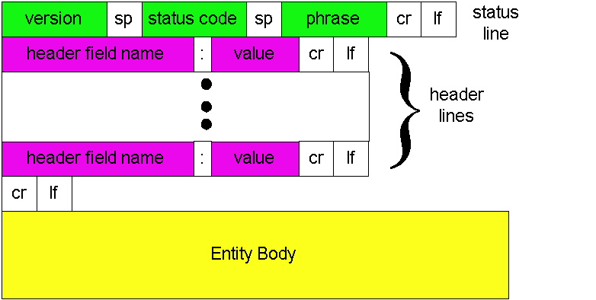
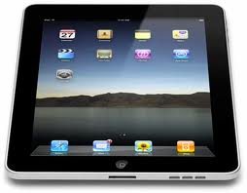
Review of concepts
Request
GET, POST, …
DNS is a distributed database
DNS Resource Records
Class, type, name, value, TTL
A, AAAA, MX, NS (SOA), CNAME
Response
200 OK, 301 Moved, etc.
HyperText Transfer Protocol (HTTP)
Client-Server Protocol
time
clientIP, clientPort, serverIP, 80
requests
responses

Slide 3
Remembering Users On the Web

Slide 4
HTTP: Remembering users
So far, HTTP mechanisms considered stateless
Each request processed independently at the server
The server maintains no memory about past client requests
However, state, i.e., memory, about the user at the server, is very useful!
User authentication (e.g., gmail)
Shopping carts (e.g., Amazon)
Video recommendations (e.g., Netflix)
Any user session state in general

Slide 5
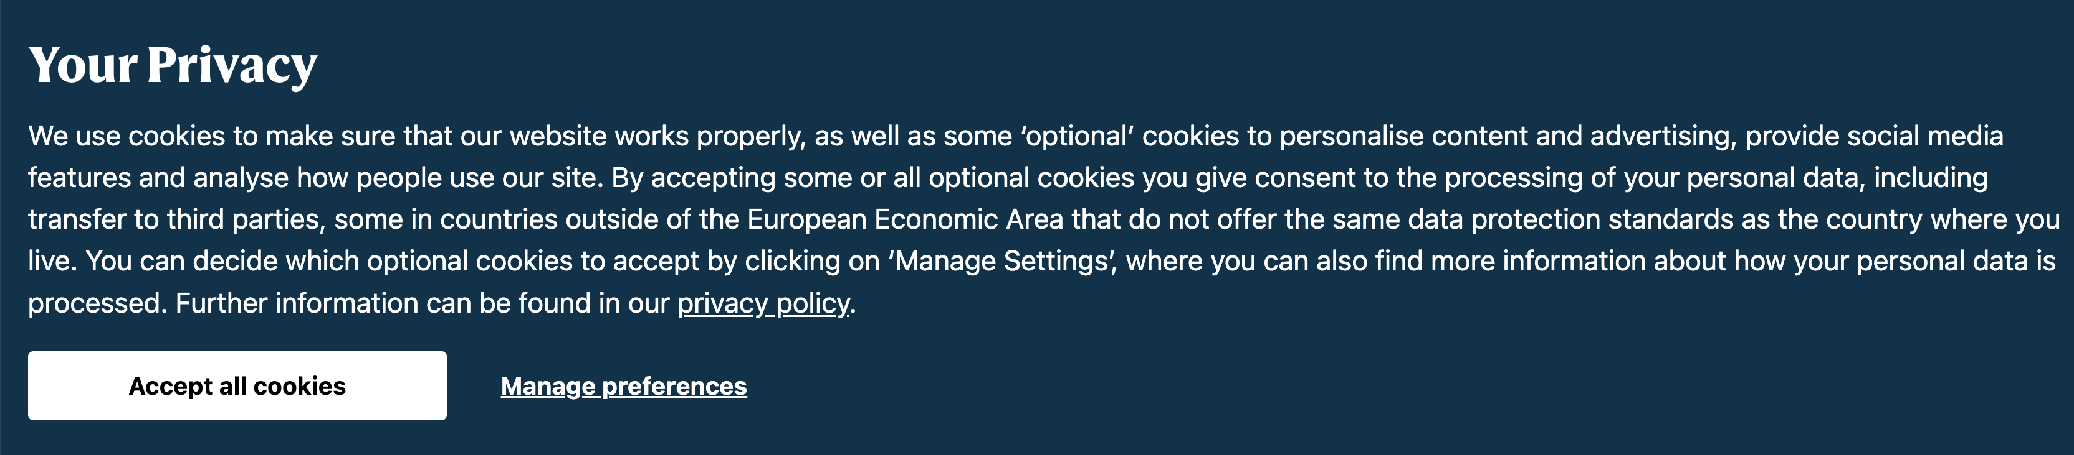
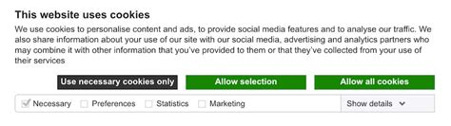
Familiar with these?

Slide 6
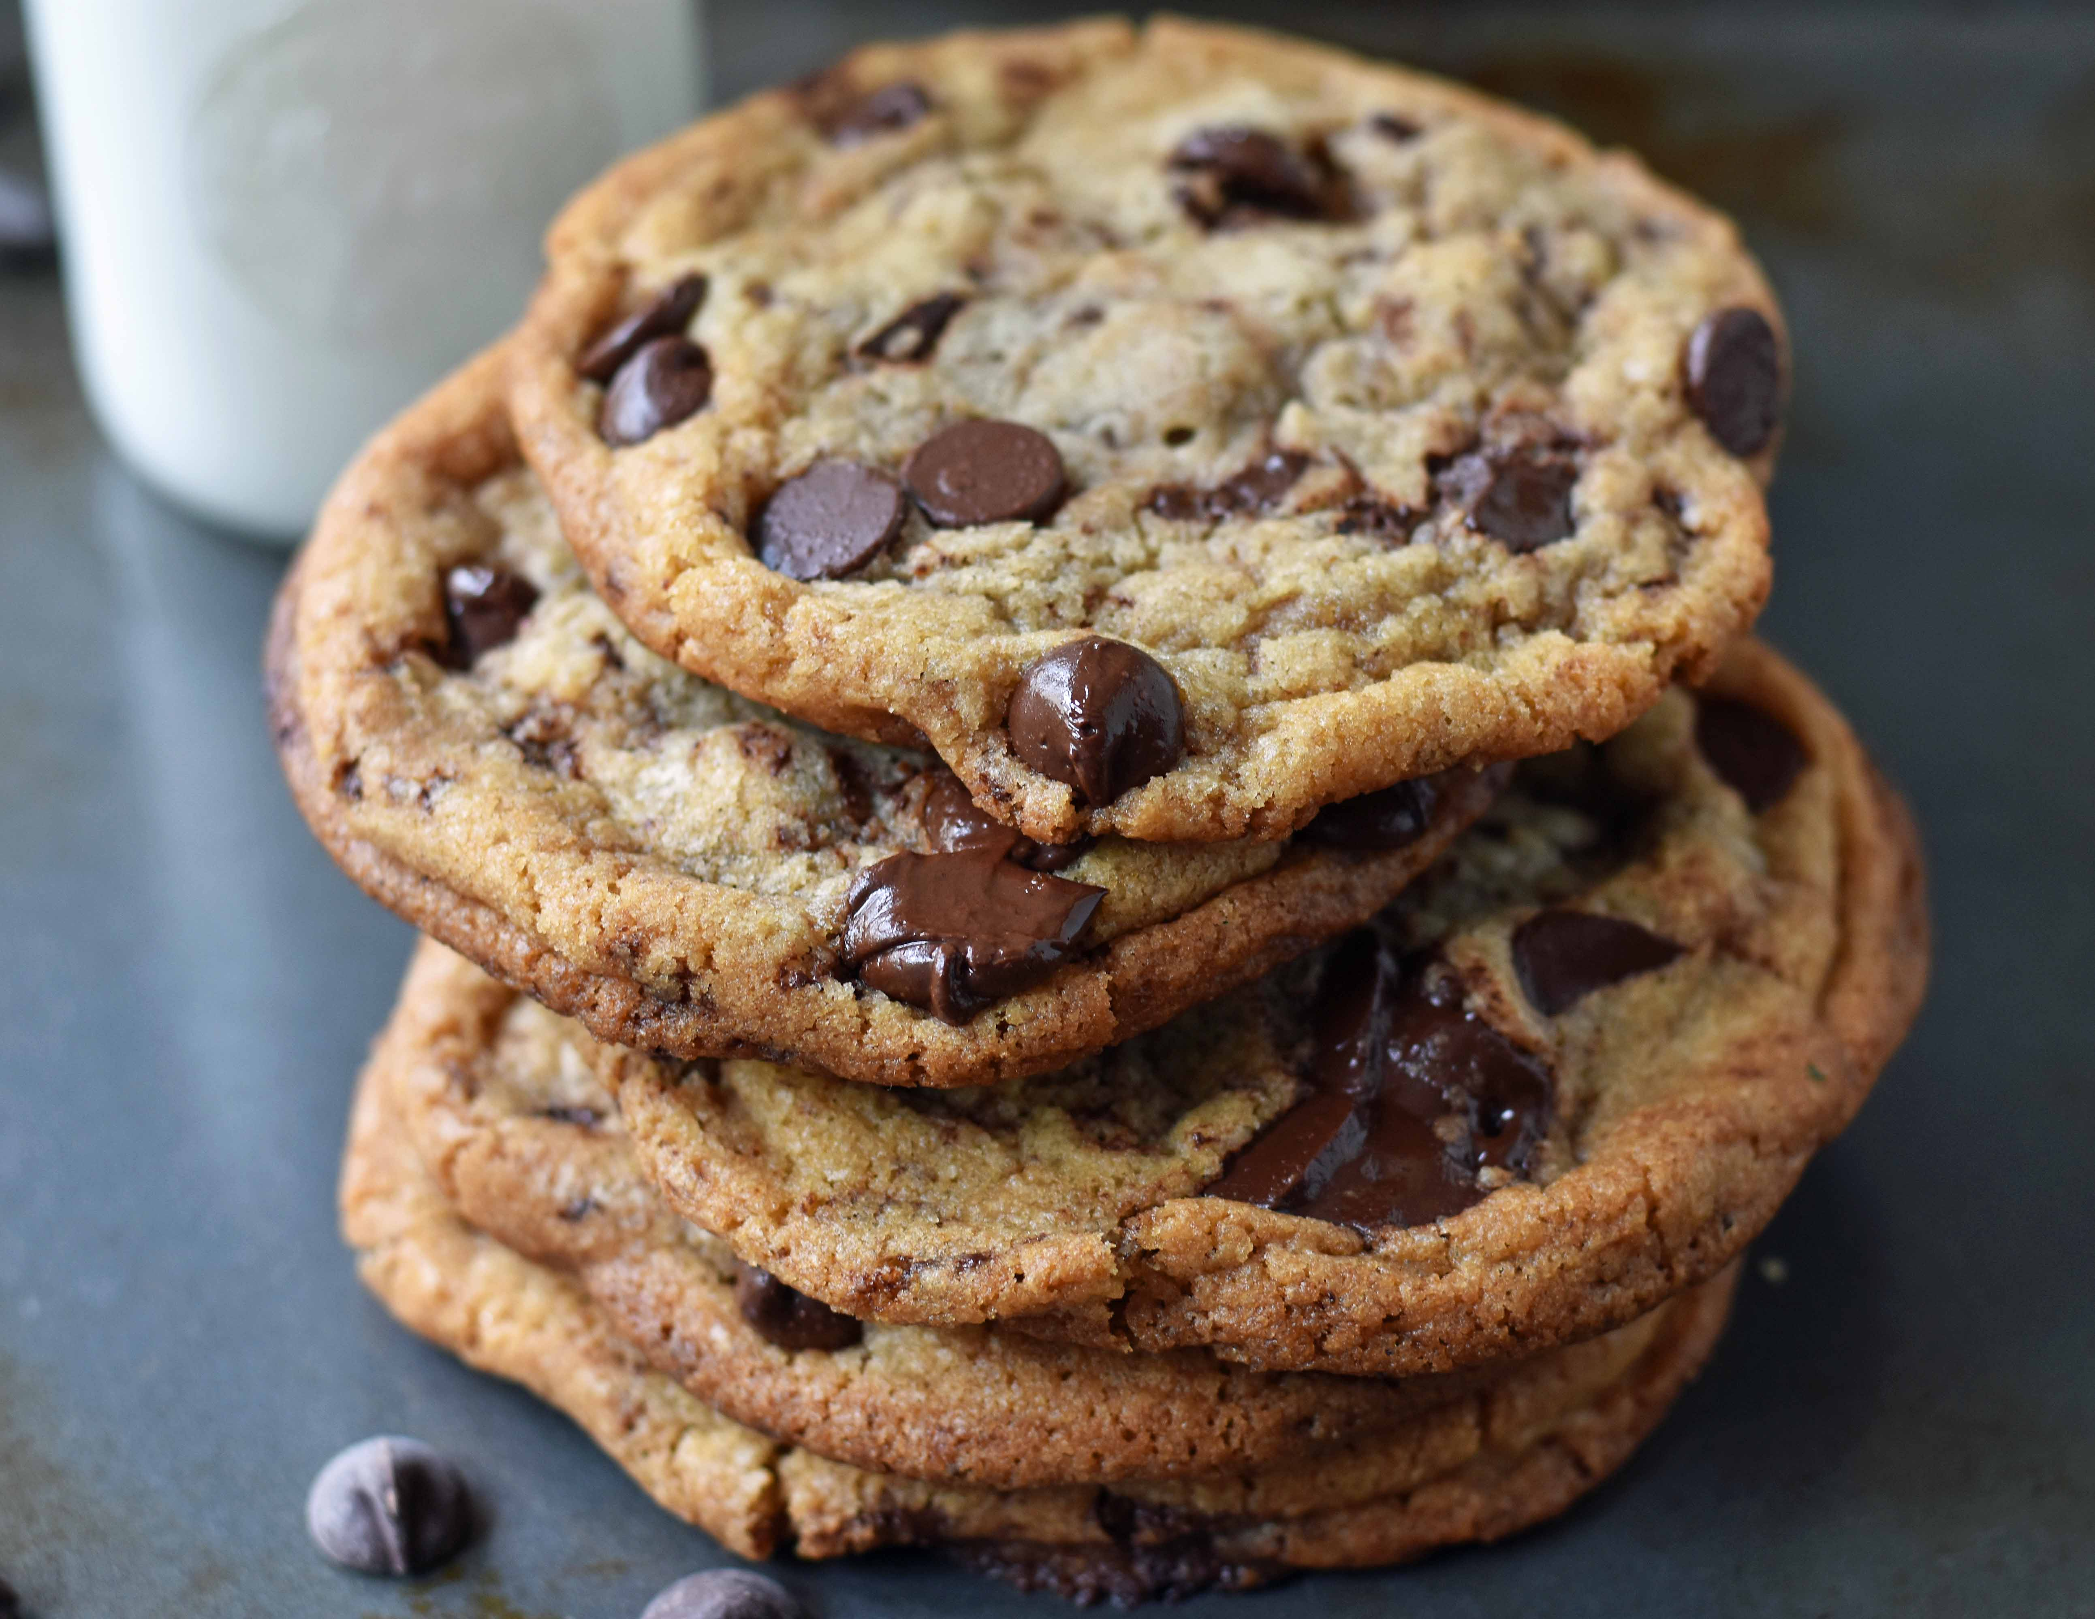
Cookies: Keeping user memory
client
server
Cookie is typically opaque to client.
Cookie file
http request msg + auth
server
creates ID
1678 for user
Netflix: 436
Amazon: 1678
http response +
Set-cookie: 1678
entry in backend
database
Cookie file
http request (no auth)
cookie: 1678
Netflix: 436
cookie-
specific
action
access
Amazon: 1678
Personalized http response
one week later:
access
Cookie file
http request (no auth)
cookie: 1678
cookie-
specific
action
Netflix: 436
Amazon: 1678
Personalized http response

Slide 7
How cookies work
Collaboration between client and server to track user state.
Four components:
cookie header line of HTTP response message
cookie header line in HTTP request message
cookie file kept on user endpoint, managed by user’s browser
back-end database maps cookie to user data at Web endpoint
Cookies come with an expiration date (yet another HTTP header!)

Slide 8
Cookies have many uses
The good: Awesome user-facing functionality
Shopping carts, auth, … very challenging or impossible without it
The bad: Unnecessary recording of your activities on the site
First-party cookies: performance statistics, user engagement, …
The ugly: Tracking your activities across the Internet
Third-party cookies (played by ad and tracking networks) to track your activities across the Internet.
Potentially personally identifiable information (PII)
Ad networks target users with ads, may sell this info
Scammers can target you too!

Slide 9
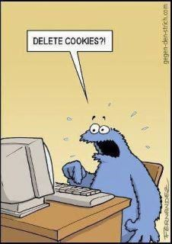
PSA: Cookies and Privacy
Disable and delete unnecessary cookies by default
Suggested privacy-conscious browsers, websites, tools:
DuckDuckGo (search)
Brave (browser)
AdBlock Plus (extension)
ToR (distract targeting)
… assuming it doesn’t break the functions of the site.
https://gdpr.eu/cookies/

Slide 10
Web Caching

Slide 11
Web caches
Web caches: Machines that remember web responses for a network
Why cache web responses?
Reduce response time for client requests
Reduce traffic on an institution’s access link

Slide 12

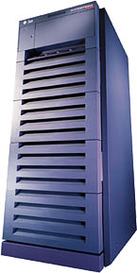
Web caching using a proxy server
You can configure a HTTP proxy on your laptop’s network settings.
If you do, your browser sends all HTTP requests to the proxy (cache).
Hit: cache returns object
Miss: obtain object from originating web server (origin server) and return to client
Also cache the object locally
Clients
Return cached object!
Web Server
(also called origin server in this context)
GET foo.html
GET foo.html
The Internet
Proxy Server
Store foo.html
on receiving response
Rutgers

Slide 13
Caching in the HTTP protocol
Cache/Client
server
Conditional GET guarantees cache content is up-to-date while still saves traffic and response time whenever possible
Date in the cache’s request is the last time the server provided in its response header Last-Modified
HTTP request msg
If-modified-since: <date>
object
not
modified
X-Cache: HIT
HTTP response
HTTP/1.0
304 Not Modified
HTTP request msg
If-modified-since: <date>
object
modified
HTTP response
HTTP/1.0 200 OK
Last-modified: <date>
DATA DATA DATA

Slide 14
Content Distribution Networks (CDNs)
A global network of web caches
Provisioned by ISPs and network operators
Or content providers, like Netflix, Google, etc.
Uses (overlaps with uses of web caching in general)
Reduce traffic on a network’s Internet connection, e.g., Rutgers
Improve response time for users: CDN nodes are closer to users than origin servers (servers holding original content)
Reduce bandwidth requirements on content provider
Reduce $$ to maintain origin servers

Slide 15
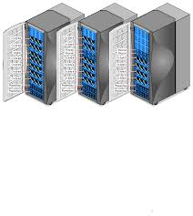
Without CDN
DOMAIN NAME | IP ADDRESS
www.yahoo.com | 98.138.253.109
cs.rutgers.edu | 128.6.4.2
www.google.com | 74.125.225.243
www.princeton.edu | 128.112.132.86
DNS
Clients distributed all over the world
Cluster of Rutgers CS origin servers (located in NJ, USA)
128.6.4.2
Problems:
Huge bandwidth requirements for Rutgers
Large propagation delays to reach users

Slide 16
Where the CDN comes in
Distribute content of the origin server over geographically distributed CDN servers
But how will users get to these CDN servers?
Use DNS!
DNS provides an additional layer of indirection
Instead of returning IP address, return another DNS server (NS record)
The second DNS server (run by the CDN) returns IP address to client
The CDN runs its own DNS servers (CDN name servers)
Custom logic to send users to the “closest” CDN web server

Slide 17
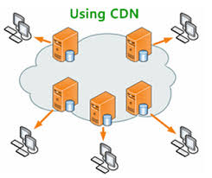
With CDN
DOMAIN NAME | IP ADDRESS
www.yahoo.com | 98.138.253.109
cs.rutgers.edu | 124.8.9.8 (NS record pointing to CDN name server)
www.google.com | 74.125.225.243
DNS reply
CDN Name Server (124.8.9.8)
NS record delegates the choice of IP address to the CDN name server.
Custom logic to map ONE domain name to one of many IP addresses!
DOMAIN NAME | IP ADDRESS
Cs.Rutgers.edu | 12.1.2.3
Cs.Rutgers.edu | 12.1.2.4
Cs.Rutgers.edu | 12.1.2.5
Cs.Rutgers.edu | 12.1.2.6
Popular CDNs:
CloudFlare
Akamai
Level3
…
12.1.2.3
CDN servers
12.1.2.4
12.1.2.6
12.1.2.5
128.6.4.2
Origin server
Most requests go to CDN servers (caches).
CDN servers may request object from origin
Few client requests go directly to origin server
Client

Slide 18
Seeing a CDN in action
dig web.mit.edu (or) dig +trace web.mit.edu
telnet web.mit.edu 80

Slide 19
Summary of HTTP
Request/response protocol
ASCII-based human-readable message structures
Enhanced stateful functionality using cookies
Improve performance using caching, and CDN
Simple, highly-customizable protocol
Just add headers
Protocol that forms of the basis of the web we enjoy today!

Slide 20
Simple Mail Transfer Protocol

Slide 21
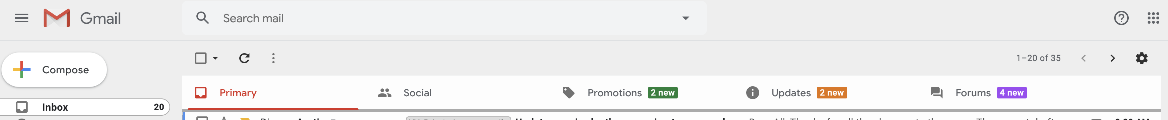
We’re all familiar with email. How does it work?

Slide 22
Electronic Mail
outgoing
message queue
user mailbox
Three major components:
User agents
a.k.a. “mail reader”
e.g., Applemail, Outlook
Web-based user agents (ex: gmail)
user
agent
mail
server
user
agent
SMTP
mail
server
user
agent
SMTP
SMTP
mail
server
user
agent
user
agent
user
agent

Slide 23
Electronic Mail: Mail servers
Mail Servers
Mailbox contains incoming messages for user
Message queue of outgoing (to be sent) mail messages
Sender’s mail server makes connection to Receiver’s mail server
IP address, port 25
SMTP protocol: client/server protocol
Used to send messages
Client: sending user agent or sending mail server
server: receiving mail server
user
agent
mail
server
user
agent
SMTP
mail
server
user
agent
SMTP
SMTP
mail
server
user
agent
user
agent
user
agent

Slide 24
Scenario: Alice sends message to Bob
1) Alice (alice@rutgers.edu) uses UA to compose message to bob@nyu.edu
2) Alice’s UA sends message to her mail server; message placed in outgoing message queue
3) Client side of SMTP opens TCP connection with Bob’s mail server
4) SMTP client sends Alice’s message over the TCP connection
5) Bob’s mail server places the message in Bob’s incoming mailbox
6) Sometime later, Bob invokes his user agent to read message
1
mail
server
mail
server
user
agent
user
agent
Alice
2
Bob
3
4
6
5
A set of durable files on the machine. Persisted on disk.
Rutgers mail server
NYU mail server

Slide 25
Observations on these exchanges
Mail servers are the “infrastructure” for email functionality
Receiving the email on behalf of Bob, should Bob’s machine be turned off
Retrying the delivery of the email to Bob on behalf of Alice, should Bob’s mail server be unavailable in the first attempt
The same machine can act as client or server based on context
Rutgers’s mail server is the server when Alice sends the mail
It is the client when it sends mail to Bob’s mail server
SMTP is push-based: info is pushed from client to server
Contrast to HTTP or DNS where info is pulled from the server

Slide 26
Sample SMTP interaction
telnet <mail-server> 25
HELO <sender-domain>
MAIL FROM: <name>@<sender-domain>
RCPT TO: <user>@<mail-server-domain>
DATA
Put data in, then [enter].[enter] Don’t forget the “.”
You can add mail headers (later) to make your email look good

