Slide 1

The Application Layer: HTTP
CS 352, Lecture 4, Spring 2020
http://www.cs.rutgers.edu/~sn624/352
Srinivas Narayana

Slide 2
Course announcements
First quiz will go online on Sakai later today
Due Tuesday at 10 PM
Can take it from anywhere. 30 minutes time limit
Please don’t reveal quiz questions to each other until Wednesday
including on Piazza
All first week recitations done
Please contact me if you had any difficulties
Find project partners
Project 0 (sample socket code) will be released later today on Sakai

Slide 3


Review of concepts
Application
HTTPS
FTP
HTTP
SIP
RTSP
Layering and modularity; application layer
4-tuples (IP_{s}, port_{s}, IP_{d}, port_{d}), socket
Client-server, peer to peer architectures
Directory services: map name to IP with Domain Name System
Iterative and recursive queries
Transport
TCP
UDP
Network
IP
Host-to-Net
X.25
…
802.11
ATM

Slide 4
DNS records
DNS: distributed db storing resource records (RR)
RR format: (name, type, class, ttl, addr)
Type=A
name is hostname
value is IP address
Type=CNAME
name is alias name for some “canonical” (the real) name
www.ibm.com is really
servereast.backup2.ibm.com
value is canonical name
Type=AAAA
name is hostname
value is IPv6 address
Type=NS
name is domain (e.g. foo.com)
value is hostname of authoritative name server for this domain
Type=MX
value is name of mailserver associated with name

Slide 5
Some themes from DNS
Request/response nature of the protocol
ASCII-based message structures
You can read and interpret the messages in natural text
Many protocols have binary-encoded messages
Tricks for scaling:
Distribution
Hierarchy
Caching
Many commonalities with our next application-layer protocol: HTTP
HyperText Transfer Protocol: the protocol of the web

Slide 6
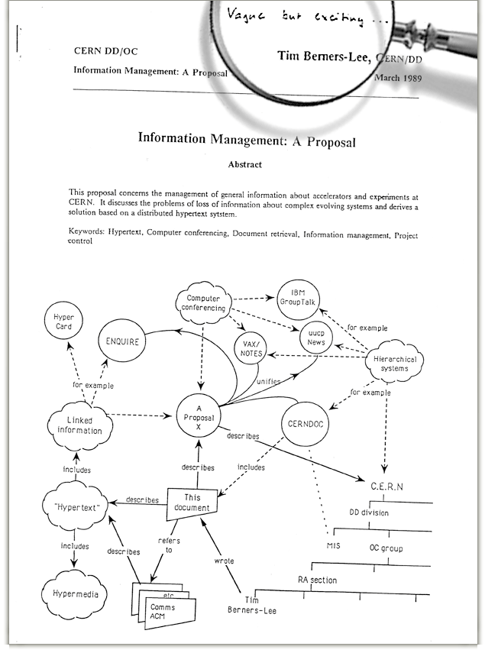
The Web: Humble origins
Tim Berners-Lee: a way to manage and access documents at CERN research lab
His boss is said to have written on his proposal:
“vague, but exciting”

Slide 7
Web and HTTP: Some terms
Web page consists of objects
Object can be HTML file, JPEG image, video stream chunk, audio file,…
Web page consists of base HTML-file which includes several referenced objects
Each object is addressable by a URL (uniform resource locator)
Example URL:
www.cs.rutgers.edu/~netid/index.php
host name
path name

Slide 8
HTTP Protocol Overview

Slide 9
HTTP overview
HTTP: hypertext transfer protocol
client/server model
Client: browser that requests, receives, “displays” Web objects
Server: Web server sends objects in response to requests
HTTP 1.0: RFC 1945
HTTP 1.1: RFC 2068
HTTP request
PC running
Explorer
HTTP response
HTTP request
Server
running
Apache Web
server
HTTP response
Mac running
Navigator

Slide 10
Client server connection
DNS
Hostname | IP address
Host name
IP Address
HTTP: port 80
IP Address, 80
http messages

Slide 11
HTTP messages: request message
HTTP request message:
ASCII (human-readable format)
request line
(GET, POST,
HEAD commands)
GET /somedir/page.html HTTP/1.1
Host: www.someschool.edu
User-agent: Mozilla/4.0
Connection: close
Accept-language:fr
(extra carriage return, line feed)
header
lines
Carriage return,
line feed
indicates end
of message

Slide 12
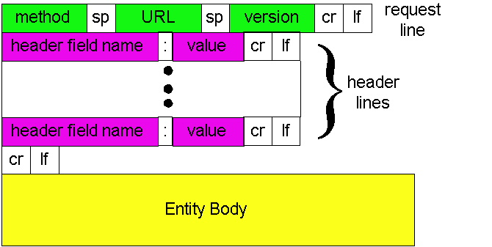
HTTP request message: general format
http://www.w3.org/Protocols/rfc2616/rfc2616-sec14.html#sec14

Slide 13
Method types
GET
Get the file specified in the path URL field in entity body
POST
accept the entity enclosed in the entity body as a new subordinate of the resource identified by the URL field
HEAD
asks server to leave requested object out of response
PUT
uploads file in entity body to path specified in URL field
DELETE
deletes file specified in the URL field

Slide 14
Uploading form input: GET and POST
POST method:
Web page often includes form input
Input is uploaded to server in entity body
Posted content not visible in the URL
Free form content (ex: images) can be posted since entity body interpreted as data bytes
GET method:
Entity body is empty
Input is uploaded in URL field of request line
Example:
http://site.com/form?first=jane&last=austen

Slide 15
Example: Client POST request
POST /cgi-bin/rats.cgi HTTP/1.0
Referer: http://nes:8192/cgi-bin/rats.cgi
Connection: Keep-Alive
User-Agent: Mozilla/4.73 [en] (X11; U; Linux 2.2.12-20 i686)
Host: nes:8192
Accept: image/gif, image/x-xbitmap, image/jpeg, image/pjpeg, image/png, */*
Accept-Encoding: gzip
Accept-Language: en
Accept-Charset: iso-8859-1,*,utf-8
Content-type: application/x-www-form-urlencoded
Content-length: 93
Account=cs111fall&First=Alice&Last=White&SSN=123456789&Bday=01011980&State=CreateAccount
http://www.w3.org/Protocols/rfc2616/rfc2616-sec14.html#sec14

Slide 16
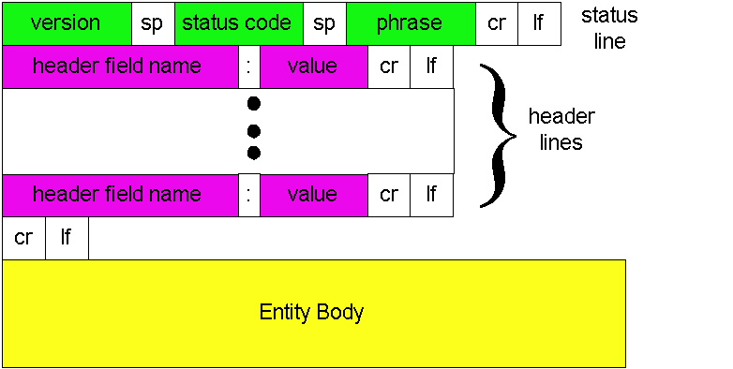
HTTP response message: general format
Unlike HTTP request, No method name

Slide 17
HTTP message: response message
status line
(protocol
status code
status phrase)
HTTP/1.1 200 OK
Connection: close
Date: Thu, 06 Aug 1998 12:00:15 GMT
Server: Apache/1.3.0 (Unix)
Last-Modified: Mon, 22 Jun 1998 …...
Content-Length: 6821
Content-Type: text/html
data data data data data ...
header
lines
data, e.g.,
requested
HTML file

Slide 18
HTTP response status codes
In first line in server->client response message.
A few sample codes:
200 OK
request succeeded, requested object later in this message
301 Moved Permanently
requested object moved, new location specified later in this message (Location:)
400 Bad Request
request message not understood by server
404 Not Found
requested document not found on this server
505 HTTP Version Not Supported

Slide 19
Try out HTTP for yourself!
1. Telnet to your favorite Web server:
Opens TCP connection to port 80
(default HTTP server port).
Anything typed in sent
to port 80 at web.mit.edu
telnet web.mit.edu 80
2. Type in a GET HTTP request:
By typing this in (hit carriage
return twice), you send
this minimal (but complete)
GET request to HTTP server
GET / HTTP/1.1
Host: web.mit.edu
3. Look at response message sent by HTTP server!

Slide 20
Additional details about HTTP
Persistent vs. Nonpersistent HTTP connections
Cookies (User-server state)
Web caches

Slide 21
Non/Persistent HTTP

Slide 22
Recall the Internet protocol stack…
Application
HTTPS
FTP
HTTP
SIP
RTSP
Transport
TCP
UDP
Network
IP
Host-to-Net
X.25
…
802.11
ATM

Slide 23
HTTP connections
Non-persistent HTTP
At most one object is sent over a TCP connection.
HTTP/1.0 uses nonpersistent HTTP
Persistent HTTP
Multiple objects can be sent over single TCP connection between client and server.
HTTP/1.1 uses persistent connections in default mode
TCP is a kind of reliable communication service provided by the transport layer. It requires the connection to be “set up” before data communication.

Slide 24

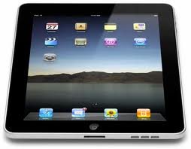
Non-persistent HTTP
1a. HTTP client initiates TCP connection to HTTP server
1b. HTTP server at host “accepts” connection, notifying client
Suppose user visits a page with text and 10 images.
2. HTTP client sends HTTP request message
3. HTTP server receives request message, replies with response message containing requested object
time

Slide 25
Non-persistent HTTP (contd.)
4. HTTP server closes TCP connection.
5. HTTP client receives response message containing html file, displays html. Parsing html file, finds 10 referenced jpeg objects
time
6. Steps 1-5 repeated for each of 10 jpeg objects

Slide 26
HTTP Response time
Definition of RTT: time to send a small packet to travel from client to server and back.
Sum of propagation and queueing delays.
Response time:
one RTT to initiate TCP connection
one RTT for HTTP request and first few bytes of HTTP response to return
file transmission time
total = 2RTT + transmit time
initiate TCP
connection
RTT
request
file
RTT
time to
transmit
file
file
received
time
time

Slide 27
Persistent vs. Non-persistent
Non-persistent HTTP issues:
requires 2 RTTs per object
Browsers can open parallel TCP connections to fetch referenced objects
Persistent HTTP
server leaves connection open after sending response
subsequent HTTP messages between same client/server sent over open connection

Slide 28
Remembering HTTP users

Slide 29
HTTP: User data on servers?
So far, HTTP is “stateless”
The server maintains no memory about past client requests
But state, i.e., memory, about the user at the server be very useful!
authorization
shopping carts
recommendations
user session state

Slide 30
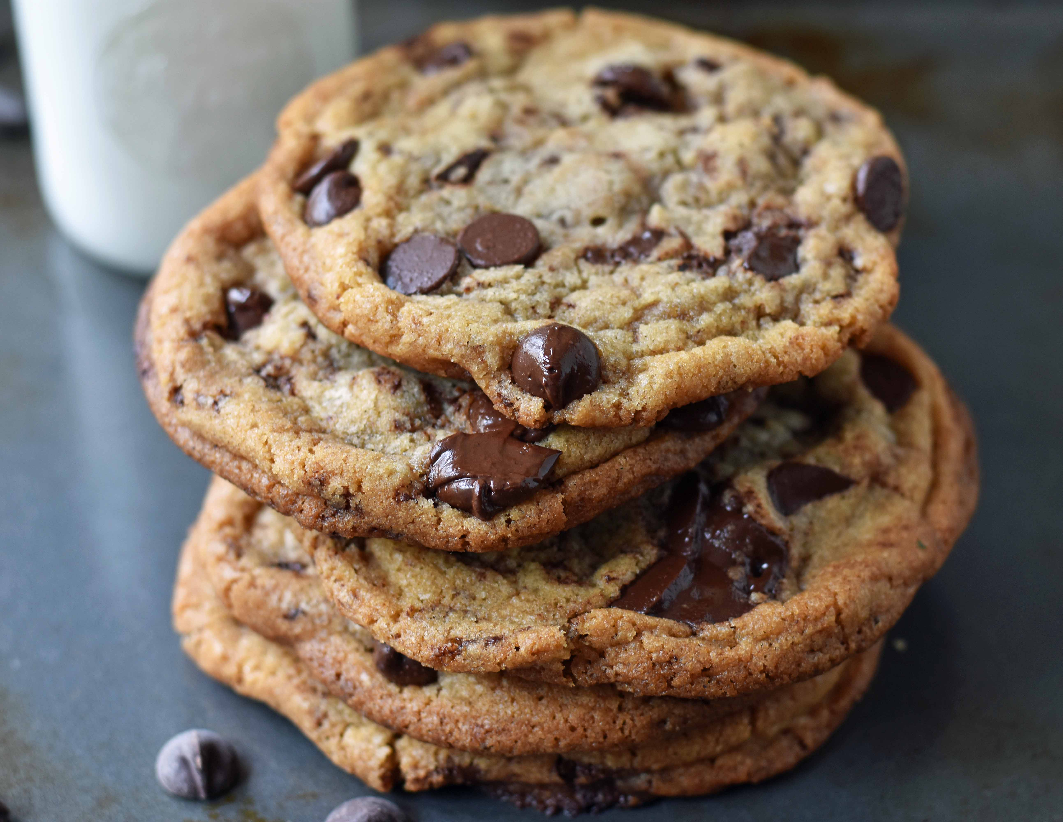
Cookies: Keeping user memory
client
server
Cookie file
usual http request msg
server
creates ID
1678 for user
ebay: 8734
usual http response +
Set-cookie: 1678
entry in backend
database
Cookie file
usual http request msg
cookie: 1678
amazon: 1678
ebay: 8734
cookie-
specific
action
access
usual http response msg
one week later:
access
Cookie file
usual http request msg
cookie: 1678
cookie-
specific
action
amazon: 1678
ebay: 8734
usual http response msg

Slide 31
How cookies work
Four components:
cookie header line of HTTP response message
cookie header line in HTTP request message
cookie file kept on user endpoint, managed by user’s browser
back-end database maps cookie to user data at Web endpoint
Client and server collaboratively track and remember the user’s state.

Slide 32

Cookies and Privacy
Aside
Cookies and privacy
cookies permit sites to learn a lot about you
e.g., you may supply name and e-mail to sites

Slide 33
Caching in HTTP

Slide 34
Web caches
Web caches: Machines that remember web responses for a network
Why cache web responses?
Reduce response time for client requests
Reduce traffic on an institution’s access link
Caches can be implemented in the form of a proxy server

Slide 35

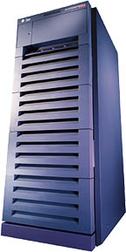
Web caching using a proxy server
You can configure a HTTP proxy on your laptop’s network settings.
If you do, your browser sends all HTTP requests to the proxy (cache).
Hit: cache returns object
Miss:
cache requests object from origin server
caches it locally
and returns it to client
Clients
Web Server
(also called origin server in this context)
GET foo.html
GET foo.html
The Internet
Proxy Server
Store foo.html
on receiving response

Slide 36
Web Caches: how does it look on HTTP?
cache
server
Conditional GET guarantees cache content is up-to-date while still saves traffic and response time whenever possible
Date in the cache’s request is the last time the server provided in its response header “last modified”
HTTP request msg
If-modified-since: <date>
object
not
modified
HTTP response
HTTP/1.0
304 Not Modified
HTTP request msg
If-modified-since: <date>
object
modified
HTTP response
HTTP/1.0 200 OK
<data>

Slide 37
Content Distribution Networks (CDN)
A global network of web caches
Provisioned by ISPs and network operators
Or content providers, like Netflix, Google, …
Uses
Reduce bandwidth requirements on content provider
Reduce $$ to maintain origin servers
Reduce traffic on a network’s Internet connection, e.g., Rutgers
Improve response time to user for a service

Slide 38
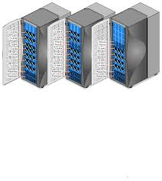
Without CDN
DOMAIN NAME | IP ADDRESS
www.yahoo.com | 98.138.253.109
cs.rutgers.edu | 128.6.4.2
www.google.com | 74.125.225.243
www.princeton.edu | 128.112.132.86
Cluster with Yahoo’s origin servers
Huge bandwidth requirements
Large propagation delays to reach users
So, distribute content to geographically distributed cache servers.
Often, use DNS to redirect request to users to copies of content
98.138.253.109

Slide 39
CDN terms
Origin server
Server that holds the authoritative copy of the content
CDN server
A replica server owned by the CDN provider
CDN name server
A DNS like name server used for redirection
Client

Slide 40
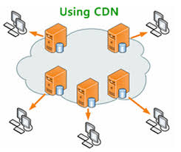
With CDN
DOMAIN NAME | IP ADDRESS
www.yahoo.com | 124.8.9.8 (NS of CDN)
cs.rutgers.edu | 128.6.4.2
www.google.com | 74.125.225.243
www.princeton.edu | 128.112.132.86
Scale through indirection to CDN name server.
CDN Name Server (124.8.9.8)
Custom logic to map ONE domain name to one of many IP addresses!
DOMAIN NAME | IP ADDRESS
www.yahoo.com | 12.1.2.3
www.yahoo.com | 12.1.2.4
www.yahoo.com | 12.1.2.5
www.yahoo.com | 12.1.2.6
12.1.2.3
12.1.2.4
CDN servers
12.1.2.6
12.1.2.5
98.138.253.109
Origin server
Client

Slide 41
Themes from HTTP
Request/response nature of protocols
Headers determine the actions of all the parties of the protocol
ASCII-based message structures
Higher performance using caching
Scaling using indirection
These principles form of the basis of the web that we enjoy today!

