Slide 1

CS 352 Network Service Guarantees
CS 352, Lecture 20.1
http://www.cs.rutgers.edu/~sn624/352
Srinivas Narayana

Slide 2


Network
Application
HTTPS
FTP
HTTP
SMTP
DNS
Transport
TCP
UDP
Network
IP
Host-to-Net
X.25
…
802.11
ATM
The network layer moves packets from one place to another.
The network will put in its best effort but makes no guarantees.

Slide 3
Network support for applications
A best effort Internet architecture does not offer any guarantees on delay, bandwidth, and loss
Network may drop, reorder, corrupt packets
Network may treat traffic randomly regardless of their “importance”
However, many apps require special treatment & guarantees
E.g., voice over IP (phone calls) require strict delay guarantees
E.g., HD video requires a reasonable minimum bandwidth
E.g., remote surgery with 3D-vision requires strict sync & latency
Q: How to provide quality of service (QoS) for apps?

Slide 4


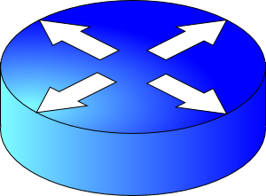
Why best effort isn’t enough: Contention
Conf call: Requires low latency
High delay
Packet drops
Resource contention occurs in the core of the network
Congestion control will react, but may be too little & too late:
Congestion control can’t prevent packet drops now
Congestion control won’t prevent larger rate flows from inflicting large delays or recurring drops
BitTorrent: Requires high throughput
FIFO queue

Slide 5
Can networks help improve the quality of service for applications?
To do this, networks must do something better than best-effort.

Slide 6
Approach 1: Provision more capacity
If you’re an ISP (e.g., AT&T), you might deploy enough capacity so that contention doesn’t occur any more
Low complexity: can use current “best effort” network
However, this approach incurs high costs (e.g., bandwidth)
A key challenge: estimating how much bandwidth is enough
Need to estimate demand over time
Network operators can do this quite well usually
But there are exceptional circumstances: pandemics, Superbowl, etc.

Slide 7
Approach 2: Classes of service
Have the network treat different traffic differently
Also called traffic differentiation
Analogy: lines at an airport (e.g., first class vs. economy)
Partition traffic into classes and offer service guarantees per class and across classes
Classes may be indicated using the IP type of service header bits
Classes may be inferred from IP & transport headers (e.g., src/dst/ports)
Let’s see some examples of service guarantees

Slide 8

(1) Strict prioritization
Transmitted immediately
Conf call
H3
H1
R1
R2
H4
HTTP
H2
1.5 Mbps link
Suppose a 1Mbps interactive flow and an HTTP connection share a 1.5 Mbps link.
A network operator (e.g., Rutgers admin) might choose to prioritize the interactive app strictly over the HTTP flow.

Slide 9
(2) Rate limiting
Rate limited to 1 Mbit/s
What if a flow doesn’t respect its allocation?
Example: Say, conf call flow goes beyond 1 Mbit/s
Don’t want to starve HTTP flow!
An operator might want to limit a flow to a certain max rate
Isolation: HTTP should not be impacted by the conf call
Conf call
H3
H1
R1
R2
H4
HTTP
H2
1.5 Mbps link

Slide 10
(3) Weighted fair sharing
Allocated 2/3rd of the link
An operator might want to partition the link’s rate C into separate allocations for each class
Partitions may have weights w (example: 2, 1)
Usually, class i gets the illusion of traversing a logical link of rate
w_{i} * C / ∑_{j} w_{j}
w=2
Conf call
H3
H1
R1
R2
H4
w=1
HTTP
H2
Allocated 1/3rd of the link

Slide 11
(3) Weighted fair sharing
Class 1
Customary to think of different classes as belonging to different queues
For this reason, weighted fair sharing is also called weighted fair queueing (WFQ)
Each queue is first-in-first-out (FIFO)
The link multiplexes among these queues
Intuitively, packets of one queue should not influence the behavior of other queues
Hence, fair queueing is also a form of isolation across traffic classes
Class 2
Link
Class 3

Slide 12
(3) Weighted fair sharing
Class 1
But what if one class doesn’t use its share?
Can other classes use the spare capacity?
Yes! WFQ is work-conserving: a router implementing WFQ will allow other classes to use the unused capacity
Work conservation makes WFQ different from rate limits applied separately to each class
Class i’s usage can exceed w_{i} * C / ∑_{j} w_{j}
Class 2
Link
Class 3

Slide 13
Where are guarantees enforced?
We’ve seen three kinds of service guarantees: prioritization, rate limiting, and fair sharing
Common goal: allocate the bottleneck link capacity across packets from traffic classes
This allocation occurs in the packet scheduler in the bottleneck router
Recall: scheduling is the task of choosing the packet (among buffered packets) which is transmitted over the output link
A router is said to implement packet scheduling policies

Slide 14
Why care about service guarantees?
Influences how packets are treated at contentious resources in the core of the network
Regardless of the endpoint transport
Service guarantees: prioritization, rate limiting, fair sharing
Implementations of scheduling (QoS) within large networks have implications for debates on network neutrality
Scheduling is a fundamental problem in computer networks
Next lecture

Slide 16
CS 352 Rate Limiting
CS 352, Lecture 20.2
http://www.cs.rutgers.edu/~sn624/352
Srinivas Narayana

Slide 17
Isolation by Rate Limits

Slide 18
Providing Isolation through Rate Limiting
Three commonly used terms:
(long term) average rate: how many pkts can be sent per unit time (in the long run)
crucial question: what is the interval length? 100 packets per sec or 6000 packets per min have same average! Instantaneous behaviors of the two may look very different.
peak rate: e.g., 6000 pkts per min (ppm) avg.; 1500 ppm peak rate
(max.) burst size: max number of pkts sent consecutively (with no intervening idle)

Slide 19
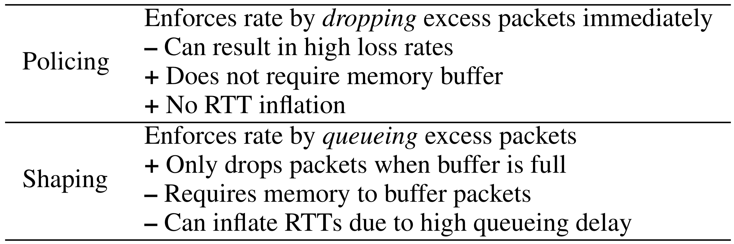
Shaping and Policing

Slide 20
Mechanism (1): Leaky Bucket Shaper
Packets from source
Leaky
Bucket
Leaky
Bucket
Packets leaving leaky bucket

Slide 21
Mechanism (1): Leaky Bucket Shaper
Packets may be generated in a bursty manner, but after they pass through the leaky bucket, they enter the network evenly spaced
The “bucket” buffers packets up to a certain point
If the bucket is full, packets are dropped.
May be used in conjunction with resource reservation to police the host’s resource use
E.g., at the host-network interface, allow packets into the network at a constant rate
May be used in the core of a network to limit bandwidth use

Slide 22
Shaping traffic with leaky buckets
The leaky bucket is a traffic shaper: It changes the downstream arrival times & characteristics of packets passing through it
Traffic shaping makes traffic more manageable and more predictable downstream (e.g., always under a certain rate)
Usually, a system/network administrator would set the rate at which packets may be sent through the leaky bucket
Administrator also sets up policies to map any connection that started up to a leaky bucket (and rate) of its own

Slide 23
Issues with a leaky bucket
Many short transfers just have a few packets
E.g., web requests and responses
Enforcing rate limit for those can significantly delay completion
For a leaky bucket shaper, average rate == peak rate
Sometimes, we wish to have peak rate higher than avg rate
For this purpose we use a token bucket, which is a burst-tolerant version of a leaky bucket

Slide 24
Token buckets

Slide 25
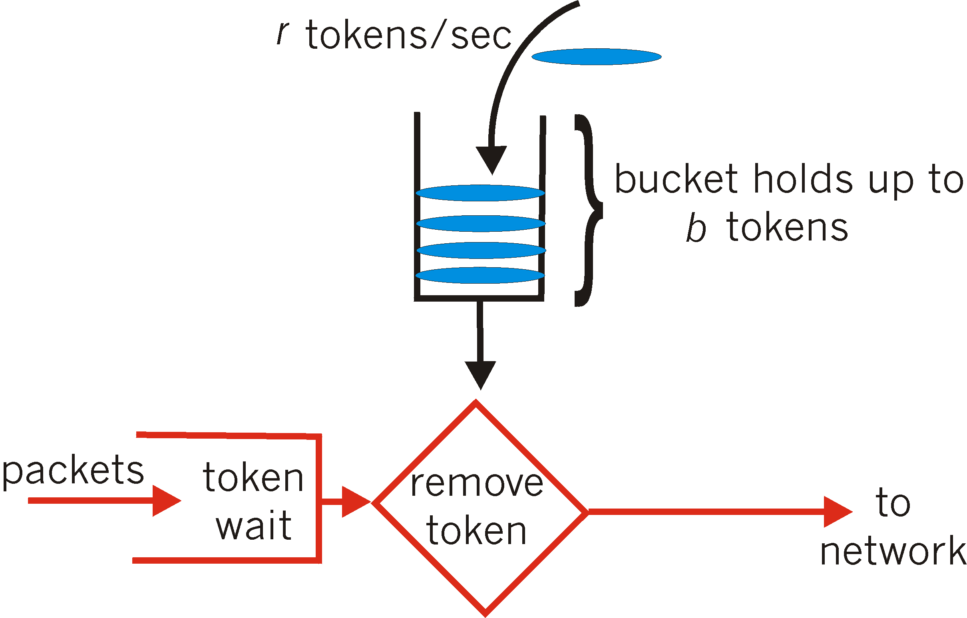
Mechanism (2): Token Bucket Shaper
token bucket: limit input to specified burst size and average rate
Tokens generated at rate r tokens/sec, put into bucket
Bucket can hold b tokens. Tokens are dropped if bucket is full
A packet can leave as long as a token is available
Over interval of time t: number of packets that leave the token bucket is less than or equal to (r * t + b)

Slide 26
Token Bucket Shaper
There is a bucket for tokens and a packet buffer for packets
Packets will be dropped if the associated packet buffer is full
A token bucket policer doesn’t contain a packet buffer: any packet arriving without a token is immediately dropped
Bucket of tokens enables small bursts to go through unscathed
Short flows can exceed rate limit r, since they use up the reserve in the bucket
Long flows will fit into the rate limit r over longer periods of time, since once they use up the reserve, they are limited by the token-fill rate r

Slide 27
Token Bucket vs. Leaky Bucket
Case 1: Small burst of packet arrivals
Arrival time at bucket
0
1
2
3
4
5
6
Departure time from a leaky bucket shaper
Leaky bucket rate = 1 packet in 2 time units
Assume packet buffer size is very large
0
1
2
3
4
5
6
Departure time from a token bucket
Token bucket fill rate = 1 tokens in 2 time units
Token bucket size = 2 tokens
Assume packet buffer size is very large
0
1
2
3
4
5
6

Slide 28
Token Bucket vs. Leaky Bucket
Case 2: Large burst of packet arrivals
Arrival time at bucket
0
1
2
3
4
5
6
Departure time from a leaky bucket shaper
Leaky bucket rate = 1 packet in 2 time units
Assume packet buffer size is very large
0
1
2
3
4
5
6
Departure time from a token bucket shaper
Token bucket fill rate = 1 token in 2 time units
Token bucket size = 2 tokens
Assume packet buffer size is very large
0
1
2
3
4
5
6
??
Departure time from a token bucket policer
Token bucket fill rate = 1 token in 2 time units
Token bucket size = 2 tokens

Slide 29
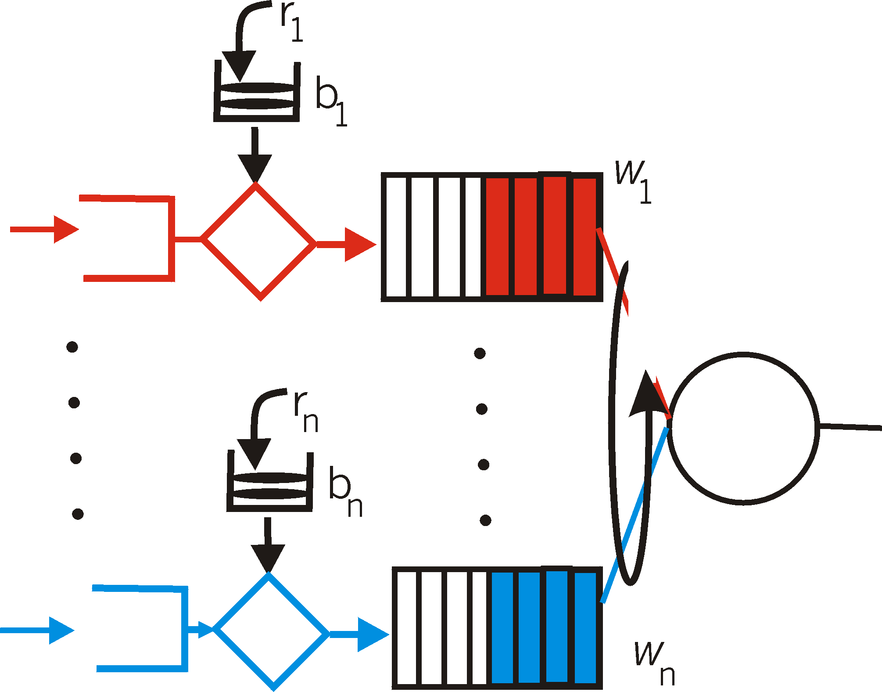
Token buckets can be used to provide delay QoS guarantees
token bucket + WFQ combine to provide a guaranteed upper bound on delay
arriving
traffic
token rate, r
bucket size, b
per-flow
rate, R
WFQ
D = b/R
arriving
traffic
max

Slide 30
Impact of Token Bucket Policers
The Internet has tons of them, and they affect application performance

Slide 31
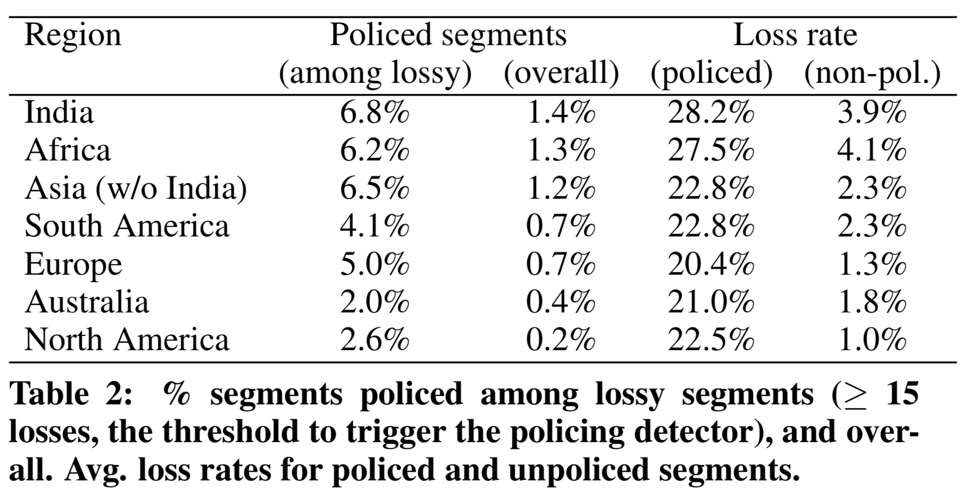
Google study from 2016
Flach et al., An Internet-Wide Analysis of Traffic Policing, SIGCOMM 2016

Slide 32
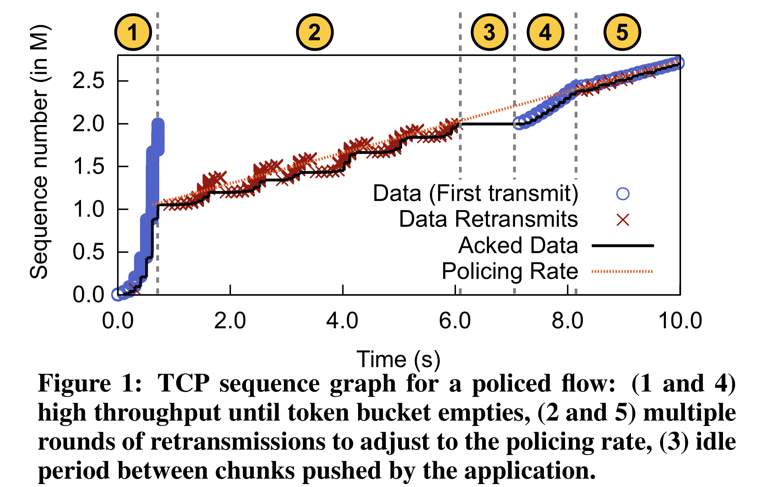
Impact on TCP

Slide 33
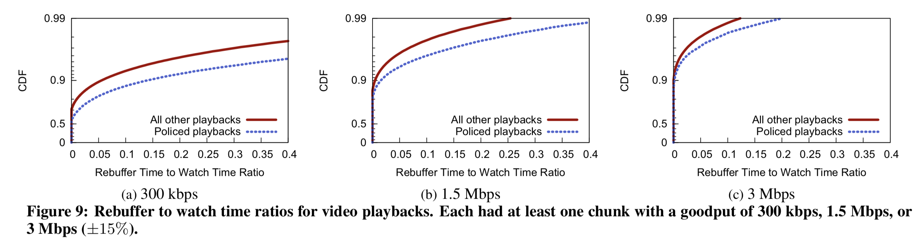
Policing losses impact applications
Video rebuffer rate: rebuffer time / overall watch time

