Slide 1

The Link Layer: Addressing, Error Detection, & Correction
CS 352, Lecture 19, Spring 2020
http://www.cs.rutgers.edu/~sn624/352
Srinivas Narayana

Slide 2
Course announcements
Project 3 released
Ensure you attend recitation this week
Avoid setup issues by walking together with the TA
Resolve any issues by asking TAs right there
Download (large) mininet VM and install VirtualBox before the recitation
Quiz 7 due next Tuesday
Final exam dates shifted slightly
The exam window is now May 7 @ 7 PM to May 12 @ 7 PM
Conditions and honor code same as mid-term 2
Covers all lectures
All multiple-choice questions

Slide 3
Network layer: the big picture
The network layer provides connectivity between Internet hosts
Split into control plane and data plane
Data plane: the IP protocol
Supported by DHCP, ICMP, NATs
Routers implement data plane through ports + fabric + queues
Control plane: routing protocols
Link state: flooding + centralized information + independent computations across routers
Distance vector: neighbor exchange + decentralized + dependent computations across routers
Path vector: flooding + decentralized + policy-based dependent computations across routers
Quality of service: isolation, work conservation
Shaping vs. policing; leaky buckets vs. token buckets

Slide 4


The Link layer
Application
HTTPS
FTP
HTTP
SMTP
DNS
Transport
TCP
UDP
Network
IP
Link layer
802.3
…
802.11
ATM
Ethernet

Slide 5

















Link layer: introduction
terminology:
hosts and routers: nodes
communication channels that connect adjacent nodes along communication path: links
wired links
wireless links
LANs
layer-2 packet: frame, encapsulates datagram
data-link layer has responsibility of
transferring datagram from one node
to physically adjacent node over a link

Slide 6
Link layer: context
datagram transferred by different link protocols over different links:
e.g., Ethernet on first link, frame relay on intermediate links, 802.11 on last link
each link protocol provides different services
e.g., may or may not provide reliability over link
transportation analogy:
trip from Piscataway to Lausanne
limo: Piscataway to JFK
plane: JFK to Geneva
train: Geneva to Lausanne
tourist = datagram
transport segment (road/flight/rail) = communication link
transportation mode (car/plane/train) = link layer protocol
travel agent = routing algorithm

Slide 7
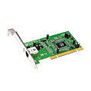
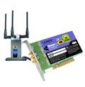

Where is the link layer implemented?
in every host
link layer implemented in “adapter” (aka network interface card NIC) or on a chip
Ethernet card, 802.11 card; Ethernet chipset
implements link, physical layer
Adapter attaches into host’s system buses (PCI)
Link layer: a combination of hardware, software, firmware
application
transport
network
link
cpu
memory
link
physical
host
bus
(e.g., PCI)
controller
physical
transmission
network adapter
card

Slide 8
Adapters communicating
datagram
datagram
controller
controller
sending host
receiving host
datagram
frame
sending side:
encapsulates datagram in frame
adds reliability/error checking bits
receiving side
Check for errors
extracts datagram, passes to upper layer at receiving side (usually: link layer address must match)

Slide 9
Link layer services
Encoding
convert bits to signals and recover bits from received signals
framing, link access:
encapsulate datagram into frame, adding header, trailer
channel access if shared medium
“MAC” addresses used in frame headers to identify source, destination
different from IP address!
reliable delivery between adjacent nodes
we learned how to do this already (chapter 3)!
seldom used on low bit-error link (fiber, some twisted pair)
wireless links: high error rates
Q: why both link-level and end-end reliability?

Slide 10
Encoding
Signals propagate over a physical medium
modulate electromagnetic waves
e.g., vary voltage
Encode binary data onto signals
e.g., 0 as low signal and 1 as high signal
known as Non-Return to zero (NRZ)
Problem: consecutive 1s and 0s, noise levels
Bits
0
0
1
0
1
1
1
1
0
1
0
0
0
0
1
0
NRZ

Slide 11
Encodings (cont’d)
Bits
0
0
1
0
1
1
1
1
0
1
0
0
0
0
1
0
NRZ
Clock
Manchester
NRZI
Manchester encoding: +ve transition → 0; -ve transition → 1
XOR(bit,clock)

Slide 12
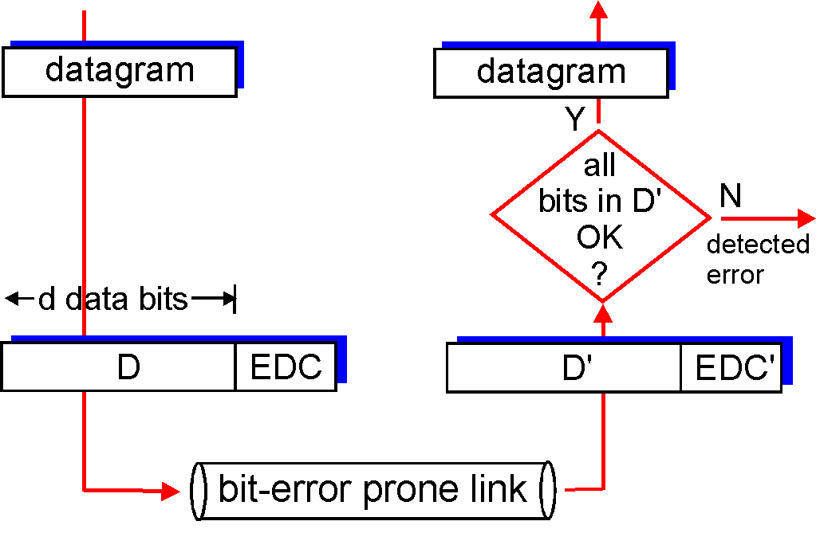
Error detection
EDC = Error Detection and Correction bits (redundancy)
D = Data protected by error checking, may include header fields
Error detection not 100% reliable!
protocol may miss some errors, but rarely
larger EDC field yields better detection and correction
otherwise

Slide 13
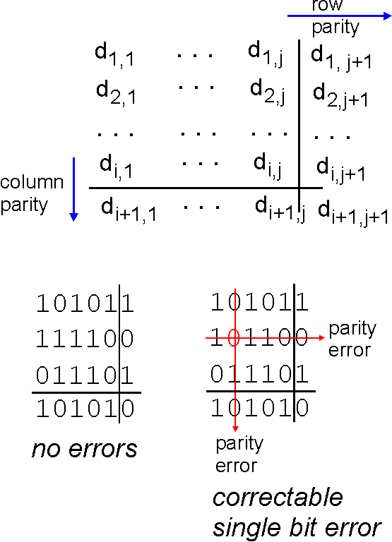
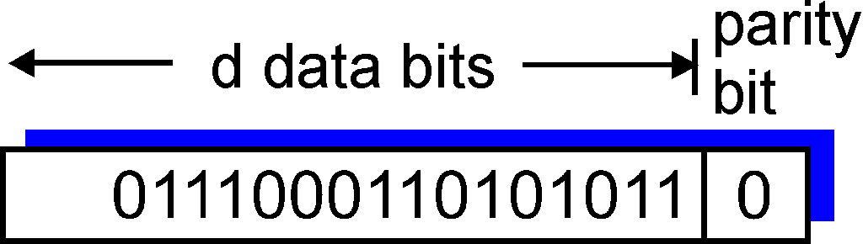
Parity checking
single bit parity:
detect single bit errors
two-dimensional bit parity:
detect and correct single bit errors
0
0

Slide 14
Internet checksum (review)
goal: detect “errors” (e.g., flipped bits) in transmitted packet (note: used at transport layer only)
sender:
treat segment contents as sequence of 16-bit integers
checksum: addition (1’s complement sum) of segment contents
sender puts checksum value into UDP checksum field
receiver:
compute checksum of received segment
check if computed checksum equals checksum field value:
NO - error detected
YES - no error detected. But maybe errors nonetheless?

Slide 15
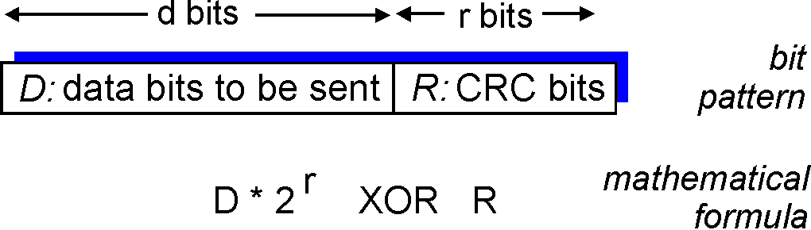
Cyclic redundancy check
more powerful error-detection coding
view data bits, D, as a binary number
choose r+1 bit pattern (generator), G
goal: choose r CRC bits, R, such that
<D,R> exactly divisible by G (modulo 2)
receiver knows G, divides <D,R> by G. If non-zero remainder: error detected!
can detect all burst errors less than r+1 bits
widely used in practice (Ethernet, 802.11 WiFi, ATM)

Slide 16
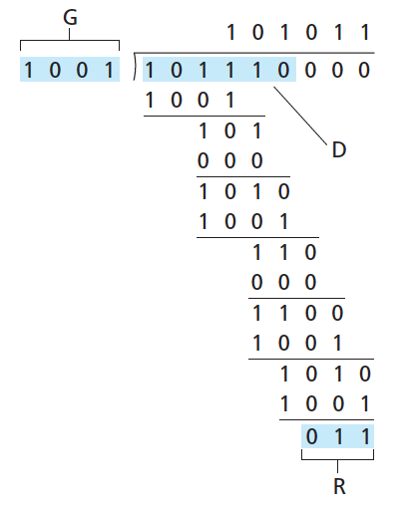
CRC example
want:
D.2^{r} XOR R = nG
equivalently:
D.2^{r} = nG XOR R
equivalently:
if we divide D.2^{r} by G, want remainder R to satisfy:
D.2^{r}
G
R = remainder[ ]

Slide 17
ARP
How to get a MAC address for an IP address?

Slide 18
ARP: Address Resolution Protocol
By default, NICs only pass on packets destined to their destination MAC address to the higher layers
In a broadcast-based LAN, each source needs to know its destination’s MAC address
After a packet reaches a router, the link layer header needs to be added to reflect the destination host on that link
ARP returns a link layer address when given an Internet address
Communication requires IP → MAC address translation

Slide 19
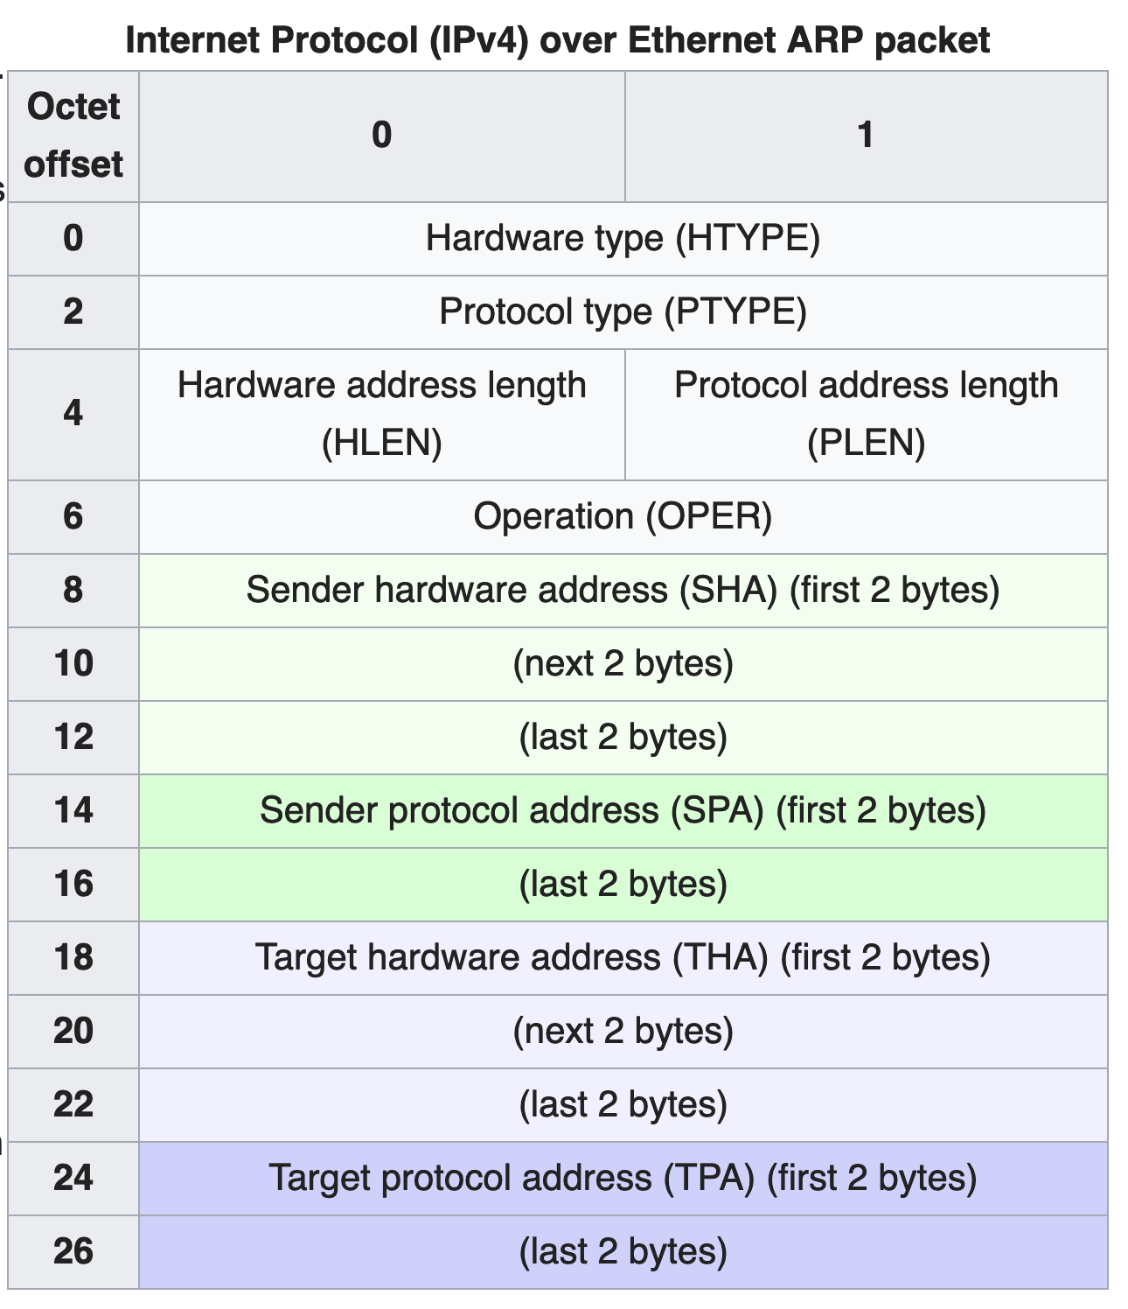
ARP packet format
Hardware type: ex: Ethernet (1)
Hardware address length: 6 octets
Protocol Type: ex: IPv4 0x0800 (requesting IPv4 addr)
Protocol address length: 4 octets
Opcode ARP request:1
Opcode ARP reply:2

Slide 20
ARP operation
Proto=IPv4
0x0800
Oper=1
Sender H/W address
Sender IP address
Target H/W address
target IP address
ARP packet
containing “128.195.1.38?”
ARP
Ethernet Address:
05:23:f4:3d:e1:04
IP Address:
128.195.1.20
Ethernet Address:
12:04:2c:6e:11:9c
IP Address:
128.195.1.122
Ethernet Address:
98:22:ee:f1:90:1a
IP Address:
128.195.1.38
Wants to transmit
to 128.195.1.38
Ignored
Answered

