Slide 1
DeepBGP: A Machine Learning Approach for BGP Configuration Synthesis
Mahmoud Bahnasy Fenglin Li Shihan Xiao Xiangle Cheng
ACM NetAI 2020, Woodstock, NW, US
June, 2020

Slide 2
Network Configuration synthesis: Background
Network configuration could be defined as the process of acquiring, organizing, and maintaining information about all the components of a computer network.
Such a process is often done manually.
With the huge increase in the number of network devices and the complexity of operator intent, network configuration became very challenging and error-prone.
Manual configuration is not fully evaluated under various fault conditions, for example:
Google leaked prefixes that knocked Japan off the Internet in 2017.
NYSE stock market closed after glitch caused major outage in 2017.
Facebook outage due configuration error in 2015.
United Airlines jets grounded by computer router glitch in 2015.

Slide 3
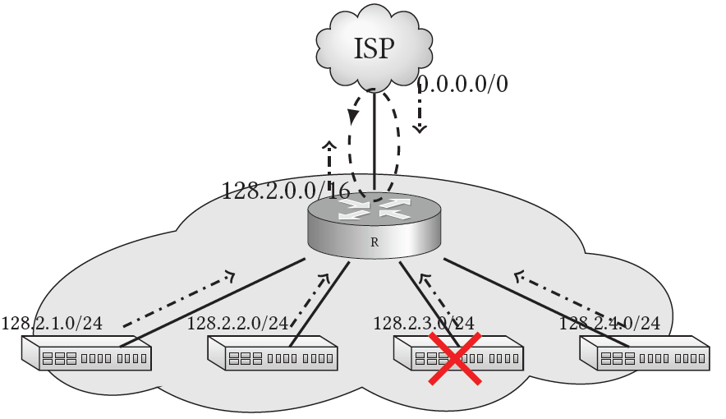
BGP misconfiguration example:
The figure below illustrate a BGP misconfiguration example that causes traffic loop when router fails.
In this Example:
A data center is allocated IP address space 128.2.0.0/16.
Router 𝑅 announces one aggregated route to the ISP to increase routing table stability and reduce required memory.
Also, router 𝑅 receives a default route from the ISP for unknown prefixes.
When prefix 128.2.3.0/24 fails, the ISP keeps sending traffic to this prefix through router 𝑅.
Because prefix 128.2.3.0/24 is no longer available, this traffic matches
the default route and get redirected to the ISP.
Therefore, It keeps bouncing between the ISP and router 𝑅.
BGP misconfiguration example

Slide 4
Network Configuration synthesis Prior art
Current research directions address such a problem in three directions:
By verifying exiting configuration (e.g. Bagpipe [1], RCC [2], ARC [3])
Run a predefined verification scenarios on existing network configuration.
By filling out existing network templates (e.g. NetComplete [4])
Uses a pre-defined template and fill out the blanks in such template.
By synthesizing network configuration (e.g. ConfigAssure [5], Propane [6], and Propane/AT [7]).
synthesizes high-level user requirements into a network-wide BGP configuration.
Such methods use Satisfiability Modulo Theory (SMT)-based solutions.
Do not scale well for large network topologies.
In this research, we represent a neural network-based model to synthesis network-wide BGP configuration.

Slide 5
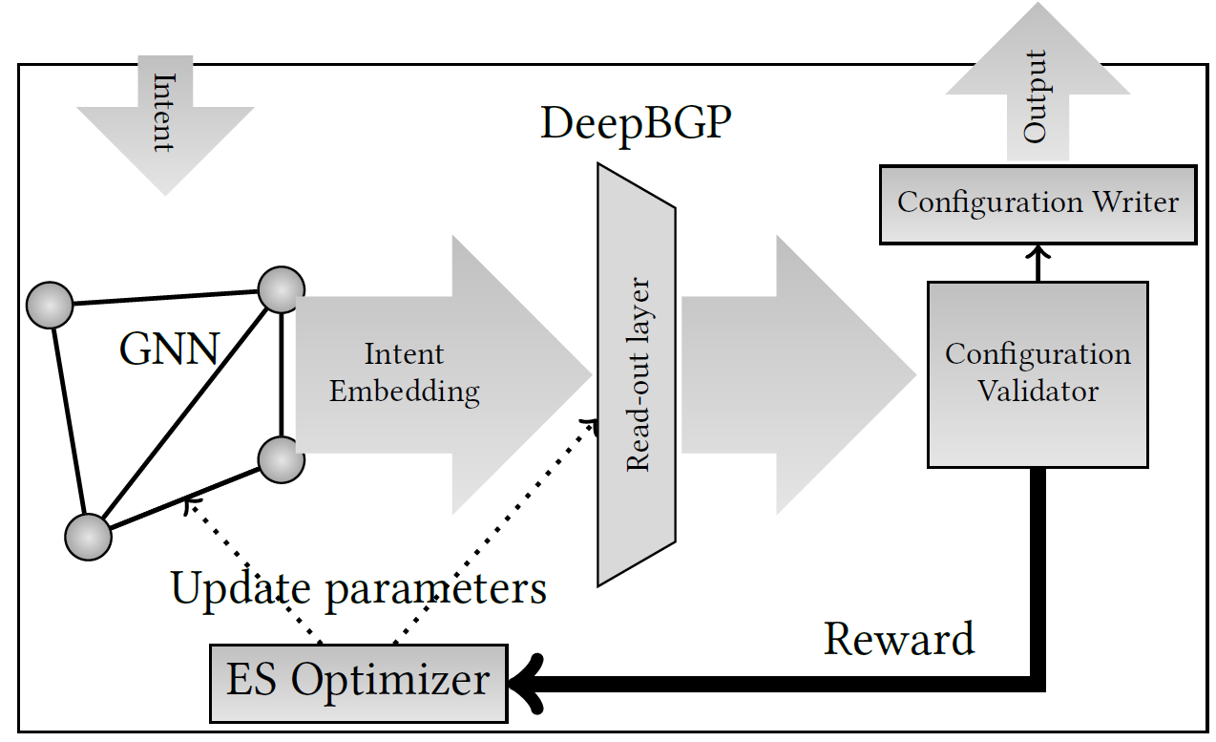

DeepBGP:
In this research, we represent a neural network-based model to synthesis network-wide BGP configuration.
DeepBGP is composed of four main components:
i) Intent embedding (GNN), ii) Configuration validator, iii) Evolution Strategies (ES) optimizer and iv) Configuration writer.
Intent from YAML file
Label Matrix
(one vector per node)
$$Ov$$
Edge State Matric

Slide 6
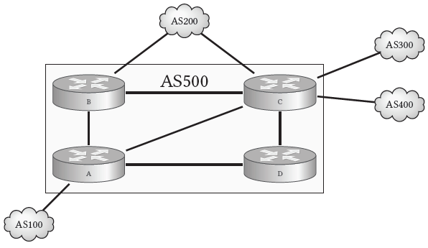






Work Mechanism: Illustrative Example
First: Redesign the network and represent it in two layers (IGP plane, and EGP plane).
Second: For EGP graph, DeepBGP encodes the network intent into node labels.
intent: # Represented in YAML file
reachability: # AS1 can reach all nodes
- [1, 2]
- [1, 3]
- [1, 4]
- [1, 5]
isolation: # AS3 can’t reach AS4
- [3, 4]
$$\left[\begin{matrix}1 \\ 1 \\ −1 \\ −1 \\ 1\end{matrix}\right]$$
$$\left[\begin{matrix}1 \\ −1 \\ 1 \\ −1 \\ 1\end{matrix}\right]$$
$$\left[\begin{matrix}1 \\ 1 \\ 1 \\ 1 \\ 1\end{matrix}\right]$$
_{AS200}
_{AS300}
B’
C’
_{AS400}
$$\left[\begin{matrix}1 \\ −1 \\ −1 \\ 1 \\ 1\end{matrix}\right]$$
B
C
$$\left[\begin{matrix}1 \\ 1 \\ 1 \\ 1 \\ 1\end{matrix}\right]$$
_{AS100}
A’
D’
A
D

Slide 7
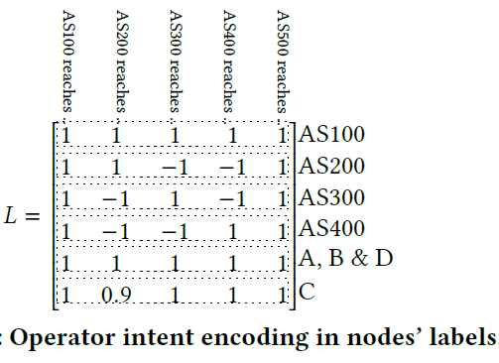
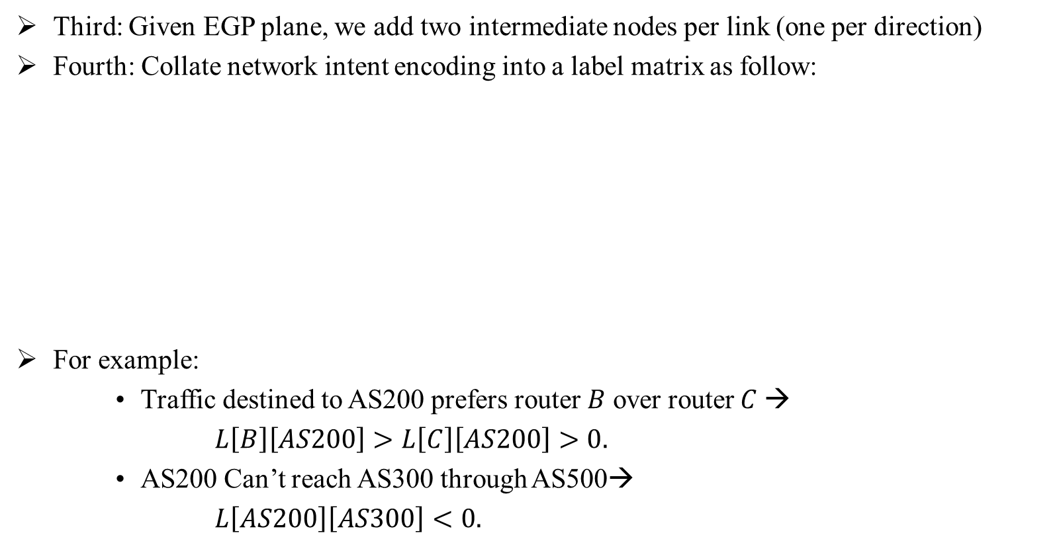
Work Mechanism: Illustrative Example
Third: Given EGP plane, we add two intermediate nodes per link (one per direction)
Fourth: Collate network intent encoding into a label matrix as follow:
For example:
Traffic destined to AS200 prefers router 𝐵 over router 𝐶 →
$L\left[B\right]\left[AS200\right]>L\left[C\right]\left[AS200\right]>0.$
AS200 Can’t reach AS300 through AS500→
$L\left[AS200\right]\left[AS300\right]<0.$
_{AS200}
B
_{AS100}
A

Slide 8
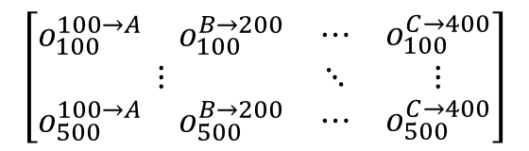
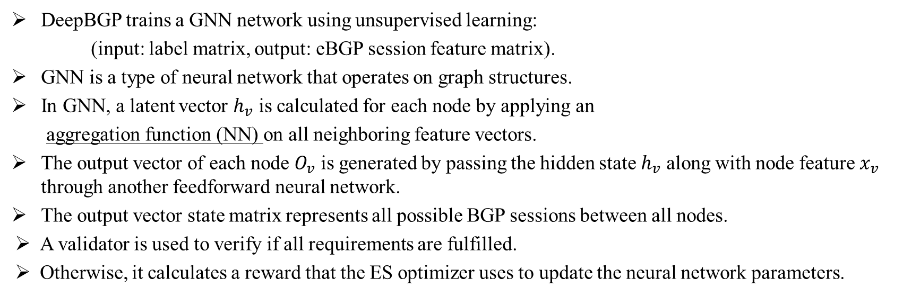
Work Mechanism: Illustrative Example
DeepBGP trains a GNN network using unsupervised learning:
(input: label matrix, output: eBGP session feature matrix).
GNN is a type of neural network that operates on graph structures.
In GNN, a latent vector $h_{v}$ is calculated for each node by applying an
aggregation function (NN) on all neighboring feature vectors.
The output vector of each node $O_{v}$ is generated by passing the hidden state $h_{v}$ along with node feature $x_{v}$ through another feedforward neural network.
The output vector state matrix represents all possible BGP sessions between all nodes.
A validator is used to verify if all requirements are fulfilled.
Otherwise, it calculates a reward that the ES optimizer uses to update the neural network parameters.
_{AS200}
E
C
Feature propagation
B
$$\left[\begin{matrix}\begin{matrix}o_{100}^{100→A} & o_{100}^{B→200}\end{matrix} & ⋯ & o_{100}^{C→400} \\ ⋮ & ⋱ & ⋮ \\ \begin{matrix}o_{500}^{100→A} & o_{500}^{B→200}\end{matrix} & ⋯ & o_{500}^{C→400}\end{matrix}\right]$$
C
NN
A
D
B
D
B
E
Feature propagation
_{AS100}
A
NN
A
Target node

Slide 9
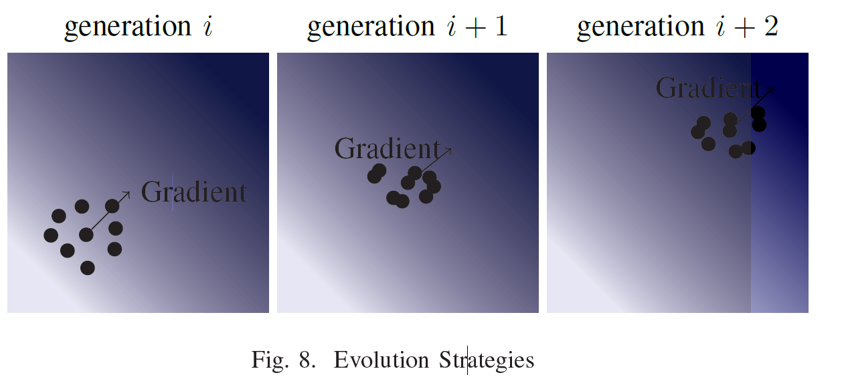
Evolution strategy
ES depends on randomly sampling a set of solution candidates (named population) in a multidimensional Gaussian distribution.
The fitness of these solutions is calculated and used to calculate the gradient.
Thereafter, ES updates the solution candidate distribution.
Then, ES repeats the same process.
ES resembles hill-climbing optimization problem, therefore, it does not require back-propagation which reduces the required computational power compared to Deep Reinforcement Learning (DRL).
Iteration i
Iteration i+1
Iteration i+2
Evolution strategies

Slide 10
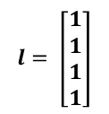
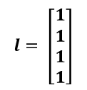
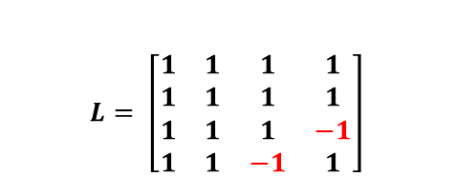

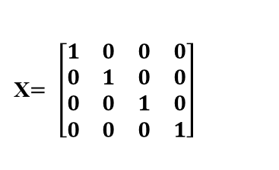
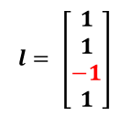
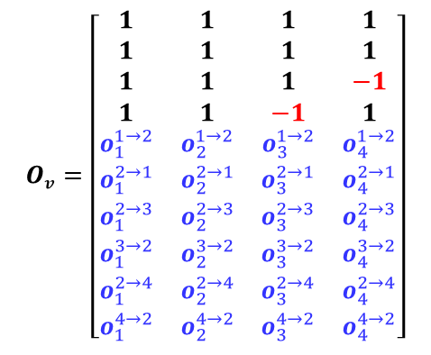
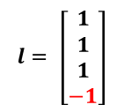
Work Mechanism: Another Example
Intent from YAML file
Label Matrix
(one vector per node)
intent:
reachability: # AS1 can reach all nodes
- [1, 2]
- [1, 3]
- [1, 4]
isolation: # AS3 can’t reach AS4
- [3, 4]
_{AS3}
$$Ov$$
_{AS1}
Edge State Matric (V)
_{AS2}
Example Topology
_{AS4}
GNN is trained to match these labels and generate missing labels (for link nodes)
$$l= \left[\begin{matrix}1 \\ 1 \\ 1 \\ −1\end{matrix}\right]$$
$$L= \left[\begin{matrix}1 & 1 & 1 & 1 \\ 1 & 1 & 1 & 1 \\ 1 & 1 & 1 & −1 \\ 1 & 1 & −1 & 1\end{matrix}\right]$$
Can reach: AS1 AS2 AS3 AS4
AS1
AS2
AS3
AS4
Training labels
$$l= \left[\begin{matrix}1 \\ 1 \\ 1 \\ 1\end{matrix}\right]$$
_{AS3}
$$Ov=\left[\begin{matrix}1 & 1 & 1 & 1 \\ 1 & 1 & 1 & 1 \\ 1 & 1 & 1 & −1 \\ 1 & 1 & −1 & 1 \\ o_{1}^{1→2} & o_{2}^{1→2} & o_{3}^{1→2} & o_{4}^{1→2} \\ o_{1}^{2→1} & o_{2}^{2→1} & o_{3}^{2→1} & o_{4}^{2→1} \\ o_{1}^{2→3} & o_{2}^{2→3} & o_{3}^{2→3} & o_{4}^{2→3} \\ o_{1}^{3→2} & o_{2}^{3→2} & o_{3}^{3→2} & o_{4}^{3→2} \\ o_{1}^{2→4} & o_{2}^{2→4} & o_{3}^{2→4} & o_{4}^{2→4} \\ o_{1}^{4→2} & o_{2}^{4→2} & o_{3}^{4→2} & o_{4}^{4→2}\end{matrix}\right]$$
AS1
AS2
AS3
AS4
a
b
c
d
e
f
b
c
d
_{AS1}
_{AS2}
X$= \left[\begin{matrix}1 & 0 & 0 & 0 \\ 0 & 1 & 0 & 0 \\ 0 & 0 & 1 & 0 \\ 0 & 0 & 0 & 1\end{matrix}\right]$
a
$$l= \left[\begin{matrix}1 \\ 1 \\ 1 \\ 1\end{matrix}\right]$$
e
f
AS1
AS2
AS3
AS4
_{AS4}
$$l= \left[\begin{matrix}1 \\ 1 \\ −1 \\ 1\end{matrix}\right]$$
3- Validate the result.
4- Invoke the ES module.
1- Encode network intent.
2- Train the GNN.
Notes:
X: input features, L: is expected labels that encode network intent

Slide 11
Work Mechanism: Summary
Work mechanism summary:
Generate two graphs one for IGP and another for EGP.
Two intermediate nodes are added to represent links in both directions.
A high-level intent is encoded into the Graph Neural Network (GNN).
Link features are extracted as a representation of BGP configuration.
A validation unit is used to verify if all requirements are fulfilled.
Otherwise, it calculates a reward based on which an Evolution Strategies (ES) optimizer updates neural network parameters.
Once an optimum solution is achieved, the final output is converted into device-based configuration using the Configuration Writer.

Slide 12
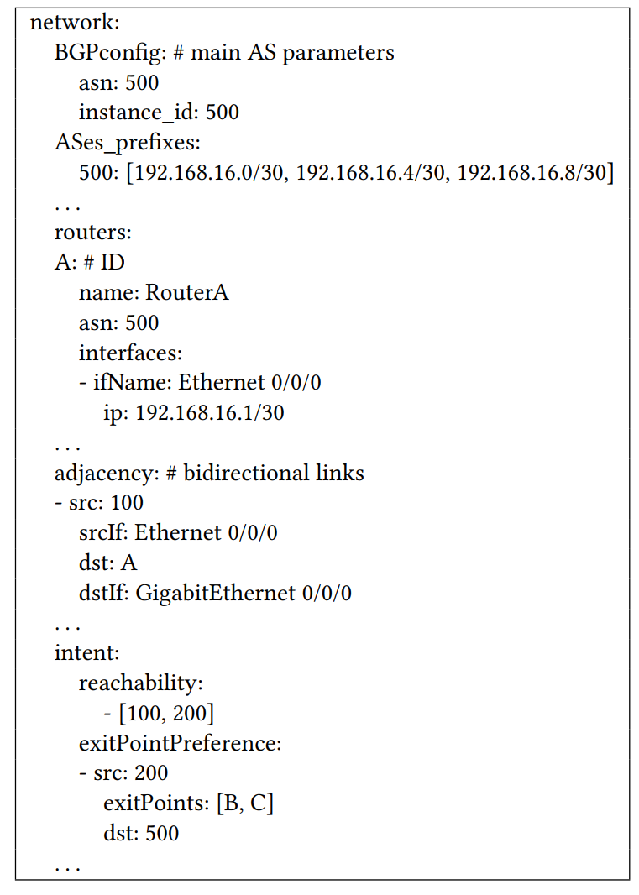
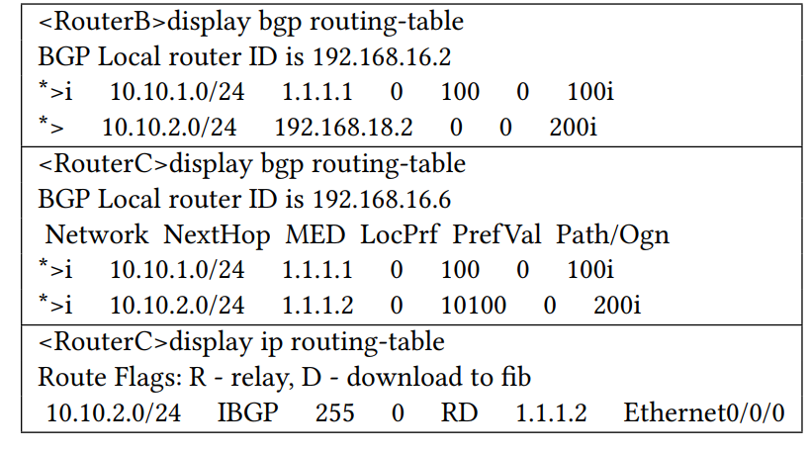
Experimental Results:
_{AS200}
_{AS300}
AS500
B
C
_{AS400}
Experiment I - Functionality Evaluation :
We demonstrate the functionality of DeepBGP.
A
D
_{AS100}
Generated BGP configuration snippet
YAML file snippet
Network Intent
AS100 → B → AS200 >> AS100 → C → AS200.
!AS200 → AS300, !AS200 → AS400,
!AS300 → AS200, !AS300 → AS400,
!AS400 → AS200, !AS400 → AS300.
# output Configuration for node A system-view ip ip-prefix IP_PREFIX_1_100 index 10 permit 192.168.16.0 24 ip ip-prefix IP_PREFIX_1_100 index 20 permit 10.10.2.0 24 ip ip-prefix IP_PREFIX_1_100 index 30 permit 10.10.3.0 24 ip ip-prefix IP_PREFIX_1_100 index 40 permit 10.10.4.0 24 route-policy ROUTE_POLICY_1_100 permit node 10 if-match ip-prefix IP_PREFIX_1_100 quit ip ip-prefix IP_PREFIX_1_2 index 50 permit 10.10.1.0 24 route-policy ROUTE_POLICY_1_2 permit node 10 if-match ip-prefix IP_PREFIX_1_2 quit ip ip-prefix IP_PREFIX_1_3 index 50 permit 10.10.1.0 24 route-policy ROUTE_POLICY_1_3 permit node 10 if-match ip-prefix IP_PREFIX_1_3 quit bgp 500 peer 192.168.17.2 as-number 100 peer 192.168.16.2 as-number 500 peer 192.168.16.6 as-number 500 peer 192.168.17.2 route-policy ROUTE_POLICY_1_100 export peer 192.168.16.2 route-policy ROUTE_POLICY_1_2 export peer 192.168.16.6 route-policy ROUTE_POLICY_1_3 export ipv4-family unicast network 192.168.16.0 24
BGP routing table at routers B and C

Slide 13
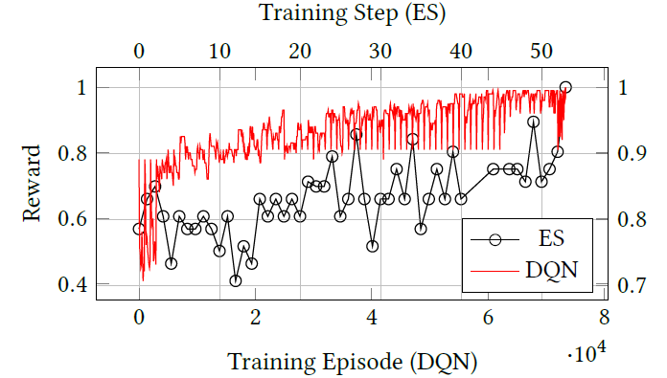
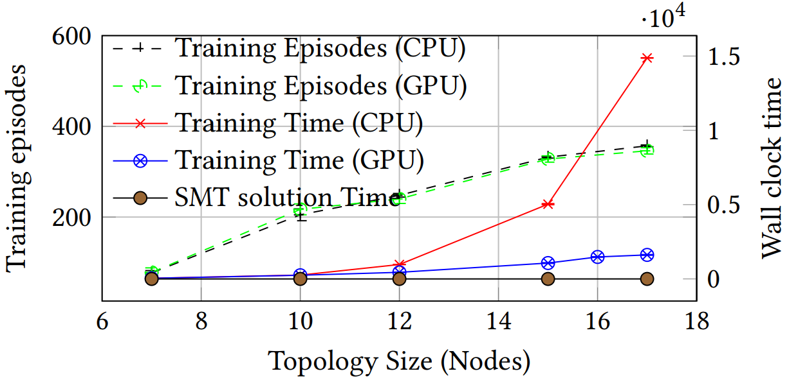
Experimental Results:
Experiment I - Functionality Evaluation :
We also compared between convergence time using ES and DQN.
Reward vs training step using ES and DQN
Experiment II - Scalability Analysis:
We demonstrate the scalability of DeepBGP by testing it on a set of randomly generated networks with a different number of nodes.
We also show the effect of using hardware accelerator on the training process.
Training steps vs topology size

Slide 14
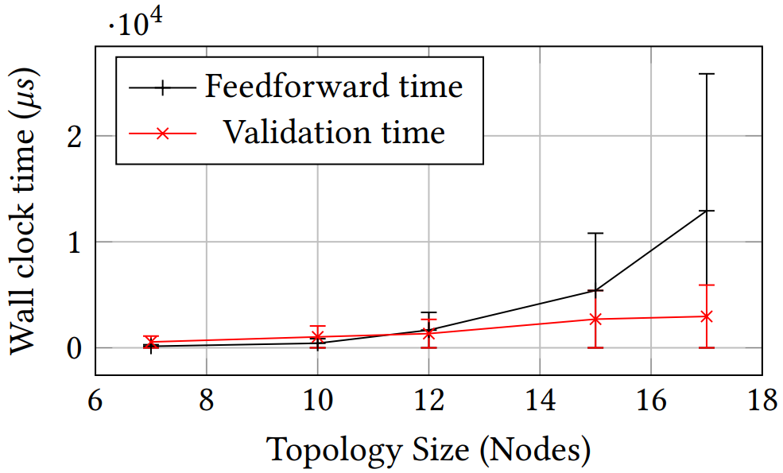
Experimental Results:
Experiment III – Detecting Time-Consuming Process:
To determine which process is responsible for increasing the training time increases exponentially.
conducted a third experiment to validate the two main culprits, namely i) the neural network feedforward time and ii) the validation time.
Feedforward VS. validation time

Slide 15
Conclusion and Future Work
Conclusion:
We introduce DeepBGP that uses neural networks to generate with certainty network-wide BGP configuration.
We demonstrate that neural networks have the potential to be used in network configuration synthesizing.
Experimental results illustrated that hardware acceleration and ES enhanced the execution time.
Future work:
Scaling DeepBGP to larger network topologies is left for future work.
Accelerating the training process on different intent and network topologies using meta-learning is considered for future work.
Generalizing DeepBGP to generate other network configurations, such as IGP and Access List Control is also left for future work.

Slide 16
References
Weitz, K., Woos, D., Torlak, E., Ernst, M. D., Krishnamurthy, A., & Tatlock, Z. (2016, October). Scalable verification of border gateway protocol configurations with an SMT solver. In Proceedings of the 2016 ACM SIGPLAN International Conference on Object-Oriented Programming, Systems, Languages, and Applications (pp. 765-780).
Feamster, N., & Balakrishnan, H. (2005, May). Detecting BGP configuration faults with static analysis. In Proceedings of the 2nd conference on Symposium on Networked Systems Design & Implementation-Volume 2 (pp. 43-56).
Gember-Jacobson, A., Viswanathan, R., Akella, A., & Mahajan, R. (2016, August). Fast control plane analysis using an abstract representation. In Proceedings of the 2016 ACM SIGCOMM Conference (pp. 300-313).
El-Hassany, A., Tsankov, P., Vanbever, L., & Vechev, M. (2018). NetComplete: Practical network-wide configuration synthesis with autocompletion. In 15th {USENIX} Symposium on Networked Systems Design and Implementation ({NSDI} 18) (pp. 579-594).
Narain, S., Levin, G., Malik, S., & Kaul, V. (2008). Declarative infrastructure configuration synthesis and debugging. Journal of Network and Systems Management, 16(3), 235-258.
Beckett, R., Mahajan, R., Millstein, T., Padhye, J., & Walker, D. (2016, August). Don't mind the gap: Bridging network-wide objectives and device-level configurations. In Proceedings of the 2016 ACM SIGCOMM Conference (pp. 328-341).
Beckett, R., Mahajan, R., Millstein, T., Padhye, J., & Walker, D. (2017, June). Network configuration synthesis with abstract topologies. In Proceedings of the 38th ACM SIGPLAN Conference on Programming Language Design and Implementation (pp. 437-451).

Slide 18

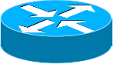



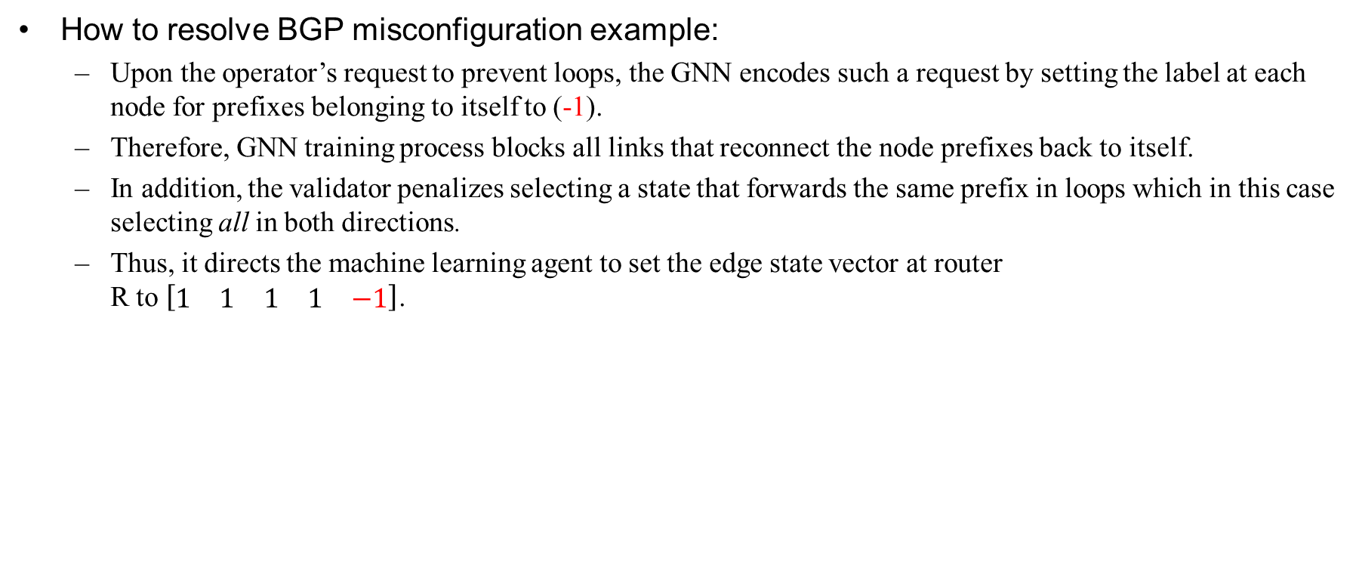




Appendex:
How to resolve BGP misconfiguration example:
Upon the operator’s request to prevent loops, the GNN encodes such a request by setting the label at each node for prefixes belonging to itself to (-1).
Therefore, GNN training process blocks all links that reconnect the node prefixes back to itself.
In addition, the validator penalizes selecting a state that forwards the same prefix in loops which in this case selecting all in both directions.
Thus, it directs the machine learning agent to set the edge state vector at router R to $\left[\begin{matrix}1 & 1 & 1 & 1 & −1\end{matrix}\right]$.
ISP
$$\left[\begin{matrix}A \\ B \\ C \\ D \\ all\end{matrix}\right]$$
$$\left[\begin{matrix}all\end{matrix}\right]$$
$$\left[\begin{matrix}A\end{matrix}\right]$$
$$\left[\begin{matrix}B\end{matrix}\right]$$
$$\left[\begin{matrix}C\end{matrix}\right]$$
$$\left[\begin{matrix}D\end{matrix}\right]$$

