Slide 1

CORGIKIKI / HACKATHON PITCH
Your AI architecture
sketching buddy
For beginners, the blank page is the hardest part.
Guided sketch exercises turn first lines into
useful feedback and a clear next step.
Learn to see space. Then draw it.

Slide 2
CORGIKIKI
02 / 05
One sketch, one focused next step
A complete learning loop for first-year drawing
01
02
03
04
05
CHOOSE
›
DRAW
›
REVIEW
›
FEEDBACK
›
IMPROVE
Cube, room, or hallway
Sketch with guides
Submit the canvas
Critic + Kiki Coach
Start tailored practice
Demo shortcut: load a sample drawing, then request AI Review.

Slide 3
CORGIKIKI
03 / 05
A sketch powers learning and career guidance
Next.js + TypeScript frontend
Server-side API routes
Drawing canvas
Synthetic geometry
→
POST /api/review
↗
OpenAI Vision
Critic
→
Kiki Drawing
Coach
Ask Kiki /api/chat / web search
Feedback + career map
Review, chat, and job search call OpenAI on the server.

Slide 4
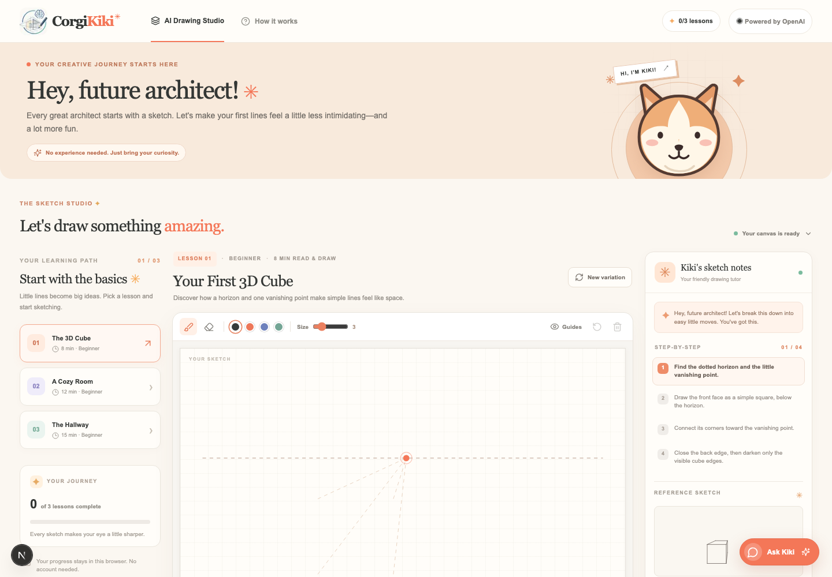
CORGIKIKI
04 / 05
From sketch feedback to career direction
DRAW
Canvas with undo, eraser, clear, and perspective guides
PRACTICE
Generated variations and a career roadmap
UNDERSTAND
Vision critique of perspective and proportions
IMPROVE
Kiki Coach turns critique into a practice exercise
ASK
Chat tutor with cited web resources
Career match and readiness reuse the same Vision Critic result.

Slide 5
LIVE DEMO
05 / 05
Watch a first sketch
become a lesson
1
Choose The 3D Cube
NEXT
2
Load Sample Drawing
Portfolio progress
More exercise types
Richer visual guidance
3
Click AI Review
4
Explore career paths; start practice
Every great architect starts with a sketch.

