Slide 1
Lending Under Imperfect Information
November 2 follow-up: two scenarios and three methods
Nguyen Phan Nguyen
Virginia Tech - ECON 4994
2 November 2026
Corrected +0.01B penalty
Systemic risk and gradient-boosting comparison
100,000 applicants. 80,000 training. 20,000 evaluation.
Single matched synthetic run. Earlier studies appear only in the historical appendix.
01
Notes:
This update implements the changes from our November 2 discussion. The manual adjustment is now plus 0.01 times B, which increases perceived default risk for B=1. I compare an unadjusted OLS model, the same OLS score with the penalty, and gradient boosting. I evaluate both the original no-systemic world and a world with a one-standard-deviation upward epsilon shift for B=1. The original population, noise and split are matched. The previous results remain in the historical appendix under their original definitions.
Evidence and interpretation
configs/professor_model/nov2_followup.yaml; results/metrics/professor_model/nov2_followup/run_manifest.json.
/Users/macbook/Desktop/nov_2_followup_slide_update.pptx.pdf; supplied 14-page reference PDF SHA-256 97e471a5e34be3e42011d77999e4456af5c1d3dee1c5f8090a7d52b4bc0b821a.
Single matched synthetic realization. No empirical mortgage-discrimination claim.

Slide 2
From True Risk to Lending Decisions
Synthetic applicants
Y, D, B, C
Hidden true default risk
true_PD = f(Y, D, ε)
Noisy target PN
PN = 0.8 true_PD + η
Scenario 1 predictors: Y, D, C
Scenario 2 predictors: Y, D, C, B
Bank estimates raw scores
OLS / OLS + 0.01B / gradient boosting
Capital-constrained
common lending cutoff
Expected loan profit
Σ c_t (1−p)^t − L
Accounting probability
p = clip(raw, 0, 1)
Approval decisions, group outcomes, and evaluator-only true expected profit
Working contract: T=30, theta=0.10, r=5% per period. Fixed capital $1.826087B.
02
Notes:
The overall model is unchanged in its economic accounting. The bank observes applicant characteristics and learns the noisy PN target, but it does not receive true PD or epsilon as predictors. The three methods produce raw scores. I then clip those scores to probability bounds, calculate expected loan profit, and optimize the same common bounded-PD cutoff under capital. The penalty enters the raw score before clipping. PN is the target, not the fitted prediction. Higher estimated default risk disfavors an applicant. True default probability means constant conditional per-period default risk, with absorbing default.
Evidence and interpretation
src/fair_lending/professor_model/risk.py and profit.py; frozen true-risk and survival equations.
configs/professor_model/loan_economics.yaml: c_t denotes scheduled payment ell*(1+r)^t, principal T*ell, no funding costs, recovery or discounting.
The overview shows the common workflow, not an unrestricted portfolio optimizer or a calibrated mortgage model.
Single matched synthetic realization. No empirical mortgage-discrimination claim.

Slide 3
Scenario 1: No Systemic Differences
B=0 and B=1 share the same underlying risk process
The bank fits PN using income, DTI and the credit signal.
Only the manual-penalty branch explicitly adds +0.01B.
Finite-sample group differences can still appear without a group effect in true risk.
Original group-neutral population. Same applicants, saved noise and fixed evaluation cohort.
03
Notes:
Scenario 1 uses the saved original population without changing epsilon, C, PN, contracts or split assignments. Group membership has no structural effect on the original true-risk process. Both OLS and gradient boosting use Y, D and C, excluding B. The penalty branch deliberately adds B after the OLS fit. Financial characteristics need not be exactly equal in the finite realized groups, but they were generated from the same group-neutral process.
Evidence and interpretation
data/synthetic/professor_model/baseline/; original saved applicants, private factors, PN, eta and applicant splits.
Scenario 1 OLS control replays the frozen group-blind model, with no refit.
Single matched synthetic realization. No empirical mortgage-discrimination claim.

Slide 4
Scenario 1: Methods and Corrected Penalty
Higher estimated default risk disfavors B=1
Method | Raw score | Information / adjustment
OLS control | f_OLS(Y, D, C) | Unadjusted fitted score
OLS + penalty | f_OLS(Y, D, C) + 0.01 B | Same OLS fit, +1 pp for B=1
Gradient boosting | f_ML(Y, D, C) | Same predictors, no added penalty
The control and penalty share exactly the same OLS fit
ML settings use training-only validation PN error. Evaluation truth stays hidden.
PN remains the continuous regression target. Raw scores and bounded accounting PD remain separate.
04
Notes:
For Scenario 1, all fitted methods have the same allowed information set, Y, D, C. The OLS control and manual-penalty model are not two separate regressions: the penalty adds exactly 0.01 times B to the control raw score before clipping. Gradient boosting learns the continuous PN measurement with no added penalty. I select its four predeclared candidate settings using validation PN mean squared error inside the original training cohort, then refit the chosen setting on all 80,000 training applicants. Evaluation PN, true risk and profit are not used to choose settings.
Evidence and interpretation
configs/professor_model/nov2_followup.yaml; results/metrics/professor_model/nov2_followup/model_metadata.json.
HistGradientBoostingRegressor, squared-error loss; max_leaf_nodes {3,7}, max_iter {25,75}; learning_rate .05, min_samples_leaf 1000, l2_regularization 10, early_stopping False, random_state 4994.
Common 64,000/16,000 fitting/validation split within the original 80,000 training IDs; PCG64 SeedSequence(4994,spawn_key=(1102,0)).
The ML method is a regressor because PN is continuous and may be outside [0,1]. No binary default labels are fabricated.
Single matched synthetic realization. No empirical mortgage-discrimination claim.

Slide 5
Scenario 1: Approval Rates and True Profit
ML uses 72.4% of capital. The next whole score group exceeds budget
Within-group approval rate
True expected profit by group ($B)
Penalty minus control: true portfolio profit −$3.821M
Profit bars sum funded-loan contributions. Group sizes: B=0 16,970 and B=1 3,030.
Source: nov2_followup/group_results.csv and portfolio_results.csv. Same contracts and capital.
05
Notes:
Here are the actual results for Scenario 1. The approval chart uses all applicants in each group as its denominator. The profit chart sums true expected bank profit from funded loans in each group. The three methods use the same capital budget and contract. The penalty-versus-control true portfolio profit difference is −$3.821M. B=1 minus B=0 approval gaps are ols_control: +0.16 percentage points, ols_penalty: −25.18 percentage points, ml_histgb: +0.73 percentage points. The ML policy uses 72.4065 percent of capital. Its next complete tied-score block exceeds the remaining budget, so the exact common cutoff cannot fund that whole block. These are observed outcomes, not imposed validation targets. Higher approval counts do not imply higher total capital use or profit. Group profit totals reflect the unequal group sizes, so the accompanying table also reports profit per eligible applicant.
Evidence and interpretation
results/tables/professor_model/nov2_followup/group_results.csv; filter scenario_id=scenario_1_no_systemic. Twelve rows across two scenarios, three methods and two groups.
results/tables/professor_model/nov2_followup/portfolio_results.csv; group true profits sum to each method’s portfolio true profit.
results/tables/professor_model/nov2_followup/penalty_comparisons.csv. Expected synthetic USD under the undiscounted stylized growing-payment contract, not realized annual returns.
results/metrics/professor_model/nov2_followup/bank_selections.json: ML capital_limits_next_cutoff and exact tied-score policy. The same capital ceiling is available to every method; utilization can differ.
The exact bounded-PD cutoff preserves indivisible score ties and reject-all. No hidden truth selects models, cutoffs or presentation examples.
Single matched synthetic realization. No empirical mortgage-discrimination claim.

Slide 6
Scenario 2: Systemic Differences
B=1 has a higher hidden risk factor
ε₂ = ε₁ + B
C₂ = 0.4 ε₂ + ω
PN₂ = 0.8 true_PD₂ + the same η
OLS and ML now use Y, D, C and B
B=1 population mean true PD: 0.14229% to 0.14476%.
Between-world results also reflect the change in permitted predictors.
Researcher-chosen +1 SD epsilon shift for B=1. Frozen true-risk coefficients remain unchanged.
06
Notes:
Scenario 2 shifts epsilon upward by one standard deviation for B=1. I keep the same residual draws and recompute C so the credit-signal equation remains internally consistent. I then recalculate true PD using the original coefficients and rebuild PN using the same eta. Income, DTI, group identities, contracts, capital and split stay fixed. B=0 is unchanged. The bank still cannot observe epsilon directly, although C partially signals it. OLS and ML now include B, as the revised slide specifies. The existing risk sigmoid is near saturation, so a one-standard-deviation epsilon shift does not imply a large default-probability gap. I do not retune it to produce an expected graph.
Evidence and interpretation
configs/professor_model/nov2_followup.yaml: systemic_epsilon_shift=1.0; scenario-specific feature allowlists.
Original true PD = sigmoid(.52-.65 logY)*sigmoid(4+.06D+epsilon). No extra B term is inserted into that equation. Population B=1 mean PD changes from 0.0014228507670244134 to 0.0014475891359883011 raw probability units.
This is an explicitly researcher-defined synthetic upstream difference. The between-scenario comparison changes both risk conditions and whether B is permitted in the fit; it is not an isolated epsilon-only effect.
Single matched synthetic realization. No empirical mortgage-discrimination claim.

Slide 7
Scenario 2: Methods and Corrected Penalty
Higher estimated default risk disfavors B=1
Method | Raw score | Information / adjustment
OLS control | f_OLS(Y, D, C, B) | Unadjusted fitted score
OLS + penalty | f_OLS(Y, D, C, B) + 0.01 B | Same OLS fit, +1 pp for B=1
Gradient boosting | f_ML(Y, D, C, B) | Same predictors, no added penalty
The control and penalty share exactly the same OLS fit
ML settings use training-only validation PN error. Evaluation truth stays hidden.
PN remains the continuous regression target. Raw scores and bounded accounting PD remain separate.
07
Notes:
For Scenario 2, all fitted methods have the same allowed information set, Y, D, C, B. The OLS control and manual-penalty model are not two separate regressions: the penalty adds exactly 0.01 times B to the control raw score before clipping. Gradient boosting learns the continuous PN measurement with no added penalty. I select its four predeclared candidate settings using validation PN mean squared error inside the original training cohort, then refit the chosen setting on all 80,000 training applicants. Evaluation PN, true risk and profit are not used to choose settings. Because B enters the Scenario 2 fits, I use the neutral label OLS control rather than calling this branch blind.
Evidence and interpretation
configs/professor_model/nov2_followup.yaml; results/metrics/professor_model/nov2_followup/model_metadata.json.
HistGradientBoostingRegressor, squared-error loss; max_leaf_nodes {3,7}, max_iter {25,75}; learning_rate .05, min_samples_leaf 1000, l2_regularization 10, early_stopping False, random_state 4994.
Common 64,000/16,000 fitting/validation split within the original 80,000 training IDs; PCG64 SeedSequence(4994,spawn_key=(1102,0)).
The ML method is a regressor because PN is continuous and may be outside [0,1]. No binary default labels are fabricated.
Single matched synthetic realization. No empirical mortgage-discrimination claim.

Slide 8
Scenario 2: Approval Rates and True Profit
ML uses 87.2% of capital. The next whole score group exceeds budget
Within-group approval rate
True expected profit by group ($B)
Penalty minus control: true portfolio profit −$3.179M
Profit bars sum funded-loan contributions. Group sizes: B=0 16,970 and B=1 3,030.
Source: nov2_followup/group_results.csv and portfolio_results.csv. Same contracts and capital.
08
Notes:
Here are the actual results for Scenario 2. The approval chart uses all applicants in each group as its denominator. The profit chart sums true expected bank profit from funded loans in each group. The three methods use the same capital budget and contract. The penalty-versus-control true portfolio profit difference is −$3.179M. B=1 minus B=0 approval gaps are ols_control: −14.56 percentage points, ols_penalty: −25.18 percentage points, ml_histgb: +0.07 percentage points. The ML policy uses 87.2452 percent of capital. Its next complete tied-score block exceeds the remaining budget, so the exact common cutoff cannot fund that whole block. These are observed outcomes, not imposed validation targets. Higher approval counts do not imply higher total capital use or profit. Group profit totals reflect the unequal group sizes, so the accompanying table also reports profit per eligible applicant.
Evidence and interpretation
results/tables/professor_model/nov2_followup/group_results.csv; filter scenario_id=scenario_2_systemic. Twelve rows across two scenarios, three methods and two groups.
results/tables/professor_model/nov2_followup/portfolio_results.csv; group true profits sum to each method’s portfolio true profit.
results/tables/professor_model/nov2_followup/penalty_comparisons.csv. Expected synthetic USD under the undiscounted stylized growing-payment contract, not realized annual returns.
results/metrics/professor_model/nov2_followup/bank_selections.json: ML capital_limits_next_cutoff and exact tied-score policy. The same capital ceiling is available to every method; utilization can differ.
The exact bounded-PD cutoff preserves indivisible score ties and reject-all. No hidden truth selects models, cutoffs or presentation examples.
Single matched synthetic realization. No empirical mortgage-discrimination claim.

Slide 9
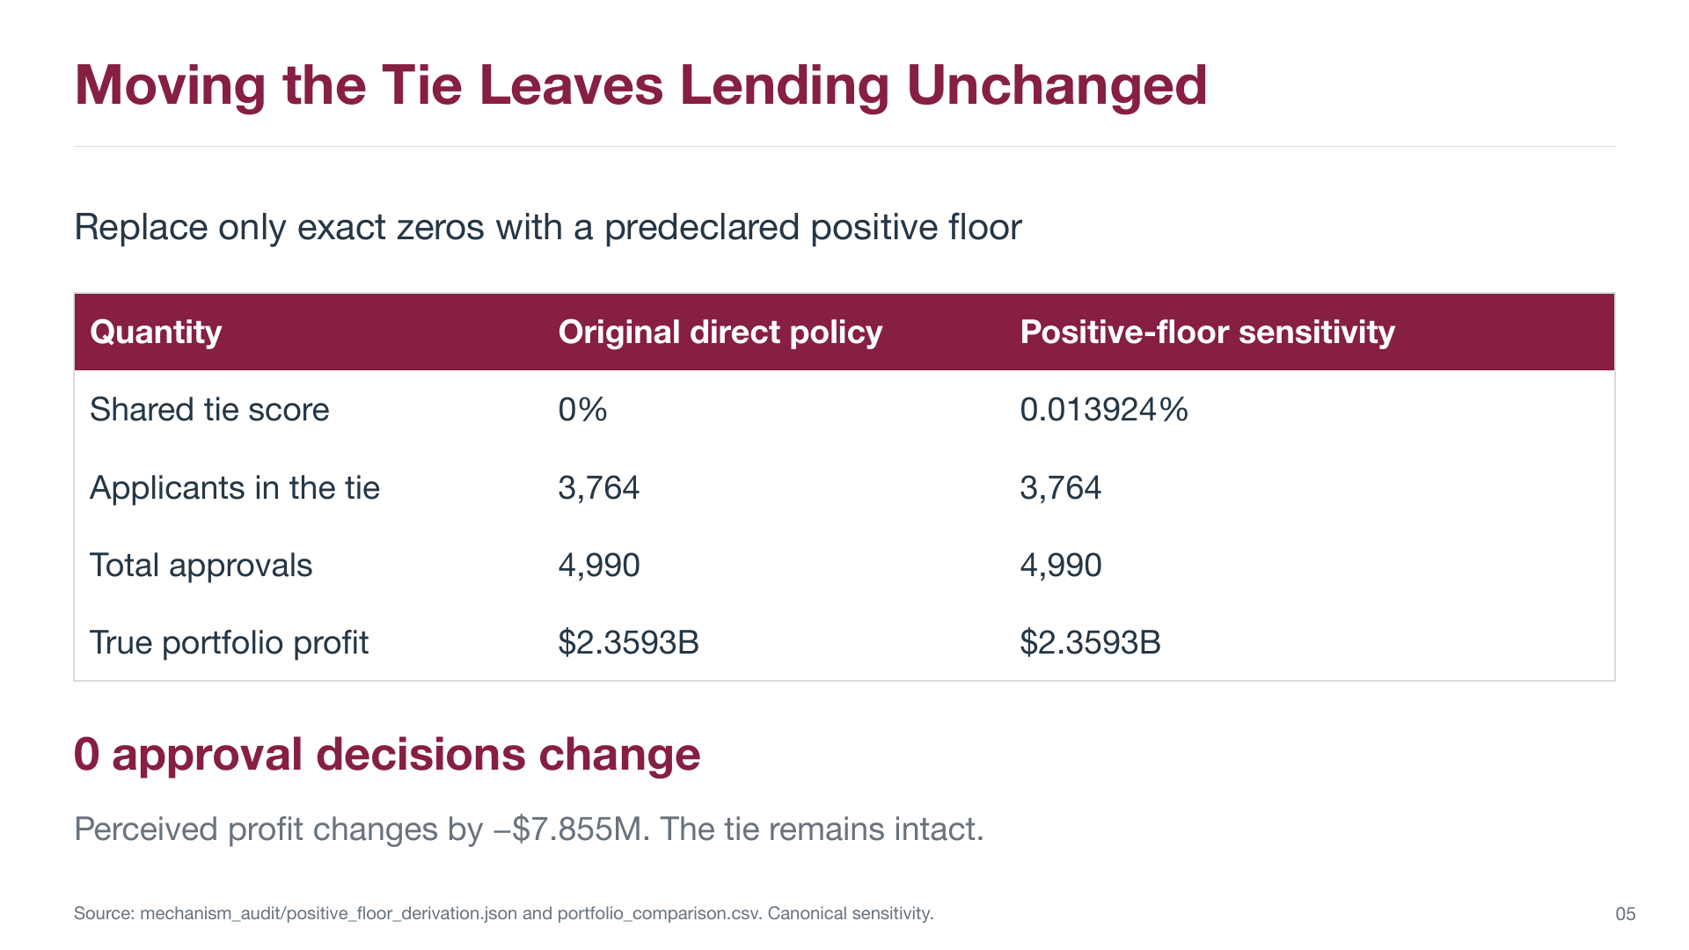
Historical appendix: earlier specification and saved results
09
Notes:
This page preserves the earlier slide for context. The original -0.1B treatment and positive-floor sensitivity. Its numbers, methods, and original page marker are unchanged. It does not describe the new +0.01B/Systemic/ML run. The new November 2 conclusions are on slides 3 through 8.
Evidence and interpretation
/Users/macbook/Desktop/nov_2_followup_slide_update.pptx.pdf, original PDF page 9. Source SHA-256 97e471a5e34be3e42011d77999e4456af5c1d3dee1c5f8090a7d52b4bc0b821a.
Historical reference image: full page preserved with proportional fit, below an explicit historical banner. Native new-result charts appear only on slides 5 and 8.
The historical experiment was not rerun or reinterpreted as a new result.
Single matched synthetic realization. No empirical mortgage-discrimination claim.

Slide 10
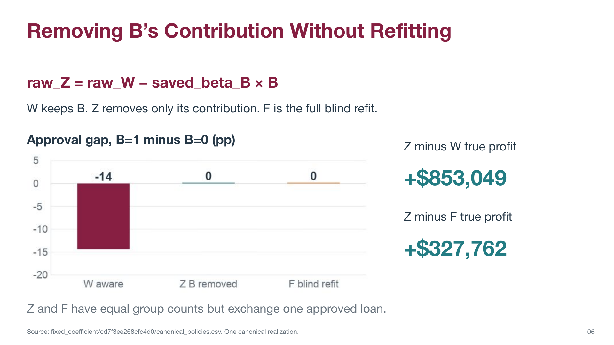
Historical appendix: earlier specification and saved results
10
Notes:
This page preserves the earlier slide for context. The prior W/Z/F coefficient-removal comparison. Its numbers, methods, and original page marker are unchanged. It does not describe the new +0.01B/Systemic/ML run. The new November 2 conclusions are on slides 3 through 8.
Evidence and interpretation
/Users/macbook/Desktop/nov_2_followup_slide_update.pptx.pdf, original PDF page 10. Source SHA-256 97e471a5e34be3e42011d77999e4456af5c1d3dee1c5f8090a7d52b4bc0b821a.
Historical reference image: full page preserved with proportional fit, below an explicit historical banner. Native new-result charts appear only on slides 5 and 8.
The historical experiment was not rerun or reinterpreted as a new result.
Single matched synthetic realization. No empirical mortgage-discrimination claim.

Slide 11
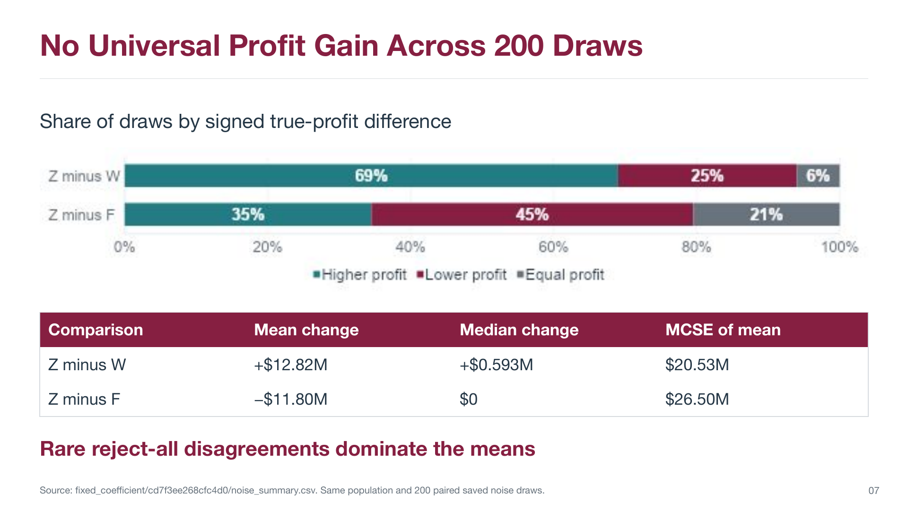
Historical appendix: earlier specification and saved results
11
Notes:
This page preserves the earlier slide for context. The prior 200-noise-draw study on one fixed population. Its numbers, methods, and original page marker are unchanged. It does not describe the new +0.01B/Systemic/ML run. The new November 2 conclusions are on slides 3 through 8.
Evidence and interpretation
/Users/macbook/Desktop/nov_2_followup_slide_update.pptx.pdf, original PDF page 11. Source SHA-256 97e471a5e34be3e42011d77999e4456af5c1d3dee1c5f8090a7d52b4bc0b821a.
Historical reference image: full page preserved with proportional fit, below an explicit historical banner. Native new-result charts appear only on slides 5 and 8.
The historical experiment was not rerun or reinterpreted as a new result.
Single matched synthetic realization. No empirical mortgage-discrimination claim.

Slide 12
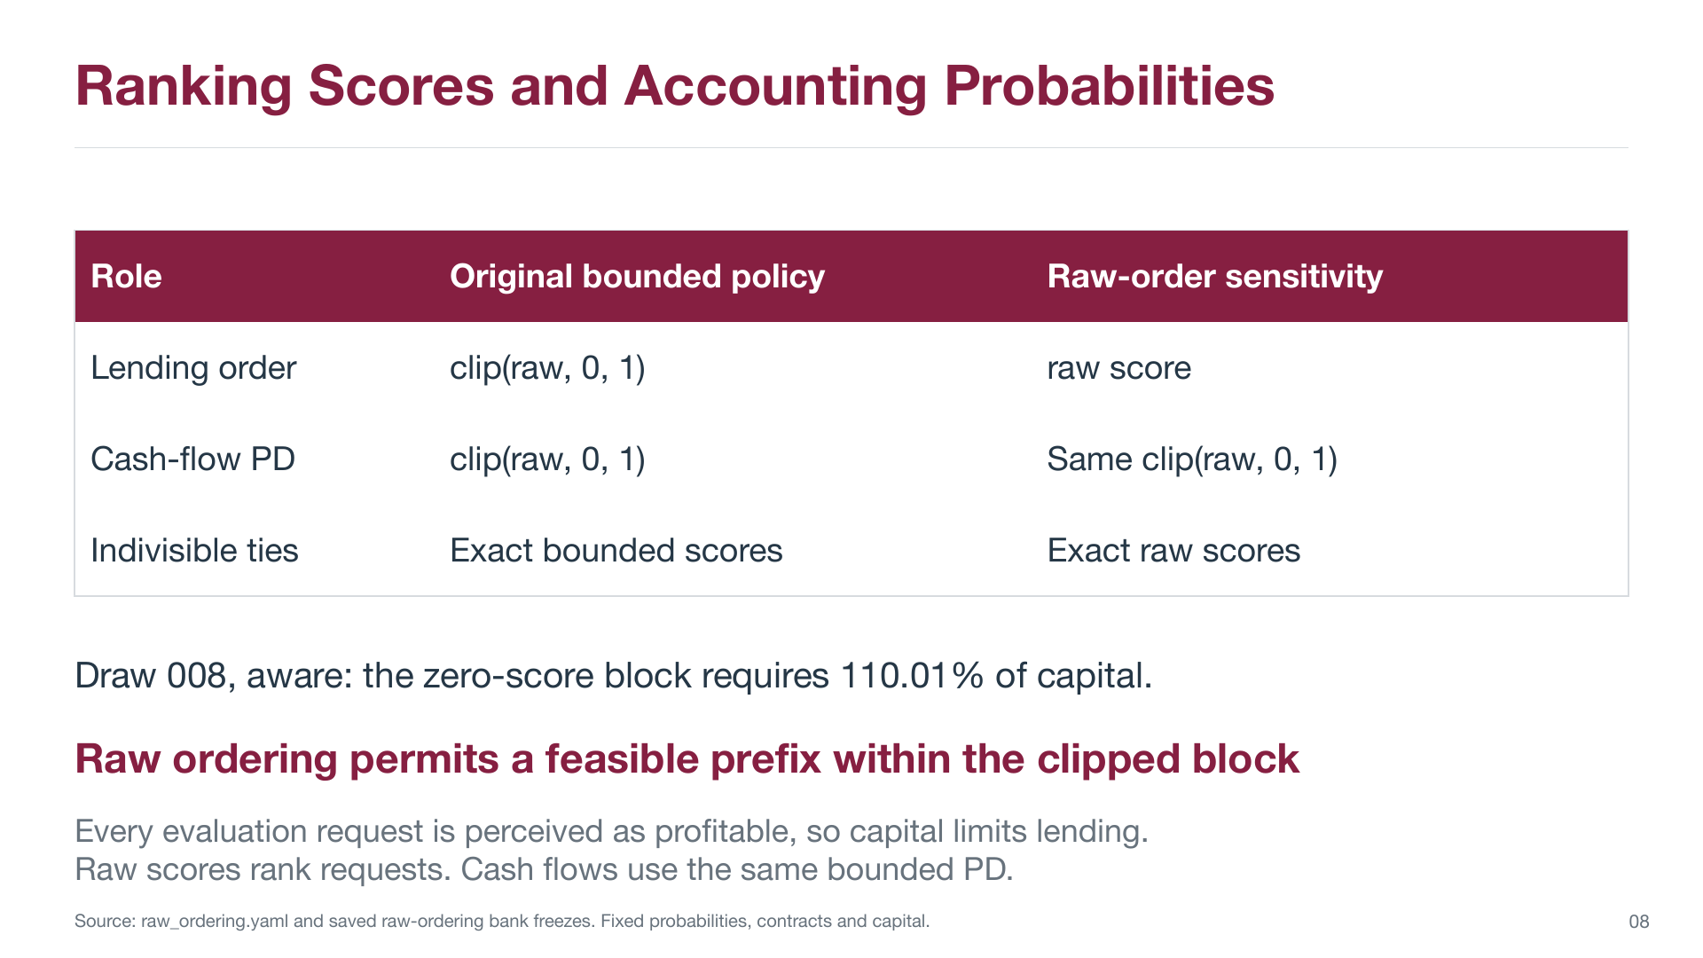
Historical appendix: earlier specification and saved results
12
Notes:
This page preserves the earlier slide for context. The separate prior raw-ordering policy sensitivity. Its numbers, methods, and original page marker are unchanged. It does not describe the new +0.01B/Systemic/ML run. The new November 2 conclusions are on slides 3 through 8.
Evidence and interpretation
/Users/macbook/Desktop/nov_2_followup_slide_update.pptx.pdf, original PDF page 12. Source SHA-256 97e471a5e34be3e42011d77999e4456af5c1d3dee1c5f8090a7d52b4bc0b821a.
Historical reference image: full page preserved with proportional fit, below an explicit historical banner. Native new-result charts appear only on slides 5 and 8.
The historical experiment was not rerun or reinterpreted as a new result.
Single matched synthetic realization. No empirical mortgage-discrimination claim.

Slide 13
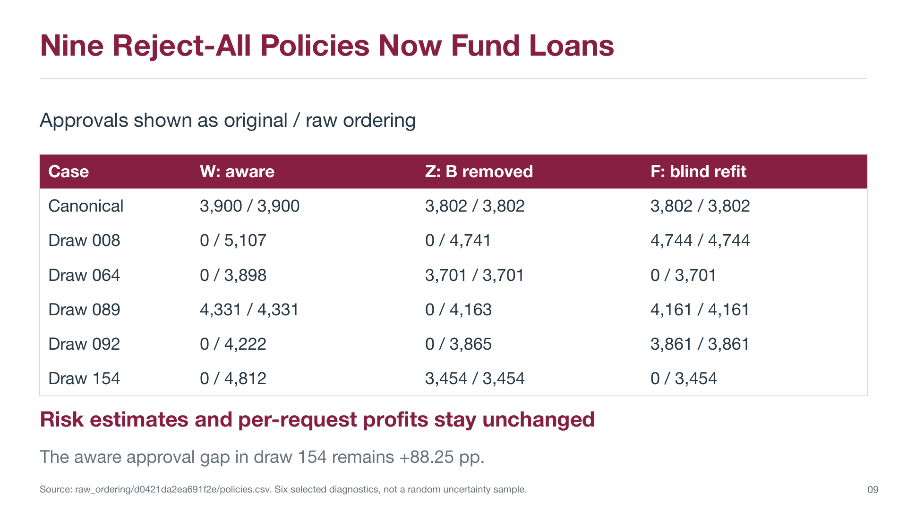
Historical appendix: earlier specification and saved results
13
Notes:
This page preserves the earlier slide for context. The prior six selected raw-ordering diagnostic cases. Its numbers, methods, and original page marker are unchanged. It does not describe the new +0.01B/Systemic/ML run. The new November 2 conclusions are on slides 3 through 8.
Evidence and interpretation
/Users/macbook/Desktop/nov_2_followup_slide_update.pptx.pdf, original PDF page 13. Source SHA-256 97e471a5e34be3e42011d77999e4456af5c1d3dee1c5f8090a7d52b4bc0b821a.
Historical reference image: full page preserved with proportional fit, below an explicit historical banner. Native new-result charts appear only on slides 5 and 8.
The historical experiment was not rerun or reinterpreted as a new result.
Single matched synthetic realization. No empirical mortgage-discrimination claim.

Slide 14
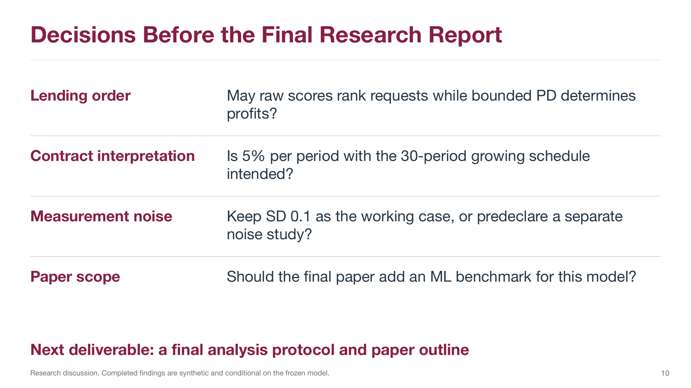
Historical appendix: earlier specification and saved results
14
Notes:
This page preserves the earlier slide for context. Historical discussion questions, not a current work-status claim. Its numbers, methods, and original page marker are unchanged. It does not describe the new +0.01B/Systemic/ML run. The new November 2 conclusions are on slides 3 through 8.
Evidence and interpretation
/Users/macbook/Desktop/nov_2_followup_slide_update.pptx.pdf, original PDF page 14. Source SHA-256 97e471a5e34be3e42011d77999e4456af5c1d3dee1c5f8090a7d52b4bc0b821a.
Historical reference image: full page preserved with proportional fit, below an explicit historical banner. Native new-result charts appear only on slides 5 and 8.
The prior question about adding an ML benchmark is historical; this new experiment now implements the specified gradient-boosting regressor.
Single matched synthetic realization. No empirical mortgage-discrimination claim.

