Slide 1
Lending Under Imperfect Information
Final update: discrimination and predictive lending
Nguyen Phan Nguyen
Virginia Tech - ECON 4994
3 November 2026
How does direct discrimination affect bank profit,
and how does gradient boosting compare with OLS?
Group A (B=0). Minority Group B (B=1). Selected penalty: +0.005B.
80,000 training. 20,000 prediction. Profits only from the prediction subset.
Single matched synthetic run. Penalty calibrated to prediction-group approvals for illustration.
01
Notes:
Following your feedback, I reduced the manual penalty. I started with 0.005 times B and used the predeclared descending sequence only if needed. The common selected value is 0.005. Group B now receives some loans but has a lower approval rate than Group A in both risk scenarios. The models remain frozen from the previous run. They learned from 80,000 training applicants, and all lending and profit results use the separate 20,000 prediction applicants. I frame the comparison as naïve OLS estimation, direct discrimination through an added penalty, and a more flexible gradient-boosting estimator, without assuming that ML must win.
Evidence and interpretation
Professor feedback supplied in the conversation; the 14-slide structure and earlier results remain preserved in prior deliveries.
configs/professor_model/small_penalty.yaml; results/metrics/professor_model/small_penalty/selection.json; run_manifest.json.
/Users/macbook/Desktop/nov_2_followup_slide_update.pptx.pdf; supplied source PDF SHA-256 97e471a5e34be3e42011d77999e4456af5c1d3dee1c5f8090a7d52b4bc0b821a.
The penalty is chosen using prediction-cohort approval counts. This is an illustrative policy calibration, not independent empirical evidence of discrimination.
Single matched synthetic realization. No empirical mortgage-discrimination claim.

Slide 2
Training, Prediction and Bank Profit
80,000 TRAINING applicants
Observed characteristics, credit proxy C
and historical-style noisy PN
20,000 PREDICTION applicants
Frozen OLS and gradient-boosting models
produce default-risk scores
The bank cannot observe true PD or every risk determinant.
PN = 0.8 true_PD + η
C is a noisy proxy for the hidden risk factor.
OLS control / OLS + 0.005B / ML
Bounded PD = clip(raw score, 0, 1)
Capital-constrained
common lending cutoff
Expected loan profit
Σ c_t (1−p)^t − L
Prediction-subset
expected cash flows
All approvals and all reported profits use prediction applicants only
Working contract: T=30, theta=0.10, r=5% per period. Fixed capital $1.826087B.
02
Notes:
This makes the split explicit. The training subset mimics past loan information and prior noisy risk measurements. OLS and Gradient Boosting use permitted characteristics and the credit proxy to learn PN. The bank does not observe true PD or every determinant of risk. We then apply frozen models to a separate prediction subset, add the manual group penalty only in that branch, clip scores for economic accounting, and select a common cutoff under capital. We calculate profits only from those prediction applicants. For ML, its original 64,000/16,000 fitting-validation subdivision is entirely within the 80,000 training applicants, followed by an 80,000-row refit. No model was refit for this smaller-penalty update.
Evidence and interpretation
Original applicant_splits.csv and model_metadata.json from the frozen November 2 experiment; new split audit verifies disjointness and exact prediction-contract coverage.
The original contracts/profit functions use constant conditional per-period default and a survival-weighted payment sum. They are stylized expected values, not conventional mortgage returns.
No prediction target, hidden true risk or true profit is used to fit or choose the original models.
Single matched synthetic realization. No empirical mortgage-discrimination claim.

Slide 3
Scenario 1: No Systemic Differences
Group A and minority Group B share
the same underlying risk process
The bank observes Y, D and C to estimate default risk.
The direct-discrimination branch adds +0.005B
after the OLS fit and before probability clipping.
The added group penalty is arbitrary relative to the group-neutral true-risk process.
Same group-neutral generating process. Finite realized group averages may differ.
03
Notes:
In the first risk scenario, Group A and minority Group B are generated under the same underlying risk conditions. This does not require their finite sample means to be numerically identical. Neither the OLS control nor Gradient Boosting includes B. The bank with direct discrimination adds a positive penalty after estimation, despite the lack of an underlying group treatment in true risk. This lets us compare an unadjusted estimate with the same estimate plus arbitrary discriminatory treatment.
Evidence and interpretation
Original November 2 Scenario 1 population, truth, observed inputs and noise remain unchanged.
Scenario 1 feature set: Y, D, C for both OLS and Gradient Boosting. The only new score change is the selected post-fit penalty.
Single matched synthetic realization. No empirical mortgage-discrimination claim.

Slide 4
Scenario 1: Three Lending Methods
Higher estimated default risk lowers lending priority
Method | Raw score | Interpretation
OLS control | f_OLS(Y, D, C) | Naïve risk estimation
OLS + penalty | f_OLS(Y, D, C) + 0.005 B | Direct discrimination: +0.5 pp for B=1
Gradient boosting | f_ML(Y, D, C) | Flexible predictive estimation
Training: 80,000. Prediction and profit: 20,000.
Penalty selected from prediction-group approvals for illustration. True profit is not a selection criterion.
Same permitted information within each scenario. Historical models and prediction scores remain frozen.
04
Notes:
These are three methods under Scenario 1, not three different applicant populations. OLS control is the naïve linear risk estimator. The discriminatory method uses exactly the same fitted OLS score and adds 0.005 times B. Gradient Boosting is the flexible predictive comparator, with performance evaluated empirically rather than assumed to be superior. The information set is Y, D, C; B is excluded from the first scenario fitted models. The common penalty was selected using prediction-cohort approval rates to meet the professor’s illustrative condition. This does not contaminate the model-fitting split with prediction labels, but the policy choice is not an untouched confirmatory evaluation.
Evidence and interpretation
results/metrics/professor_model/small_penalty/selection.json; results/tables/professor_model/small_penalty/penalty_search.csv.
Parent November 2 model metadata: original 80,000 training rows, 64,000/16,000 internal ML selection, then final 80,000-row refit.
No OLS refit, ML tuning, new noise, new population or true-profit-based penalty choice occurs in this update.
Single matched synthetic realization. No empirical mortgage-discrimination claim.

Slide 5
Scenario 1: Prediction-Subset Results
Profits: prediction subset only. Gradient boosting uses 72.4% of capital.
Within-group approval rate
True expected profit by group ($B)
Penalty +0.005B: A 4,251/16,970 (25.05%); B 3/3,030 (0.10%).
Penalty minus control: true expected portfolio profit −$3.733M
Source: small_penalty/group_results.csv and portfolio_results.csv. Same contracts and capital.
05
Notes:
All results here use the same 20,000 prediction applicants, never the 80,000 training applicants. For Scenario 1, the selected common penalty is 0.005 times B, added to the frozen OLS raw score before clipping. Group A has 4251 approvals out of 16970 and minority Group B has 3 out of 3030. Group B therefore has positive lending at a lower rate than A. The true expected portfolio profit difference from control is −$3.733M. The profit bars sum each group's funded-loan contributions, so unequal group sizes matter. ML uses 72.4065 percent of capital; its next indivisible prediction block cannot fit under the common cutoff. More approvals need not mean greater capital use or greater profit. These are nominal synthetic expected values, not annual realized returns.
Evidence and interpretation
results/tables/professor_model/small_penalty/group_results.csv; portfolio_results.csv; penalty_comparisons.csv.
Raw model predictions, control/ML portfolios, the 80,000/20,000 split, contracts and capital are reused unchanged from the November 2 experiment.
Penalty selection uses prediction-cohort group approval counts for illustration, not hidden true risk or true profit. The selected comparison is not an untouched confirmatory test.
Group A = B=0. Minority Group B = B=1. Exact approval counts remain visible because a small positive rate can otherwise look like zero.
Single matched synthetic realization. No empirical mortgage-discrimination claim.

Slide 6
Scenario 2: Systemic Differences
Group B has a higher hidden risk factor
from a process outside the lending decision
ε₂ = ε₁ + B
C₂ = 0.4 ε₂ + ω
PN₂ = 0.8 true_PD₂ + the same η
OLS and Gradient Boosting use Y, D, C and B
Group B mean true PD: 0.14229% to 0.14476%.
The risk function is unchanged. Between-world results also change the permitted predictors.
Existing +1 SD epsilon shift for minority Group B. No new population or risk-equation change.
06
Notes:
The second scenario represents a systemic difference outside this bank’s lending decision, potentially analogous to unequal treatment in other domains or the past. We do not claim real-world evidence about why any actual group is riskier. The existing synthetic world shifts epsilon by one standard deviation for Group B and updates C consistently. The noisy measurement uses the same eta. That existing risk response is modest because the frozen sigmoid is near saturation. We preserve it without retuning. Both fitted methods include B in this scenario. Changing both risk conditions and the feature set means the cross-scenario contrast is not a pure epsilon-only causal effect.
Evidence and interpretation
results/tables/professor_model/small_penalty/systemic_risk_audit.csv is a hash-identical copy of the parent audit.
Original risk: sigmoid(.52-.65 logY)*sigmoid(4+.06D+epsilon); C=.4epsilon+omega. The small-penalty study does not regenerate these variables.
Single matched synthetic realization. No empirical mortgage-discrimination claim.

Slide 7
Scenario 2: Three Lending Methods
Higher estimated default risk lowers lending priority
Method | Raw score | Interpretation
OLS control | f_OLS(Y, D, C, B) | Naïve risk estimation
OLS + penalty | f_OLS(Y, D, C, B) + 0.005 B | Direct discrimination: +0.5 pp for B=1
Gradient boosting | f_ML(Y, D, C, B) | Flexible predictive estimation
Training: 80,000. Prediction and profit: 20,000.
Penalty selected from prediction-group approvals for illustration. True profit is not a selection criterion.
Same permitted information within each scenario. Historical models and prediction scores remain frozen.
07
Notes:
These are three methods under Scenario 2, not three different applicant populations. OLS control is the naïve linear risk estimator. The discriminatory method uses exactly the same fitted OLS score and adds 0.005 times B. Gradient Boosting is the flexible predictive comparator, with performance evaluated empirically rather than assumed to be superior. The information set is Y, D, C, B; B is included in the second scenario because group membership can contain information about the systemic difference. It is therefore not a group-blind fit. The common penalty was selected using prediction-cohort approval rates to meet the professor’s illustrative condition. This does not contaminate the model-fitting split with prediction labels, but the policy choice is not an untouched confirmatory evaluation.
Evidence and interpretation
results/metrics/professor_model/small_penalty/selection.json; results/tables/professor_model/small_penalty/penalty_search.csv.
Parent November 2 model metadata: original 80,000 training rows, 64,000/16,000 internal ML selection, then final 80,000-row refit.
No OLS refit, ML tuning, new noise, new population or true-profit-based penalty choice occurs in this update.
Single matched synthetic realization. No empirical mortgage-discrimination claim.

Slide 8
Scenario 2: Prediction-Subset Results
Profits: prediction subset only. Gradient boosting uses 87.2% of capital.
Within-group approval rate
True expected profit by group ($B)
Penalty +0.005B: A 4,265/16,970 (25.13%); B 1/3,030 (0.03%).
Penalty minus control: true expected portfolio profit −$2.983M
Source: small_penalty/group_results.csv and portfolio_results.csv. Same contracts and capital.
08
Notes:
All results here use the same 20,000 prediction applicants, never the 80,000 training applicants. For Scenario 2, the selected common penalty is 0.005 times B, added to the frozen OLS raw score before clipping. Group A has 4265 approvals out of 16970 and minority Group B has 1 out of 3030. Group B therefore has positive lending at a lower rate than A. The true expected portfolio profit difference from control is −$2.983M. The profit bars sum each group's funded-loan contributions, so unequal group sizes matter. ML uses 87.2452 percent of capital; its next indivisible prediction block cannot fit under the common cutoff. More approvals need not mean greater capital use or greater profit. These are nominal synthetic expected values, not annual realized returns.
Evidence and interpretation
results/tables/professor_model/small_penalty/group_results.csv; portfolio_results.csv; penalty_comparisons.csv.
Raw model predictions, control/ML portfolios, the 80,000/20,000 split, contracts and capital are reused unchanged from the November 2 experiment.
Penalty selection uses prediction-cohort group approval counts for illustration, not hidden true risk or true profit. The selected comparison is not an untouched confirmatory test.
Group A = B=0. Minority Group B = B=1. Exact approval counts remain visible because a small positive rate can otherwise look like zero.
Single matched synthetic realization. No empirical mortgage-discrimination claim.

Slide 9
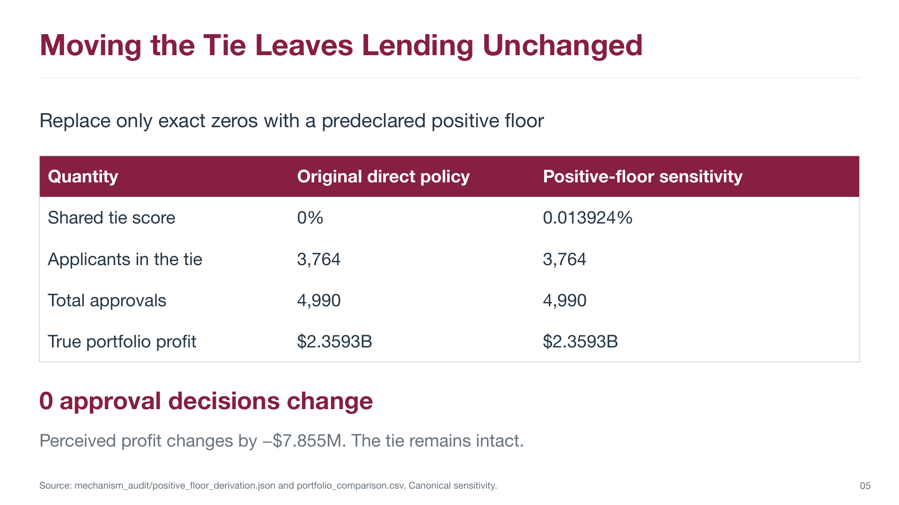
Historical appendix: earlier specification and saved results
09
Notes:
This page preserves the earlier slide for context. The original -0.1B treatment and positive-floor sensitivity. Its numbers, methods, and original page marker are unchanged. It does not describe the new smaller-penalty demonstration. The new smaller-penalty results are on slides 3 through 8.
Evidence and interpretation
/Users/macbook/Desktop/nov_2_followup_slide_update.pptx.pdf, original PDF page 9. Source SHA-256 97e471a5e34be3e42011d77999e4456af5c1d3dee1c5f8090a7d52b4bc0b821a.
Historical reference image: full page preserved with proportional fit, below an explicit historical banner. Native new-result charts appear only on slides 5 and 8.
The historical experiment was not rerun or reinterpreted as a new result.
Single matched synthetic realization. No empirical mortgage-discrimination claim.

Slide 10
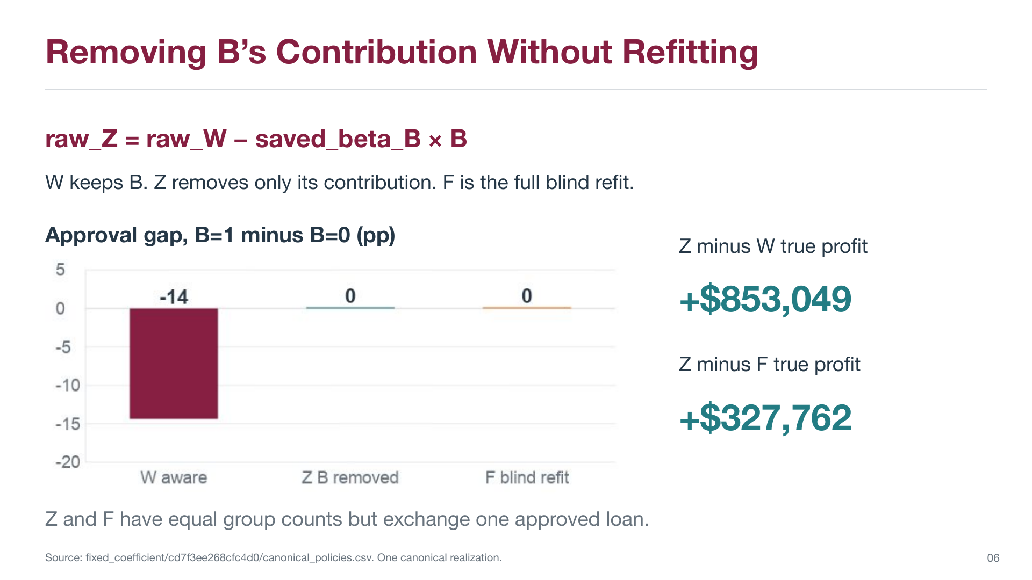
Historical appendix: earlier specification and saved results
10
Notes:
This page preserves the earlier slide for context. The prior W/Z/F coefficient-removal comparison. Its numbers, methods, and original page marker are unchanged. It does not describe the new smaller-penalty demonstration. The new smaller-penalty results are on slides 3 through 8.
Evidence and interpretation
/Users/macbook/Desktop/nov_2_followup_slide_update.pptx.pdf, original PDF page 10. Source SHA-256 97e471a5e34be3e42011d77999e4456af5c1d3dee1c5f8090a7d52b4bc0b821a.
Historical reference image: full page preserved with proportional fit, below an explicit historical banner. Native new-result charts appear only on slides 5 and 8.
The historical experiment was not rerun or reinterpreted as a new result.
Single matched synthetic realization. No empirical mortgage-discrimination claim.

Slide 11
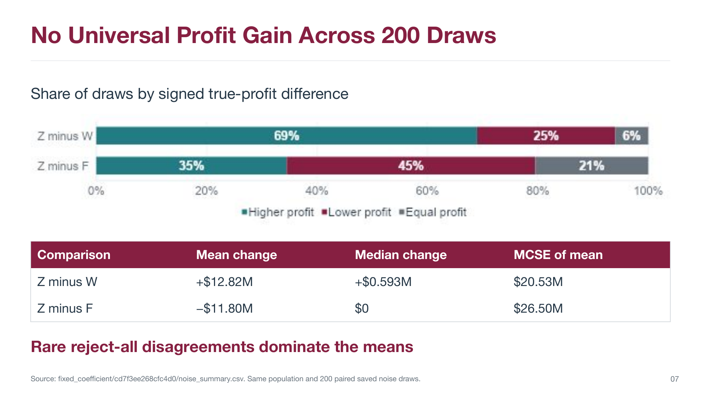
Historical appendix: earlier specification and saved results
11
Notes:
This page preserves the earlier slide for context. The prior 200-noise-draw study on one fixed population. Its numbers, methods, and original page marker are unchanged. It does not describe the new smaller-penalty demonstration. The new smaller-penalty results are on slides 3 through 8.
Evidence and interpretation
/Users/macbook/Desktop/nov_2_followup_slide_update.pptx.pdf, original PDF page 11. Source SHA-256 97e471a5e34be3e42011d77999e4456af5c1d3dee1c5f8090a7d52b4bc0b821a.
Historical reference image: full page preserved with proportional fit, below an explicit historical banner. Native new-result charts appear only on slides 5 and 8.
The historical experiment was not rerun or reinterpreted as a new result.
Single matched synthetic realization. No empirical mortgage-discrimination claim.

Slide 12
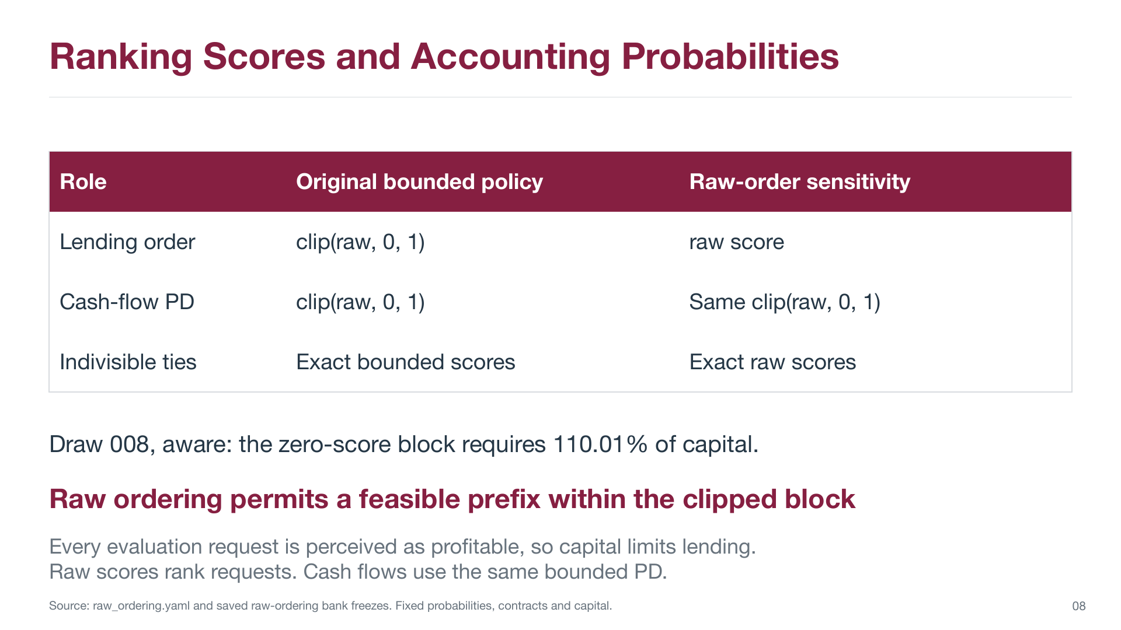
Historical appendix: earlier specification and saved results
12
Notes:
This page preserves the earlier slide for context. The separate prior raw-ordering policy sensitivity. Its numbers, methods, and original page marker are unchanged. It does not describe the new smaller-penalty demonstration. The new smaller-penalty results are on slides 3 through 8.
Evidence and interpretation
/Users/macbook/Desktop/nov_2_followup_slide_update.pptx.pdf, original PDF page 12. Source SHA-256 97e471a5e34be3e42011d77999e4456af5c1d3dee1c5f8090a7d52b4bc0b821a.
Historical reference image: full page preserved with proportional fit, below an explicit historical banner. Native new-result charts appear only on slides 5 and 8.
The historical experiment was not rerun or reinterpreted as a new result.
Single matched synthetic realization. No empirical mortgage-discrimination claim.

Slide 13
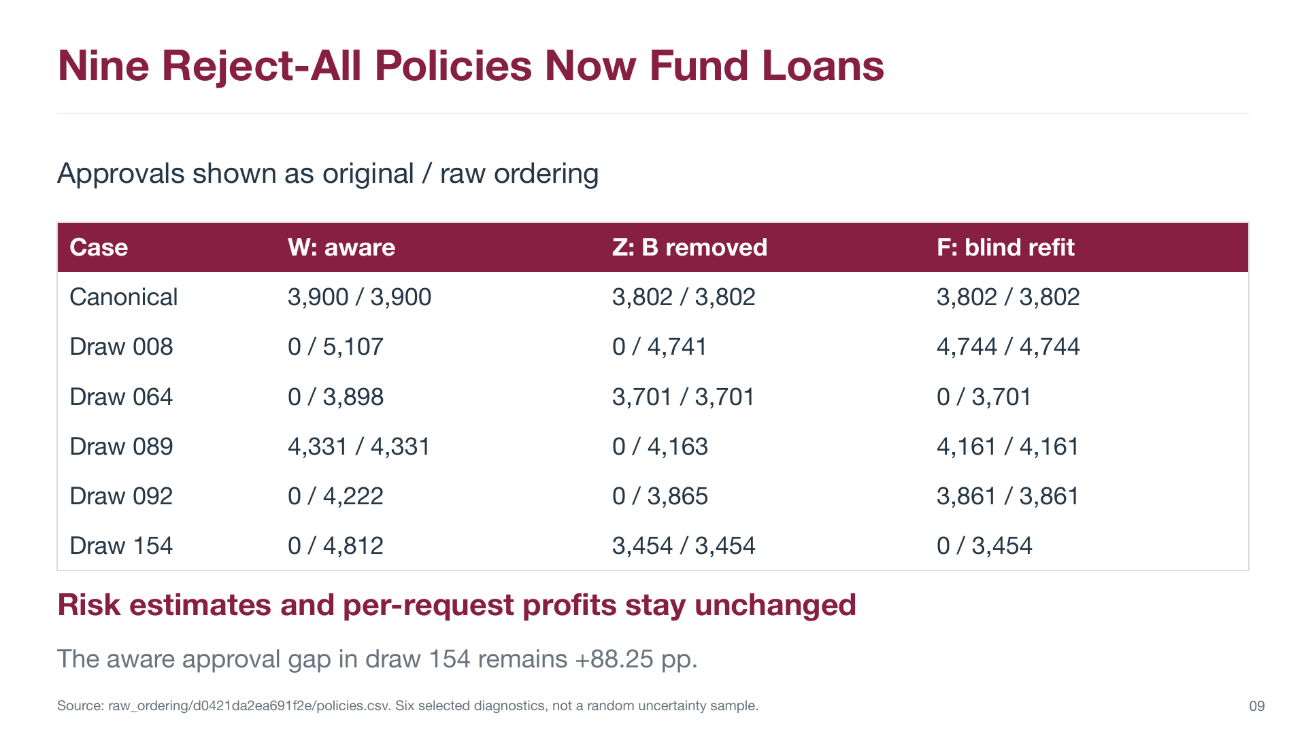
Historical appendix: earlier specification and saved results
13
Notes:
This page preserves the earlier slide for context. The prior six selected raw-ordering diagnostic cases. Its numbers, methods, and original page marker are unchanged. It does not describe the new smaller-penalty demonstration. The new smaller-penalty results are on slides 3 through 8.
Evidence and interpretation
/Users/macbook/Desktop/nov_2_followup_slide_update.pptx.pdf, original PDF page 13. Source SHA-256 97e471a5e34be3e42011d77999e4456af5c1d3dee1c5f8090a7d52b4bc0b821a.
Historical reference image: full page preserved with proportional fit, below an explicit historical banner. Native new-result charts appear only on slides 5 and 8.
The historical experiment was not rerun or reinterpreted as a new result.
Single matched synthetic realization. No empirical mortgage-discrimination claim.

Slide 14
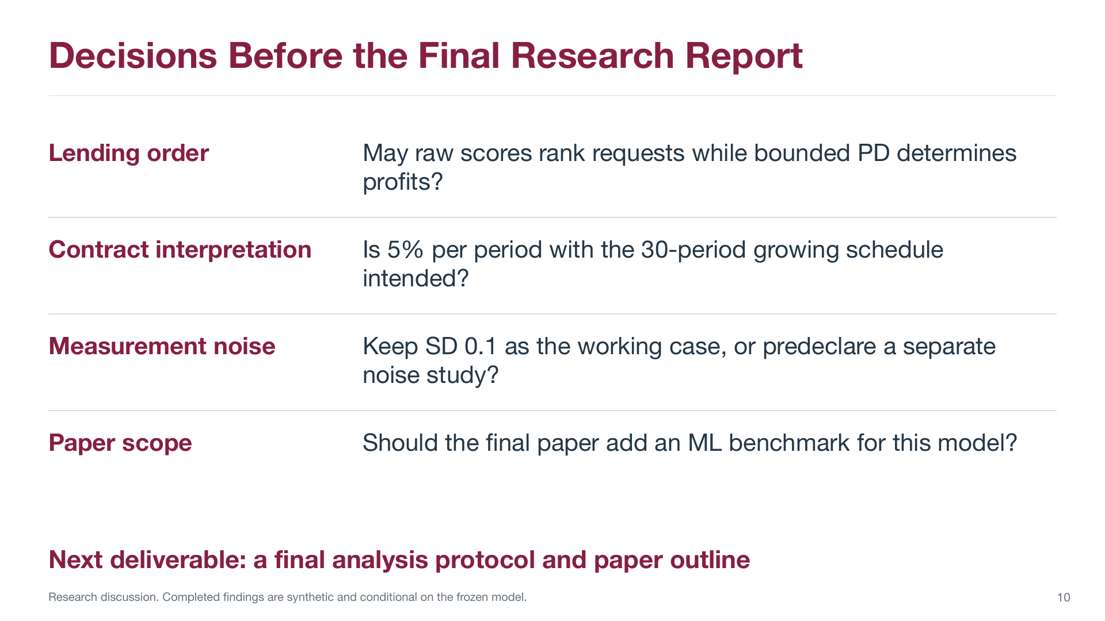
Historical appendix: earlier specification and saved results
14
Notes:
This page preserves the earlier slide for context. Historical discussion questions, not a current work-status claim. Its numbers, methods, and original page marker are unchanged. It does not describe the new smaller-penalty demonstration. The new smaller-penalty results are on slides 3 through 8.
Evidence and interpretation
/Users/macbook/Desktop/nov_2_followup_slide_update.pptx.pdf, original PDF page 14. Source SHA-256 97e471a5e34be3e42011d77999e4456af5c1d3dee1c5f8090a7d52b4bc0b821a.
Historical reference image: full page preserved with proportional fit, below an explicit historical banner. Native new-result charts appear only on slides 5 and 8.
The prior question about adding an ML benchmark is historical; the parent November 2 experiment already implemented the frozen gradient-boosting regressor.
Single matched synthetic realization. No empirical mortgage-discrimination claim.

