Slide 1
Lending Under Imperfect Information
Follow-up: group effects, clipping and lending order
Nguyen Phan Nguyen
Virginia Tech — ECON 4994
28 October 2026
Which lending differences come from the fitted score,
and which come from clipping and the lending rule?
20,000 evaluation applicants. Contracts and capital stay fixed.
Synthetic simulation. Follow-up to the supplied eight-slide progress report.
01
Notes:
Last time, I showed that noisy bank estimates could produce unstable group lending gaps. This update follows the revised direct and no-direct comparison in the slide you reviewed. I have now separated the manual group adjustment, removal of the fitted group contribution, and the effect of using clipped probabilities to order loans. The applicant population, contracts, and capital stay fixed throughout.
Evidence
/Users/macbook/Desktop/oct15_progress.pptx.pdf, slides 2 and 8. Source PDF SHA-256: 1560a66b7670853981c00ccec4b0eef7e067e57720f89ccfe570158bda4f62d4.
docs/CURRENT_RESEARCH.md; docs/professor_raw_ordering_sensitivity.md. The original 200-noise-draw study and new selected diagnostics are distinct designs.

Slide 2
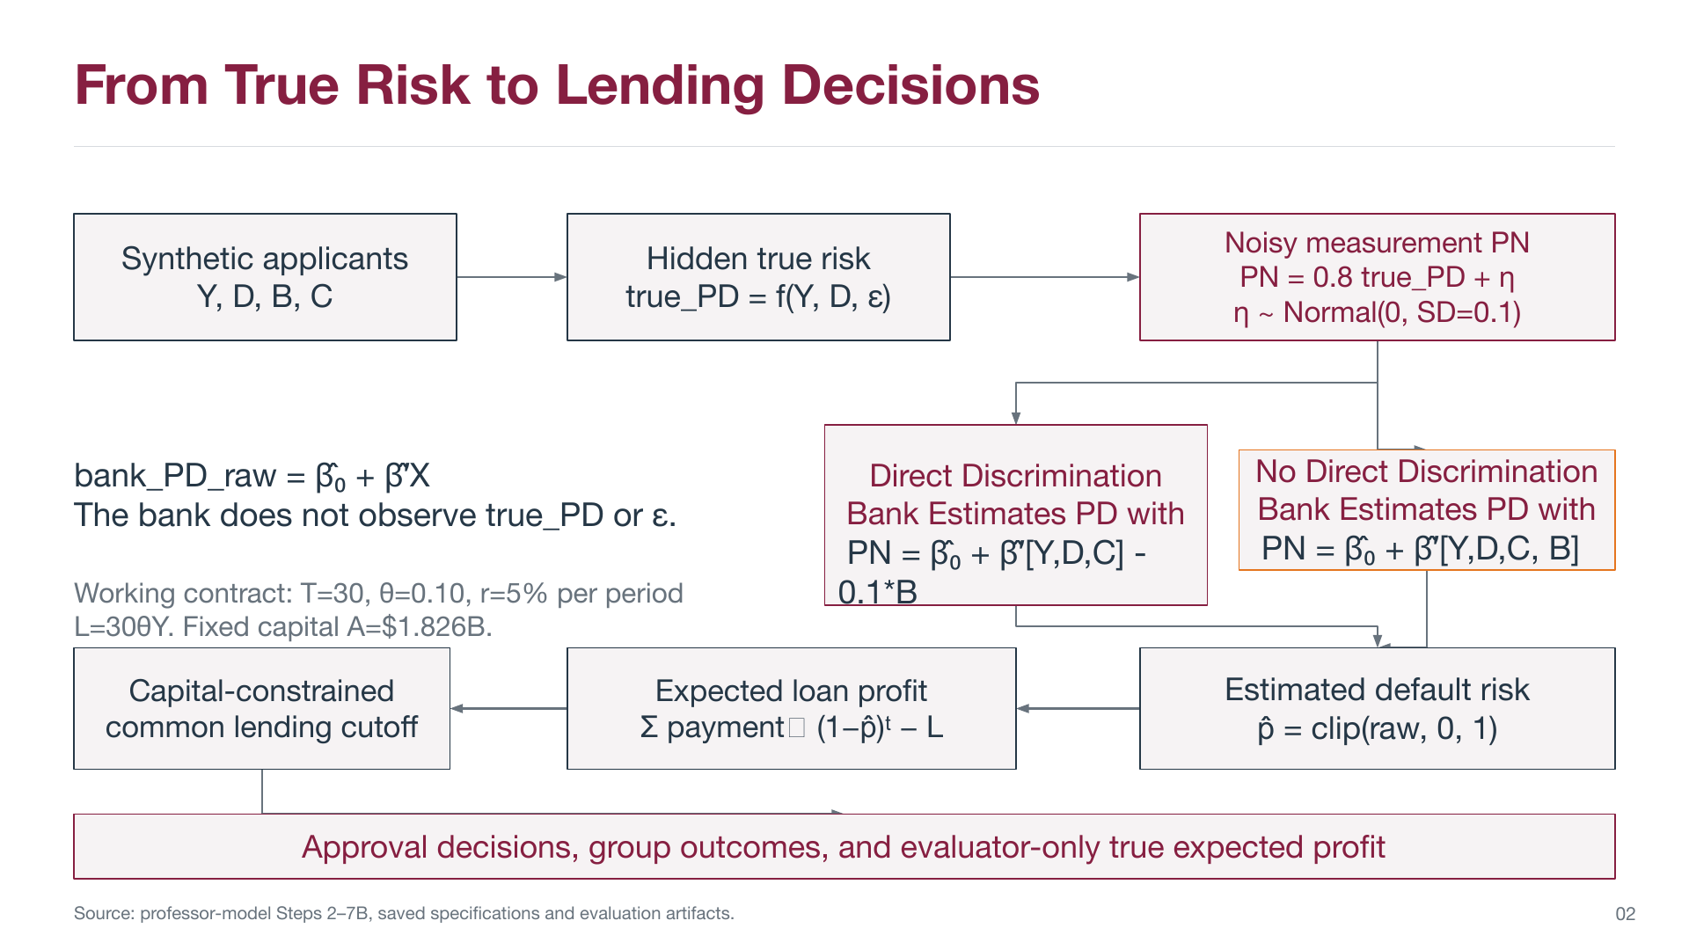
Σ payment_t (1−p̂)^t − L
Notes:
This is the model diagram from the previous presentation, included for context with its missing payment-subscript glyph displayed as payment_t. Applicants have observable Y, D, B and C, but the bank does not observe hidden true risk or epsilon. The bank fits the noisy PN target, forms a raw score, clips it for default-probability accounting, and chooses a common lending cutoff under fixed capital. The two branches show the professor-reviewed direct and no-direct specifications. The following slide clarifies the score notation and introduces the matched blind control. In this original diagram the branch formulas are labeled PN. In the follow-up I use raw bank score for those fitted expressions and reserve PN for the observed noisy target.
Evidence
/Users/macbook/Desktop/oct15_progress.pptx.pdf, original slide 2, inserted at the user’s explicit request. Original PDF SHA-256: 1560a66b7670853981c00ccec4b0eef7e067e57720f89ccfe570158bda4f62d4.
Imported as a high-resolution reference image to preserve the original reviewed content and diagram. The expected-profit formula uses a native text overlay to repair the source PDF’s missing subscript glyph, with unchanged mathematics. The remaining slides retain native editable objects.
This is context from the earlier deck, not new research evidence. Its manual minus 0.1B adjustment is distinct from removing the fitted B coefficient.

Slide 3
The Revised Direct and No-Direct Comparison
PN = 0.8 true_PD + η remains the regression target
Scenario | Raw bank score | Interpretation
No manual adjustment Aware model | f_W(Y, D, C, B) | B remains a fitted predictor
Direct adjustment Blind base | f_F(Y, D, C) − 0.1 B | Lower estimated PD favors B=1
Matched control Blind base | f_F(Y, D, C) | Same fit without the adjustment
The direct/control comparison keeps the blind fit fixed
Comparing aware and blind fits also changes the intercept and other slopes.
Source: revised_lending/portfolio_comparison.csv and the supplied reference slide 2. Canonical synthetic fits.
03
Notes:
The revised slide splits lending into an aware model without a manual adjustment and a blind model with minus 0.1 times B. I added the unadjusted blind model as a matched control. This matters because aware versus blind also changes the estimated intercept and other slopes. I label these expressions as raw bank scores. PN itself remains the noisy measurement used as the regression target. The minus sign reduces perceived default risk, so this particular treatment favors B=1.
Evidence
/Users/macbook/Desktop/oct15_progress.pptx.pdf, slide 2. Its branch labels are part of the reference content. The PDF has no separate annotation comments.
configs/professor_model/revised_scenarios.yaml; docs/professor_revised_scenarios.md.
results/tables/professor_model/revised_lending/portfolio_comparison.csv: professor_no_direct_group_aware, professor_direct_minus_0p1_B, group_blind_no_adjustment_reference.
Notation: f_W and f_F are the frozen fitted linear equations including intercepts. This is distinct from true_PD and from the observed noisy PN target.

Slide 4
The −0.1B Adjustment Favors B=1
Approval rate by group
B=1 minus B=0 approval gap
+88.45 pp
Blind control +0.16 pp
True profit versus control
−$7.332M
All 3,030 B=1 requests receive funding after their estimated PD clips to zero.
Source: revised_lending/group_outcome_audit.csv and portfolio_comparison.csv. One canonical realization.
04
Notes:
The minus 0.1 adjustment is ten percentage points on the raw default-score scale, much larger than the original predicted risks. It makes every B=1 raw score negative, so clipping sets all of them to zero. All 3,030 B=1 requests receive funding. The B=0 approval rate falls because applicants compete for the same capital. The approval gap rises to 88.45 percentage points, while true expected portfolio profit falls by about 7.33 million dollars relative to the same blind fit without the adjustment. These dollar values use the unchanged stylized cash flows.
Evidence
results/tables/professor_model/revised_lending/group_outcome_audit.csv: direct B=0 1960/16970, B=1 3030/3030; control B=0 3222/16970, B=1 580/3030.
Approval gaps: direct 88.45020624631704 pp; control 0.1554675208239764 pp.
Direct minus blind-control true expected profit: -7332311.994407177 synthetic USD.
This is an intentionally inserted synthetic score adjustment. It does not identify real-world discrimination or imply that the frozen aware model is causally neutral.

Slide 5
Moving the Tie Leaves Lending Unchanged
Replace only exact zeros with a predeclared positive floor
Quantity | Original direct policy | Positive-floor sensitivity
Shared tie score | 0% | 0.013924%
Applicants in the tie | 3,764 | 3,764
Total approvals | 4,990 | 4,990
True portfolio profit | $2.3593B | $2.3593B
0 approval decisions change
Perceived profit changes by −$7.855M. The tie remains intact.
Source: mechanism_audit/positive_floor_derivation.json and portfolio_comparison.csv. Canonical sensitivity.
05
Notes:
I tested whether the exact zero level caused the direct-policy allocation. The floor is the first percentile of strictly positive frozen blind-control probabilities, chosen without looking at outcomes. I replaced only exact zeros, so positive scores below the floor stayed unchanged. The same 3,764-person block moves to a small positive risk level. It is still one indivisible tie. All 4,990 approvals and true profit remain identical, although perceived profit falls by about 7.855 million dollars. This rules out a need for the exact zero level in this one sensitivity. It does not show that ties are irrelevant.
Evidence
results/metrics/professor_model/mechanism_audit/positive_floor_derivation.json: quantile 0.01, NumPy method linear, floor=0.00013923734234194752, floor in percent=0.013923734234194752.
Source comprises 19,117 strictly positive control scores. Only 3,764 zeros are replaced; 161 smaller positive scores remain unchanged. No nonzero score already equals the new floor.
results/tables/professor_model/mechanism_audit/portfolio_comparison.csv: A_frozen_direct and D_positive_floor_sensitivity. Perceived profit D−A=-7854813.348162651 USD; true profit unchanged.
This is a separate researcher-chosen sensitivity, not a change to the professor-derived manual adjustment or a calibration of default probabilities.

Slide 6
Removing B’s Contribution Without Refitting
raw_Z = raw_W − saved_beta_B × B
W keeps B. Z removes only its contribution. F is the full blind refit.
Approval gap, B=1 minus B=0 (pp)
Z minus W true profit
+$853,049
Z minus F true profit
+$327,762
Z and F have equal group counts but exchange one approved loan.
Source: fixed_coefficient/cd7f3ee268cfc4d0/canonical_policies.csv. One canonical realization.
06
Notes:
This comparison isolates the fitted group contribution rather than refitting the entire model. For Z, I subtract each saved aware B coefficient times B, keep the aware intercept and every other slope fixed, then apply the original clipping. In the canonical case beta B is positive, approximately 0.0007105, so removing it lowers B=1 perceived risk. The approval gap becomes approximately 0.155 percentage points. Z increases true profit by about 853 thousand dollars relative to W, and 328 thousand relative to F. Z and F have identical group counts but approve different individual loans. This is one noise realization.
Evidence
docs/professor_fixed_coefficient_comparison.md: W=frozen_aware, Z=aware_B_zero, F=frozen_blind. All references frozen; only Z was optimized in Step 10B.
Canonical saved beta_B=0.0007105261442719142 raw probability units, or 0.07105261442719142 percentage points. This differs from the separate manual −0.1B treatment.
results/tables/professor_model/fixed_coefficient/cd7f3ee268cfc4d0/canonical_policies.csv: true profits W=2366074476.846421, Z=2366927525.686013, F=2366599763.614127.
canonical_overlap.csv: Z/F share 3,801 approvals with one exclusive approval each; group counts 3,222 B=0 and 580 B=1 for both.

Slide 7
No Universal Profit Gain Across 200 Draws
Share of draws by signed true-profit difference
Comparison | Mean change | Median change | MCSE of mean
Z minus W | +$12.82M | +$0.593M | $20.53M
Z minus F | −$11.80M | $0 | $26.50M
Rare reject-all disagreements dominate the means
Source: fixed_coefficient/cd7f3ee268cfc4d0/noise_summary.csv. Same population and 200 paired saved noise draws.
07
Notes:
I repeated the same coefficient-removal comparison using all 200 existing noise draws, with each draw’s own B coefficient and sign. Z has higher true profit than W in 138 draws, lower in 50, and equal in 12. Against F, those counts are 69, 90, and 41. The typical Z versus F difference is zero, even though the mean is negative 11.8 million dollars. Rare cases where one policy rejects everyone and another lends drive these averages. The Monte Carlo standard error exceeds the absolute mean difference in both new comparisons. I would therefore report medians, signs and tail cases together rather than rank policies using mean signs.
Evidence
results/tables/professor_model/fixed_coefficient/cd7f3ee268cfc4d0/noise_summary.csv: Z−W positive/negative/equal 138/50/12; Z−F 69/90/41.
Z−W mean=12820599.420715135, median=592951.2342464924, MCSE=20530175.828755636. Z−F mean=-11795630.333750335, median=0, MCSE=26504541.771507315. Values are synthetic USD.
The canonical case is excluded from these summaries. These are 200 paired noise realizations on one fixed population, not 200 independent populations.
docs/professor_post10b_review.md: three reject-all disagreements contribute $11.88M to the $12.82M mean Z−W effect. The partition is post-hoc, retains all draws, and is not a causal mediation decomposition.

Slide 8
Ranking Scores and Accounting Probabilities
Role | Original bounded policy | Raw-order sensitivity
Lending order | clip(raw, 0, 1) | raw score
Cash-flow PD | clip(raw, 0, 1) | Same clip(raw, 0, 1)
Indivisible ties | Exact bounded scores | Exact raw scores
Draw 008, aware: the zero-score block requires 110.01% of capital.
Raw ordering permits a feasible prefix within the clipped block
Every evaluation request is perceived as profitable, so capital limits lending.
Raw scores rank requests. Cash flows use the same bounded PD.
Source: raw_ordering.yaml and saved raw-ordering bank freezes. Fixed probabilities, contracts and capital.
08
Notes:
The next diagnostic separates two uses of the risk score. The original policy uses clipped probabilities both to rank loans and price their expected cash flows. The sensitivity uses raw scores only to order applicants while preserving the same bounded PD in the cash-flow calculation. Exact raw ties remain indivisible, and the original capital and full-loan rules remain unchanged. In draw 8 the aware zero-score block exceeds capital, forcing reject-all under bounded ordering. Raw scores preserve an ordering within that block. Every original bounded prefix remains available, so the optimized perceived profit cannot decrease. True profit has no general guarantee.
Evidence
configs/professor_model/raw_ordering.yaml: frozen raw score orders requests, unchanged clip(raw,0,1) determines survival and profit; no baseline reoptimization.
results/tables/professor_model/fixed_coefficient/cd7f3ee268cfc4d0/noise_policies.csv: noise_008/frozen_aware zero-block share of capital=1.100134051016103; 5,945 zero scores.
The exact prefix search independently checks all original bounded endpoints exist in the raw family, retains full requests and separate reject-all, and never treats negative scores as probabilities.
results/metrics/professor_model/post10b_review/cb0076a743e664e2.json: all 603 case/policy combinations perceive every evaluation request as profitable and select the largest capital-feasible prefix. This is conditional on the frozen stylized economics.
This changes the allowable cutoff policy class. It does not revise the professor’s original bounded policy, calibrate probabilities, or improve the fitted risk model.

Slide 9
Nine Reject-All Policies Now Fund Loans
Approvals shown as original / raw ordering
Case | W: aware | Z: B removed | F: blind refit
Canonical | 3,900 / 3,900 | 3,802 / 3,802 | 3,802 / 3,802
Draw 008 | 0 / 5,107 | 0 / 4,741 | 4,744 / 4,744
Draw 064 | 0 / 3,898 | 3,701 / 3,701 | 0 / 3,701
Draw 089 | 4,331 / 4,331 | 0 / 4,163 | 4,161 / 4,161
Draw 092 | 0 / 4,222 | 0 / 3,865 | 3,861 / 3,861
Draw 154 | 0 / 4,812 | 3,454 / 3,454 | 0 / 3,454
Risk estimates and per-request profits stay unchanged
The aware approval gap in draw 154 remains +88.25 pp.
Source: raw_ordering/d0421da2ea691f2e/policies.csv. Six selected diagnostics, not a random uncertainty sample.
09
Notes:
I ran the canonical case and five draws selected in advance from the previous mechanism review. The canonical portfolios are exactly unchanged. Across the five selected draws, nine policies originally rejected everyone; all nine now fund loans. The other nine portfolios remain identical, including the canonical controls. Risk estimates and per-request profits stay fixed, so this is an allocation-rule result. It does not remove group disparities: the aware model’s draw 154 gap remains above 88 percentage points. Because the cases were chosen to diagnose the extremes, these counts do not estimate a Monte Carlo success rate.
Evidence
results/tables/professor_model/raw_ordering/d0421da2ea691f2e/policies.csv: 36 rows, comprising six cases × three source models × two ordering regimes.
Cases: canonical, noise_008, noise_064, noise_089, noise_092, noise_154. Eighteen raw policies and eighteen frozen references, not thirty-six independent samples.
Original reject-all policies=9; raw reject-all policies=0; all previously nonempty portfolios are exactly unchanged.
Draw 154 W raw gap=88.25444241536705 pp, with 1,814/16,970 B=0 and 2,998/3,030 B=1 approvals. A zero gap under rejecting everyone is not a fairness success.
raw_ordering/comparisons.csv and final_validation.json verify original-dollar budgets, frozen baseline metrics and independent Fraction checks. Full 200-draw raw-ordering extension remains unrun.

Slide 10
Decisions Before the Final Research Report
Lending order
May raw scores rank requests while bounded PD determines profits?
Contract interpretation
Is 5% per period with the 30-period growing schedule intended?
Measurement noise
Keep SD 0.1 as the working case, or predeclare a separate noise study?
Paper scope
Should the final paper add an ML benchmark for this model?
Next deliverable: a final analysis protocol and paper outline
Research discussion. Completed findings are synthetic and conditional on the frozen model.
10
Notes:
The controlled comparisons are complete enough to discuss the main scientific choices. First, should the lending threshold act on bounded probabilities themselves, or may a raw score determine order while probabilities determine cash flows? Second, I would like to confirm the intended contract and time interpretation before using the dollar magnitudes as economic conclusions. Third, we can keep the current noise scale as a stylized working example or specify a separate sensitivity without changing these results. Finally, we should decide whether the final paper needs a new ML comparison in this professor-model family, since the earlier V1/V2 families already contain ML work. After those decisions I can freeze a finite analysis plan and finish the paper.
Evidence
docs/CURRENT_RESEARCH.md, Next decisions; docs/professor_raw_ordering_sensitivity.md, Recommended next research decision.
The professor-model flexible-ML benchmark, alternate noise levels, independent-population study and HMDA application are not implemented here. The 200-draw raw-ordering extension is optional and unrun.
Latest recorded professor-model test family: 534 passed, no warnings. Last recorded full repository suite: 717 passed, four existing V2 checkpoint-identity failures, 32 warnings. These are recorded research validation results, not newly run tests for this deck.
No new experiment, fit, repayment draw, policy choice, scientific parameter or original artifact is changed by preparing this presentation.

