Slide 1
Lending Under Imperfect Information
How noisy risk assessments affect lending decisions,
profitability, and group outcomes
Nguyen Phan Nguyen
Virginia Tech — ECON 4994
100,000
200
91.5%
Synthetic applicants
Independent noise
replications
Draws with a smaller absolute
group approval gap when
the bank excludes B
Noisy bank estimates can create substantial and unstable group lending
disparities even when the true-risk model has no direct group effect.
Synthetic simulation, not real-world mortgage evidence. Source: Step 8B, noise_full_results.csv
01
Notes:
Full research title: Lending Under Imperfect Information: Risk Estimation, Group Disparities, and Credit Allocation. One fixed synthetic population. 183/200 independent measurement-noise draws yield a smaller absolute group approval gap under the blind policy. This descriptive frequency does not prove normative fairness.
Evidence sources and computations:
data/synthetic/professor_model/baseline/applicants_bank_view.csv
Columns: applicant_id
Computation: unique IDs
Display rounding: integer
results/tables/professor_model/noise_robustness_full/noise_full_results.csv
Columns: replication, aware_gap_pp, blind_gap_pp
Computation: 200 unique pairs, 183 abs(blind)<abs(aware)
Display rounding: 1 decimal percent

Slide 2
From True Risk to Lending Decisions
Synthetic applicants
Y, D, B, C
Hidden true risk
true_PD = f(Y, D, ε)
Noisy measurement PN
PN = 0.8 true_PD + η
η ~ Normal(0, SD=0.1)
bank_PD_raw = β̂₀ + β̂′X
The bank does not observe true_PD or ε.
Group-aware OLS
X = [Y, D, C, B]
Group-blind OLS
X = [Y, D, C]
Working contract: T=30, θ=0.10, r=5% per period
L=30θY. Fixed capital A=$1.826B.
Capital-constrained
common lending cutoff
Expected loan profit
Σ paymentₜ (1−p̂)ᵗ − L
Estimated default risk
p̂ = clip(raw, 0, 1)
Approval decisions, group outcomes, and evaluator-only true expected profit
Source: professor-model Steps 2–7B, saved specifications and evaluation artifacts.
02
Notes:
The simulator uses hidden truth to construct PN. Banks only fit on observed Y,D,C and, for the aware model, B plus an intercept. PN is a fitting target, not a feature. Raw predictions remain separate from clipped probabilities. PD means conditional per-period default in the working contract, so survival through payment t is (1−PD)^t. Bank policies optimize perceived expected profit first, then the evaluator values saved decisions with hidden truth. No realized default labels or V1/V2 mechanisms enter this family.
Evidence sources and computations:
docs/professor_loan_economics.md; docs/professor_bank_regression.md
Columns: equations
Computation: retain exact working definitions
Display rounding: coefficients unchanged

Slide 3
How We Simulated the Lending Data
100,000 applicants
EVALUATOR-ONLY DATA PREVIEW
80,000 train / 20,000 evaluation
First five saved IDs. PD in percent, PN in raw units.
Y Annual income
D Debt-to-income ratio
B Binary group (15.07% B=1)
C Noisy credit signal
ε Hidden borrower factor
Applicant ID | B | Y ($) | D | C | PD (%) | PN raw
prof_000001 | 0 | 28,753 | 0.521 | 0.591 | 0.2109 | 0.0684
prof_000002 | 0 | 60,933 | 0.125 | 0.388 | 0.1295 | 0.0583
prof_000003 | 0 | 86,547 | 0.180 | -0.758 | 0.0930 | 0.2353
prof_000004 | 1 | 58,043 | 0.128 | -0.109 | 0.1314 | -0.0432
prof_000005 | 0 | 24,706 | 0.257 | 0.985 | 0.2338 | 0.0347
true_PD =
sigmoid(0.52 − 0.65 log Y)
× sigmoid(4 + 0.06 D + ε)
Mean true_PD 0.1422%
Noise SD 10 pp ≈ 183× scaled-signal SD
Negative PN is a noisy measurement, not negative true risk.
No empirical U.S. mortgage sample or representative preview.
Source: baseline bank-view, simulation_truth.csv, training_signals.csv. Researcher-defined synthetic distributions.
03
Notes:
Exact preview IDs: prof_000001, prof_000002, prof_000003, prof_000004, prof_000005. Values come from a 1:1 join of the three saved CSVs, sorted lexicographically, without selecting on outcomes. PN is the original canonical Step 4 draw, not a Monte Carlo target. Primitive distributions: log(Y)~N(11,SD .7), D~N(.35,SD .16), B~Bernoulli(.15), ε~N(0,SD1), ω~N(0,SD .2), C=.4ε+ω. Untruncated D includes 1,489 negative observations. True PD has no structural B term. The realized canonical SD(η)/SD(.8true_PD) is 182.652237145257. Current economics uses constant conditional per-period default.
Evidence sources and computations:
configs/professor_model/baseline.yaml; data/synthetic/professor_model/baseline/simulation_truth.csv; risk_measurement_noise_private.csv
Columns: true_PD, eta
Computation: 100*mean(PD), SD(eta)/SD(.8PD)
Display rounding: 4 decimals percent, nearest integer ratio
data/synthetic/professor_model/baseline/applicants_bank_view.csv; data/synthetic/professor_model/baseline/simulation_truth.csv; data/synthetic/professor_model/baseline/training_signals.csv
Columns: applicant_id,B,Y,D,C,true_PD,PN
Computation: 1:1 ID join, first five lexicographic IDs
Display rounding: Y whole dollars, D/C 3 decimals, PD% 4 decimals, raw PN 4 decimals

Slide 4
Initial Bank, Group-Blind, and Oracle Results
Single synthetic noise realization, not a robustness result
Approval gap (B=1 minus B=0, pp)
True expected portfolio profit
Group-aware bank
$2.3661B
Group-blind bank
$2.3666B
True-risk oracle
$2.3702B
Excluding B changed the original approval gap from −14.39 pp to +0.16 pp.
Different risk rankings create different feasible cutoff portfolios.
The oracle is neither a fairness rule nor an unrestricted optimality bound.
Source: group_aware_vs_blind_portfolio.csv and group_aware_vs_blind_group_audit.csv, Steps 7A–7B.
04
Notes:
Canonical noise uses seed 4994 child [5], while Step 8B uses master 499408 children [0] through [199]. The canonical draw is not included as replication 201. Exact true profits: aware $2366074476.846421, blind $2366599763.614127, oracle $2370206703.8651967. All three use the same saved capital $1,826,087,220.7466326, 20,000 evaluation requests, T30, theta .10, r .05 per period. Approvals are 3,900, 3,802, and 3,406. Group gaps are derived from saved group rates. Profit means nominal true expected profit, not realized profit. Signed oracle comparisons need not be nonnegative for every possible score-dependent cutoff family.
Evidence sources and computations:
results/tables/professor_model/group_aware_vs_blind_portfolio.csv; group_aware_vs_blind_group_audit.csv
Columns: approval_gap_pp,true_expected_portfolio_profit,approval_rate
Computation: cross-check gaps from B1-B0 group rates
Display rounding: gaps 2 decimals pp, profits 4 decimals billions

Slide 5
Testing Whether the Result Survives New Noise
Frozen applicants, true risk, split,
contracts, capital, and oracle
200/200
400
0
Successful
replications
Policy
observations
Scientific
failures
200 independent η draws
200 raw noisy PN targets
Only η changed
Group-aware OLS / Group-blind OLS
First three predeclared indices (gaps in pp)
Draw | Aware | Blind | Blind−aware
0 | 9.975 | 0.754 | -9.221
1 | -1.331 | 0.976 | 2.307
2 | 18.168 | 0.652 | -17.516
Re-optimize each common cutoff
Compare group outcomes and true profit
5 pilot reuses + 195 new replications
Source: Step 8B manifest, immutable replication records, noise_full_results.csv. Indices 0–199, master seed 499408.
05
Notes:
Frozen population100000, split80000/20000, contract and original capital. Exactly200 distinct successful indices0..199,400 unique policy cells, no missing pairs or duplicates. All record/source/configuration hashes match. First5 reproduce pilot science exactly and are adopted without refitting. The canonical single draw remains a separate reference. Main run641.545seconds with tests alongside part of the run. Source excerpt uses indices0,1,2 only and takes paired values once per replication, not400 repeated paired values. Raw noise rows are reconstructible, not persisted as200 complete applicant datasets.
Evidence sources and computations:
results/tables/professor_model/noise_robustness_full/noise_full_results.csv; results/metrics/professor_model/noise_robustness_full/replications/
Columns: replication,policy,aware_gap_pp,blind_gap_pp,gap_change_pp,origin
Computation: pair completeness; indices 0,1,2 only
Display rounding: 3 decimals pp, integer counts

Slide 6
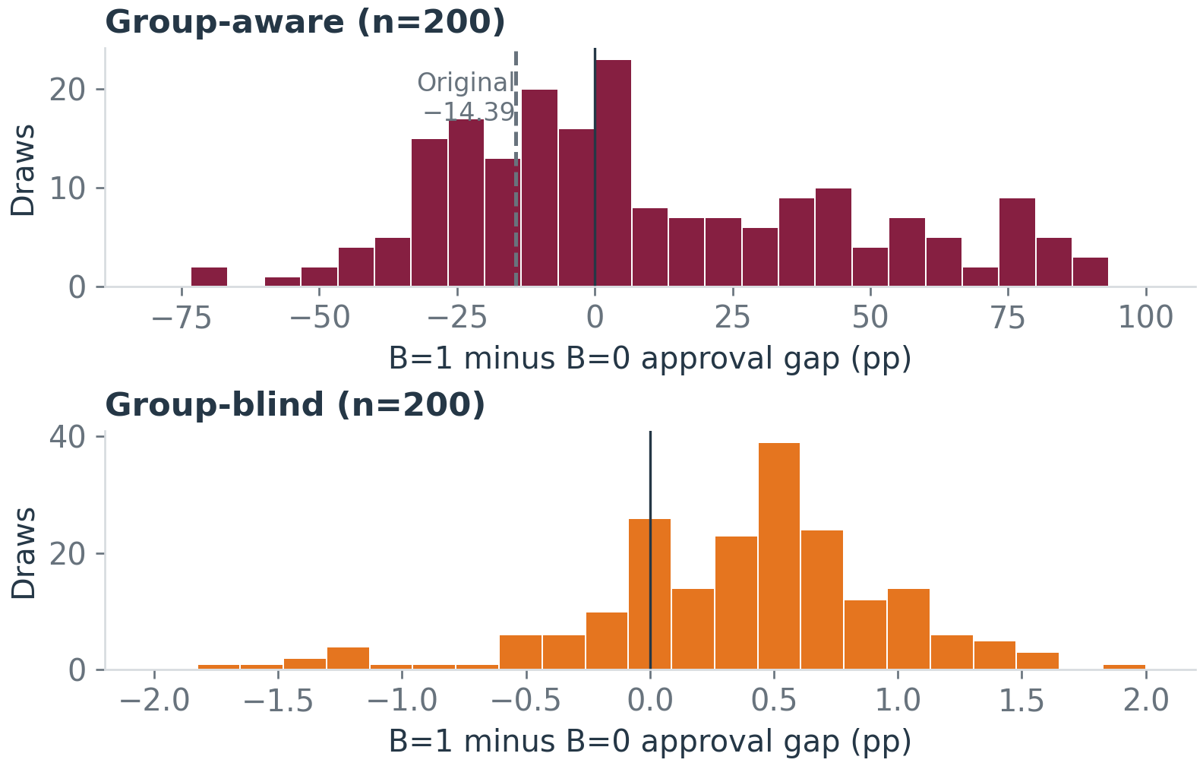
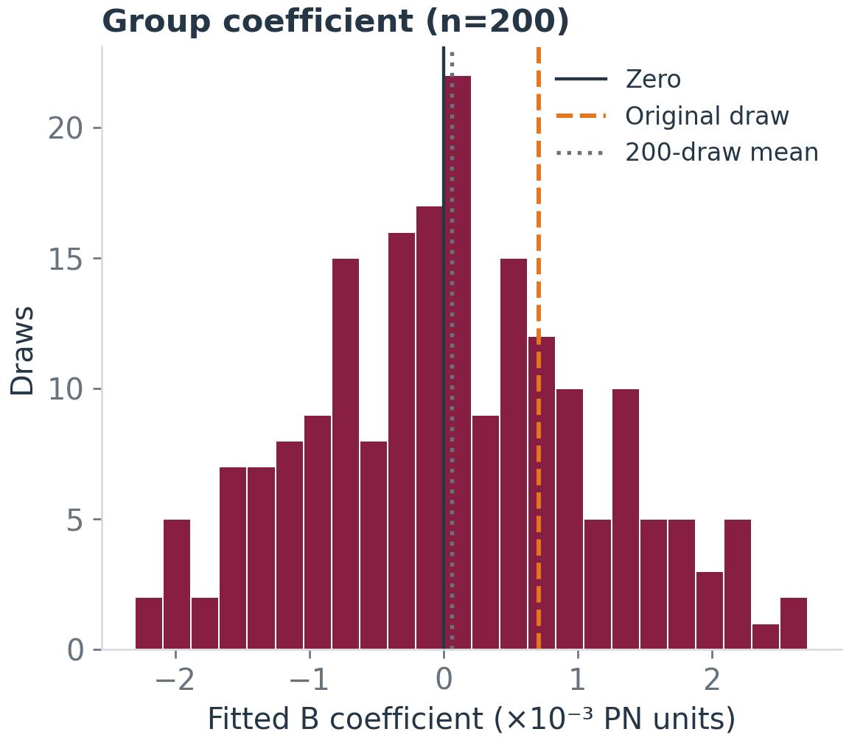
Noisy Group-Aware Estimates Produce Unstable Gaps
The original gap changed direction across independent noise draws.
Aware mean +8.840 pp, SD 36.206 [−46.658, +82.129]
Blind mean +0.366 pp, SD 0.599 [−1.200, +1.454]
52.5% positive / 47.5% negative B slopes
Nearly half of aware gaps were negative.
91.5% had smaller blind absolute gaps
65.5% reached the original |14.39 pp| gap
Source: noise_full_results.csv, 200 draws. Brackets show p2.5–p97.5 empirical noise spreads, not causal intervals.
06
Notes:
Charts contain every replication. Gap panels deliberately use different x ranges to make the blind distribution legible. Aware p2.5/p97.5 −46.657711/+82.128929pp, MCSE2.560158pp. Blind p2.5/p97.5 −1.200024/+1.453878pp, MCSE.042370pp. Aware mean is asymmetric and median is0, with95/200negative,92positive,13zero reject-all cases. B mean.0000632779704111, SD.0010631270967191, MCSE.0000751744379353. Original B coefficient.0007105261442719142. The chart marks zero, canonical coefficient, and mean. Evaluator-only noise-free B projection 0.000003841994945131447 is small but not exactly zero. All200 OLS decompositions pass, maximum residual2.25514e−17. These finite-sample projections and descriptive noise frequencies neither prove intentional discrimination nor normative fairness.
Evidence sources and computations:
results/tables/professor_model/noise_robustness_full/noise_full_results.csv; replication_000.json through replication_199.json
Columns: beta_B_hat,aware_gap_pp,blind_gap_pp
Computation: independent record aggregation, ddof=1, SD/sqrt(200), linear quantiles
Display rounding: 3 decimals pp, 8 decimals coefficient, 1 decimal frequencies
results/metrics/professor_model/noise_robustness_full/signal_reference_EVALUATOR_ONLY.json
Columns: reference.beta_B_signal
Computation: read evaluator-only saved reference
Display rounding: 12 decimals

Slide 7
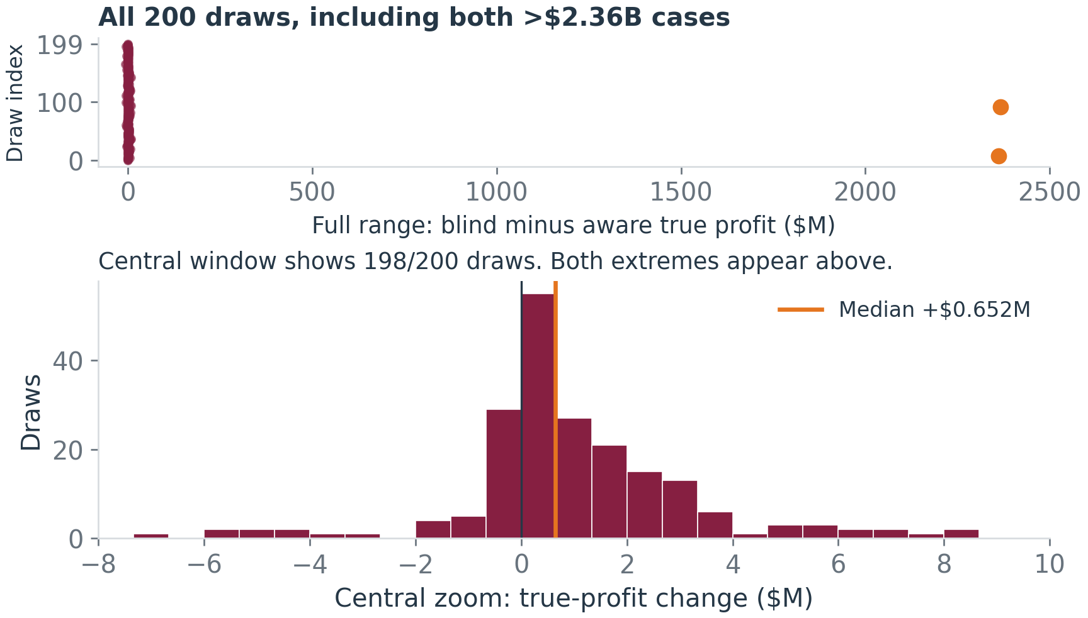
Profit Results Are Driven by Rare Extreme Cases
MEDIAN CHANGE
+$651,807
Mean +$24.616M
70.5% blind profit higher
23.5% lower / 6.0% equal
Two draws exceed +$2.36B each
Aware: zero loans in both
Blind: 4,744 / 3,861 loans
Reject-all: aware 13/200, blind 11/200
Zero block >90% capital: 17/200 each
Negative OLS
predictions
Clip to zero
Indivisible
zero-score block
Block exceeds
capital
Reject-all only
feasible cutoff
The mean advantage does not represent the typical replication.
Source: noise_full_results.csv. Nominal true expected profits under stylized 30-period growing payments, not realized returns.
07
Notes:
Paired difference means blind minus aware true expected profit. Mean$24,616,229.7545, median$651,806.6808, SD$235,673,271.0845, MCSE$16,664,616.8128. Empirical p2.5/p97.5 −$4,279,050.0811/+7,122,265.8269. Extremes: replication8 +$2,361,202,289.1137 and92 +$2,365,919,379.4631. Full-range upper plot shows all200 points. Central lower window shows198/200 and explicitly identifies that the other2 occur above. No trimming/winsorization enters summaries. Aware13/200 and blind11/200 reject-all. Zero blocks would require >90% of capital in17/200 per policy, including infeasible blocks13aware/11blind. Those infeasible blocks consume no actual capital. Every nonempty prefix contains the lowest-risk zero block, so no nonempty cutoff is feasible when it is oversized. Clipping is not calibration. No risk ties split or budgets exceeded. Payment formula thetaY(1.05)^t, without costs or discounting, creates large stylized nominal profit levels.
Evidence sources and computations:
results/tables/professor_model/noise_robustness_full/noise_full_results.csv
Columns: true_profit_change_USD,number_approved,reject_all_selected,zero_block_principal_USD,available_bank_capital
Computation: 200 paired differences, extrema retained; per-policy denominators 200
Display rounding: mean 3 decimals M, median nearest USD, counts integer

Slide 8
What We Learned and What Comes Next
Three main takeaways
Recommended next steps
Noise matters
01
Review noise SD 0.1 against the
very small underlying true-risk variation.
Very noisy measurements change fitted group
coefficients and lending outcomes.
02
Review clipping and the all-or-none
zero-score cutoff behavior.
Group-blind usually reduced disparity
Smaller absolute gap in 91.5% of draws.
Equal outcomes are not guaranteed.
03
Predeclare a matched B-coefficient
intervention to separate refitting effects.
Economic interpretation needs care
Rare clipped-zero / reject-all cases
dominate the mean profit difference.
04
Then predeclare alternative noise levels
and independent new populations.
Next goal: isolate mechanisms before broader claims
about discrimination or ML improvements.
No intentional discrimination established. Step 8B complete.
Latest documented suite: 624 passed, 4 unrelated V2 failures, 32 warnings.
Source: Step 8B audited records and current PROJECT_STATUS.md. Synthetic evidence only.
08
Notes:
Future steps are recommendations only and require separate scientific specifications. The current study fixes one population and varies onlyη. RemovingB changes all re-estimated slopes, bounded ties, and optimal cutoffs, so this comparison does not isolate a pureB-coefficient effect. An intervention could hold other coefficients fixed. No flexible ML comparisons, empirical HMDA analysis, systemic/direct interventions, or new-population study are part of the completed professor family. The latest documented full suite is624passed4preexistingV2checkpointfilename failures32warnings, not a fresh test execution for this report. Professor suite344passedwithoutwarnings. Historical Step8A heading and Step1annual-rate suggestion are retained historical evidence; current validated full records and implemented per-period accounting govern this deck.
Evidence sources and computations:
results/tables/professor_model/noise_robustness_full/noise_full_results.csv; docs/PROJECT_STATUS.md
Columns: paired metrics, latest documented suite
Computation: reuse audited findings, no fresh test run
Display rounding: documented 624 passed / 4 failures / 32 warnings

