Slide 1

Spam/Ham Messages: The hidden insights

Slide 2
Agenda
Motivation
Introduction
Preprocessing
Modeling
Training/Testing
Conclusion

Slide 3
Motivation
Annoyance : varies from small problem –> big problem
Malware spread: According Symantec's July Intelligence Report, in July2017, among 350 emails, one carries a malicious payload.

Slide 4
Introduction
Collecting dataset as large as possible.
Explore the insights of spam/ham messages.
Optimize the training process of classification for new input dataset.

Slide 5
Preprocessing:
Translation
Spelling Correct
Lemmatization
Singularize

Slide 6
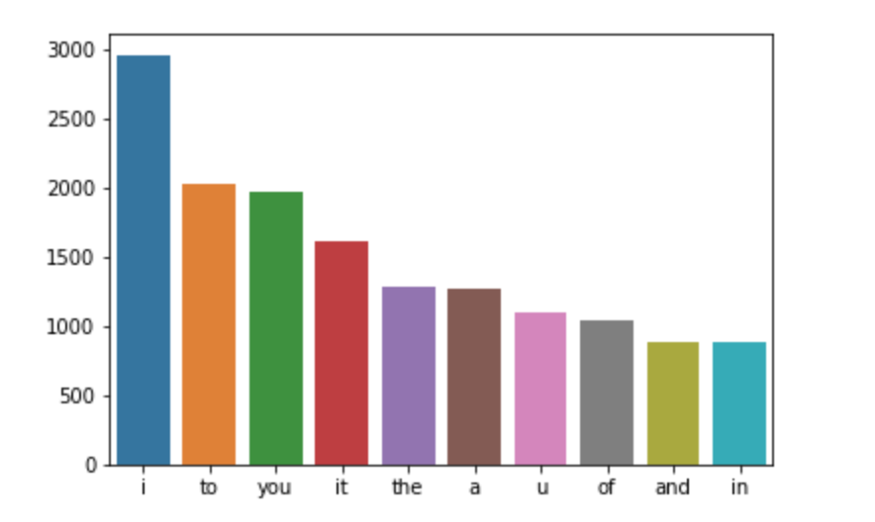
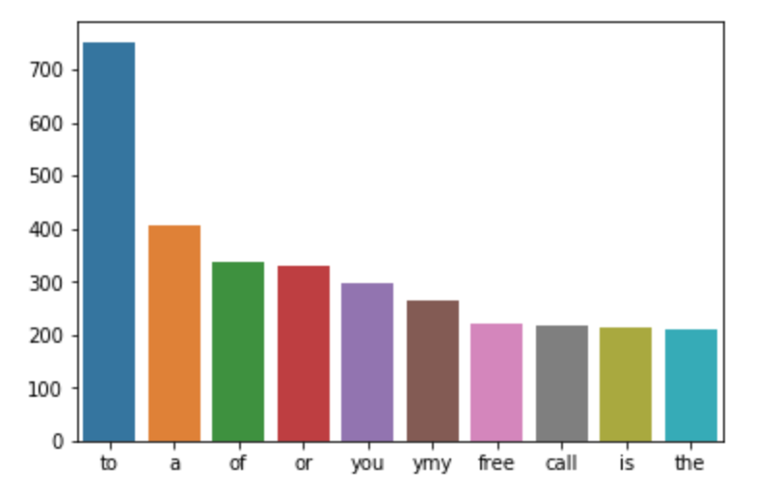
Visualization:
HAM
SPAM

Slide 7
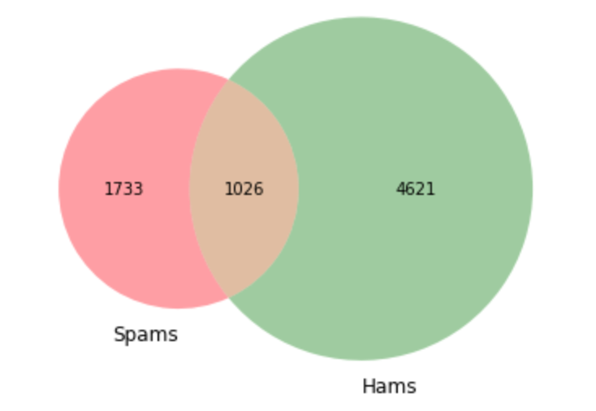
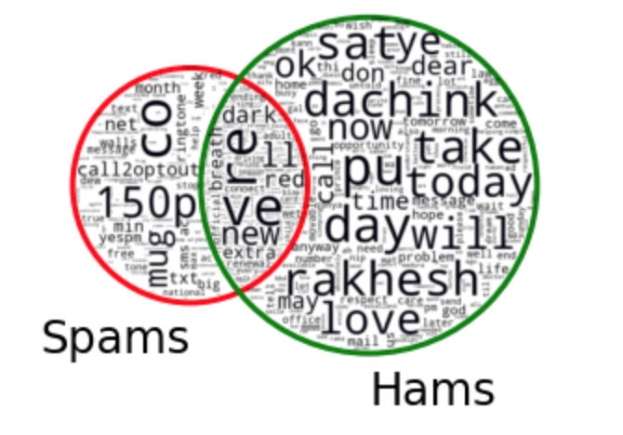
Similarity vs Differences:

Slide 8
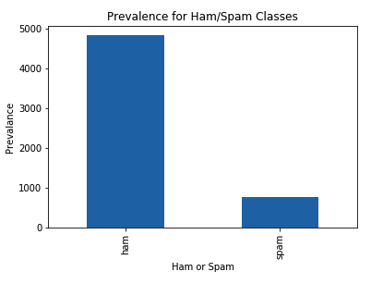
Class Imbalance:

Slide 9
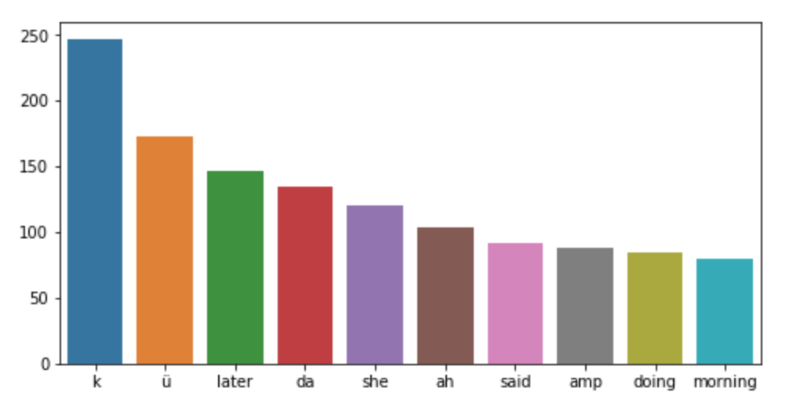
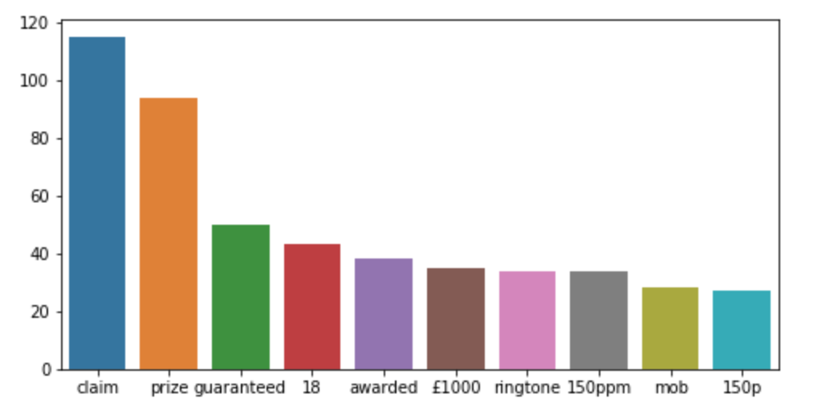
The differences:
HAM
SPAM

Slide 10
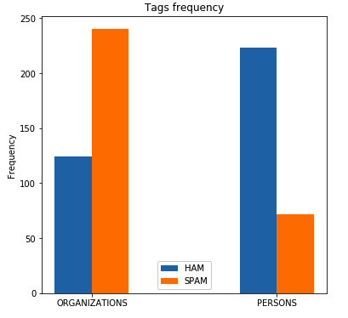
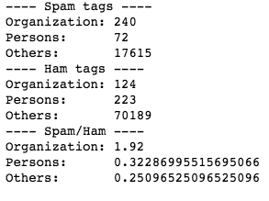
NER

Slide 11
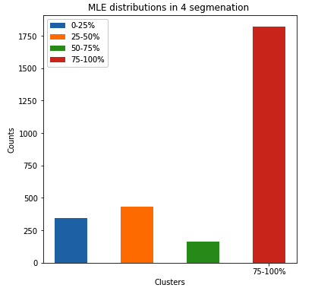
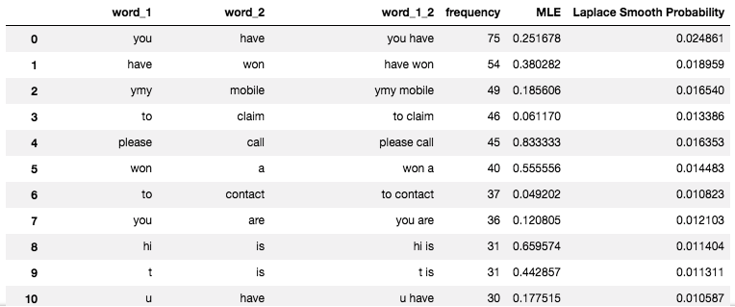
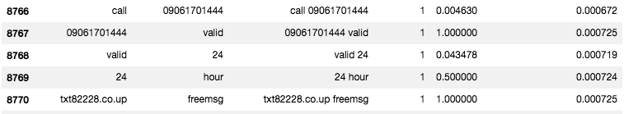
Bigram modeling:
SPAM Bigram

Slide 12
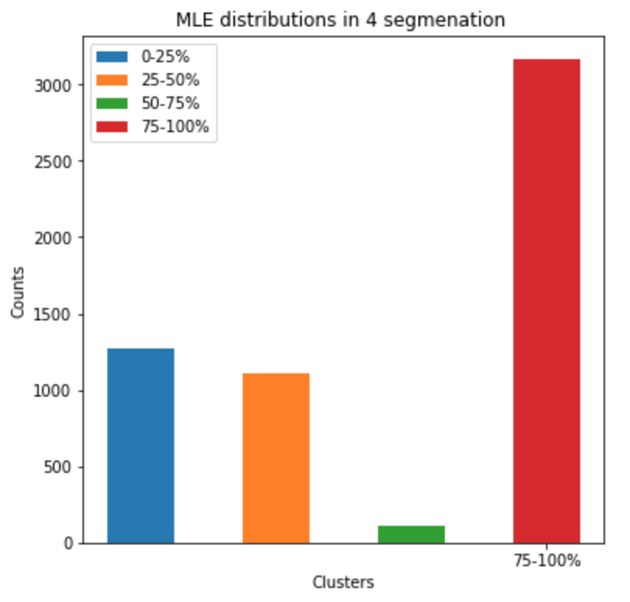
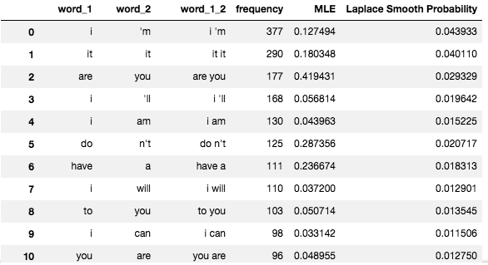
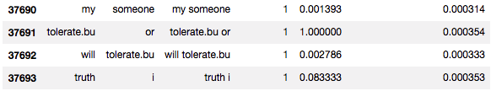
Bigram modeling:
HAM Bigram

Slide 13
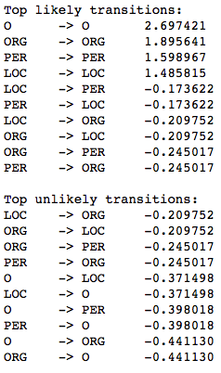
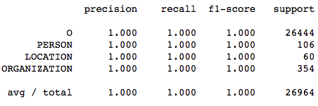
Conditional Random Field (CRF) modeling:

Slide 14
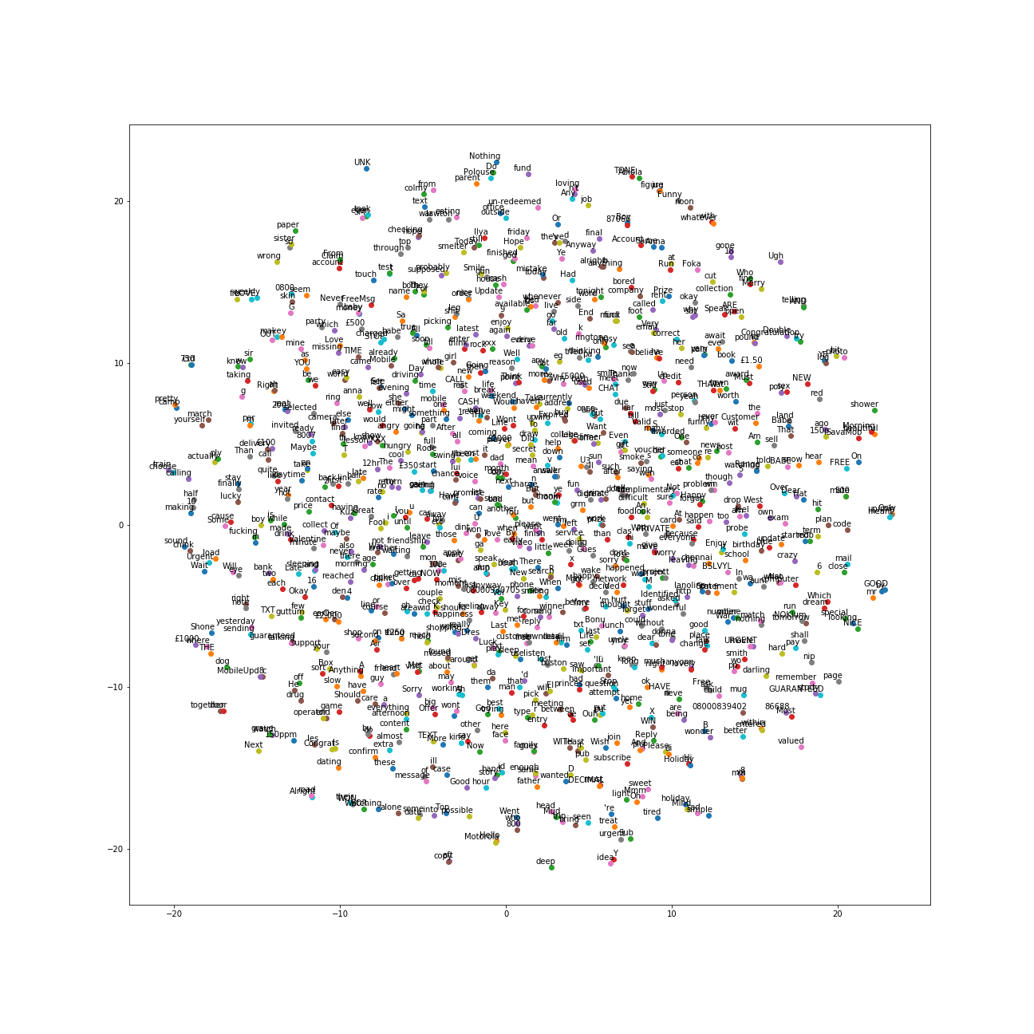
T-SNE

Slide 15
SVM, MultinomialNB, Logistic Regression classification:
 | Training with CounterVector
 | SVM | Multinomial | Logistic Regression
Precision | 0.974776240846 | 0.9884009942 | 0.979575163399
Recall | 0.997502081599 | 0.993338884263 | 0.998334721066
F1_score | 0.986008230453 | 0.990863787375 | 0.988865979381
 | Tf-idf Vectorizer
 | SVM | Multinomial | Logistic Regression
Precision | 0.987613542527 | 0.9884009942 | 0.965350523771
Recall | 0.995836802664 | 0.993338884263 | 0.997502081599
F1_score | 0.991708126036 | 0.990863787375 | 0.981162981163

Slide 16
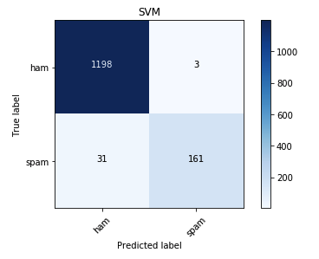
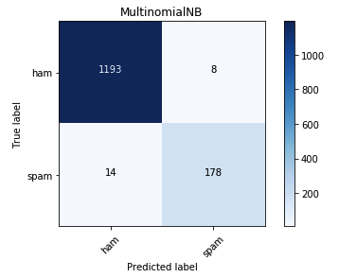
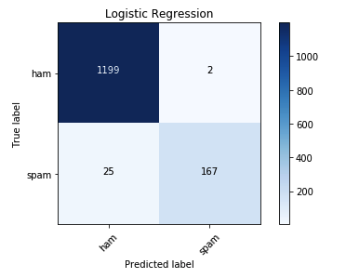
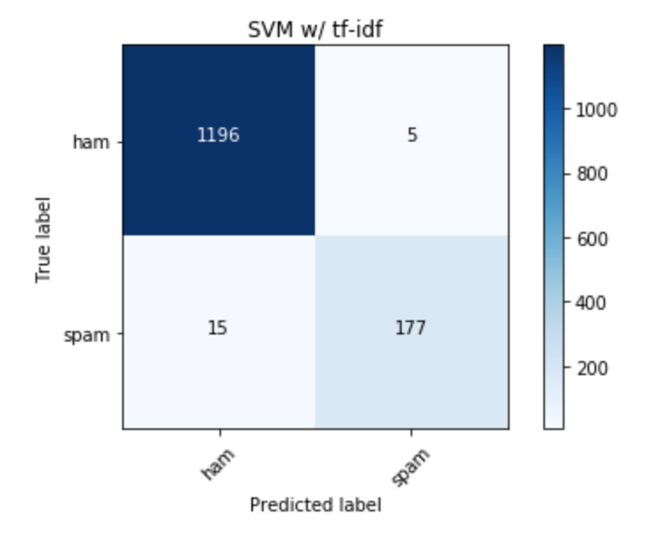
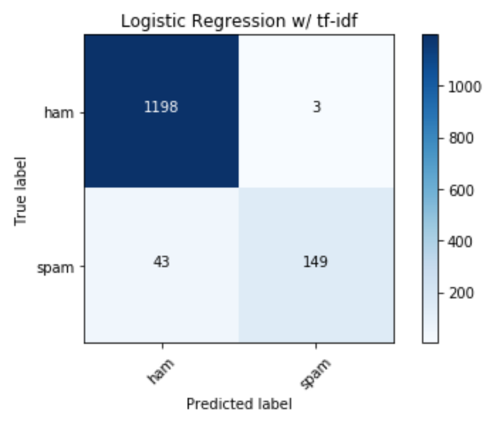
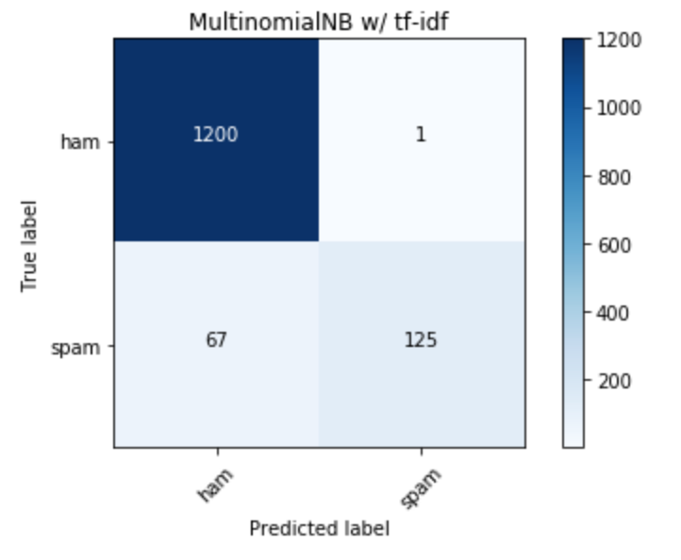

Slide 17
Kfold cross validation:
 | CounterVector with Kfold 10 cv
 | SVM | Multinomial | Logistic Regression
 | 0.983129669311 | 0.980795737534 | 0.982052791774
Precision | 0.983885045682 | 0.990262170429 | 0.981644274885
Recall | 0.99689403043 | 0.987568098096 | 0.997938549382
F1_score | 0.990334462604 | 0.988902814053 | 0.989715783121
 | Tf-idf kfold 10 cv
 | SVM | Multinomial | Logistic Regression
Accuracy | 0.984566256765 | 0.958542306133 | 0.963209847944
Precision | 0.983850891612 | 0.954523236442 | 0.960356677885
Recall | 0.998546664708 | 0.99979338843 | 0.998744630396
F1_score | 0.991138225107 | 0.976618163439 | 0.979163841673

Slide 18
QUESTIONS?

