Slide 1
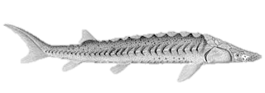


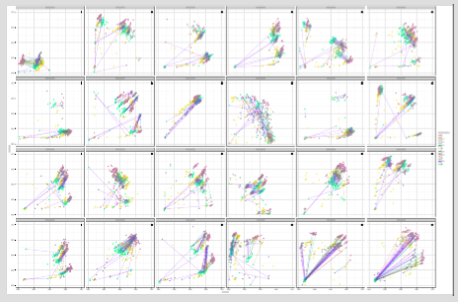
ddRAD sequencing
21,218 SNPs discovered,
1,118 SNPs were fixed for alternate alleles between the samples from the two rivers.
SNP DISCOVERY
96 SNP assays developed
from amongst these
1,118 SNPs.
4 Klamath
4 Sacramento
1. Overlapping subsets of fish typed at
96 SNPs on four Fluidigm chips
2. Visualize fluorescent intensities at all SNPs
3. Choose 74 callable SNPs
4. Define genotype category clusters
DEVELOPMENT OF SNP
CALLING METHODOLOGY
5. Use a combination of Fluidigm
software and transformations of the
fluorescent intensities to record the
genotype category of each
individual at each locus
312 sturgeon
1. Include 16 to 24 fish from
the call-development chips…
2. …and 70 to 78 newly-sampled fish
on each subsequent chip
SCORING OF MORE FISH
ON SUBSEQUENT CHIPS
4. Record genotype categories
as above
3.Visualize fluorescent intensities,
calibrated by the call development
chip data and the repeated samples
Newly-sampled sturgeon

