Slide 1
DeepNeoAG
Learning Through
Controlled Experiments
DeepNeoAG
October 2026
CS535
Nguyễn Thanh Trọng
Võ Trần Vũ Khoa
Mai Nhật Minh
Notes:
PRESENTATION SCRIPT
Our team consists of Nguyễn Thanh Trọng, Võ Trần Vũ Khoa, and Mai Nhật Minh from class CS535. We investigate peptide classification using amino acid composition, one-hot MCNN, and models built on ESM representations. We compare predictive performance, feature extraction methods, and model cost.
INTERPRETATION NOTES
Composition + LR / One-hot MCNN / ESM pooled LR / ESM CNN / ESM MCNN
SOURCE NOTES FROM V3
Target duration: 0:30
Introduce the task and explain that each model exists to answer a different question. Success means an explainable, reproducible investigation; a larger model does not need to win. Preview data, methods, experiments and lessons.
Sources (repository-relative unless URL):
docs/EXPERIMENT_PROTOCOL.md
docs/PRESENTATION_OUTLINE.md

Slide 2
Introduction
Notes:
PRESENTATION SCRIPT
SOURCE NOTES FROM V3
Introduction

Slide 3
Protein, peptide and neoantigen
A tumor mutation can change a peptide and create a new immune target
1 PROTEIN
2 PEPTIDE
3 IMMUNE RECOGNITION
Normal protein
Normal peptide
processing
presentation
T cell
A
C
D
E
F
G
H
I
K
HLA
Unaltered sequence
Usually tolerated as self
Mutated tumor protein
Mutation-derived peptide
processing
presentation
T cell
A
C
D
E
V
G
H
I
K
HLA
Candidate neoantigen
Possible T-cell recognition
Notes:
PRESENTATION SCRIPT
A protein is a long chain of amino acids. Processing a protein produces shorter fragments called peptides. Normal peptides come from the body's own proteins and are usually tolerated by the immune system. A tumor mutation can change the protein sequence and produce a mutation-derived peptide, which is a candidate neoantigen. HLA presents peptides for possible recognition by T cells. A mutation alone does not establish an immune response. Our model takes only the peptide sequence and does not directly verify these biological steps.
INTERPRETATION NOTES
Biological context only. This classifier does not establish presentation, immune response or vaccine effectiveness.
SOURCES
National Cancer Institute, Definition of neoantigen: https://www.cancer.gov/publications/dictionaries/cancer-terms/def/neoantigen
NIH, Human Leukocyte Antigen Complex: https://clinicalinfo.hiv.gov/en/glossary/human-leukocyte-antigen-complex
DIAGRAM NOTES
The diagram is schematic. Residue letters are illustrative, not measured peptide sequences. Orange marks the same altered residue in the protein, peptide and HLA-presented fragment. HLA presentation and T-cell recognition are conditional biological steps. The sequence classifier does not establish them. All diagram elements are editable PowerPoint objects.

Slide 4
Defining the prediction problem
A ranking score becomes a binary decision at a locked threshold
YES
Label 1
Neoantigen
Peptide sequence
Sequence classifier
Score s
s ≥ t?
NO
Label 0
Dataset other
No explicit HLA allele input
t selected from training OOF predictions
Notes:
PRESENTATION SCRIPT
The input is a peptide sequence. The model produces a score, which becomes a binary prediction at threshold t. We select this threshold using out-of-fold predictions on the training data and lock it before testing. Label 1 denotes a neoantigen according to the source dataset. Label 0 denotes the dataset's other category, which should not be treated as a collection of confirmed normal peptides. The model has no explicit HLA allele input, and its scores have not been established as calibrated probabilities.
INTERPRETATION NOTES
A score is not proof of immunogenicity or a calibrated probability. Label 0 reflects the dataset definition.
SOURCE NOTES FROM V3
Target duration: 0:50
Use one generic FASTA example. Explain that the zero class reflects the data source's definition and is not a universal proof of biological non-immunogenicity. Distinguish a probability-like score, a ranking and a binary decision.
Sources (repository-relative unless URL):
data/README.md
results_full/config/locked_selection.json

Slide 5
Five questions behind the model sequence
Each approach is trained independently
Approach | Research question
Composition + LR | Are residue frequencies sufficient?
One-hot + MCNN | What can ordered learning from labels achieve?
ESM pooled LR | Do frozen pretrained representations add signal?
ESM CNN | Does local extraction help contextual embeddings?
ESM MCNN | Do multiple local scales help, with added capacity?
Notes:
PRESENTATION SCRIPT
The five questions correspond to five approaches. Are amino acid frequencies sufficient? What can a model learn directly from ordered sequences and labels? Do frozen pretrained representations contain predictive signal? Does local feature extraction improve classification of contextual embeddings? Do multiple window sizes help when they also increase head capacity? We train each model independently.
INTERPRETATION NOTES
Composition versus one-hot changes representation and classifier. Later matched comparisons isolate components more closely.
SOURCE NOTES FROM V3
Target duration: 1:00
Explain that these are independently trained models rather than a chain of predictions. Mention that Composition + LR→One-hot + MCNN changes both representation and classifier; later matched comparisons isolate components more closely.
Sources (repository-relative unless URL):
docs/EXPERIMENT_PROTOCOL.md

Slide 6
Methodology
Notes:
PRESENTATION SCRIPT
SOURCE NOTES FROM V3
Methodology

Slide 7
Dataset provenance and published splits
The independent test keeps its published boundary
Published data
7,012 peptides
Training
5,608 records
Independent test
1,404 records
Partition | Neoantigen (1) | Other (0) | Total
Training | 241 | 5,367 | 5,608
Independent test | 61 | 1,343 | 1,404
Total | 302 | 6,710 | 7,012
Notes:
PRESENTATION SCRIPT
The dataset contains 7,012 peptides. We preserve the published training and test split. The training set has 5,608 records, including 241 positives. The test set has 1,404 records, with only 61 positives and 1,343 records labeled other. Configuration and threshold selection use training data only. We have not independently reconstructed the source dataset's sequence similarity filtering procedure.
INTERPRETATION NOTES
Record IDs and source labels are retained. Source similarity filtering has not been independently reconstructed.
SOURCE NOTES FROM V3
Target duration: 1:00
Describe the source and what the labels mean. Introduce the held-out test boundary. Similarity filtering is reported by the source; explain that the project checks exact duplicates but does not independently reconstruct that filtering procedure.
Sources (repository-relative unless URL):
data/README.md
results_full/tables/dataset_counts.csv
results_full/data_audit/audit.json

Slide 8
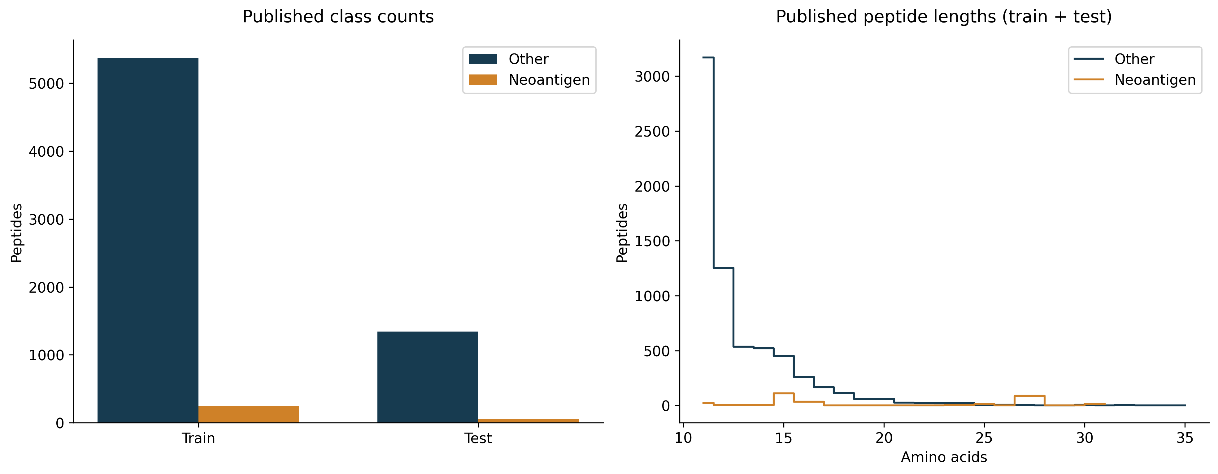
Understanding the data before training
Rare positives and a length-35 boundary case affect the method
Notes:
PRESENTATION SCRIPT
Positives make up about 4.3% of the data, or roughly one positive for every 22 other records. High accuracy alone is therefore insufficient to assess performance. The length distribution informs padding and masking. We retain the record with 35 amino acids. Sequence length alone does not identify an MHC class or explain a prediction error.
INTERPRETATION NOTES
About 1 positive per 22 others. Keep the length-35 record. Length alone does not establish an MHC class.
SOURCE NOTES FROM V3
Target duration: 1:10
Explain why an all-other classifier has high accuracy. Show the 35-residue boundary case and the choice to preserve the sample. Do not assign MHC classes from length. Use this slide to show an actual data-driven implementation decision.
Sources (repository-relative unless URL):
results_full/data_audit/audit.json
results_full/tables/length_counts.csv
docs/assets/full_results/V04_dataset.png

Slide 9
Designing a fair evaluation
Fitting, early stopping, model selection and testing use distinct roles
TRAINING ONLY: 5,608 records
Shared stratified
5-fold CV
Fit subset + inner
15% early stopping
Outer-validation
OOF predictions
Select by mean AP
Select t by OOF MCC
Neural seeds: 535, 536, 537 with shared partitions
LR uses the full outer-training portion, with no early stopping
Lock settings
and threshold
Refit on all
5,608 training records
Independent test
1,404 records
Final evaluation
Notes:
PRESENTATION SCRIPT
We use the same five stratified folds across models. For neural models, 15% of each outer training partition is reserved for early stopping, separately from the outer validation fold. We select configurations by mean cross-validation AP and thresholds by MCC on training out-of-fold predictions averaged across seeds. We then lock these choices, refit on the full training set, and evaluate on the test set. The three seeds are 535, 536, and 537. Runs on the same fold are correlated and should not be treated as independent datasets.
INTERPRETATION NOTES
Selection CV is optimistic after tuning. Seeds on the same fold are correlated evaluations, not independent datasets.
SOURCE NOTES FROM V3
Target duration: 1:20
Trace one fold from fitting to early stopping to outer validation. Explain that choosing settings from CV makes those selection scores optimistic. The independent test answers the final generalization question. Seed repetitions examine initialization variability, not new independent datasets.
Sources (repository-relative unless URL):
docs/EXPERIMENT_PROTOCOL.md
results_full/data_audit/fold_assignments.csv
results_full/config/locked_selection.json

Slide 10
Metric definitions and threshold policy
ranking quality and a binary operating point answer different questions
Measure | Meaning
Average precision (AP) | Summarizes precision across recall changes in a ranked list
ROC-AUC | Ranking discrimination across false-positive-rate levels
Precision | TP / (TP + FP)
Recall / sensitivity | TP / (TP + FN)
Specificity | TN / (TN + FP)
MCC | (TP × TN − FP × FN) / √[(TP+FP)(TP+FN)(TN+FP)(TN+FN)]
Configuration: maximize mean CV AP. Threshold: maximize MCC from seed-averaged training OOF predictions.
Independent test uses both 0.5 and the locked OOF threshold. Main slides use the OOF threshold.
Notes:
PRESENTATION SCRIPT
Average precision, or AP, summarizes ranking performance through precision and recall. It is useful when positives are rare. ROC-AUC also uses continuous scores. Precision measures how many predicted positives are correct, while recall measures how many actual positives we find. MCC uses all four entries of the confusion matrix. We select configurations by cross-validation AP and thresholds by out-of-fold MCC. AP does not depend on a decision threshold, while precision, recall, and MCC do.
INTERPRETATION NOTES
AP and ROC-AUC use scores. Precision, recall, specificity, MCC and confusion counts depend on the threshold.
SOURCE NOTES FROM V3
Sources (repository-relative unless URL):
docs/EXPERIMENT_PROTOCOL.md
results_full/config/locked_selection.json

Slide 11
Baseline 1: amino-acid composition
Composition contains some signal, but loses residue order
ACDL
LDCA
Same 20-component
frequency vector
A = C = D = L = 0.25
StandardScaler
Balanced LR, C = 1
Score
Order is lost
Mean CV AP | Test AP | Test MCC | OOF threshold
0.1287 | 0.0714 | 0.0515 | 0.6508
Notes:
PRESENTATION SCRIPT
Composition represents each sequence as the frequencies of 20 amino acids. ACDL and LDCA produce the same vector despite their different residue order. Logistic regression on these features cannot recover that order or identify local sequence patterns. Test AP is 0.0714, above the positive prevalence of 0.0434 but still low. Composition contains some signal, but it is insufficient for the classification objective in this experiment. We fit the scaler only within the relevant training partition.
INTERPRETATION NOTES
ACDL and LDCA are teaching examples. Test prevalence: 0.0434. The scaler fits within training partitions.
SOURCE NOTES FROM V3
Target duration: 0:45
Compare ACDL and LDCA: composition is identical. The model cannot see order. C=1 is selected: mean CV AP is 0.1287; test AP is 0.0714 and MCC 0.0515 at OOF threshold 0.6508. Composition contains some signal but is insufficient here; test prevalence is 0.0434.
Sources (repository-relative unless URL):
results_full/tables/selected_models.csv
results_full/tables/cv_summary.csv
results_full/tables/test_metrics.csv

Slide 12
Baseline 2: one-hot MCNN
Ordered local patterns learned directly from task labels
No pretrained encoder
Five parallel windows
k = 2, 3, 4, 5, 8
64 filters per branch
320 concatenated features
Mask padding before max pooling
Five parallel Conv1D branches
k = 2 64 filters
k = 3 64 filters
One-hot
[B, 20, 35]
Concat
[B, 320]
Dropout 0.3
Linear + sigmoid
Score
k = 4 64 filters
k = 5 64 filters
k = 8 64 filters
Trainable parameters | CV AP | Test AP | Test MCC
28,801 | 0.4943 | 0.5408 | 0.5495
Notes:
PRESENTATION SCRIPT
One-hot encoding preserves residue positions, and MCNN learns directly from the labels without a pretrained encoder. Five parallel Conv1D branches use windows of 2, 3, 4, 5, and 8 residues, with 64 filters per branch. Each branch excludes windows touching padding before max pooling. Concatenation produces 320 features. With only 28,801 trainable parameters, the model achieves test AP of 0.5408 and MCC of 0.5495. It provides a useful efficiency reference. Relative to composition, both the representation and the classifier change.
INTERPRETATION NOTES
Strong efficiency reference. Improvement over composition changes both representation and classifier.
Per branch: ReLU, valid-window mask, global max
SOURCE NOTES FROM V3
Target duration: 0:55
Explain one filter's scan and how max pooling retains its strongest valid response. This model has no pretrained protein encoder. Improvement over composition is suggestive, but the comparison changes architecture too.
Sources (repository-relative unless URL):
results_full/tables/selected_models.csv
results_full/tables/test_metrics.csv
results_full/tables/cv_summary.csv

Slide 13
From peptides to contextual embeddings
A frozen ESM encoder gives every real residue a contextual representation
Peptides
11–35 residues
Frozen ESM-2
No encoder updates
Remove BOS / EOS
Keep residue embeddings
B
Peptides per batch
L
Padded residue positions
D
Features per residue
One peptide (schematic)
D features
[B, 35, D]
Residue embeddings
1
2
Real
residues
…
ℓ
Transpose L and D
ℓ+1
Padding
35
[B, D, 35]
CNN input
35 positions in total
Mask retains the true length ℓ
8M: D = 320
35M: D = 480
Notes:
PRESENTATION SCRIPT
ESM produces a contextual representation for each amino acid and remains frozen throughout the experiment. B is the number of peptides in a batch, L is the padded sequence length, and D is the embedding dimension. D is 320 for ESM 8M and 480 for ESM 35M. We remove special tokens and compute mean pooling over real residues only. CNN branches exclude windows containing padding before max pooling so that padded positions do not contribute to the pooled features.
INTERPRETATION NOTES
Remove special tokens. Mean pooling uses real residues. CNN windows touching padding are excluded.
SOURCE NOTES FROM V3
Target duration: 1:10
Illustrate that identical residue letters may receive different contextual vectors. Separate encoder parameters from downstream trainable parameters. Explain the transpose from `[B,L,D]` to `[B,D,L]` without implying that it changes information.
Sources (repository-relative unless URL):
results_full/features/esm_8M.json
results_full/features/esm_35M.json

Slide 14
Pooling, single-window CNN and MCNN
The same frozen embeddings support three independent classifiers
Pooled LR
Real-residue mean; C = 0.1
CV / test AP: 0.3976 / 0.4764
Single-window CNN
k = 3; 64 filters
CV / test AP: 0.4868 / 0.5122
Multi-window CNN
256 filters × 5; concat 1,280
CV / test AP: 0.5142 / 0.5437
Frozen ESM embeddings [B, 35, D]
Pooled LR
Mean real residues
[B, D]
StandardScaler
Balanced LR
C = 0.1
Score
Single-window CNN
Conv1D
k = 3, 64 filters
Mask + max
[B, 64]
Dropout 0.3
Linear + sigmoid
Score
Multi-window CNN
5 parallel windows
k = 2, 3, 4, 5, 8
256 filters each
Mask + max
Concat [B, 1280]
Dropout 0.3
Linear + sigmoid
Score
Notes:
PRESENTATION SCRIPT
We train three separate classifiers on the same frozen ESM embeddings. Pooled logistic regression averages real residues, which removes local sequence detail. The single-window CNN uses a window size of 3 with 64 filters. MCNN uses five window sizes and 256 filters per branch, producing 1,280 concatenated features. With the 8M encoder, test AP is 0.4764, 0.5122, and 0.5437, respectively. These changes affect both feature extraction and head capacity, so the comparison does not isolate their individual effects.
INTERPRETATION NOTES
CNNs transpose to [B, D, 35]. ReLU follows Conv1D; masking precedes max.
SOURCE NOTES FROM V3
Target duration: 1:10
Pooling contextual vectors does not erase all order information because the encoder already used context. Explain that MCNN adds capacity as well as window diversity. Do not call a filter a biological motif without supporting analysis.
Sources (repository-relative unless URL):
results_full/tables/selected_models.csv
results_full/tables/cv_summary.csv
results_full/tables/test_metrics.csv

Slide 15
Our controlled experiment matrix
A staged, one-factor search, with 22 configurations
Changed component | Values | Held fixed / caveat
LR regularization | C = 0.1, 1, 10 | Balanced LR; shared folds
Single CNN window, 8M | k = 2, 3, 4, 5, 8 | 64 filters; weighted loss
MCNN filters, 8M | 32, 64, 128, 256 per branch | Same five windows; weighted loss
MCNN loss, 8M | Weighted / unweighted | 64 filters; same windows
Frozen encoder | 8M / 35M | Transfer selected CNN settings; D and head size change
Notes:
PRESENTATION SCRIPT
The experiment covers 22 configurations, with 240 cross-validation fits and 18 final refits, for a total of 258 fits. We vary logistic regression regularization, CNN window size, MCNN filter count, loss weighting, and encoder size. Within each experiment group, the other conditions remain fixed as shown in the table. Neural models use AdamW, a learning rate of 0.001, weight decay of 0.01, a batch size of 64, and at most 30 epochs. Changing from the 8M to the 35M encoder also changes the embedding dimension and head parameter count.
INTERPRETATION NOTES
240 CV fits + 18 final refits = 258 fits. AdamW, LR 0.001, weight decay 0.01, batch 64, maximum 30 epochs.
SOURCE NOTES FROM V3
Target duration: 1:10
State the shared optimizer, epoch budget and folds. Explain why this is not a full factorial grid. State that 35M also changes embedding dimension and downstream parameter count, which must accompany performance comparisons.
Sources (repository-relative unless URL):
results_full/config/experiment_registry.json
results_full/tables/ablations.csv
docs/EXPERIMENT_PROTOCOL.md

Slide 16
Selected configurations
settings locked before independent testing
Model | Selected setting | Parameters | OOF t | Refit epochs
Composition + LR | C = 1 | 21 | 0.650830 | Not applicable
One-hot + MCNN | k=2,3,4,5,8; 64 filters | 28,801 | 0.512465 | 23
ESM 8M + pooled LR | C = 0.1 | 321 | 0.977457 | Not applicable
ESM 8M + CNN | k=3; 64 filters | 61,569 | 0.930151 | 13
ESM 8M + MCNN | k=2,3,4,5,8; 256 filters | 1,804,801 | 0.766193 | 16
ESM 35M + pooled LR | C = 0.1 | 481 | 0.945360 | Not applicable
ESM 35M + CNN | k=3; 64 filters | 92,289 | 0.732428 | 10
ESM 35M + MCNN | k=2,3,4,5,8; 256 filters | 2,705,921 | 0.632288 | 14
Notes:
PRESENTATION SCRIPT
This table records the choices locked before independent testing. Pooled logistic regression selects C equal to 0.1. The single-window CNN selects a window size of 3 with 64 filters, and ESM MCNN selects 256 filters per branch. The parameter column counts only the trainable classifier because ESM is frozen. Refit epoch counts come from training-stage early stopping results. Final neural predictions average three seed-specific refits. Each model uses its own locked out-of-fold threshold.
INTERPRETATION NOTES
ESM is frozen. Parameters count only the trainable classifier. Neural final predictions average seeds 535, 536, 537.
SOURCE NOTES FROM V3
Sources (repository-relative unless URL):
results_full/tables/selected_models.csv
results_full/tables/cv_summary.csv

Slide 17
Results
Notes:
PRESENTATION SCRIPT
SOURCE NOTES FROM V3
Results

Slide 18
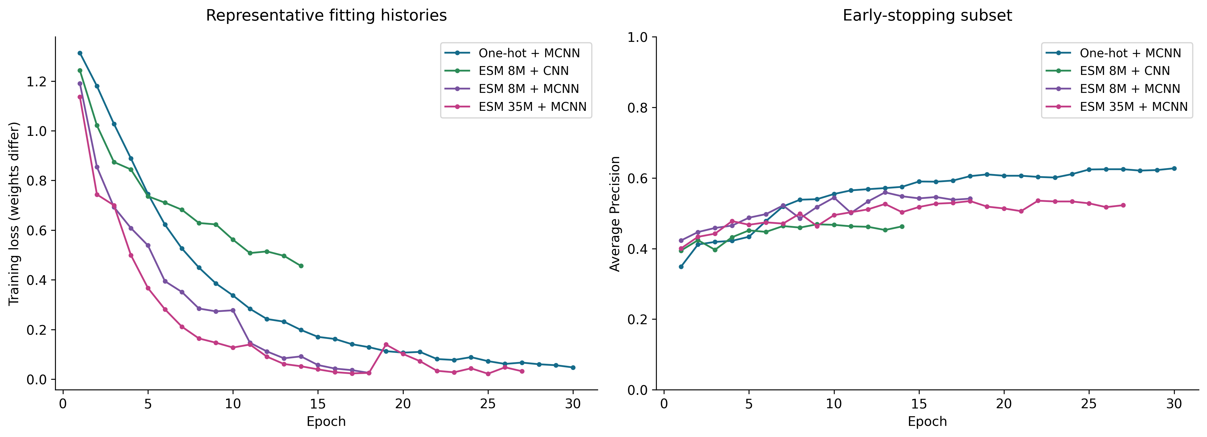
Tracking learning and computational cost
Early-stop AP can plateau while fitting loss continues to decline
Extraction (8M / 35M) | Mean MCNN CV fit (one-hot / 8M / 35M)
9.53 s / 13.21 s | 10.26 s / 11.50 s / 13.52 s
Notes:
PRESENTATION SCRIPT
Training loss can continue decreasing while early-stopping AP plateaus or fluctuates. We therefore select checkpoints using early-stopping AP rather than automatically using the final epoch. These curves show fold 0 and seed 535, not an average over all runs. Embedding extraction took about 9.53 seconds for 8M and 13.21 seconds for 35M in the recorded session. These timings depend on hardware and session state and should not be interpreted directly as deployment latency.
INTERPRETATION NOTES
Fold 0, seed 535. Raw loss scales differ. Timings depend on session state and stopping epoch, not deployment latency.
SOURCE NOTES FROM V3
Target duration: 0:55
Explain the observed training behavior only after seeing full histories. Raw weighted and unweighted losses have different scales; compare AP for cross-loss quality. Show how these records support decisions rather than discuss storage or execution infrastructure.
Sources (repository-relative unless URL):
docs/assets/full_results/V08_learning_curves.png
results_full/tables/encoder_costs.csv
results_full/tables/cv_summary.csv
outputs/full_analysis/learning_summary.csv

Slide 19
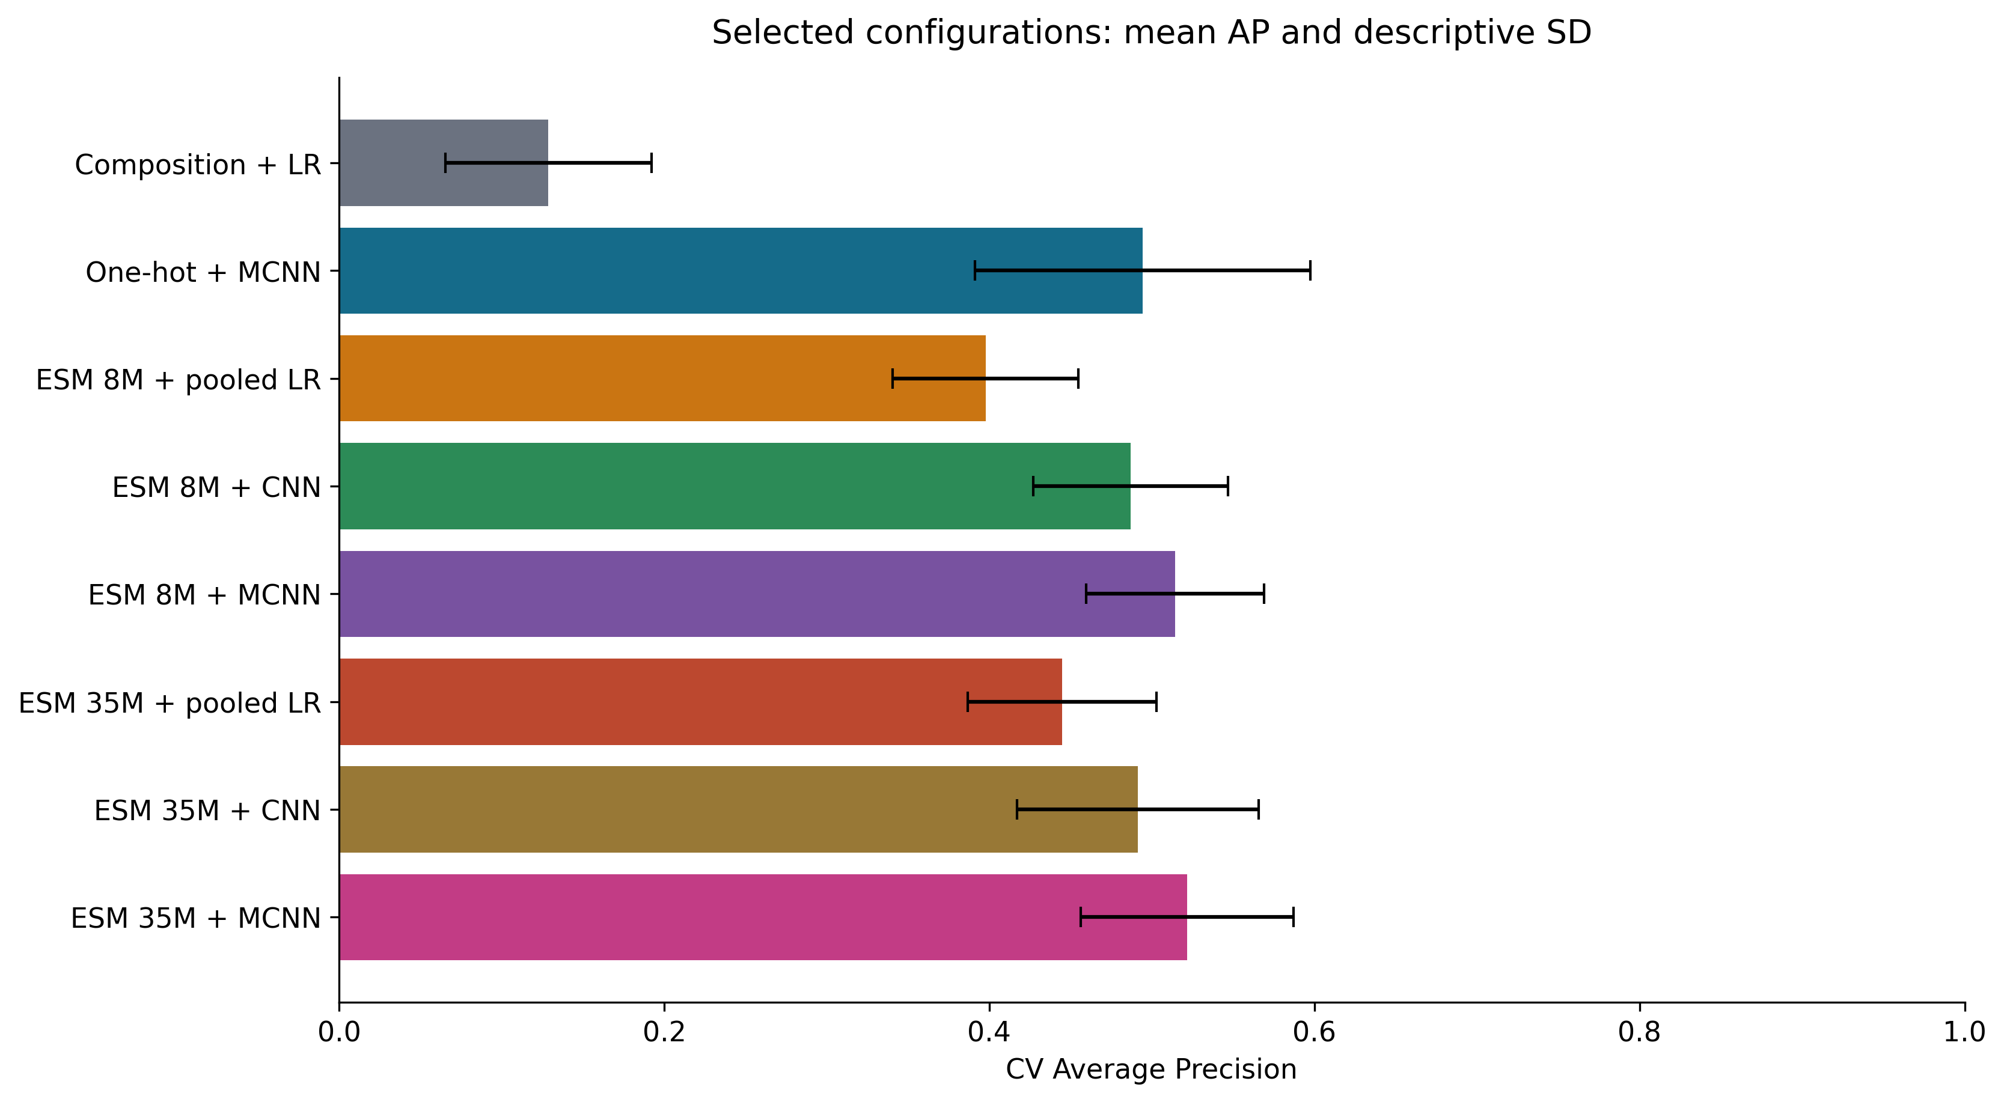
What we observed across folds and seeds
Mean AP and descriptive spread answer different questions
Mean CV AP ± SD
One-hot MCNN
0.4943 ± 0.1032
8M MCNN
0.5142 ± 0.0547
35M MCNN
0.5216 ± 0.0655
Notes:
PRESENTATION SCRIPT
Mean cross-validation AP is 0.4943 for one-hot MCNN, 0.5142 for ESM 8M MCNN, and 0.5216 for ESM 35M MCNN. Their standard deviations are 0.1032, 0.0547, and 0.0655, respectively. One-hot has greater variation under this descriptive summary. Several models perform poorly on fold 4, but the cause remains unresolved. This spread describes variation across folds and seeds, not a confidence interval. Because cross-validation also guided tuning, the selected scores may be optimistic.
INTERPRETATION NOTES
Selection CV, not an unbiased post-selection estimate. Fold 4 is difficult across neural methods; the cause is unresolved.
SOURCE NOTES FROM V3
Target duration: 1:10
One-hot + MCNN CV AP is 0.4943 with descriptive SD 0.1032; ESM 8M + MCNN is 0.5142 with SD 0.0547; ESM 35M + MCNN is 0.5216 with SD 0.0655. Fold 4 is difficult across neural methods: One-hot + MCNN/ESM 8M + MCNN/ESM 35M + MCNN fold means are 0.3252/0.4153/0.3978. The cause is unresolved. Keep observations distinct from explanations. If a sophisticated model is unstable, treat that as a useful finding, not an inconvenient result to omit.
Sources (repository-relative unless URL):
docs/assets/full_results/V11_cv_comparison.png
outputs/full_analysis/fold_summary.csv
results_full/tables/cv_summary.csv

Slide 20
Fixed defaults versus tuned selections
comparison includes the model-selection step
Model | Default CV AP | Selected CV AP | Default params | Selected params
Composition + LR | 0.1287 | 0.1287 | 21 | 21
One-hot + MCNN | 0.4943 | 0.4943 | 28,801 | 28,801
ESM 8M + pooled LR | 0.3264 | 0.3976 | 321 | 321
ESM 8M + CNN | 0.4868 | 0.4868 | 61,569 | 61,569
ESM 8M + MCNN | 0.5013 | 0.5142 | 451,201 | 1,804,801
Notes:
PRESENTATION SCRIPT
Selecting regularization increases the 8M pooled logistic regression model's cross-validation AP from 0.3264 to 0.3976. Selecting a larger ESM 8M MCNN head increases AP from 0.5013 to 0.5142, while its parameter count rises from 451,201 to 1,804,801. These results include the effects of model selection and additional capacity. At the 64-filter MCNN setting, one-hot achieves cross-validation AP of 0.4943 and ESM 8M achieves 0.5013, a difference of only 0.0070. The tuned model's full improvement cannot be attributed to the ESM encoder alone.
INTERPRETATION NOTES
Defaults and selected settings are not independent estimates. A larger selected head changes capacity as well as window coverage.
SOURCE NOTES FROM V3
Sources (repository-relative unless URL):
results_full/tables/fixed_configuration_comparison.csv

Slide 21
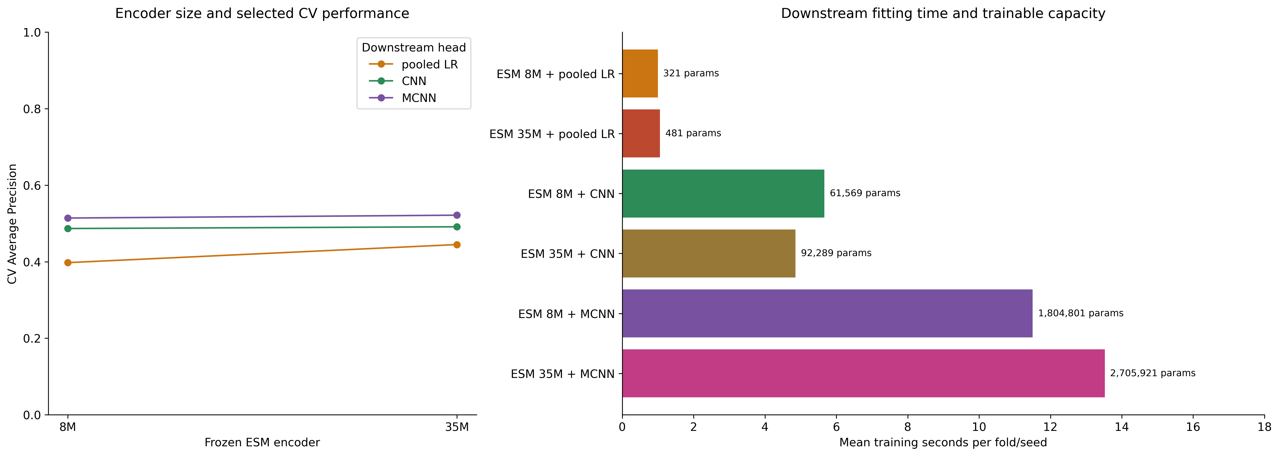
Encoder size, head quality and cost
transferred CNN settings, with changed D and head parameter count
Notes:
PRESENTATION SCRIPT
Changing the encoder from 8M to 35M increases pooled logistic regression's cross-validation AP from 0.3976 to 0.4449. The increase is smaller for CNN, from 0.4868 to 0.4913, and for MCNN, from 0.5142 to 0.5216. The embedding dimension also increases from 320 to 480, and the MCNN head grows from about 1.80 million to 2.71 million parameters. Mean MCNN cross-validation fit time increases from about 11.50 to 13.52 seconds in the recorded session. The timing chart covers classifier fitting and excludes embedding extraction. The AP gains should be assessed alongside cost and head capacity.
INTERPRETATION NOTES
8M / 35M change embedding dimension and head capacity. Downstream fit time excludes extraction and depends on hardware.
SOURCE NOTES FROM V3
Sources (repository-relative unless URL):
results_full/tables/encoder_costs.csv
results_full/tables/cv_summary.csv

Slide 22
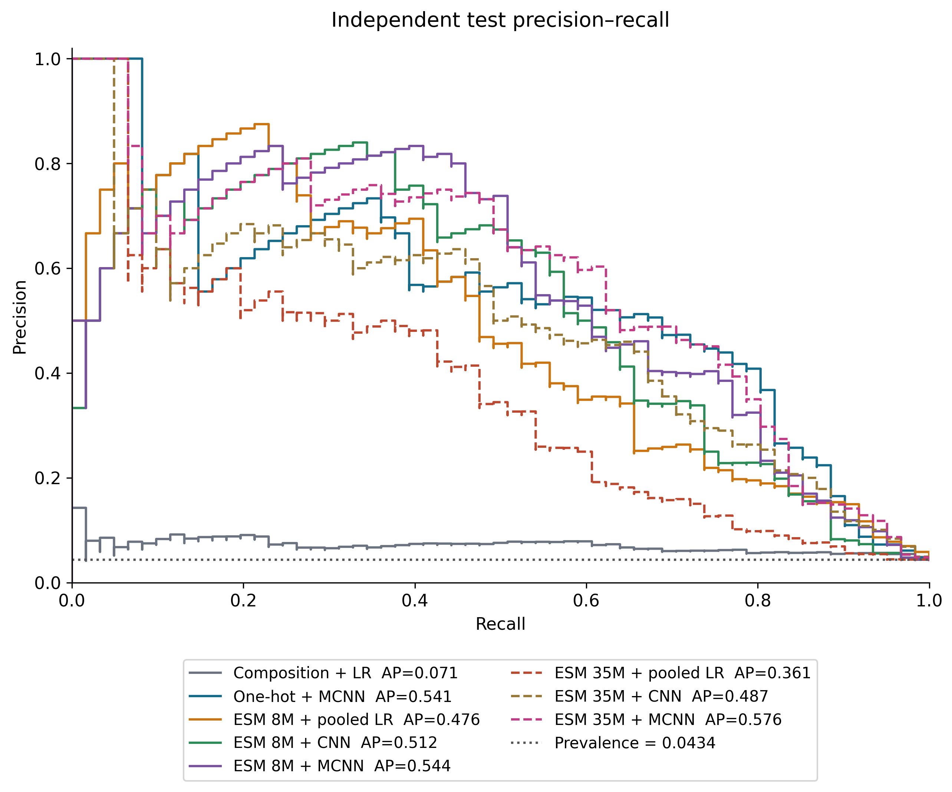
Independent test: a final check
ESM 35M MCNN has the highest observed AP, with uncertain differences
Locked model | AP | MCC
One-hot MCNN | 0.5408 | 0.5495
8M MCNN | 0.5437 | 0.5512
35M MCNN | 0.5758 | 0.5513
35M MCNN: 44 / 61 positives found
52 false positives
AP 95% CI: [0.4631, 0.7061]
Paired AP difference vs one-hot
95% CI: [−0.0444, 0.1151]
Notes:
PRESENTATION SCRIPT
On the same 1,404 test records, ESM 35M MCNN has the highest observed AP at 0.5758. One-hot MCNN achieves 0.5408, and ESM 8M MCNN achieves 0.5437. At its locked out-of-fold threshold, 35M MCNN finds 44 of the 61 positives but produces 52 false positives. The 95% confidence interval for its AP difference from one-hot runs from negative 0.0444 to 0.1151 and includes zero. The results do not establish a clear advantage over one-hot MCNN.
INTERPRETATION NOTES
All 1,404 test records. Neural probabilities average three final seeds. Thresholds are locked from OOF MCC.
SOURCE NOTES FROM V3
Target duration: 1:00
Present the final check briefly. State whether thresholds are 0.5 or OOF-selected. Avoid switching the highlighted model based on a favorable test metric or treating a narrow ranking difference as decisive.
Sources (repository-relative unless URL):
docs/assets/full_results/V12_test_curves.png
results_full/tables/test_metrics.csv
results_full/tables/test_confidence_intervals.csv
outputs/full_analysis/paired_test_differences.csv

Slide 23
Complete independent-test metrics
ensemble probabilities and locked OOF thresholds
Model | AP | ROC-AUC | MCC | Precision | Recall | Specificity | TP / FP
Composition + LR | 0.0714 | 0.6625 | 0.0515 | 0.0690 | 0.2295 | 0.8593 | 14 / 189
One-hot + MCNN | 0.5408 | 0.9179 | 0.5495 | 0.5362 | 0.6066 | 0.9762 | 37 / 32
ESM 8M + pooled LR | 0.4764 | 0.9077 | 0.4743 | 0.6667 | 0.3607 | 0.9918 | 22 / 11
ESM 8M + CNN | 0.5122 | 0.8880 | 0.5262 | 0.7143 | 0.4098 | 0.9926 | 25 / 10
ESM 8M + MCNN | 0.5437 | 0.9108 | 0.5512 | 0.6000 | 0.5410 | 0.9836 | 33 / 22
ESM 35M + pooled LR | 0.3614 | 0.8213 | 0.3693 | 0.5143 | 0.2951 | 0.9873 | 18 / 17
ESM 35M + CNN | 0.4870 | 0.9154 | 0.4938 | 0.4557 | 0.5902 | 0.9680 | 36 / 43
ESM 35M + MCNN | 0.5758 | 0.9224 | 0.5513 | 0.4583 | 0.7213 | 0.9613 | 44 / 52
Notes:
PRESENTATION SCRIPT
ESM 35M MCNN achieves AP of 0.5758 and recall of 0.7213, but precision is 0.4583 at the locked threshold. ESM 8M CNN has the highest precision in the table at 0.7143, with recall of 0.4098. One-hot MCNN reaches MCC of 0.5495, close to 35M MCNN's 0.5513, despite having far fewer trainable parameters. The highest-AP model does not also have the highest precision. An operating point must reflect the acceptable balance of false positives and false negatives.
INTERPRETATION NOTES
N = 1,404, including 61 positives and 1,343 others. LR has one refit. Neural probabilities average three refits.
SOURCE NOTES FROM V3
Sources (repository-relative unless URL):
results_full/tables/test_metrics.csv

Slide 24
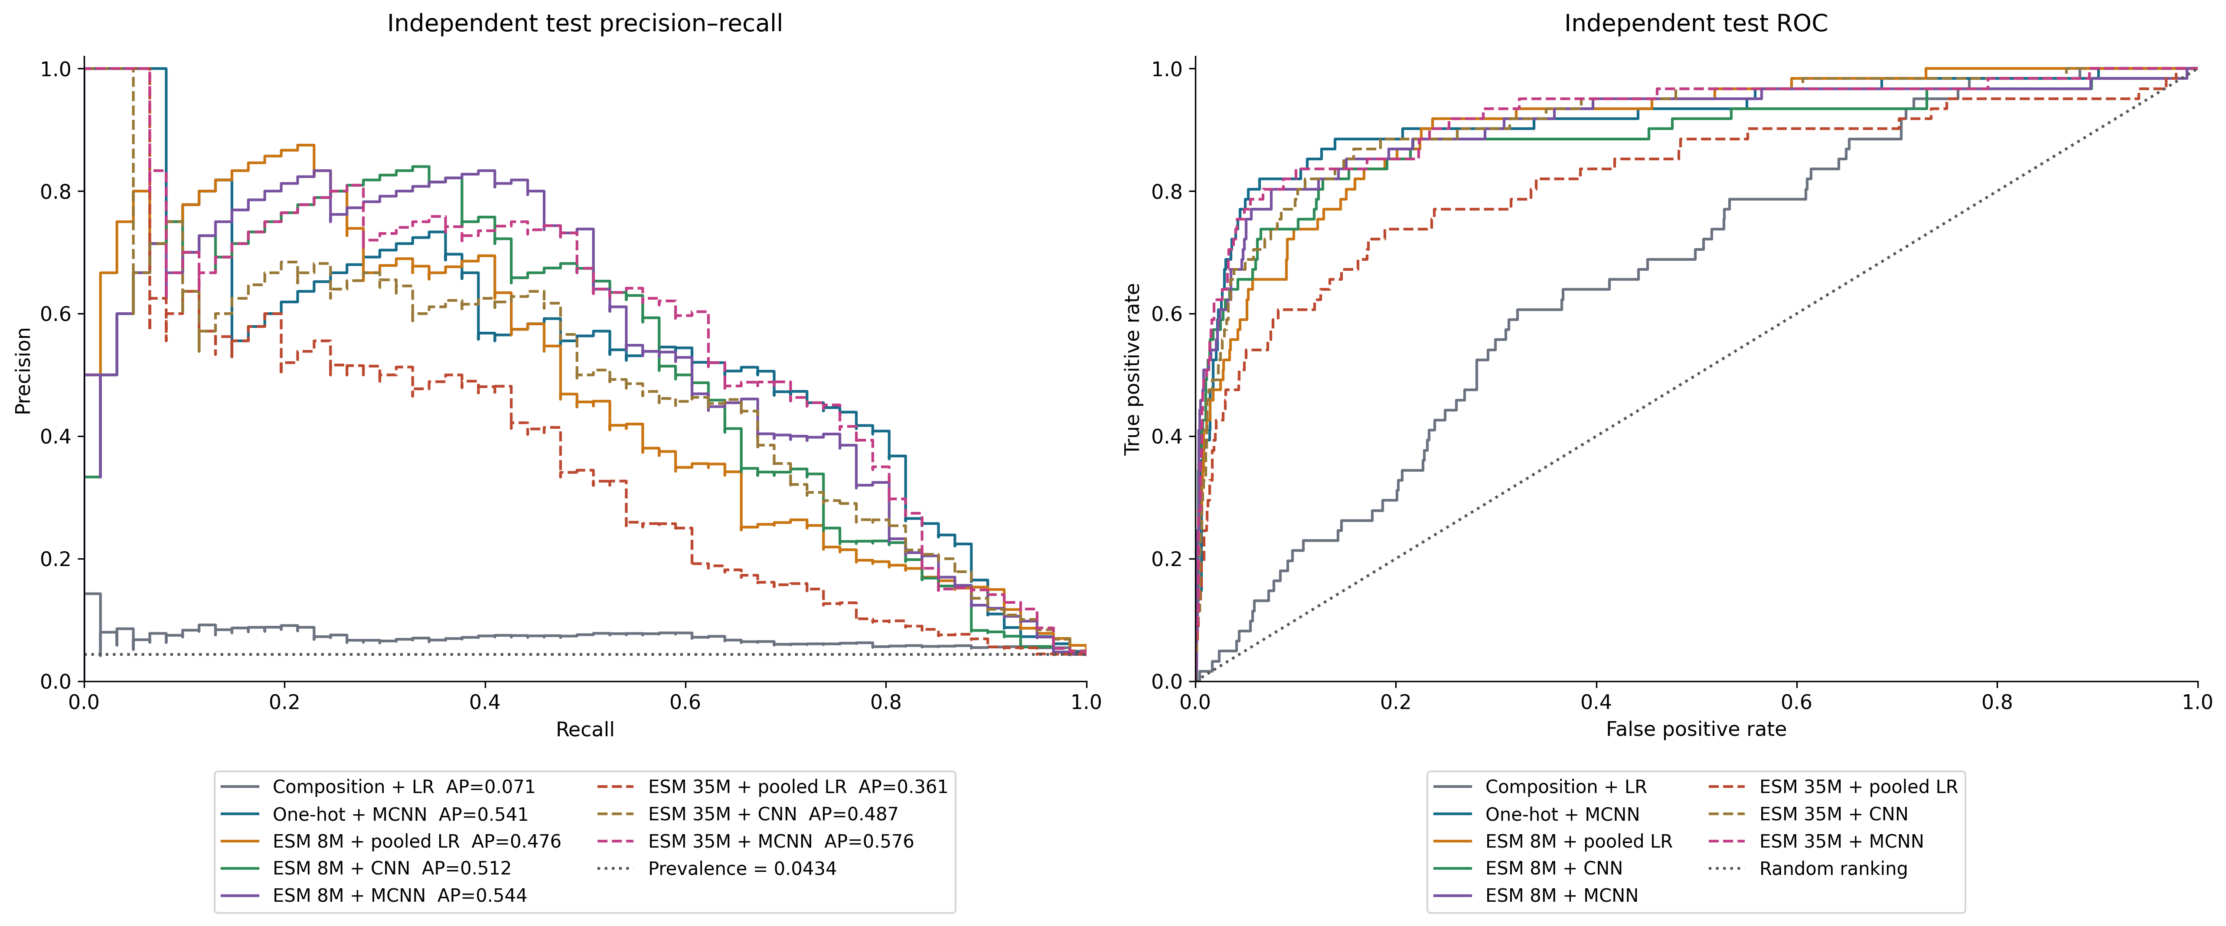
Complete test precision–recall and ROC
all eight locked methods on the same independent test
Notes:
PRESENTATION SCRIPT
The precision-recall curves show how precision changes as we recover more positives. Test prevalence is 0.0434. The ROC curves compare true-positive rates with false-positive rates. With this class imbalance, viewing PR and ROC together helps assess positive retrieval. All eight models use the same test set, and no configuration changes were made based on test performance.
INTERPRETATION NOTES
N = 1,404. PR prevalence = 0.0434. Neural scores average three seed refits. No test-driven configuration changes.
SOURCE NOTES FROM V3
Sources (repository-relative unless URL):
docs/assets/full_results/V12_test_curves.png
results_full/tables/test_metrics.csv

Slide 25
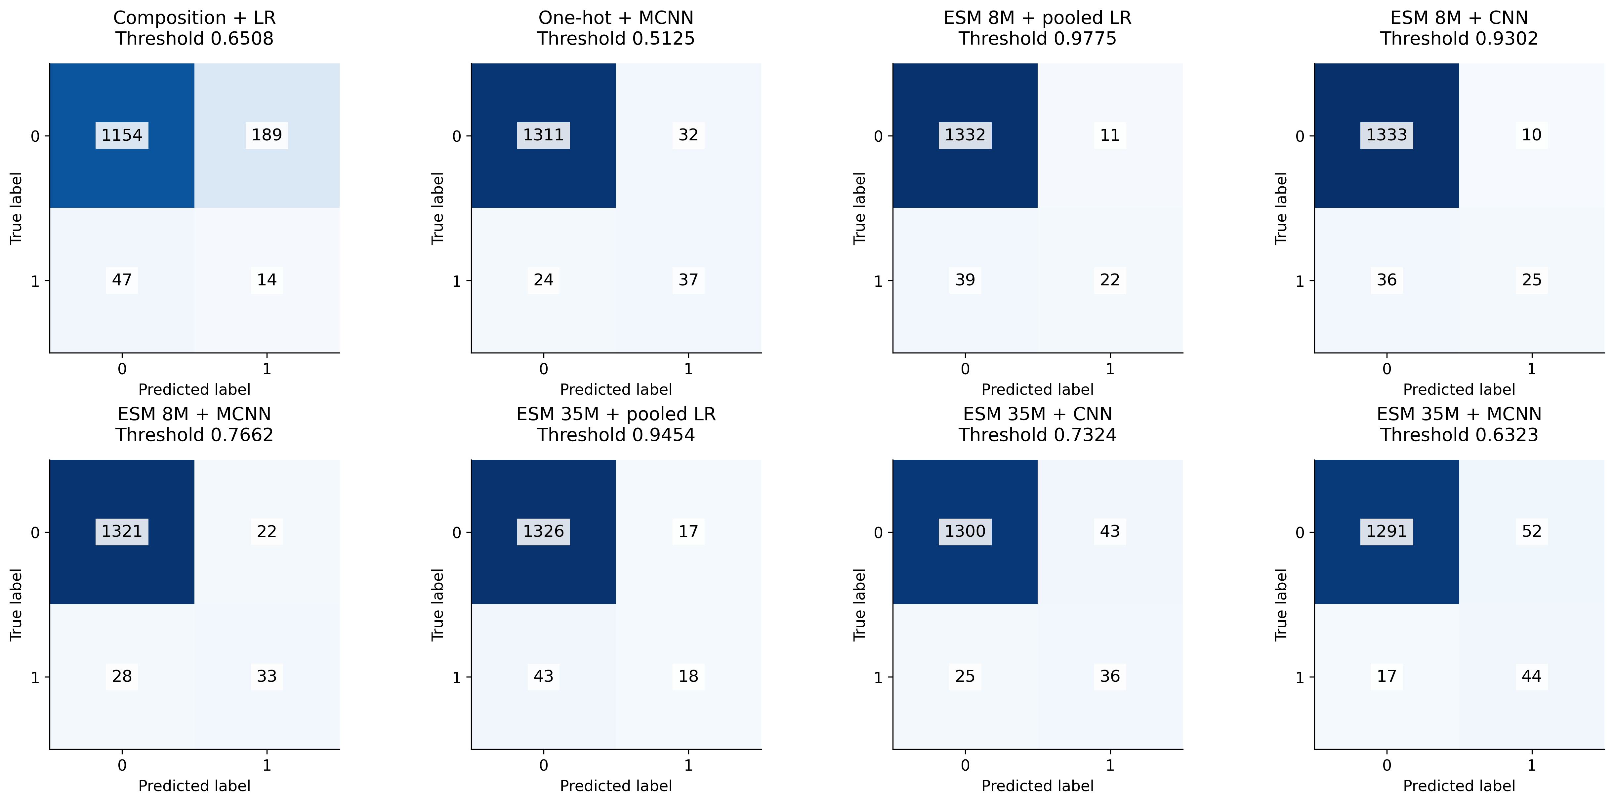
All eight confusion matrices
raw counts at locked OOF-selected thresholds
Notes:
PRESENTATION SCRIPT
The confusion matrices express performance as actual error counts at the locked out-of-fold thresholds. One-hot MCNN has 37 true positives and 32 false positives. ESM 8M MCNN has 33 true positives and 22 false positives. ESM 35M MCNN increases true positives to 44 but also increases false positives to 52. Every panel covers the same 61 positives and 1,343 other records. The counts make the tradeoff between finding more positives and generating more false alarms explicit.
INTERPRETATION NOTES
Label 1: neoantigen. Label 0: dataset other. Common color scale. Every panel covers the same 1,404 records.
SOURCE NOTES FROM V3
Sources (repository-relative unless URL):
docs/assets/full_results/V12_confusion.png
results_full/tables/test_metrics.csv

Slide 26
Conclusion
Notes:
PRESENTATION SCRIPT
SOURCE NOTES FROM V3
Conclusion

Slide 27
Answers to the five research questions
Five questions from the introduction, answered with independent-test evidence
Question | Independent-test answer
Are residue frequencies sufficient? | Limited signal here: composition + LR AP 0.0714.
What can ordered learning from labels achieve? | One-hot MCNN: AP 0.5408 with 28,801 trainable parameters.
Do frozen pretrained representations add signal? | Yes: 8M pooled LR AP 0.4764. Below one-hot MCNN in this test.
Does local extraction help contextual embeddings? | 8M CNN AP 0.5122 vs pooled LR 0.4764. The classifier also changes.
Do multiple local scales help, with added capacity? | 8M MCNN AP 0.5437 vs CNN 0.5122. More windows and head capacity.
Notes:
PRESENTATION SCRIPT
First, amino acid frequencies are insufficient in this dataset: composition logistic regression reaches test AP of only 0.0714. Second, learning from ordered sequences and labels already gives strong results: one-hot MCNN achieves AP of 0.5408 with 28,801 trainable parameters. Third, frozen ESM representations contain useful signal: 8M pooled logistic regression reaches AP of 0.4764, although it remains below one-hot MCNN on this test. Fourth, local extraction with the 8M CNN raises AP to 0.5122 from 0.4764 for pooled logistic regression, while also changing the classifier. Fifth, 8M MCNN achieves AP of 0.5437 versus 0.5122 for CNN, with more window sizes and greater head capacity. These are observations under the current protocol and do not isolate the effect of every component.
INTERPRETATION NOTES
35M MCNN has the highest observed test AP. Close model differences remain unresolved.
SOURCE NOTES FROM V3
Target duration: 0:25
Do not promise a clinical application. End with the most informative next experiment, which should address an actual limitation observed during the project.
Sources (repository-relative unless URL):
docs/FULL_RESULTS_REPORT.md
results_full/tables/test_metrics.csv

Slide 28
Complete CV configurations (1/2)
Appendix A1: all 22 settings, including unselected configurations
Model | Setting | Mean AP | SD AP | MCC at 0.5 | Params
Composition + LR | C=0.1 | 0.1286 | 0.0631 | 0.1507 | 21
Composition + LR | C=1 | 0.1287 | 0.0635 | 0.1505 | 21
Composition + LR | C=10 | 0.1287 | 0.0635 | 0.1505 | 21
One-hot + MCNN | k=2,3,4,5,8; F=64; weighted | 0.4943 | 0.1032 | 0.4182 | 28,801
ESM 8M + pooled LR | C=0.1 | 0.3976 | 0.0572 | 0.3191 | 321
ESM 8M + pooled LR | C=1 | 0.3264 | 0.0431 | 0.3173 | 321
ESM 8M + pooled LR | C=10 | 0.2895 | 0.0397 | 0.2853 | 321
ESM 8M + CNN | k=2; F=64; weighted | 0.4782 | 0.0607 | 0.3439 | 41,089
ESM 8M + CNN | k=3; F=64; weighted | 0.4868 | 0.0600 | 0.3603 | 61,569
ESM 8M + CNN | k=4; F=64; weighted | 0.4730 | 0.0692 | 0.3668 | 82,049
ESM 8M + CNN | k=5; F=64; weighted | 0.4765 | 0.0427 | 0.3560 | 102,529
Notes:
PRESENTATION SCRIPT
The appendix includes every tested configuration, including those not selected. Mean AP should be read together with standard deviation and parameter count. C equal to 0.1 gives the highest cross-validation AP within the 8M pooled logistic regression group. Because these scores also guided model selection, they are not unbiased estimates of performance after selection.
INTERPRETATION NOTES
Mean and sample SD over saved outer-fold/seed rows. Selection reuses CV, so these are optimistic after tuning.
SOURCE NOTES FROM V3
Sources (repository-relative unless URL):
results_full/tables/cv_summary.csv
results_full/config/experiment_registry.json

Slide 29
Complete CV configurations (2/2)
Appendix A2: all 22 settings, including unselected configurations
Model | Setting | Mean AP | SD AP | MCC at 0.5 | Params
ESM 8M + CNN | k=8; F=64; weighted | 0.4740 | 0.0413 | 0.3604 | 163,969
ESM 8M + MCNN | k=2,3,4,5,8; F=32; weighted | 0.4922 | 0.0651 | 0.3718 | 225,601
ESM 8M + MCNN | k=2,3,4,5,8; F=64; weighted | 0.5013 | 0.0551 | 0.4225 | 451,201
ESM 8M + MCNN | k=2,3,4,5,8; F=128; weighted | 0.4985 | 0.0659 | 0.4280 | 902,401
ESM 8M + MCNN | k=2,3,4,5,8; F=256; weighted | 0.5142 | 0.0547 | 0.4594 | 1,804,801
ESM 8M + MCNN | k=2,3,4,5,8; F=64; unweighted | 0.4713 | 0.0384 | 0.4398 | 451,201
ESM 35M + pooled LR | C=0.1 | 0.4449 | 0.0581 | 0.3712 | 481
ESM 35M + pooled LR | C=1 | 0.3812 | 0.0319 | 0.3714 | 481
ESM 35M + pooled LR | C=10 | 0.3193 | 0.0267 | 0.3631 | 481
ESM 35M + CNN | k=3; F=64; weighted | 0.4913 | 0.0744 | 0.3769 | 92,289
ESM 35M + MCNN | k=2,3,4,5,8; F=256; weighted | 0.5216 | 0.0655 | 0.4645 | 2,705,921
Notes:
PRESENTATION SCRIPT
The remaining configurations show that more filters do not consistently improve AP. The 256-filter setting has the highest mean AP within the 8M MCNN group but also uses more parameters. Comparing 8M and 35M additionally changes the embedding dimension and head parameter count. This table documents the experimental conditions rather than establishing a universal model ranking.
INTERPRETATION NOTES
Mean and sample SD over saved outer-fold/seed rows. Selection reuses CV, so these are optimistic after tuning.
SOURCE NOTES FROM V3
Sources (repository-relative unless URL):
results_full/tables/cv_summary.csv
results_full/config/experiment_registry.json

Slide 30
Complete learning histories
Appendix A3: selected settings, first fold and first seed
Notes:
PRESENTATION SCRIPT
The full learning histories show the selected models on fold 0 and seed 535. Checkpoints are selected by early-stopping AP. Raw loss magnitudes should not be compared directly when loss weighting differs. Some runs reach their best epoch at the 30-epoch limit, but that alone does not establish that longer training would improve test performance.
INTERPRETATION NOTES
Fold 0, seed 535. Raw weighted losses have different scales. Early-stop AP supports checkpoint selection.
SOURCE NOTES FROM V3
Sources (repository-relative unless URL):
results_full/tables
outputs/full_analysis/learning_summary.csv

Slide 31
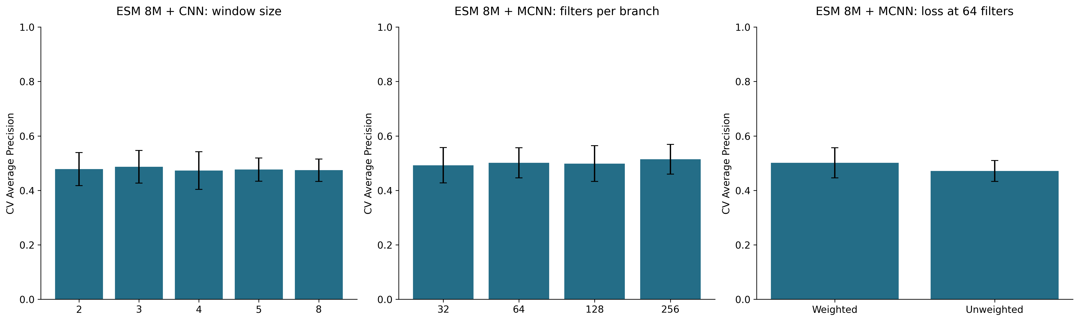
Complete controlled ablations
Appendix A4: one-factor 8M comparisons
Notes:
PRESENTATION SCRIPT
Each ablation group holds its stated conditions fixed while varying window size, filter count, or loss weighting. A window size of 3 performs best among the tested single-window settings. The filter-count trend is not monotonic. Weighted loss improves AP for the 64-filter MCNN but does not improve MCC at a threshold of 0.5. Error bars show descriptive standard deviations across folds and seeds.
INTERPRETATION NOTES
Error bars show descriptive fold/seed SD. Window, filter and loss contrasts retain their fixed conditions.
SOURCE NOTES FROM V3
Sources (repository-relative unless URL):
results_full/tables/ablations.csv

Slide 32
Additional representative errors
Appendix A5: two FP and two FN examples for selected multi-window models
Model | Record | Length | Label | Score | Threshold | Error
One-hot + MCNN | neo_sequence56 | 11 | 1 | 0.000960 | 0.512465 | FN
One-hot + MCNN | neo_sequence664 | 15 | 1 | 0.003104 | 0.512465 | FN
One-hot + MCNN | sgh_sequence28676 | 30 | 0 | 0.964475 | 0.512465 | FP
One-hot + MCNN | sgh_sequence19933 | 16 | 0 | 0.962445 | 0.512465 | FP
ESM 35M + MCNN | neo_sequence56 | 11 | 1 | 0.000162 | 0.632288 | FN
ESM 35M + MCNN | neo_sequence664 | 15 | 1 | 0.000451 | 0.632288 | FN
ESM 35M + MCNN | sgh_sequence7831 | 35 | 0 | 0.999930 | 0.632288 | FP
ESM 35M + MCNN | sgh_sequence7861 | 26 | 0 | 0.999847 | 0.632288 | FP
Notes:
PRESENTATION SCRIPT
The examples include two false positives and two false negatives for each listed multi-window model. Scores should be interpreted with the true label and each model's threshold. These examples are selected deterministically by confidence and do not represent the overall error rate. Explaining an error mechanism would require additional biological context and source-data checks.
INTERPRETATION NOTES
Deterministic confidence-based examples, not a mechanistic explanation. Full sequences and all model examples remain in the source CSV.
SOURCE NOTES FROM V3
Sources (repository-relative unless URL):
outputs/full_analysis/representative_errors.csv

Slide 33
References and image credits
Appendix A6: sources for biological context, methods and empirical figures
Chuang et al. (2024), International Journal of Biological Macromolecules
https://doi.org/10.1016/j.ijbiomac.2024.136252
Dataset and original project: https://github.com/B1607/DeepNeoAG
ESM models and implementation: https://github.com/facebookresearch/esm
Biological definitions: National Cancer Institute and NIH
https://www.cancer.gov/publications/dictionaries/cancer-terms/def/neoantigen
https://clinicalinfo.hiv.gov/en/glossary/human-leukocyte-antigen-complex
Empirical figures: supplied full training run, results_full/
Operating Review template: retained and adapted
Notes:
PRESENTATION SCRIPT
The main sources are the DeepNeoAG paper, its original data and code repository, and the ESM repository. Experimental tables and figures come from the supplied full run. The definitions of neoantigen and HLA peptide presentation draw on the National Cancer Institute and NIH.
INTERPRETATION NOTES
No AI-generated illustration is presented. Conceptual architecture placeholders remain for later image insertion.
SOURCE NOTES FROM V3
Sources (repository-relative unless URL):
docs/VISUAL_ASSET_GUIDE.md
docs/assets/references/sources.json
docs/FULL_RESULTS_REPORT.md

Slide 34
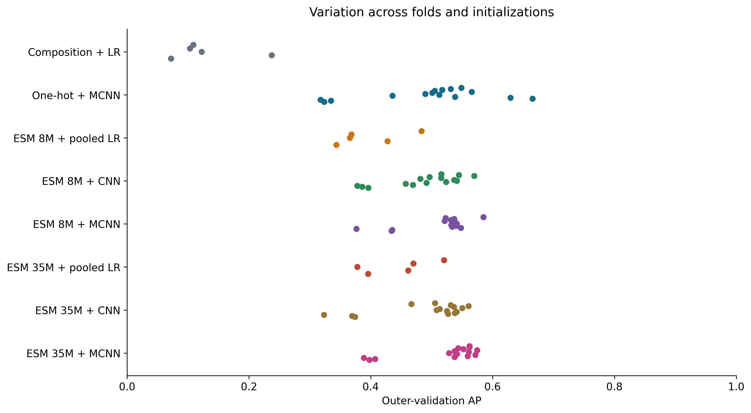
Fold and seed variation
each point is one run on the same published training split
Notes:
PRESENTATION SCRIPT
Each point represents one run on a particular fold and seed. The spread shows sensitivity to the data partition and initialization. Several neural models have lower AP on fold 4. These points are correlated because they reuse data, so their count cannot be treated as the number of independent observations when assessing uncertainty.
INTERPRETATION NOTES
Seeds and folds are correlated. Spread is descriptive, not a confidence interval. Difficult fold causes remain unresolved.
SOURCE NOTES FROM V3
Sources (repository-relative unless URL):
results_full/tables
outputs/full_analysis/fold_summary.csv

Slide 35
What changed when one component changed?
Ablations describe conditional effects under the same protocol
Window | Capacity | Loss at 64 filters
k = 3 selected Best–worst mean AP: 0.0138 | AP does not rise monotonically 32 / 64 / 128 / 256 filters | Weighted AP: 0.5013 Unweighted AP: 0.4713
Notes:
PRESENTATION SCRIPT
For the single-window 8M CNN, a window size of 3 gives the highest mean cross-validation AP. The difference between the best and worst window settings is only 0.0138. Increasing the filter count does not improve AP monotonically. With the same 64-filter MCNN architecture, weighted loss achieves AP of 0.5013 versus 0.4713 without weighting. However, MCC at a threshold of 0.5 decreases from 0.4398 to 0.4225. A change can improve ranking without improving every metric at a fixed threshold.
INTERPRETATION NOTES
Error bars show descriptive fold/seed SD. Weighted loss improves AP here, while MCC at 0.5 decreases (0.4225 vs 0.4398).
SOURCE NOTES FROM V3
Target duration: 1:20
Choose two or three observed contrasts rather than list every number. State the fixed conditions for each. Avoid declaring a universal best window from one dataset. Include negative findings such as no measurable benefit from added capacity.
Sources (repository-relative unless URL):
docs/assets/full_results/V09_ablations.png
results_full/tables/ablations.csv

Slide 36
Test uncertainty and seed spread
2,000 stratified bootstrap repetitions, fixed trained models
Model | Test AP | AP 95% interval | MCC 95% interval | Single-seed AP range
Composition + LR | 0.0714 | [0.0577, 0.1057] | [-0.0052, 0.1140] | 0.0714–0.0714
One-hot + MCNN | 0.5408 | [0.4347, 0.6662] | [0.4465, 0.6465] | 0.5112–0.5373
ESM 8M + pooled LR | 0.4764 | [0.3655, 0.6187] | [0.3517, 0.5934] | 0.4764–0.4764
ESM 8M + CNN | 0.5122 | [0.4025, 0.6606] | [0.4026, 0.6394] | 0.5094–0.5100
ESM 8M + MCNN | 0.5437 | [0.4322, 0.6933] | [0.4479, 0.6544] | 0.5211–0.5328
ESM 35M + pooled LR | 0.3614 | [0.2573, 0.4934] | [0.2484, 0.4912] | 0.3614–0.3614
ESM 35M + CNN | 0.4870 | [0.3786, 0.6198] | [0.3998, 0.5905] | 0.4667–0.4966
ESM 35M + MCNN | 0.5758 | [0.4631, 0.7061] | [0.4681, 0.6338] | 0.5696–0.5833
Notes:
PRESENTATION SCRIPT
The 2,000 stratified bootstrap repetitions show substantial uncertainty with only 61 positive test records. ESM 35M MCNN has AP of 0.5758, with a 95% interval from 0.4631 to 0.7061. The interval for its AP difference from one-hot includes zero. These intervals hold the trained models fixed and do not capture uncertainty from retraining or a change in the source domain. The paired difference analysis is exploratory and has no correction for multiple comparisons.
INTERPRETATION NOTES
Exploratory paired AP difference, 35M MCNN minus one-hot MCNN: 0.0350, 95% CI [−0.0444, 0.1151].
No multiplicity correction. These intervals do not cover retraining or source-domain uncertainty.
SOURCE NOTES FROM V3
Sources (repository-relative unless URL):
results_full/tables/test_confidence_intervals.csv
results_full/tables/test_metrics.csv
outputs/full_analysis/paired_test_differences.csv

Slide 37
Errors, limitations and lessons learned
Confident errors require inspection without inventing a biological mechanism
Only 61 positive test records
Source similarity filtering remains unverified
Labels and source domain limit generalization
Sequence appearance does not identify an error mechanism
Record ID | Length | Label | Score | Error
sgh_sequence7831 | 35 | 0 | 0.999930 | FP
neo_sequence56 | 11 | 1 | 0.000162 | FN
ESM 35M + MCNN
Locked threshold: 0.632288
Notes:
PRESENTATION SCRIPT
The 35M MCNN false-positive example has 35 residues and a score close to one. A false-negative example has 11 residues and a score close to zero. High-confidence predictions can still be wrong. We select these examples by confidence within each error group, not as evidence of a biological mechanism. One error on a 35-residue sequence does not establish a padding defect. Other limitations include dataset labels, source-domain differences, and unverified sequence similarity filtering.
INTERPRETATION NOTES
Examples selected reproducibly by confidence within FP/FN groups. A length-35 error alone does not prove a padding defect.
SOURCE NOTES FROM V3
Target duration: 1:10
Error examples are selected reproducibly by confidence within FP/FN categories, not by a convenient biological story. Do not invent causal explanations from sequence appearance. Highlight padding and validation as methodological lessons.
Sources (repository-relative unless URL):
outputs/full_analysis/representative_errors.csv
docs/FULL_RESULTS_REPORT.md

Slide 38
Execution provenance and limitations
numerical reconciliation does not establish exact execution-source identity
258 completed fits and saved numerical evidence reconcile
The recorded run hash differs from the current pipeline and notebook. The exact executed notebook snapshot is missing.
Recorded full-run code SHA-256
3bd6cb69a8bfeca0a63bf91c461152c45312a7e5c3b9ff55308d7090009b997e
Current scripts/course_pipeline.py SHA-256
a01bdafcf50131f31f1cc5bca963e66cfa6f9a6ac4240bbada93a6ec33fcdf95
Next evidence: archive the executed notebook, audit sequence similarity reproducibly, then evaluate locked choices on an external cohort.
Notes:
PRESENTATION SCRIPT
The tables and saved numerical evidence reconcile with 258 completed fits. However, the code hash recorded during the run differs from the current pipeline hash, and the exact executed notebook snapshot is missing. We can reconcile the numerical results but cannot establish the identity of the complete executed source. The next evidence needed is an archived execution snapshot, a reproducible sequence similarity audit, and evaluation on an external cohort with locked choices.
INTERPRETATION NOTES
Source-domain generalization, label quality and only 61 positive test cases limit the interpretation.
SOURCE NOTES FROM V3
Sources (repository-relative unless URL):
docs/FULL_RESULTS_REPORT.md
outputs/full_analysis/validation_receipt.json

