Slide 1
DeepNeoAG
Learning Through
Controlled Experiments
DeepNeoAG
October 2026
Computational Biology
Course investigation
Complete experimental run
25 October 2026
Composition + LR / One-hot MCNN / ESM pooled LR / ESM CNN / ESM MCNN
Notes:
Target duration: 0:30
Introduce the task and explain that each model exists to answer a different question. Success means an explainable, reproducible investigation; a larger model does not need to win. Preview data, methods, experiments and lessons.
Sources (repository-relative unless URL):
docs/EXPERIMENT_PROTOCOL.md
docs/PRESENTATION_OUTLINE.md

Slide 2
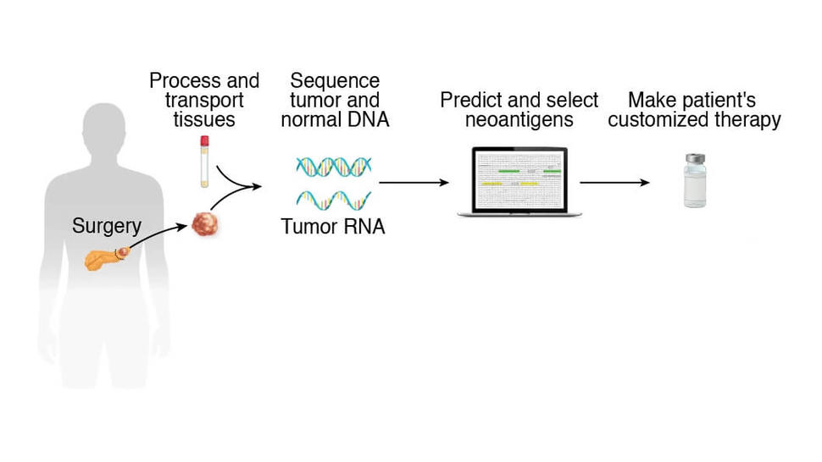
Why predict neoantigen-like peptides?
Sequence prediction covers one part of a wider biological process
Tumor-specific mutations can alter peptides. Presentation and T-cell recognition depend on biological context.
Biological context only. This classifier does not establish presentation, immune response or vaccine effectiveness.
Notes:
Target duration: 1:00
Walk from altered protein to peptide, MHC presentation and T-cell recognition. Point out where the computational classifier sits. Do not imply that a high probability proves presentation, immune response or vaccine effectiveness.
Image: Adapted from Nature (2023), doi:10.1038/s41586-023-06063-y, via National Cancer Institute, CC BY 4.0. Unchanged image, resized only. https://www.cancer.gov/news-events/cancer-currents-blog/2025/neoantigen-vaccine-pancreatic-kidney-cancer
Sources (repository-relative unless URL):
docs/VISUAL_ASSET_GUIDE.md
data/README.md

Slide 3
Defining the prediction problem
A ranking score becomes a binary decision at a locked threshold
YES
Label 1
Neoantigen
Peptide sequence
Sequence classifier
Score s
s ≥ t?
NO
Label 0
Dataset other
No explicit HLA allele input
t selected from training OOF predictions
A score is not proof of immunogenicity or a calibrated probability. Label 0 reflects the dataset definition.
Notes:
Target duration: 0:50
Use one generic FASTA example. Explain that the zero class reflects the data source's definition and is not a universal proof of biological non-immunogenicity. Distinguish a probability-like score, a ranking and a binary decision.
Sources (repository-relative unless URL):
data/README.md
results_full/config/locked_selection.json

Slide 4
Five questions behind the model sequence
Each approach is trained independently
Approach | Research question
Composition + LR | Are residue frequencies sufficient?
One-hot + MCNN | What can ordered learning from labels achieve?
ESM pooled LR | Do frozen pretrained representations add signal?
ESM CNN | Does local extraction help contextual embeddings?
ESM MCNN | Do multiple local scales help, with added capacity?
Composition versus one-hot changes representation and classifier. Later matched comparisons isolate components more closely.
Notes:
Target duration: 1:00
Explain that these are independently trained models rather than a chain of predictions. Mention that Composition + LR→One-hot + MCNN changes both representation and classifier; later matched comparisons isolate components more closely.
Sources (repository-relative unless URL):
docs/EXPERIMENT_PROTOCOL.md

Slide 5
Dataset provenance and published splits
The independent test keeps its published boundary
Published data
7,012 peptides
Training
5,608 records
Independent test
1,404 records
Partition | Neoantigen (1) | Other (0) | Total
Training | 241 | 5,367 | 5,608
Independent test | 61 | 1,343 | 1,404
Total | 302 | 6,710 | 7,012
Record IDs and source labels are retained. Source similarity filtering has not been independently reconstructed.
Notes:
Target duration: 1:00
Describe the source and what the labels mean. Introduce the held-out test boundary. Similarity filtering is reported by the source; explain that the project checks exact duplicates but does not independently reconstruct that filtering procedure.
Sources (repository-relative unless URL):
data/README.md
results_full/tables/dataset_counts.csv
results_full/data_audit/audit.json

Slide 6
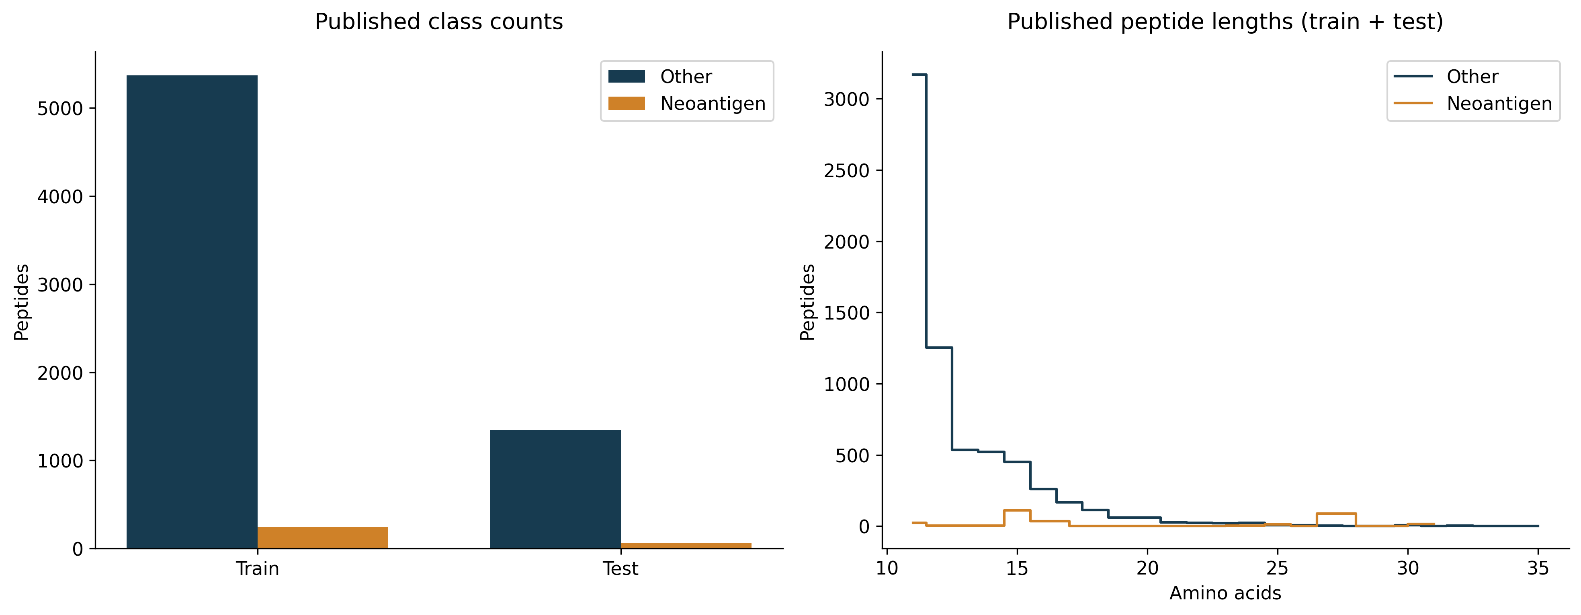
Understanding the data before training
Rare positives and a length-35 boundary case affect the method
About 1 positive per 22 others. Keep the length-35 record. Length alone does not establish an MHC class.
Notes:
Target duration: 1:10
Explain why an all-other classifier has high accuracy. Show the 35-residue boundary case and the choice to preserve the sample. Do not assign MHC classes from length. Use this slide to show an actual data-driven implementation decision.
Sources (repository-relative unless URL):
results_full/data_audit/audit.json
results_full/tables/length_counts.csv
docs/assets/full_results/V04_dataset.png

Slide 7
Designing a fair evaluation
Fitting, early stopping, model selection and testing use distinct roles
TRAINING ONLY: 5,608 records
Shared stratified
5-fold CV
Fit subset + inner
15% early stopping
Outer-validation
OOF predictions
Select by mean AP
Select t by OOF MCC
Neural seeds: 535, 536, 537 with shared partitions
LR uses the full outer-training portion, with no early stopping
Lock settings
and threshold
Refit on all
5,608 training records
Independent test
1,404 records
Final evaluation
Selection CV is optimistic after tuning. Seeds on the same fold are correlated evaluations, not independent datasets.
Notes:
Target duration: 1:20
Trace one fold from fitting to early stopping to outer validation. Explain that choosing settings from CV makes those selection scores optimistic. The independent test answers the final generalization question. Seed repetitions examine initialization variability, not new independent datasets.
Sources (repository-relative unless URL):
docs/EXPERIMENT_PROTOCOL.md
results_full/data_audit/fold_assignments.csv
results_full/config/locked_selection.json

Slide 8
Baseline 1: amino-acid composition
Composition contains some signal, but loses residue order
ACDL
LDCA
Same 20-component
frequency vector
A = C = D = L = 0.25
StandardScaler
Balanced LR, C = 1
Score
Order is lost
Mean CV AP | Test AP | Test MCC | OOF threshold
0.1287 | 0.0714 | 0.0515 | 0.6508
ACDL and LDCA are teaching examples. Test prevalence: 0.0434. The scaler fits within training partitions.
Notes:
Target duration: 0:45
Compare ACDL and LDCA: composition is identical. The model cannot see order. C=1 is selected: mean CV AP is 0.1287; test AP is 0.0714 and MCC 0.0515 at OOF threshold 0.6508. Composition contains some signal but is insufficient here; test prevalence is 0.0434.
Sources (repository-relative unless URL):
results_full/tables/selected_models.csv
results_full/tables/cv_summary.csv
results_full/tables/test_metrics.csv

Slide 9
Baseline 2: one-hot MCNN
Ordered local patterns learned directly from task labels
No pretrained encoder
Five parallel windows
k = 2, 3, 4, 5, 8
64 filters per branch
320 concatenated features
Mask padding before max pooling
IMAGE PLACEHOLDER
One-hot MCNN architecture
Prompt I in IMAGE_GENERATION_PROMPTS.md
Trainable parameters | CV AP | Test AP | Test MCC
28,801 | 0.4943 | 0.5408 | 0.5495
Strong efficiency reference. Improvement over composition changes both representation and classifier.
Notes:
Target duration: 0:55
Explain one filter's scan and how max pooling retains its strongest valid response. This model has no pretrained protein encoder. Improvement over composition is suggestive, but the comparison changes architecture too.
Sources (repository-relative unless URL):
results_full/tables/selected_models.csv
results_full/tables/test_metrics.csv
results_full/tables/cv_summary.csv

Slide 10
From peptides to contextual embeddings
A frozen ESM encoder gives every real residue a contextual representation
IMAGE PLACEHOLDER
One-hot, embeddings and tensor layout
Prompt C in IMAGE_GENERATION_PROMPTS.md
B
Peptides per batch
L
Padded residue positions
D
Features per residue
8M: D = 320
35M: D = 480
Remove special tokens. Mean pooling uses real residues. CNN windows touching padding are excluded.
Notes:
Target duration: 1:10
Illustrate that identical residue letters may receive different contextual vectors. Separate encoder parameters from downstream trainable parameters. Explain the transpose from `[B,L,D]` to `[B,D,L]` without implying that it changes information.
Sources (repository-relative unless URL):
results_full/features/esm_8M.json
results_full/features/esm_35M.json

Slide 11
Pooling, single-window CNN and MCNN
The same frozen embeddings support three independent classifiers
Pooled LR
Real-residue mean; C = 0.1
CV / test AP: 0.3976 / 0.4764
Single-window CNN
k = 3; 64 filters
CV / test AP: 0.4868 / 0.5122
Multi-window CNN
256 filters × 5; concat 1,280
CV / test AP: 0.5142 / 0.5437
IMAGE PLACEHOLDER
Selected pooled, CNN and MCNN architectures
Prompt D; five parallel MCNN branches
MCNN adds capacity as well as window diversity. Contextual mean pooling retains information learned by ESM.
Notes:
Target duration: 1:10
Pooling contextual vectors does not erase all order information because the encoder already used context. Explain that MCNN adds capacity as well as window diversity. Do not call a filter a biological motif without supporting analysis.
Sources (repository-relative unless URL):
results_full/tables/selected_models.csv
results_full/tables/cv_summary.csv
results_full/tables/test_metrics.csv

Slide 12
Our controlled experiment matrix
A staged, one-factor search, with 22 configurations
Changed component | Values | Held fixed / caveat
LR regularization | C = 0.1, 1, 10 | Balanced LR; shared folds
Single CNN window, 8M | k = 2, 3, 4, 5, 8 | 64 filters; weighted loss
MCNN filters, 8M | 32, 64, 128, 256 per branch | Same five windows; weighted loss
MCNN loss, 8M | Weighted / unweighted | 64 filters; same windows
Frozen encoder | 8M / 35M | Transfer selected CNN settings; D and head size change
240 CV fits + 18 final refits = 258 fits. AdamW, LR 0.001, weight decay 0.01, batch 64, maximum 30 epochs.
Notes:
Target duration: 1:10
State the shared optimizer, epoch budget and folds. Explain why this is not a full factorial grid. State that 35M also changes embedding dimension and downstream parameter count, which must accompany performance comparisons.
Sources (repository-relative unless URL):
results_full/config/experiment_registry.json
results_full/tables/ablations.csv
docs/EXPERIMENT_PROTOCOL.md

Slide 13
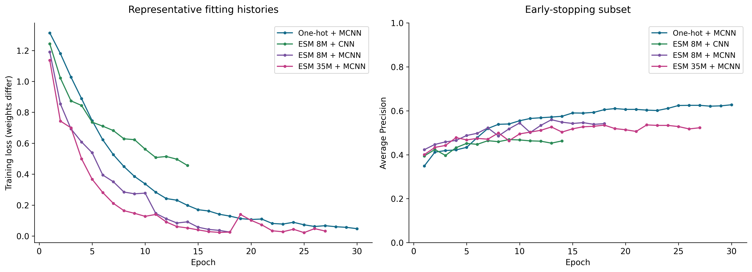
Tracking learning and computational cost
Early-stop AP can plateau while fitting loss continues to decline
Extraction (8M / 35M) | Mean MCNN CV fit (one-hot / 8M / 35M)
9.53 s / 13.21 s | 10.26 s / 11.50 s / 13.52 s
Fold 0, seed 535. Raw loss scales differ. Timings depend on session state and stopping epoch, not deployment latency.
Notes:
Target duration: 0:55
Explain the observed training behavior only after seeing full histories. Raw weighted and unweighted losses have different scales; compare AP for cross-loss quality. Show how these records support decisions rather than discuss storage or execution infrastructure.
Sources (repository-relative unless URL):
docs/assets/full_results/V08_learning_curves.png
results_full/tables/encoder_costs.csv
results_full/tables/cv_summary.csv
outputs/full_analysis/learning_summary.csv

Slide 14
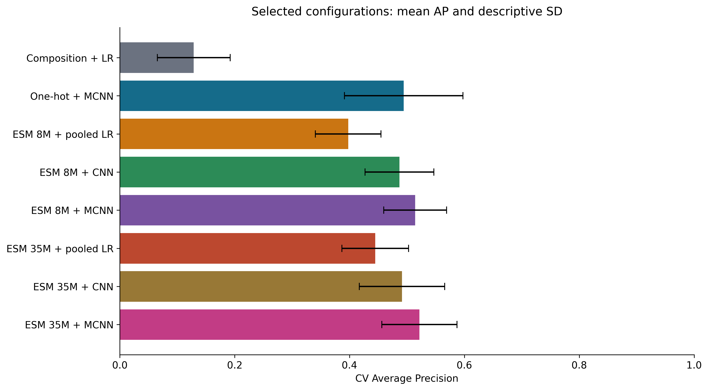
What we observed across folds and seeds
Mean AP and descriptive spread answer different questions
Mean CV AP ± SD
One-hot MCNN
0.4943 ± 0.1032
8M MCNN
0.5142 ± 0.0547
35M MCNN
0.5216 ± 0.0655
Selection CV, not an unbiased post-selection estimate. Fold 4 is difficult across neural methods; the cause is unresolved.
Notes:
Target duration: 1:10
One-hot + MCNN CV AP is 0.4943 with descriptive SD 0.1032; ESM 8M + MCNN is 0.5142 with SD 0.0547; ESM 35M + MCNN is 0.5216 with SD 0.0655. Fold 4 is difficult across neural methods: One-hot + MCNN/ESM 8M + MCNN/ESM 35M + MCNN fold means are 0.3252/0.4153/0.3978. The cause is unresolved. Keep observations distinct from explanations. If a sophisticated model is unstable, treat that as a useful finding, not an inconvenient result to omit.
Sources (repository-relative unless URL):
docs/assets/full_results/V11_cv_comparison.png
outputs/full_analysis/fold_summary.csv
results_full/tables/cv_summary.csv

Slide 15
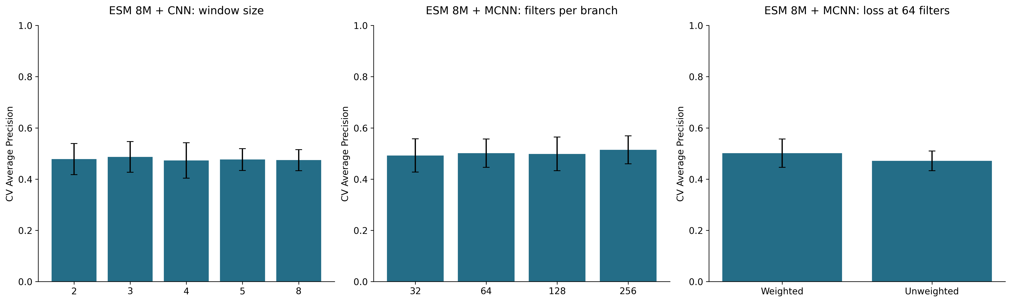
What changed when one component changed?
Ablations describe conditional effects under the same protocol
Window | Capacity | Loss at 64 filters
k = 3 selected Best–worst mean AP: 0.0138 | AP does not rise monotonically 32 / 64 / 128 / 256 filters | Weighted AP: 0.5013 Unweighted AP: 0.4713
Error bars show descriptive fold/seed SD. Weighted loss improves AP here, while MCC at 0.5 decreases (0.4225 vs 0.4398).
Notes:
Target duration: 1:20
Choose two or three observed contrasts rather than list every number. State the fixed conditions for each. Avoid declaring a universal best window from one dataset. Include negative findings such as no measurable benefit from added capacity.
Sources (repository-relative unless URL):
docs/assets/full_results/V09_ablations.png
results_full/tables/ablations.csv

Slide 16
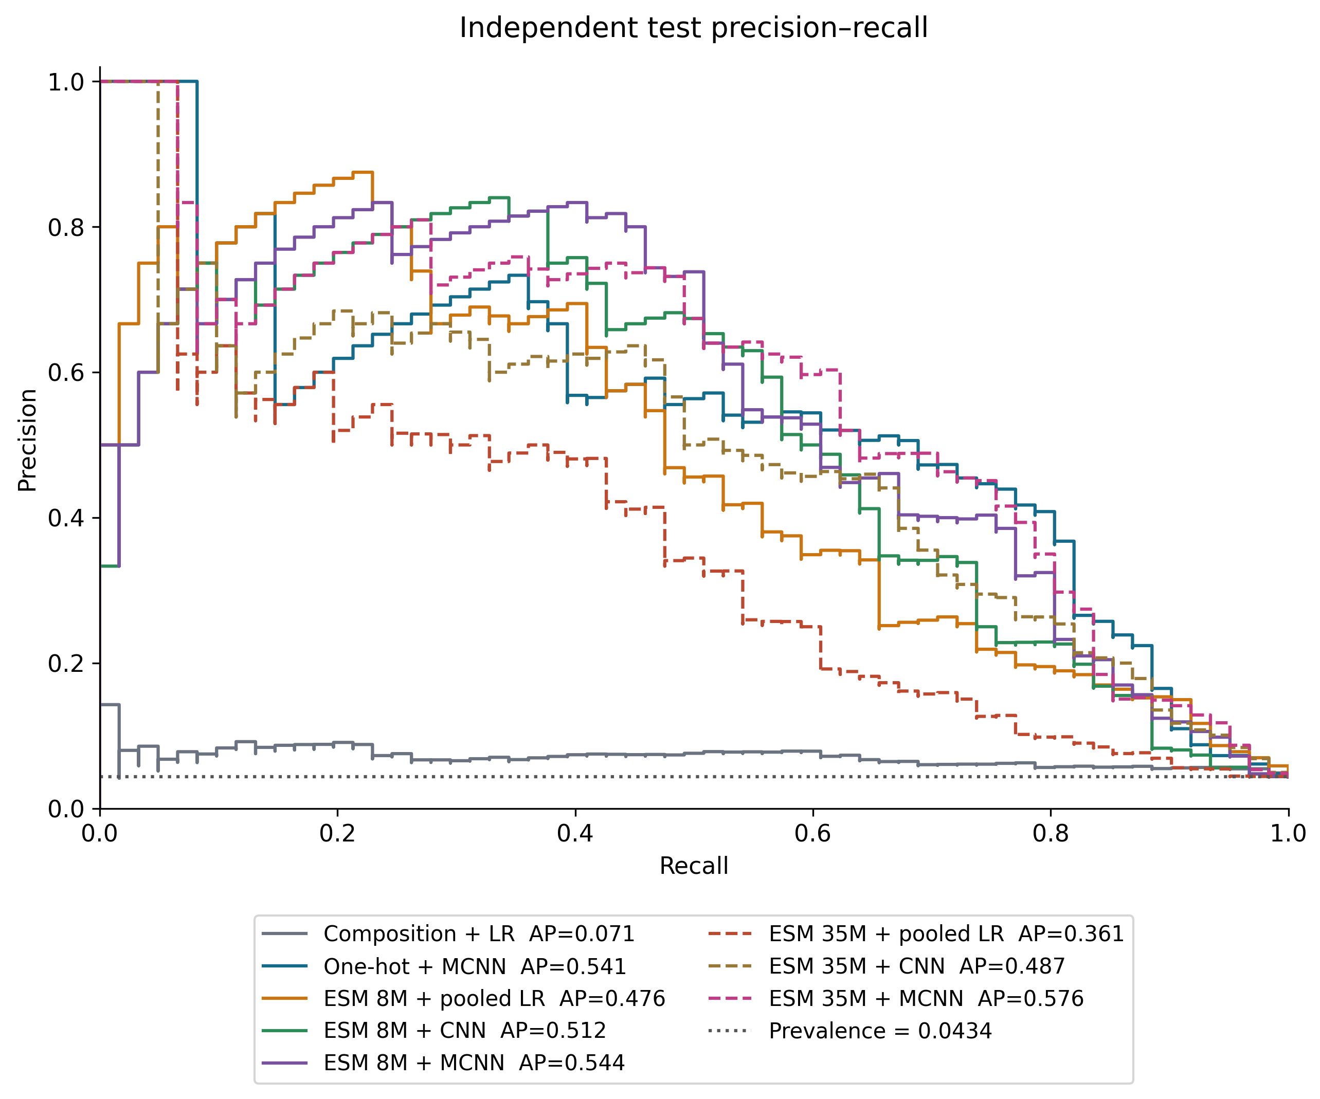
Independent test: a final check
ESM 35M MCNN has the highest observed AP, with uncertain differences
Locked model | AP | MCC
One-hot MCNN | 0.5408 | 0.5495
8M MCNN | 0.5437 | 0.5512
35M MCNN | 0.5758 | 0.5513
35M MCNN: 44 / 61 positives found
52 false positives
AP 95% CI: [0.4631, 0.7061]
Paired AP difference vs one-hot
95% CI: [−0.0444, 0.1151]
All 1,404 test records. Neural probabilities average three final seeds. Thresholds are locked from OOF MCC.
Notes:
Target duration: 1:00
Present the final check briefly. State whether thresholds are 0.5 or OOF-selected. Avoid switching the highlighted model based on a favorable test metric or treating a narrow ranking difference as decisive.
Sources (repository-relative unless URL):
docs/assets/full_results/V12_test_curves.png
results_full/tables/test_metrics.csv
results_full/tables/test_confidence_intervals.csv
outputs/full_analysis/paired_test_differences.csv

Slide 17
Errors, limitations and lessons learned
Confident errors require inspection without inventing a biological mechanism
Only 61 positive test records
Source similarity filtering remains unverified
Labels and source domain limit generalization
Sequence appearance does not identify an error mechanism
Record ID | Length | Label | Score | Error
sgh_sequence7831 | 35 | 0 | 0.999930 | FP
neo_sequence56 | 11 | 1 | 0.000162 | FN
ESM 35M + MCNN
Locked threshold: 0.632288
Examples selected reproducibly by confidence within FP/FN groups. A length-35 error alone does not prove a padding defect.
Notes:
Target duration: 1:10
Error examples are selected reproducibly by confidence within FP/FN categories, not by a convenient biological story. Do not invent causal explanations from sequence appearance. Highlight padding and validation as methodological lessons.
Sources (repository-relative unless URL):
outputs/full_analysis/representative_errors.csv
docs/FULL_RESULTS_REPORT.md

Slide 18
Conclusions and next experiments
Observed lessons under this dataset and protocol
Question | Observed lesson
Composition sufficient? | Insufficient in this dataset
Ordered supervised patterns? | One-hot MCNN is a strong efficiency reference
Pretrained features? | Useful signal, but pooled classification is limited
Local extraction? | CNN improves over pooled 8M features here
Multiple scales? | Higher observed AP, with added head capacity
Next: similarity-aware validation and an external cohort with locked choices
35M MCNN has the highest observed test AP. Close model differences remain unresolved.
Notes:
Target duration: 0:25
Do not promise a clinical application. End with the most informative next experiment, which should address an actual limitation observed during the project.
Sources (repository-relative unless URL):
docs/FULL_RESULTS_REPORT.md
results_full/tables/test_metrics.csv

Slide 19
Selected configurations
Appendix A1: settings locked before independent testing
Model | Selected setting | Parameters | OOF t | Refit epochs
Composition + LR | C = 1 | 21 | 0.650830 | Not applicable
One-hot + MCNN | k=2,3,4,5,8; 64 filters | 28,801 | 0.512465 | 23
ESM 8M + pooled LR | C = 0.1 | 321 | 0.977457 | Not applicable
ESM 8M + CNN | k=3; 64 filters | 61,569 | 0.930151 | 13
ESM 8M + MCNN | k=2,3,4,5,8; 256 filters | 1,804,801 | 0.766193 | 16
ESM 35M + pooled LR | C = 0.1 | 481 | 0.945360 | Not applicable
ESM 35M + CNN | k=3; 64 filters | 92,289 | 0.732428 | 10
ESM 35M + MCNN | k=2,3,4,5,8; 256 filters | 2,705,921 | 0.632288 | 14
ESM is frozen. Parameters count only the trainable classifier. Neural final predictions average seeds 535, 536, 537.
Notes:
Sources (repository-relative unless URL):
results_full/tables/selected_models.csv
results_full/tables/cv_summary.csv

Slide 20
Complete CV configurations (1/2)
Appendix A2: all 22 settings, including unselected configurations
Model | Setting | Mean AP | SD AP | MCC at 0.5 | Params
Composition + LR | C=0.1 | 0.1286 | 0.0631 | 0.1507 | 21
Composition + LR | C=1 | 0.1287 | 0.0635 | 0.1505 | 21
Composition + LR | C=10 | 0.1287 | 0.0635 | 0.1505 | 21
One-hot + MCNN | k=2,3,4,5,8; F=64; weighted | 0.4943 | 0.1032 | 0.4182 | 28,801
ESM 8M + pooled LR | C=0.1 | 0.3976 | 0.0572 | 0.3191 | 321
ESM 8M + pooled LR | C=1 | 0.3264 | 0.0431 | 0.3173 | 321
ESM 8M + pooled LR | C=10 | 0.2895 | 0.0397 | 0.2853 | 321
ESM 8M + CNN | k=2; F=64; weighted | 0.4782 | 0.0607 | 0.3439 | 41,089
ESM 8M + CNN | k=3; F=64; weighted | 0.4868 | 0.0600 | 0.3603 | 61,569
ESM 8M + CNN | k=4; F=64; weighted | 0.4730 | 0.0692 | 0.3668 | 82,049
ESM 8M + CNN | k=5; F=64; weighted | 0.4765 | 0.0427 | 0.3560 | 102,529
Mean and sample SD over saved outer-fold/seed rows. Selection reuses CV, so these are optimistic after tuning.
Notes:
Sources (repository-relative unless URL):
results_full/tables/cv_summary.csv
results_full/config/experiment_registry.json

Slide 21
Complete CV configurations (2/2)
Appendix A3: all 22 settings, including unselected configurations
Model | Setting | Mean AP | SD AP | MCC at 0.5 | Params
ESM 8M + CNN | k=8; F=64; weighted | 0.4740 | 0.0413 | 0.3604 | 163,969
ESM 8M + MCNN | k=2,3,4,5,8; F=32; weighted | 0.4922 | 0.0651 | 0.3718 | 225,601
ESM 8M + MCNN | k=2,3,4,5,8; F=64; weighted | 0.5013 | 0.0551 | 0.4225 | 451,201
ESM 8M + MCNN | k=2,3,4,5,8; F=128; weighted | 0.4985 | 0.0659 | 0.4280 | 902,401
ESM 8M + MCNN | k=2,3,4,5,8; F=256; weighted | 0.5142 | 0.0547 | 0.4594 | 1,804,801
ESM 8M + MCNN | k=2,3,4,5,8; F=64; unweighted | 0.4713 | 0.0384 | 0.4398 | 451,201
ESM 35M + pooled LR | C=0.1 | 0.4449 | 0.0581 | 0.3712 | 481
ESM 35M + pooled LR | C=1 | 0.3812 | 0.0319 | 0.3714 | 481
ESM 35M + pooled LR | C=10 | 0.3193 | 0.0267 | 0.3631 | 481
ESM 35M + CNN | k=3; F=64; weighted | 0.4913 | 0.0744 | 0.3769 | 92,289
ESM 35M + MCNN | k=2,3,4,5,8; F=256; weighted | 0.5216 | 0.0655 | 0.4645 | 2,705,921
Mean and sample SD over saved outer-fold/seed rows. Selection reuses CV, so these are optimistic after tuning.
Notes:
Sources (repository-relative unless URL):
results_full/tables/cv_summary.csv
results_full/config/experiment_registry.json

Slide 22
Fixed defaults versus tuned selections
Appendix A4: comparison includes the model-selection step
Model | Default CV AP | Selected CV AP | Default params | Selected params
Composition + LR | 0.1287 | 0.1287 | 21 | 21
One-hot + MCNN | 0.4943 | 0.4943 | 28,801 | 28,801
ESM 8M + pooled LR | 0.3264 | 0.3976 | 321 | 321
ESM 8M + CNN | 0.4868 | 0.4868 | 61,569 | 61,569
ESM 8M + MCNN | 0.5013 | 0.5142 | 451,201 | 1,804,801
Defaults and selected settings are not independent estimates. A larger selected head changes capacity as well as window coverage.
Notes:
Sources (repository-relative unless URL):
results_full/tables/fixed_configuration_comparison.csv

Slide 23
Metric definitions and threshold policy
Appendix A5: ranking quality and a binary operating point answer different questions
Measure | Meaning
Average precision (AP) | Summarizes precision across recall changes in a ranked list
ROC-AUC | Ranking discrimination across false-positive-rate levels
Precision | TP / (TP + FP)
Recall / sensitivity | TP / (TP + FN)
Specificity | TN / (TN + FP)
MCC | (TP × TN − FP × FN) / √[(TP+FP)(TP+FN)(TN+FP)(TN+FN)]
Configuration: maximize mean CV AP. Threshold: maximize MCC from seed-averaged training OOF predictions.
Independent test uses both 0.5 and the locked OOF threshold. Main slides use the OOF threshold.
AP and ROC-AUC use scores. Precision, recall, specificity, MCC and confusion counts depend on the threshold.
Notes:
Sources (repository-relative unless URL):
docs/EXPERIMENT_PROTOCOL.md
results_full/config/locked_selection.json

Slide 24
Complete learning histories
Appendix A6: selected settings, first fold and first seed
Fold 0, seed 535. Raw weighted losses have different scales. Early-stop AP supports checkpoint selection.
Notes:
Sources (repository-relative unless URL):
results_full/tables
outputs/full_analysis/learning_summary.csv

Slide 25
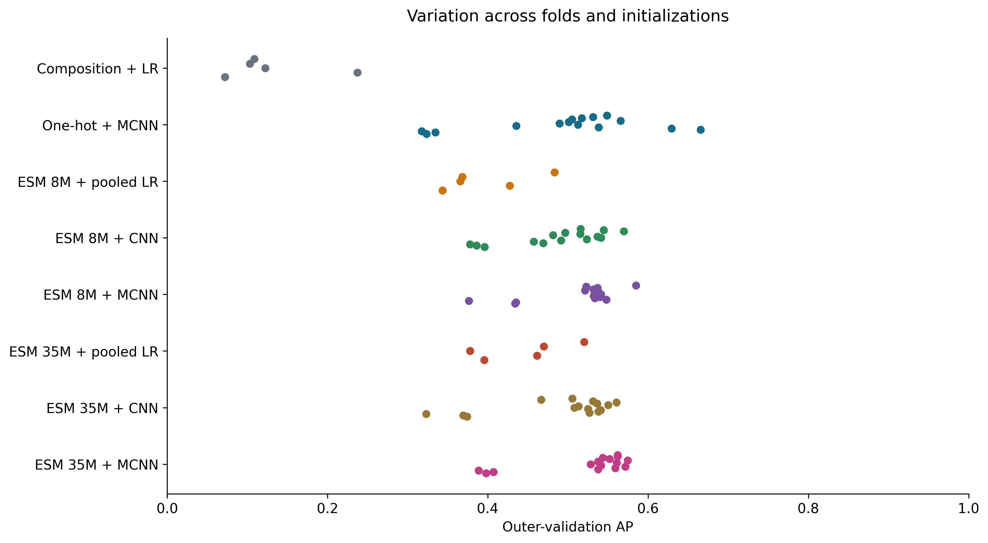
Fold and seed variation
Appendix A7: each point is one run on the same published training split
Seeds and folds are correlated. Spread is descriptive, not a confidence interval. Difficult fold causes remain unresolved.
Notes:
Sources (repository-relative unless URL):
results_full/tables
outputs/full_analysis/fold_summary.csv

Slide 26
Complete controlled ablations
Appendix A8: one-factor 8M comparisons
Error bars show descriptive fold/seed SD. Window, filter and loss contrasts retain their fixed conditions.
Notes:
Sources (repository-relative unless URL):
results_full/tables/ablations.csv

Slide 27
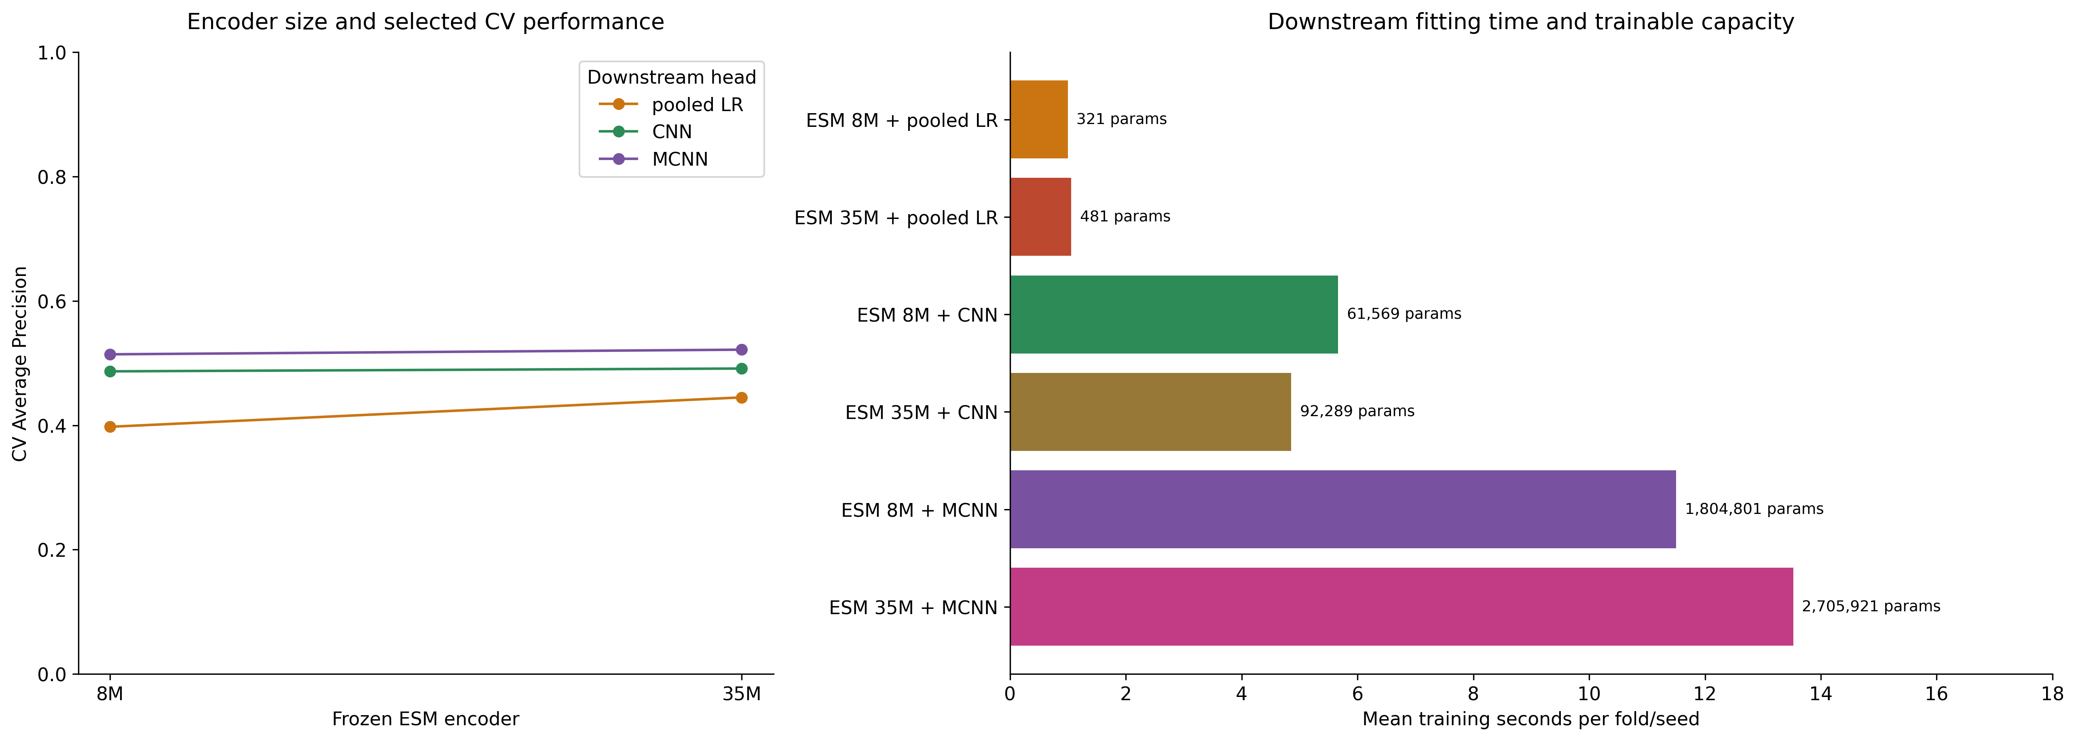
Encoder size, head quality and cost
Appendix A9: transferred CNN settings, with changed D and head parameter count
8M / 35M change embedding dimension and head capacity. Downstream fit time excludes extraction and depends on hardware.
Notes:
Sources (repository-relative unless URL):
results_full/tables/encoder_costs.csv
results_full/tables/cv_summary.csv

Slide 28
Complete independent-test metrics
Appendix A10: ensemble probabilities and locked OOF thresholds
Model | AP | ROC-AUC | MCC | Precision | Recall | Specificity | TP / FP
Composition + LR | 0.0714 | 0.6625 | 0.0515 | 0.0690 | 0.2295 | 0.8593 | 14 / 189
One-hot + MCNN | 0.5408 | 0.9179 | 0.5495 | 0.5362 | 0.6066 | 0.9762 | 37 / 32
ESM 8M + pooled LR | 0.4764 | 0.9077 | 0.4743 | 0.6667 | 0.3607 | 0.9918 | 22 / 11
ESM 8M + CNN | 0.5122 | 0.8880 | 0.5262 | 0.7143 | 0.4098 | 0.9926 | 25 / 10
ESM 8M + MCNN | 0.5437 | 0.9108 | 0.5512 | 0.6000 | 0.5410 | 0.9836 | 33 / 22
ESM 35M + pooled LR | 0.3614 | 0.8213 | 0.3693 | 0.5143 | 0.2951 | 0.9873 | 18 / 17
ESM 35M + CNN | 0.4870 | 0.9154 | 0.4938 | 0.4557 | 0.5902 | 0.9680 | 36 / 43
ESM 35M + MCNN | 0.5758 | 0.9224 | 0.5513 | 0.4583 | 0.7213 | 0.9613 | 44 / 52
N = 1,404, including 61 positives and 1,343 others. LR has one refit. Neural probabilities average three refits.
Notes:
Sources (repository-relative unless URL):
results_full/tables/test_metrics.csv

Slide 29
Test uncertainty and seed spread
Appendix A11: 2,000 stratified bootstrap repetitions, fixed trained models
Model | Test AP | AP 95% interval | MCC 95% interval | Single-seed AP range
Composition + LR | 0.0714 | [0.0577, 0.1057] | [-0.0052, 0.1140] | 0.0714–0.0714
One-hot + MCNN | 0.5408 | [0.4347, 0.6662] | [0.4465, 0.6465] | 0.5112–0.5373
ESM 8M + pooled LR | 0.4764 | [0.3655, 0.6187] | [0.3517, 0.5934] | 0.4764–0.4764
ESM 8M + CNN | 0.5122 | [0.4025, 0.6606] | [0.4026, 0.6394] | 0.5094–0.5100
ESM 8M + MCNN | 0.5437 | [0.4322, 0.6933] | [0.4479, 0.6544] | 0.5211–0.5328
ESM 35M + pooled LR | 0.3614 | [0.2573, 0.4934] | [0.2484, 0.4912] | 0.3614–0.3614
ESM 35M + CNN | 0.4870 | [0.3786, 0.6198] | [0.3998, 0.5905] | 0.4667–0.4966
ESM 35M + MCNN | 0.5758 | [0.4631, 0.7061] | [0.4681, 0.6338] | 0.5696–0.5833
Exploratory paired AP difference, 35M MCNN minus one-hot MCNN: 0.0350, 95% CI [−0.0444, 0.1151].
No multiplicity correction. These intervals do not cover retraining or source-domain uncertainty.
Notes:
Sources (repository-relative unless URL):
results_full/tables/test_confidence_intervals.csv
results_full/tables/test_metrics.csv
outputs/full_analysis/paired_test_differences.csv

Slide 30
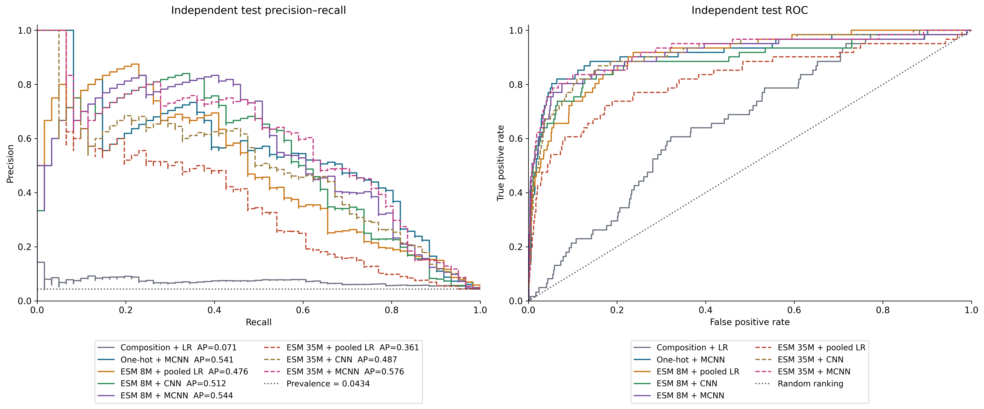
Complete test precision–recall and ROC
Appendix A12: all eight locked methods on the same independent test
N = 1,404. PR prevalence = 0.0434. Neural scores average three seed refits. No test-driven configuration changes.
Notes:
Sources (repository-relative unless URL):
docs/assets/full_results/V12_test_curves.png
results_full/tables/test_metrics.csv

Slide 31
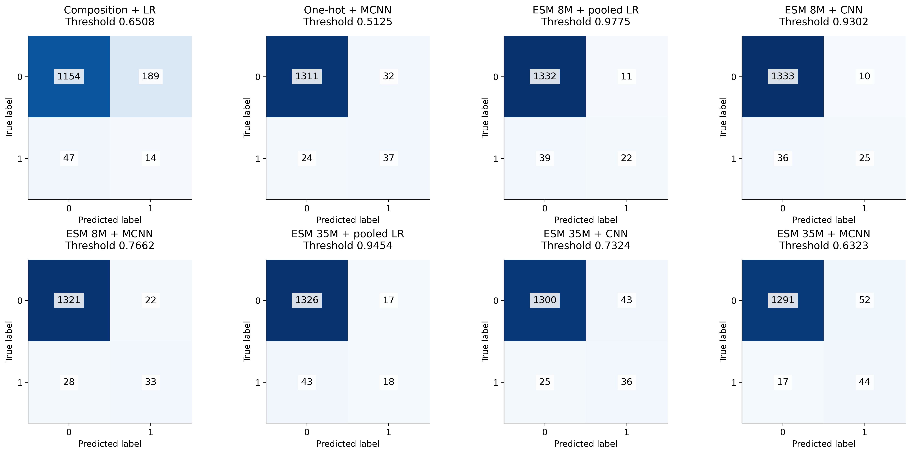
All eight confusion matrices
Appendix A13: raw counts at locked OOF-selected thresholds
Label 1: neoantigen. Label 0: dataset other. Common color scale. Every panel covers the same 1,404 records.
Notes:
Sources (repository-relative unless URL):
docs/assets/full_results/V12_confusion.png
results_full/tables/test_metrics.csv

Slide 32
Additional representative errors
Appendix A14: two FP and two FN examples for selected multi-window models
Model | Record | Length | Label | Score | Threshold | Error
One-hot + MCNN | neo_sequence56 | 11 | 1 | 0.000960 | 0.512465 | FN
One-hot + MCNN | neo_sequence664 | 15 | 1 | 0.003104 | 0.512465 | FN
One-hot + MCNN | sgh_sequence28676 | 30 | 0 | 0.964475 | 0.512465 | FP
One-hot + MCNN | sgh_sequence19933 | 16 | 0 | 0.962445 | 0.512465 | FP
ESM 35M + MCNN | neo_sequence56 | 11 | 1 | 0.000162 | 0.632288 | FN
ESM 35M + MCNN | neo_sequence664 | 15 | 1 | 0.000451 | 0.632288 | FN
ESM 35M + MCNN | sgh_sequence7831 | 35 | 0 | 0.999930 | 0.632288 | FP
ESM 35M + MCNN | sgh_sequence7861 | 26 | 0 | 0.999847 | 0.632288 | FP
Deterministic confidence-based examples, not a mechanistic explanation. Full sequences and all model examples remain in the source CSV.
Notes:
Sources (repository-relative unless URL):
outputs/full_analysis/representative_errors.csv

Slide 33
Execution provenance and limitations
Appendix A15: numerical reconciliation does not establish exact execution-source identity
258 completed fits and saved numerical evidence reconcile
The recorded run hash differs from the current pipeline and notebook. The exact executed notebook snapshot is missing.
Recorded full-run code SHA-256
3bd6cb69a8bfeca0a63bf91c461152c45312a7e5c3b9ff55308d7090009b997e
Current scripts/course_pipeline.py SHA-256
a01bdafcf50131f31f1cc5bca963e66cfa6f9a6ac4240bbada93a6ec33fcdf95
Next evidence: archive the executed notebook, audit sequence similarity reproducibly, then evaluate locked choices on an external cohort.
Source-domain generalization, label quality and only 61 positive test cases limit the interpretation.
Notes:
Sources (repository-relative unless URL):
docs/FULL_RESULTS_REPORT.md
outputs/full_analysis/validation_receipt.json

Slide 34
References and image credits
Appendix A16: sources for biological context, methods and empirical figures
Chuang et al. (2024), International Journal of Biological Macromolecules
https://doi.org/10.1016/j.ijbiomac.2024.136252
Dataset and original project: https://github.com/B1607/DeepNeoAG
ESM models and implementation
https://github.com/facebookresearch/esm
Slide 2 illustration: adapted from Nature (2023) via National Cancer Institute
doi:10.1038/s41586-023-06063-y, CC BY 4.0. Resized only.
https://creativecommons.org/licenses/by/4.0/
Empirical figures: complete supplied training run, results_full/
Named figure exports: docs/assets/full_results/
Operating Review template: retained source deck, cloned and adapted
No AI-generated illustration is presented. Conceptual architecture placeholders remain for later image insertion.
Notes:
Sources (repository-relative unless URL):
docs/VISUAL_ASSET_GUIDE.md
docs/assets/references/sources.json
docs/FULL_RESULTS_REPORT.md

