Slide 1
Chromatic Anchoring for Unsupervised
Microstructural Analysis of Lightweight Concrete
Hai Thanh Nguyen, Bao Gia Nguyen Tran,
Tuyen Thanh Thi Truong, and Trong-Phuoc Huynh
Can Tho University, Vietnam
Paper 8253
Notes:
Today, I will present our study entitled “Chromatic Anchoring for Unsupervised Microstructural Analysis of Lightweight Concrete.” This work investigates a lightweight image-processing method for estimating EPS particles, cementitious matrix, and internal air voids from concrete cross-sectional images. The main idea is to use a controlled exterior color to reduce confusion between the image background and dark internal voids.

Slide 2
Presentation overview
01
Problem, prior approaches, and study scope
02
Experimental material and proposed workflow
03
Chromatic Anchoring and RGB K-means
04
Ablation, sensitivity, baselines, and efficiency
05
Exploratory extensions, limitations, and next validation steps
Notes:
This presentation begins with the research problem and the gap in existing approaches. I will then describe the experimental material, image-processing workflow, and Chromatic Anchoring strategy. Next, I will present the ablation study, cluster-count sensitivity, baseline comparison, and computational results. Finally, I will discuss the exploratory strength relationship, the serial-section illustration, and the main limitations of the study.

Slide 3
Microstructural porosity in lightweight concrete
Why it matters
Why current inspection is difficult
EPS and air-void fractions provide descriptors of material variability.
The pore structure relates to density, transport behavior, and mechanical response.
Micro-CT requires suitable equipment and reconstruction procedures.
Two-dimensional segmentation can change with lighting, surface preparation, and weak phase boundaries.
Study question: Can controlled exterior encoding reduce confusion between dark padding and internal voids in an unsupervised RGB workflow?
Notes:
Microstructural porosity is an important descriptor of lightweight concrete. The proportions of EPS particles and internal air voids relate to material density, transport behavior, and mechanical response.
However, conventional characterization can be difficult. Micro-CT requires suitable equipment and reconstruction procedures, while two-dimensional image segmentation can be sensitive to lighting, surface preparation, and weak phase boundaries.
Therefore, our main question is whether controlled exterior encoding can reduce confusion between dark exterior padding and internal voids in an unsupervised RGB workflow.

Slide 4
Related approaches and the study gap
Conventional characterization
Learning-based segmentation
Gap examined here
Optical microscopy and polished-section image analysis
Thresholding, morphology, and watershed segmentation
X-ray microtomography for three-dimensional characterization
CNN and U-Net methods for cracks and air voids
Performance depends on suitable annotations and acquisition conditions
Exterior padding can influence fitted RGB centroids when clustering includes those pixels.
The paper examines red exterior encoding within a lightweight unsupervised pipeline.
The current experiments do not establish superiority over ROI-only fitting, other color spaces, or deep clustering methods.
Notes:
Existing characterization methods include optical microscopy, polished-section analysis, thresholding, morphology, watershed segmentation, and X-ray microtomography.
Deep-learning methods, including CNN and U-Net architectures, can capture spatial information effectively. However, supervised models normally require representative annotated datasets, and their performance may change under different acquisition conditions.
Classical clustering provides a simpler alternative when labeled training data are limited. Our study specifically examines how exterior padding affects RGB K-means centroids. We investigate red exterior encoding, but the current experiment does not establish superiority over ROI-only fitting, other color spaces, or deep clustering methods.

Slide 5
Study scope and contributions
01
Unsupervised workflow
RGB K-means estimates EPS, matrix, and air-void area fractions without semantic labels for model fitting.
02
Chromatic Anchoring
A circular ROI and red exterior encoding reduce similarity between exterior padding and dark void pixels.
03
CPU assessment
The paper reports descriptive processing time and traced Python allocations on a laptop CPU.
04
Exploratory analyses
Synthetic perturbations, a porosity-strength association, and a serial-section illustration extend the feasibility study.
Notes:
The study has four main components.
First, we investigate an unsupervised RGB K-means workflow. Semantic labels are not used to fit the clustering model, although reference annotations are still required for evaluation.
Second, we introduce Chromatic Anchoring, which combines circular specimen isolation with red exterior encoding.
Third, we report descriptive CPU processing time and traced Python memory allocations.
Finally, all quantitative findings should be interpreted within the eight-observation development collection.

Slide 6
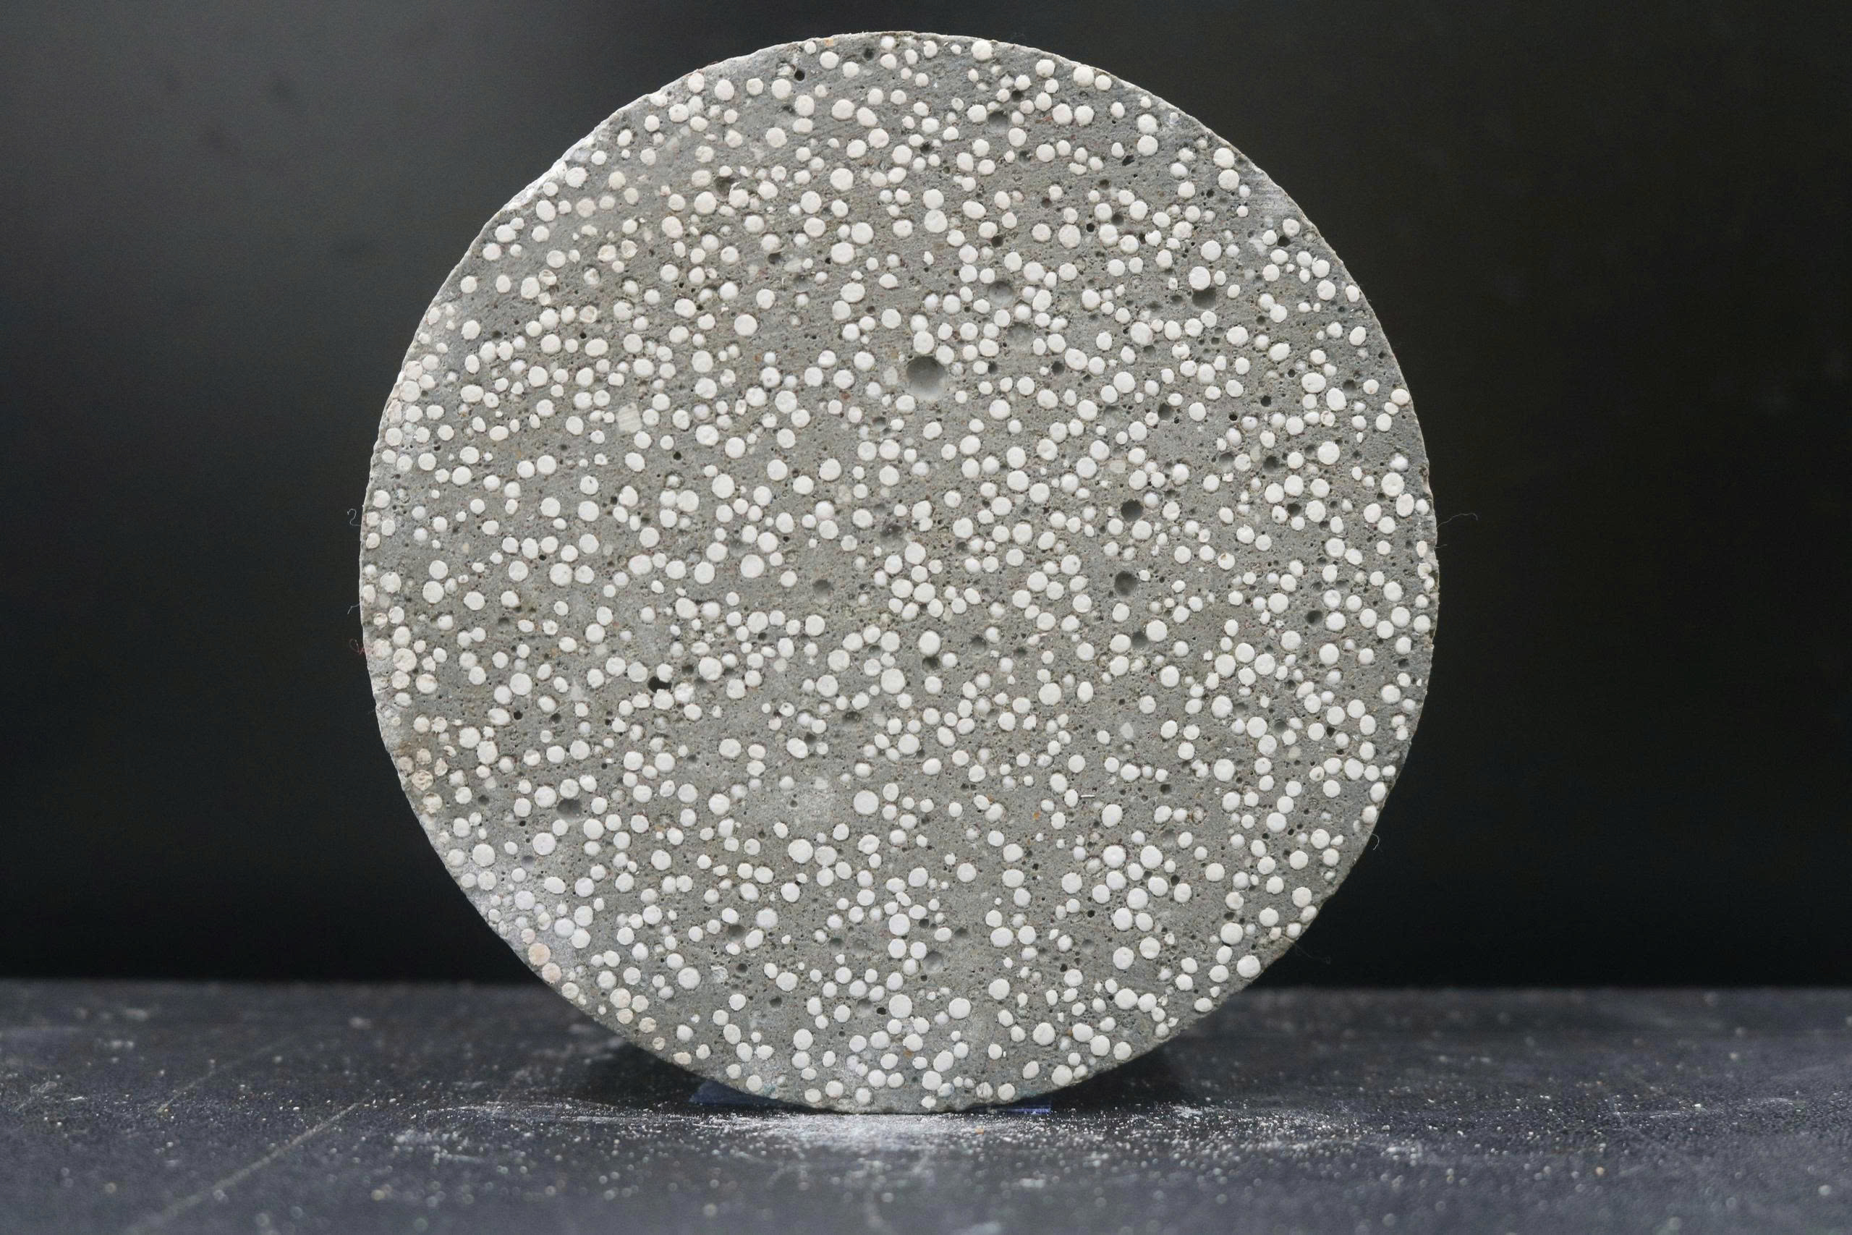
Experimental material and development collection
Property | Reported value
EPS particle size | 1-3 mm
Nominal EPS volume fraction | 60%
Fresh density | 1554 kg/m³
28-day dry density | 1395 kg/m³
28-day compressive strength | 14.74 MPa
28-day water absorption | 5.55%
Representative polished cross-section
8 physical specimens, 8 cross-sectional images, 1920 × 1080 pixels
Notes:
Importantly, the same collection supported parameter selection, evaluation, and regression. We did not reserve an independent hold-out set.

Slide 7

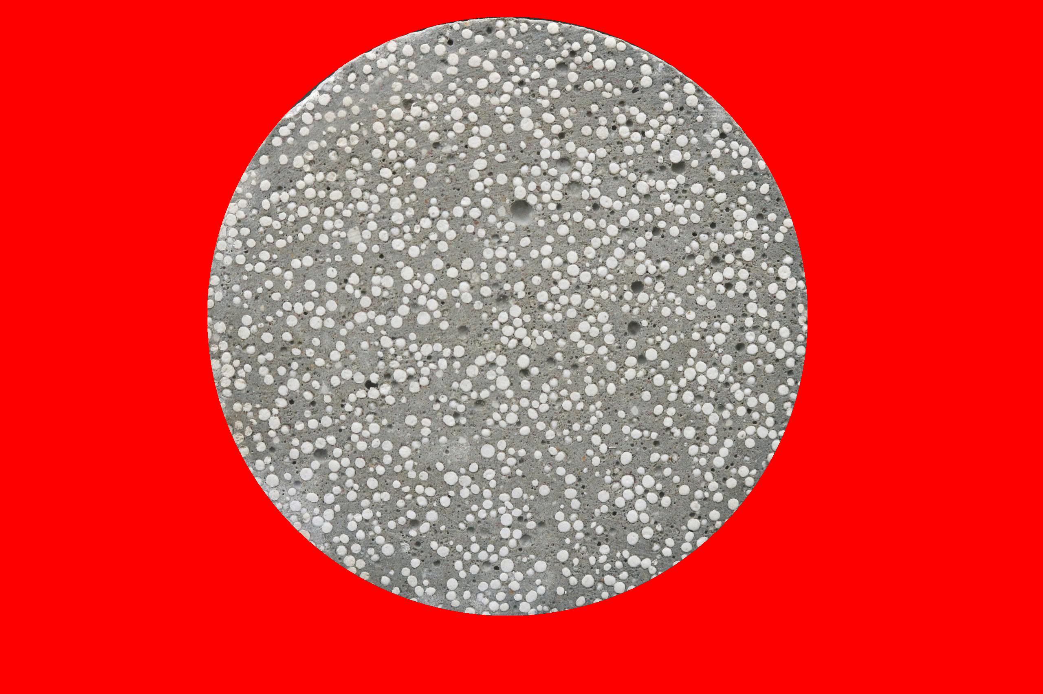
Proposed image-analysis workflow
1
2
3
4
Cross-sectional image
Circular ROI mask
Red exterior encoding
RGB K-means and phase fractions
Polish and image under controlled laboratory conditions
Estimate EPS, matrix, and air-void area fractions
Notes:
The workflow contains four main stages
First, we polish and photograph the specimen under controlled laboratory conditions.
Second, the Circular Hough Transform estimates the circular specimen boundary and creates the region-of-interest mask.
Third, pixels outside the specimen are encoded in pure red.
Finally, RGB K-means estimates the area fractions associated with EPS, matrix, and air voids.

Slide 8
Chromatic Anchoring in RGB space
Dark exterior padding can resemble internal void pixels and influence K-means centroids when those pixels remain in the fit.
Black padding
Red anchor
RGB values may overlap
with dark void appearance
a = (255, 0, 0)
Notes:
The motivation for Chromatic Anchoring comes from RGB geometry.
Dark exterior padding can have values similar to dark internal void pixels. If these exterior pixels participate in K-means fitting, they can influence the cluster centroids.
This provides a geometric rationale, but it does not guarantee correct phase assignment. If exterior pixels are completely excluded from clustering, changing their display color would not affect the K-means objective.

Slide 9
RGB K-means and phase interpretation
Primary configuration
EPS particles
Relatively bright regions
k = 3
Cementitious matrix
Intermediate appearance
Maximum 25 iterations
Air voids
Relatively dark regions
K-means uses 8-bit RGB pixel vectors.
A consistent cluster-to-phase mapping supports comparisons across k = 3, 4, 5, and 6.
Shadows, reflections, and mixed pixels can affect the appearance-based phase hypothesis.
Notes:
The primary configuration uses three clusters and a maximum of 25 iterations.
The intended interpretation associates relatively bright regions with EPS particles, intermediate regions with the cementitious matrix, and relatively dark regions with air voids.
We apply a consistent mapping when comparing different cluster counts. However, this remains an appearance-based interpretation. Shadows, reflections, surface texture, and mixed pixels can change RGB values and affect the physical meaning assigned to each cluster.

Slide 10
Evaluation protocol and interpretation limits
Reference construction
Reported metrics
A primary researcher prepared masks in Roboflow.
A senior domain expert reviewed ambiguous boundaries and adjudicated revisions.
The study did not quantify independent inter-annotator agreement.
MAE
Mean absolute area-fraction error
RMSE
Root mean squared area-fraction error
DBI
Feature-space compactness and separation
Area-fraction agreement does not establish pixel-level overlap. Dice, IoU, and confusion metrics remain future evaluation targets.
Notes:
A primary researcher prepared the reference masks in Roboflow. A senior domain expert then reviewed ambiguous boundaries and adjudicated the revisions.
However, the study did not use multiple independent annotators, so quantitative inter-annotator agreement is unavailable.
We report MAE and RMSE for area-fraction agreement. We also report the Davies–Bouldin index to describe compactness and separation in feature space.
These metrics have different meanings. Area-fraction agreement does not establish correct pixel-level overlap, while a low Davies–Bouldin index does not necessarily indicate correct physical phase labels.

Slide 11
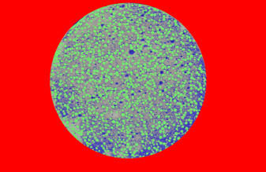
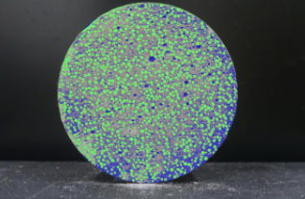
Exterior-padding ablation on one specimen
Chromatic Anchoring
Conventional black padding
1.39 pp
4.81 pp
void-fraction error
void-fraction error
Reference void fraction: 15.28% Red prediction: 16.67% Black prediction: 20.09%
Notes:
The adjudicated reference void fraction was 15.28 percent.
With red encoding, the predicted void fraction was 16.67 percent, producing an absolute error of 1.39 percentage points.
With black padding, the prediction increased to 20.09 percent, giving an error of 4.81 percentage points.

Slide 12
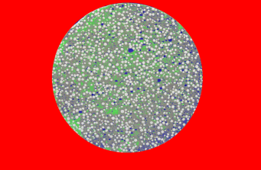
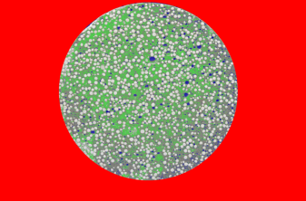
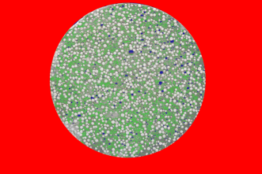
Qualitative sensitivity to the cluster count
k = 3
k = 4
k = 5
k = 6
Green: EPS
Gray: matrix
Blue: voids
Red: exterior
Notes:
These images show the segmentation outputs for cluster counts from three to six.
With larger values of $k$, K-means divides the RGB feature space into more numerical clusters. These clusters must then be aggregated into the same physical phase categories.

Slide 13
Quantitative sensitivity to the cluster count
k | MAE | RMSE
3 | 1.51 | 1.51
4 | 12.38 | 12.93
5 | 8.28 | 8.87
6 | 11.44 | 11.57
k = 3 yielded the lowest two-phase error among the tested settings
Notes:
These images show the segmentation outputs for cluster counts from three to six.
With larger values of $k$, K-means divides the RGB feature space into more numerical clusters. These clusters must then be aggregated into the same physical phase categories.

Slide 14
Exploratory comparison with baseline methods
Algorithm | DBI | MAE (pp) | Time (s/image)
Multi-level Otsu | 0.5429 ± 0.0115 | 4.59 | ≈ 0.08
Gaussian Mixture | 0.4605 ± 0.0234 | - | ≈ 14.02
Fuzzy C-Means | - | 5.78 | ≈ 5.46
Deep Embedded Clustering | - | 1.12 | ≈ 145.20*
K-means (k = 3) | 0.5336 ± 0.0182 | 1.51 | ≈ 3.10
* DEC time excludes autoencoder pre-training.
Missing measurements and non-harmonized timing prevent a definitive ranking.
Notes:
This table provides an exploratory comparison with four baseline methods.
Multi-level Otsu was the fastest, at approximately 0.08 seconds per image, but its reported MAE was 4.59 percentage points.
K-means required approximately 3.10 seconds and produced an MAE of 1.51 percentage points.
Some methods lack either MAE or DBI measurements, and the timing protocols were not fully harmonized. Therefore, this table provides descriptive context rather than a definitive ranking.

Slide 15
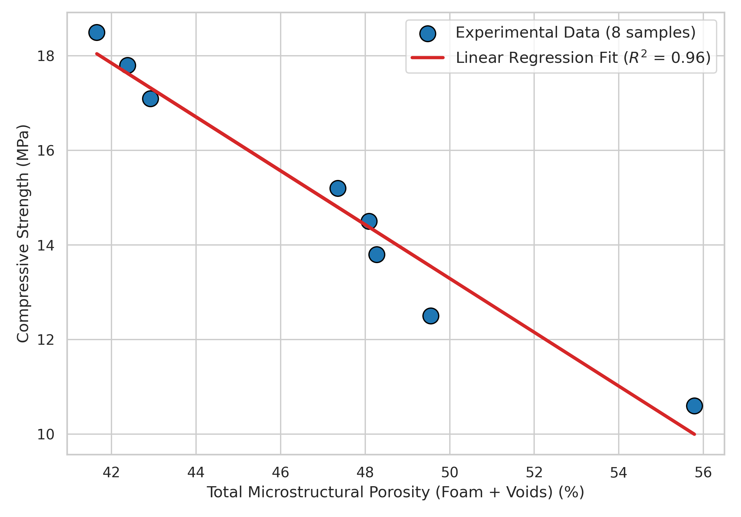
Exploratory porosity-strength association
R² = 0.9585
LOOCV
MAE 0.5757 MPa
RMSE 0.7336 MPa
n = 8 development specimens
Same observations used for fitting and internal resampling
Notes:
This figure shows the exploratory relationship between image-derived total porosity and compressive strength.
The fitted linear model produced an $R^{2}$value of 0.9585, indicating a strong inverse association within these eight observations.
Leave-one-out cross-validation produced an MAE of 0.5757 megapascals and an RMSE of 0.7336 megapascals.

Slide 16
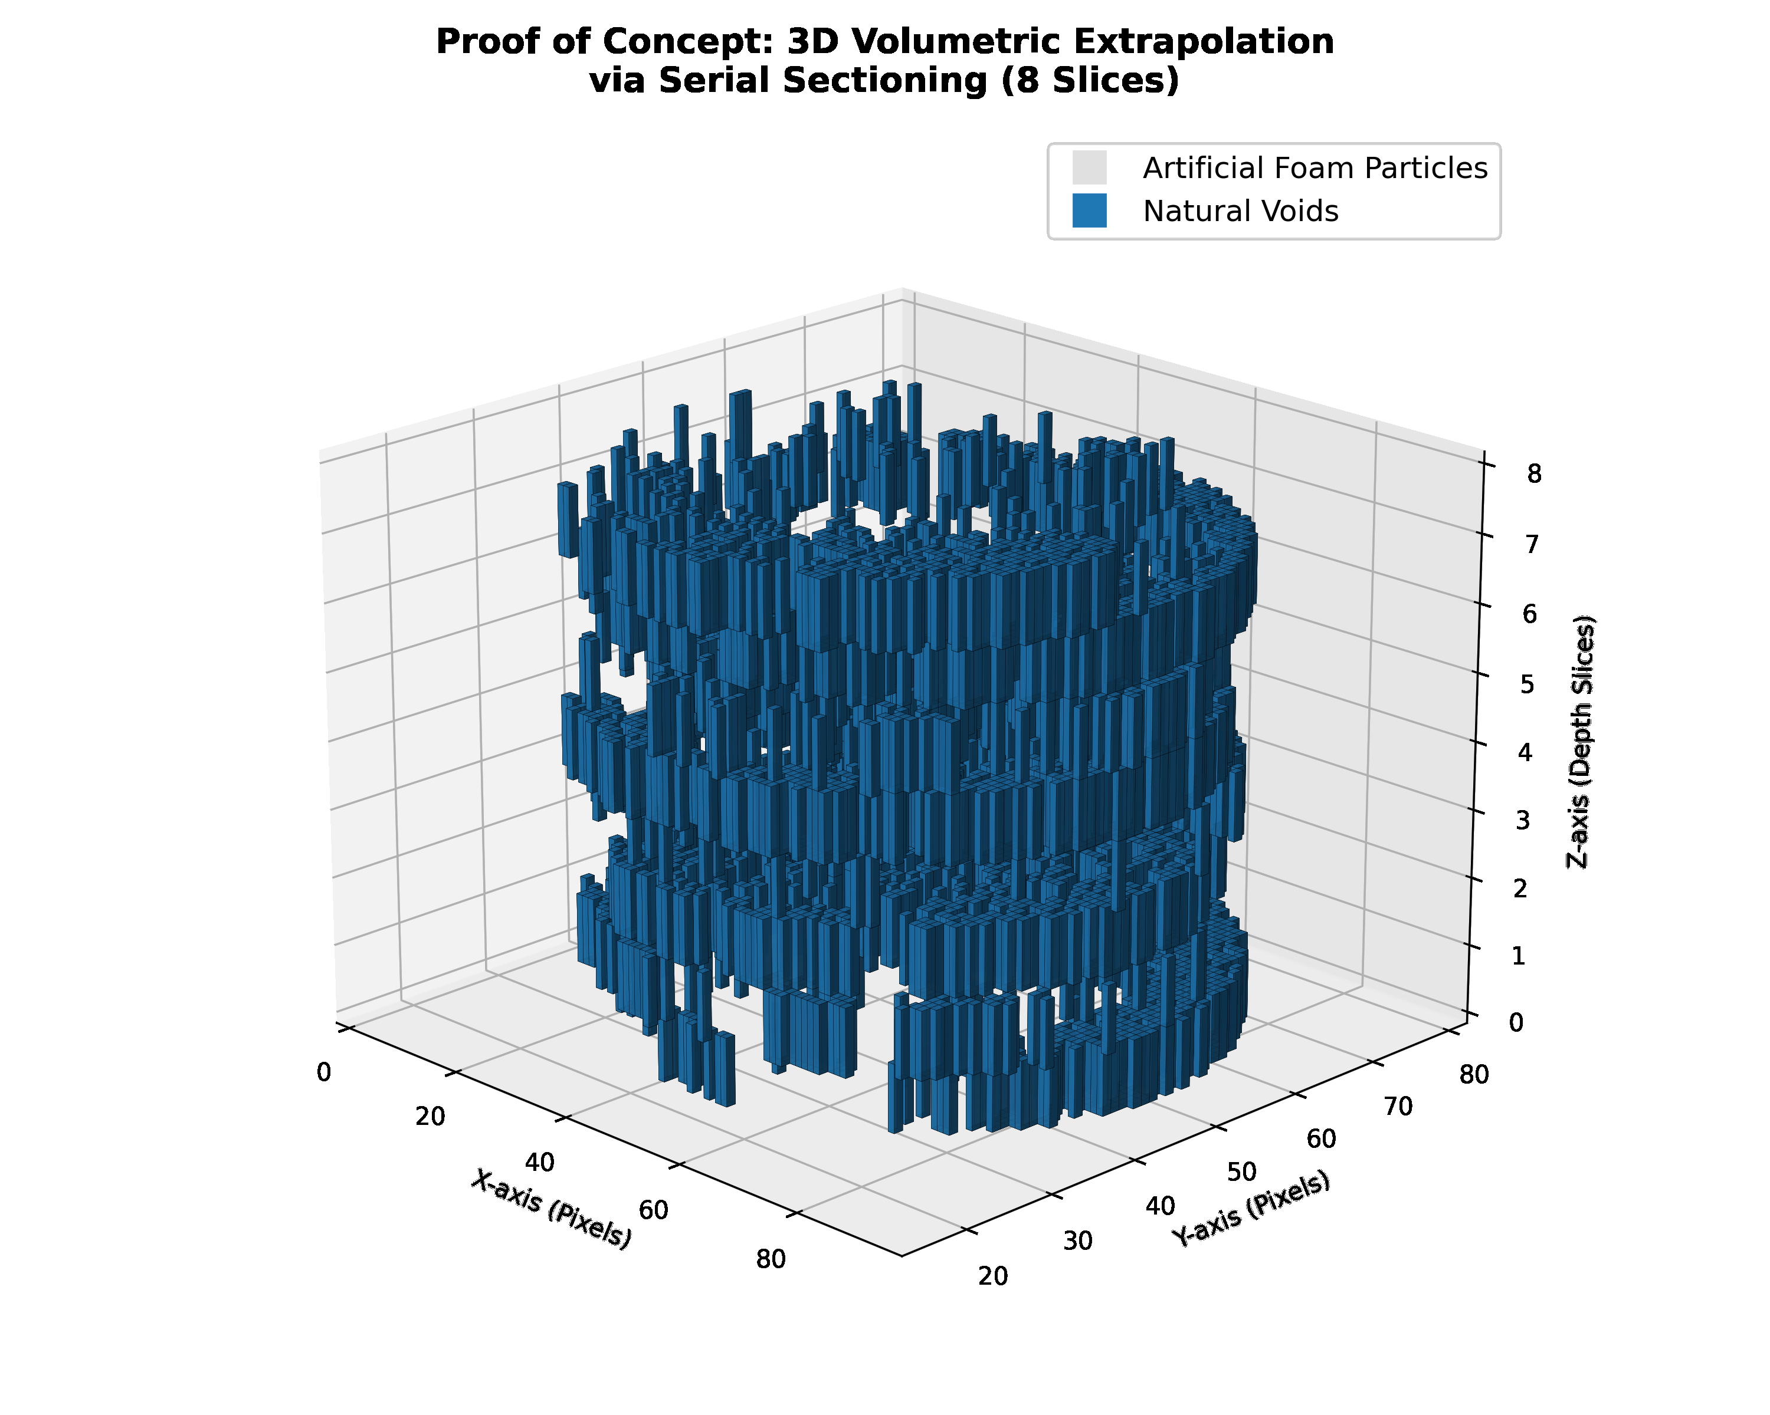
Preliminary serial-section illustration
What the illustration shows
Eight sequential two-dimensional sections
Independent K-means segmentation for each section
Label maps stacked along the depth axis
What remains unvalidated
Inter-slice label consistency
Absolute volumetric accuracy
Comparison with an independent three-dimensional reference
Notes:
This figure illustrates a possible extension from two-dimensional analysis to serial-section visualization.
Eight sequential two-dimensional sections were segmented independently and then stacked along the depth axis.
The result demonstrates how the workflow could support volumetric visualization.
Therefore, this result should be viewed only as a preliminary illustration rather than a validated three-dimensional segmentation method.

Slide 17
Conclusion
Chromatic Anchoring reduced background–void confusion within a lightweight, unsupervised RGB K-means workflow.
What the study demonstrates
Evidence to interpret cautiously
Red exterior encoding reduced the representative void-fraction error from 4.81 to 1.39 pp.
RGB K-means with k = 3 achieved a two-phase case-level MAE of 1.51 pp.
CPU processing required about 3.10 s per 1920 × 1080 image, with approximately 17 MB of traced Python allocations.
Synthetic perturbations reached a maximum MAE of 2.15 pp on the same development images.
The porosity–strength association was strong (R² = 0.9585), but it used only eight development specimens.
No independent hold-out, inter-annotator agreement, or fully harmonized baseline benchmark was available.
The results support preliminary feasibility, not generalization or superiority across imaging conditions.
Notes:
To conclude, Chromatic Anchoring helped reduce confusion between the exterior background and internal voids in our unsupervised RGB K-means workflow.
In the representative experiment, the void-fraction error decreased from 4.81 to 1.39 percentage points, while the selected configuration achieved an MAE of 1.51 percentage points.
The method also required only about 3.10 seconds per image on a standard CPU.
However, because the study used only eight development specimens without an independent test set, these results should be considered preliminary evidence rather than proof of generalization.

Slide 18
Future Work
01
Independent validation
Freeze the pipeline and evaluate a larger, held-out, multi-batch dataset spanning mixtures, laboratories, cameras, lighting, and surface preparation.
02
Reliable ground truth
Use a standardized multi-annotator protocol and report inter-annotator agreement together with Dice, IoU, and class-wise errors.
03
Controlled comparisons
Compare red encoding with ROI-only fitting, alternative anchors and color spaces, plus paired baselines under one timing and statistical protocol.
04
Deployment and 3D extension
Measure end-to-end memory and latency on target edge hardware, then validate serial-section estimates against micro-CT or another independent 3D reference.
Goal: establish when Chromatic Anchoring generalizes, where it fails, and whether it is reliable in field use.
Notes:
For future work, our first priority is to validate the method on a larger and independent dataset under different materials and imaging conditions.
We also plan to improve ground-truth reliability by using multiple annotators and reporting agreement, Dice, and IoU scores. In addition, Chromatic Anchoring should be compared with ROI-only fitting, alternative colors, and other color spaces under the same evaluation protocol.
Finally, we will evaluate the method on actual edge devices and validate the preliminary three-dimensional extension against micro-CT or another independent reference.

Slide 19
References (1 of 2)
[1]
Ramamurthy, K., Nambiar, E.K.K., Ranjani, G.I.I.S.: A classification of studies on properties of foam concrete. Cement and Concrete Composites 31(6), 388-396 (2009).
[2]
De Souza, A.C.A.: Evaluation of concrete porosity by x-ray microtomography: Limitations and benefits. Materials Characterization 142, 110-120 (2018).
[3]
Amran, Y.H.M., Farzadnia, N., Ali, A.A.A.: Properties and applications of foamed concrete: A review. Construction and Building Materials 101, 990-1005 (2015).
[4]
Kearsley, E.P., Wainwright, P.J.: The effect of porosity on the strength of foamed concrete. Cement and Concrete Research 32(2), 233-239 (2002).
[5]
Yang, M.: Macro-properties and microstructures of foam concrete containing porosity sludge gasification particles. Buildings 15(16), 2914 (2025).
[6]
Miled, K.: Compressive strength of idealized lightweight concrete: Application of machine learning and image processing. Cement and Concrete Research 37(6), 841-848 (2007).
[7]
Liu, Z.: Image-based characterization of pore structure in lightweight cellular concrete. Construction and Building Materials 144, 493-505 (2017).
[8]
Cha, Y.J., Choi, W., Büyüköztürk, O.: Deep learning-based crack damage detection using convolutional neural networks. Computer-Aided Civil and Infrastructure Engineering 32(5), 361-378 (2017).
[9]
Perez-Perez, V.: Real-time concrete surface crack detection using yolov4. Automation in Construction 126, 103657 (2021).

Slide 20
References (2 of 2)
[10]
Li, H., Liu, C., Zhang, N., Shi, W.: An enhanced method of cnns by incorporating the clustering-guided block for concrete crack recognition. Frontiers of Structural and Civil Engineering (2025).
[11]
Zheng, Y.: Automatic pore structure analysis of concrete using deep learning. Construction and Building Materials 240, 117865 (2020).
[12]
Li, H.: Semantic segmentation of air voids in concrete using u-net. Journal of Computing in Civil Engineering 35(4), 04021008 (2021).
[13]
Nehdi, M.L.: Machine learning framework for predicting the durability of lightweight aggregate concrete. Materials 14(11), 3020 (2021).
[14]
Afshoon, I., Miri, M., Mousavi, S.R.: Combining kriging meta models with u-function and k-means clustering for prediction of fracture energy of concrete. Journal of Building Engineering 35, 102050 (2021).
[15]
Chen, L., Shan, W., Liu, P.: Identification of concrete aggregates using k-means clustering and level set method. Structures 34, 2069-2076 (2021).
[16]
Ouyang, X.: Application of k-means clustering algorithm for image segmentation of concrete microscopic pores. Journal of Materials in Civil Engineering 33(8), 04021182 (2021).
[17]
Wei, Y.: Unsupervised machine learning for phase segmentation in heterogeneous cementitious materials. Cement and Concrete Composites 128, 104446 (2022).
[18]
Li, P.: Integrating backscattered electron imaging and multi-feature-weighted clustering for quantification of hydrated c3s microstructure. Buildings 15(10), 1699 (2025).

Slide 21
THANK YOU
Questions and discussion
Notes:
Thank you for your attention.

