Slide 1
CTU research presentation
Reusable layout catalog
Your research team
Can Tho University
Layout demonstration · illustrative content
Notes:
This is a reusable layout example. Replace its content with the new topic's verified evidence before presenting it as research.
Source: {"id": "template", "title": "Supplied CTU PowerPoint template", "citation": "Can Tho University. Supplied English PowerPoint template. Local visual source.", "path": "../assets/CTU_PowerPoint_Template_English.pptx"}

Slide 2
Presentation overview
01
Problem and research gap
Explain why the work is needed.
02
Data and methods
Define the inputs and core concepts.
03
Evaluation and results
Define metrics before interpreting results.
04
Conclusion and next steps
State evidence limits and proposed validation.
02
Notes:
This is a reusable layout example. Replace its content with the new topic's verified evidence before presenting it as research.
Source: {"id": "template", "title": "Supplied CTU PowerPoint template", "citation": "Can Tho University. Supplied English PowerPoint template. Local visual source.", "path": "../assets/CTU_PowerPoint_Template_English.pptx"}

Slide 3
Build a clear research narrative
Example structure; adjust it to the topic and audience
Start with the problem
Use one concrete situation to motivate the research question.
Explain unfamiliar concepts
Introduce algorithms, symbols and metrics before reporting values.
Keep claim and evidence together
Distinguish observed results, mathematical conditions and proposed work.
03
Notes:
This is a reusable layout example. Replace its content with the new topic's verified evidence before presenting it as research.
Source: {"id": "template", "title": "Supplied CTU PowerPoint template", "citation": "Can Tho University. Supplied English PowerPoint template. Local visual source.", "path": "../assets/CTU_PowerPoint_Template_English.pptx"}

Slide 4
Compare three parallel ideas
Plain boxes with a uniform outline and no colored left strip
Context
Contribution
Evidence limits
What is the practical problem?
Which audience needs the answer?
What does the work introduce?
What comparison tests it?
Which conditions were tested?
What remains unknown?
04
Notes:
This is a reusable layout example. Replace its content with the new topic's verified evidence before presenting it as research.
Source: {"id": "template", "title": "Supplied CTU PowerPoint template", "citation": "Can Tho University. Supplied English PowerPoint template. Local visual source.", "path": "../assets/CTU_PowerPoint_Template_English.pptx"}

Slide 5
An editable process diagram
Native PowerPoint shapes; adapt the stages to the actual workflow
Input
Preparation
Method
Evaluation
Name the data and the observable fields.
Describe transformations and exclusions.
Explain the decision or computation.
Compare outputs with independent evidence.
05
Notes:
This is a reusable layout example. Replace its content with the new topic's verified evidence before presenting it as research.
Source: {"id": "template", "title": "Supplied CTU PowerPoint template", "citation": "Can Tho University. Supplied English PowerPoint template. Local visual source.", "path": "../assets/CTU_PowerPoint_Template_English.pptx"}

Slide 6
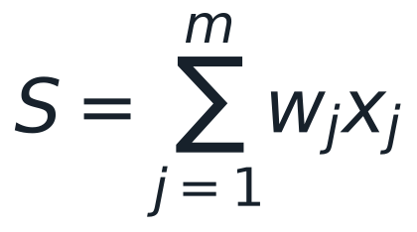
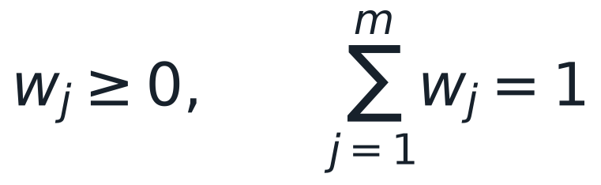
Explain formulas before presenting results
Generic weighted score shown only as a notation example
Weighted combination
S: a generic score
x: input components
w: component weights
m: number of components
Replace this illustration with the actual method.
Example constraints
06
Notes:
This is a reusable layout example. Replace its content with the new topic's verified evidence before presenting it as research.
Source: {"id": "template", "title": "Supplied CTU PowerPoint template", "citation": "Can Tho University. Supplied English PowerPoint template. Local visual source.", "path": "../assets/CTU_PowerPoint_Template_English.pptx"}

Slide 7
Define reported metrics
Give meaning, unit and direction before showing a result
Error
Describe the error endpoint and its unit. State what it does not measure.
LOWER IS BETTER
Agreement
Explain what is being compared and the interpretation of the scale.
HIGHER IS BETTER
Latency
Specify hardware, batch size and measurement boundary.
LOWER IS BETTER
07
Notes:
This is a reusable layout example. Replace its content with the new topic's verified evidence before presenting it as research.
Source: {"id": "template", "title": "Supplied CTU PowerPoint template", "citation": "Can Tho University. Supplied English PowerPoint template. Local visual source.", "path": "../assets/CTU_PowerPoint_Template_English.pptx"}

Slide 8
A compact comparison table
Illustrative descriptions; no measured performance is claimed
Aspect | Candidate A | Candidate B
Input | Describe A | Describe B
Assumption | State assumption | State assumption
Evaluation | Name endpoint | Name endpoint
08
Notes:
This is a reusable layout example. Replace its content with the new topic's verified evidence before presenting it as research.
Source: {"id": "template", "title": "Supplied CTU PowerPoint template", "citation": "Can Tho University. Supplied English PowerPoint template. Local visual source.", "path": "../assets/CTU_PowerPoint_Template_English.pptx"}

Slide 9
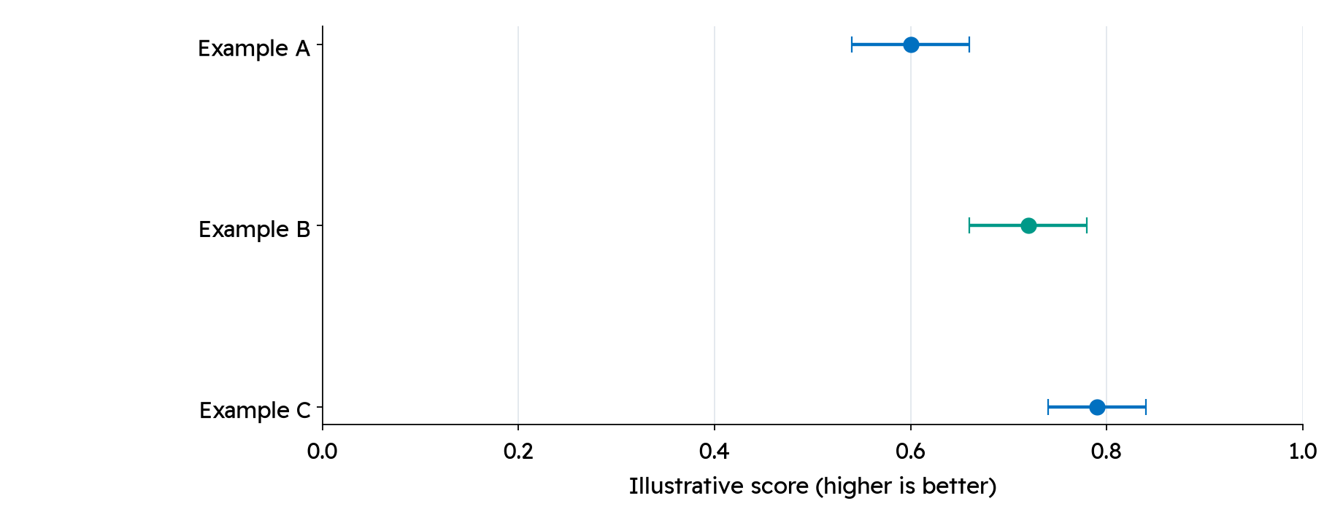
Plot verified data with uncertainty
Layout demonstration — ALL numbers and intervals here are illustrative
09
Notes:
These values are invented for layout demonstration. Replace illustrative.csv with an actual exported result table, record units and the meaning of the intervals, then edit this interpretation.
Source: {"id": "template", "title": "Supplied CTU PowerPoint template", "citation": "Can Tho University. Supplied English PowerPoint template. Local visual source.", "path": "../assets/CTU_PowerPoint_Template_English.pptx"}

Slide 10
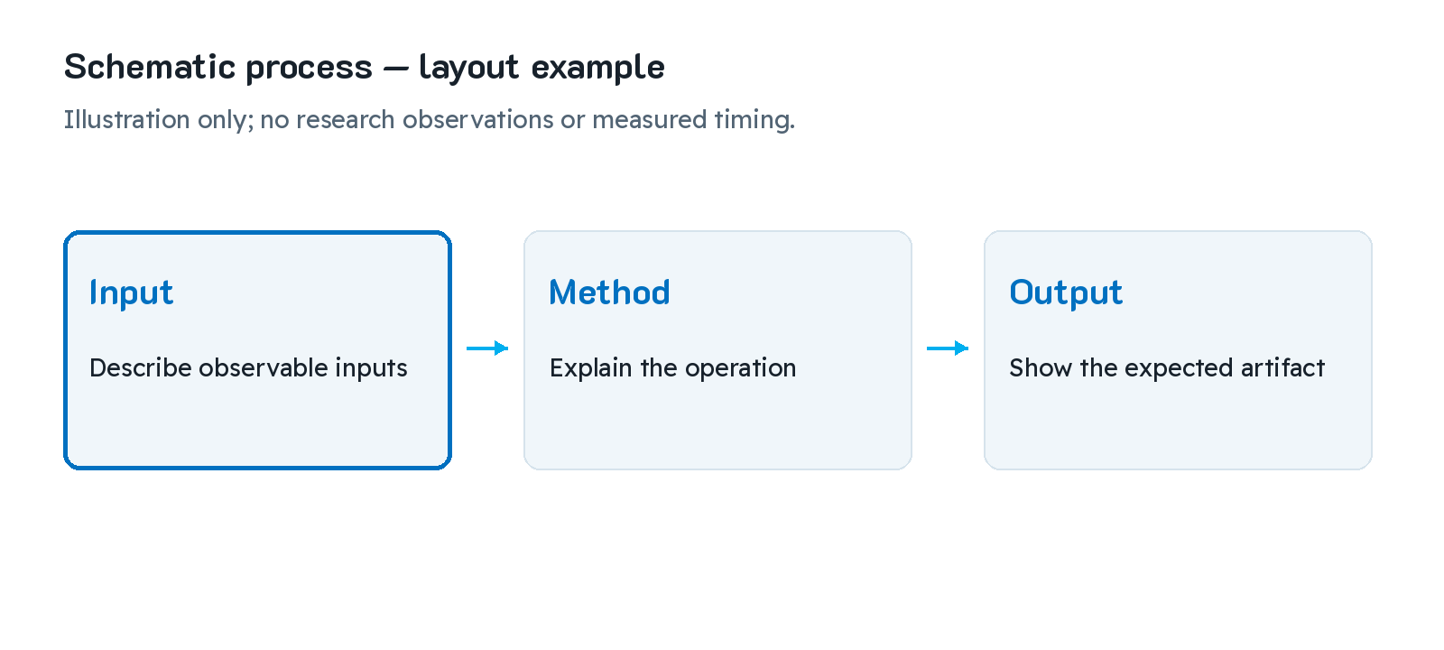
Use a large figure with a short explanation
Schematic image; replace it with a relevant source-backed visual
The figure supports one main point.
Keep labels large enough to read.
Put detailed source locators in speaker notes.
10
Notes:
This is a reusable layout example. Replace its content with the new topic's verified evidence before presenting it as research.
Source: {"id": "template", "title": "Supplied CTU PowerPoint template", "citation": "Can Tho University. Supplied English PowerPoint template. Local visual source.", "path": "../assets/CTU_PowerPoint_Template_English.pptx"}

Slide 11

Animate only when it explains a change
Schematic GIF assembled from three supplied image frames
11
Notes:
This GIF is an instructional schematic. Its frame sequence is not an event timeline or a measured experimental result. PowerPoint Slide Show plays the animation; the PDF shows a static frame.
Source: {"id": "template", "title": "Supplied CTU PowerPoint template", "citation": "Can Tho University. Supplied English PowerPoint template. Local visual source.", "path": "../assets/CTU_PowerPoint_Template_English.pptx"}

Slide 12
Conclusion
State the supported outcome
Tie each conclusion to the evidence actually available.
Retain essential conditions
Keep assumptions and tested scope explicit in the spoken explanation.
12
Notes:
This is a reusable layout example. Replace its content with the new topic's verified evidence before presenting it as research.
Source: {"id": "template", "title": "Supplied CTU PowerPoint template", "citation": "Can Tho University. Supplied English PowerPoint template. Local visual source.", "path": "../assets/CTU_PowerPoint_Template_English.pptx"}

Slide 13
Future work
Close a named evidence gap
State a concrete next validation step instead of implying it has been completed.
Keep the scope appropriate
Choose new data, comparisons or deployment checks only when they answer the remaining question.
13
Notes:
This is a reusable layout example. Replace its content with the new topic's verified evidence before presenting it as research.
Source: {"id": "template", "title": "Supplied CTU PowerPoint template", "citation": "Can Tho University. Supplied English PowerPoint template. Local visual source.", "path": "../assets/CTU_PowerPoint_Template_English.pptx"}

Slide 14
References
[1]
Can Tho University. Supplied English PowerPoint template. Local visual source.
[2]
K2D / Readex Pro / Barlow. SIL Open Font License 1.1; bundled font files retain their licenses.
https://openfontlicense.org/
14
Notes:
The catalog's references document the bundled visual template and font license only. A research presentation must replace or supplement them with the actual cited sources.
Source: {"id": "template", "title": "Supplied CTU PowerPoint template", "citation": "Can Tho University. Supplied English PowerPoint template. Local visual source.", "path": "../assets/CTU_PowerPoint_Template_English.pptx"}
Source: {"id": "fonts", "title": "Bundled font license", "citation": "K2D / Readex Pro / Barlow. SIL Open Font License 1.1; bundled font files retain their licenses.", "path": "../assets/fonts/k2d/OFL.txt", "url": "https://openfontlicense.org/"}

Slide 15
Thank you
Questions and discussion
Can Tho University · reusable research slide template
Notes:
This is a reusable layout example. Replace its content with the new topic's verified evidence before presenting it as research.
Source: {"id": "template", "title": "Supplied CTU PowerPoint template", "citation": "Can Tho University. Supplied English PowerPoint template. Local visual source.", "path": "../assets/CTU_PowerPoint_Template_English.pptx"}

