Slide 1

TowaSHOP Project
Group member: 1. Nguyễn Thanh Phát
2. Huỳnh Phi Hồng
Instructor: Ph.D Trần Công Án

Slide 2
introduction
Towashop
Is a grocery automation application that helps business in performing transactions, managing storage, calculating orders and updating product information. Essentially, it computerizes the process of retailing.
The application architecture is built upon MVP(model-view-presenter) model.
Current functions:
Managing inventory
Performing and managing transactions: calculating orders and updating the state of the orders
Managing customers’ and suppliers’ information.
Search and filter
Authorized access depending on privilege

Slide 3
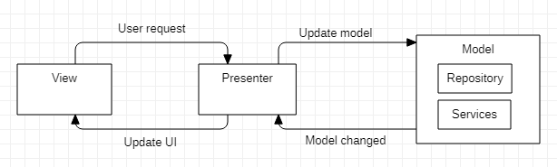
View: The interface that displays the data, and where the user send command to the application
Presenter: It sends user’s command to the model, and then fetches data from the model and formats it to update the GUI of the view layer
Model: The data definition layer, it is where data is handled.
Repository: The layer communicating with the network and database, it fetches data from database to the services to perform tasks and then updates to server
Services: It is where most of the data validation, calculation, and processing is done.

Slide 4
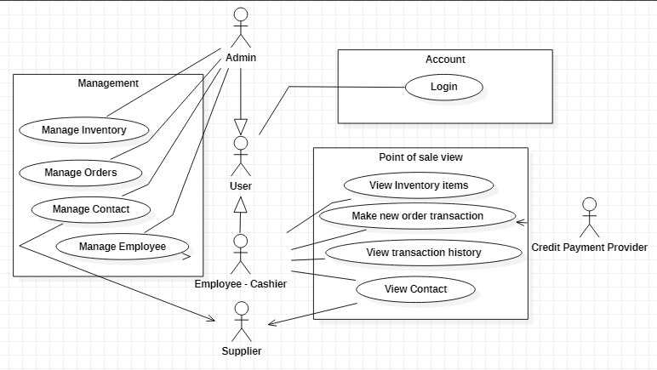
Actors
Currently, The Towashop application consists of two main actors:
The admin:
They have full authority, they could add, update, delete on all entities
The cashiers:
The person who is responsible for performing transactions. They could only add new orders and new customers information. They can not modify orders which are not created by the individual responsible for the specific orders

Slide 5
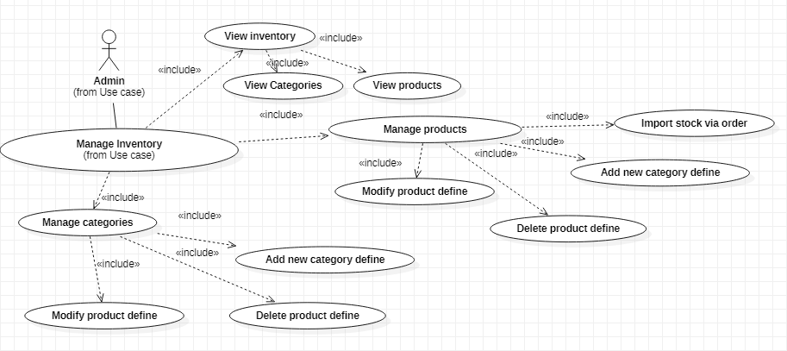
Admin use cases
Managing Inventory: The user can add, modify and delete data of products and categories through using application

Slide 6
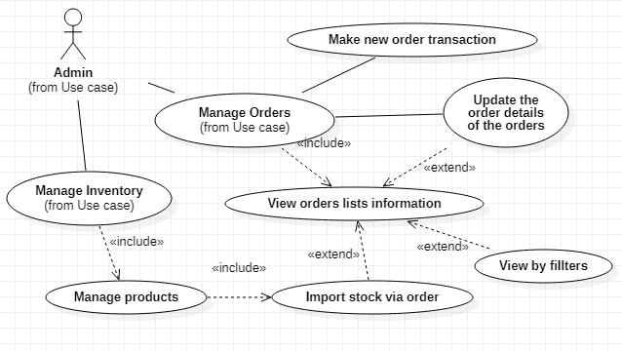
Admin use cases
Managing Order: Admin can add and modify information on any order. However, they can not remove orders that have been processed

Slide 7
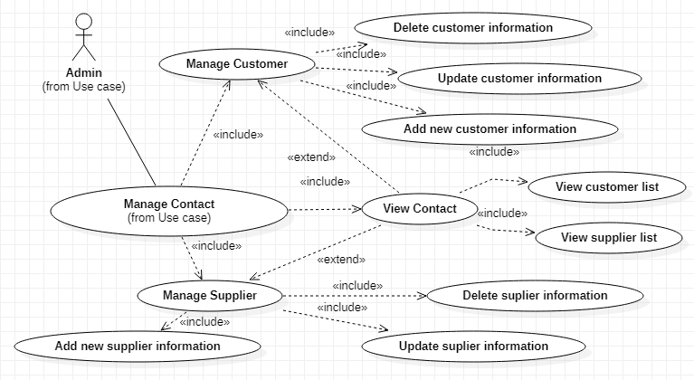
Admin use cases
Managing Contact: Admin user can add, modify and delete data of customers and suppliers on the DBMS through application

Slide 8
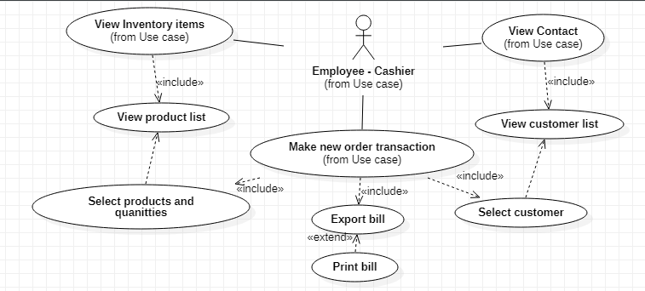
Employee use case
Managing Order: Cashiers could add orders and modify the orders they added themselves
They could also view customers’ information on the database

Slide 9
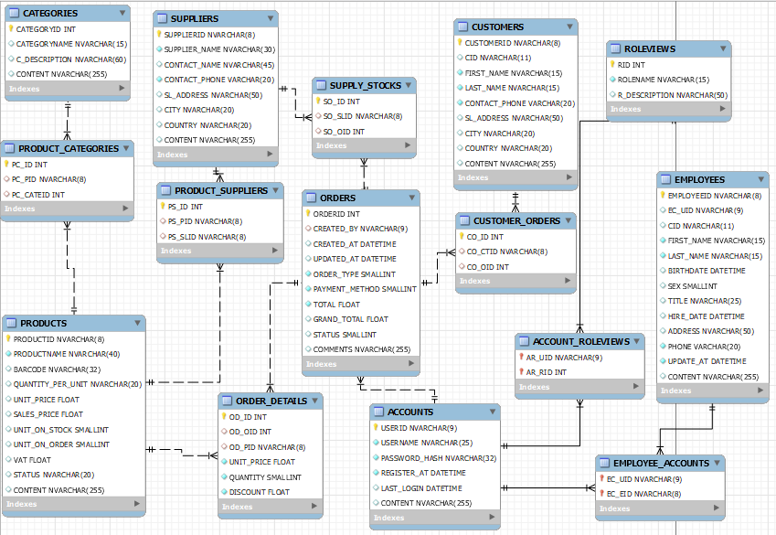
Data Design
The data model includes 15 tables:

Slide 10
List of stored procedures and functions
spAccountRole_GetAll
spAccount_GetByUID
spAccount_GetByUsername
spCategory_Insert
spCategory_Update
spCategory_GetByValue
spCategory_GetAll
spCategory_Delete
spCustomerOrder_GetAll
spCustomerOrder_GetByValue
spCustomerOrder_Insert
spCustomerOrder_Update
spCustomer_Delete
spCustomer_GetAll
spCustomer_GetByValue
spCustomer_Insert
spCustomer_Update
spEmployee_Delete
spEmployee_GetAll
spEmployee_GetByValue
spEmployee_Insert
spEmployee_Update

Slide 11
List of stored procedures and functions
spOrderDetails_Delete
spOrderDetails_GetAll
spOrderDetails_GetByValue
spOrderDetails_Insert
spOrderDetails_Update
spOrder_GetAll
spOrder_GetByValue
spOrder_Insert
spOrder_Update
spProduct_Insert
spProduct_Update
spProduct_GetByValue
spProduct_GetAll
spProduct_Delete
spProduct_UpdateProductOrder
spProduct_UpdateProductStock
spSupplier_Insert
spSupplier_Update
spSupplier_GetByValue
spSupplier_GetAll
spSupplier_Delete
spStockOrder_Insert
spStockOrder_Update
spStockOrder_GetByValue
spStockOrder_GetAll

Slide 12
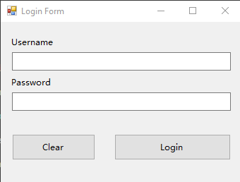
Interface/ Login Form
- Using admin privileged account will direct to Admin View
- Using employee privileged account will direct to Employee View

Slide 13


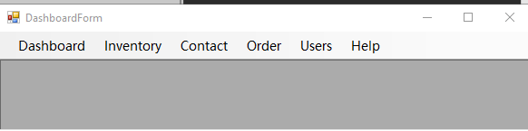


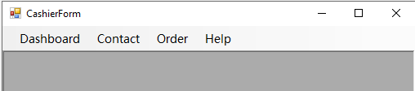


Interface/ dashboard form
Admin View
Employee View

Slide 14
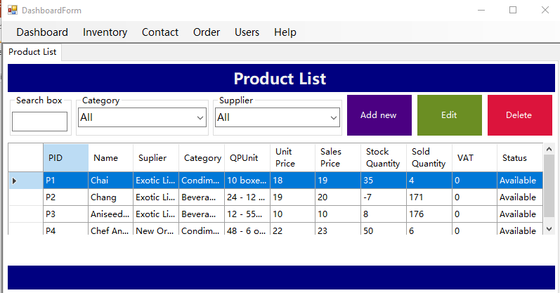
Interface/ Product list

Slide 15
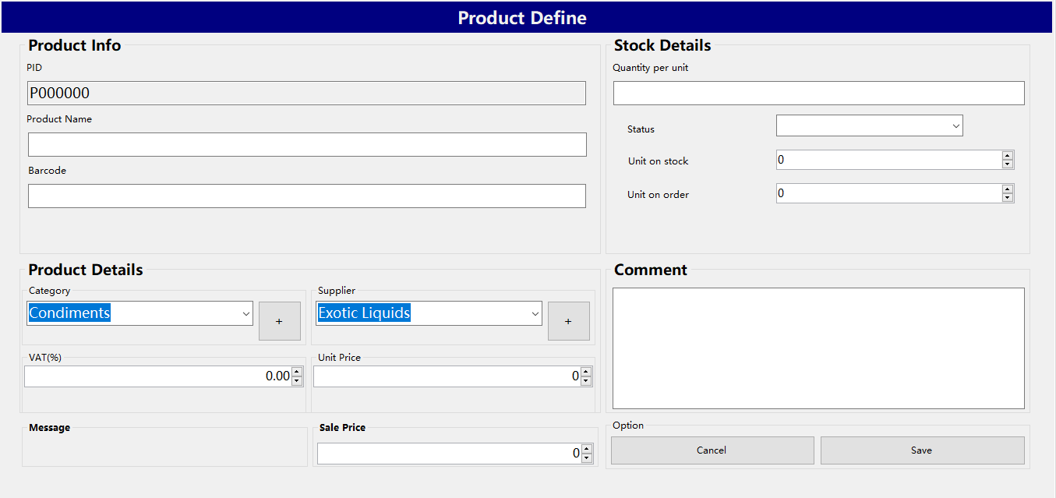
Interface/ add/Edit product

Slide 16
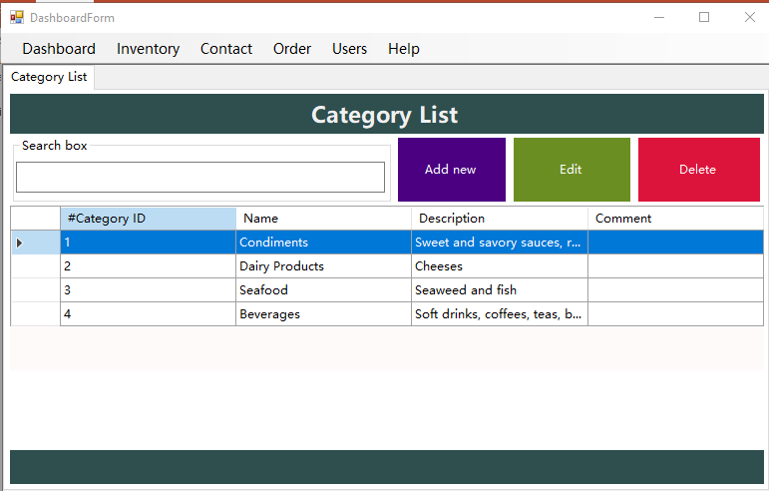
Interface/ Category list

Slide 17
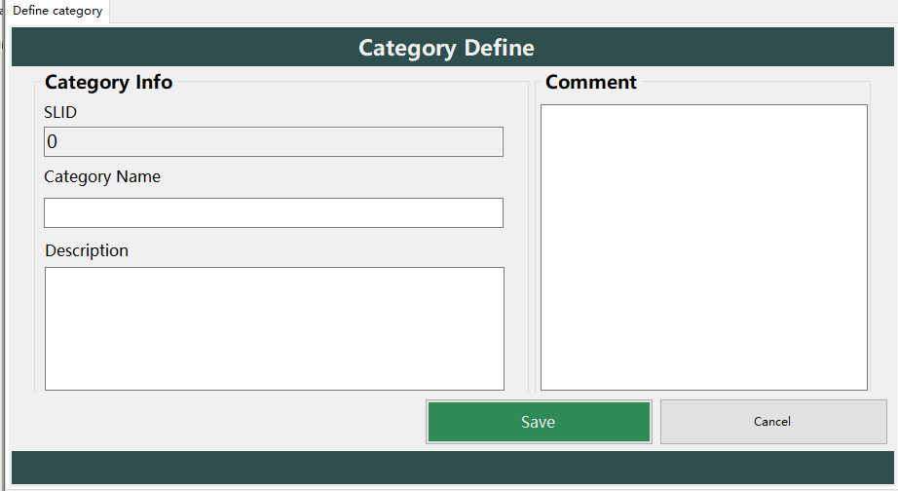
Interface/ add/Edit Category

Slide 18
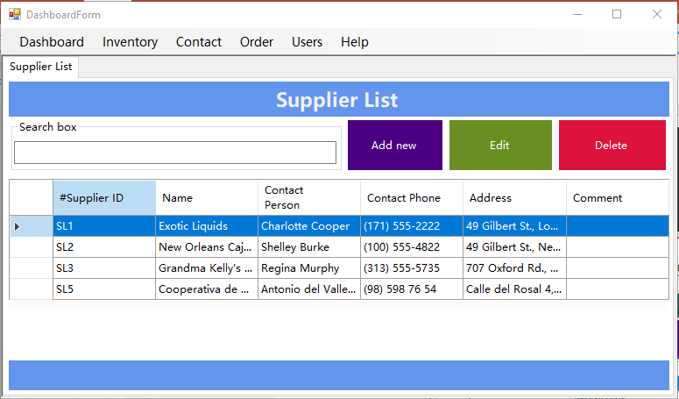
Interface/ Supplier list

Slide 19
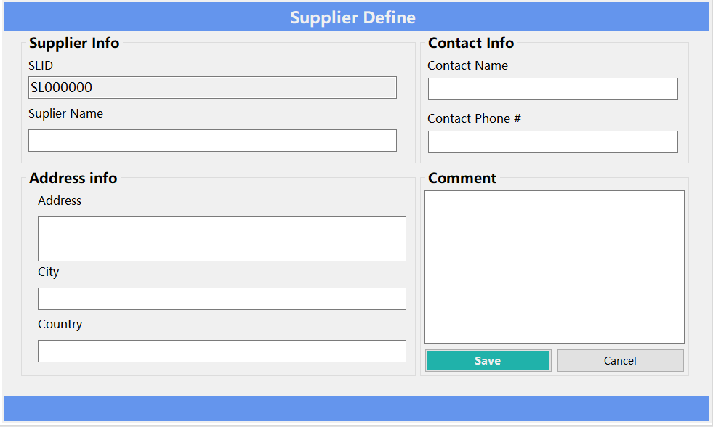
Interface/ Add/edit supplier

Slide 20
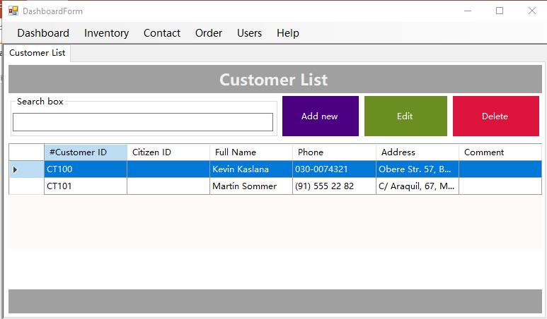
Interface/ Customer list

Slide 21
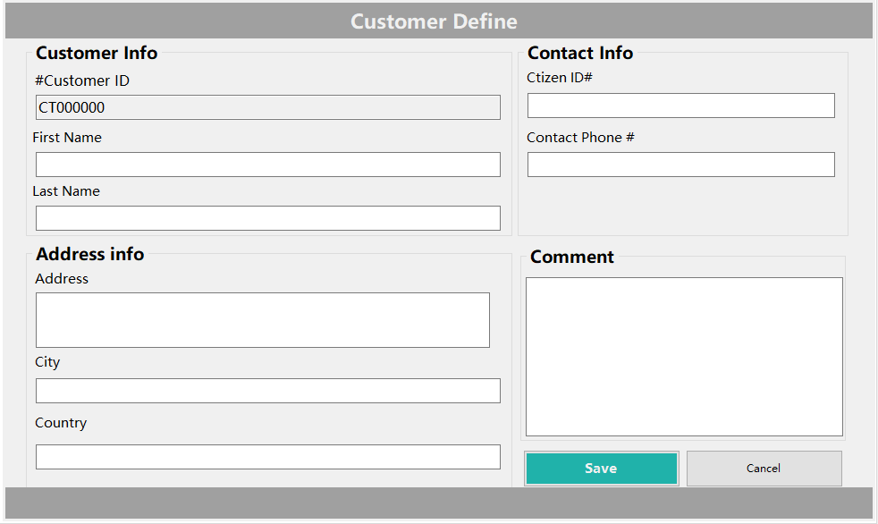
Interface/ Add/edit customer

Slide 22
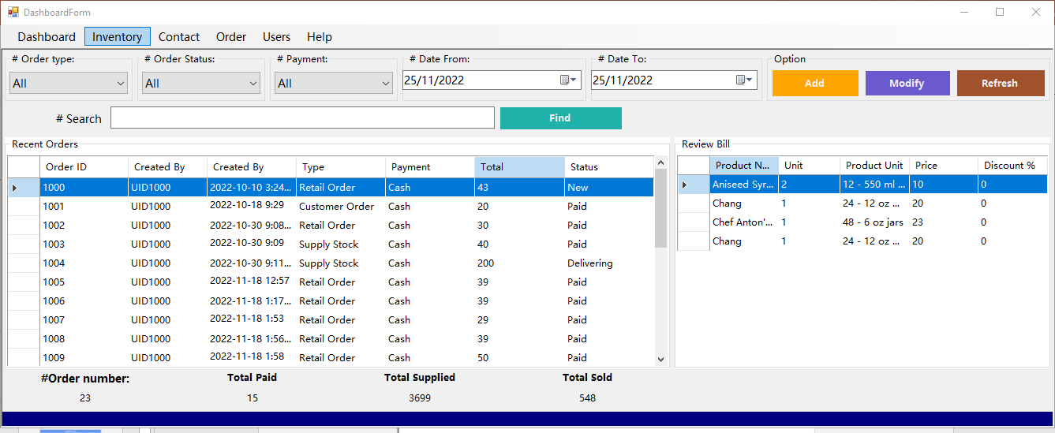
Interface/ order list

Slide 23
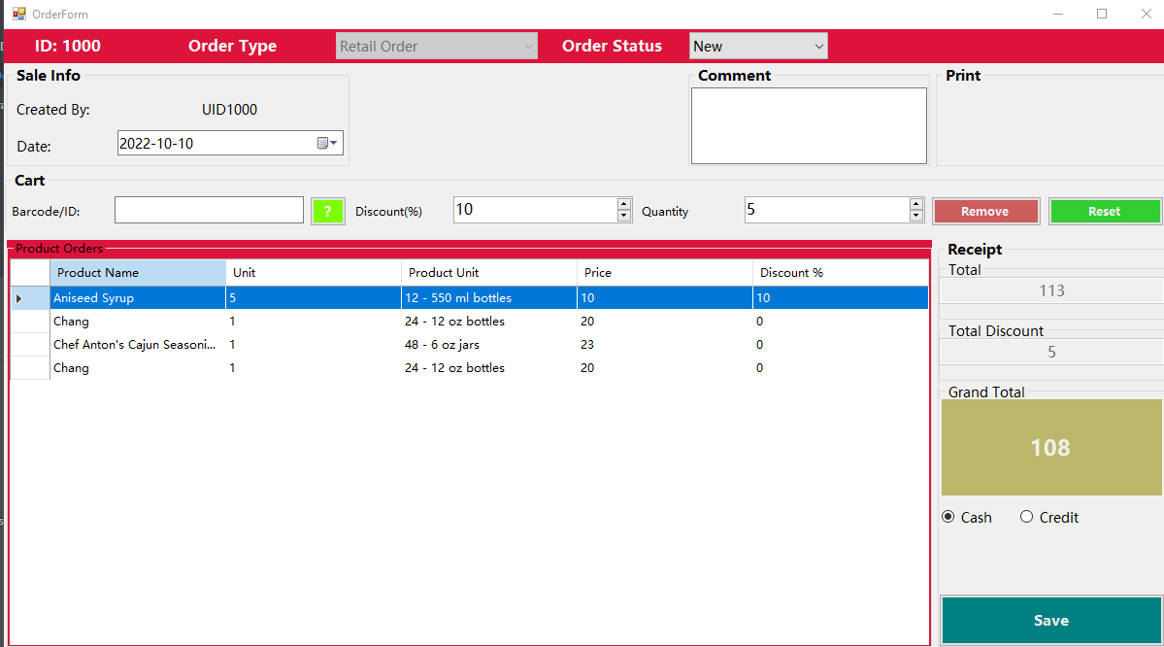
Interface/ add/edit order

Slide 24
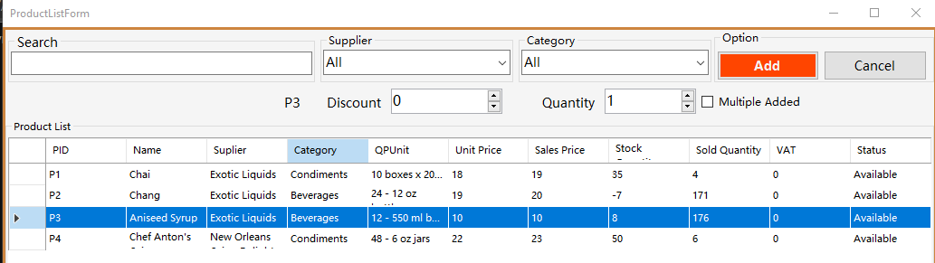
Interface/ add/edit order (add products into order)

Slide 25
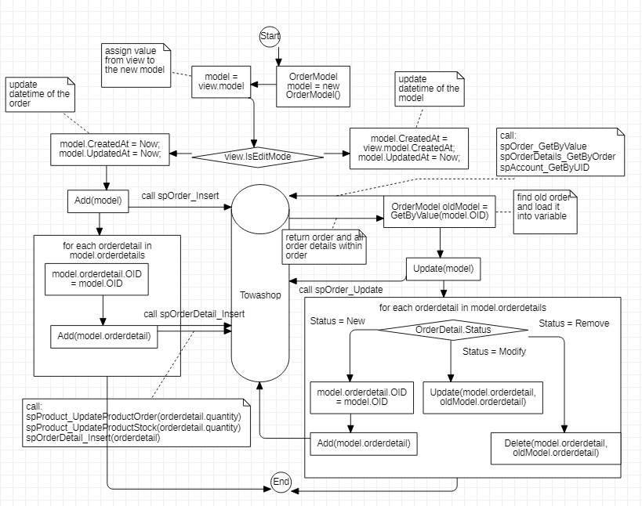
Dataflow editing order

Slide 26
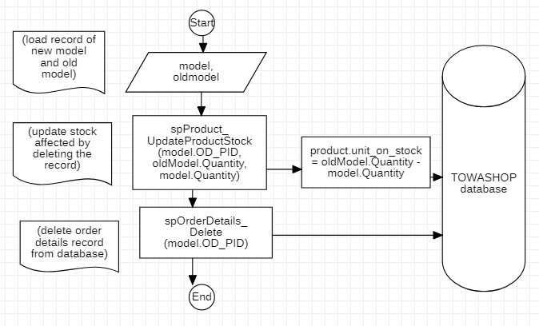
Dataflow/order details

Slide 27
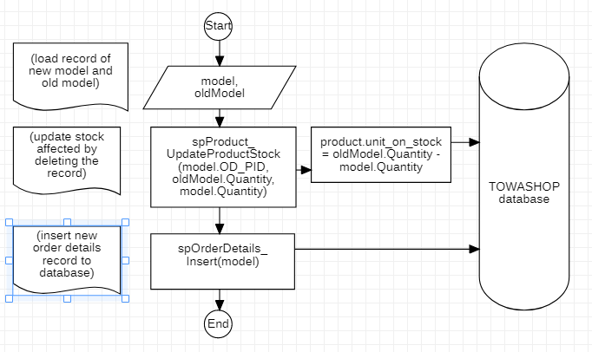
Dataflow/Delete order details

Slide 28
TowaSHOP Project
END OF GROUP PROJECT REPORT

