Slide 1
Embedded projects 1.
2024

Slide 2
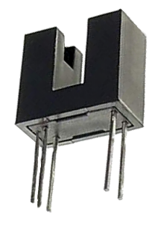
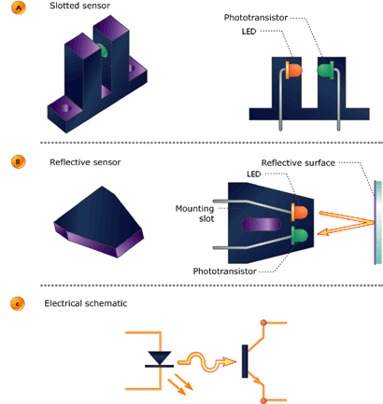
Measuring rotation

Slide 3
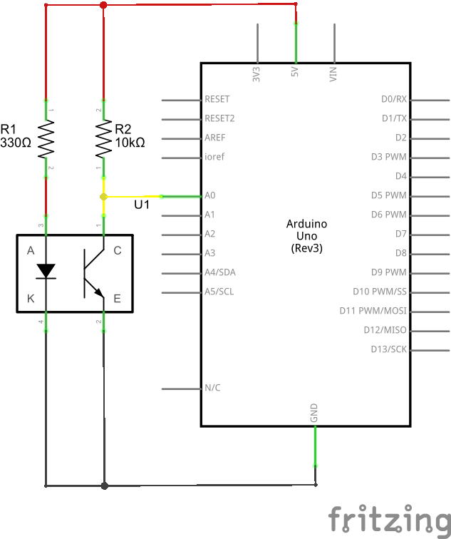
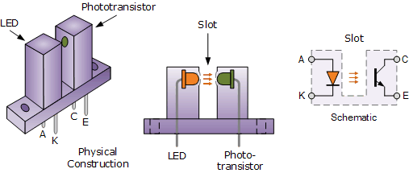
Measuring rotation

Slide 4
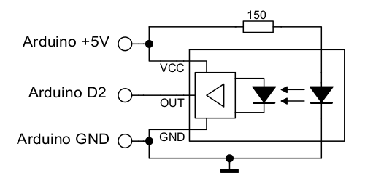
Measuring rotation

Slide 5
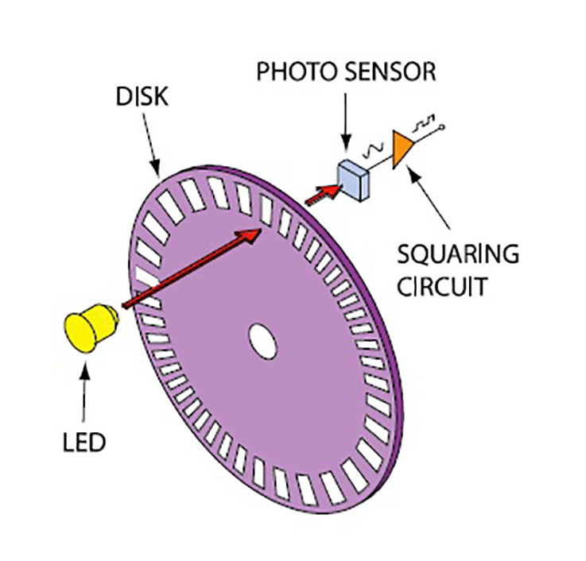
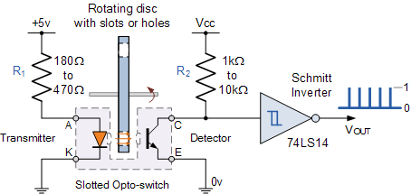
Measuring rotation

Slide 6
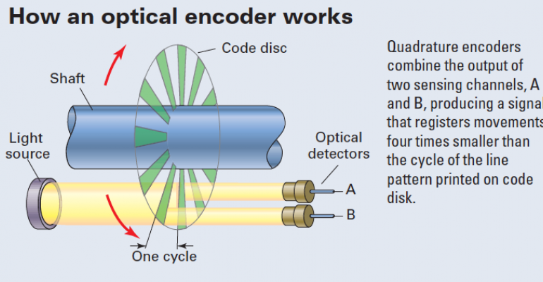
Encoder

Slide 7
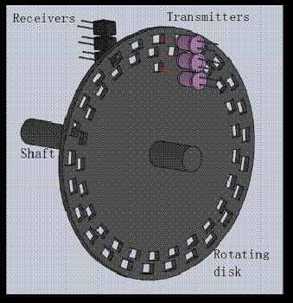
Encoder

Slide 8
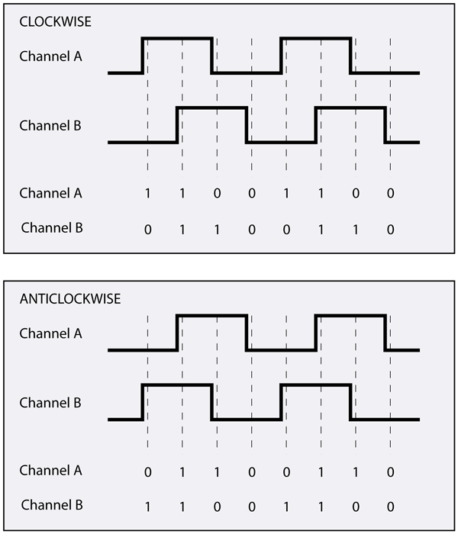
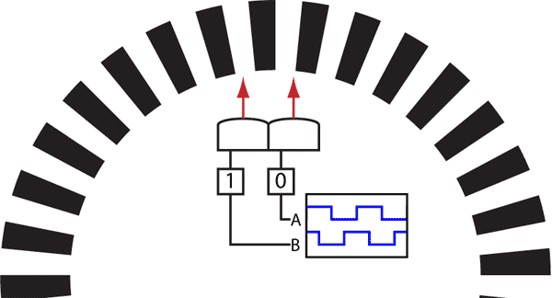
Encoder
http://www.creative-robotics.com/quadrature-intro

Slide 9
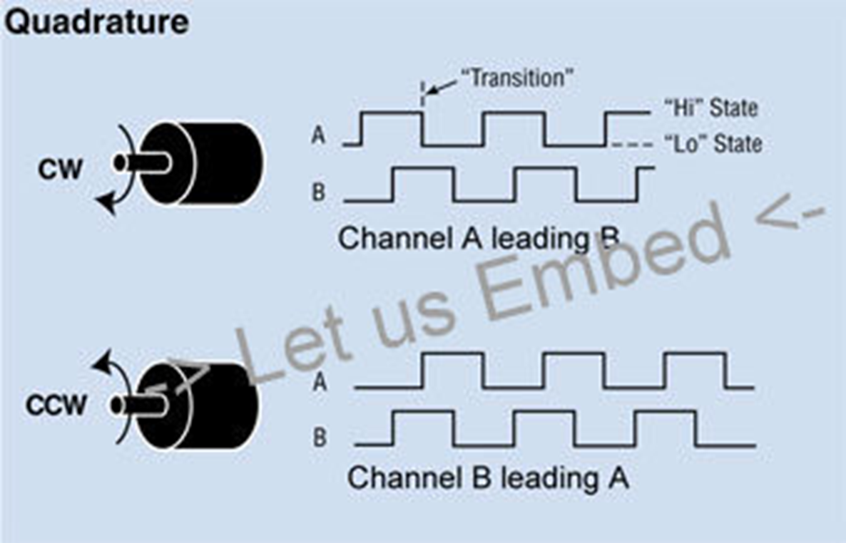
Encoder

Slide 10
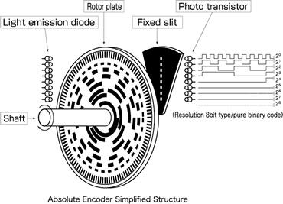
Absolute Encoder

Slide 11
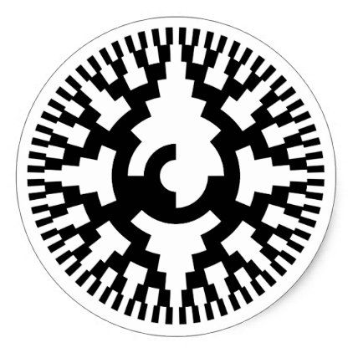
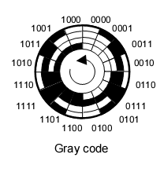
Absolute Encoder
8-bit gray code
4-bit gray code

Slide 12
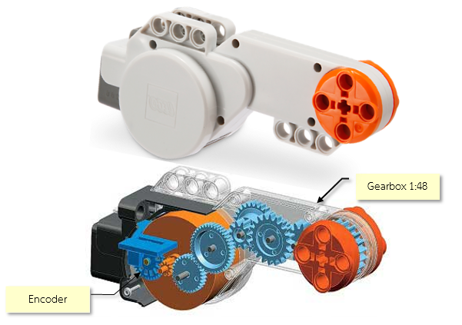
Encoder - lego

Slide 13
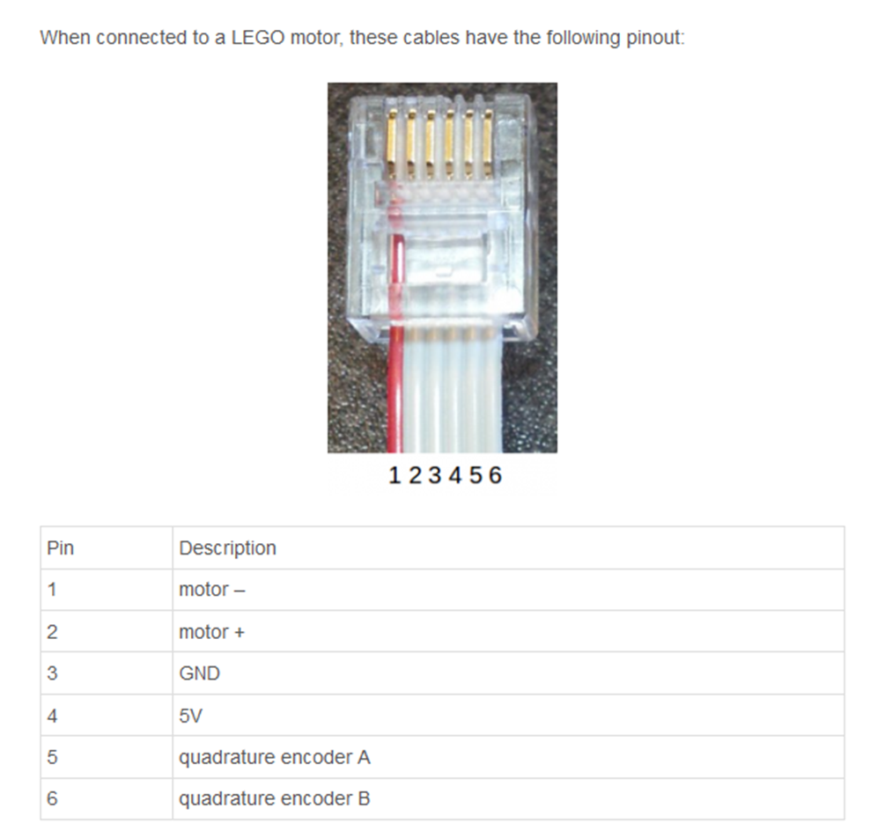
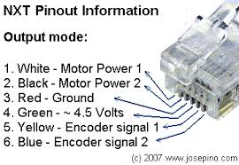
Encoder - lego

Slide 14
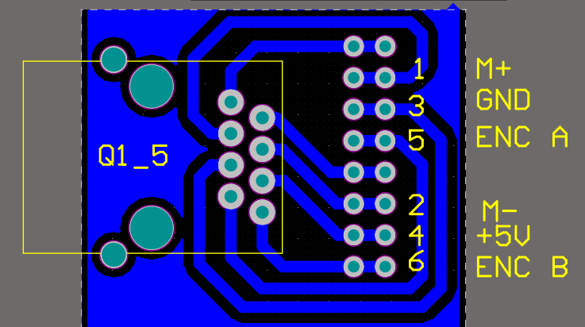
Encoder - lego

Slide 15
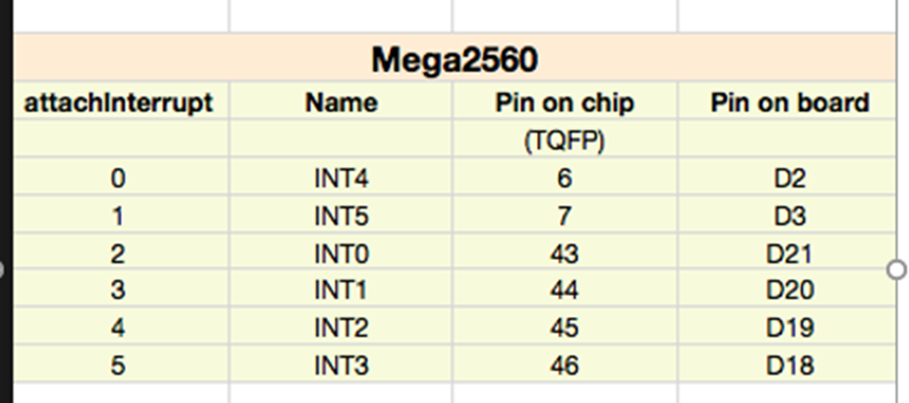
Measuring rotation
Exercise enc.1.0
Encoder signal B will trigger IRS (rising edge)
Connect signal right motor encoder:
ENC B (right motor) to Externa interrupt is Pin D2 = INT4
(for pulse counting)
ENC A (right motor) signal to pin D23 – for direction sensing
Connect also GND and +5 to lego encoder

Slide 16
Measuring rotation
Exercise enc.1.0
Connect signal -left motor encoder:
ENC B (left motor) to Externa interrupt pin is Pin D3 = INT5
(for pulse counting)
ENC A (left motor) signal to pin D24 – for direction sensing

Slide 17
Measuring rotation
Exercise enc.1.0
Pick your button pressing counting code
(Exercise int.1.3 )
Modify code to activate ISR from pin 2 = INT4
(= Encoder pulses)

Slide 18
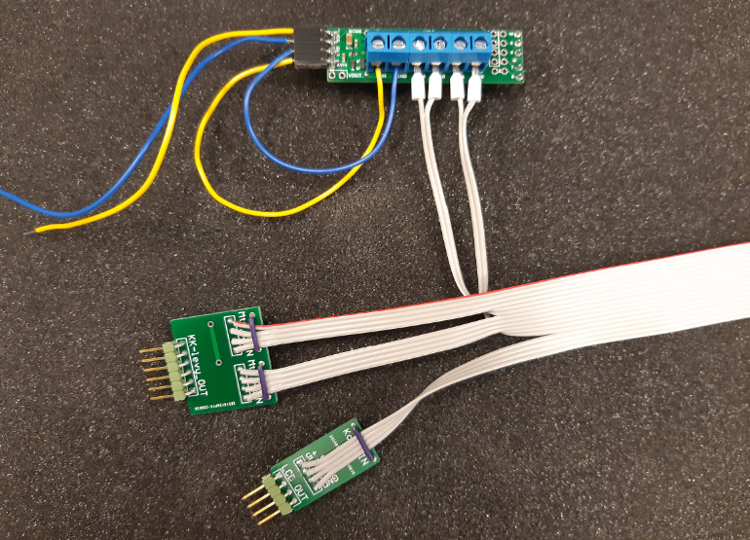
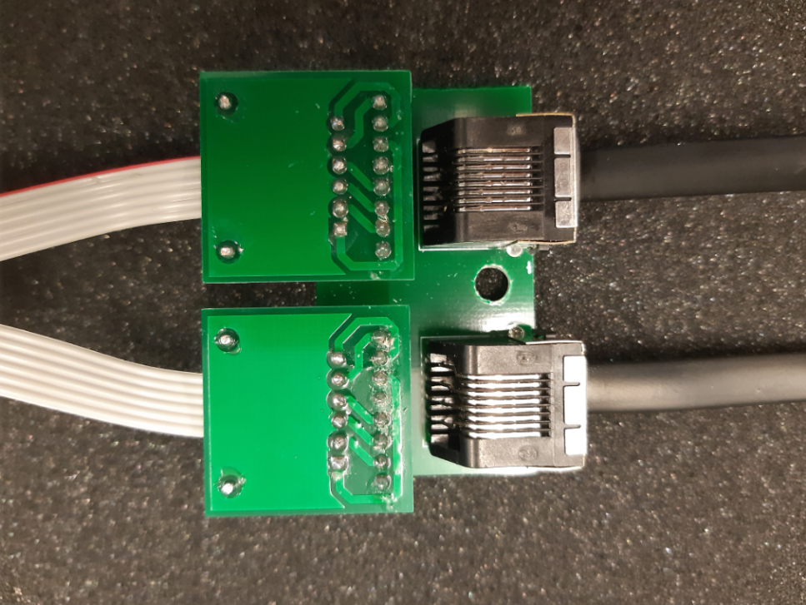
Measuring rotation
Exercise enc.1.0

Slide 19
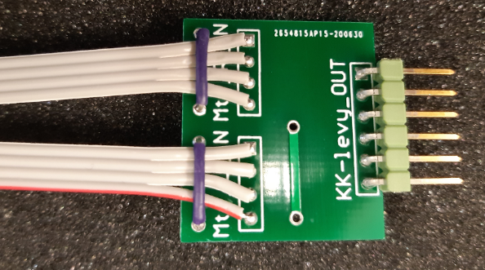
Measuring rotation
Exercise enc.1.0
Bread board connector pinout
0V = GND
ENC A R-motor
ENC B R-motor
ENC A L-motor
ENC B L-motor
+5V

Slide 20
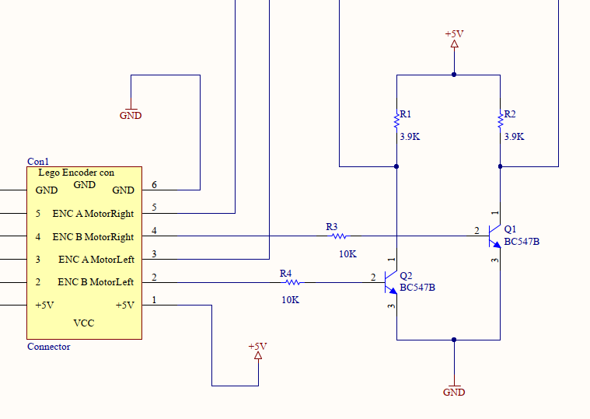
Measuring rotation
Exercise enc.1.0
Level shifter
for INT signal
PA2 / pin D24
INT4 / pin D2
PA1 / pin D23
INT5 / pin D3

Slide 21
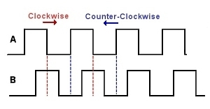
Measuring rotation
Using external interrupt with encoder
ENC A signal =“1”
= Pin 23
“1”
“1”
“1”
“1”
ISR call

Slide 22
Measuring rotation
Using external interrupt with encoder
“0”
“0”
“0”
“0”
ENC A signal =“0”
= Pin 23
ISR call

Slide 23
Measuring rotation
Extra exercises
Create program that show on LCD display count of ENC B pulses
How many pulses one round contain ?
What is wheel distance in one round ?
How many pulses driving 1m gives ?
How many pulses 1 cm driving gives ?

Slide 24
Measuring rotation
Extra exercises
Create program that show on display signed rotation of wheel from starting point
  Rotating wheel forward increase the value and returning will decrease value.

Slide 25
Measuring rotation
Extra exercises
Create program that show on display signed rotation in cm:s for both wheels.

Slide 26
Measuring rotation
Extra exercises
Create program that drives you vehicle 10 cm forward. Distance is measured by encoder.

Slide 27
Measuring rotation
Extra exercises
Create program that drives you vehicle 10 cm forward. Distance is measured by encoder.
Show both wheel driven length separately on LCD

Slide 28
Measuring rotation
Extra exercises
Create program that drives you vehicle:
- 30 cm forward,
- turns 180 degree
- returns back to original place

Slide 29
Measuring rotation
Extra exercises
Create program that drives you vehicle:
- 3 cm forward or return, each time when turning joystick full to front or back ( next 3cm drive possible only after joystick returned back to middle)
- by giving left or right pulse by joystick, car turns 22.5° left or right( next turn possible only after joystick returned back to middle)

