Slide 1
Embedded projects 1.

Slide 2
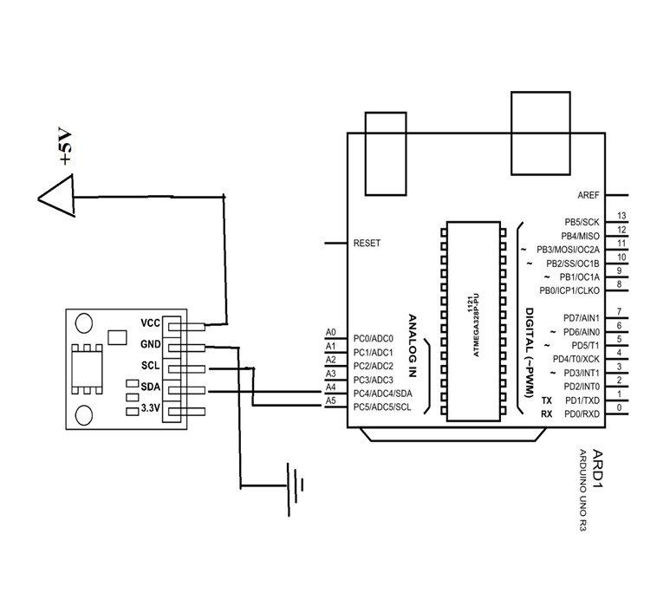
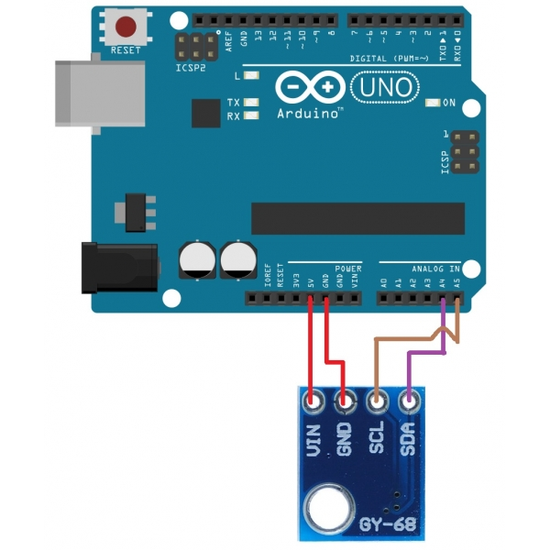
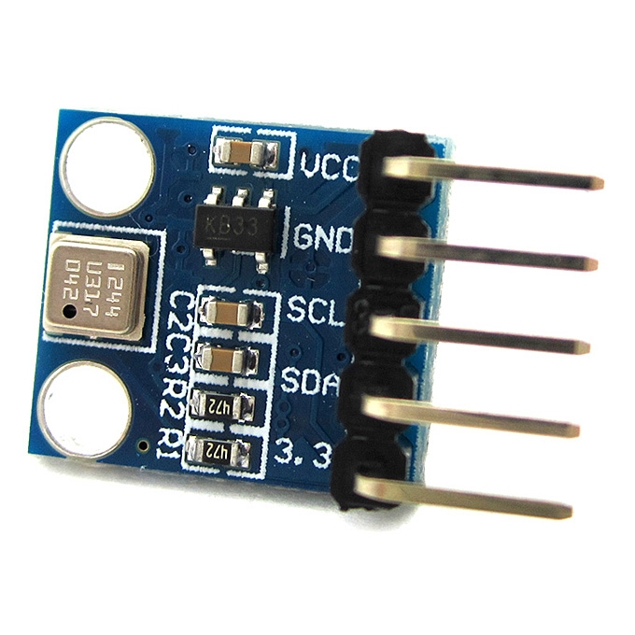
I2C bus
Air pressure sensor
BMP180

Slide 3
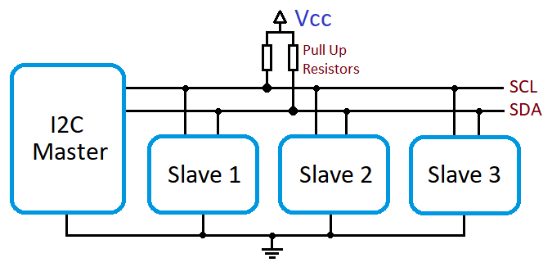

I2C bus
I2C
  Arduino Bus master
  Air pressure sensor BMP180 slave
Arduino
BMP180

Slide 4
I2C bus
General I2C bus structure

Slide 5
I2C bus
Links for I2C tutorial
https://www.best-microcontroller-projects.com/i2c-tutorial.html
https://robot-electronics.co.uk/i2c-tutorial/?SID=b76c522dd61b5d333d81c710bc4c5102
https://www.youtube.com/watch?v=RoGNbshGM_M

Slide 6
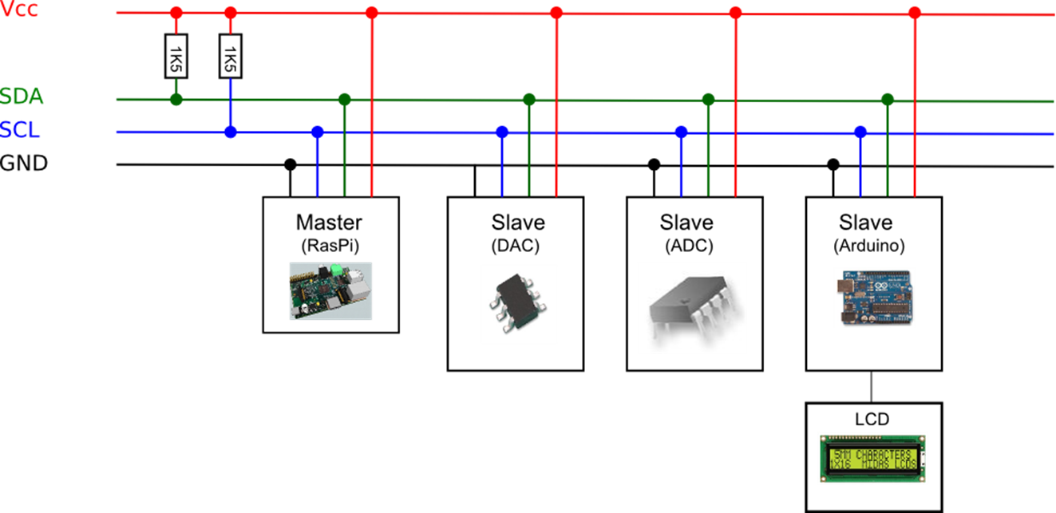
I2C bus

Slide 7
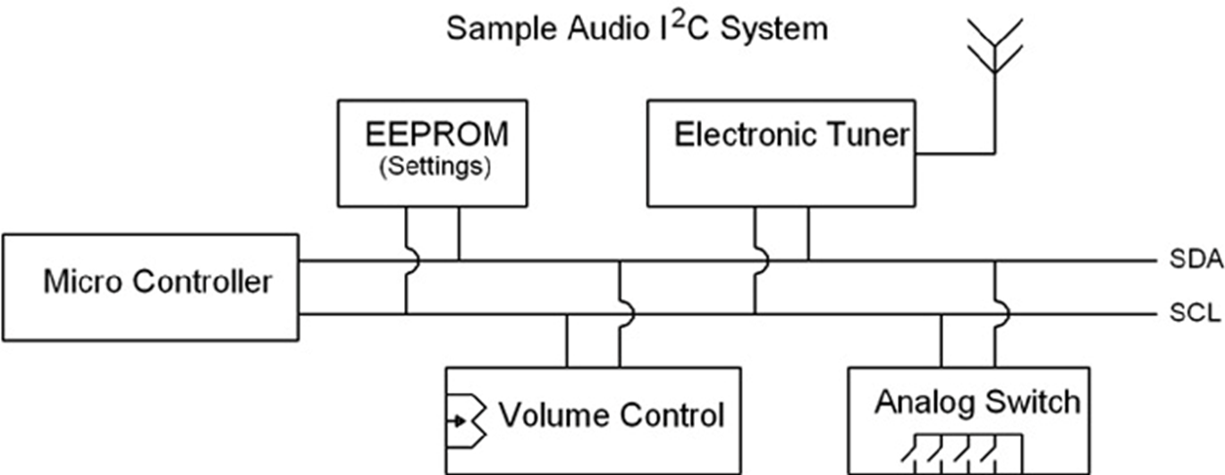
I2C bus

Slide 8
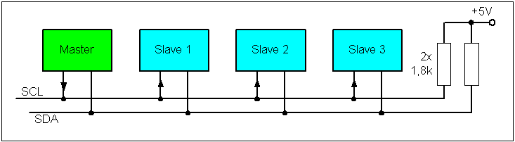
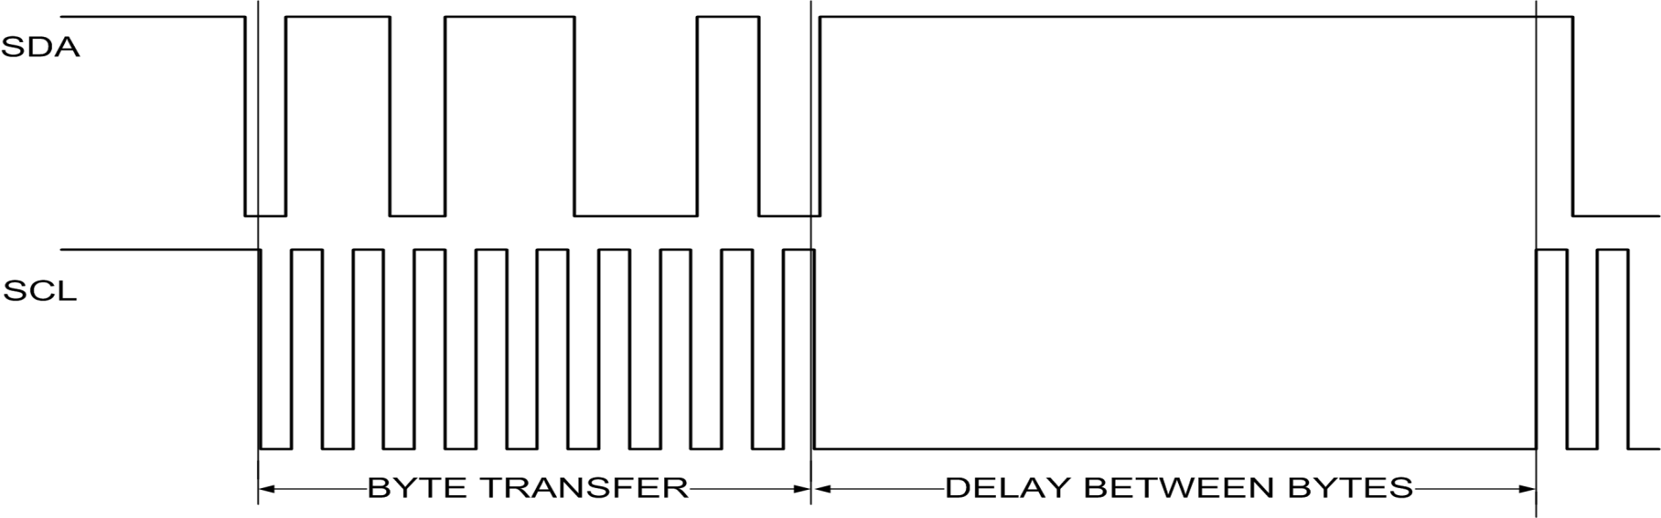
I2C bus
SCL = serial clock signal
SDA = serial data signal

Slide 9
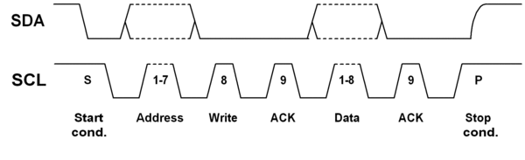
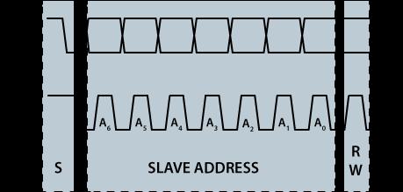
I2C bus
The first byte of an I2C transfer contains the slave address and the data direction.
The address is 7 bits long, followed by the direction bit. Like all data bytes, the address is transferred with the most significant bit first.
https://www.i2c-bus.org/addressing/

Slide 10
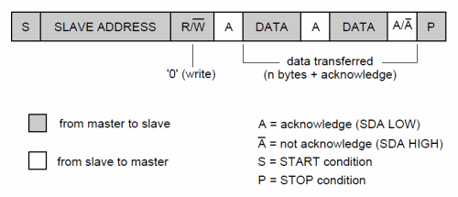
I2C bus
Handshaking

Slide 11
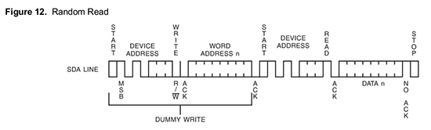
I2C bus
Write / Read

Slide 12
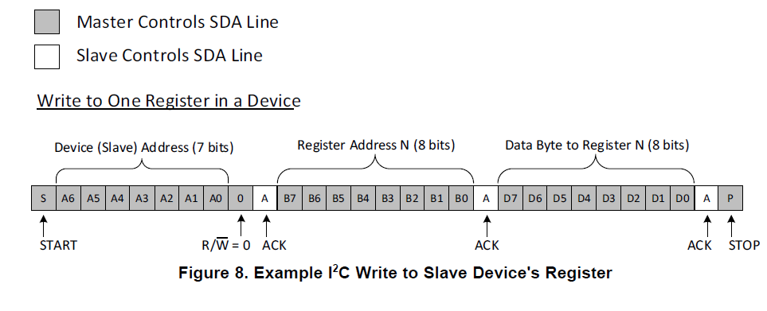
I2C bus
Write to slave

Slide 13
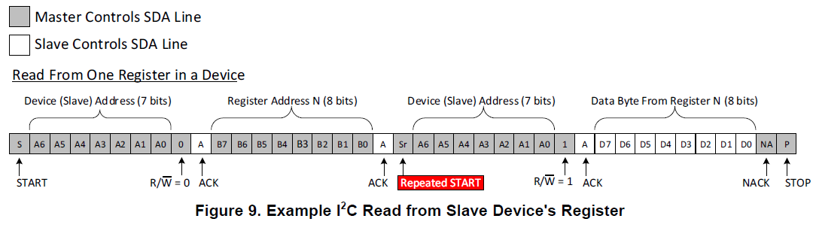
I2C bus
Read from slave

Slide 14
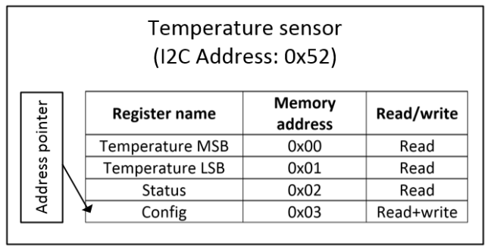
I2C bus
I2C device register map example

Slide 15
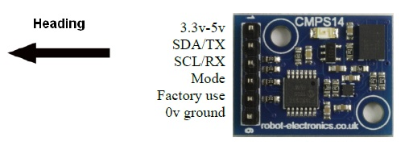
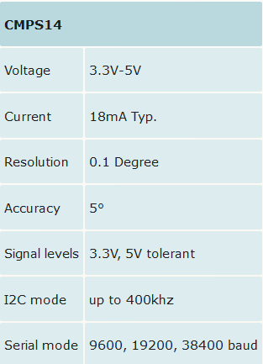
I2C bus
CMPS14
Tilt Compensated Magnetic Compass

Slide 16
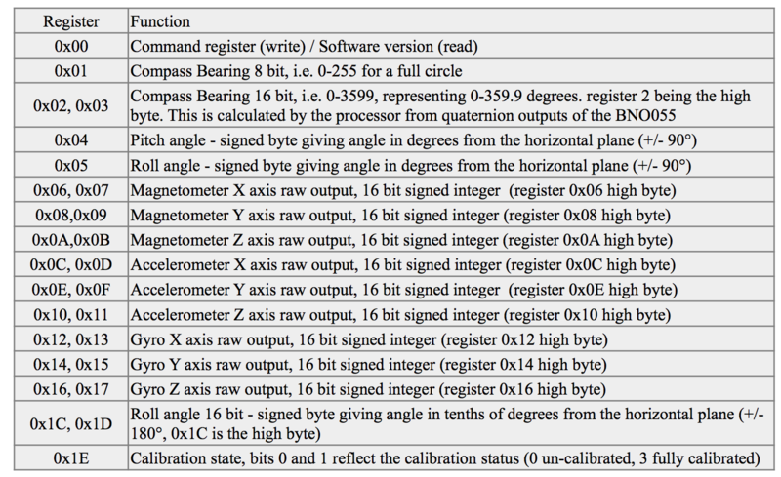
I2C bus
CMPS14
Register map

Slide 17
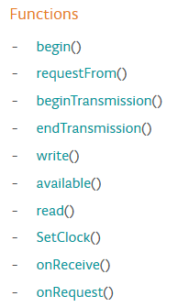
I2C bus
Wire Library
https://www.arduino.cc/en/Reference/Wire

Slide 18
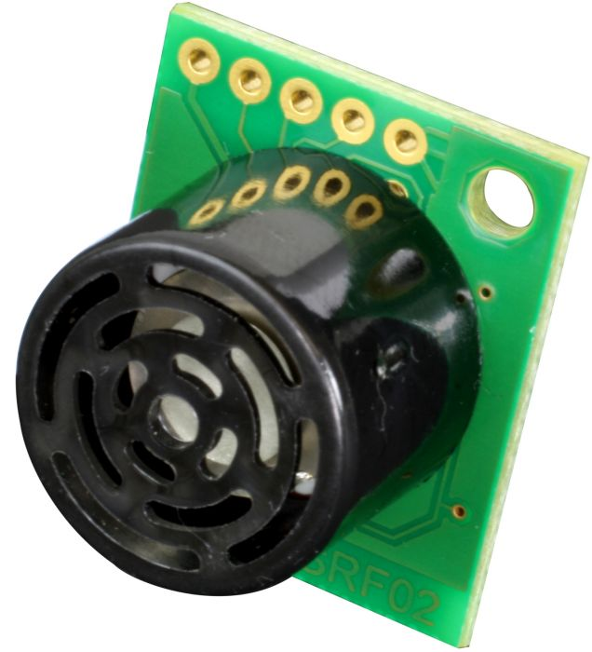
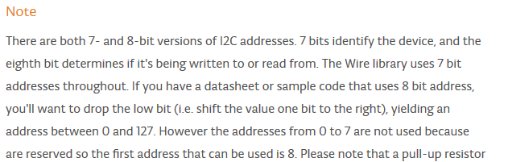

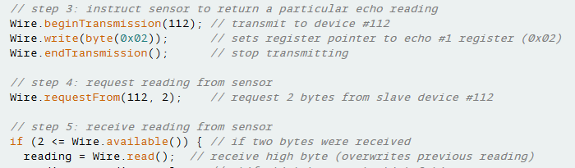
I2C bus
Wire Library
Example of reading I2C sonic range finder SRF02:

Slide 19
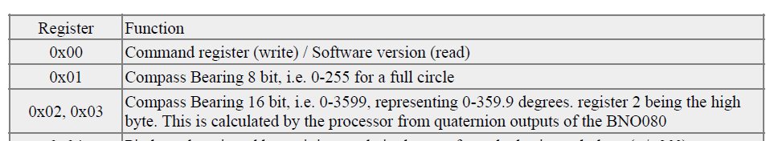
I2C bus
CMPS14 registers
0xC0= 1100 000
>> 0110 000
Addr for wire library = 0x60

Slide 20

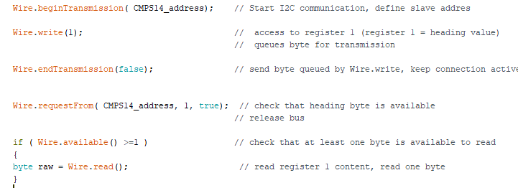
I2C bus
CMPS14 heading reading
CMPS slave address is = 0x60
Add I2C library / #include <Wire.h>
Initiate I2C communication / BeginTransmission, define slave address
Set slave register to be read / write (“register number”)
Send slave address and register number / endTransmission
Check that data is available from slave / requestFrom define slave address and number of readed bytes
If available, read byte

Slide 21
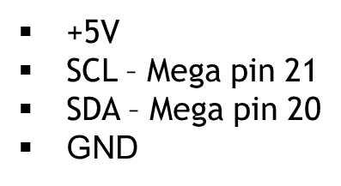
I2C bus
Exercise I2C 1.0
Connect CMPS14 module to your board
  +5V
  SCL – Mega pin 21
  SDA – Mega pin 20
  GND

Slide 22
I2C bus
Exercise I2C 1.0
Create code that reads raw 8 bits bearing value from sensor
  Show raw value in your LCD

Slide 23
I2C bus
Exercise I2C 1.1
Create code that shows bearing ( 0-360° ) value in your LCD
Add text names for bearing directions(N,NW,W,SW,S,SE,E,NE)

Slide 24
I2C bus
Exercise I2C 1.2
Create code that shows calibrated bearing ( 0-360° ) value in your LCD
Do calibration so, that your table side direction equal 0° bearing (North).
360/0° = North =N

Slide 25
I2C bus
Exercise I2C 1.3
Add press button to your board
Use press button to define the North direction calibration.
360/0°

Slide 26
I2C bus
Exercise I2C 2.0
Create program that turns you car to any heading 0 - 360°
Turning heading is defined by potentiometer in your board

Slide 27
I2C bus
Exercise I2C 2.5
Create program that turns you car to any heading 0 - 360°
Turning heading is defined by potentiometer in your board
With joystick you can move (forward and return) car to direction defined by potentiometer

Slide 28
I2C bus
Exercise I2C 3.0
Your table
Create program that runs your car according route on right (red arrow)
Car initiate direction is shown in brown arrow
20cm

Slide 29
I2C bus
Exercise I2C 3.1
Your table
40cm
Create program that runs your car automatically according route on right
20cm
20cm
39cm

