Slide 1

Mini Explorer
A mobile environment sensor
By Duc Nguyen and Jordan Pulido

Slide 2
I. Introduction
1. Mission
A moving device that can be controlled from afar
Display real-time environmental readings
2. Mechanism
- The Raspberry Pi car will use the sensor to read environment data and send to database
The app retrieves readings from database
Users can control the car by Bluetooth

Slide 3
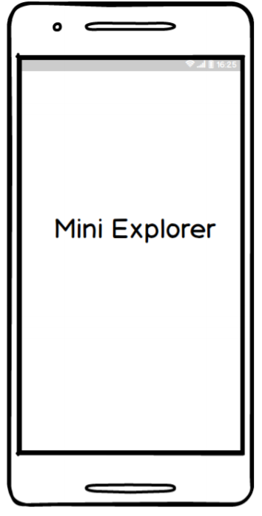
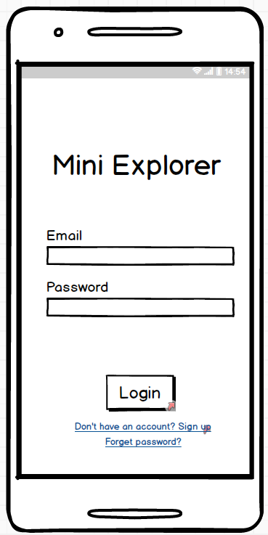
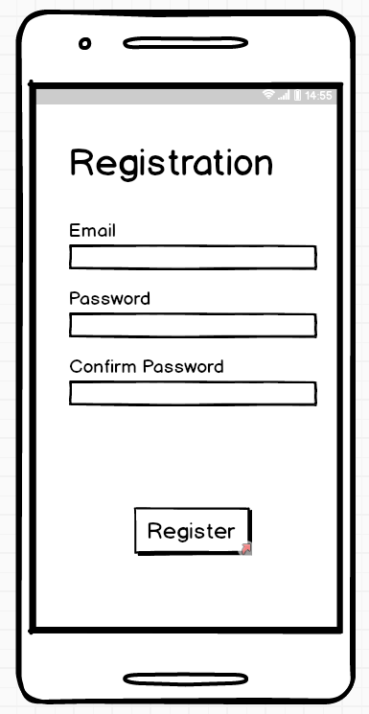
II. App Information
1. Screen Mockups

Slide 4
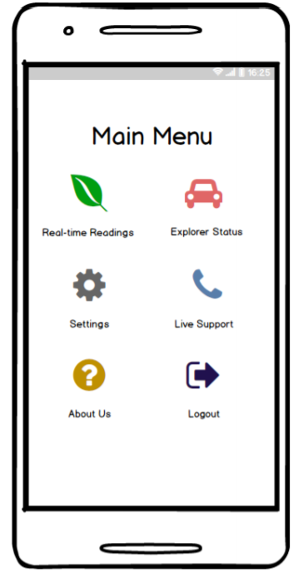
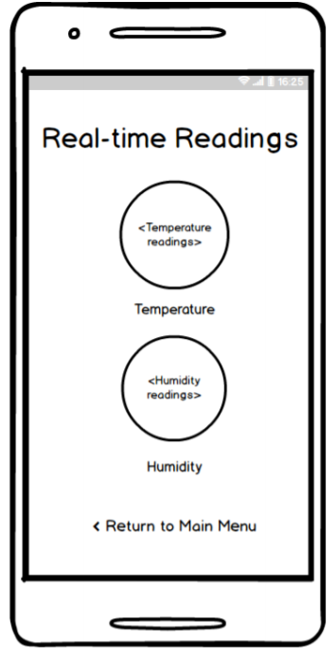
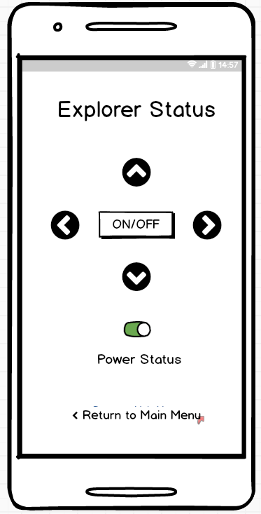
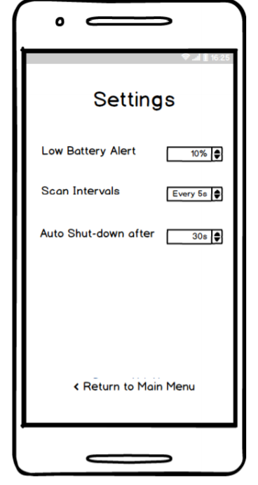

Slide 5
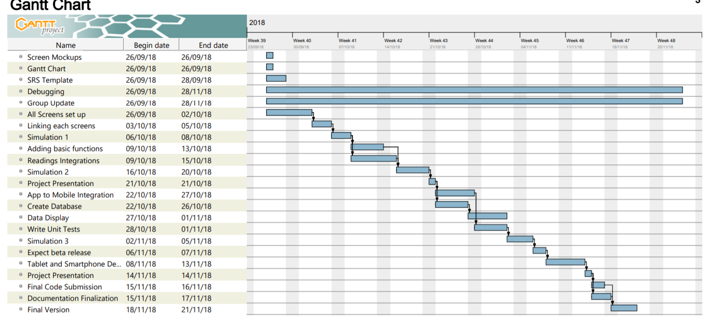
2. Gantt Chart

Slide 6
3. Progress
Finished all main functions and screens
No bugs
Future plans to be implemented in the next semester

Slide 7
4. Demonstration + Test cases
RegistrationScreen (Authentication, adding to Firebase)
LoginScreen (Authentication)
MainMenu (Layout)
ReadingScreen (Firebase Reading)
ExplorerScreen (Firebase Writing)
SettingScreen (Firebase Writing, Language)
LiveSupport (Change to phone number)
Logout (Log out of Firebase Current User)

Slide 8
5. What’s next?
Improve Layout formats
More language options
Registration Email confirmation
Forget password option
Work on Hardware Integrations (Powering the device, Car’s movement, Application of the App’s settings to Hardware)

Slide 9
6. Contribution
Duc Nguyen – Main Idea, Gantt Chart, Main Menu Layout, Icon Designs, Database Writing and Reading.
Jordan Pulido – SRS Documentation, Registration Screen, Login Screen, Authentication, Live Support, Language.

Slide 10
7. Source Code
Github: https://github.com/ngtrangminhduc/MiniExplorer

