Slide 1
HTKH GV-SV 2026 • Student Paper Conference
An Adaptive Learning Platform for University Programming Courses
Integrating Bayesian Knowledge Tracing, Elo Rating,
Multi-Armed Bandits, and FSRS
Nguyễn Tuấn Dương
Class 1C22, Faculty of Information Technology
Advisor: M.Sc. Bùi Quốc Khánh
Implementation paper with a pre-registered pilot evaluation protocol.
Notes:
Greet: name → Nguyễn Tuấn Dương, class 1C22, Faculty of IT.
Advisor: M.Sc. Bùi Quốc Khánh.
One-line pitch: "a five-layer adaptive platform that personalises programming practice on every code submission."
Frame upfront: implementation paper + pre-registered pilot protocol.
Pause 2s after advisor's name. Don't rush.

Slide 2
The 30–40% problem
30–40%
Stable for decades.
Not because students lack practice material —
the gap is structural.
Programming skill is acquired
individually and through practice;
it is taught
uniformly and at scale.
→ The mismatch — not the volume — is the bottleneck.
Failure rate in introductory programming
(Luxton-Reilly et al., ITiCSE 2018)
2/13
Nguyen Tuan Duong • HTKH GV-SV 2026
Notes:
30–40% failure in CS1. Stable for decades (Luxton-Reilly 2018).
Not lack of practice — millions of problems online (LeetCode, HackerRank, Codeforces).
Root cause is structural: skill is acquired individually, taught uniformly.
→ bottleneck is the mismatch, not the volume.
Stress "30–40%". Pause 2s.

Slide 3
The integration gap
Each adaptive technique is mature — but no one has composed all four for programming.
BKT
Elo
MAB
FSRS
Bayesian Knowledge Tracing
Dual rating + ZPD
Thompson Sampling
Spaced Repetition
Corbett & Anderson, 1995
Pelánek, 2016
Chapelle & Li, 2011
Ye et al., 2022
Studied alone or in pairs.
Commercial platforms (LeetCode, HackerRank, Codeforces) have huge problem libraries —
but rely on static difficulty tags and offer no closed loop from learner outcome back to problem selection.
→ This paper closes that loop, and integrates all four under a shared knowledge graph.
3/13
Nguyen Tuan Duong • HTKH GV-SV 2026
Notes:
Four mature techniques:
BKT (Corbett & Anderson 1995) — per-concept mastery.
Elo (Pelánek 2016) — difficulty calibration.
MAB / Thompson Sampling — explore vs. exploit.
FSRS (Ye et al. 2022) — spaced reviews.
Each studied alone or in pairs. Nobody has composed all four for programming education under a shared knowledge graph.
That gap is what this paper closes.
Slow on the four names — they're the four pillars of the rest of the talk.

Slide 4
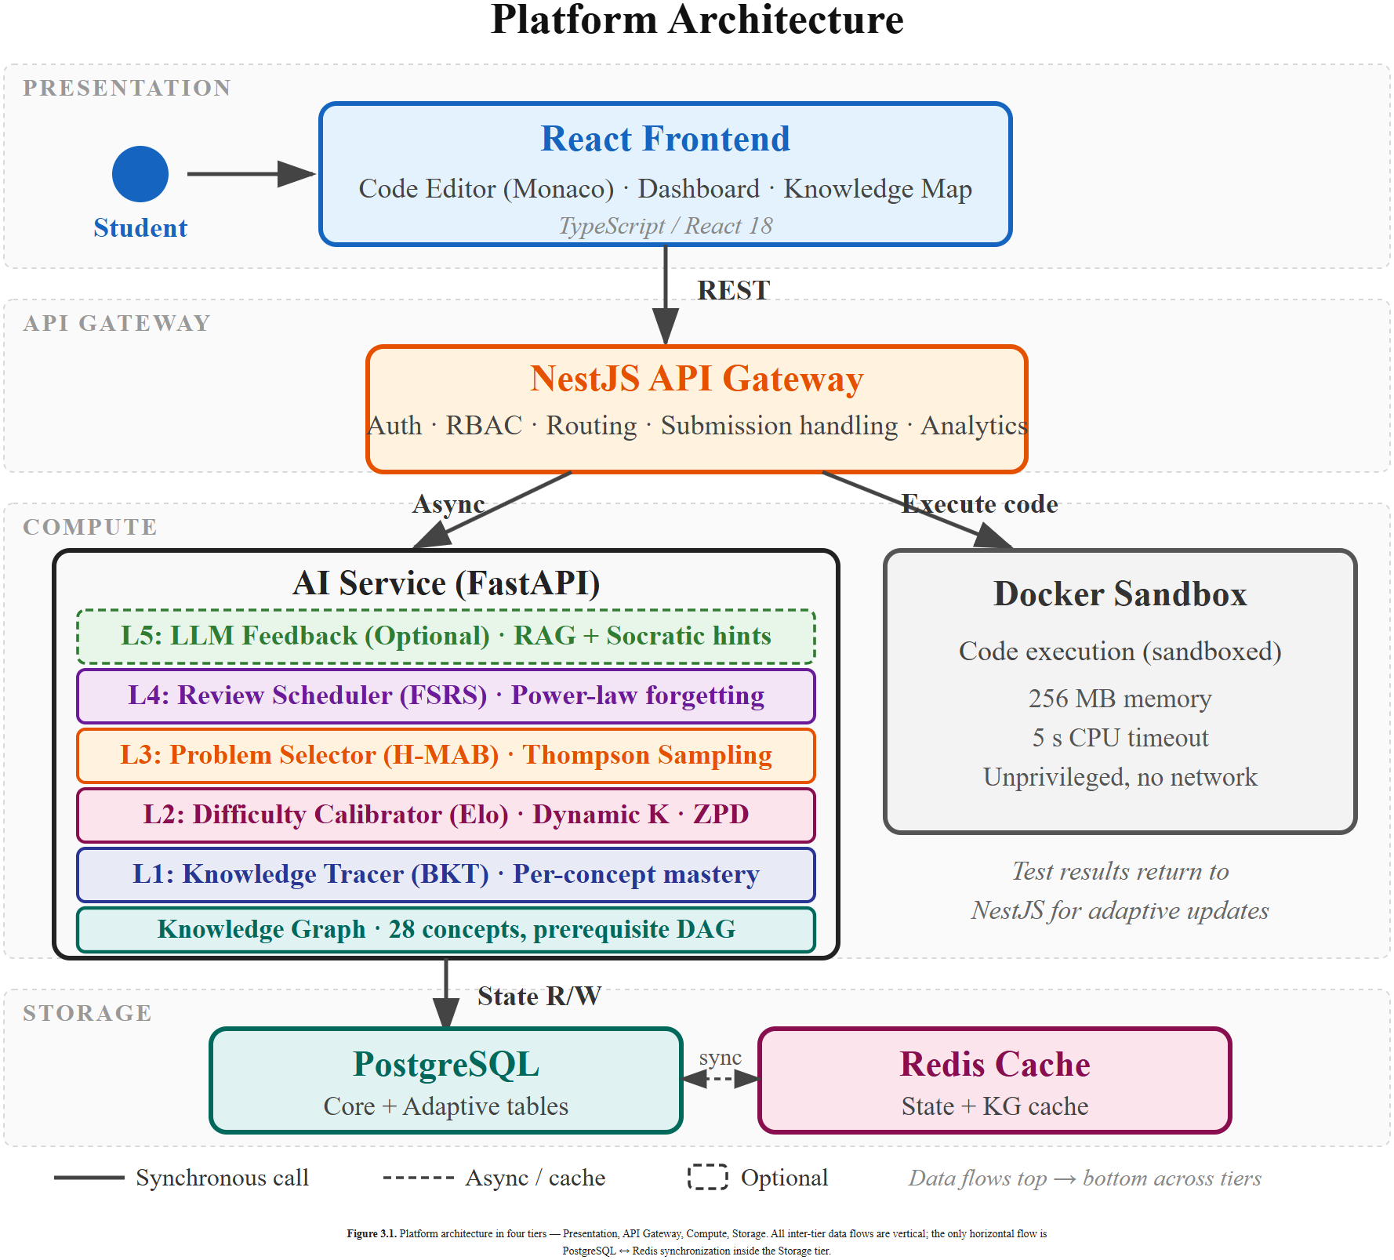
A five-layer adaptive engine on a shared knowledge graph
Knowledge graph: 28 programming concepts, ~45 prerequisite edges, 5 difficulty tiers, 7 topic clusters.
Layer 1 — BKT
per-concept mastery posterior
Layer 2 — Dynamic Elo
difficulty calibration + ZPD
Layer 3 — Hierarchical MAB
concept → problem selection
Layer 4 — FSRS
review scheduling
Layer 5 — LLM hints
optional, off in evaluation
4/13
Nguyen Tuan Duong • HTKH GV-SV 2026
Notes:
Foundation: knowledge graph of 28 concepts, ~45 prerequisite edges.
L1 BKT — mastery posterior.
L2 dynamic Elo — difficulty calibration.
L3 hierarchical MAB — picks next concept and next problem.
L4 FSRS — review scheduling.
L5 LLM Socratic hints — off by default during evaluation.
Use laser pointer top-down. Mention L5 quickly, then move on.

Slide 5
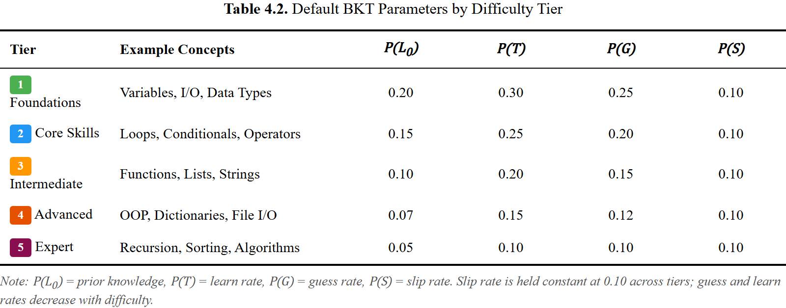
Layer 1 — Bayesian Knowledge Tracing
Per-concept mastery posterior, interpretable, cold-start friendly.
Four-parameter HMM, per concept
P(L₀) prior knowledge
P(T) transition (learning) probability
P(G) guess • P(S) slip
Mastered when posterior P(L) ≥ θₘ = 0.85.
Design choice — tiered priors, not textbook BKT
Each of the 5 difficulty tiers gets its own (P(L₀), P(T), P(G), P(S)).
→ Calibrated cold-start across the curriculum, not one prior fits all.
Why BKT, not Deep Knowledge Tracing?
Interpretable. Data-efficient (~hundreds of learners).
Posterior consumed by the bandit downstream — calibration matters more than raw accuracy.
5/13
Nguyen Tuan Duong • HTKH GV-SV 2026
Notes:
Per-learner, per-concept posterior — 4 classical params (prior, transition, guess, slip).
Mastered when posterior crosses θₘ = 0.85.
Tiered priors — 5 sets, one per difficulty tier → calibrated cold-start across the curriculum.
Anticipate "Why BKT not DKT?" — answer is on the slide; defer to Q&A if asked.

Slide 6
Layer 2 — Dynamic Elo + Zone of Proximal Development
Difficulty calibration that operationalises Bjork’s desirable difficulty.
Dual ratings
Each learner rated. Each problem rated.
Initial: learner = 1200; problem = 1000 / 1200 / 1400 (E / M / H), clamped to [400, 2800].
Dynamic K-factor K ∈ [10, 40]
K shrinks for stable learners → higher K when struggling, lower K when steady.
Computed from an exponentially weighted residual trend over the last 10 submissions.
ZPD filter δ ∈ [50, 250]
Keep only problems whose Elo is in [student_elo + 50, student_elo + 250].
≈ 36–64% predicted success — “hard, but not too hard”.
→ This filtered candidate pool is what Layer 3 picks from.
Predicted success vs. learner rating
ZPD band (δ ∈ [50, 250])
−250
+250
Learner Elo
Inside the band: predicted success ≈ 36–64%
(Bjork’s desirable difficulty, formalised by Pelánek 2016)
6/13
Nguyen Tuan Duong • HTKH GV-SV 2026
Notes:
Dual ratings — every learner rated, every problem rated.
Dynamic K ∈ [10, 40] — bigger K when struggling, smaller when steady.
ZPD filter δ ∈ [50, 250] rating points → ≈ 36–64% predicted success ("hard, but not too hard" — Bjork's desirable difficulty).
Output: candidate pool that L3 picks from.
Stress "dual" and "dynamic". Slow on the 36–64% number.

Slide 7
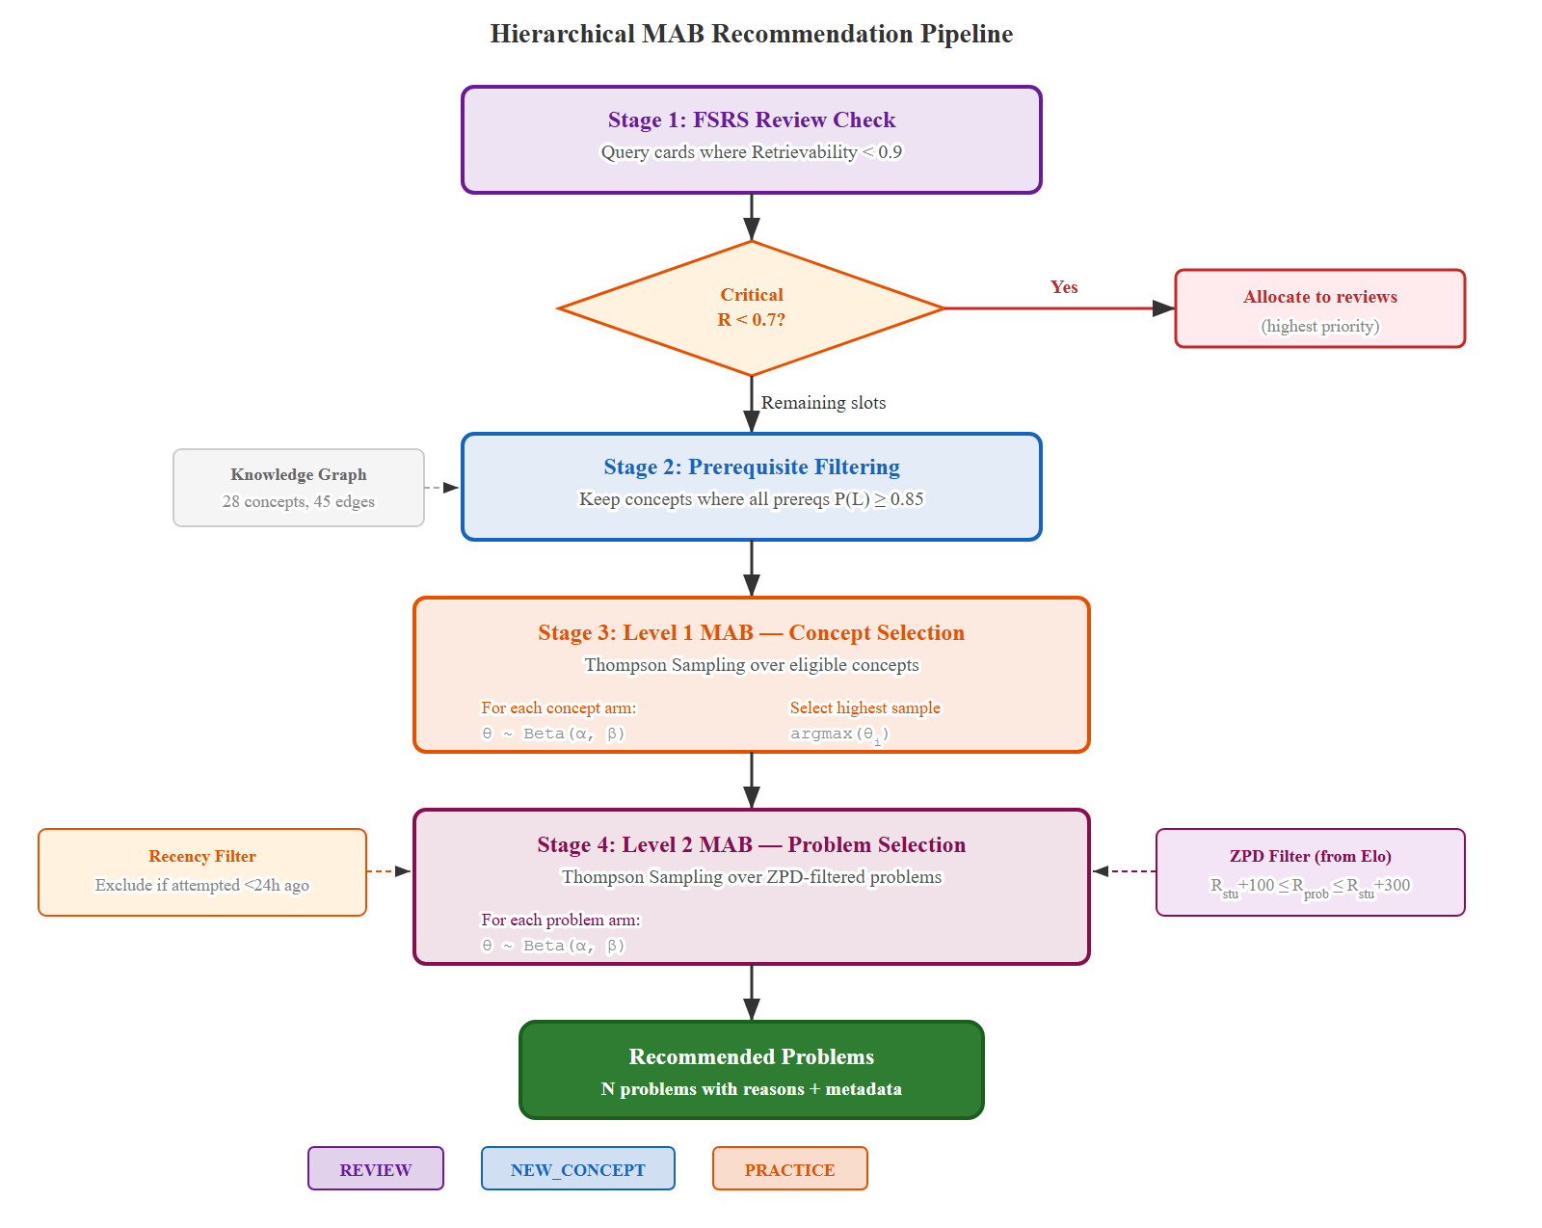
Layer 3 — Hierarchical MAB with prerequisite gating
Two-level Thompson Sampling: outer arm gated by BKT mastery; inner arm by Layer 2’s ZPD.
Two-level Thompson Sampling
Outer arm = next concept to practise.
Inner arm = next problem within that concept.
Each arm: Beta(α, β) posterior, updated on every reward.
Prerequisite gate
A concept becomes an arm only when
every prerequisite has BKT mastery ≥ θₘ = 0.85.
Inner level then filtered by Layer 2’s ZPD band.
Reward = scalar in [0, 1]
0.5 · learning gain (BKT posterior delta)
0.3 · correctness (attempt-aware)
0.2 · efficiency (capped at 300 s)
Heuristic weights — re-estimation from pilot traces is named future work.
7/13
Nguyen Tuan Duong • HTKH GV-SV 2026
Notes:
Two-level Thompson Sampling — outer arm = concept, inner arm = problem.
Each arm: Beta(α, β) posterior.
Prerequisite gate — concept becomes an arm only if every prerequisite has BKT mastery ≥ θₘ. Inner level filtered by ZPD.
Reward ∈ [0, 1] = weighted combo of BKT learning gain + correctness + solve-time efficiency. Weights are heuristic — re-estimation from pilot traces is named future work.
Densest slide. Hand-mime the two-level structure if helpful.

Slide 8
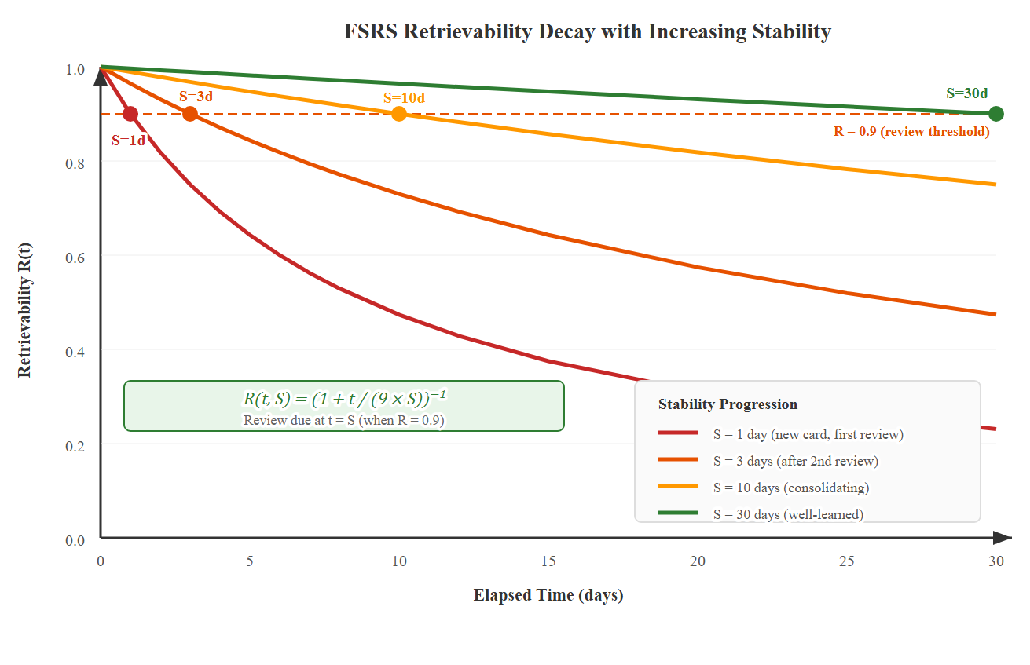
Layer 4 — FSRS for programming retention
Novel: first reported application of FSRS to programming, via a code-submission-to-rating mapping.
Code submission → FSRS rating
fsrs_service.py · submission_to_fsrs_rating()
if not is_correct:
return 1 # Again
if attempt_number == 1:
if time_spent < 120:
return 4 # Easy
elif time_spent < 300:
return 3 # Good
else:
return 2 # Hard
else:
return 2 # Hard
Review fires when retrievability R(t) drops below 0.9.
8/13
Nguyen Tuan Duong • HTKH GV-SV 2026
Notes:
Most original single idea — first application of FSRS to programming retention.
FSRS designed for flashcards (single signal, 4-level recall: Again/Hard/Good/Easy).
Code submission has richer signal — correctness + attempts + time.
Mapping (right side):
wrong → Again
correct, 1st attempt, < 2 min → Easy
2–5 min → Good; > 5 min → Hard; > 1 attempt → Hard
Review fires when retrievability R(t) < 0.9.
Quotable slide. Deliver slowly. Point at code as you read each branch.

Slide 9
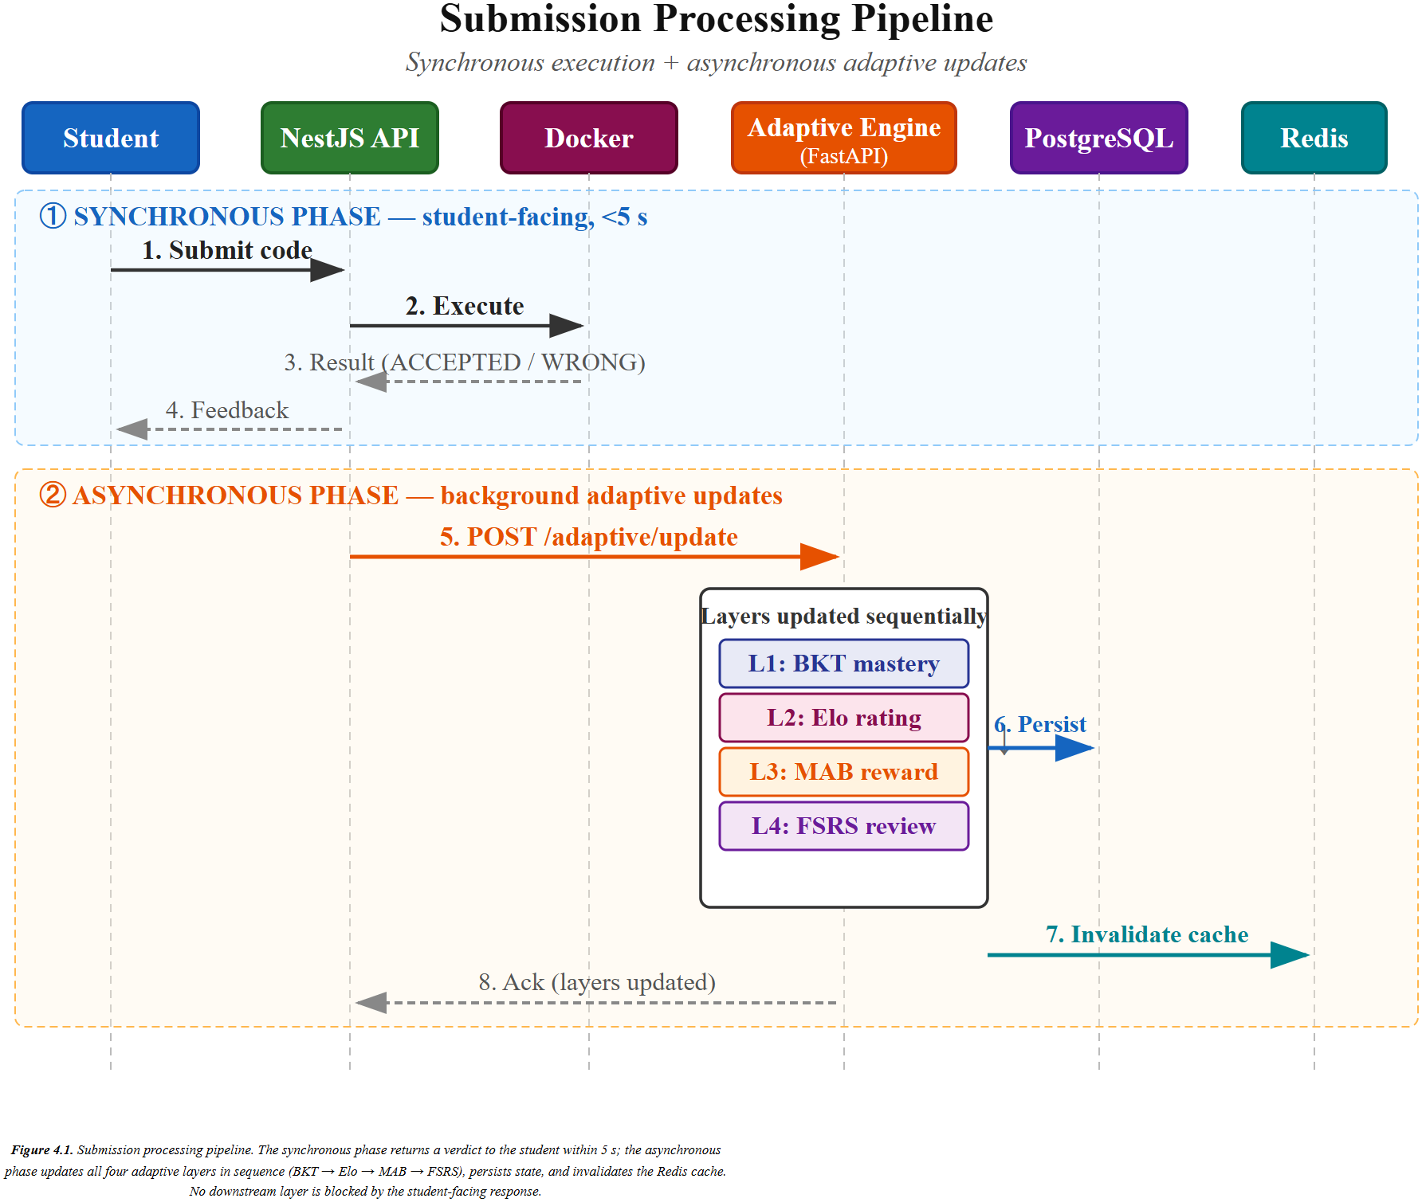
The closed loop — every code submission
One concrete submission, four parallel updates, sub-500-ms recommendation.
1. Submit
Python code, sandboxed.
256 MB · 5 s · no network · unprivileged.
2. Verdict
(correctness, attempts, time)
3. asyncio.gather(…)
BKT updates posterior
Elo updates both ratings
FSRS rewrites due date
MAB re-ranks candidates
4. Cache invalidated
Next request gets fresh state.
→ The learner model is never stale.
9/13
Nguyen Tuan Duong • HTKH GV-SV 2026
Notes:
Most important slide of the talk.
One concrete submission — Python solution, problem tagged recursion.
Sandboxed run → verdict triple (correctness, attempts, time).
Single asyncio.gather(...) → 4 parallel updates:
L1 updates BKT posterior for recursion
L2 updates learner's & problem's Elo
L4 maps verdict → FSRS rating, rewrites due date
L3 takes new state, re-ranks candidate pool
Cache invalidated → next request gets fresh state. Learner model never stale.
All under 500 ms at 100 concurrent users.
Walk the sequence diagram left → right with laser pointer.

Slide 10
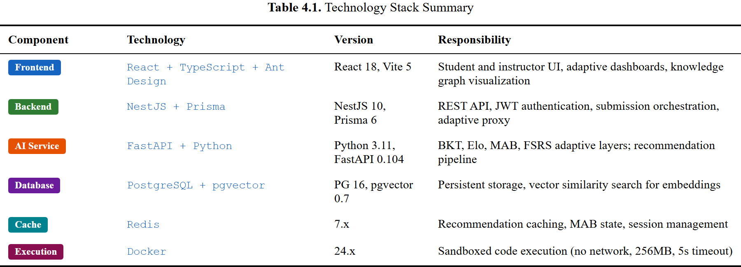
The artifact today
Built. Deployed. Tested. Open-source.
~15 k
lines of code (Python + TS)
28
concepts · 45 prerequisite edges
170
curated problems
< 500 ms
p95 recommendation latency
100
concurrent users (NFR target)
1
command Docker deployment
10/13
Nguyen Tuan Duong • HTKH GV-SV 2026
Notes:
What's actually built:
4 components: React + NestJS + FastAPI + PostgreSQL/Redis.
~15k LOC, 28 concepts, 170 problems, < 500 ms p95 recommendation latency.
E2E tests cover full submit-to-recommend round-trip.
One Docker Compose command to deploy. Open-source.
Read the numbers crisply. Slow on the digits.

Slide 11
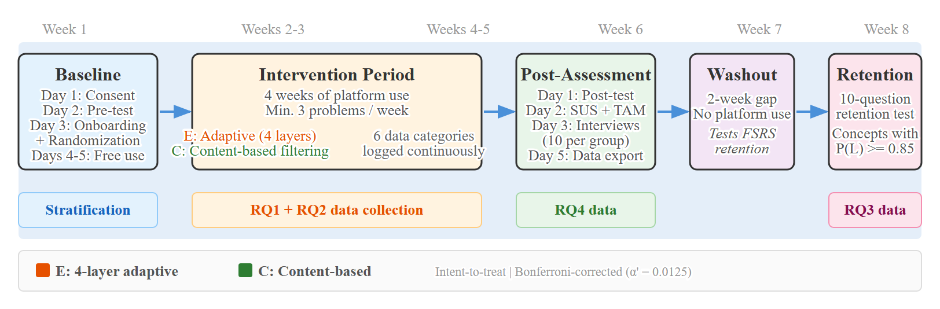
What is *not* in this paper — the pre-registered pilot
Designed, IRB-cleared, pre-registered. Empirical results in a follow-up.
Design
Between-subjects, pre/post test.
Control = same UI, non-adaptive recommendations.
Cohort
n = 40–60 undergraduates
Hanoi University, IRB-cleared.
Schedule
4 weeks intervention + Week 8 retention.
RQ1 (primary)
BKT + Elo predictive validity.
Target AUC ≥ 0.70.
RQ2 / RQ3 = supporting:
acceptance rate, convergence, learning gain.
11/13
Nguyen Tuan Duong • HTKH GV-SV 2026
Notes:
Between-subjects, control = same UI on non-adaptive recs.
n = 40–60 Hanoi University undergrads.
4-week intervention + Week-8 retention follow-up.
IRB completed. Protocol pre-registered.
Primary RQ1 = predictive validity → AUC ≥ 0.70 for BKT/Elo on post-intervention items.
Acceptance rate, convergence speed, learning gain = supporting indicators.
results → follow-up paper.
Most important risk-defusal moment. Slow, calm, no apology.

Slide 12
Contributions, recapped
C1
Integrated five-layer adaptive platform
BKT + Elo + Hierarchical MAB + FSRS, unified by a knowledge graph of 28 programming concepts. The prerequisite-constrained bandit (BKT-mastery-gated arms) and the code-submission-to-FSRS-rating mapping are internal technical innovations that make this integration work, not separate claims. Deployed and open-sourced.
C2
Pre-registered pilot evaluation protocol
Between-subjects classroom study, 4-week intervention + Week-8 retention follow-up, n = 40–60 Hanoi University undergraduates. IRB-cleared. Primary RQ: BKT/Elo predictive validity, AUC ≥ 0.70. Empirical results to be reported in a follow-up paper.
C1 is implemented and demonstrated technically.
C2 is specified, IRB-reviewed, and pre-registered — but not yet executed.
12/13
Nguyen Tuan Duong • HTKH GV-SV 2026
Notes:
Two contributions:
C1 — Integrated five-layer adaptive platform (BKT + Elo + MAB + FSRS unified by KG of 28 concepts). The prerequisite-bandit and submission-to-FSRS-rating mapping are internal technical innovations, not separate claims.
C2 — Pre-registered pilot evaluation protocol.
Closing reminder:
C1 = implemented and demonstrated.
C2 = specified, IRB-reviewed, pre-registered, but not yet executed.
Hold up two fingers when saying "Two contributions" — audience anchor.

Slide 13
Thank you.
By integrating four adaptive techniques that have, until now, been studied in isolation, this work offers a working architectural step toward individualised programming education at scale.
Questions?
Nguyễn Tuấn Dương · Class 1C22 · Faculty of IT · Hanoi University
Email: ntduongvbhp@gmail.com
Advisor: M.Sc. Bùi Quốc Khánh
Notes:
"By integrating four adaptive techniques that have, until now, been studied in isolation, this work offers a working architectural step toward individualised programming education at scale."
Thank you.
Look at the chair, take questions.

