Slide 1

Introduction to Unix/Linux
Nicolò Gualandi
Raffaella Picco

Slide 2
What is Linux?
Linux is an open-source and Unix-like operating system kernel that serves as the core component of many different operating systems, known as Linux distributions (or distros). It was created by Linus Torvalds in 1991 and has become one of the most widely used operating system kernels in the world
Popular Linux distributions include Ubuntu, Debian, Red Hat, CentOS, Fedora, Arch Linux, and many more. Each distribution may have its own package management system and configuration, but they all share the Linux kernel at their core
Linux is used in a wide range of applications, from running web servers and cloud computing infrastructure to powering embedded devices and serving as the basis for operating systems on smartphones and tablets (e.g., Android)…. And also in Bioinformatics! It has a strong and active community of users and developers, making it a popular choice for many computing needs.

Slide 3
What is Linux?
free, secure, and stable
It's essential for tasks like system administration and software development.
You can customize it and benefit from a helpful community
Bioinformatics Tools: Linux is the preferred platform for many bioinformatics tools and software. By learning Linux, you can efficiently use and manage these tools for tasks like DNA sequencing analysis, protein structure prediction, and genomics research.
High-Performance Computing: Bioinformatics often involves computationally intensive tasks, such as genome sequencing and data analysis. Linux is widely used on high-performance computing clusters and supercomputers, allowing you to harness substantial computational power for your research.
Custom Data Analysis Pipelines: Linux's flexibility and scripting capabilities make it ideal for creating custom data analysis pipelines. You can tailor your workflows to suit your specific research needs, streamlining data processing and analysis in bioinformatics projects.

Slide 4
What is the Linux command line interface (CLI)?
The Linux CLI and Bash shell offer a versatile and efficient means of interacting with a Linux system, enabling users to perform a wide range of tasks and automate processes through scripting
Text-Based Interaction: The CLI provides a text-based interface where users interact with the system by entering commands
Bash Shell: Bash is one of the most common Linux shells, acting as an interpreter for command input
Command Structure: Linux commands typically consist of a command name followed by options and arguments. Options modify a command's behavior, while arguments provide data or specify targets. “For example, ls -l /home lists the contents of the /home directory in a detailed format”
Scripting and Automation: Bash enables the creation of shell scripts, which are sequences of commands that can be saved in a file and executed

Slide 5

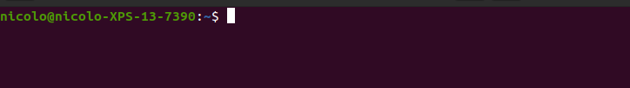
BASH
BASH stands for "Bourne Again Shell." It is a popular and widely used command-line interface (CLI) for Unix-like operating systems, including Linux
Open your “CLI” (CTRL + ALT + T or from software menu)
Should look like this (you can change color and appearance..)

Slide 6
The first command: pwd
By using the CLI you can interact with the OS and perform operation
Linux command are in the form of “command [options] [arguments]”
Our first command: “pwd”
“pwd” print to the stout the current working directory
Every command have its own manual (“man command”) or –help option
What the “pwd” command do?
What is you current working directory?

Slide 7
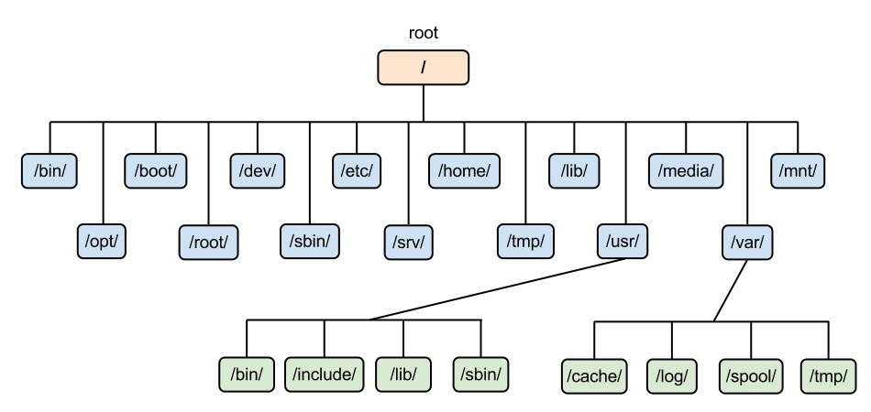
Navigate the filesystem
A filesystem in Linux is a hierarchical structure used to organize and store data on storage devices like hard drives, solid-state drives, and other storage media. It provides a way to manage and access files and directories on the storage device. In essence, a filesystem defines the rules and structures for storing and retrieving data efficiently.
“ls” list the current wd or the directory inserted as argument
“cd” change the current working directory to the directory inserted as argument
“mkdir” create a new directory
“rmdir” delete an empty directory (“rm -rf” delete a directory and all its subdirectories and files…..!!!!)
Navigate your filesystem and directories to find what is inside
Create a directory called “Bioinfo_excercise” in your home directory

Slide 8
Files
In linux everything is a file
You can view the content of a file (plain text) using “cat” or “less”
You can view the top N rows or last N rows with “head” and “tail” (useful to display large files)
You can modify files using “vim” (more complex) or “nano” (simpler)
You can create an empty file using “touch”
You can print the content of a file using “echo”
Create a directory called “fastq” and a directory called “script”
Navigate to the “script” directory and create a file called “Workflow.txt”
Use the Workflow.txt file to save the scripts throughtout the course, you can also take notes by adding the “#” at the beginning of the line (lines starting with “#” are interpreted as comments by bash)

Slide 9
Special characters
“.” → current directory
“..” → parent directory
“~” → Home directory
“.file” → hidden file ( ls -a)
“cd -” → previoulsy visited directory

Slide 10
Copy and move files and directories
“cp” copy the current file (usage: cp file1 destination)( cp -r → recursive copy all files and subfolders)
“mv” move the current file (usage: mv file1 destination)(mv -r → recursive move all files and subfolders)

Slide 11
Basic counts and file analysis
Wc (word count): is primarily used to count lines, words, and characters in a text file. (-l count lines, -w count words)
Sort: sort lines of text data alphabetically or numerically (-n sort numerically)
Uniq: filter adjacent matching lines and display unique lines (-c prefix lines with their count occurrence)
Usage: sort file.txt | uniq -c

Slide 12
Searching the content of a files
“grep” is a powerful command-line tool to search for specific patterns (regular expressions) within text files or the output of other commands.
Basic usage: “grep [options] pattern [file…]”
A regular expression is a powerful and flexible pattern-matching language used for searching and manipulating text. It allows you to define a pattern, which can include characters, metacharacters, and quantifiers, to match strings of text with specific structures.
Common regular expression:
“.” (dot): Matches any single character except a newline.
“*” (asterisk): Matches zero or more occurrences of the preceding element.
“+” (plus): Matches one or more occurrences of the preceding element.
? (question mark): Matches zero or one occurrence of the preceding element
Downaload the “htseqcounts/SRR2993055” file from the github repository (it contains the number of reads per gene)
Search the expression levels of Actin (ACTB, ensembl ENSG00000075624)
Create a file containg the expression of ACTB and GAPDH (ENSG00000111640) (hint: to redirect the output of a command to a file use “>” filename.txt, “>>” to append to the end of a file)

Slide 13
Chain of multiple commands (Pipes)
Pipes are a powerful and fundamental feature that allow you to connect the standard output (stdout) of one command to the standard input (stdin) of another command
This enables you to create a sequence of commands, where the output of one command serves as the input for the next, allowing for data processing, filtering, and manipulation
Pipes are represented by the vertical bar symbol “|”
“cat data.txt | wc -l” (wc -l counts the number of line in a file and prints it to the stout)
Pipes are widely used in Linux for a variety of tasks, including text processing and data analysis. They are a foundational concept for working with the command line and are an essential tool for connecting and coordinating different command-line utilities to accomplish complex tasks efficiently
Excercise: Count the number of genes in the SRR2993055 file

Slide 14
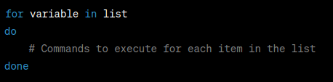
For loops
In Bash, a for loop is a control structure that allows you to iterate over a list of items, such as a range of numbers, a list of filenames, or any set of values
The basic for loop syntax is the following

Slide 15
Data retrieval
“wget” is a command-line utility used for non-interactive downloading of files from the web.
Very simple and easy to use
wget “file URL”
Save file to the local filesystem
Useful to download file from the CLI
Download the human chr22 fasta file and save it to the local filesystem
Download the human gtf annotation file for chr22 and save it to the local filesystem

Slide 16
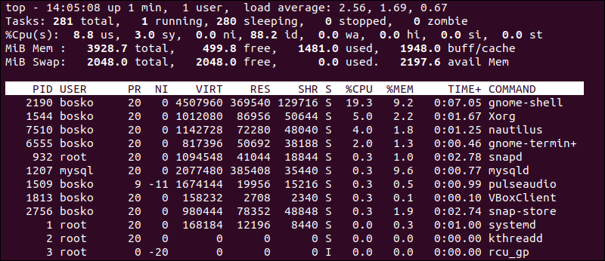
Handling PC resource
You can check for memory usage using “top”
“ps” and “top” shows the processes
“df” and “du” shows disk space and directory sizes respectively
“jobs” print the list of running jobs
“kill” interrupt a process
Command “&” run a process in backgroud
“fg” followed by process number put the process in foreground
“nohup” command “&” detact processes from your terminal

Slide 17
Compile and run software
Compiling software in Linux typically involves transforming human-readable source code into executable machine code
Download the Source Code (typically from linux repositories or software developer)
Extract the source code (using unzip or tar for compressed source codes)
Configure the build (i.e set the directory in which the software will be installed) “./configure”
Compile the software using “make” (gcc compiler or others, i.e translate the human-redable code into machine readable code)
Install the software “make install”
Different software have different ways to be installed, always read the “README” file or software manual
Download and install STAR (software for align reads to reference genome, RNA-seq)
You can also download and install software using “apt get install” from ubuntu repository
wget https://github.com/alexdobin/STAR/archive/2.7.11a.tar.gz

