Slide 1
Introduction to Bioinformatics

Slide 2
What is Bioinformatics?
Bioinformatics is defined as the application of tools of computation and analysis to the capture and interpretation of biological data.
It is an interdisciplinary field, which harnesses computer science, mathematics, physics, and biology

Slide 3
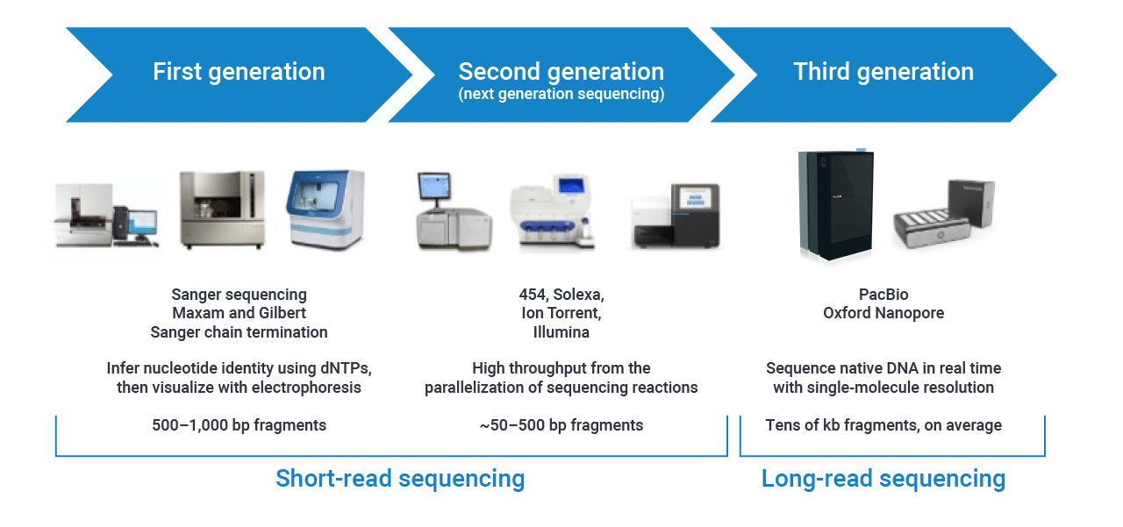
Next Sequencing technologies
Next-generation sequencing (NGS) technologies have the capability of producing a huge amount of reads
Roche 454 System
AB SOLiD System
Illumina

Slide 4
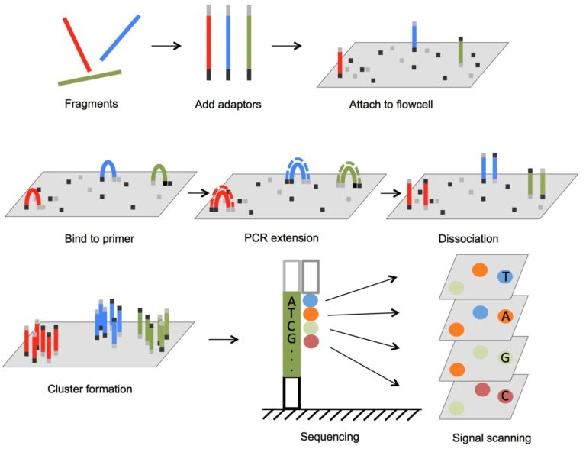
Next Generation Sequencing technologies (DNA-seq)(Illumina)
Produce short reads (50-500 bp)

Slide 5
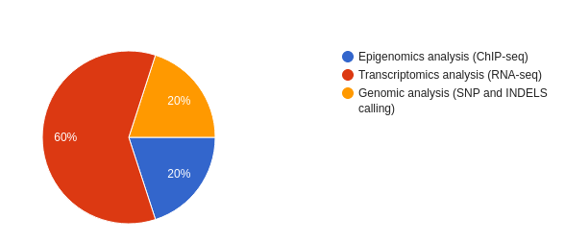
Your vote

Slide 6
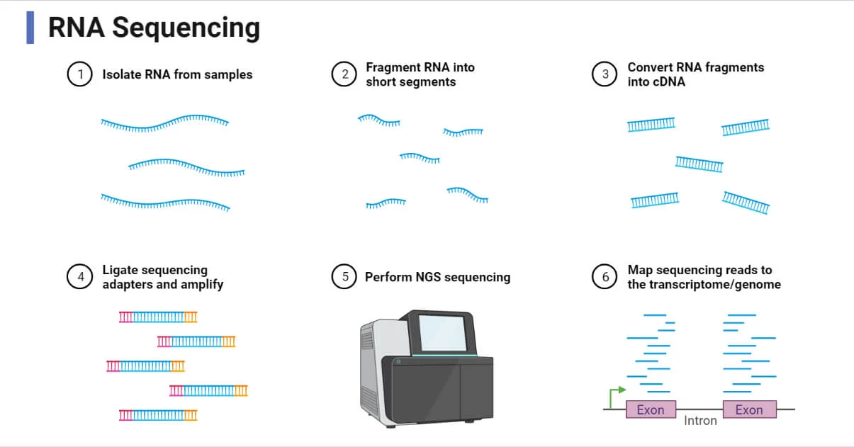
RNA-sequencing

Slide 7
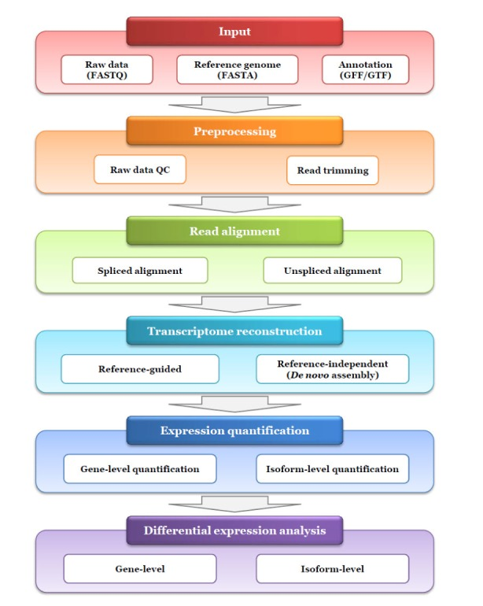
RNA-sequencing
Transcriptomics is the study of all RNA molecules withing a cell
Gene expression analysis
Transcriptome reconstruction
RNA editing
Splicing analysis
Gene discovery
Many others ...

Slide 8
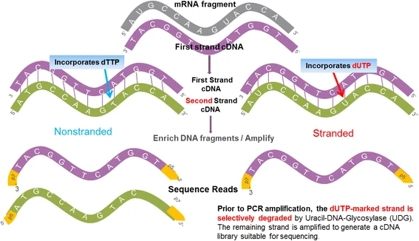
Types of RNA-sequencing
Total RNA-seq
PolyA+
Small RNA-seq
Strand-specific RNA-seq

Slide 9
Advantages of RNA-sequencing
Covers an extremely broad dynamic range
Provides sensitive, accurate measurement of gene expression
Captures both known and novel features; does not require predesigned probes
Generates both qualitative and quantitative data
Reveals the full transcriptome, not just a few selected transcripts
Can be applied to any species, even if a reference sequence is not available
Relatively low costs

Slide 10
Raw reads and fastq files
The output of a sequencing run is a fastq file
A sequence identifier with information about the sequencing run and the cluster
The sequence (the base calls; A, C, T, G and N).
A separator, which is simply a plus (+) sign.
The base call quality scores Phred +33 encoded using ASCII characters (represents numerical scores

Slide 11

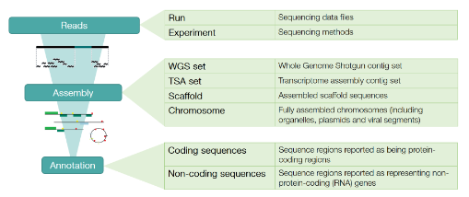
Databases: ENA
The European Nucleotide Archive provides a comprehensive record of the world’s nucleotide sequencing information, covering raw sequencing data, sequence assembly information and functional annotation
Searches are allowed using Projects accessing keys and/or keywords
You can also access ENA programmtically throught API

Slide 12
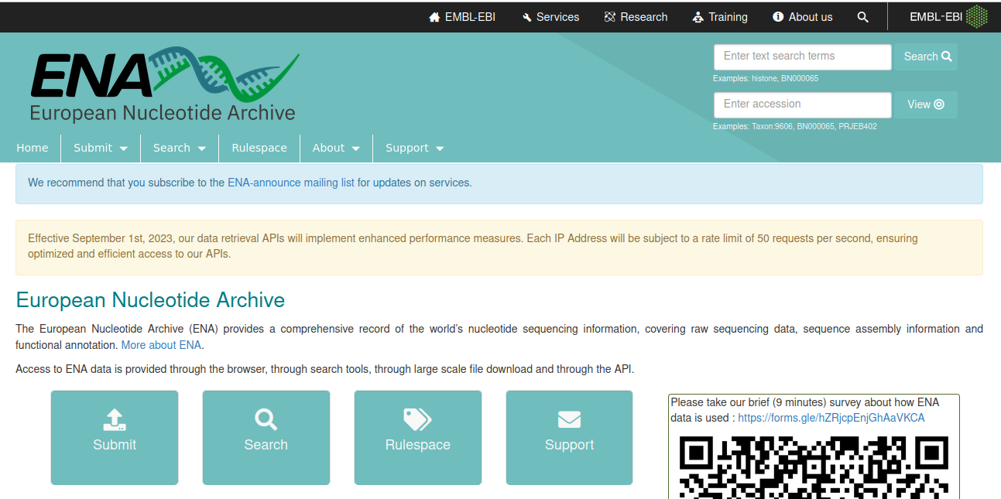
Databases: ENA

Slide 13
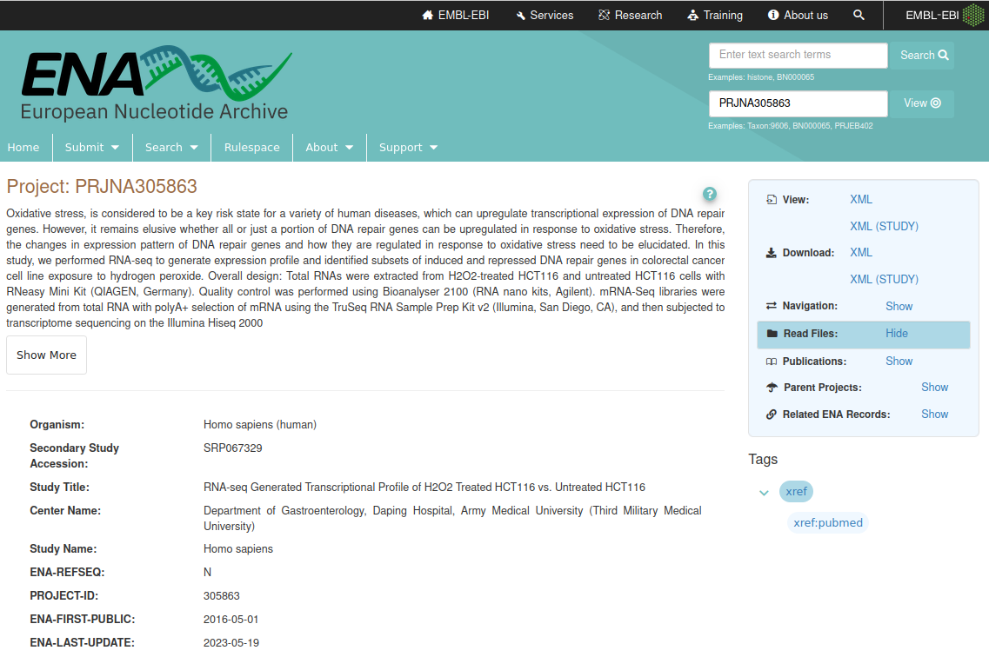
Databases: ENA

Slide 14
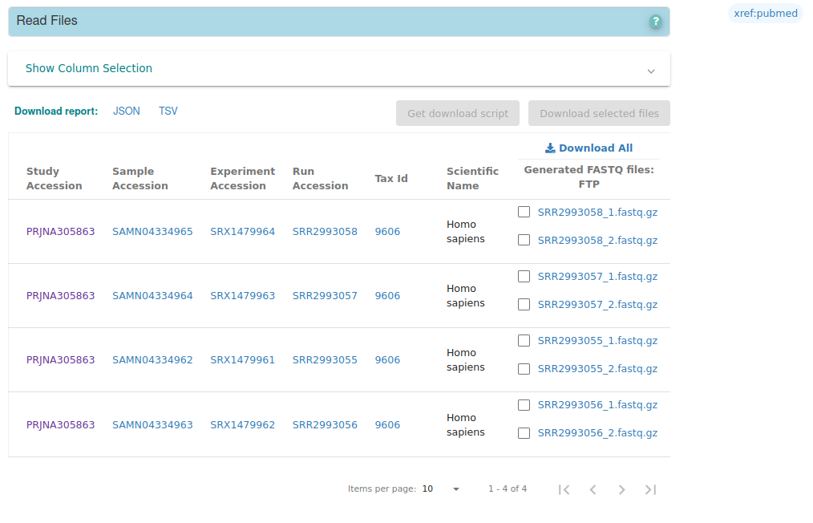
Databases: ENA
Paired end sequencing

Slide 15

Databases: Genecode
The goal of the GENCODE project is to identify and classify all gene features in the human and mouse genomes
It provides genome sequence files (fasta format) and gene annotation files (gtf and gff formats)

Slide 16
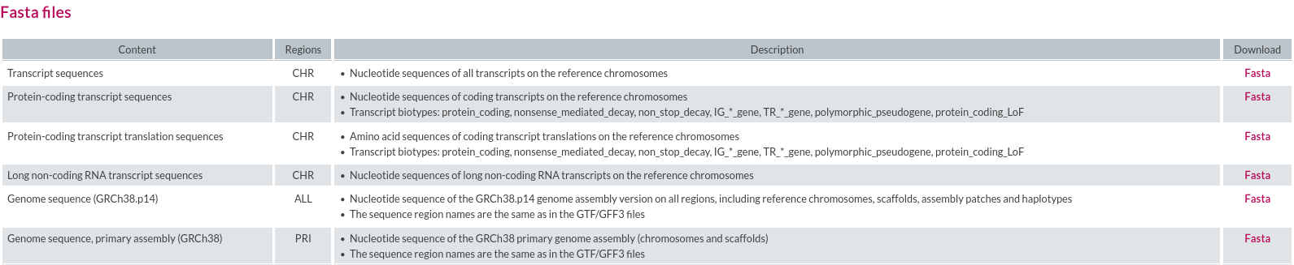
Databases: Genecode

Slide 17
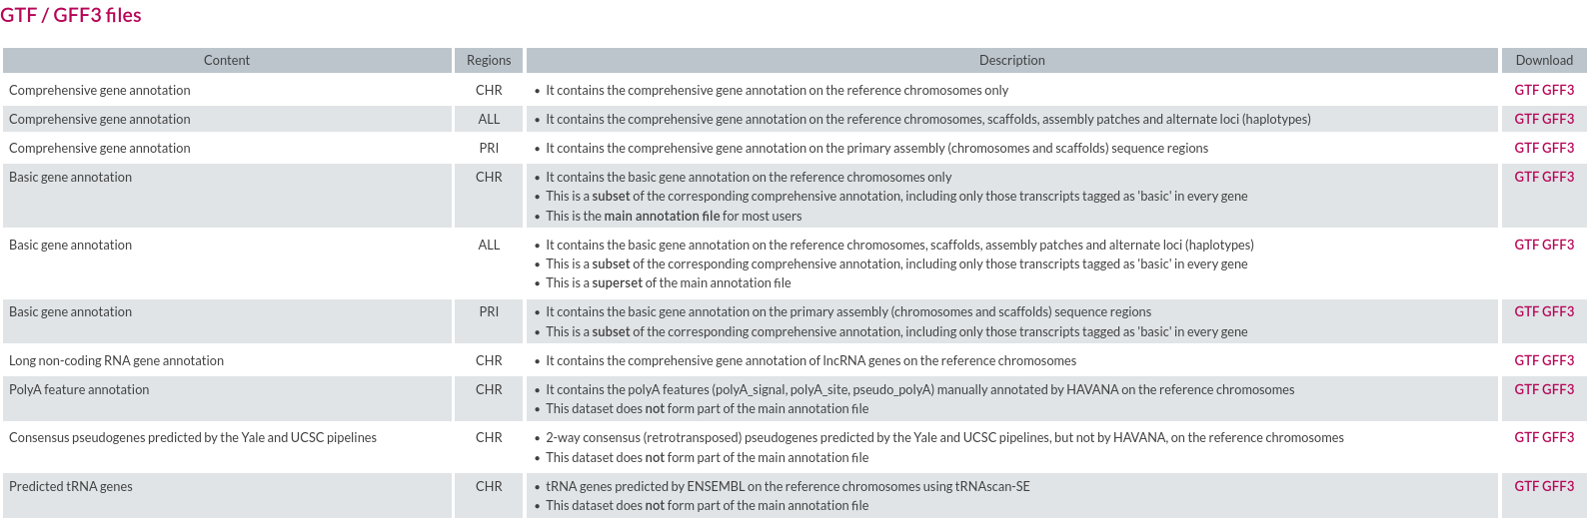
Databases: Genecode

Slide 18
Databases: Genecode
The GFF (General Feature Format) format consists of one line per feature, each containing 9 columns of data, plus optional track definition lines
Fields must be tab-separated. Also, all but the final field in each feature line must contain a value; "empty" columns should be denoted with a '.'
seqname - name of the chromosome or scaffold; chromosome names can be given with or without the 'chr' prefix. Important note: the seqname must be one used within Ensembl, i.e. a standard chromosome name or an Ensembl identifier such as a scaffold ID, without any additional content such as species or assembly. See the example GFF output below.
source - name of the program that generated this feature, or the data source (database or project name)
feature - feature type name, e.g. Gene, Variation, Similarity
start - Start position* of the feature, with sequence numbering starting at 1.
end - End position* of the feature, with sequence numbering starting at 1.
score - A floating point value.
strand - defined as + (forward) or - (reverse).
frame - One of '0', '1' or '2'. '0' indicates that the first base of the feature is the first base of a codon, '1' that the second base is the first base of a codon, and so on..
attribute - A semicolon-separated list of tag-value pairs, providing additional information about each feature.

Slide 19
Excercise:Download fastq reads and reference genome and genes annotations
Create a directory called “genome_human_hg38” and download the human genome “hg38” version from Genecode (hint: mkdir genome_human_hg38, wget https://ftp.ebi.ac.uk/pub/databases/gencode/Gencode_human/release_44/GRCh38.primary_assembly.genome.fa.gz)
Create a directory called “annotations” and download the GTF file for human genes from Genecode( hint: mkdir annotations, wget https://ftp.ebi.ac.uk/pub/databases/gencode/Gencode_human/release_44/gencode.v44.primary_assembly.annotation.gtf.gz)

Slide 20

Ensembl
Ensembl is a bioinformatics project that provides a comprehensive and integrated source of genomic information for a wide variety of organisms
The primary goal of Ensembl is to annotate and analyze genomic sequences, providing researchers with a valuable resource for studying genes, variations, and other genomic features.
Genome Browser
Gene Annotations

Slide 21
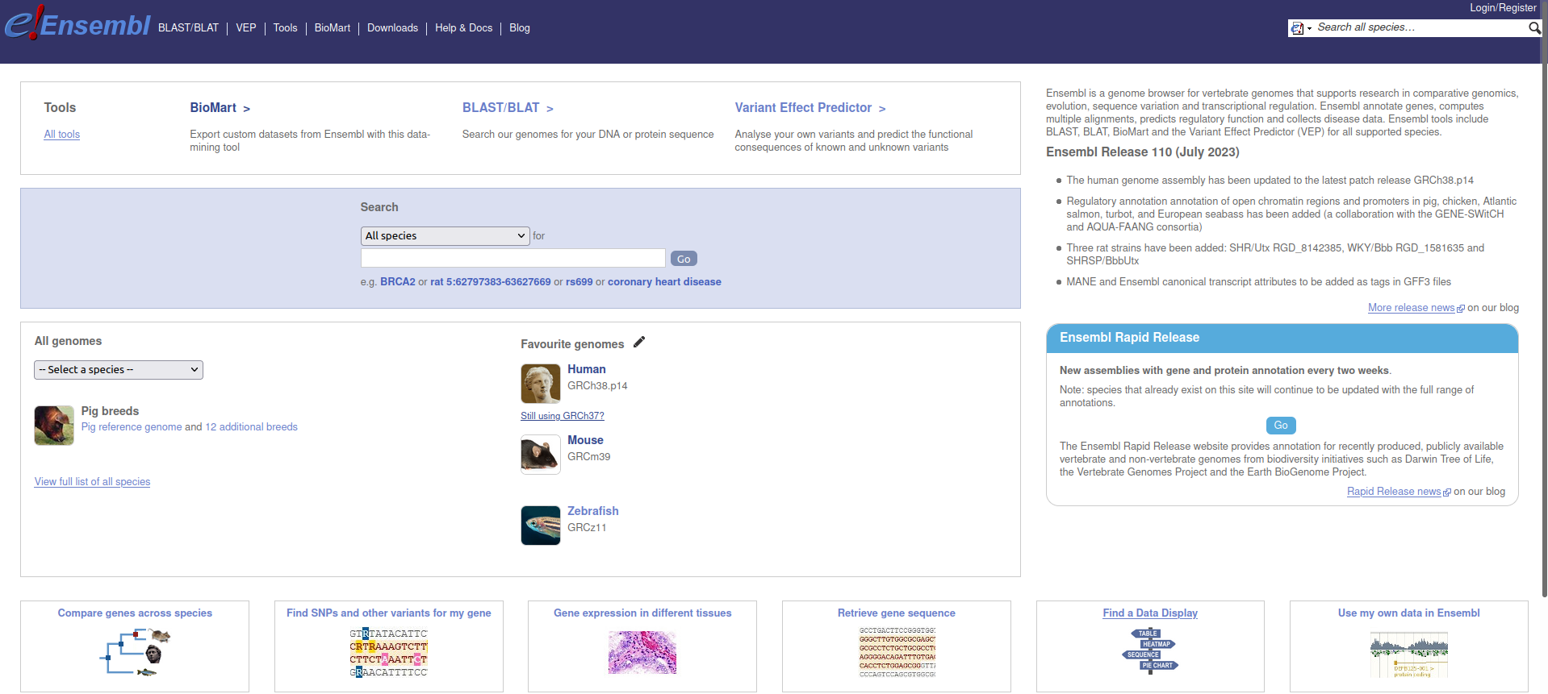
Ensembl

Slide 22
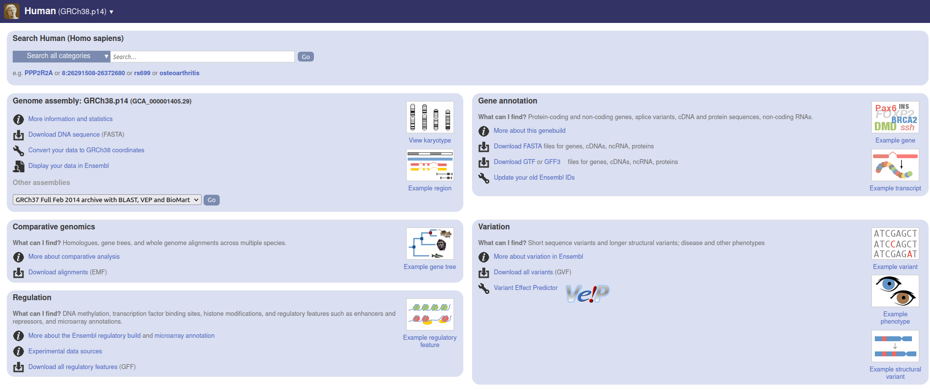
Ensembl

Slide 23
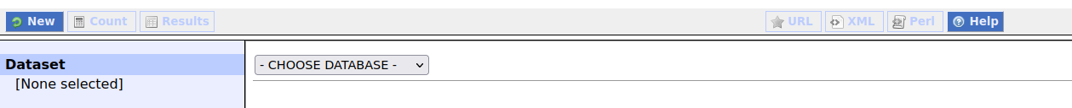
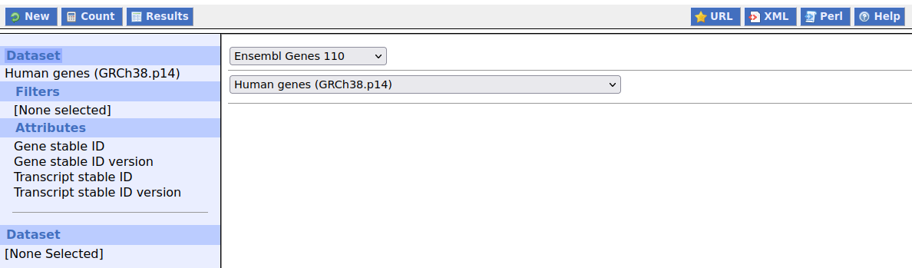
Ensembl BioMart

Slide 24
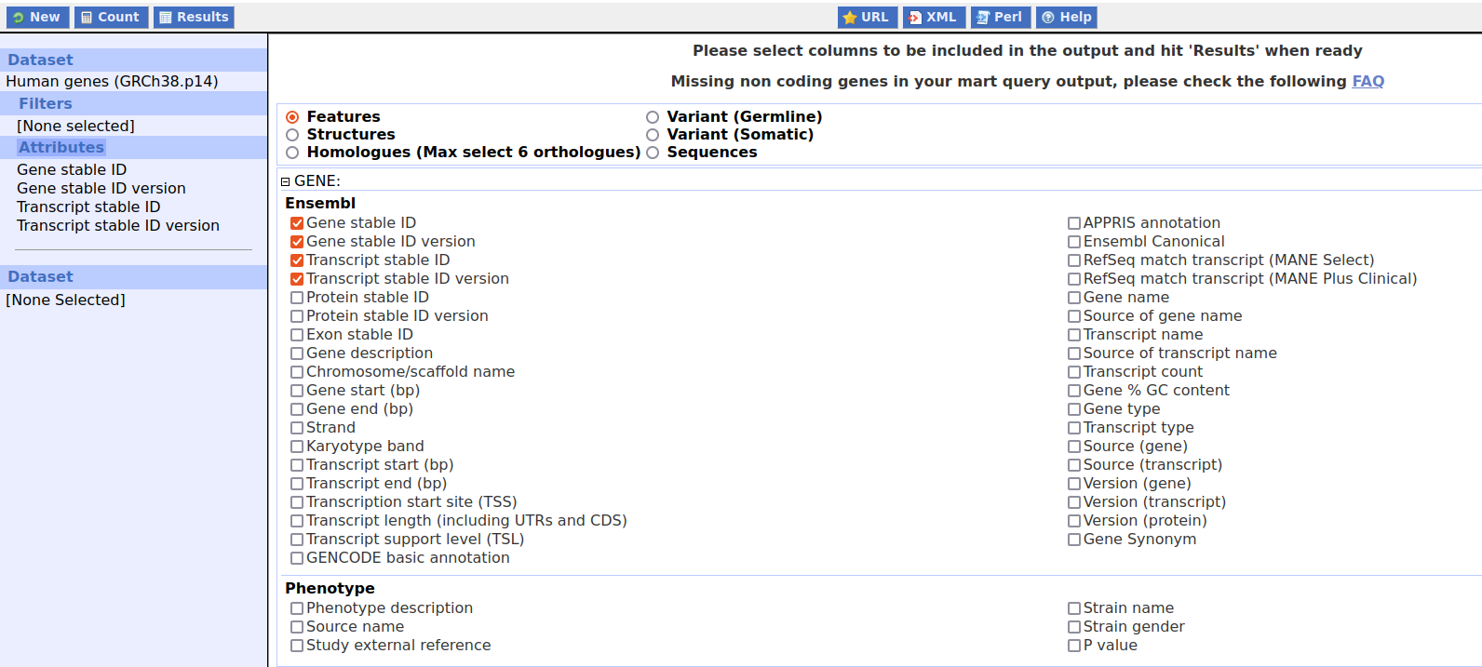
Ensembl BioMart

Slide 25
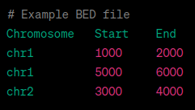
Gene annotations: BED files
A BED file in bioinformatics is a plain-text file format that is commonly used to represent genomic annotations and features
A typical BED file consists of rows, each representing a genomic feature or annotation. The columns in a BED file have specific meanings, and at a minimum, a BED file contains the following three mandatory columns: Chromosome, start position, end position
Important: BED files are 0-based
Additional optional columns can be included to provide more information about the features. Some common optional columns include: Name, score, strand
Exercise: Create a BED file containing the human genes annotation (chromosome, start, end, name, score and strand columns), download and save it to the “annotation” folder, it will be useful for gene and genomic regions annotation

