Slide 1
Pratical excercise
Differential gene expression analysis: from fastq to differentially expressed genes

Slide 2
Main steps
Download reads from ENA (github https://github.com/ngualand/Introduction_to_bioinformatics)
Perform quality controls (Fastqc)
Mapping reads to a reference genome and QC (STAR and samtools)
Quantify ReadsPerGene (Htseqcounts)
Differential expression analysis (DESeq2)
Enrichment analysis(EnrichR and Gprofiler2)

Slide 3

Dataset overview
Oxidative stress, is considered to be a key risk state for a variety of human diseases, which can upregulate transcriptional expression of DNA repair genes. However, it remains elusive whether all or just a portion of DNA repair genes can be upregulated in response to oxidative stress. Therefore, the changes in expression pattern of DNA repair genes and how they are regulated in response to oxidative stress need to be elucidated. In this study, we performed RNA-seq to generate expression profile and identified subsets of induced and repressed DNA repair genes in colorectal cancer cell line exposure to hydrogen peroxide. Overall design: Total RNAs were extracted from H2O2-treated HCT116 and untreated HCT116 cells with RNeasy Mini Kit (QIAGEN, Germany). Quality control was performed using Bioanalyser 2100 (RNA nano kits, Agilent). mRNA-Seq libraries were generated from total RNA with polyA+ selection of mRNA using the TruSeq RNA Sample Prep Kit v2 (Illumina, San Diego, CA), and then subjected to transcriptome sequencing on the Illumina Hiseq 2000
study_accession | run_accession | scientific_name | instrument_platform | instrument_model | library_layout | library_strategy | library_source | library_selection | read_count | base_count | center_name | sample_title | Group
PRJNA305863 | SRR2993055 | Homo sapiens | ILLUMINA | Illumina HiSeq 2000 | PAIRED | RNA-Seq | TRANSCRIPTOMIC | cDNA | 25092168 | 5018433600 | GEO | RNA-seq_Control_rep1 | CTRL
PRJNA305863 | SRR2993056 | Homo sapiens | ILLUMINA | Illumina HiSeq 2000 | PAIRED | RNA-Seq | TRANSCRIPTOMIC | cDNA | 25956702 | 5191340400 | GEO | RNA-seq_H2O2_rep1 | H2O2
PRJNA305863 | SRR2993058 | Homo sapiens | ILLUMINA | Illumina HiSeq 2000 | PAIRED | RNA-Seq | TRANSCRIPTOMIC | cDNA | 23684111 | 4736822200 | GEO | RNA-seq_H2O2_rep2 | H2O2
PRJNA305863 | SRR2993057 | Homo sapiens | ILLUMINA | Illumina HiSeq 2000 | PAIRED | RNA-Seq | TRANSCRIPTOMIC | cDNA | 23796138 | 4759227600 | GEO | RNA-seq_Control_rep2 | CTRL
https://www.ebi.ac.uk/ena/browser/view/PRJNA305863

Slide 4
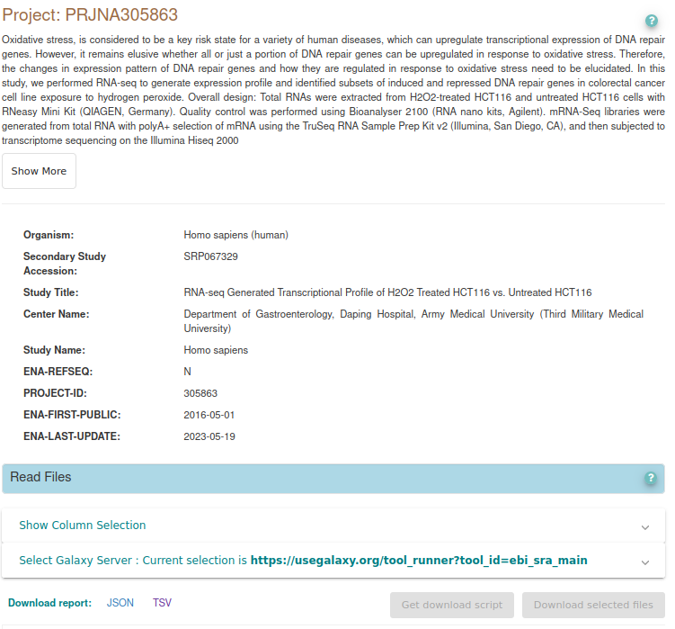
Download reads from ENA
We only use a subset of reads sampled from chr22 (for speed and space) please download them from https://github.com/ngualand/Introduction_to_bioinformatics/fastq
https://www.ebi.ac.uk/ena/browser/view/PRJNA305863

Slide 5
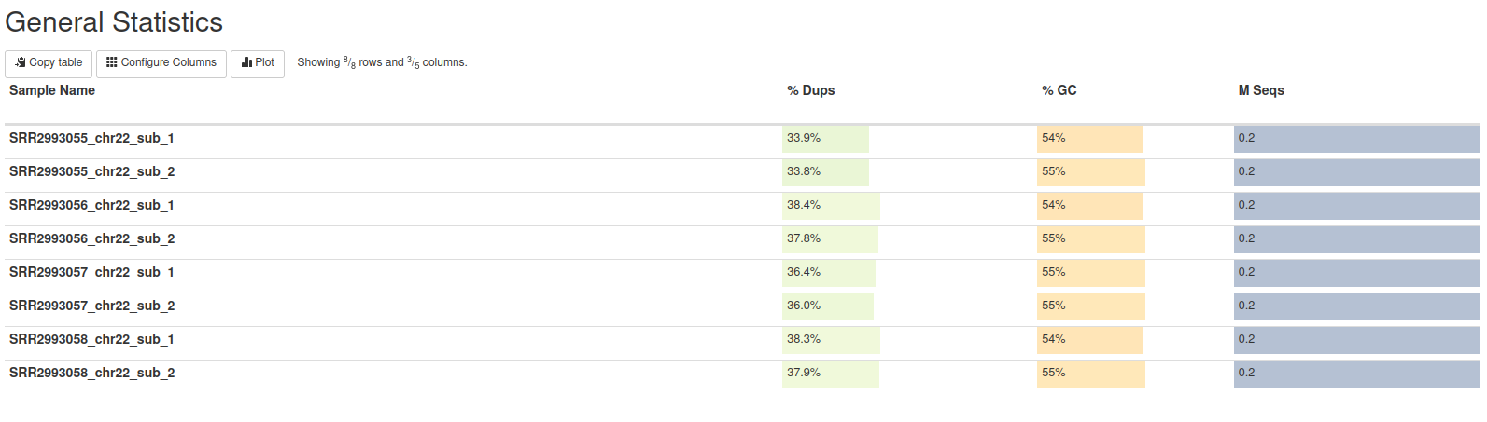
Quality control (Fastqc)
Command: fastqc FASTQ FILE
Output: Zip and HTML file
Summarise results using Multiqc
Command: multiqc DIRECTORY
Output: HTML file
https://www.bioinformatics.babraham.ac.uk/projects/fastqc/
https://github.com/ewels/MultiQC

Slide 6
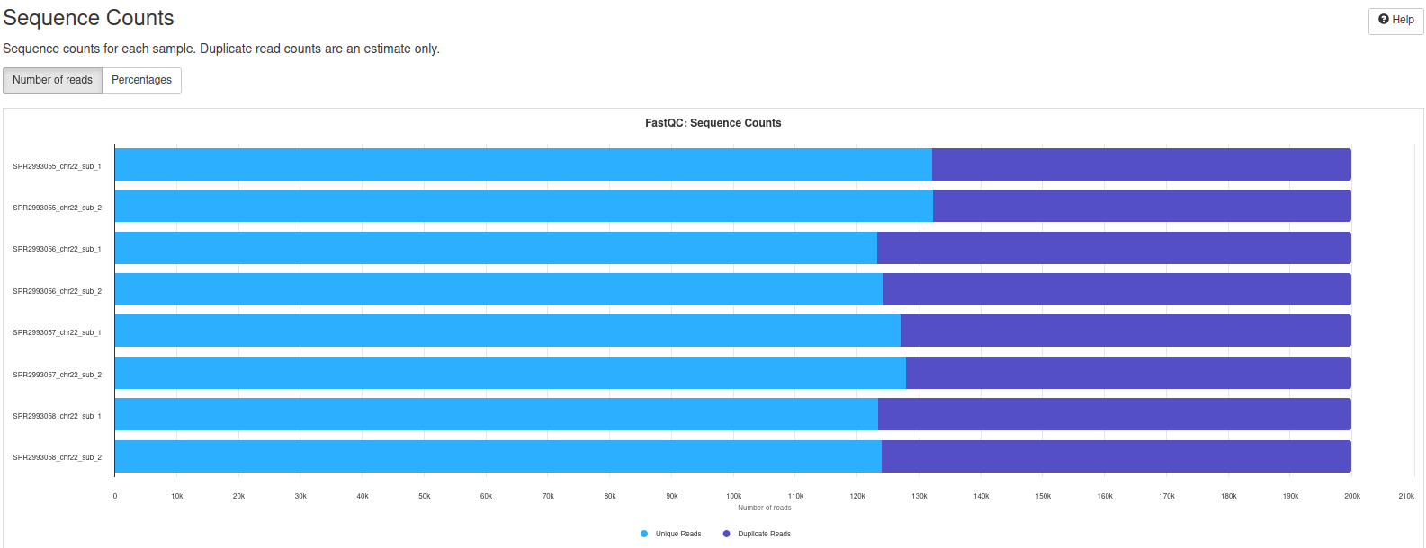
Quality control (Fastqc)
Count the total number of reads
Duplicate reads from highly expressed genes are expected in RNA-seq data

Slide 7
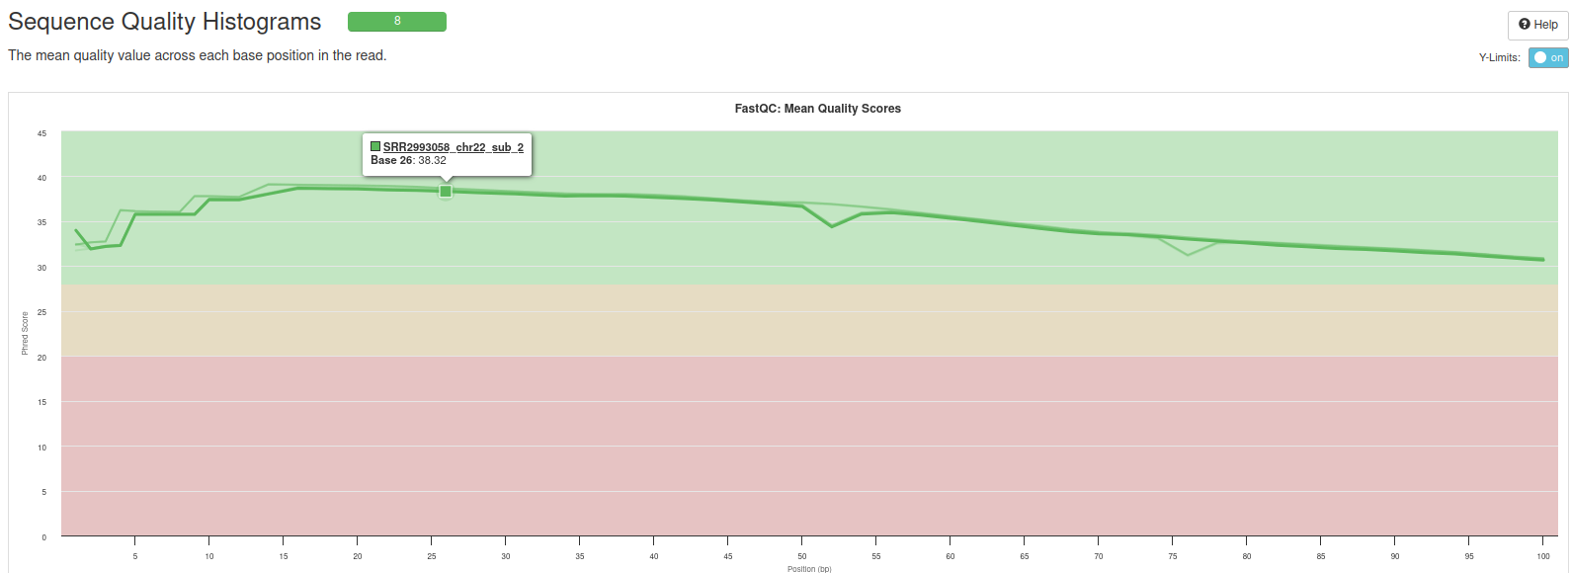
Quality control (Fastqc)
Reports the quality of the avery base in the reads for every sample
Reads quality is very high

Slide 8
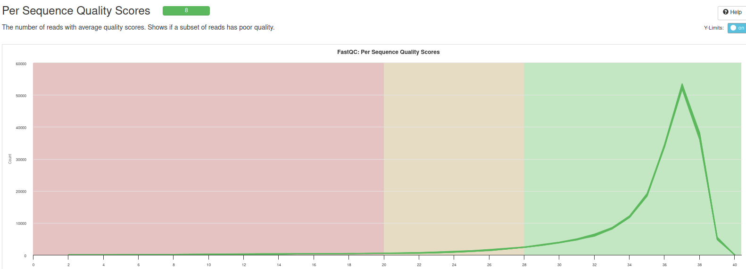
Quality control (Fastqc)
Reports the distribution of the reads quality in every samples
As expected from the previous plot most of the base have high quality

Slide 9
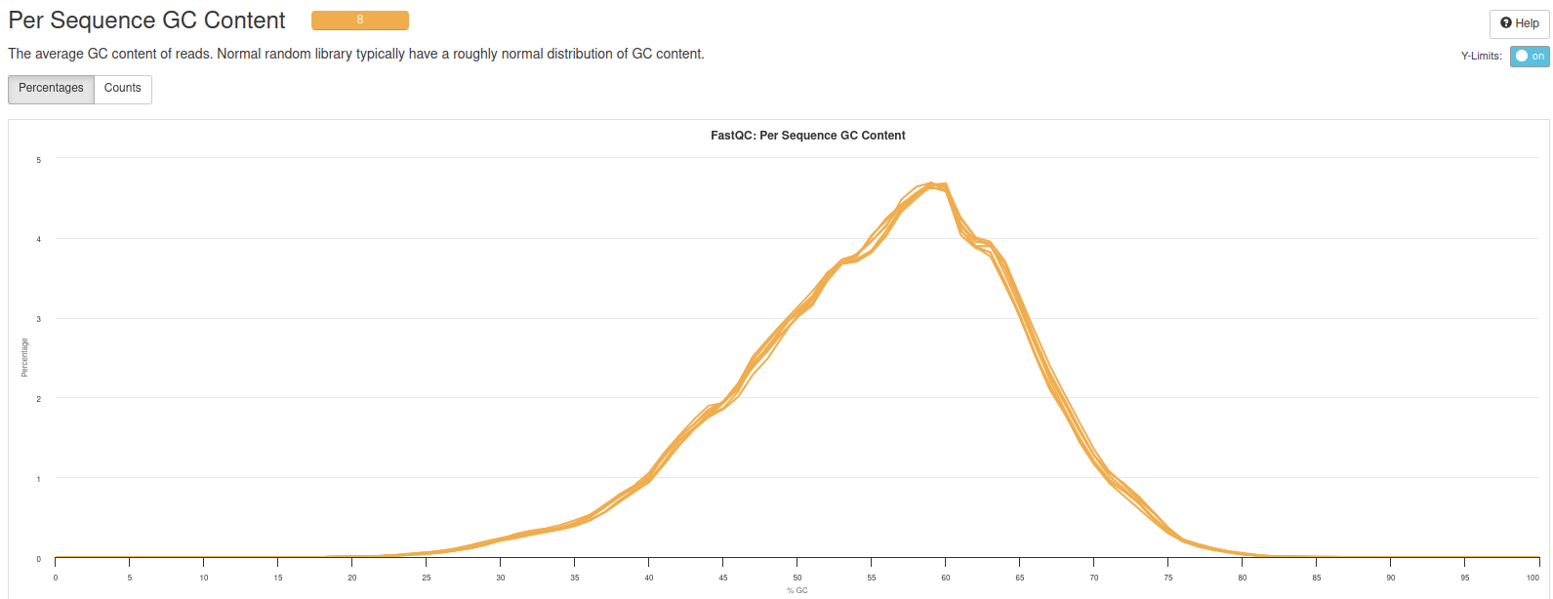
Quality control (Fastqc)
Report the GC content distribution for every samples
Alterated GC content can be an indication of contamination of low library complexity
GC content is good ~55%

Slide 10
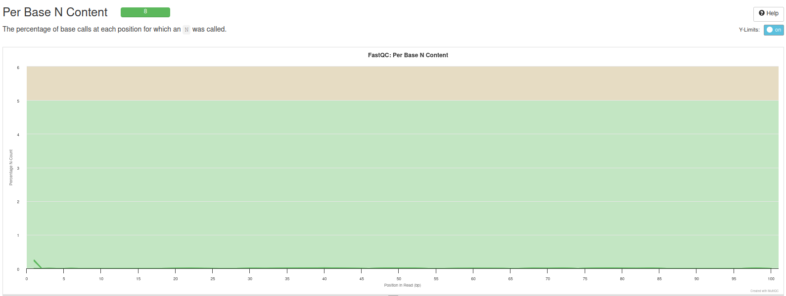
Quality control (Fastqc)
Reports the number of “non called” bases (N)
Most of bases are called in a proper way

Slide 11
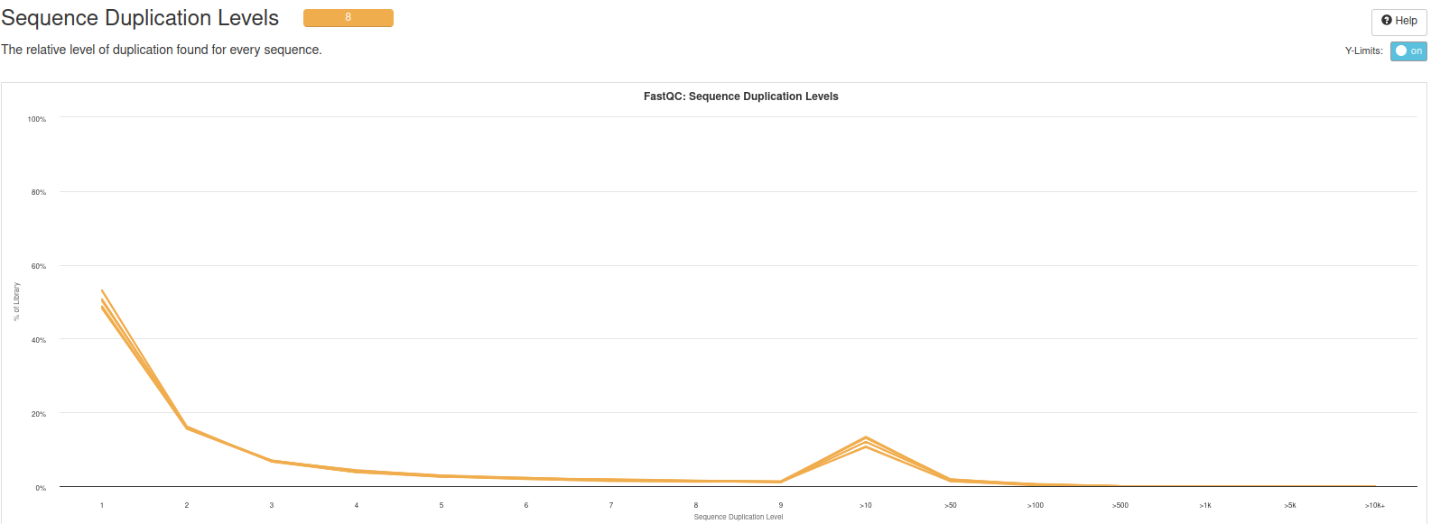
Quality control (Fastqc)
Report the number of duplicated sequences
Reads duplication may be exprected in RNA-seq experiments (not in general DNA-seq)

Slide 12
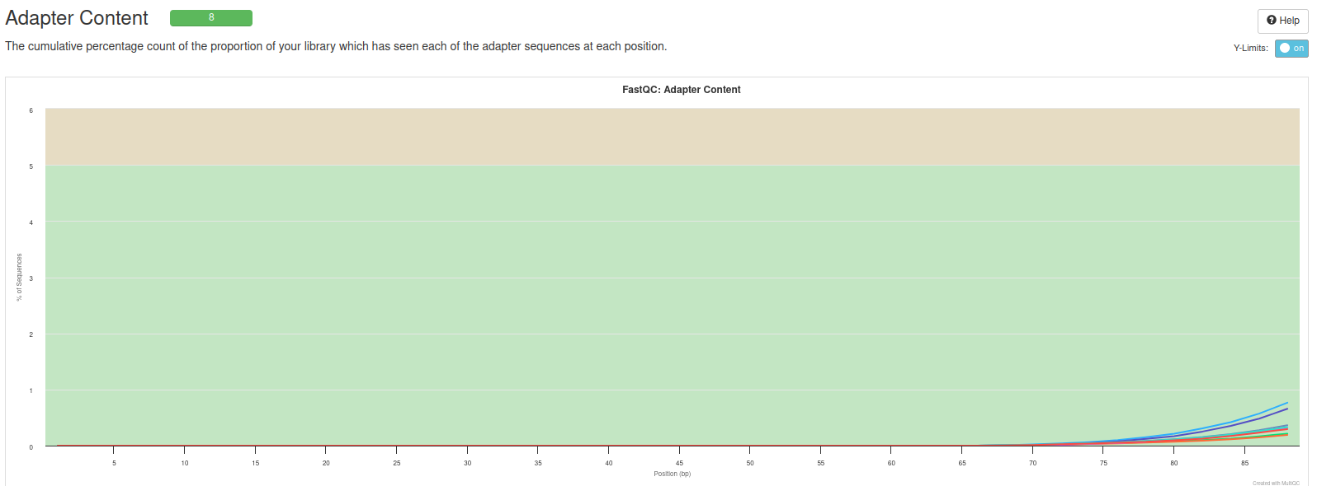
Quality control (Fastqc)
Reports the adapter content
Adapter are normally expected after sequencing and normally should be removed
You can use Trimmomatic or other software to remove Illumina adapters and low quality reads
Reads pass all quality checks

Slide 13
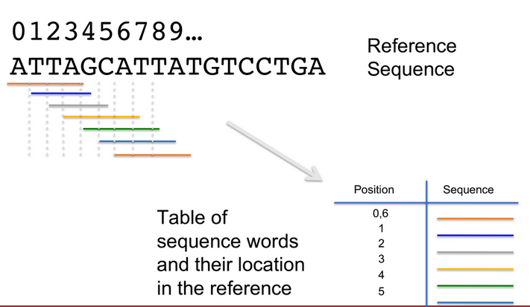
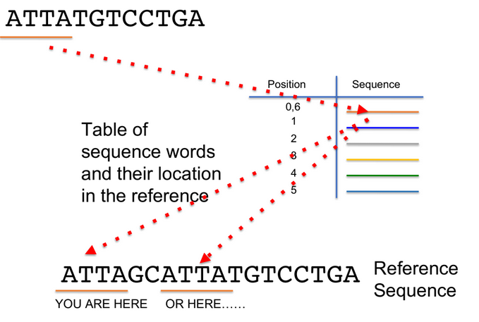
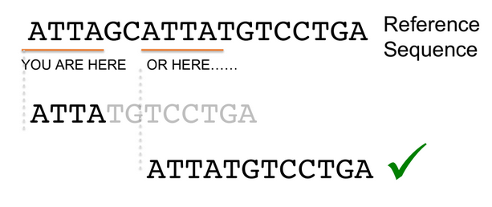
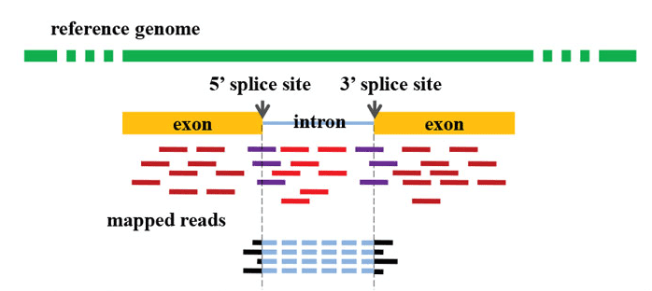
Mapping reads to a reference genome (STAR)
Build index for the genome (fast access)
STAR
Map reads to the reference genome (STAR)
Quality controls

Slide 14
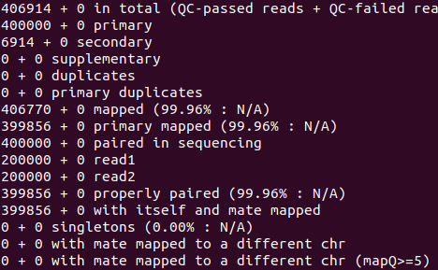
Mapping reads to a reference genome (QC)
Samtools flagstat BAMFILE
Multiqc DIRECTORY

Slide 15
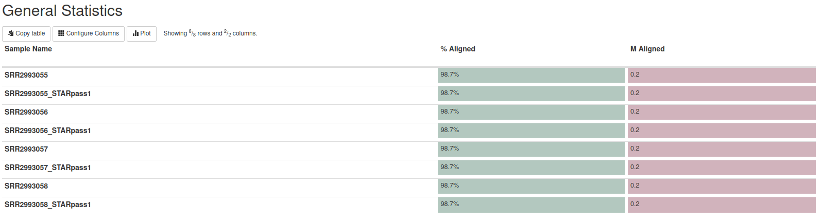
Mapping reads to a reference genome (QC)
Most of the reads aligned

Slide 16
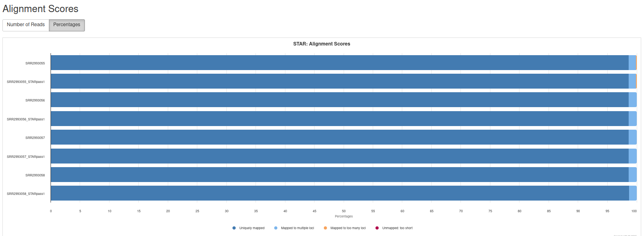
Mapping reads to a reference genome (QC)
Most of the reads aligned

Slide 17
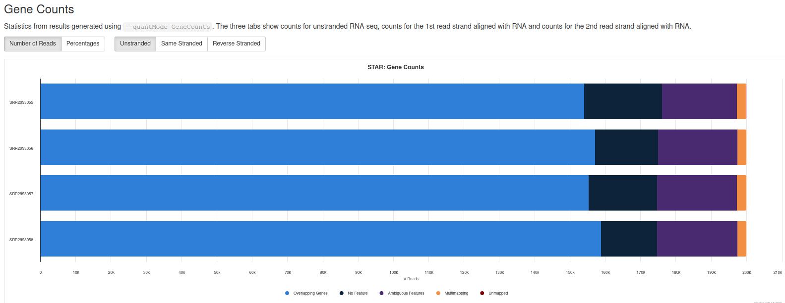
Mapping reads to a reference genome (QC)
Most of the reads aligned to genes (exprected from an RNA-seq experiments)

Slide 18
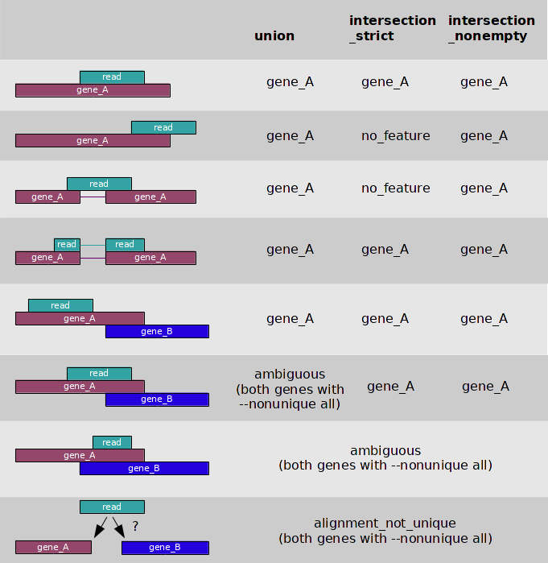
Quantify reads per gene (Htseq counts)
pip install HTSeq
https://htseq.readthedocs.io/en/release_0.11.1/count.html

Slide 19
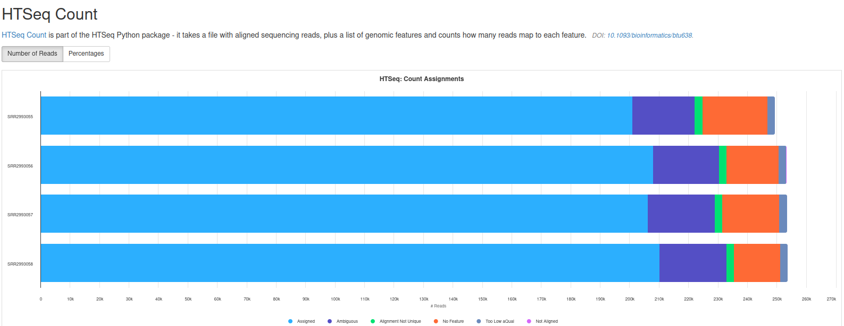
Quantify reads per gene (Htseq counts QC)

Slide 20
Differential expression analysis (DESeq2)
Attention: Never run DESeq2 on a subset of genes as it will compute the “sizefactors” from the sums of columns for each samples (In this case it is only a practical test, use all genes in real-life problems)

