Slide 1

Introduction to R programming
Nicolò Gualandi
Raffaella Picco

Slide 2
What is R?
R is a powerful, open-source programming language for statistical computing and graphics
Developed by Ross Ihaka and Robert Gentleman at the University of Auckland, New Zealand, in the early '90s

Slide 3
Why R?
Popularity: Widely used in academia, industry, and research.
Versatility: Suited for statistical analysis, data visualization, and machine learning.
Applications: Used in fields such as data science, bioinformatics, and finance
Many Bioinformatics softwares are written in R
Bioconductor repository contains many bioinformatics softwares

Slide 4
Getting Started with R
Downloading and installing R from CRAN (Comprehensive R Archive Network)
“sudo apt-get install r-base”
Excercise: download and install R using apt

Slide 5
Getting Started with R
Open R by typing “R” into your command line interface

Slide 6
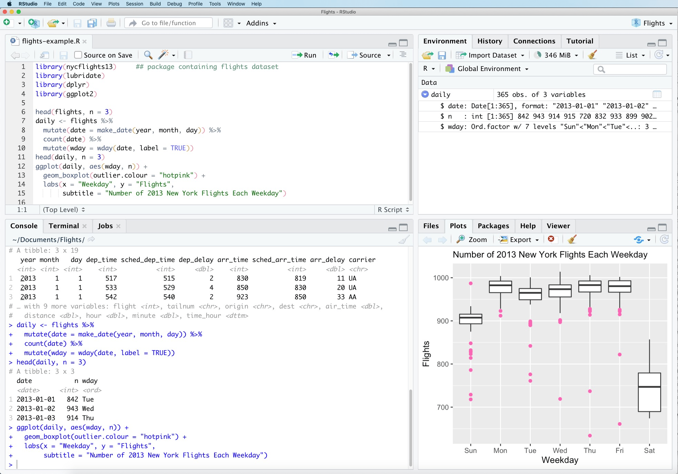
R IDE: Rstudio

Slide 7
Installing Rstudio
https://posit.co/download/rstudio-desktop/
Download Rstudio installer (Choose your system and the free version)
For Ubuntu use “dpkg –install Package_name
You can run Rsudio from your console by typing “rstudio” or you can find it I your software menu
Rstudio automatically runs the R installed on your PC (different options are avaiable but usually the default is good)

Slide 8
Installing Rstudio
Interactive Rstudio exploration
Create and save a new script
Running code
Console
Data Visualization
Objects panel

Slide 9
Introduction to R programming
R is an interpreted language so you don’t need to compile your code but an interpreter let it run in “real time”
R is best for statistics data manipultaion and graphics
It contains a lot of functions and algorithms to perform and automate most of the statistical analysis
You can also develop your own methods and functions

Slide 10
Introduction to R programming
R is composed by data structures, variables, objects, function and classes and everything is stored in the current enviroment
Variables are named storage locations that holds data, and are used to represent and store information for later use in your program
Variable Naming Rules: Variable names can consist of letters, numbers, dots, and underscores. They must start with a letter or a dot, followed by any combination of letters, numbers, dots, or underscores
Variable names are case-sensitive
You can assign a value to a variable using the assignment operator <- or =
R is a dynamically typed language, meaning that you don't need to explicitly declare the data type of a variable
Common data types include numeric, character, logical, and more complex types like vectors and data frames
You can access the value of a variable simply by referencing its name
You can remove a variable from the workspace using the rm() function
Create 3 variables called “x”, “y” and “z” and assign to them the value of 5, 2 and 7 respectively
Look at the “variables” panel in Rstudio? What information do you see?

Slide 11
Installing and importing external packages
You can install external packages by running “install.packages(PACKAGENAME)”
You can import external package by running “library(PACKAGENAME)”

Slide 12

Bioconductor
Bioconductor is an open-source project that provides tools and resources for the analysis and comprehension of high-throughput genomic data.
Developed in the R programming language, Bioconductor offers a comprehensive collection of bioinformatics packages and workflows, facilitating researchers in tasks such as preprocessing, statistical analysis, and visualization of biological data.
strong focus on reproducibility, Bioconductor plays a pivotal role in advancing genomics research by fostering collaboration and providing a platform for the development and dissemination of cutting-edge computational methods
install.packages("BiocManager")
BiocManager::install(version = "3.18")
https://www.bioconductor.org/

Slide 13


Vectors
a vector is a fundamental data structure that represents a sequence of data elements of the same basic type. Vectors are one-dimensional arrays that can store numeric, character, or logical values
You can create a vector using the c() function, which stands for "combine" or "concatenate."
Vectors in R are atomic, meaning all elements must be of the same data type: numeric, character, or logical. !Mixed types will be coerced to a common type if possible!
Elements in a vector are accessed using indexing. Indexing in R starts from 1
You can assign names to elements in a vector for easier reference

Slide 14
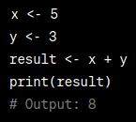
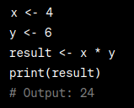
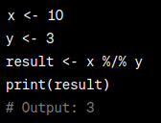


Common logics and arithmetics
In R you can perfom every type of arithmenics
Addition (+), Subtraction (-), Multiplication (*), Division (/), **Exponentiation (^ or ), Modulus (%%), Integer Division (%/%)
Logical operations and logical values play a crucial role in decision-making, conditional statements, and filtering data. Logical operations typically result in logical values (TRUE or FALSE), Equality (“==”), Inequality (“!=), Greater Than (>), Less Than (<), Greater Than or Equal To (>=), Less Than or Equal To (<=), AND (“&”), OR (“|”) and NOT (“!”)
Arithmetic and logic operations can be performed element-wise on vectors

Slide 15

Functions in R
A function is a set of instructions designed to perform a specific task or computation. Functions are essential building blocks in programming, allowing you to encapsulate and reuse code. They take input values, perform a series of operations, and (not always …) return a result.
There could be a function to perform your task so... always search!
You can use built-in R functions (print(), sum(), mean(), length()…), import functions from external packages or ever wite your own function
The basic syntax is the following “functionName(value1, value2, …)”
You can redirect the output of a function to a variable “result <- functionName(value1, value2, …)”
R uses lexical scoping, meaning a function can access variables defined in its own body, in the environment where it was created, and in the global environment
Many functions in R are designed to operate on entire vectors without the need for explicit loops.

Slide 16
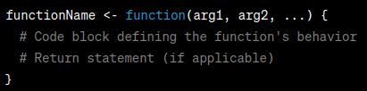
Create functions
The return() statement is used to specify the result that the function should return.
If a function doesn't include a return statement, it implicitly returns the result of the last evaluated expression.
Create a function that take as input 2 numbers and return their sums
Run your function and save the output to a variable called “z” … what appened to the “z” variable present in the enviroment?

Slide 17
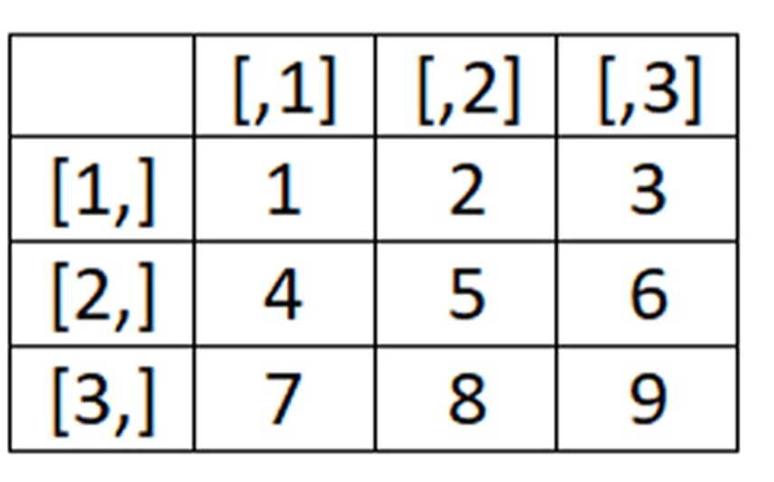

Matrices
Matrices are a two-dimensional array of elements of the same data type
They can be created using the “matrix()” function
Elements can be accessed with the following syntax
Aritmethics and logical functions works also on matrices

Slide 18
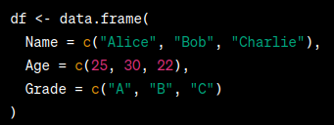
DataFrames
DataFrames, similar to matrix, are two-dimensional table with columns of different data types
They can be created using the “data.frame()” function but re not commonly created “by hands”
Flexible Structure: Different data types in each column
Column Names: Use meaningful names for easy reference
Easy to Read: Organized like a table for easy understanding

Slide 19
DataFrames: Accessing elements and perfom operations
Columns can be accessed using the “$” sign or the square brakets annotation this returna a vector
Rows can be accessed using the square brackets notation
Columns can be added using the “$” sign

Slide 20
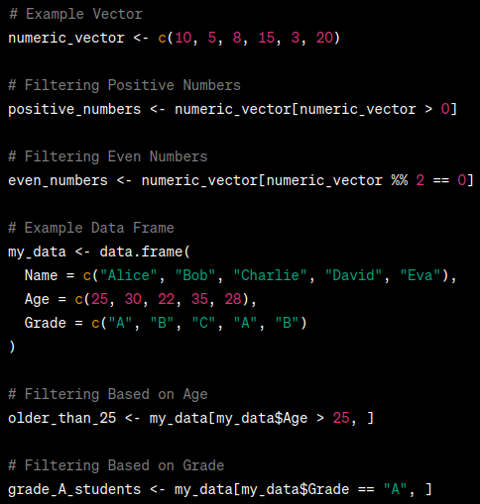
Filtering data
Data filtering is a process of selecting specific elements or rows from a vector or a data frame based on certain conditions
This is commonly done using logical conditions to filter elements that meet specific criteria
Data filtering and subsetting is mainly done using square brackets

Slide 21
Excersice
Load the geneData dataset (“data(geneData)”) and (“data(geneCovariates)”)
What is the structure fo this object? Is it a dataframe? (function: “str”)
Can you create a dataframe from those data?
Compute basic statistics (function: “summary”)

Slide 22
Write data to disk
Saving data from R to external files.
Preserve analysis results, share data with others
The main type of files used in bioinformatics are CSV, Excel and Txt
Txt and other character separated files are write with “write.table()” or “write.csv()” functions
Excel files are read using extenral packages like “openxlsx” with the “write.xlsx()” function
All this fiunction takes as input the path to the files and other additional arguments like the field separator, colum names ecc…
You can also save a full R enviroment using “save.data()”
Excercise: write the mtcars table to a file

Slide 23
Import data in R
Import data is foundamental for work with external datasets
The main type of files used in bioinformatics are CSV, Excel and Txt
CSV files are read with the “read.csv” function
Txt and other character separated files are read with read.table or read.delim
Excel files are read using extenral packages like “readxl” with the “read_excel()” function
All this fiunction takes as input the path to the files and other additional arguments like the field separator, colum names ecc…
You can also import a full R enviroment using “load.data()”
Excercise: read the mtcars table

Slide 24
Plotting data
Plotting data is crucial for visually revealing patterns, trends, and relationships, making complex information accessible, and aiding in effective communication, decision-making, and hypothesis testing
There are more customizable and high-quality graphics library for R but their use is out of the scope of this course (ggplot2: https://ggplot2.tidyverse.org/), we will briefly cover the basic R plotting library
The R plotting library can works with the majority of R objects libe dataframe and vectors

Slide 25
Scatterplot
Scatterplots are visual representations of the relationship between two continuous variables. Each point on the plot represents a unique combination of values for the two variables, allowing for the identification of patterns, trends, and the strength of correlation between them
Scatterplot can be created with the “plot” function:
plot(x_variable, y_variable, main = "Scatter Plot", xlab = "X-axis Label", ylab = "Y-axis Label", col = "blue", pch = 19)

Slide 26
Barplots
Barplots are graphical representations of categorical data where bars of different lengths represent the frequency or proportion of each category. They are useful for comparing the distribution of discrete variables and visually assessing the differences or similarities between categories
Barplot can be created wit the “barplot()” function
barplot(height = my_data$y_variable, names.arg = my_data$x_variable, col = "green", main = "Bar Plot", xlab = "X-axis Label", ylab = "Y-axis Label")

Slide 27
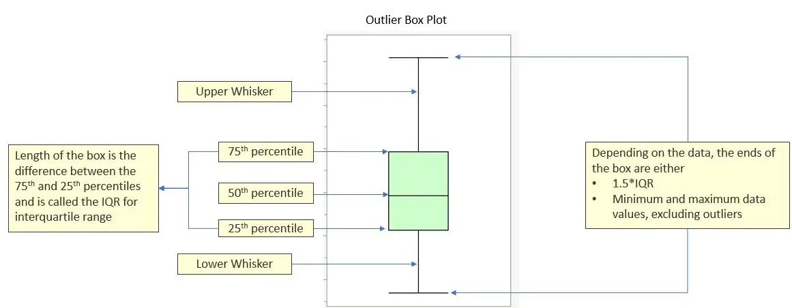
Boxplots
A boxplot, also known as a box-and-whisker plot, is a graphical representation of the distribution of a dataset. It provides a summary of the central tendency, dispersion, and skewness of the data. In R, you can create boxplots using the boxplot() function
boxplot(mtcars$mpg, main = "Boxplot of Miles Per Gallon", ylab = "Miles Per Gallon", col = "skyblue")
You can also use the “~” (tilde) to group data according to a grouping vector:
boxplot(mtcars$mpg ~ mtcars$cyl, main = "Boxplot", xlab = "Number of Cylinders", ylab = "Miles Per Gallon", col = "orange")

Slide 28
Statistics with R
Statistics is the study of collecting, analyzing, interpreting, presenting, and organizing data
Helps in making informed decisions based on data
R contains the implementation of the most common statistical test and the most common data distributions

Slide 29
Descriptive statistics
Descriptive statistics are a set of summary measures that provide a concise overview of the main features of a dataset. These statistics help in organizing, simplifying, and describing the essential characteristics of data
Mean: The average value of a set of data points “mean()”
Median: The middle value when the data is arranged in ascending or descending order “median()”
Range: The difference between the maximum and minimum values in a dataset “range()”
Variance: The average of the squared differences from the mean “var()”
Standard Deviation: The square root of the variance, providing a measure of how spread out the values are around the mean “sd()”

Slide 30
Hypothesis testing
Hypothesis testing is a statistical method used to determine whether there is enough evidence to reject a null hypothesis in favor of an alternative hypothesis
T-test (one-sample, paired, and independent two-sample)
Chi-square test
ANOVA (Analysis of Variance)
Wilcoxon signed-rank test
Mann-Whitney U test
Many more!

Slide 31
Example: T-test
A statistical method for comparing the means of two groups to assess whether they are significantly different from each other, it assumes normal distribution of data and homogeneity of variances
t.test(group1,group2)

Slide 32
Example: Correlation test
Correlation test is used to assess the strength and direction of the linear relationship between two numeric variables.
The most commonly used correlation test is the Pearson correlation coefficient, which measures the linear association between two variables.
There are other correlation coefficients, such as Spearman's rank correlation and Kendall's tau, that are used when the relationship between variables is not necessarily linear or when the data is not normally distributed
Function: cor.test(variable1, variable2, method = “pearson”)

