Slide 1
ORACLE’S HR SCHEMA ANALYSIS
Created by arnold ngumete

Slide 2
Goal
The intention of this analysis is to practice the use of a variety of SQL functions, clauses, and aggregates . To that end, I created 2 business question I could answer using Oracle’s HR schema.

Slide 3
Question
Is the average salary for each job above or below the standard salary?
Estimation* of employees 401k

Slide 4
Dataset
The dataset we are analyzing is the Human Resource (HR) schema from Oracle. It contains 13 tables which hold the information of fictitious employees, departments, job history, etc.

Slide 5



Data Cleaning
Null Value

Slide 6
Data Cleaning
Duplicates
The schema indicates that the employee_id column is a Primary Key. Since Primary keys must be unique, it is safe to say there are no duplicate employees.

Slide 7
Analysis
Question 1
Is the average salary for each job above or below the standard salary?
Standard Salary = the average of the position’s entry level salary and salary cap

Slide 8
Analysis
SELECT job_title, a.avg_salary AS avg_salary, max_salary-min_salary AS standard_salary,
a.avg_salary - (max_salary-min_salary) AS salary_difference
FROM jobs JOIN(
SELECT job_id, AVG(salary) AS avg_salary
FROM employees
GROUP BY job_id) a
ON jobs.job_id= a.job_id
ORDER BY salary_difference DESC

Slide 9
Analysis
Results:
Only three positions have average salaries lower than the standard salary
Stock Clerk
Purchasing Clerk
Programmer (gasp)

Slide 10

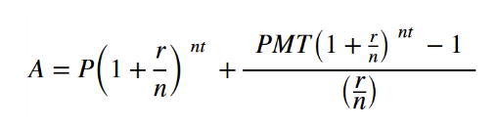
Analysis
Question 2
Estimation* of employees 401k
Employee Contribution: 10% of Salary
Employer Contribution: 6% of Salary
Interest Rate: 6%
No IRS Contribution Limit applied
**Disclaimer**: Some research has led me to realize there are so many factors that go into a 401k that I had to cheat. Essentially, this is a compound interest with monthly deposits formula.

Slide 11
Analysis
SELECT FIRST_NAME || ' ' || LAST_NAME AS EMP_NAME, SALARY * 10,
EXTRACT(YEAR FROM SYSDATE) - EXTRACT(YEAR FROM HIRE_DATE) AS Work_Span,
ROUND((SALARY + 0.6*SALARY) * ((POWER(1 + (0.06/12),
(EXTRACT(YEAR FROM SYSDATE) - EXTRACT(YEAR FROM HIRE_DATE)) * 12) - 1) / (0.06/12)))
AS RETIREMENT_FUNDS
FROM HR.EMPLOYEES

Slide 12
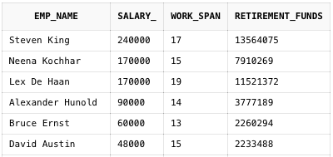
Analysis
Results:

Slide 13
What more can be done?
The salary question.
We could compare salaries to market-standard to see if the receiving fair wages
The 401k question.
I can account for the IRS limit on contributions
Vary the rates so I can better simulate the effects of the market

