Slide 1
Predicting Performance of Integrated Circuits using Regression Analysis
DS6372: Project 1
Joanna Duran, Nikhil Gupta, Max Moro

Slide 2
Agenda
Introduction
Objective
Dataset and Data Collection Process
Exploratory Data Analysis
Good Modeling Practices
Full Model Analysis
Best Model Selection
Conclusions and Recommendations

Slide 3
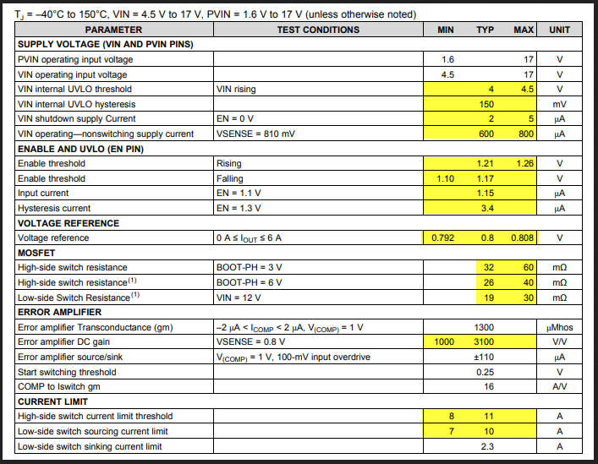
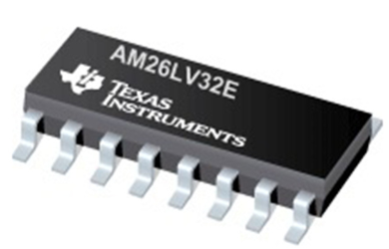
Introduction
Semiconductor manufacturing is a variable process
Parameters
some controlled by engineers
some are beyond human control (e.g. process variation).
Challenges:
Not all values can be practically measured (due to time, resource and cost constraints)
Issues if the variation of output is outside target specs
Reference
Notes:
Semiconductor manufacturing is a variable process and outcomes depending on several factors.
In order to meet target specifications, some parameters are controlled by engineers, however some are beyond human control (e.g. process variation).
Manufacturing process variation leads to output variables varying between a min and max value
Challenges:
Range is typically measured after the manufacturing process is completed and all R&D has been done
Not all values can be practically measured (due to time, resource and cost constraints)
Can lead to issues if the variation of output is outside target specs

Slide 4
Objective
Can we predict the limits before the specs are expected to be out of range?
Currently Monte Carlo simulations but very resource and time intensive
Objective: Build a model to predict the mean value of the output.
Target accuracy: +/- 10% desired, but +/- 15% would be acceptable also

Slide 5

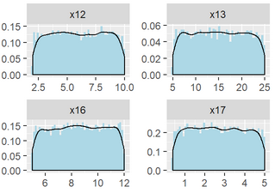
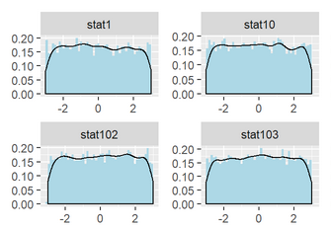
Dataset and Collection Process
Data has been sponsored and approved for use by Texas Instruments Inc.
10,000 rows capturing the performance of a circuit under various conditions.
240 features
x1 - x23: values that can be controlled by engineers to tune the performance
Wide range of values, some ranging from to 100, others are in the Nano or Micro range
stat1 – stat217: process variation parameters beyond human control
Range from -3 to 3, with mean of 0
Values represent sigma variation around mean
Output variable to target: y3 (most critical)
Data Collection Process
Engineer controlled variables were uniformly randomly selected
Statistical features were uniformly randomly sampled
Population: Entire design (xN variables) and manufacturing space (statN variables) of the circuit

Slide 6
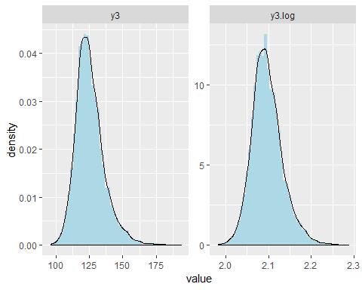
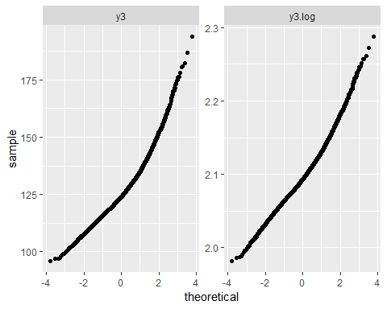
Exploratory Data Analysis | Output Variable
3020 cases have NA values for output variables
Consulted with domain expert.
Points were not valid features in combination.
Can be removed without affecting inference capability
Output Variable (y3):
Right skewed histogram
Log transformation performed
Note: log base 10 is more common in this industry

Slide 7
Exploratory Data Analysis | Input Predictors (1)
Correlation of input predictors (features) to each other
Correlation table and VIF values confirmed no multicollinearity
vifDF = usdm::vif(select_at(data,predictors)) %>% arrange(desc(VIF)) head(vifDF,15)
## Variables VIF ## 1 stat204 1.063870 ## 2 stat175 1.063370 ## 3 stat66 1.062060 ## 4 stat105 1.062008 ## 5 x6 1.061394 ## 6 stat2 1.061388 ## 7 stat14 1.061212 ## 8 x7 1.060532 ## 9 stat216 1.060477 ## 10 stat142 1.060190 ## 11 stat154 1.059695 ## 12 stat32 1.059608 ## 13 stat141 1.059564 ## 14 stat138 1.059507 ## 15 stat73 1.059386
 | x1 | x2 | x3 | x4 | x5 | x6 | x7 | x8 | x9 | x10
x1 | 1.0000 | 0.0034 | -0.0028 | 0.0085 | 0.0068 | 0.0159 | 0.0264 | -0.0012 | 0.0142 | 0.0013
x2 | 0.0034 | 1.0000 | -0.0057 | 0.0004 | -0.0094 | -0.0101 | 0.0089 | 0.0078 | 0.0049 | -0.0214
x3 | -0.0028 | -0.0057 | 1.0000 | 0.0029 | 0.0046 | 0.0006 | -0.0105 | -0.0002 | 0.0167 | -0.0137
x4 | 0.0085 | 0.0004 | 0.0029 | 1.0000 | -0.0059 | 0.0104 | 0.0098 | 0.0053 | 0.0061 | -0.0023
x5 | 0.0068 | -0.0094 | 0.0046 | -0.0059 | 1.0000 | 0.0016 | -0.0027 | 0.0081 | 0.0259 | -0.0081
x6 | 0.0159 | -0.0101 | 0.0006 | 0.0104 | 0.0016 | 1.0000 | 0.0200 | -0.0157 | 0.0117 | -0.0072
x7 | 0.0264 | 0.0089 | -0.0105 | 0.0098 | -0.0027 | 0.0200 | 1.0000 | -0.0018 | -0.0069 | -0.0221
x8 | -0.0012 | 0.0078 | -0.0002 | 0.0053 | 0.0081 | -0.0157 | -0.0018 | 1.0000 | 0.0142 | -0.0004
x9 | 0.0142 | 0.0049 | 0.0167 | 0.0061 | 0.0259 | 0.0117 | -0.0069 | 0.0142 | 1.0000 | 0.0149
x10 | 0.0013 | -0.0214 | -0.0137 | -0.0023 | -0.0081 | -0.0072 | -0.0221 | -0.0004 | 0.0149 | 1.0000
Partial correlation view of 240 features
Top features by VIF

Slide 8
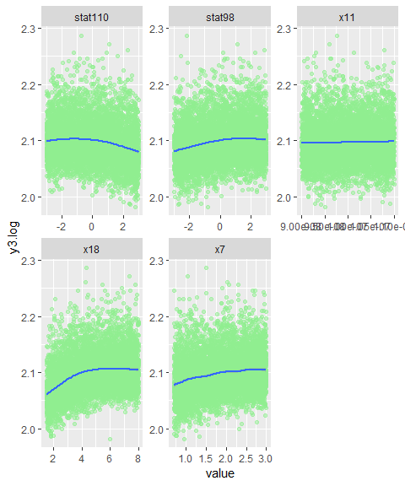
Exploratory Data Analysis | Input Predictors (2)
Correlation of features to y3.log
Few features are highly correlated
Features by themselves may not have a lot of predictive power
variable | y3.log
x18 | 0.3120
x7 | 0.2091
stat98 | 0.1784
x9 | 0.1127
x17 | 0.0611
x16 | 0.0489
x10 | 0.0472
x21 | 0.0412
x11 | 0.0322
x8 | 0.0318
stat156 | 0.0287
stat23 | 0.0234
stat100 | 0.0206
stat144 | 0.0203
stat59 | 0.0202
stat60 | 0.0199
stat195 | 0.0199
stat141 | 0.0194
stat73 | 0.0192
stat197 | 0.0185
variable | y3.log
stat110 | -0.1594
x4 | -0.0603
stat13 | -0.0345
stat41 | -0.0345
stat14 | -0.0317
stat149 | -0.0309
stat113 | -0.0279
stat4 | -0.0248
stat106 | -0.0236
stat146 | -0.0236
stat186 | -0.0217
stat91 | -0.0210
stat214 | -0.0209
stat5 | -0.0207
stat22 | -0.0202
stat39 | -0.0202
stat175 | -0.0194
stat187 | -0.0193
stat128 | -0.0192
stat37 | -0.0191
Notes:
Correlation of Features to y3.log
Shows that very few features are highly correlated (positive or negative) with output
Same is visible from the scatter plots of output vs. inputs
Hence, features by themselves may not have a lot of predictive power

Slide 9
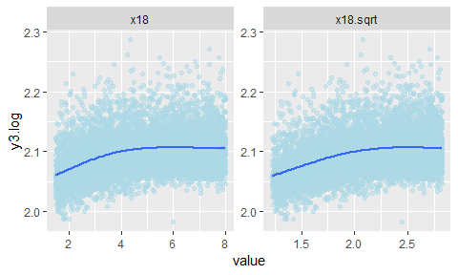
Exploratory Data Analysis | Input Predictors (3)
Feature Transformation
For the most highly correlated features, x18, shows a slight curvature in the scatter plot
Minor improvement to linearity can be obtained by using a square root transformation on x18.
Notes:
Add the important scatterplots

Slide 10
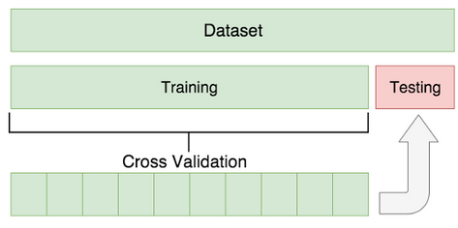
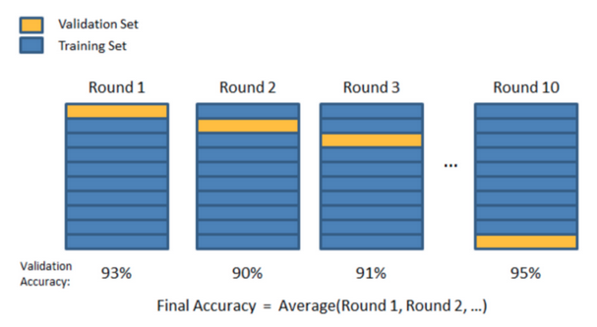
Good Modeling Practices
Avoiding overfitting
Even though we have a lot of data points, with so many features it is possible to overfit the data
Train and Test splits 80:20 ratio
During training process, 10-fold cross validation technique was used for model selection
Allows for the use of the entire training dataset for model development
Source

Slide 11
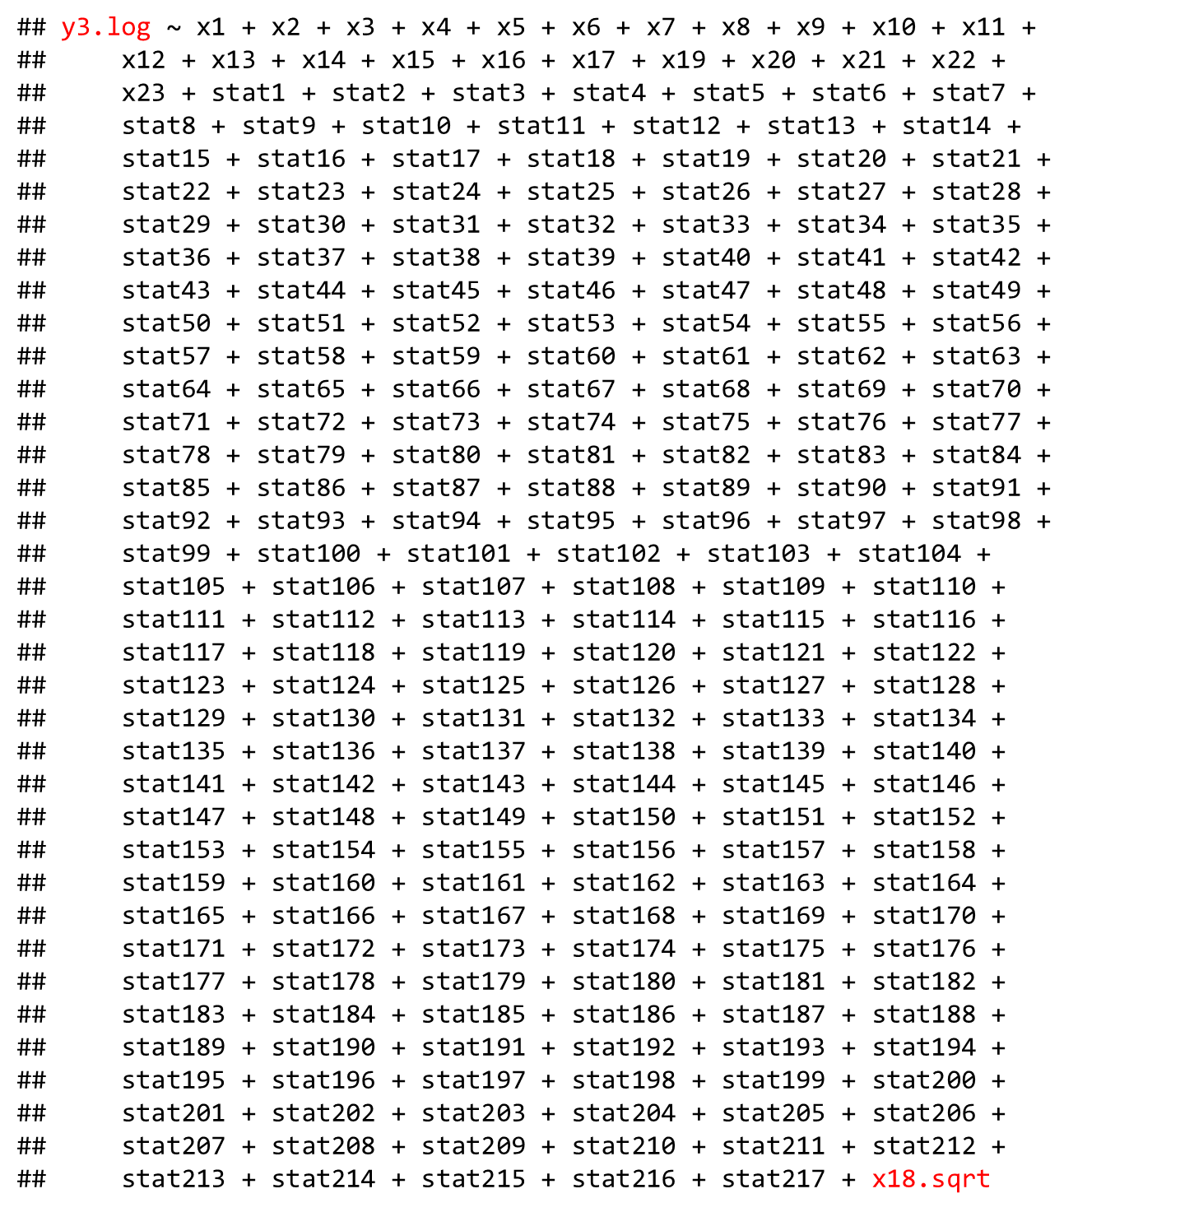
Full Model Analysis
Analyze full model consisting of all 240 features with appropriate transformations
Analyze fit statistics
Analyze the plots for issues with model assumption.
This will guide the next step in the process.

Slide 12
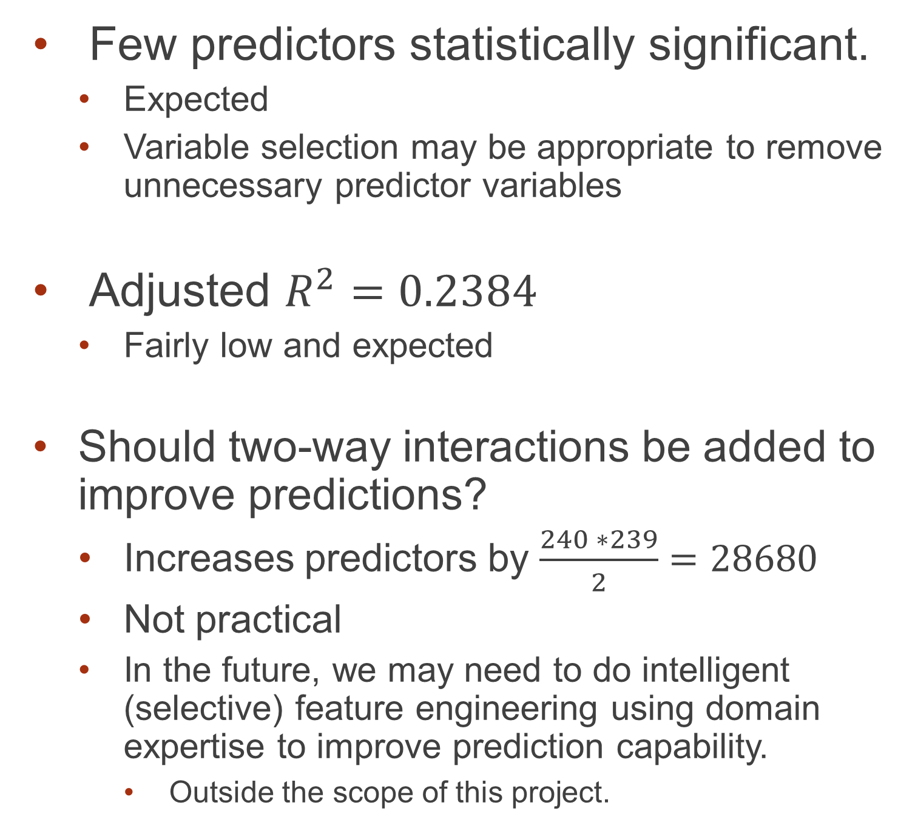
Full Model Analysis | Fit Statistics
Few predictors statistically significant.
Expected
Variable selection may be appropriate to remove unnecessary predictor variables
Adjusted $R^{2}=0.2384$
Fairly low and expected
Should two-way interactions be added to improve predictions?
Increases predictors by $\frac{240 ∗239}{2}=28680$
Not practical
In the future, we may need to do intelligent (selective) feature engineering using domain expertise to improve prediction capability.
Outside the scope of this project.
## Estimate Std. Error t value Pr(>|t|)
## Coefficients:
## Estimate Std. Error t value Pr(>|t|)
## (Intercept) 1.970e+00 9.597e-03 205.243 < 2e-16 ***
## x4 -5.252e-05 9.046e-06 -5.806 6.76e-09 ***
## x7 1.136e-02 6.408e-04 17.728 < 2e-16 ***
## x8 3.673e-04 1.488e-04 2.468 0.013599 *
## x9 3.299e-03 3.309e-04 9.970 < 2e-16 ***
## x10 1.172e-03 3.082e-04 3.804 0.000144 ***
## x11 1.889e+05 7.379e+04 2.560 0.010499 *
## x16 8.416e-04 2.150e-04 3.915 9.16e-05 ***
## x17 1.519e-03 3.254e-04 4.670 3.09e-06 ***
## x21 1.298e-04 4.216e-05 3.078 0.002093 **
## x22 -5.997e-04 3.457e-04 -1.735 0.082801 .
## stat4 -5.704e-04 2.485e-04 -2.295 0.021752 *
## stat13 -6.822e-04 2.480e-04 -2.751 0.005964 **
## stat14 -7.839e-04 2.476e-04 -3.167 0.001551 **
## stat18 -4.600e-04 2.477e-04 -1.857 0.063317 .
## stat22 -4.362e-04 2.499e-04 -1.745 0.080965 .
## stat23 6.593e-04 2.487e-04 2.651 0.008048 **
## stat24 -4.303e-04 2.484e-04 -1.733 0.083206 .
## stat35 -4.613e-04 2.496e-04 -1.848 0.064630 .
## stat41 -4.256e-04 2.476e-04 -1.719 0.085760 .
## stat45 -4.338e-04 2.479e-04 -1.750 0.080178 .
## stat51 4.864e-04 2.469e-04 1.970 0.048836 *
## stat59 4.114e-04 2.484e-04 1.656 0.097693 .
## stat91 -4.426e-04 2.461e-04 -1.798 0.072172 .
## stat98 3.599e-03 2.455e-04 14.659 < 2e-16 ***
## stat100 5.062e-04 2.498e-04 2.027 0.042727 *
## stat103 -4.194e-04 2.506e-04 -1.673 0.094353 .
## stat110 -3.282e-03 2.473e-04 -13.273 < 2e-16 ***
## stat113 -4.284e-04 2.510e-04 -1.707 0.087947 .
## stat146 -4.353e-04 2.499e-04 -1.742 0.081524 .
## stat149 -4.619e-04 2.493e-04 -1.853 0.063961 .
## stat175 -5.229e-04 2.478e-04 -2.110 0.034862 *
## stat195 4.201e-04 2.480e-04 1.694 0.090350 .
## stat204 -5.073e-04 2.462e-04 -2.060 0.039421 *
## stat207 5.098e-04 2.482e-04 2.054 0.040009 *
## x18.sqrt 2.657e-02 9.510e-04 27.943 < 2e-16 ***
## (Note: only showing the significant predictors above) ## Residual standard error: 0.03114 on 5343 degrees of freedom ## Multiple R-squared: 0.2711, Adjusted R-squared: 0.2384 ## F-statistic: 8.28 on 240 and 5343 DF, p-value: < 2.2e-16
Notes:
Few predictors were statistically significant.
Expected based on the correlation of features to output analyzed in the exploratory analysis
Variable selection may be appropriate to remove unnecessary predictor variables
Adjusted $R^{2}=0.2275$
Fairly low and expected based on low correlation of features to outputs
Should two-way interactions be added to improve predictions?
Increases predictors by $\frac{239 ∗238}{2}=28441$
Hence not practical
In the future, we may need to do intelligent (selective) feature engineering using domain expertise to improve prediction capability.
Outside the scope of this project.

Slide 13


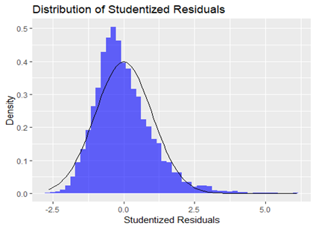
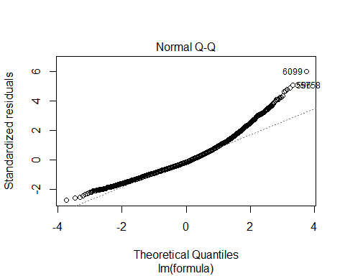
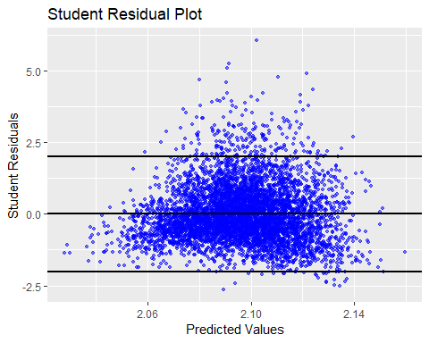
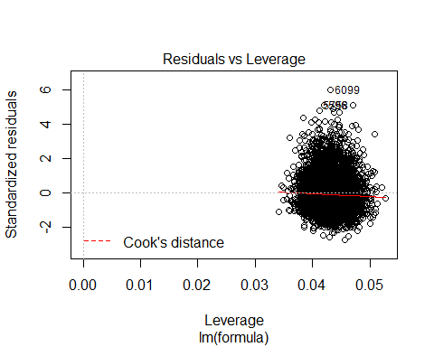
Full Model Analysis | Plots and Model Assumptions
Independence
Since the features were sampled randomly, the independence assumption has been met.
Normality
Equal Variance
Notes:
Independence
Since the features were sampled randomly, the independence assumption has been met.
Normality
Histogram and QQ plot of residuals shows that they are not normally distributed
Residual Plot shows that there are several values beyond the 2 sigma line again pointing to non-normality
However, given the large sample size, this may not be much of a concern by itself
Equal Variance
The residual plot shows that the points do not exhibit equal variance at all predicted levels.
Points at the lower predicted levels have much smaller variance compared to other points

Slide 14
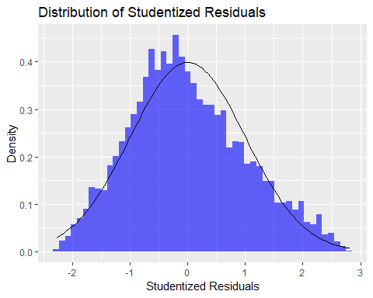
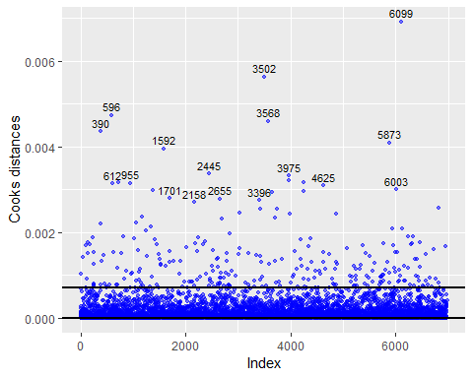
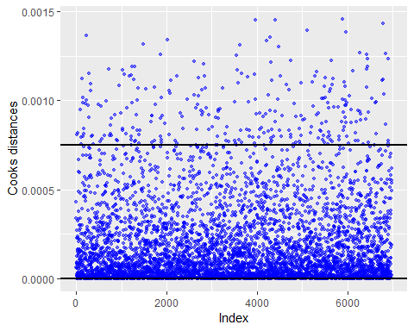
Full Model Analysis | Case Influence Statistics
Cook’s D plot
Not practical to analyze all points manually
Points are influential
Consulted with domain experts, we found that these are valid points and hence there is no justification to remove them.
## [1] "Number of data points that have Cook's D > 4/n: 288"
With High Cook’s D points removed
Notes:
Cook’s D plot shows that there are several points beyond the 4/n line
Not practical to analyze all points manually
These points are influential and hence can impact the model coefficients adversely
It is tempting to remove them since, it improves the model fit drastically
After consulting with domain experts, we found that these are valid points and hence there is no justification to remove them.
Hence, we will proceed with these points included, noting that the assumptions for linear regression have not been satisfied entirely.

Slide 15
Variable Selection Process
Try
Try various variable selection techniques
Forward Selection
Backward Elimination
Stepwise Selection
LASSO
LARS
Compare
Compare fit statistics and performance on test set
Pick
Pick best model

Slide 16
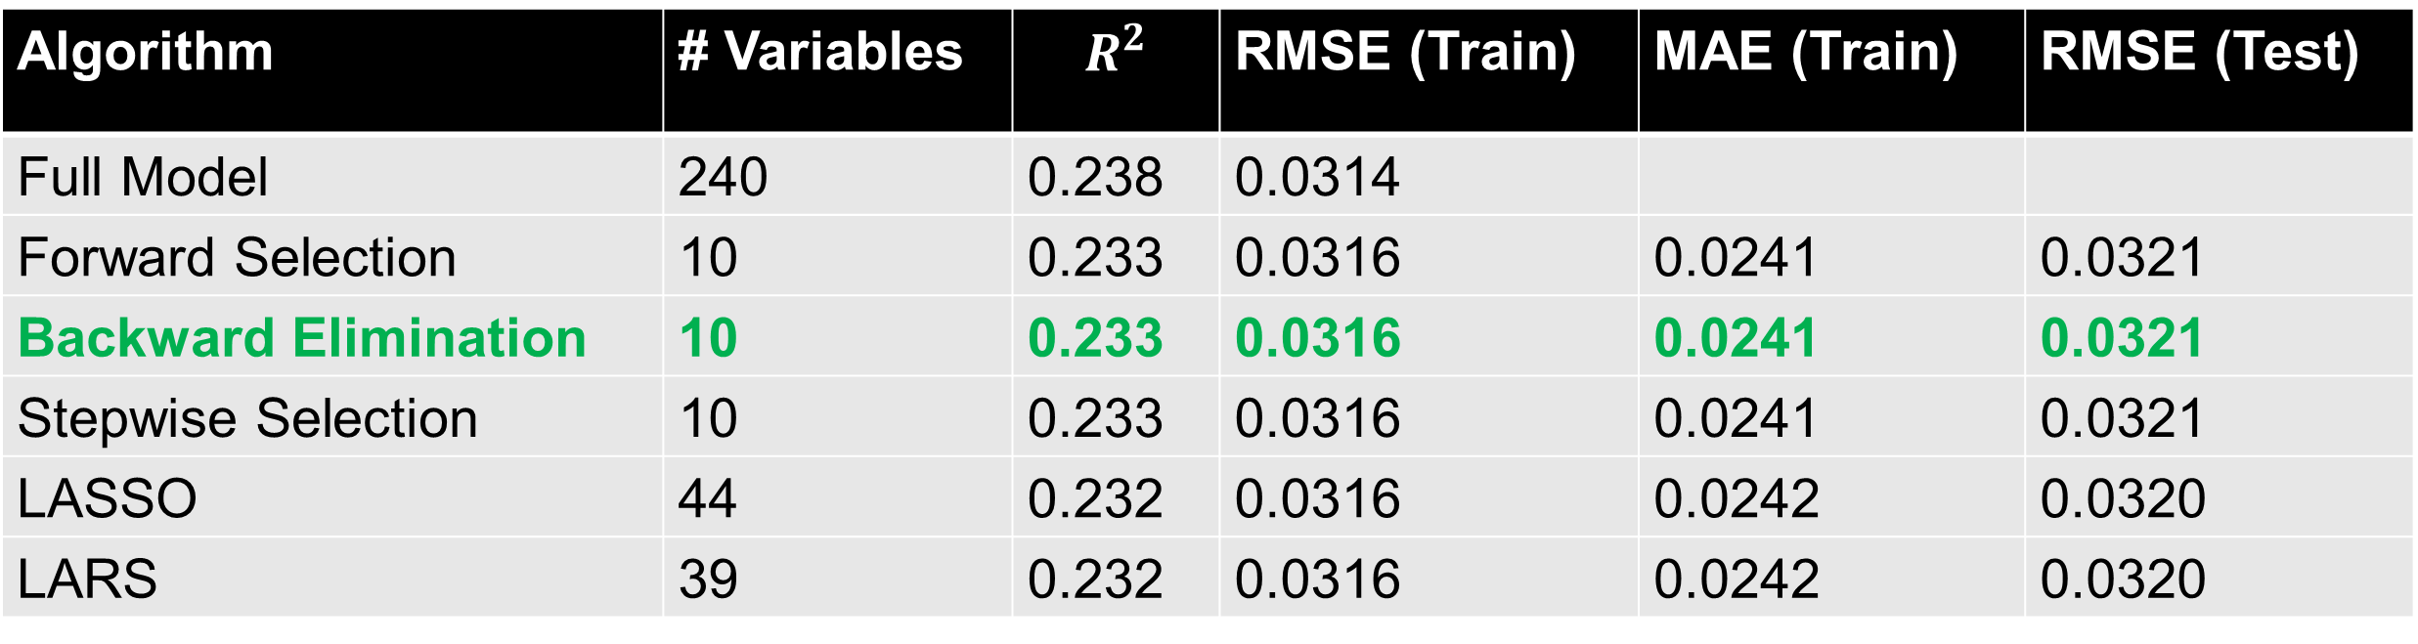
Variable Selection Comparison
All techniques give essentially the same fit statistics.
Forward Selection, Backward Elimination and Stepwise Selection have only 10 predictors in the final model
LASSO and LARS have 44 and 39 predictors respectively in the final model
Best Model: Backward Elimination (since it has the least predictors)
Algorithm | # Variables | $$R^{2}$$ | RMSE (Train) | MAE (Train) | RMSE (Test)
Full Model | 240 | 0.238 | 0.0314
Forward Selection | 10 | 0.233 | 0.0316 | 0.0241 | 0.0321
Backward Elimination | 10 | 0.233 | 0.0316 | 0.0241 | 0.0321
Stepwise Selection | 10 | 0.233 | 0.0316 | 0.0241 | 0.0321
LASSO | 44 | 0.232 | 0.0316 | 0.0242 | 0.0320
LARS | 39 | 0.232 | 0.0316 | 0.0242 | 0.0320
Notes:
Changed MSE (Test) to RMSE (Test) for easier comparison, else the scales are vary different
Need to update code accordingly

Slide 17
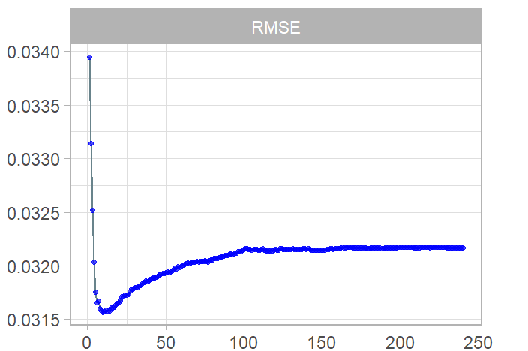
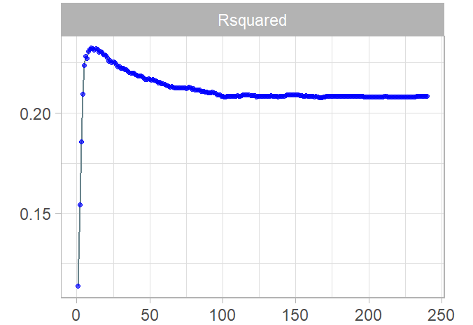
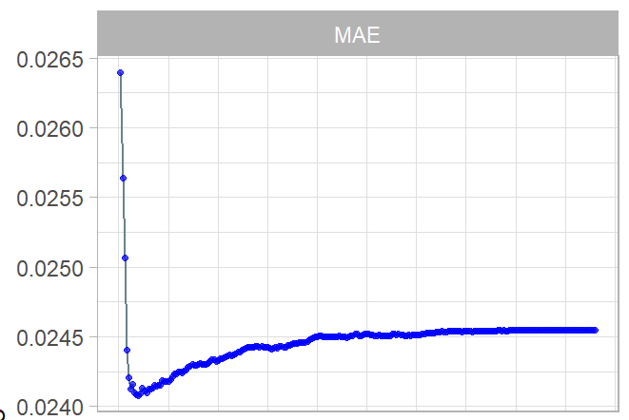
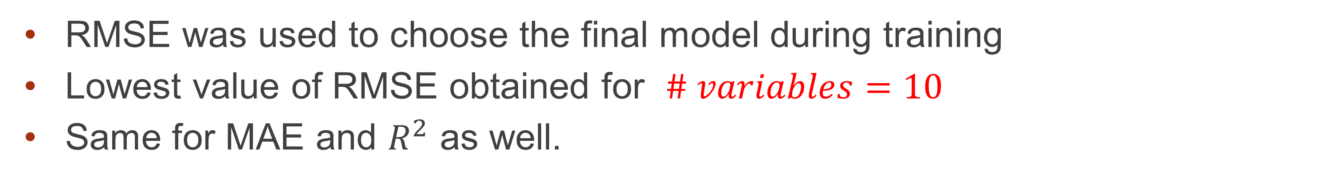
Best Model | Training Progression
RMSE was used to choose the final model during training
Lowest value of RMSE obtained for $\# variables=10$
Same for MAE and $R^{2}$ as well.

Slide 18
Best Model | Variables, Coefficients, Confidence Intervals
Final model includes some of the same variables that we identified to be highly correlated to output in the exploratory analysis
variable | y3.log
x18 | 0.3120
x7 | 0.2091
stat98 | 0.1784
x9 | 0.1127
x17 | 0.0611
x16 | 0.0489
x10 | 0.0472
x21 | 0.0412
x11 | 0.0322
x8 | 0.0318
stat156 | 0.0287
stat23 | 0.0234
stat100 | 0.0206
stat144 | 0.0203
stat59 | 0.0202
stat60 | 0.0199
stat195 | 0.0199
stat141 | 0.0194
stat73 | 0.0192
stat197 | 0.0185
variable | y3.log
stat110 | -0.1594
x4 | -0.0603
stat13 | -0.0345
stat41 | -0.0345
stat14 | -0.0317
stat149 | -0.0309
stat113 | -0.0279
stat4 | -0.0248
stat106 | -0.0236
stat146 | -0.0236
stat186 | -0.0217
stat91 | -0.0210
stat214 | -0.0209
stat5 | -0.0207
stat22 | -0.0202
stat39 | -0.0202
stat175 | -0.0194
stat187 | -0.0193
stat128 | -0.0192
stat37 | -0.0191
## [1] "Coefficients of final model:"
## Estimate 2.5 % 97.5 %
## (Intercept) 1.998273e+00 1.9917085286 2.004838e+00
## x4 -5.278274e-05 -0.0000701811 -3.538438e-05
## x7 1.111579e-02 0.0098875519 1.234402e-02
## x9 3.312648e-03 0.0026744967 3.950798e-03
## x10 1.097724e-03 0.0005042726 1.691175e-03
## x16 9.043039e-04 0.0004909551 1.317653e-03
## x17 1.401563e-03 0.0007762335 2.026893e-03
## stat23 7.648038e-04 0.0002862667 1.243341e-03
## stat98 3.626398e-03 0.0031550681 4.097728e-03
## stat110 -3.209726e-03 -0.0036849776 -2.734474e-03
## x18.sqrt 2.651106e-02 0.0246828804 2.833923e-02

Slide 19
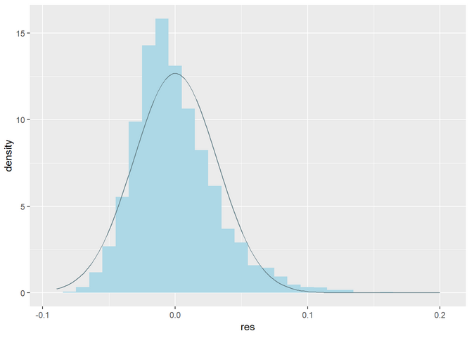
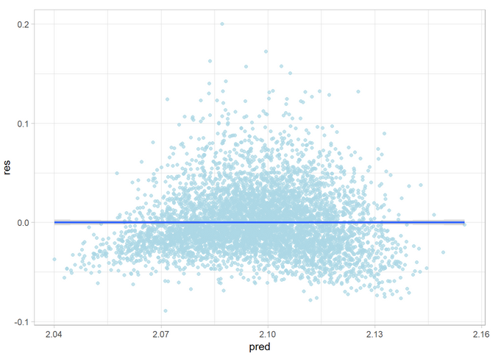
Best Model | Residual Analysis
Histogram of residual shows similar right skewed distribution as was seen in the full model.
Equality of variance at lower values of prediction is questionable as before.
Conclusion: Final model after variable selection suffers from same assumption violations as the full model.

Slide 20
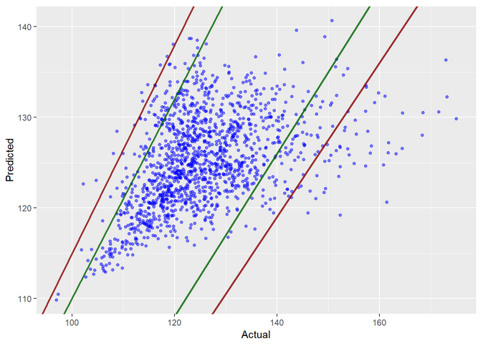
Best Model | Inference and Conclusion
Test Data Prediction
Since features were sampled randomly, any predictions drawn from this model can be applied to the entire design and manufacturing space of the integrated circuit.
Causality is not a concern here since the goal is mainly prediction of performance using the model.
However, given the fact that some of the model assumptions for multiple linear regression have not been met, we should be careful in using this model to predict new values

Slide 21
Model Improvement Recommendations
Intelligent feature engineering to improve prediction performance.
Use non parametric models that do not need to satisfy normality and equal variance assumptions.
Divide data into clusters and model each cluster separately.

