Slide 1
Forecasting the Next Recession
Nikhil Gupta
Stuart Miller

Slide 2
Motivation
The Need
We would like to forecast the next recession.
Definition
Two consecutive quarters of decline in GDP is considered a working definition of a recession.*
Proposed Solution
We will forecast the GDP for the next 2 quarters to see if the models can predict the next recession.
* https://www.investopedia.com/terms/r/recession.asp

Slide 3
Dataset
Response Variable
Exogenous Variables
An additional 20 exogenous variables were also collected.
Response Variable: % change in GDP (USA)
Quarterly observations from 1982 to 2019
151 observations
Contained economic indicators related to the labor market, monitory policy, consumer related data, business environment, stock data, exchange rates and several macro-economic factors
Data was collected from the Federal Reserve Bank of St. Louis Economic Data (FRED) https://fred.stlouisfed.org/

Slide 4
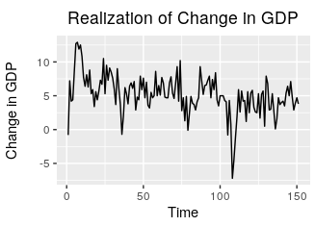
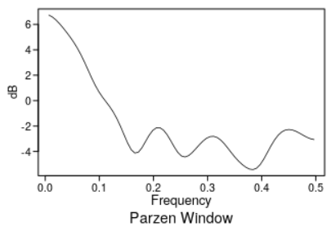
Univariate EDA: Checking Stationarity
Condition 1 & 2: Constant Mean & Variance
The mean does not appear to change over time. There does not appear to be evidence of a deterministic signal or oscillatory process.
Constant Mean
Constant Variance
The realization does not appear to show sufficient evidence of non-constant variance.
However, we only have one realization so this is difficult to assess.

Slide 5
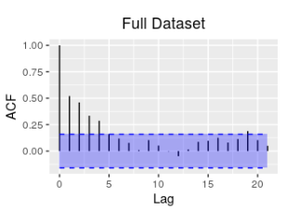
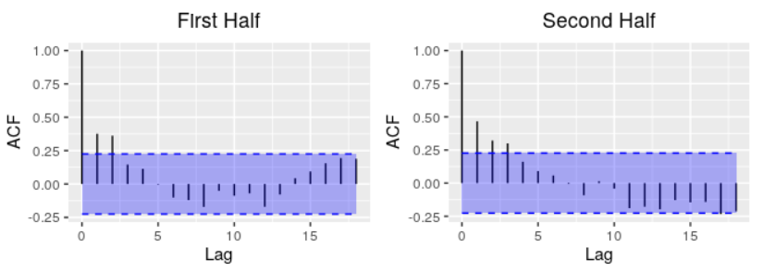
Univariate EDA: Checking Stationarity
Condition 3: The correlation of $X_{t_{1}}$ and $X_{t_{2}}$ depends only on $t_{2}−t_{1}$
Condition 3: The correlation of 𝑿_(𝒕_𝟏 ) and 𝑿_(𝒕_𝟐 ) depends only on 𝒕_𝟐−𝒕_𝟏
The significant ACFs of the first and second half of the realization exhibit similar. Additionally, they appear to exhibit similar characteristics as the full data set.
Notes:
Update for new data

Slide 6
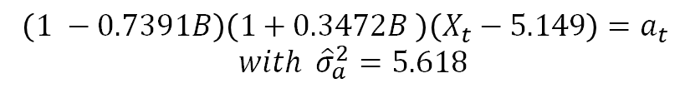
Univariate Modeling: Model ID
An ARMA(2, 0) was selected by both AIC and BIC.
ARMA(2,0) Factored Model
$$\left(1 −0.7391B\right)\left(1+0.3472B \right)\left(X_{t}−5.149\right)=a_{t}$$
$$with {\hat{σ}}_{a}^{2}=5.618$$

Slide 7
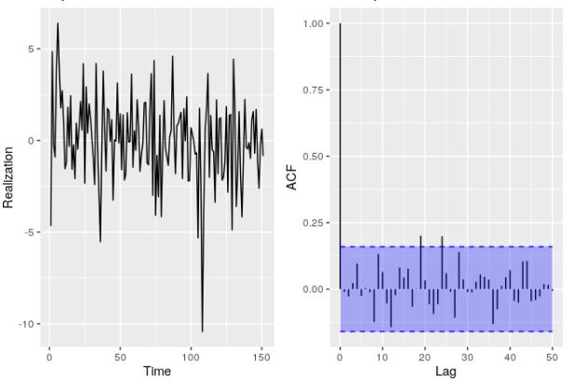
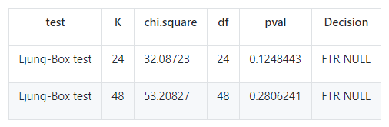
Univariate Modeling: White Noise Evaluation
The time plot of the model residuals appear to be generally consistent with white noise.
Only two of the autocorrelations of the residuals appear to be marginally significant. This is not unusual with at 95% confidence level.
The Ljung-Box test fails to reject the null hypothesis at K = 24 and K = 48.

Slide 8
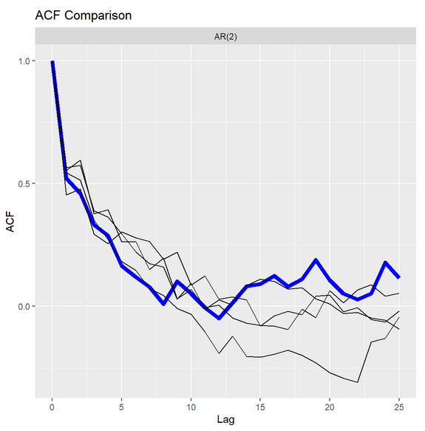
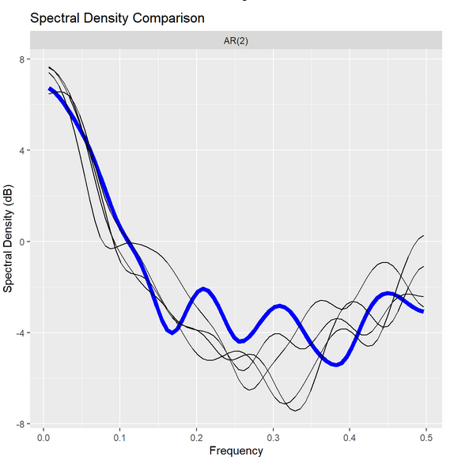
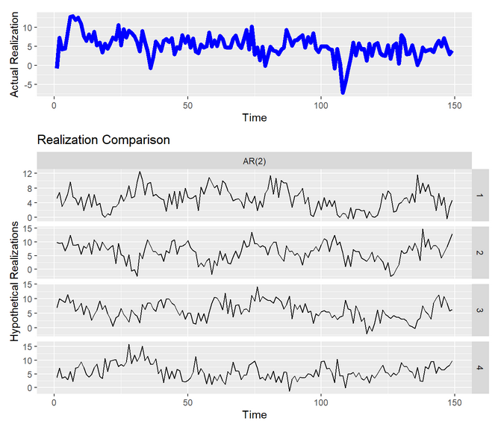
Univariate Modeling: Simulated Realizations
Notes:
One slide on performance of the univariate model

Slide 9
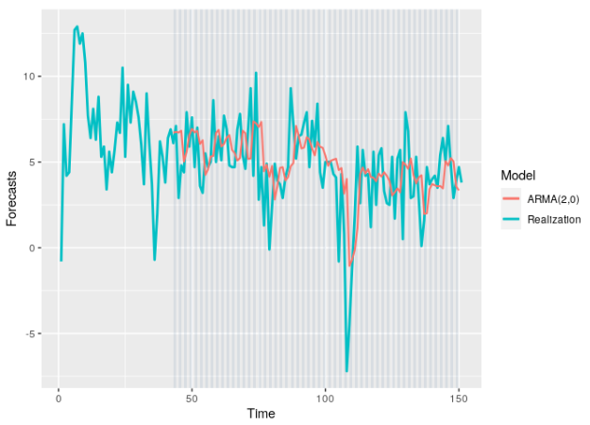
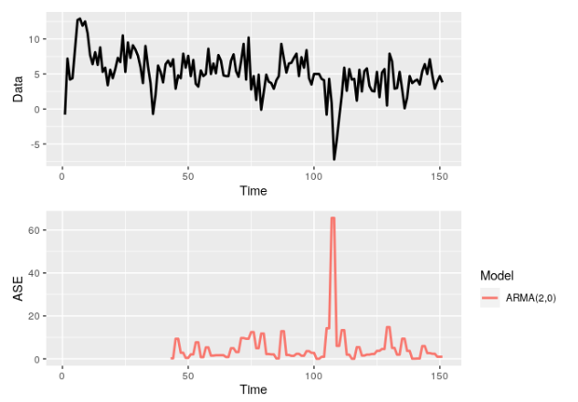
Univariate Modeling: Performance
Batch Size = 50 observations (Use 4 years of data to predict the next 2 quarters)
As expected, the ARMA model appears to capture the movement of the realization. However, it does not capture the sharp changes in the realization.
Generally, the model appears forecast ASE less than 15 over the sliding window. The primary error occurs at the large change in step 100.
Notes:
One slide on performance of the univariate model

Slide 10
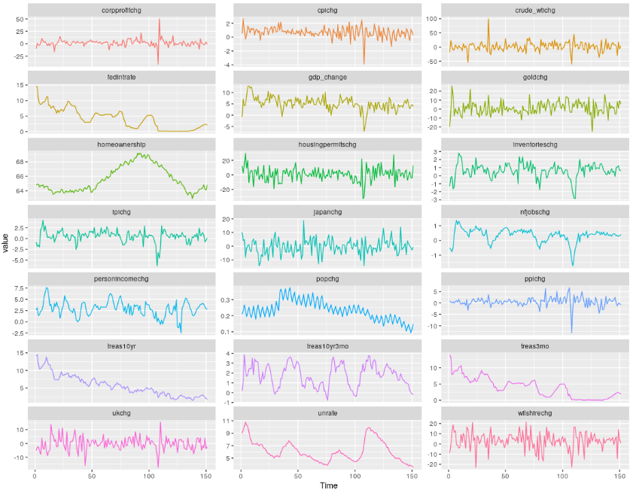
Multivariate EDA: Realizations

Slide 11
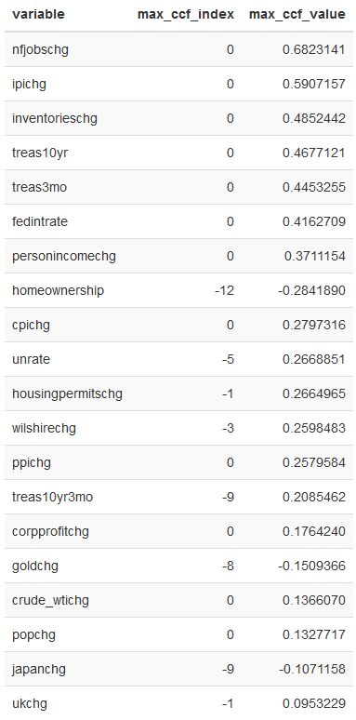
Multivariate EDA: Cross Correlation Analysis
Exogeneous Variable
Cross-correlations
Observations:
Several variables show strong cross-correlation with "GDP change".
Most of the strongly cross corelated exogenous variables show maximum cross correlation at lag = 0.
NOTE: We only considered negative lags in this evaluation since we would not have access to future values while building the models

Slide 12
VAR Modeling: Process
Need for variable selection to reduce overfitting
Use VARselect and BIC to select the maximum lag to consider for various trend types
Fit the model with selected lag from VARselect
Remove insignificant elements
Remove variables that are not significant at any lag
Reduce the maximum lag to the maximum significant found in the fit.
Select trend type based on ASE performance
Model | VARSelect p | Sig. Lags | Significant Variables
VAR BIC Both | 6 | 3 | gdp_change, nfjobschg, cpichg, ppichg
VAR BIC None | 6 | 6 | nfjobschg, corpprofitchg
VAR BIC Trend | 6 | 6 | nfjobschg, corpprofitchg
Notes:
NOTE:
Insignificant variables and lags were removed to reduce the chance of overfitting.
This was a crude variable selection technique and could be improved in the future.
Final result included nfjobchg which is the variable with the most Cross Correlation, hence we were happy with this reduced set of exogenous variables.

Slide 13
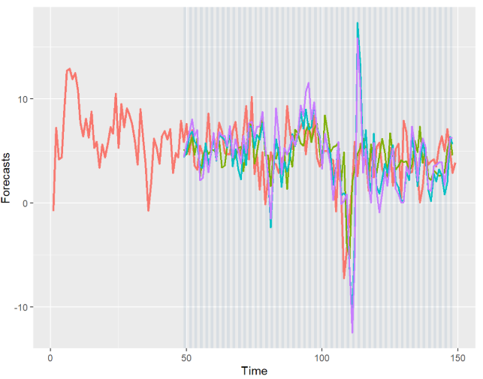
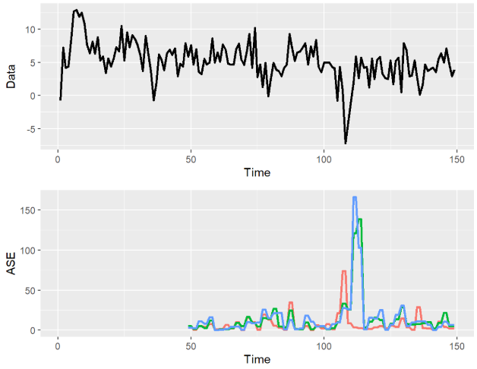
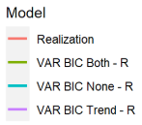
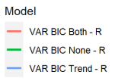
VAR Modeling: Model ID
Batch Size = 50 observations (Use 4 years of data to predict the next 2 quarters)
Notes:
trend only (VAR BIC Trend - R)
Trend and constant terms (VAR BIC None - R),
large ASEs sharp dip in the realization just after time step 100.
The model with trend only (VAR BIC Trend - R) and the model without trend and constant terms (VAR BIC None - R), appear to overshoot the movement of the realization. This is especially true just after the large dip in the realization after time step 100.

Slide 14
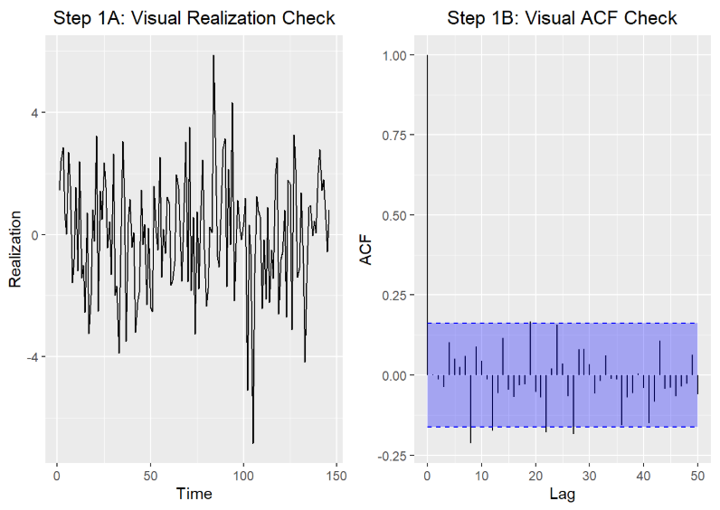
VAR Modeling : White Noise Evaluation
“VAR BIC Both – R” Model
The time plot of the model residuals appear to be generally consistent with white noise.
A few autocorrelations are marginally significant, but this is with in the 95% confidence level.

Slide 15
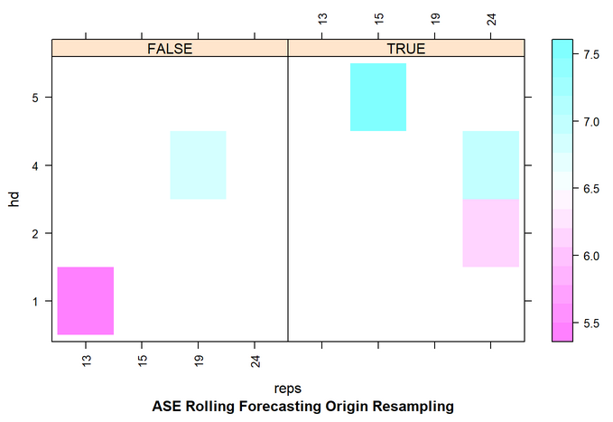
MLP Modeling: Grid Search
There are a large number of variables and hyperparameters that could affect the performance of an MLP model.
We used a random search to find a good set of hyperparameters
Batch Size = 50 observations (Use 4 years of data to predict the next 2 quarters)
Best Hyperparameters
Hidden Layers: 1
Repetitions: 13
Use Seasonality: False

Slide 16
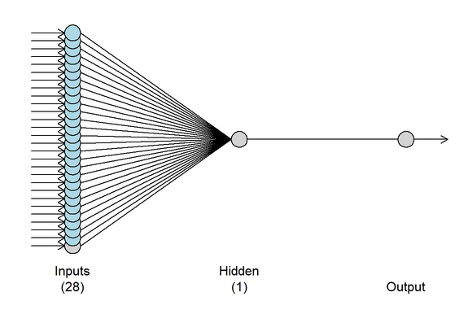
MLP Modeling: Final Model
## MLP fit with 1 hidden node and 13 repetitions.
## Univariate lags: (3)
## 17 regressors included.
## - Regressor 1 lags: (3)
## - Regressor 2 lags: (1,2,3)
## - Regressor 3 lags: (2)
## - Regressor 4 lags: (3)
## - Regressor 5 lags: (2)
## - Regressor 6 lags: (2)
## - Regressor 7 lags: (1,3)
## - Regressor 8 lags: (2)
## - Regressor 9 lags: (1,3,4)
## - Regressor 10 lags: (1,3)
## - Regressor 11 lags: (4)
## - Regressor 12 lags: (1,3)
## - Regressor 13 lags: (2)
## - Regressor 14 lags: (3,4)
## - Regressor 15 lags: (1,3,4)
## - Regressor 16 lags: (1)
## - Regressor 17 lags: (1)
## Forecast combined using the median operator.
## MSE: 2.0414.
1 Univariate Lag + 27 Exogenous Variable Lags

Slide 17
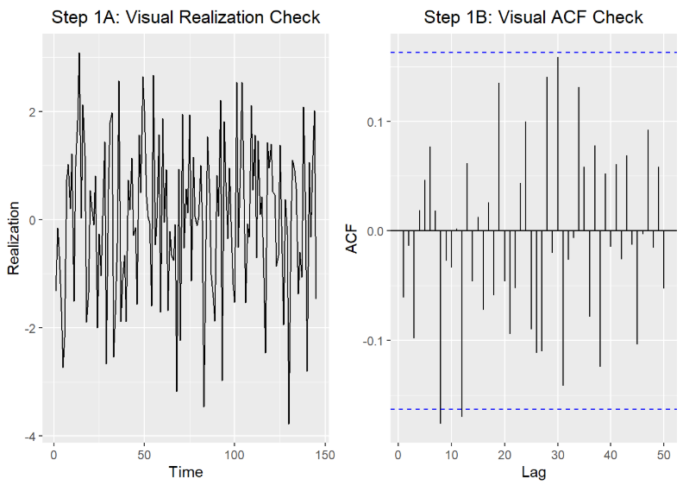
VAR Modeling : White Noise Evaluation
The time plot of the model residuals appear to be generally consistent with white noise.
A few autocorrelations are marginally significant, but this is with in the 95% confidence level.

Slide 18
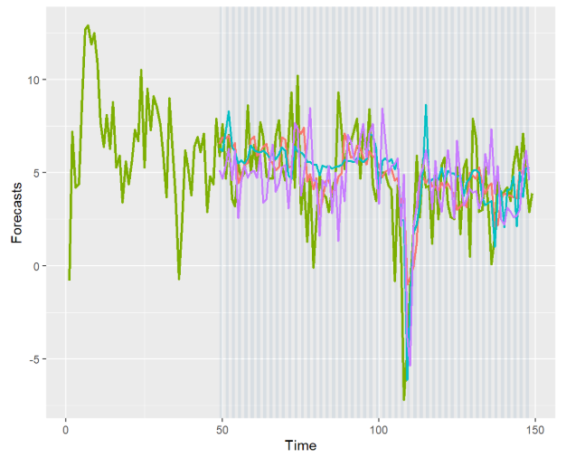
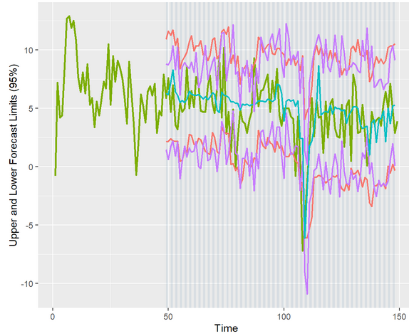
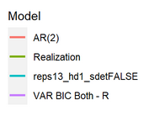
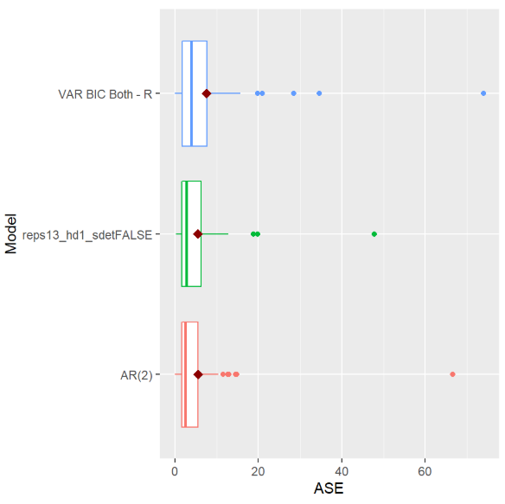
Base Models: Comparison
AR(2) shows the best performance
Lowest mean ASE
Tightest distribution of rolling window ASEs
All models show a large ASE value, occurring at the steep dip in the realization

Slide 19
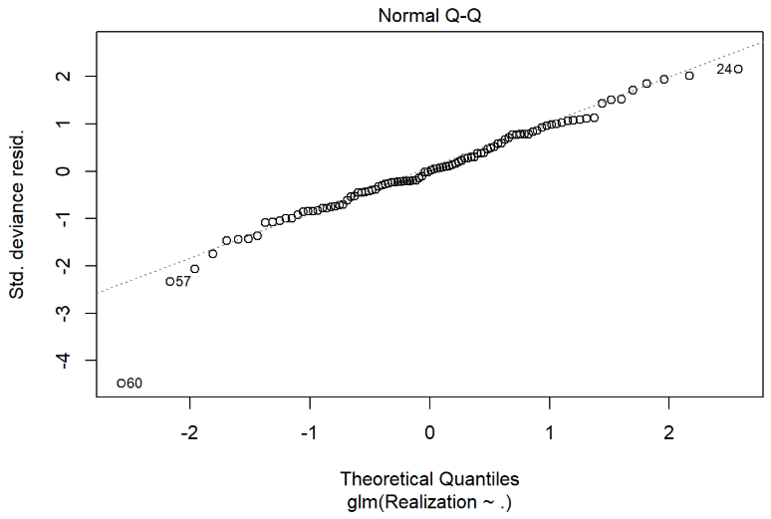
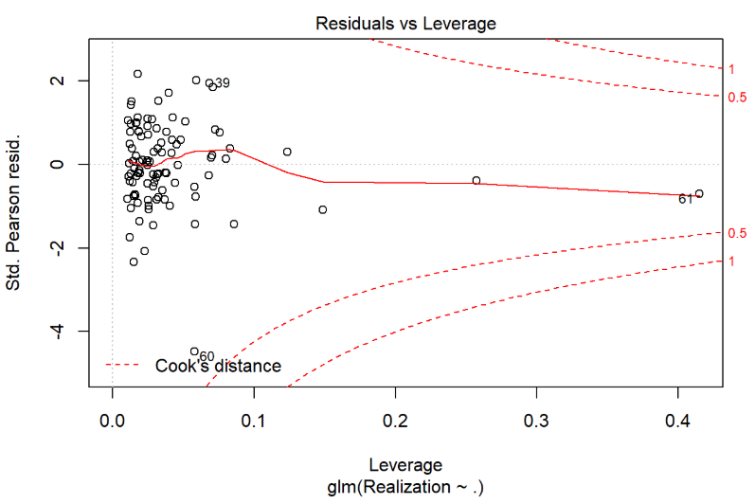
Modeling: Ensemble
Three types of ensemble models were created
Mean of the forecasts of the base models
Median of the forecasts of the base models
Linear regression combining the forecasts of the base models
Coefficient | Estimate | Std. Error | Pr(>|t|)
(Intercept) | 0.41118 | 0.74790 | 0.58374
AR(2) | 0.31278 | 0.24443 | 0.20376
VAR BIC Both - R | -0.09548 | 0.15598 | 0.54190
reps13_hd1_sdetFALSE | 0.60804 | 0.22717 | 0.00875*

Slide 20
Ensemble Modeling: Performance
Base Models and Ensemble Models were used to make predictions on the 2 holdout (test) observations
Observations:
GLM ensemble provides lowest ASE
Median is slightly better on the first data point.
Median forecast lower values for second test data point.
Notes:
One slide on performance of the univariate model

Slide 21
Conclusion
GDP data was very noisy and overall, models are not able to capture variance in this data.
The univariate model AR(2) performs better than VAR and MLP models.
Ensembles appear to improve forecasts, but further analysis should be performed.
Addition of other exogenous variables with even stronger cross correlations may improve performance of multivariate models.

Slide 22
Reproducible Research: Code for the complete analysis is available on GitHub
Youtube Video:
References:
Jim Chappelow, Recession, Investopedia. Accessed March 6, 2020. https://www.investopedia.com/terms/r/recession.asp
U.S. Bureau of Economic Analysis, Gross Domestic Product [A191RP1Q027SBEA], retrieved from FRED, Federal Reserve Bank of St. Louis; https://fred.stlouisfed.org/series/A191RP1Q027SBEA, March 6, 2020.
U.S. Bureau of Labor Statistics, All Employees, Total Nonfarm [PAYEMS], retrieved from FRED, Federal Reserve Bank of St. Louis; https://fred.stlouisfed.org/series/PAYEMS, March 6, 2020.
Board of Governors of the Federal Reserve System (US), 10-Year Treasury Constant Maturity Rate [DGS10], retrieved from FRED, Federal Reserve Bank of St. Louis; https://fred.stlouisfed.org/series/DGS10, March 6, 2020.
Board of Governors of the Federal Reserve System (US), Effective Federal Funds Rate [FEDFUNDS], retrieved from FRED, Federal Reserve Bank of St. Louis; https://fred.stlouisfed.org/series/FEDFUNDS, March 6, 2020.
U.S. Bureau of Economic Analysis, Real Disposable Personal Income [A067RO1Q156NBEA], retrieved from FRED, Federal Reserve Bank of St. Louis; https://fred.stlouisfed.org/series/A067RO1Q156NBEA, March 6, 2020.
U.S. Bureau of Labor Statistics, Consumer Price Index for All Urban Consumers: All Items in U.S. City Average [CPIAUCNS], retrieved from FRED, Federal Reserve Bank of St. Louis; https://fred.stlouisfed.org/series/CPIAUCNS, March 6, 2020.
U.S. Bureau of Economic Analysis, Population [POPTHM], retrieved from FRED, Federal Reserve Bank of St. Louis; https://fred.stlouisfed.org/series/POPTHM, March 6, 2020.
U.S. Bureau of Economic Analysis, Corporate Profits After Tax (without IVA and CCAdj) [CP], retrieved from FRED, Federal Reserve Bank of St. Louis; https://fred.stlouisfed.org/series/CP, March 6, 2020.
Federal Reserve Bank of St. Louis, Spot Crude Oil Price: West Texas Intermediate (WTI) [WTISPLC], retrieved from FRED, Federal Reserve Bank of St. Louis; https://fred.stlouisfed.org/series/WTISPLC, March 6, 2020.
ICE Benchmark Administration Limited (IBA), Gold Fixing Price 10:30 A.M. (London time) in London Bullion Market, based in U.S. Dollars [GOLDAMGBD228NLBM], retrieved from FRED, Federal Reserve Bank of St. Louis; https://fred.stlouisfed.org/series/GOLDAMGBD228NLBM, March 6, 2020.
Board of Governors of the Federal Reserve System (US), Japan / U.S. Foreign Exchange Rate [EXJPUS], retrieved from FRED, Federal Reserve Bank of St. Louis; https://fred.stlouisfed.org/series/EXJPUS, March 6, 2020.
Board of Governors of the Federal Reserve System (US), U.S. / U.K. Foreign Exchange Rate [EXUSUK], retrieved from FRED, Federal Reserve Bank of St. Louis; https://fred.stlouisfed.org/series/EXUSUK, March 6, 2020.
Notes:
Add the new references

