Slide 1
Predicting Performance of Integrated Circuits using Regression Analysis
DS6372: Project 2
Joanna Duran, Nikhil Gupta, Max Moro

Slide 2
Agenda
Introduction
Project 1 Review
Project 2 Objective and Approach
x
x
x
x
Conclusions and Recommendations

Slide 3

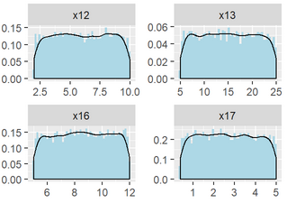
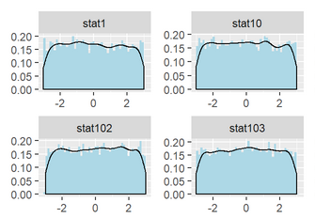
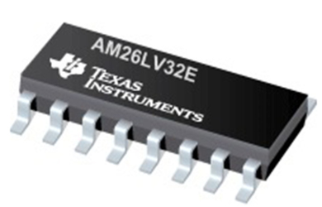
Introduction
Data has been sponsored and approved for use by Texas Instruments Inc.
10,000 rows capturing the performance of a circuit under various conditions.
240 features
x1 - x23: values that can be controlled by engineers to tune the performance
Wide range of values, some ranging from to 100, others are in the Nano or Micro range
stat1 – stat217: process variation parameters beyond human control
Range from -3 to 3, with mean of 0
Values represent sigma variation around mean
Output variable to target: y3 (most critical)
Data Collection Process
Engineer controlled variables were uniformly randomly selected
Statistical features were uniformly randomly sampled

Slide 4

Project 1
Cleaned data
Exploratory data analysis on the target variable y3 and transformed variable to “y3.log”
After running the analysis, the correlation table and VIF values confirmed that there is no multicollinearity.
One of the highly correlated features, x18, transformed with square root.
The full model analysis was performed. The adjusted $R^{2}$is 0.2275 which is low and expected based on low correlation of features to outputs.
The influence statistics were also analyzed and from the Cook’s D plot we notice that there are 288 points beyond the 4/n line). But there is no justification to remove them.
Synopsis of steps taken in Project1

Slide 5
Project 1
The variable selection techniques that were used were
Forward Selection
Backward Elimination
Stepwise Selection
LASSO
LARS.
We found that all techniques give essentially the same fit statistics. The best model is Backward Elimination.
In analyzing the residuals, we conclude that the final model suffers from same assumption violations as the full model.
Synopsis of steps taken in Project1- Continued

Slide 6
Project 2
Goal for project 2
The goal of the second project was to Improve the model fit from Project 1 utilizing Principal Component Regression, Linear/Quadratic Discriminate Analysis and Logistic Regression. Target accuracy of ±10% is desired, but ±15% would be acceptable.
Approach 1: Principal Component Regression with intelligent feature selection
Approach 2: Clustering based on High Cook’s D and using the cluster as a predictor in the regression model

