Slide 1
Forecasting the Next Recession
Nikhil Gupta
Stuart Miller

Slide 2
Motivation
The Need
We would like to forecast the next recession.
Definition
Two consecutive quarters of decline in GDP is considered a working definition of a recession.*
Proposed Solution
We will forecast the GDP for the next 2 quarters to see if the models can predict the next recession.
* https://www.investopedia.com/terms/r/recession.asp

Slide 3
Dataset
Response Variable
Exogenous Variables
An additional 13 exogenous variables were also collected.
Response Variable: % change in GDP (USA)
Quarterly observations from 1971 to 2019
195 observations
Contained economic indicators related to the labor market, monitory policy, consumer related data, business environment, and several macro-economic factors
Data was collected from the Federal Reserve Bank of St. Louis Economic Data (FRED) https://fred.stlouisfed.org/

Slide 4
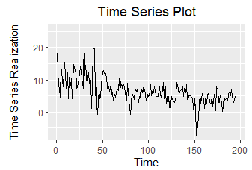
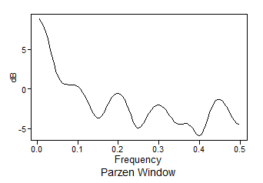
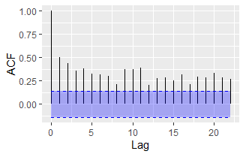
EDA: Checking Stationarity (Condition 1)
Condition 1: Mean does not depend on time
There appears to be a slight downward trend in the realization.
The spectral density shows a high peak at 0, which could be generated by a stationary or non-stationary process.
The ACF shows a hint of extended autocorrelations, which could indicate a non-stationary process.
Since the mean appears to change over time, this suggests a non-stationary process.
However, once could argue that looking at the second half of the data (beyond time point 100), there is no long term trend and that the GDP hovers around a mean value.
This makes sense since the US is a developed country and we would not expect the GDP to show very big fluctuations or trends.
So going forward this data could be generated through a stationary process also.
Case for Non Stationarity
Case for Stationarity

Slide 5
EDA: Checking Stationarity (Condition 2)
Condition 2: Variance does not depend on time
Since only one realization is possible, it is difficult to assess the realization variance.
However, there is more volatility in the first half (before 75) than in the second half.
This may be an indication of non-constant variance, which would suggest a non-stationary process, but again difficult to say with just one realization.

Slide 6
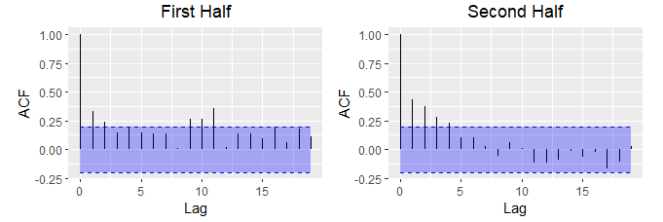
EDA: Checking Stationarity (Condition 3)
Condition 3: The correlation of $X_{t_{1}}$ and $X_{t_{2}}$ depends only on $t_{2}−t_{1}$
Condition 3: The correlation of 𝑿_(𝒕_𝟏 ) and 𝑿_(𝒕_𝟐 ) depends only on 𝒕_𝟐−𝒕_𝟏
The ACFs of the first and second half exhibit different characteristics.
A hint of seasonality in first half of the data though it is not appreciable
More exponentially damped autocorrelations and no hints of seasonality in the second half of the data.
This may suggest a non-stationary process, though the evidence is weak.

Slide 7
EDA: Checking Stationarity
Conclusion
However, we expect that the change in GDP will eventually stabilize to a stationary process in the long run. If so, it may be possible to model this as a stationary process as well.
We will continue the analysis modeling the data using both an ARMA (stationary) model and an ARIMA (non stationary) model.
Based on the analysis, there appears to be some evidence that the process is non-stationary.

Slide 8
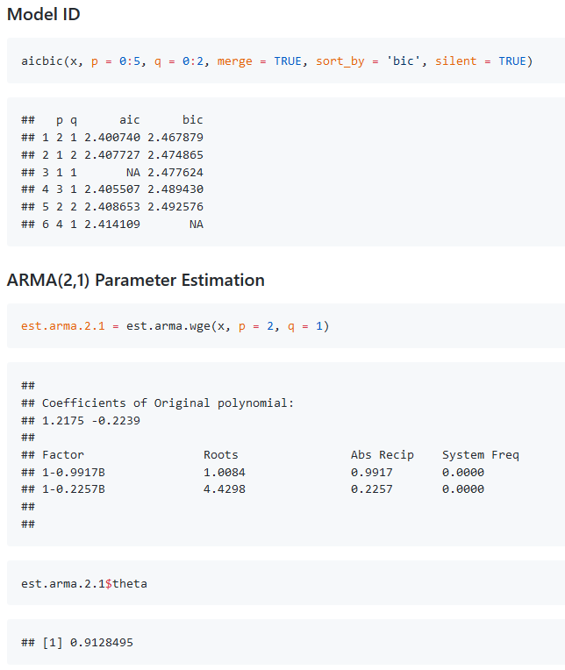
ARMA: Model ID
AIC and BIC both indicate that an ARMA(2,1) might be an appropriate model.
The parameter estimation clears a lot of confusion about whether this is coming from a stationary or non stationary process. Even when fitting a stationary ARMA model, we get an estimated root of 0.9917 in the factor table which is very close to 1 (non stationary model).

Slide 9
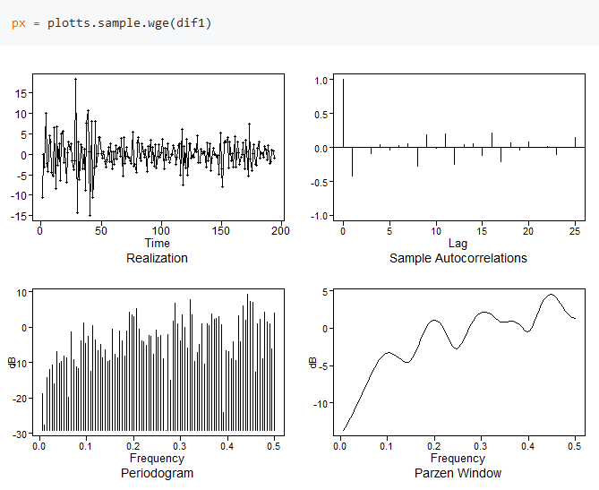
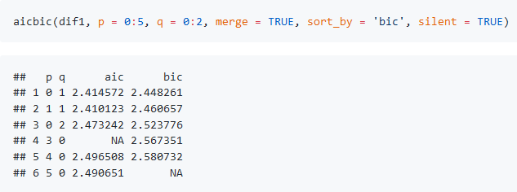
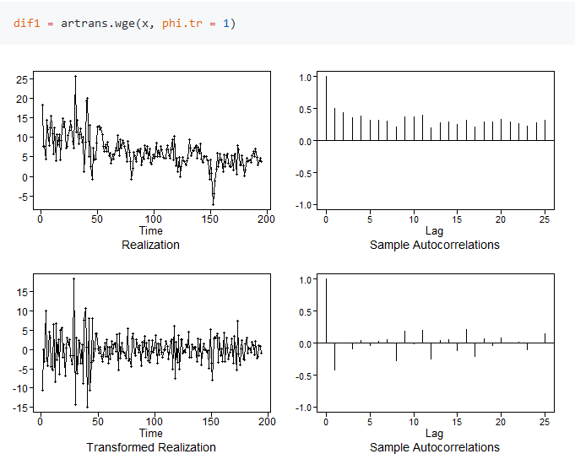
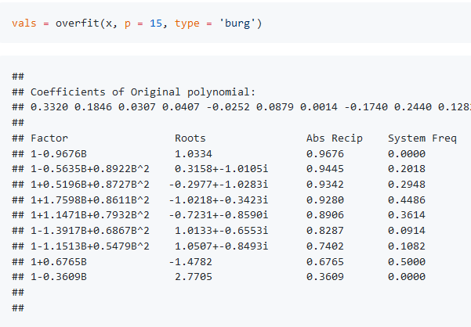
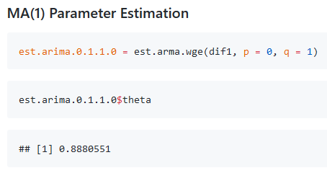
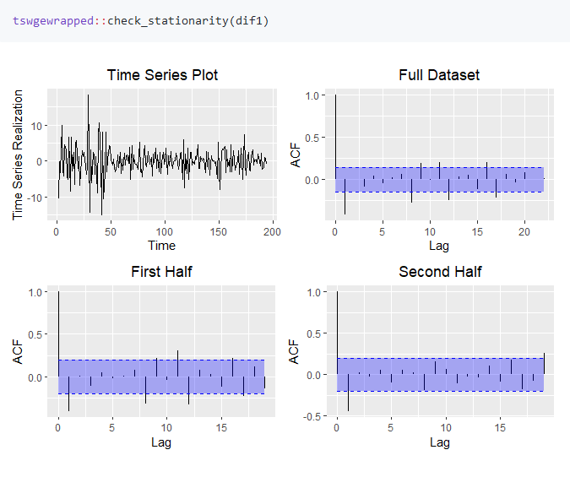
ARIMA: Model ID
The overfit tables show that 1-B may be a dominant factor in the model. The other factors don’t indicate any major seasonality
We will proceed with including only a (1-B) term (i.e. d = 1).
The differenced data seems stationary and seems to be indicative of an MA(1) process due to the appreciable dip at f = 0.
AIC and BIC both confirm that an ARMA(0,1) model is appropriate for the differenced data.

Slide 10
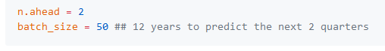
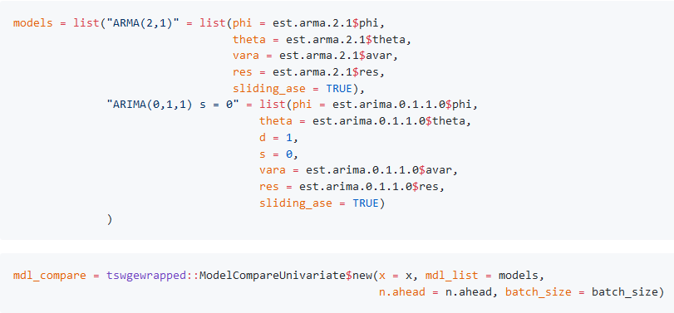
Model Comparison
Model Comparison was done using the ModelCompareUnivariate class object available in the tswgewrapped package.
Note that this class was developed by our team.

Slide 11
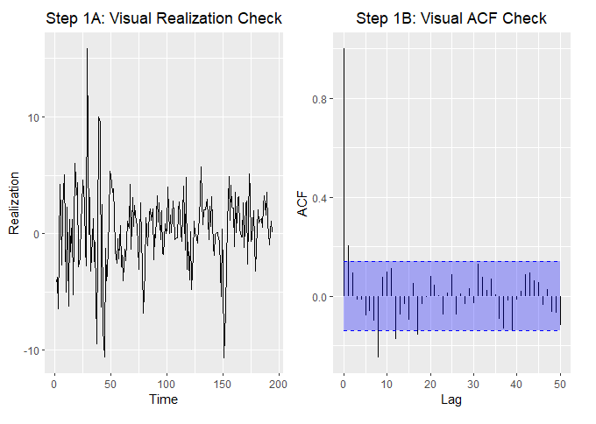
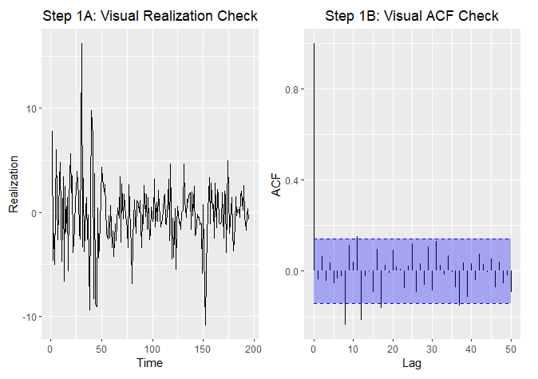
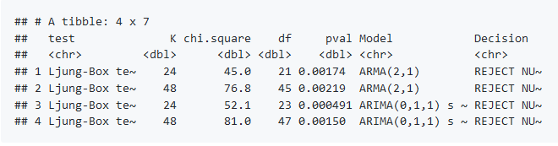
Model Comparison: White Noise Evaluation
Evaluating the residuals for the ARMA(2,1) model, we see that they do not look like white noise.
Evaluating the residuals for the ARIMA(0,1,1) model also do not indicate that the residuals are white noise
The Ljung-Box test for white noise also rejects the null hypothesis for both models for K = 24 and K = 48.
Hence both these models may not be the best model since they are not capturing all the trend in the data.
ARMA(2,1) White Noise Evaluation
ARIMA(0,1,1) White Noise Evaluation

Slide 12
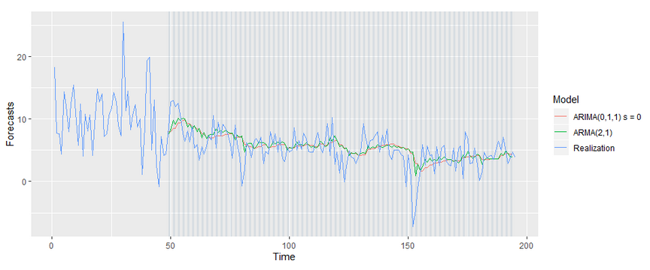
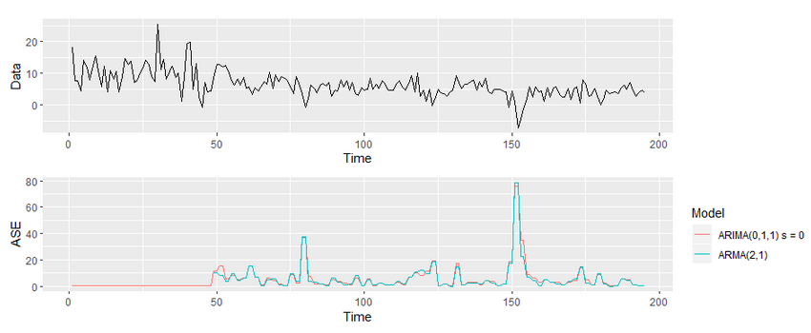
Model Comparison: Forecasting

Slide 13
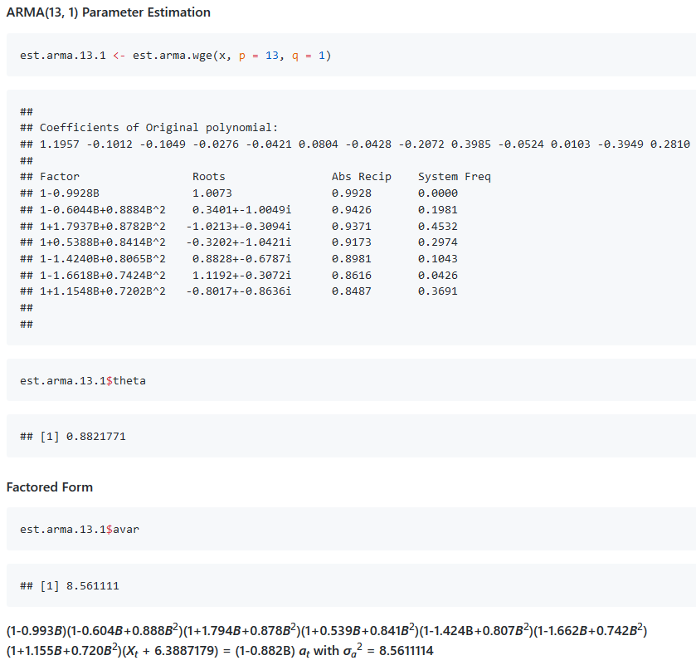
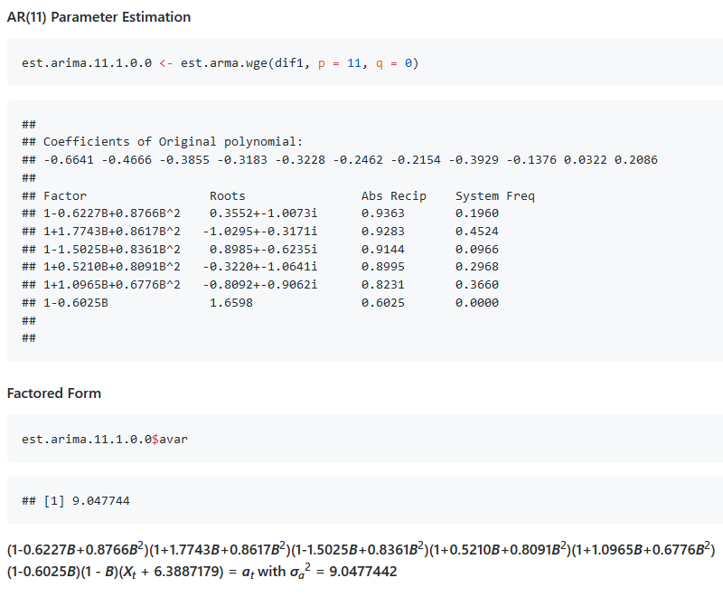
Fitting Higher Ordered Models
Stationary ARMA(13,1) Model
Non Stationary ARIMA(11,1,0) Model

Slide 14
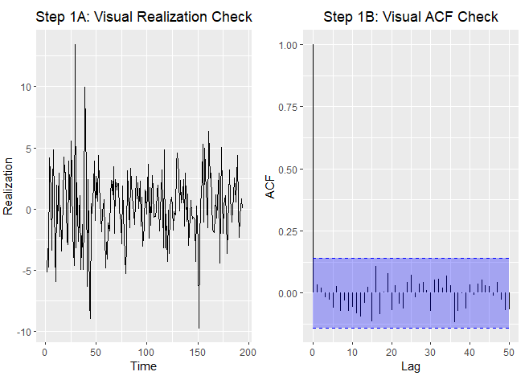
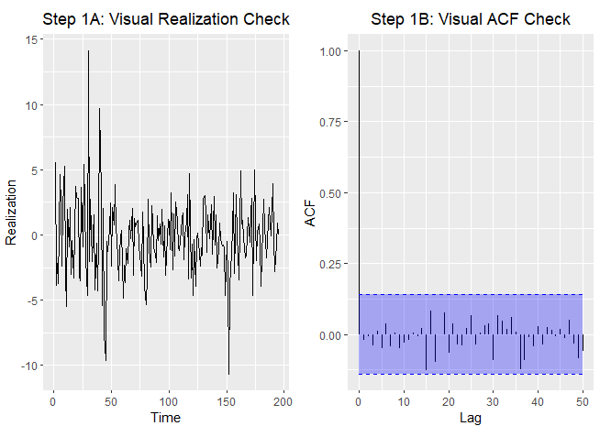
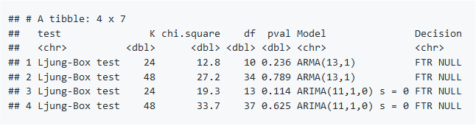
Model Comparison: White Noise Evaluation
Evaluating the residuals for the ARMA(13,1) model, we see that they now look like white noise.
Evaluating the residuals for the ARIMA(11,1,0) model also indicate that the residuals are white noise
The Ljung-Box test for white noise also fails to reject the null hypothesis for both models for K = 24 and K = 48.
Hence both these models are appropriately capturing the trends in the data and whitening the residuals to the best of their abilities.
ARMA(13,1) White Noise Evaluation
ARIMA(11,1,0) White Noise Evaluation

Slide 15
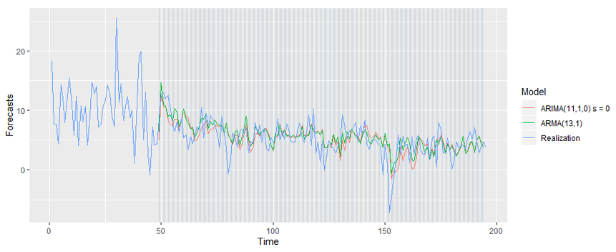
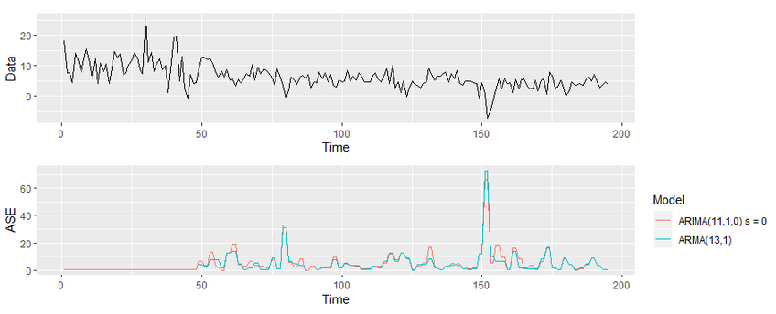
Model Comparison: Forecasting

Slide 16
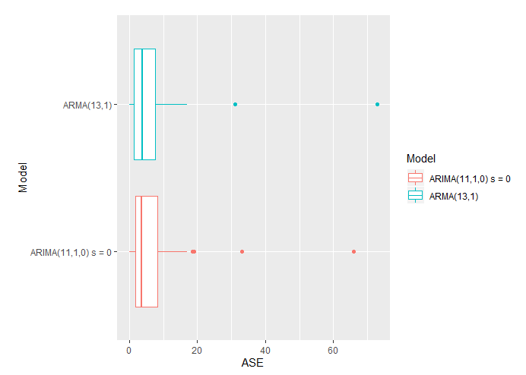
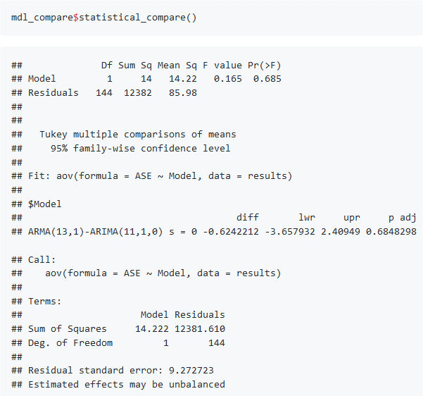
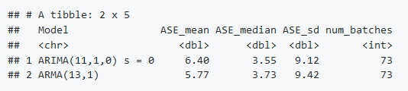
Model Comparison: Rolling ASE Values

Slide 17
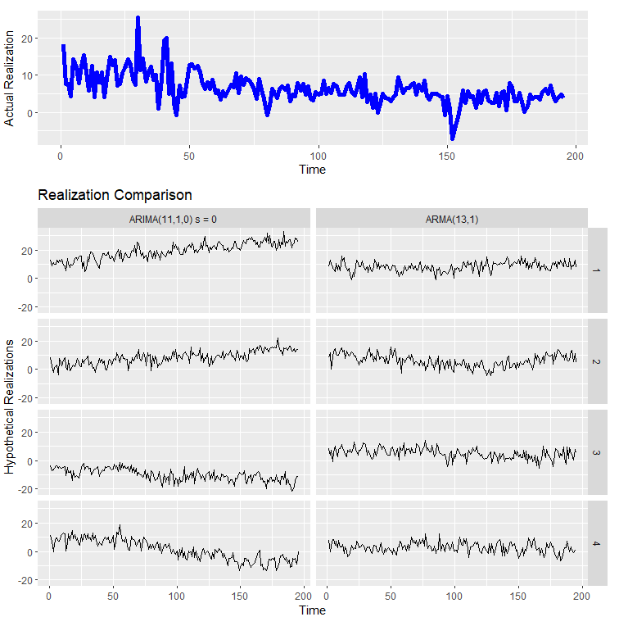
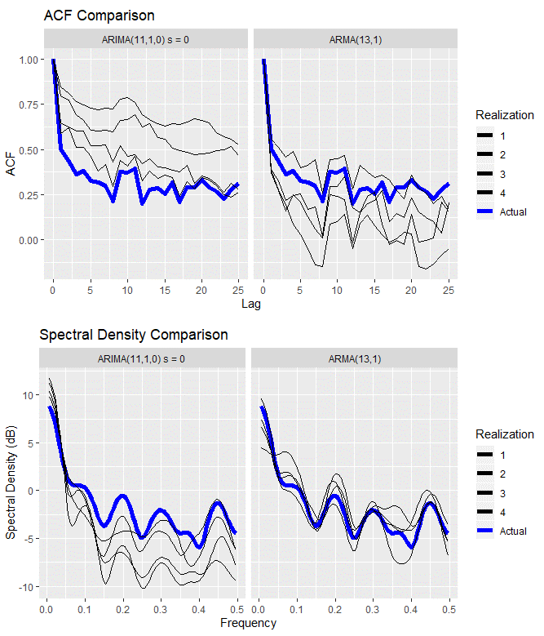
Model Comparison: Realizations and Characteristics

Slide 18
Key Findings & Next Steps
Lower Ordered Models
Not sufficient to capture the trend in the data.
Higher Ordered Models
ARMA(13,1) vs. ARIMA(11,1,0)
ARMA captures characteristics of the data better than ARIMA
Add exogenous variables to improve modeling.
Next Steps
Residuals are not white noise.
Forecasts are better than Lower Ordered Models.
Mean ASE lower for ARMA although statistically not different.
Modeling the GDP using univariate analysis is not easy.
Generate residuals that are white noise.
However, not good enough to capture sharp changes in GDP.

Slide 19
Reproducible Research: Code for the complete analysis is available on GitHub
Youtube Video: Link
References:
Jim Chappelow, Recession, Investopedia. Accessed March 6, 2020. https://www.investopedia.com/terms/r/recession.asp
U.S. Bureau of Economic Analysis, Gross Domestic Product [A191RP1Q027SBEA], retrieved from FRED, Federal Reserve Bank of St. Louis; https://fred.stlouisfed.org/series/A191RP1Q027SBEA, March 6, 2020.
U.S. Bureau of Labor Statistics, All Employees, Total Nonfarm [PAYEMS], retrieved from FRED, Federal Reserve Bank of St. Louis; https://fred.stlouisfed.org/series/PAYEMS, March 6, 2020.
Board of Governors of the Federal Reserve System (US), 10-Year Treasury Constant Maturity Rate [DGS10], retrieved from FRED, Federal Reserve Bank of St. Louis; https://fred.stlouisfed.org/series/DGS10, March 6, 2020.
Board of Governors of the Federal Reserve System (US), Effective Federal Funds Rate [FEDFUNDS], retrieved from FRED, Federal Reserve Bank of St. Louis; https://fred.stlouisfed.org/series/FEDFUNDS, March 6, 2020.
U.S. Bureau of Economic Analysis, Real Disposable Personal Income [A067RO1Q156NBEA], retrieved from FRED, Federal Reserve Bank of St. Louis; https://fred.stlouisfed.org/series/A067RO1Q156NBEA, March 6, 2020.
U.S. Bureau of Labor Statistics, Consumer Price Index for All Urban Consumers: All Items in U.S. City Average [CPIAUCNS], retrieved from FRED, Federal Reserve Bank of St. Louis; https://fred.stlouisfed.org/series/CPIAUCNS, March 6, 2020.
U.S. Bureau of Economic Analysis, Population [POPTHM], retrieved from FRED, Federal Reserve Bank of St. Louis; https://fred.stlouisfed.org/series/POPTHM, March 6, 2020.
U.S. Bureau of Economic Analysis, Corporate Profits After Tax (without IVA and CCAdj) [CP], retrieved from FRED, Federal Reserve Bank of St. Louis; https://fred.stlouisfed.org/series/CP, March 6, 2020.
Federal Reserve Bank of St. Louis, Spot Crude Oil Price: West Texas Intermediate (WTI) [WTISPLC], retrieved from FRED, Federal Reserve Bank of St. Louis; https://fred.stlouisfed.org/series/WTISPLC, March 6, 2020.
ICE Benchmark Administration Limited (IBA), Gold Fixing Price 10:30 A.M. (London time) in London Bullion Market, based in U.S. Dollars [GOLDAMGBD228NLBM], retrieved from FRED, Federal Reserve Bank of St. Louis; https://fred.stlouisfed.org/series/GOLDAMGBD228NLBM, March 6, 2020.
Board of Governors of the Federal Reserve System (US), Japan / U.S. Foreign Exchange Rate [EXJPUS], retrieved from FRED, Federal Reserve Bank of St. Louis; https://fred.stlouisfed.org/series/EXJPUS, March 6, 2020.
Board of Governors of the Federal Reserve System (US), U.S. / U.K. Foreign Exchange Rate [EXUSUK], retrieved from FRED, Federal Reserve Bank of St. Louis; https://fred.stlouisfed.org/series/EXUSUK, March 6, 2020.

